Slide 1
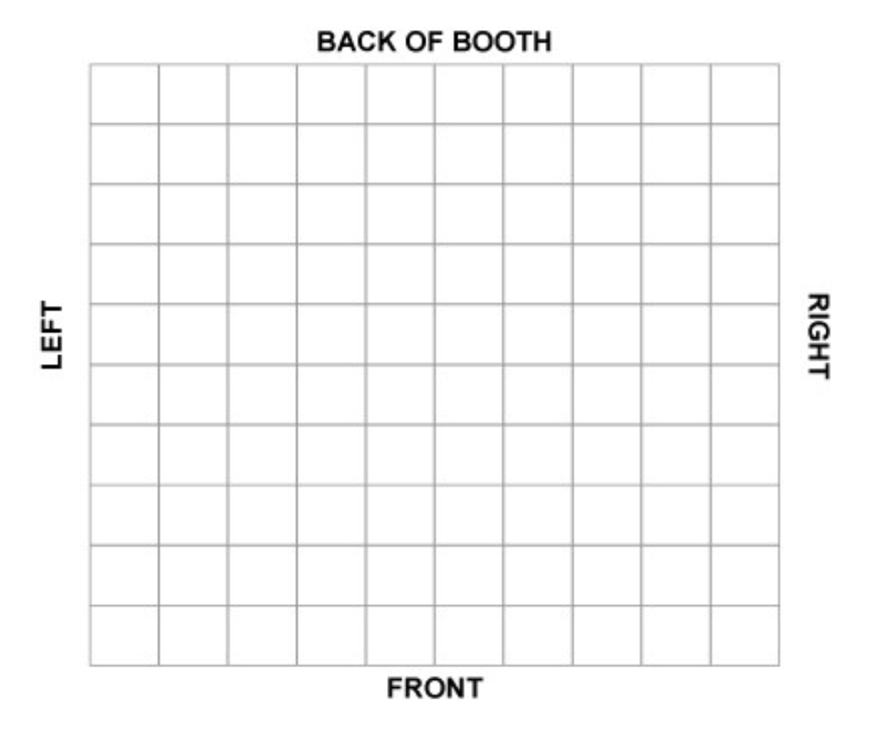
What CSTE will provide:
Rather than a typical “booth”, the RCKMS booth is setup like a meeting space, so we can have more informal conversations and gather there.
Note due to costs, we elected to bring a small monitor rather than get the Ipads we were originally considering.
The booth comes with the furniture and items to the right, but we are responsible for ordering and bringing our own decorations/branding:
Things we may want to consider:
- Branded tablecloths/runners
- Signage (to hang on the curtain walls?)
- Posters (to put on the easel)
- One pagers
Snacks/decorations for meeting tables
Swag (as discussed)
Lower Table
(for meeting)
Lower Table
(for meeting)
Small Monitor
One Pager Holder
Easel
Taller Table
Booth is ~ 8x10 with curtains on all sides; All tables come with black table cloths

Slide 2
What CSTE will provide:
Notes:
Ordered:
2 lower cocktail tables
4-6 chairs (included)
Taller table
Upgraded Wifi for booth/room
BRING:
- Monitor
- Extension cords and power strips
- One pager holder
- Easel
Lower Table
(for meeting)
Lower Table
(for meeting)
Small Monitor
One Pager Holder
Easel
Taller Table
Booth is ~ 8x10 with curtains on all sides; All tables come with black table cloths

