Slide 1

2017 Annual Conference Overview
May 2017 Staff Meeting

Slide 2

What is your number?
What is the total number?

Slide 3

Budget

Slide 4
Budget
What does it cost?
  Meeting expenses are non-federal
  $120,000 deficit in State Dues
  Limited income, AC generates revenues that support all non-federal activities
  Board approves budget and any reductions in expenditures
  Total budget for 2017 is $464,000

Slide 5
Before You Arrive

Slide 6
Before You Arrive
Review
  CONFERENCE WEBSITE(Information galore)
    Guidelines & FAQs
    Maps and onsite information on website
  ONLINE AGENDA(webprogram)
    Latest and greatest
    No Change Sheet – changes reflected in webprogram and app
  Download the CONFERENCE APP
    2nd year with CoreApps
    Better integration with Confex
    Sync across all of your devices
    Download handouts
    Find attendees and new directory (attendees must self identify)

Slide 7
Before You Arrive
Review
  Download WhatsApp for onsite communication tool
    Chat group – ONLY for AV Help
    Identify your room location and issue (i.e. Room 410C, problem with projector)
  Materials
    Everything packed and labeled by May 24 for truck
    Shared document for load list
    Do not ship anything to AC - Emergency ship to yourself at hotel
    Leave your computer on at the office

Slide 8
Travel

Slide 9
Travel
Hotel
  Verify your flight and hotel dates
  Room & tax charged to master, credit card for incidentals
    2 hotels for staff – The Inn at 500 and The Grove Hotel
    Those staying additional night(s) are on their own for room charge
  Tons of food options nearby, includes a Trader Joes

Slide 10
Travel
Reimbursement
  Keep ALL receipts charged to CSTE credit card
  Keep ALL receipts for anything over $50
  Accounting will accept photos of receipts, but original preferred
  Meals or any travel items charged for a group to one card can delay reimbursements

Slide 11
Travel
Payroll and Credit Time
  Credit Time Limits for exempt employees increased during AC
    Up to 12 hours per day on Saturday and Sunday
    Up to 6 hours per day on Monday – Wednesday
    40 hours maximum carryover
  OT for non-exempt employees
  See your supervisor regarding support expectations and travel
  Administrative Leave no longer awarded the Friday after the AC

Slide 12
Onsite Set-Up

Slide 13
Onsite Set-Up
Schedule
  Staff traveling on Friday and Saturday
  Most set-up will occur on Saturday
  Independent AV Team
    AV cell number and WhatsApp Help
  Different Confex staff onsite for support this year
    Tracy and Andy
    Tracy will conduct a Moderator training on Confex
  Exhibitors and Sponsors set-up on Saturday afternoon
    4 Sponsors and 5 Exhibitors not including RCKMS or CSTE

Slide 14
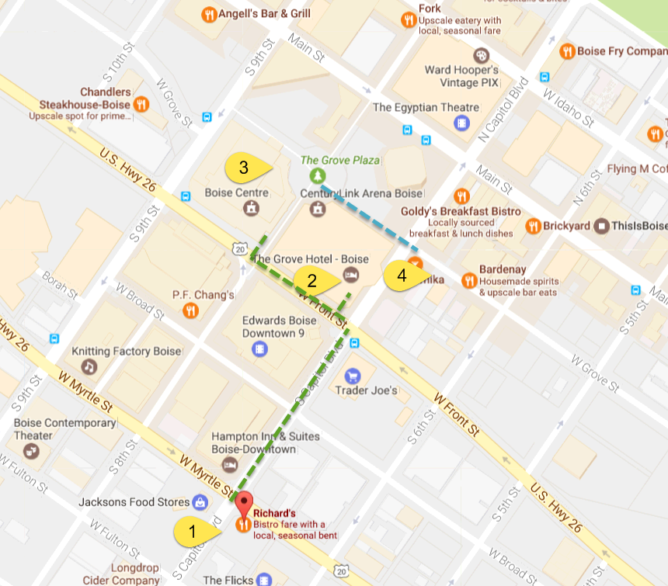
Onsite Set-Up
1 = The Inn at 500
2 = The Grove Hotel
3 = Boise Centre
4 = Basque Block

Slide 15
Onsite Set-Up
Schedule
  ALL name badges printed onsite
  Assistance from all available staff with line directions and refill supplies on Sunday and Monday mornings
  AV staff float between rooms
  Combined Business Office / Speaker Ready / Position Statement Office
    Confex Staff support Speaker Ready Area
    CSTE Interns Mia and Meghan support Position Statements
  Shuttle service Sunday – Wednesday, schedule and routes with hotels on website, pocket agenda and app

Slide 16
Onsite Set-Up
Schedule
  Plenary, networking hall, registration, workshops and breakouts at Boise Centre
    Hint: Rooms in Boise Centre East are numbers (400+) other rooms are in Boise Centre
  Roundtables at Boise Centre & The Grove Hotel
  One workshop (AMD), fellowship graduation, banquet & business meeting at The Grove Hotel
  Opening reception at The Basque Block (directly across street from Boise Centre)

Slide 17
Events

Slide 18
Events
Schedule
  Social media campaign during the conference #CSTE2017
    Daily prizes awarded
  Photographer at graduation, reception, banquet and plenary
    Communications Team will coordinate schedule
    State Epi Headshots
  Fellowship Graduation
    Reserved seating for fellows and speakers
  Opening Reception
  Banquet
    Reserved seating for staff attending, Board, past presidents & VIPs at banquet

Slide 19
New or Important Info

Slide 20
New or Important Info
Important
  Do not order anything for a meeting onsite from the hotel or convention center, see Beverly or ask our AV
  Do not ask bellman from hotel to bring items over to the convention center
  Do not bring anything into convention center that you can’t carry in your hands
  Do wear you name badge at all times, security at convention center will check
  Complimentary wireless in Boise Centre only

Slide 21
New or Important Info
Important
  Confex process to upload breakout presentations for availability and recording in meeting rooms
    Advance deadline is Friday, May 26 (system will close)
    Onsite no later than 24 hours prior to session
    Emergency in room, upload in system not on desktop
    Laptops will be preloaded with presentations just for that room
    Click presentation to start and recording will start
    Stay on last slide for Q&A for recording to continue
  Confex handout feature for Sunday agendas, poster and roundtable handouts
  Confex training onsite for moderators
  Moderator onsite guide as handout at desk, in app and in meeting room

Slide 22
New or Important Info
New
  4 Sponsors with AM or PM roundtable sessions and booths
  5 Exhibitor booths
  Name Badges and Sunday Sessions
    Coded name badges and sign-in sheets
  Representative of CSTE at ALL times

Slide 23
New or Important Info
  Board Elections
    Open May 4, Close May 18
    Secondary Election Open May 25, Close June 2
    May need Third Election after conference
  Dues Adjustment Proposal
    Increase individual Active and Associate member dues by $10
    Increase tiers from 5 to 8 and dues by $500 each level
    Voting at Business Meeting
  App review (Clay)
  Position Statement review (Meredith/Dhara)
  Poster Awards (Jennifer)
  CE review (Jessica A.)

Slide 24
  Questions????

Slide 25
CSTE Values
Commitment to Service,
Teamwork and Excellence
through Integrity, and Respect for all.

Slide 26



CSTE National Office
2872 Woodcock Boulevard, Suite 250
Atlanta, Georgia 30341
770.458.3811
770.458.8516
bchristner@cste.org

