Slide 1
2018 CSTE Annual Conference
CE Overview

Slide 2
Why CE?
The educational purpose of the CSTE Annual Conference is to offer professionals and practitioners the opportunity to enhance their knowledge, improve their skills, and exchange information on best practices and strategies in applied epidemiology.

Slide 3
History
Year | Provider | CE Offered | Cost | Eligible Sessions
2015 | NBPHE | CPH | $10 | Entire Conference
2016 | CDC | CME, CNE, CHES, RACE, CPH, CEU | Free | Workshops, Plenaries, & Breakouts
2017 | APHA & NBPHE | CME, CNE, CHES, RACE, CPH | $25 | Workshops & Plenaries

Slide 4
Important Dates
Date | Activity
March 1 | Speaker forms due for all workshops and plenaries; commercial sponsorship forms due
April 12 | CSTE submits application to APHA
May 31 | Deadline for any speaker changes

Slide 5
Attachment 6
How to complete Attachment 6
How to complete Attachment 6 Tracking Sheet

Slide 6
Forms Needed for Completion
Attachment 6
Attachment 8
All speakers for workshops and plenaries
Moderators for workshops and plenaries (Executive Board)
Executive Board
CE Planners (CME, CNE, CHES, RACE)
Executive Board
Program Staff Conference Planning Leads

Slide 7
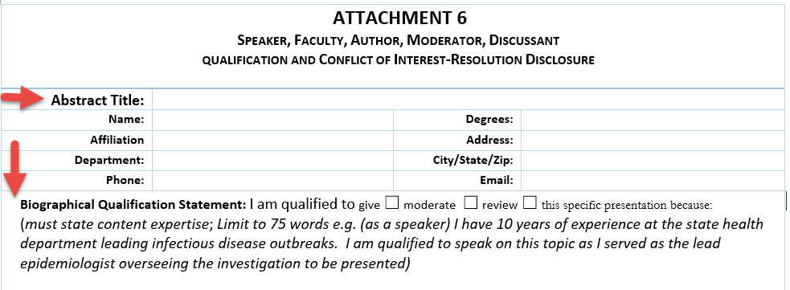

Slide 8
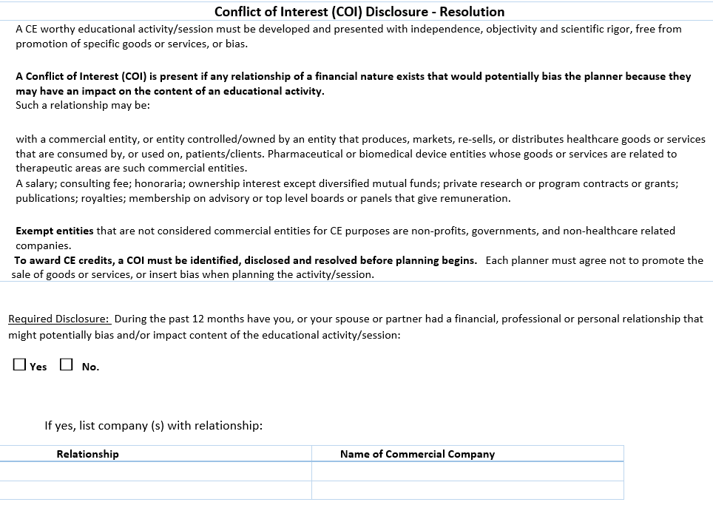

Slide 9


Slide 10
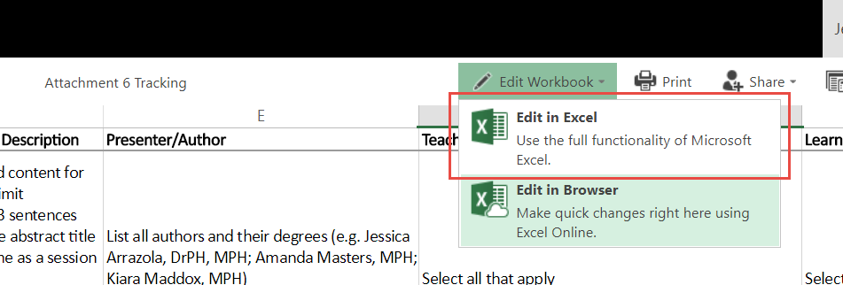
Attachment 6 Tracking

Slide 11

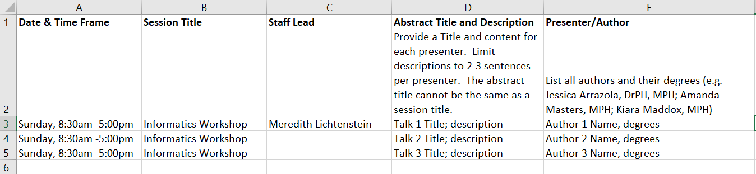
Each speaker needs to have their own line.
Column B - The session title is the title of the workshop.
Column D - The abstract title cannot be the same as the session title.
Column D – Write up 2-3 sentences describing what the presenter will discuss.
Column E – Author names should be listed: First, Last, degrees.

Slide 12
Insert screenshot of dropdown teaching methods and learning outcomes
Column F – Select at least discussion and Q&A.
Column G – Select all learning outcomes that apply. All workshops must include: Apply public health practice skills presented in workshops
Note: You can only select multiple when editing in excel – not in browser.

Slide 13

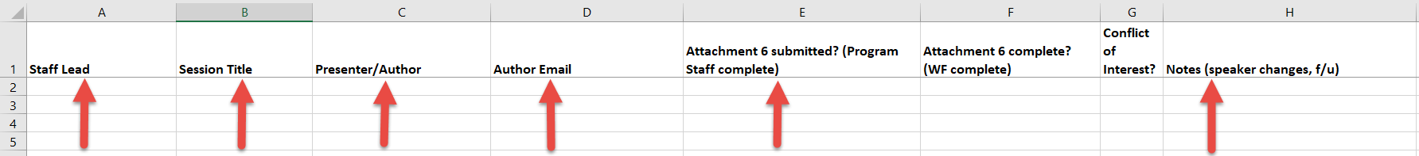

Slide 14

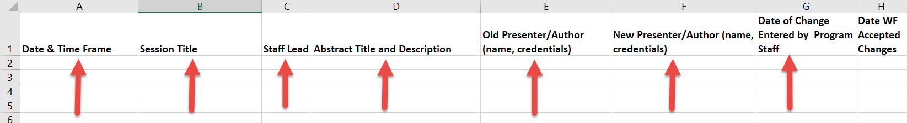
Copy and Paste Columns A-E from “All Speakers” Tab.
Do not add new presenters in the “All Speakers Tab.

Slide 15
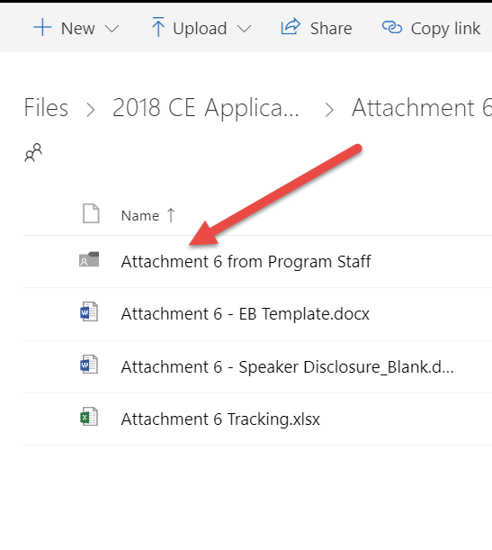
Upload each attachment 6 into the share drive folder.
Name the file (e.g. Jessica C Arrazola).
Note the file has been uploaded in the “All Speakers” tab.

Slide 16
Attachment 8
How to complete Attachment 8

Slide 17
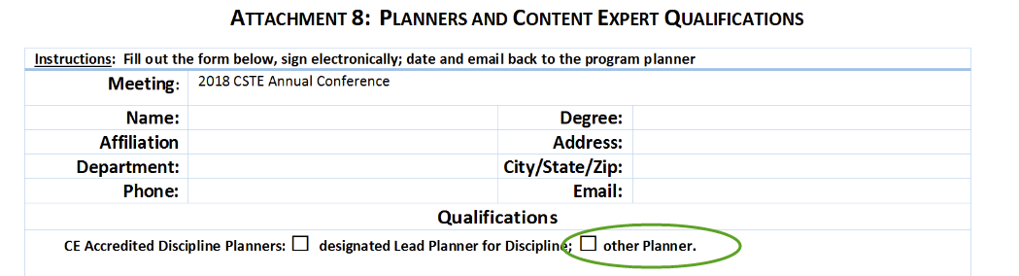
Complete your contact information.
Select “other planner.”

Slide 18
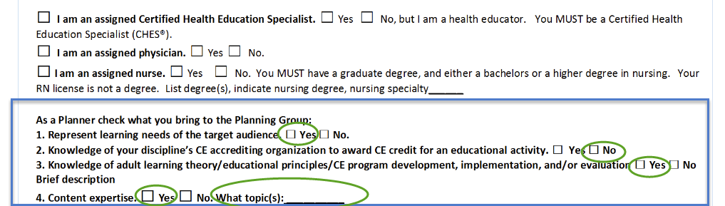
#1 – select yes.
#2-4 as appropriate. #4 expertise can be the track subject area.

Slide 19
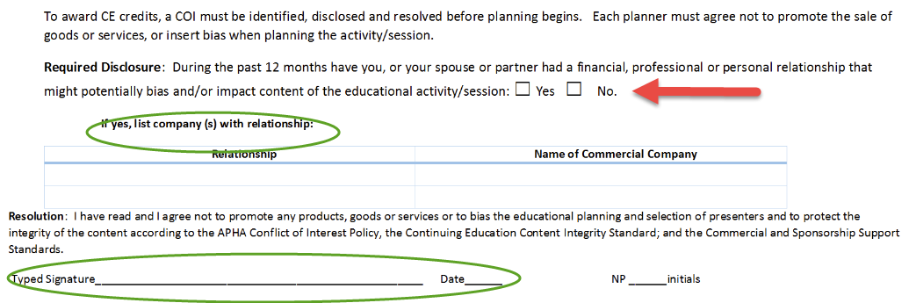
Indicate if you have a conflict of interest that requires a disclosure.
If yes, indicate the relationship and company.
Electronically sign the document.

Slide 20
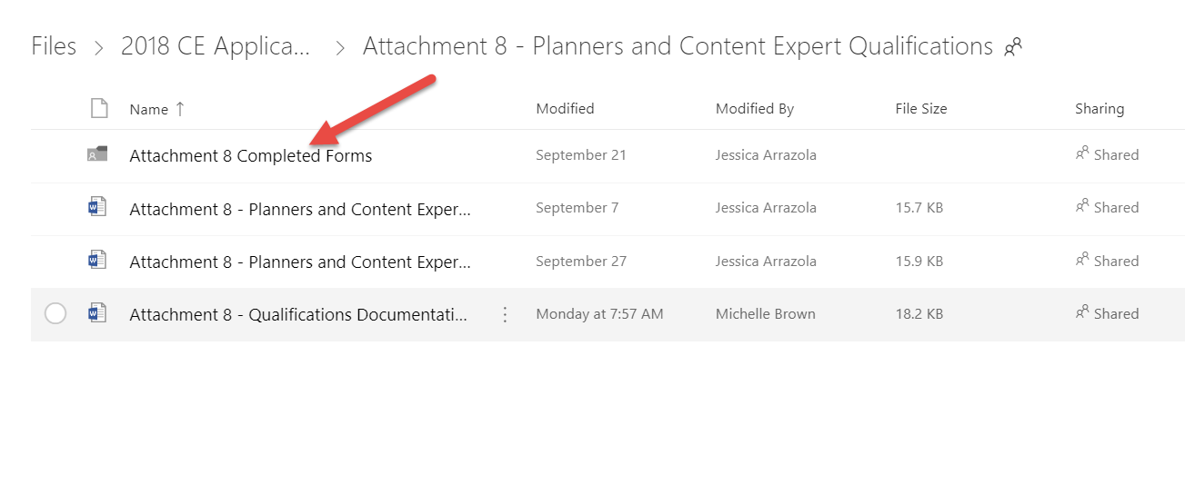
Upload your form to Attachment 8 Completed Forms folder.
Rename your form to your name (e.g. Jessica Arrazola).

Slide 21
Questions?

