Slide 1


Slide 2

Welcome to the
Healthcare-associated Infection and Antimicrobial Resistance Workshop: Contain, Control, and Prevent
Sunday, June 10, 2018
9:00 AM-5:00 PM

Slide 3

Announcements
Please sign in on the attendance sheet
Wi-Fi:
    network:
    password:

Slide 4
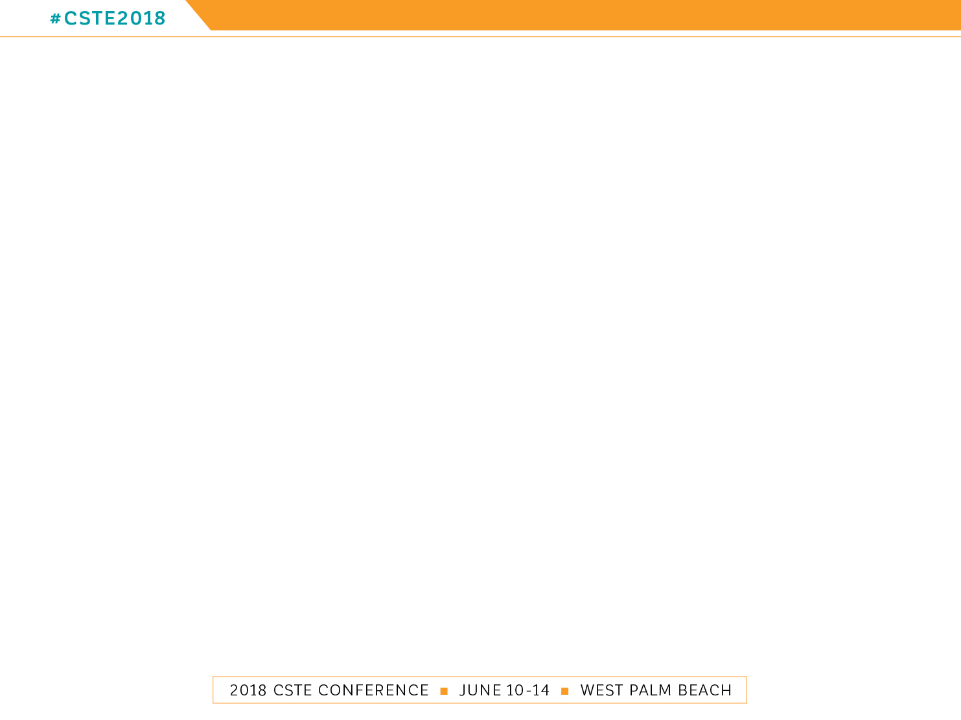
Download the Conference App
Search “CSTE Annual Conferences” in App Store / Google Play

Slide 5


CSTE Media
@CSTEconference
@cstenews
Council of State and Territorial Epidemiologists
Follow CSTE on Social Media
Use #CSTE2018

Slide 6

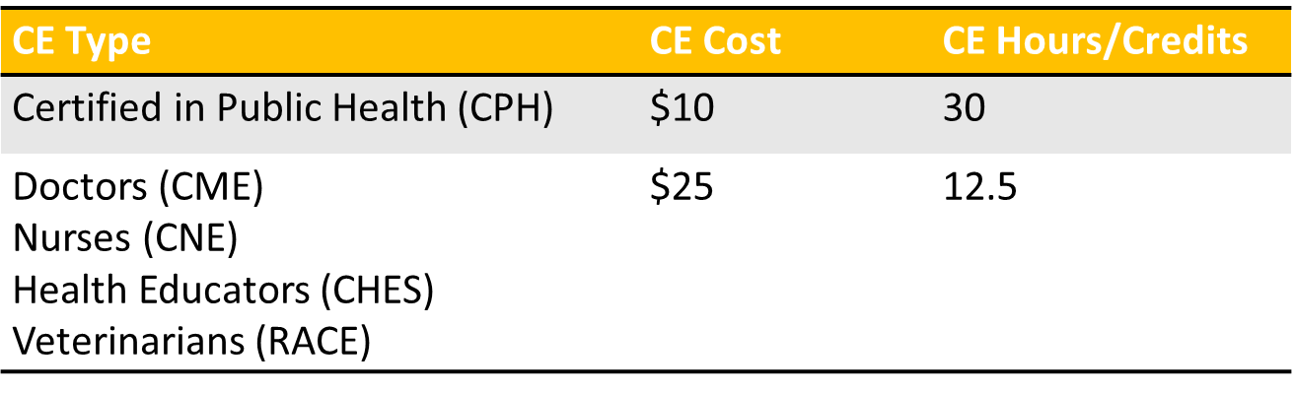
2018 Attendees Eligible for Continuing Education (CE) Credits
CE is available for physicians, nurses, health educators, veterinarians, and those Certified in Public Health (CPH)
Ask for more information at the registration desk

Slide 7
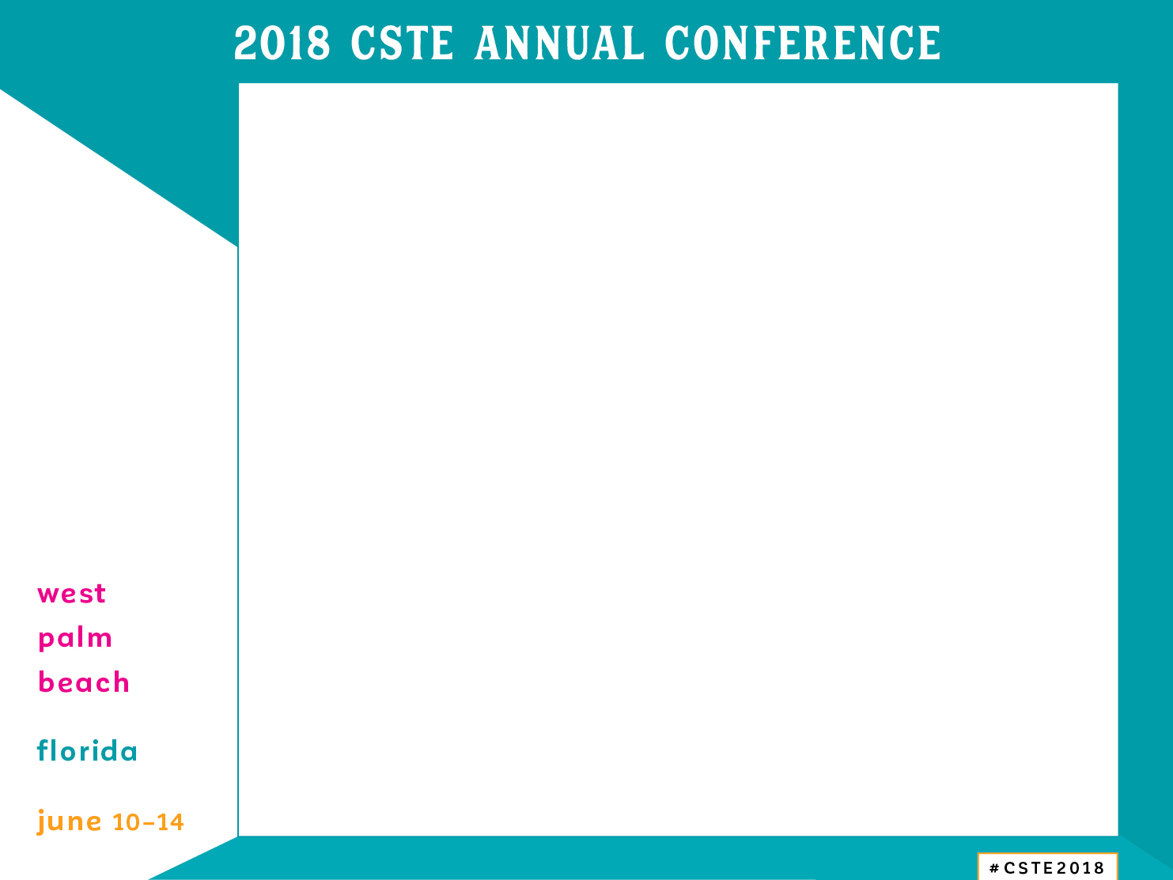
Rate and Evaluate
After the session, please RATE the session in the CSTE App
Click on the clipboard on the left side of the screen on the event page to leave a 1 to 5 star rating
Make sure to complete your CSTE annual conference evaluation

Slide 8
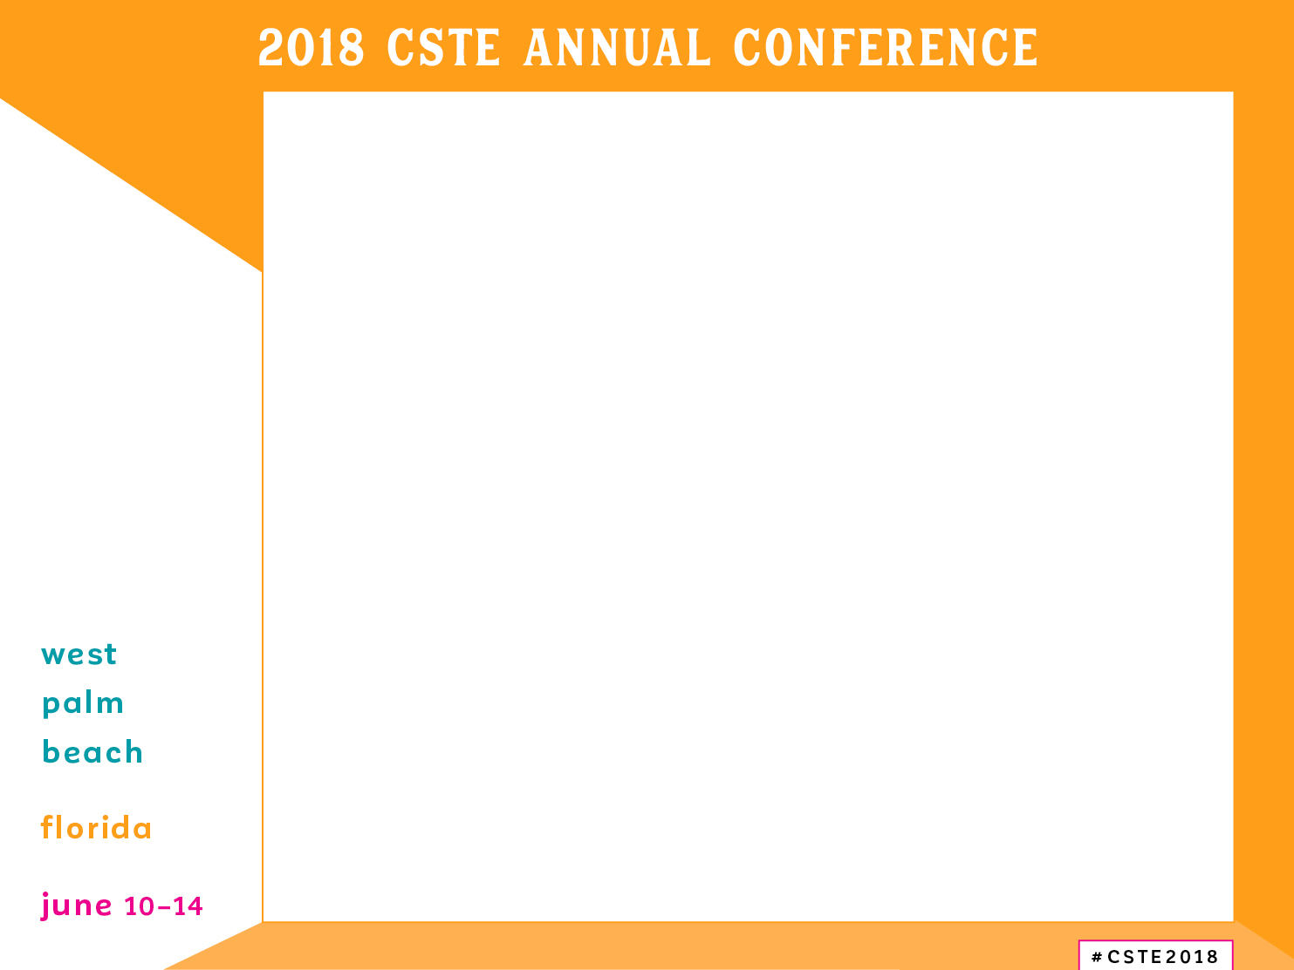
Conference Meal Options
Quick options
  BurgerFi
  The Cheesecake Factory
  Panera Bread
  Moe’s Southwest Grill
  Brother Jimmy’s BBQ
  Starbucks
Sit-down options
  Mellow Mushroom
  The Regional Kitchen & Public House
  Ruth’s Chris Steak House
  Sweet Ginger Asian Bistro
  BRIO Tuscan Grille
  IL Bellagio Italian Restaurant

Slide 9
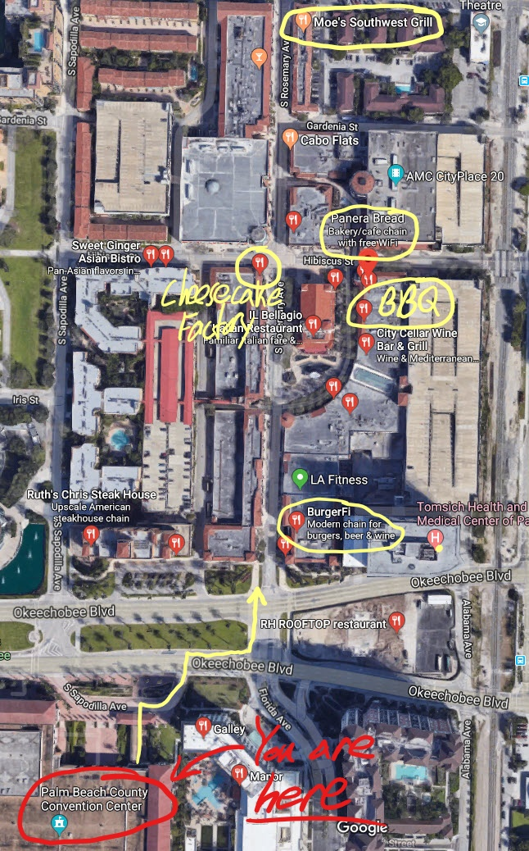
Restaurant Map
BurgerFi
The Cheesecake Factory
Panera Bread
Moe’s Southwest Grill
Brother Jimmy’s BBQ
Starbucks

