Slide 1

Update
Allison C Brown, PhD MPH
Division of Healthcare Quality Promotion
CDC
2018 CSTE
West Palm Beach

Slide 2

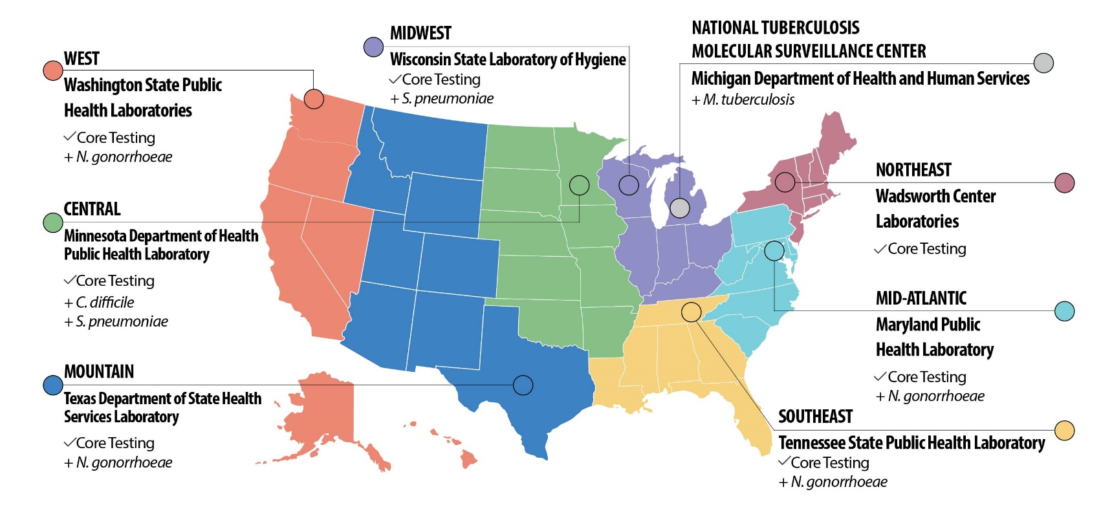

AR Lab Network
Establishing nationwide lab capacity to detect AR threats
Detecting and stopping outbreaks faster
56 state and local labs
  7 regional/specialty labs
Coordination of public health response

Slide 3

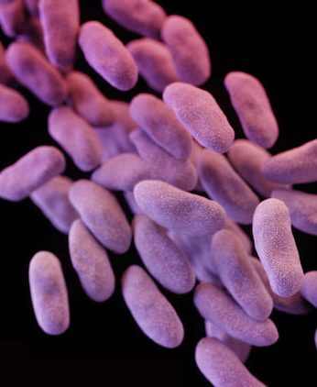
AR Lab Network Regional Lab Core Testing
Outbreak Response
Colonization Screening
REGIONAL
Confirmed CRE Case
Engage HAI Coordinator
Identify Patient Contacts
Coordinate Swab Collection
CRE Colonization Screening from Rectal Swabs
Results to Facility, Epidemiologist, and Lab in 2 Days
CRE/CRPA Isolate Characterization
Targeted surveillance
  Carbapenem-R Acinetobacter spp.
  ESBL-producing Enterobacteriaceae – Isolate testing for mcr-mediated colistin resistance

Slide 4
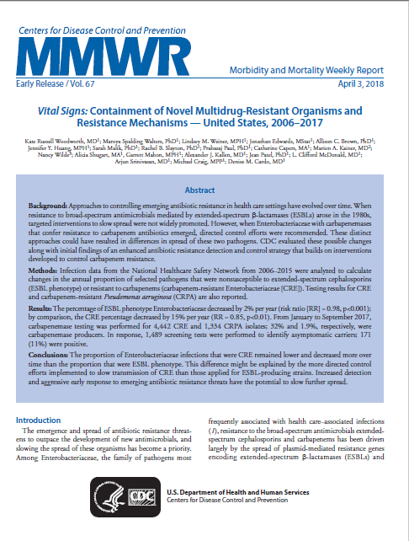
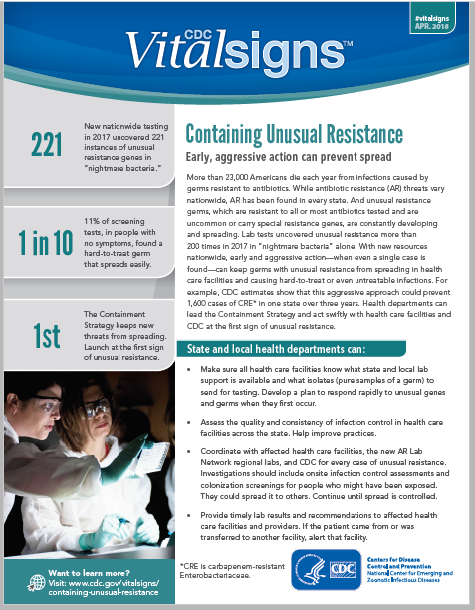
First Results from AR Lab Network
MMWR report summarized the experience over the first several months of improved lab testing by CDC’s Antibiotic Resistance Lab Network.
Expanded laboratory testing capacity in all 50 states, 5 cities, and Puerto Rico for rapid identification. Regional labs support colonization testing.
Health departments and health care facilities can work together to aggressively respond to protect patients from these threats and keep infections from spreading within and between facilities.

Slide 5
CRE/CRPA Testing Summary—2017
Total isolates tested: 10,590
  CRE tested: 6,891
    34% (2,311) CP-CRE
  CRPA tested: 3,699
    3% (98) CP-CRPA
  >1600 screening swabs tested in >50 facilities
    11% positive overall
      14% positive in post-acute care facilities vs 6% in short-stay acute care
Number of ARLN Alerts sent: 425
  2018: >500 alerts reported
Preliminary data
Notes:
-by developing this network, we are helping to connect the dots between CDC and state labs, clinical labs
-creates surge capacity-better able to support outbreaks and have a more robust investigation
-CDC can learn more and improve infection prevention guidance
To identify asymptomatically colonized health care contacts of index patients, 1,489 screening tests for carbapenemases were performed during 70 surveys (defined as all screening tests performed at a single facility within a 14-day period) in 50 facilities. A median of 10.5 contacts (interquartile range = 2–25) were screened per survey. Overall, 11% of screening tests were positive for at least one of the five carbapenemases of primary public health concern (Table 2). A higher percentage of post–acute care facility contacts screened positive for carbapenemases (14% [147 of 1,074 contacts]) than did contacts from short-stay acute care hospitals (5.8% [21 of 365]) (p<0.01). Screening tests performed increased from 363 in the first quarter of 2017, to 732 in the third.

Slide 6
CRE/CRPA Testing Summary—2017
Genus | Isolates Tested N | Carbapenemase Producing n (%) | Carbapenemase Gene
 |  |  | KPC n (% CP) | NDM n (% CP) | OXA-48 n (% CP) | VIM n (% CP) | IMP n (% CP)
Enterobacteriaceae | 6891 | 2311 (33%) | 2056 (30%) | 185 (3%) | 77 (1%) | 24 (<1%) | 24 (<1%)
Klebsiella | 2383 | 1585 (67%) | 1431 (60%) | 96 (4%) | 51 (2%) | 6 (<1%) | 1 (<1%)
Enterobacter | 2557 | 383 (15%) | 346 (14%) | 21 (<1%) | 0 (0%) | 8 (<1%) | 8 (<1%)
Escherichia | 1096 | 202 (18%) | 119 (11%) | 60 (5%) | 23 (2%) | 0 (0%) | 0 (0%)
Citrobacter | 162 | 52 (32%) | 47 (29%) | 1 (<1%) | 0 (0%) | 4 (2%) | 0 (0%)
Serratia | 133 | 25 (19%) | 25 (19%) | 0 (0%) | 0 (0%) | 0 (0%) | 0 (0%)
Proteus | 106 | 17 (16%) | 9 (8%) | 5 (5%) | 0 (0%) | 1 (<1%) | 2 (2%)
Providencia | 57 | 19 (33%) | 2 (4%) | 0 (0%) | 0 (0%) | 5 (9%) | 12 (23%)
Other species | 397 | 83 (21%) | 77 (19%) | 2 (<1%) | 3 (<1%) | 0 (0%) | 1 (<1%)
Pseudomonas aeruginosa | 3699 | 98 (3%) | 11 (<1%) | 3 (<1%) | 0 (0%) | 52 (1%) | 8 (<1%)
Preliminary data
Notes:
-by developing this network, we are helping to connect the dots between CDC and state labs, clinical labs
-creates surge capacity-better able to support outbreaks and have a more robust investigation
-CDC can learn more and improve infection prevention guidance

Slide 7
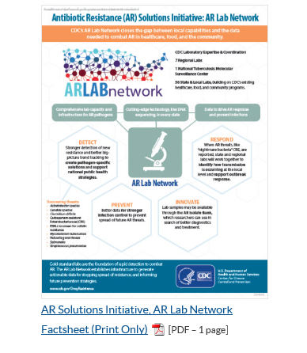
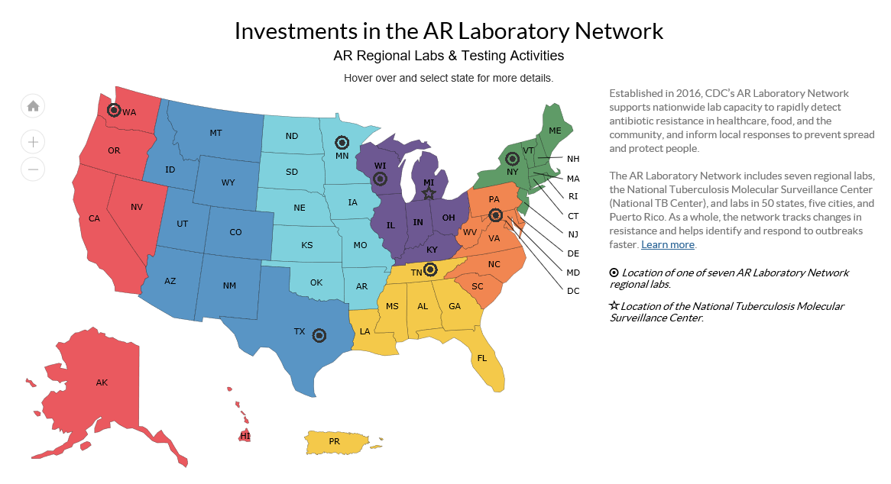
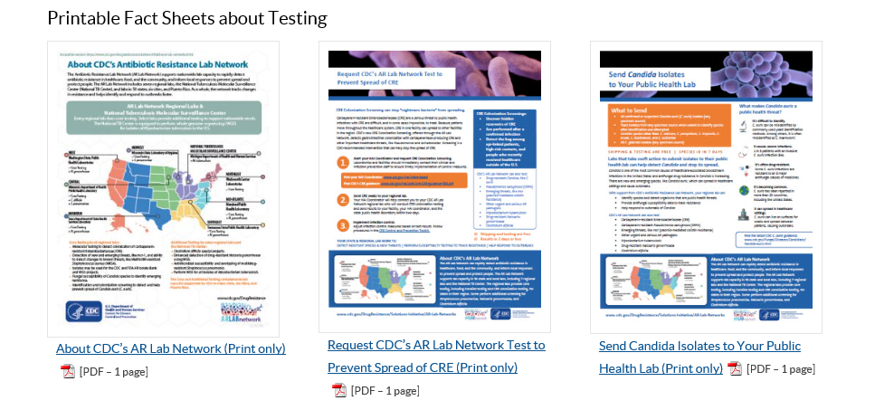
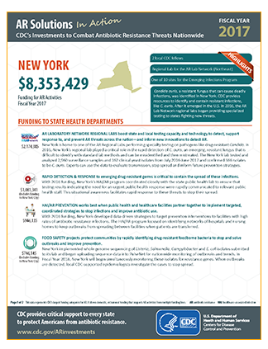
Resources

Slide 8
AR Lab Network Data for Action
Testing numbers to date (January, 2017-March, 2018)
Neisseria gonorrhoeae
  9,935 isolates tested (AST)
  1347 isolates sequenced
Candida
  673 isolates tested
    227 identified as C. auris
  1412 colonization screenings performed
    133 C. auris identified
Streptococcus pneumoniae
  372 isolates serotyped with AST
Clostridium difficile
  510 isolates sequenced
  271 isolates cultured
Over 800 alerts sent to CDC since January 1, 2017
Notes:
-by developing this network, we are helping to connect the dots between CDC and state labs, clinical labs
-creates surge capacity-better able to support outbreaks and have a more robust investigation
-CDC can learn more and improve infection prevention guidance

Slide 9
Goals for 2018
Testing
  Increase use of colonization screening capacities
  Increase submissions and target long-term care facilities
  Integrate new testing protocols and capacities (OXA-23 multiplex, mcr3/mcr4 multiplex, custom AST panels for new drugs)
Reporting
  Send data using APHL AIMS portal
  Implement ETOR for screening
Programmatic
  Increase recruitment and testing for targeted AR threats
  Improve use of ARLN data to initiate containment activities and guide prevention efforts
  Provide communications materials to facilitate recruitment and collaboration
Notes:
Finish off talk discussing some goals for 2018
Testing: we are in the process of validating new assays for PCR including OXA48/mcr3 and mcr4. These will be rolled out to all labs in the near future
Reporting: mentioned we hope to have all labs uploading to APHL AIMS portal
Programmatic: focus on increasing awareness for colonization screening by working with partners such as APIC and SHEA
Hope to increase the number of isolates tested for targeted surveillance so we have a better understanding of CRAB and we can monitor the emergence of mcr in ESBLs
One big goal is to improve partnerships between lab and epi both within states and regions.
Now that testing for almost all labs is up and running, we hope that ARLN data can be used to improve containment of CP CRE/CP CRPA. So looking at your data to look for specific trends to come up with an epi for your state or region if you are a regional lab.
An example of how we use ARLN data is to provide novel isolates that arise through ARLN into the CDC FDA AR isolate bank so that it is available to you. We develop assays such as the OXA23 assay that we can provide protocols alongside the isolates to validate these assays in your lab.

Slide 10
ETOR via the AR Lab Network’s LabWeb Portal
ETOR provides a critical data solution to disrupt CRE transmission in healthcare facilities
  Easy test ordering and rapid return of results are needed to quickly test and report CRE colonization tests results to healthcare facilities
Who orders CRE colonization screening tests?
  State HAI coordinators/epidemiologists or a facility-level infection preventionist can request CRE colonization screening testing services from their AR Lab Network Regional Laboratory
  Facility-level requests still require approval from the jurisdictional state HAI coordinator/epidemiologist
Test results are delivered electronically within 2 days of the lab’s receipt of samples
  Data recipients are notified via email when reports are available

Slide 11
ARLN Lab Web Portal/ETOR Snapshot
Regional Testing: CRE Colonization (5 Regional PHLs)
Status | CRE Colonization (LWP/ETOR)
In Production | MD, WI
End to End Testing | TX
Validation | WA, TN
Notes:
Reminder on production troubleshooting. Have tara help with discussing dasta quality monitoring (handled by CDC)

Slide 12
Custom AST Panels for New Drugs
There is often a gap between the approval of a new drug and the availability of testing methods in hospital laboratories
This gap can result in under use and over use of a new antibiotic
Testing is most important for pan or nearly pan-resistant bacteria
We can leverage AR Lab Network capacity to place reference broth microdilution testing capabilities in regional labs and use electronic test order and report capabilities for rapid reporting

Slide 13
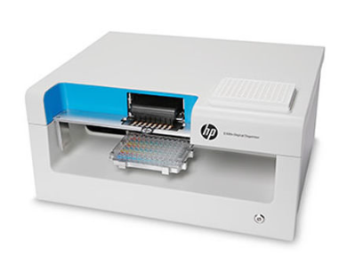
On Demand MIC Panels
Easy method to place reference BMD capacity in AR Lab Network regional labs
Applications
  Testing susceptibility of pan-R pathogens to new drugs
  Collect AST data for breakpoint decisions
Can leverage electronic test order and result processes for faster turn-around times

Slide 14






AR Lab Network: Partnerships Make it Possible
Organizational Partnerships
CDC
State/Local PHDs
PHLs
Academia
ARLN
Regional Labs
Hospital and Clinical Labs
CDC
AR Bank
Notes:
-by developing this network, we are helping to connect the dots between CDC and state labs, clinical labs
-creates surge capacity-better able to support outbreaks and have a more robust investigation
-CDC can learn more and improve infection prevention guidance

