Slide 1
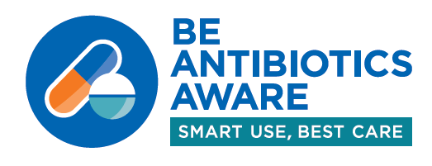

CDC Antibiotic Stewardship Update
Katherine Fleming-Dutra, MD
Deputy Director
Office of Antibiotic Stewardship
Prevention and Response Branch
Division of Healthcare Quality Promotion
Notes:
I am …
Introduce Lauri
Today we will begin our session by updating you on what we have been up to in the Office of Antibiotic Stewardship, with a focus on some of the key things that we hope will be helpful to you all in your work at the state and local levels. Then the majority of our session will be spent hearing from our panel and hopefully having some good discussion.
Of course, our goal in the Office of Antibiotic Stewardship is that Every patient gets optimal antibiotic treatment—meaning antibiotics only when needed and when needed, the right antibiotic is used at the right dose for the right duration. That will mean that moving towards every provider and healthcare facility implementing antibiotic stewardship, and all initiatives in healthcare incorporating appropriate antibiotic use.

Slide 2
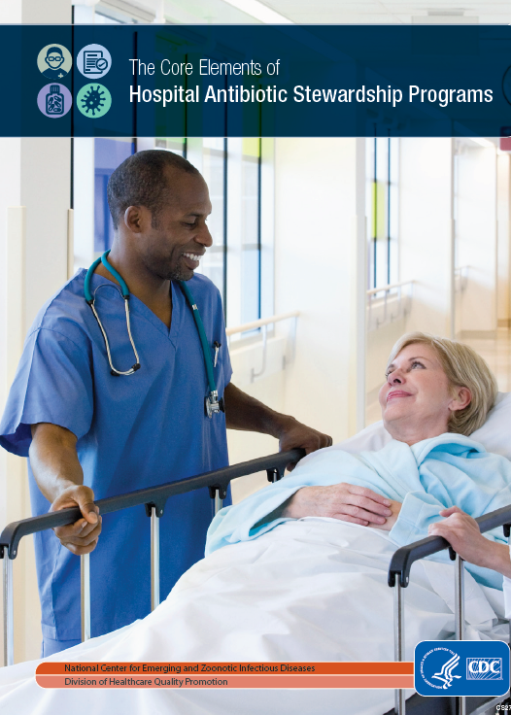


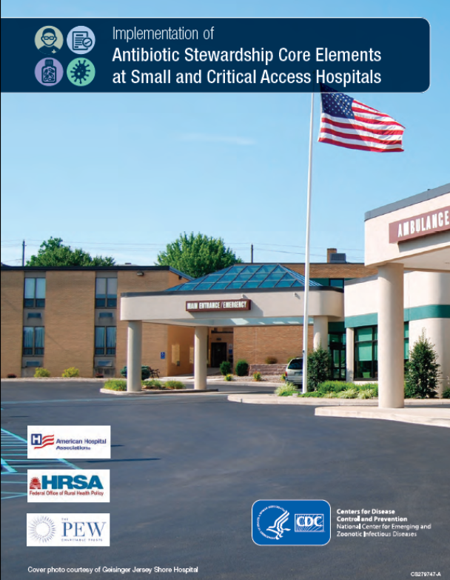
Core Elements of Antibiotic Stewardship
https://www.cdc.gov/getsmart/healthcare/implementation/core-elements.html;
https://www.cdc.gov/getsmart/healthcare/implementation/core-elements-small-critical.html
https://www.cdc.gov/longtermcare/prevention/antibiotic-stewardship.html
https://www.cdc.gov/getsmart/community/improving-prescribing/core-elements/core-outpatient-stewardship.html
Notes:
As you all know, in order to accomplish our goal, CDC has Core Elements of Antibiotic Stewardship which provide a framework for antibiotic stewardship across the spectrum of healthcare. The first were the Core Elements of Hospital Antibiotic Stewardship, followed by the Core Elements of Antibiotic Stewardship in Nursing Homes, and the Core Elements of Outpatient Antibiotic Stewardship. The most recent are The Implementation of Antibiotic Stewardship Core Elements at Small and Critical Access Hospitals, which were published last summer.
Melinda Neuhauser, who leads acute care antibiotic stewardship in our office, also led the work on the small and critical access hospital Core Elements. I also want to let you know that Melinda is also an expert on the NHSN Antibiotic Use Option, and will be available to answer your questions during the networking event this afternoon, after this session, so please talk with her if you have questions.

Slide 3
Antibiotic Stewardship Programs in Hospitals:
Using CDC’s Core Elements
Adopted by several initiatives:
  The Joint Commission for their antibiotic stewardship standard
  DNV for their antibiotic stewardship standard
  CMS-funded Hospital Improvement Innovation Networks (HIINs)
  Agency for Healthcare Research and Quality (AHRQ) Comprehensive Unit-based Safety Program (CUSP)
Notes:
A big help has been that the hospital Core Elements have been adopted by several initiatives, which have really moved the needle on implementation in hospitals.
The Joint Commission, which as you all know accredits many hospitals and is a partner here at the meeting, has included the Core Elements in their antibiotic stewardship standard for accreditation—and that definitely gets hospitals attention.
DNV, which is another accrediting organization, has also included the Core Elements for their antibiotic stewardship standard
The CMS-funded Hospital Improvement Innovation Networks (HIINs)s and the Agency for Healthcare Research and Quality Comprehensive Unit-based Safety Program (or CUSP) also use CDC’s Core Elements

Slide 4
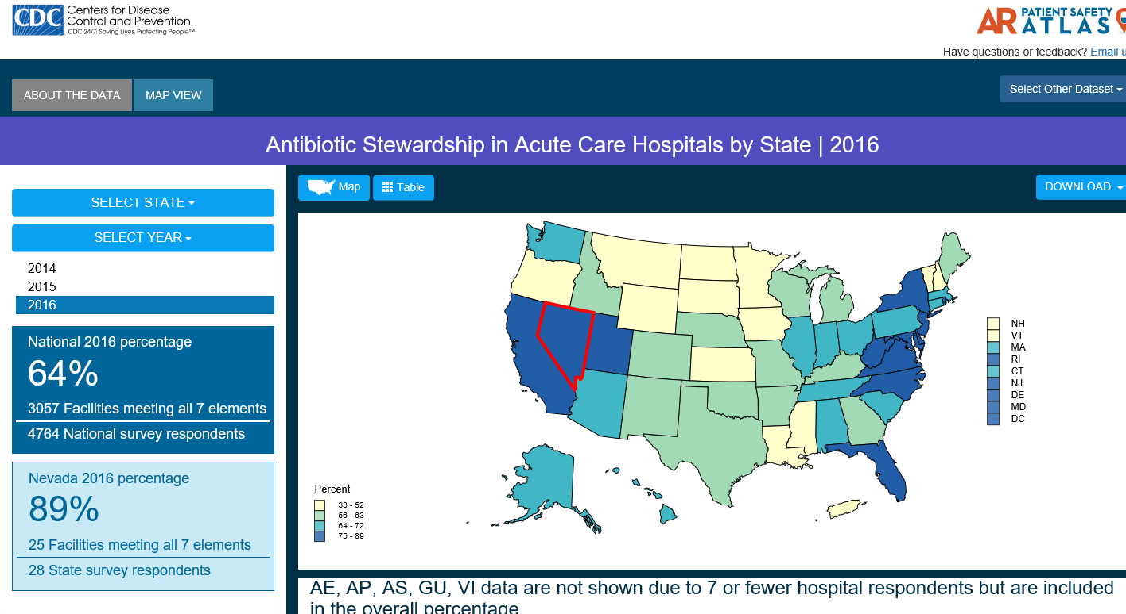
https://gis.cdc.gov/grasp/PSA/
Notes:
The National Healthcare Safety Network (or NHSN) annual survey collects data on whether hospitals have an antibiotic stewardship program that meets all 7 Core elements. These data are posted online by state in CDC’s Antibiotic Resistance Patient Safety Atlas (available at the link on this slide). The lighter yellow indicates a percentages in the lowest quartile to the darker blue which indicates the highest quartile.
Overall in 2016, you can see over on the left that nationally 64% of hospitals had an ASP that met all 7 Core Elements. You can also click on your state and determine your percentage, as well as the number of hospitals responding. In this example, I have selected Nevada, the state with the highest percentage, and you can see that 89% of their reporting 28 facilities have an ASP that meets all 7 Core Elements.
We hope that you find this information and the Atlas useful.

Slide 5
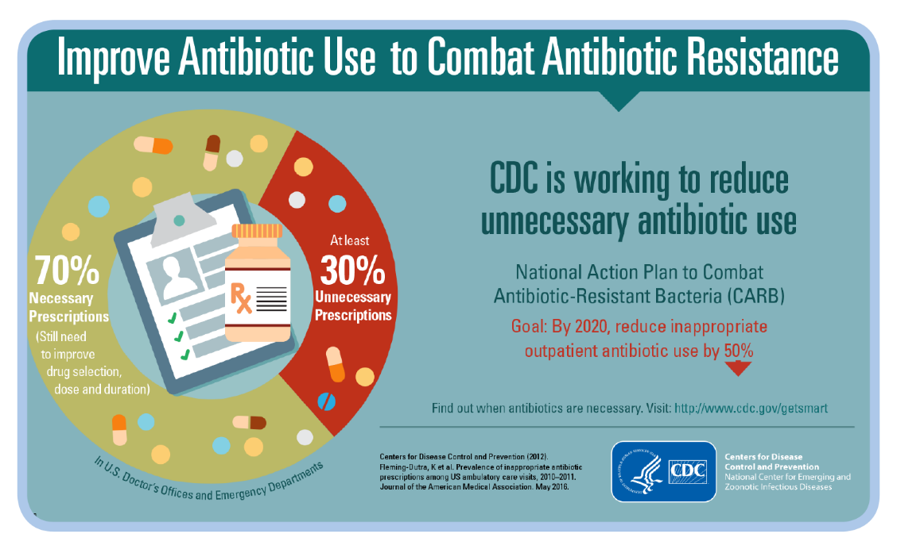
Outpatient Antibiotic Prescribing: Opportunity for Improvement
Notes:
What about the outpatient setting? We know that there is opportunity for improvement.
You all have probably seen this graphic before. From a study we did a few years ago, we estimate that at least 30% of outpatient antibiotic prescriptions are unnecessary, and we know that respiratory conditions are major drivers of unnecessary antibiotic use. Even among that “necessary 70%”, there are still opportunities to improve antibiotic selection, dose and duration.
We can use data to help us target our interventions to specific populations and settings that need the most improvement.

Slide 6
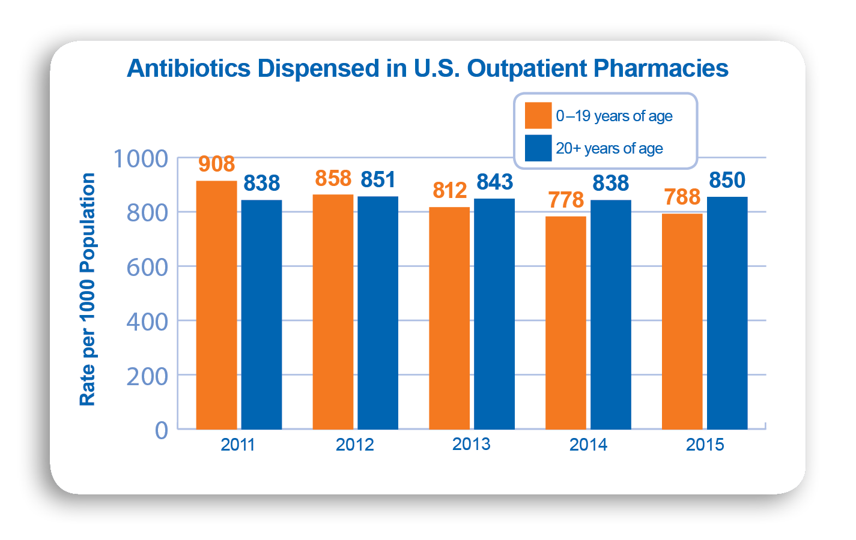
Antibiotic Stewardship in Outpatient Setting:
Need for Targeted Interventions
Outpatient prescriptions decreased 13% from 2011 to 2015
No change in adult prescribing
Collaborating with The Pew Charitable Trusts to engage partners from diverse settings
Data: IQVIA (formerly IMS Health, QuintilesIMS)
http://gis.cdc.gov/grasp/PSA/indexAU.html
Notes:
As an example of that, we use proprietary national dispensing data from IQVIA (formerly IMS Health) to examine trends in the rate of antibiotics dispensed in outpatient pharmacies per 1000 population by age group, as shown in this graph. You can see that outpatient antibiotic prescribing to children, shown in orange, decreased from 2011 to 2015. It actually decreased by 13%. However, the rate for adults, shown in blue, has not changed. For our program, this really signals a need to have stewardship efforts targeted at adult patients and clinicians who care for adults, and that is a specific focus of the new Be Antibiotics Aware educational effort.
Additionally, partners are really important in helping us to reach target audiences. For example, we have been working with The Pew Charitable Trusts to engage partners from diverse settings and to reach our target audiences. David Hyun from Pew is here today.

Slide 7
Antibiotic Stewardship in Outpatient Setting:
Need for Targeted Interventions
Palms et al. IDWeek 2017
Notes:
Another example is that we have been using MarketScan claims data to examine antibiotic prescribing patterns in different outpatient settings in order to inform our work as well. This graph shows the percent of visits for respiratory diagnoses that do not require antibiotics — such as upper respiratory infections, acute bronchitis, flu — that received an antibiotic prescription in urgent care, emergency departments, medical offices, and retail clinics.
First, you can see that we have opportunities to improve in all of these settings—the goal for these diagnoses is 0 antibiotic prescribing for these conditions. You can also see that urgent care has the highest percentage of antibiotic prescribing for these diagnoses at 45%. Urgent care can be a hard setting to reach with stewardship efforts, as urgent care centers are often independently owned or owned by small regional chains. We need your help to reach urgent care centers with stewardship efforts.

Slide 8
What data can states use for outpatient antibiotic prescribing to target areas for improvement?
Patient Safety Atlas
Medicaid data
All Payers All Claims data
IQVIA (formerly IMS Health and QuintilesIMS) Xponent
Notes:
What data can states use for outpatient antibiotic prescribing to target areas for improvement?
First there is the Patient Safety Atlas—which also has outpatient antibiotic prescription data, and I will show you that next.
We will hear soon about how New York has used Medicaid data.
Some states have access to All Payers All Claims data
Additionally, some states have purchased access to IQVIA (formerly IMS Health and QuintilesIMS) Xponent data. We also provide these data to a small number, 6 states, each year. If you are interested, you can e-mail Chaity Naik. We have some requirements and we try to be fair and rotate states by year.

Slide 9
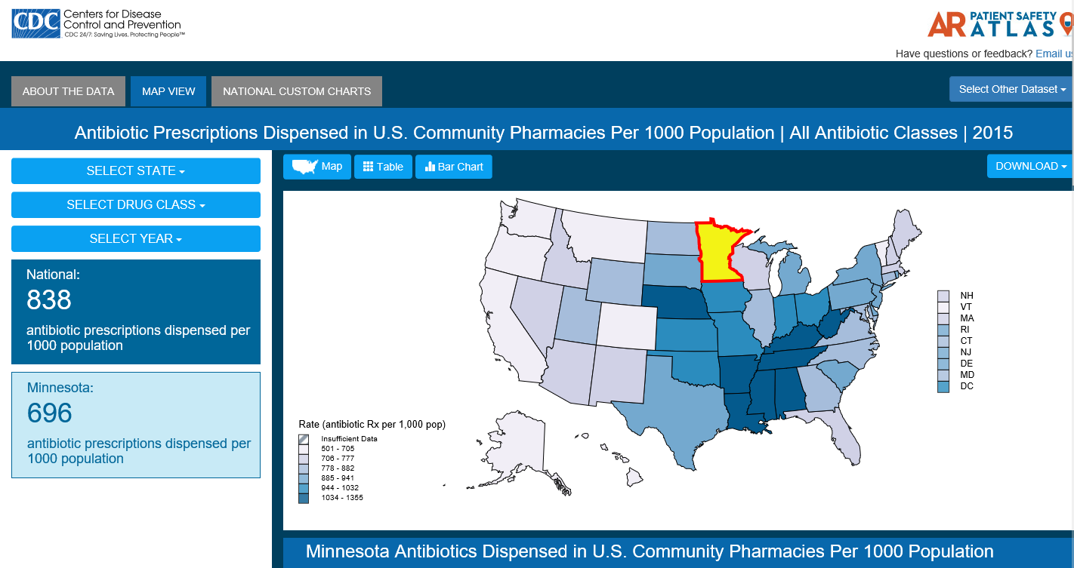
CDC’s Antibiotic Resistance Patient Safety Atlas: Outpatient Antibiotic Prescriptions
http://gis.cdc.gov/grasp/PSA/indexAU.html
Notes:
We have posted state-level rates of antibiotic prescriptions dispensed in outpatient pharmacies per 1000 population from 2011-2015 in CDC’s Antibiotic Resistance Patient Safety Atlas (available at the link below). These data are from IQVIA. Again, you can see how your state compares in overall antibiotic prescribing and for selected classes: penicillins, cephalosporins, fluoroquinolones and macrolides. On this map, lighter blue indicates antibiotic prescription rates in lowest sextile to the darkest blue which indicates the highest sextile.
You can see over here on the left side that nationally in 2015, 838 outpatient antibiotic prescriptions were dispensed per 1000 population. In this example, I have selected Minnesota—which is why it is yellow, and they had 696 antibiotic prescriptions per 1000 population, well below the national average.
Again, we hope you will find these data useful.

Slide 10
Improving Programs and Practices in Outpatient Care
CMS Quality Innovation Networks and Quality Improvement Organizations (QIN-QIOs) are implementing Core Elements of Outpatient Antibiotic Stewardship
Total Recruited Facilities | 7,626
Physician practices | 5,954
Hospital Emergency Departments | 703
Standalone Emergency Room/Urgent Care | 499
Others | 470
Notes:
How can we increase the implementation of stewardship in the outpatient setting? Partners are critical here. CMS’s Quality Innovation Networks and Quality Improvement Organizations (or QIN-QIOs) are very important partners in this space as you all know. The QIN-QIOs have been tasked with implementing Core Elements of Outpatient Antibiotic Stewardship in recruited outpatient facilities. Nationally, they have recruited over 7600 outpatient facilities, including almost 6000 physician offices, 700 EDs, almost 500 Standalone Emergency Rooms and Urgent Care centers. So many of you have really great examples of how the collaboration between the state health departments and QIN-QIOs can really advance this work.
I want to introduce both Yolanda Jones at CMS who is the task lead for the QIN-QIO outpatient stewardship work and Kaylie Doyle at the QIN-QIO National Coordinating Center who are both here at this meeting. So I encourage you to talk with them, especially if you have any questions about working with your QIOs or what is possible and what other QIOs are doing.

Slide 11

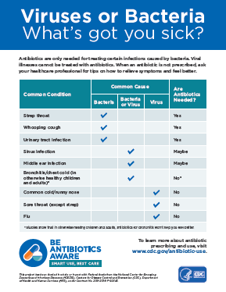
Be Antibiotics Aware: Smart Use, Best Care
New educational effort: Refining messaging and expanding to new target audiences.
  Focus on patient safety
  Increased messaging for adult patients
  New effort to reach hospitalists, nurse practitioners, physician assistants
Public Service Announcement: https://www.youtube.com/watch?v=dETK7Jc-XWA
www.cdc.gov/antibiotic-use
Notes:
I know that you all have heard this, but we launched our new educational effort:
Be Antibiotics Aware: Smart Use, Best Care in the fall.
This educational effort was developed for and tested among a broader audience.
Focus on patient safety
Increased messaging for adult patients
New effort to reach hospitalists, nurse practitioners, physician assistants
If you haven’t seen our new Public Service Announcement, please watch it and promote it. I want to let you know that Meredith Reagan who leads our partnership work and Chaity Naik our state partner coordinator will be staffing at table on Be Antibiotics Aware at Meet the Experts Session on Wednesday.

Slide 12
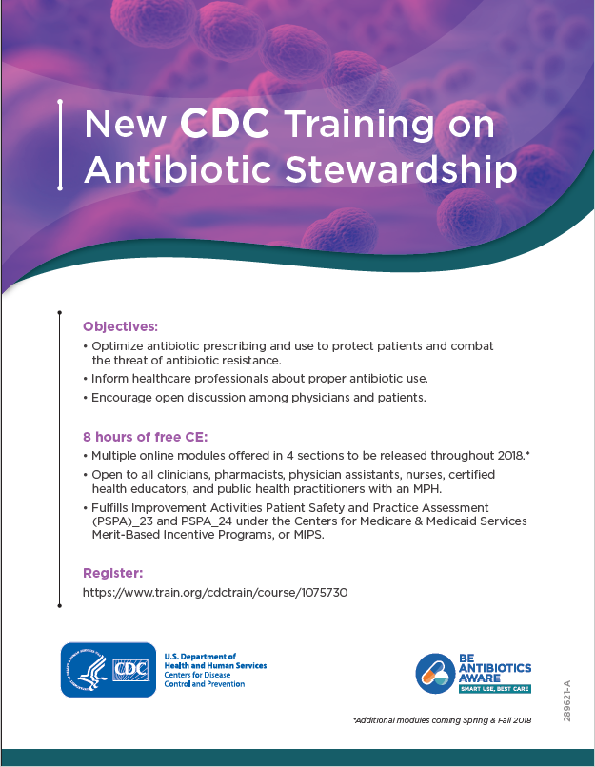
New CDC Training on Antibiotic Stewardship
Objectives:
  Optimize antibiotic prescribing
  Inform healthcare professionals about proper antibiotic use
  Encourage open discussion among clinicians and patients
8 hours of free CE, released in 4 sections through 2018
  Section 1 is available now
https://www.train.org/cdctrain/course/1075730
Notes:
Lastly, I want to let you know that we have a new continuing education training on antibiotic stewardship.
It is 8 hours of free CE—including for medicine, nursing, pharmacy, certified health educators, and public health practitioners. It will be released in 4 sections through 2018. Section 1 is available now! You can register at the link here. We have a pdf flyer shown here, so please share the flyer widely and help us promote this course.

Slide 13
Selected Stewardship Partners Present
Agency for Healthcare Research and Quality (AHRQ): Dale Burwen
Centers for Medicaid and Medicare Services: Dan Schwartz, Yolanda Jones, Kim Seechuk
Infectious Disease Society of America (IDSA): Kevin Hsueh
National Coordinating Center for the QIN-QIOs: Kaylie Doyle
Society of Healthcare Epidemiology of American (SHEA): Eve Humphreys, Judy Guzman
Society for Infectious Disease Pharmacists: Elizabeth Schumacher
The Joint Commission: Barbara Braun
The Pew Charitable Trusts: David Hyun
Vermont Oxford Network: Madge Buus-Frank
And others!
Notes:
As you have heard there are a number of partner organizations here at the meeting. I have listed some selected stewardship partners here—and I ran out of space in a font size that you can read, so I apologize to those I did not list. There will be a meet the partners session tomorrow, so please stop and say hello, ask questions, and find out how we can all work together and collaborate to further our work.

Slide 14

www.cdc.gov/antibiotic-use
Notes:
With that, I will close and let you know that U.S. Antibiotics Awareness week will be November 12-18 this year.
I will turn it over to Lauri who will introduce our panel.

Slide 15
Antibiotic Stewardship Panel
Erica Runningdear, Illinois
Erin Epson, California
Marisa D’Angeli, Washington
Belinda Ostrowsky, New York State

Slide 16
Outpatient
Antibiotic Stewardship
Activities
March 19, 2018
CALIFORNIA DEPARTMENT OF PUBLIC HEALTH
Erin Epson, MD
Healthcare-Associated Infections (HAI) Program
Center for Health Care Quality
California Department of Public Health

Slide 17
Antimicrobial Stewardship Across the Continuum of Care in California
Hospitals
  Legislation
  Spotlight project, toolkit, statewide collaborative, promoting NHSN AU Option
Skilled Nursing Facilities
  Legislation
  Webinar series, toolkit
  (in development)
Health care facility networks
  Regional AR prevention collaboratives, toolkit
Outpatient settings
  Clinics
  Emergency Departments
  Dentistry

Slide 18

Collaborate with 10 health plans to identify high-prescribing physicians
CMAF mails AWARE Toolkit
  Cover letter, including: “You have been identified as being in the highest 20% of antibiotic prescribers when compared to your colleagues.”
  Prescribing guidelines for adults and pediatrics, patient/family education materials and posters
Notes:
Each year an expert clinical work group meets to develop timely educational materials regarding appropriate antibiotic use for adult and pediatric care. These tools, known as the AWARE Toolkit, are available in English and Spanish. The CMA Foundation mails these Toolkit materials to high-prescribing physicians to promote adherence to appropriate prescribing guidelines.

Slide 19
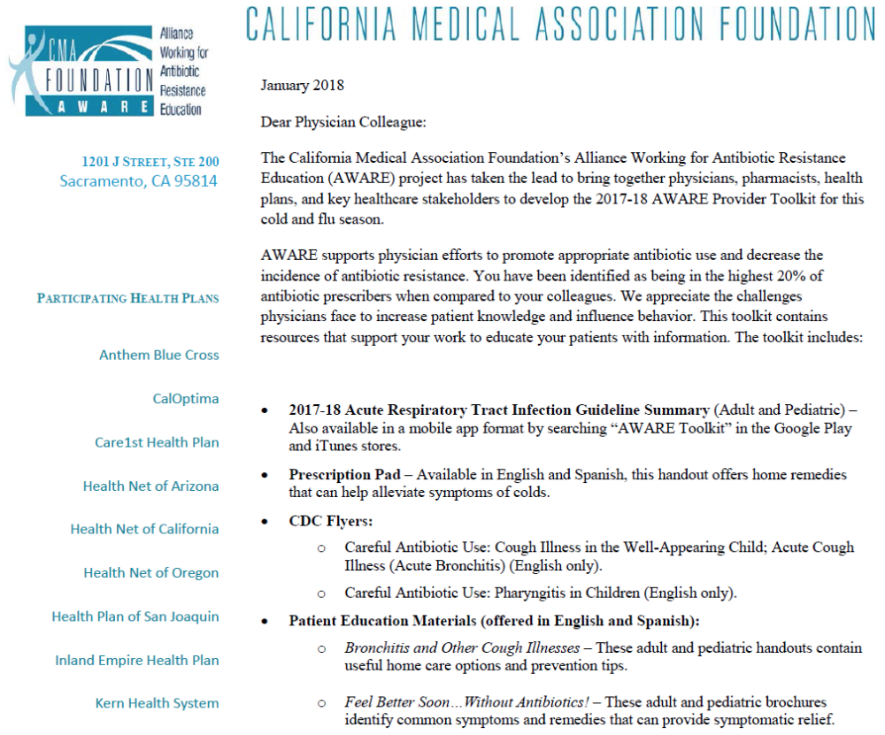
Notes:
For 2017-2018, how many physicians were identified as high prescribers and sent letters/packets? 43, 307 toolkits were mailed out this year.

Slide 20














Public Health - Academic Partnership to Improve Antibiotic Prescribing in ED
Notes:
NOTE; Animations will not work in WebEx if slides are loaded into the program. They will only work if you are sharing your desktop.
Harbor UCLA Medical Center
Highland Hospital
HSAG
KP San Diego
LA County DHS
LA Co DHS LAC USC MC
Olive View UCLA MC
Riverside University Health System
San Gorgonio
Stanford
Sutter Delta Antioch
Torrance Memorial MC
UC Davis
UCSF

Slide 21
ED Antibiotic Stewardship Collaborative
Kick-off session
Q&A
In-person meetings
In-person meetings
Webinar
Webinar
Recruitment
Jan 2018 | Mar | Apr | May | Jun |  | Sep |  | Dec |  | Mar 2019
ED Survey
Provider Survey
One-on-one calls
Notes:
Pre-collaborative ED survey
Webinars and regional in-person meetings
Quality improvement project, ED provider surveys at each participating ED
Dissemination of guidance and tools
Opportunities to discuss and share best practices

Slide 22
CDC Core Elements of Outpatient Antibiotic Stewardship
Notes:
Pre-collaborative survey
20 questions regarding
CDC Core Elements:
Commitment, Action, Tracking and Reporting, Education and Expertise
ED prescribing practices and challenges
Establish baseline, guide discussion topics, identify resources/tools for sharing, and assess progress throughout the year
Many have all four elements in place
But there are areas to expand and improve the way each element is implemented

Slide 23
ED Prescribing Practices
Perceived Frequency of ED Clinicians Prescribing
Antibiotics for Specific Conditions
Notes:
Pie charts show the perceived frequency of ED clinician antibiotic prescribing for acute bronchitis
acute bronchitis should be <10%

Slide 24
ED Antibiotic Stewardship Collaborative Quality Improvement Project
Feasible in 12 months (duration of collaborative)
Can build upon an existing initiative
Syndrome-specific
Track existing quality measures, e.g., HEDIS

Slide 25
Outpatient Antibiotic Stewardship Toolkit
Marisa D’Angeli, MD, MPH
Washington State Department of Health
CDC ELC Grantees’ Meeting, 3/19/18

Slide 26
Why focus on outpatient AMS?
80% of antibiotics prescribed in outpatient settings
50% antibiotic prescribed incorrectly or unnecessarily
Respiratory illnesses commonly treated with antibiotics
Most respiratory illnesses viral

Slide 27
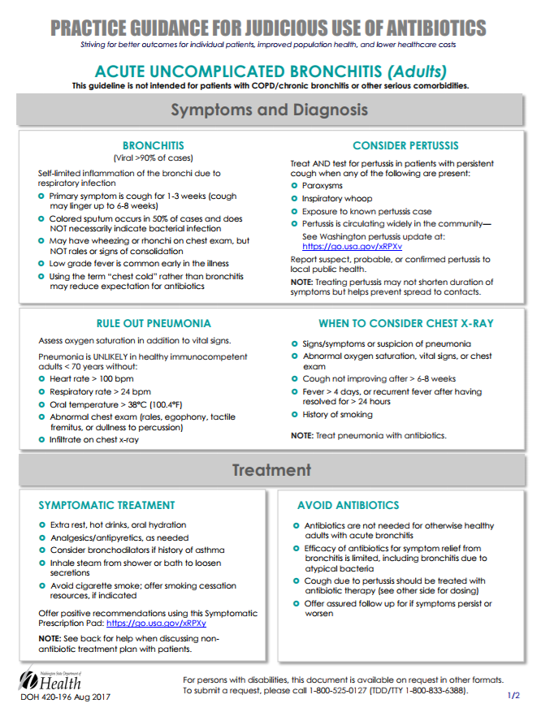
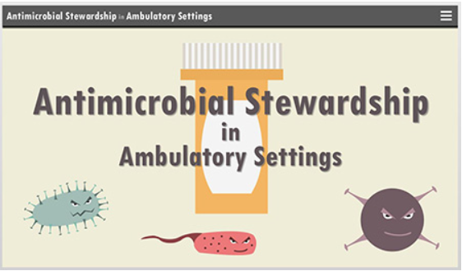
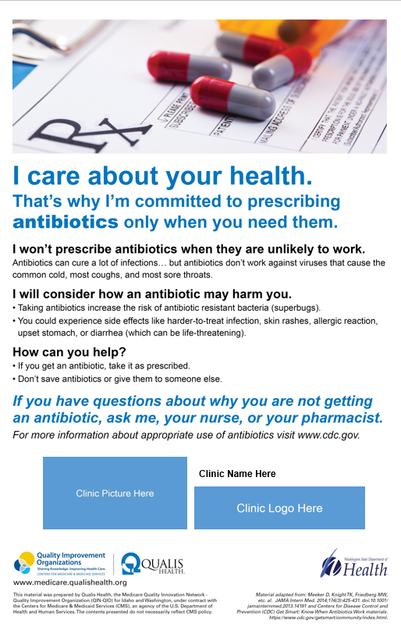
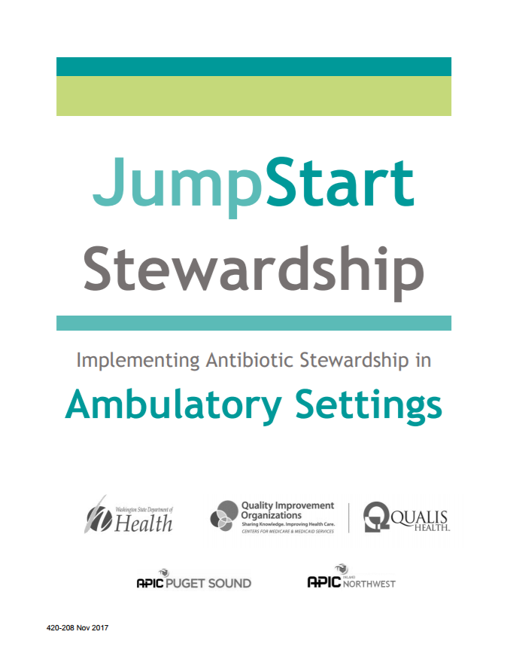
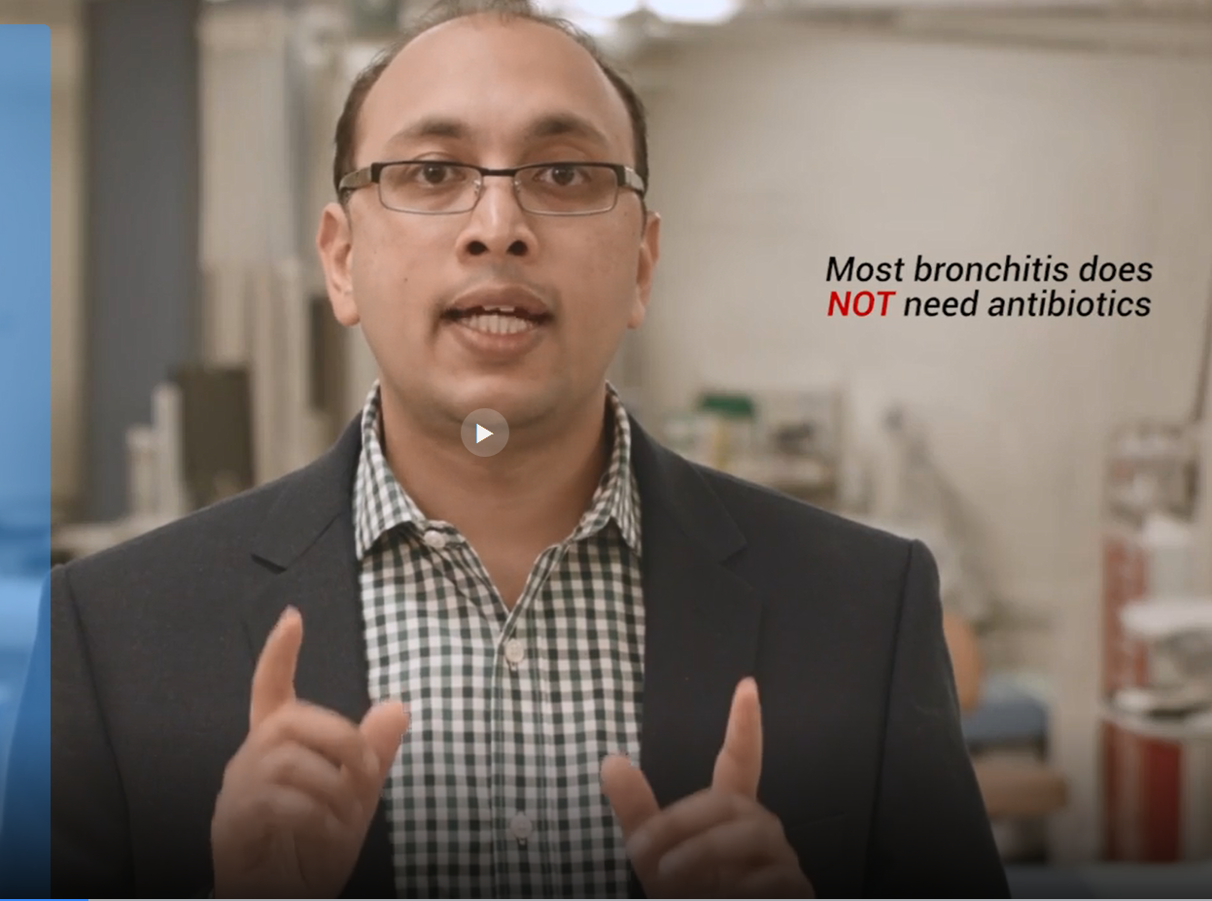
Moving Stewardship in the Right Direction

Slide 28
Next steps
Dissemination
  Antibiotic Awareness Week
  QIN/QIO Outpatient AMS Initiative
Assess uptake…
Measure outcomes…
https://www.doh.wa.gov/YouandYourFamily/IllnessandDisease/HealthcareAssociatedInfections/EQuIP/AmbulatoryCare
marisa.dangeli@DOH.wa.gov 206-418-5595

Slide 29
Analysis of Outpatient Antibiotic Medicaid Claims Data for Acute Upper Respiratory Infections
2018 ELC Grantees Meeting
Atlanta, GA

Slide 30

Overview
Background
Analysis of NY Medicaid data
Outreach to healthcare providers
Benefits, challenges, and next steps

Slide 31
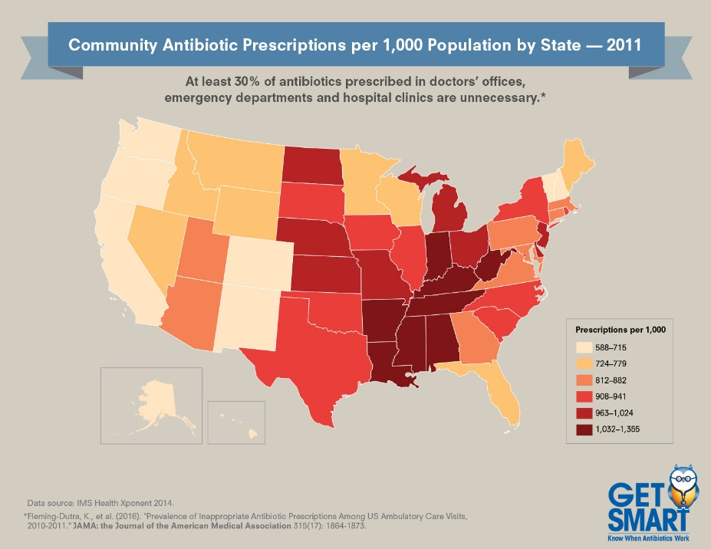
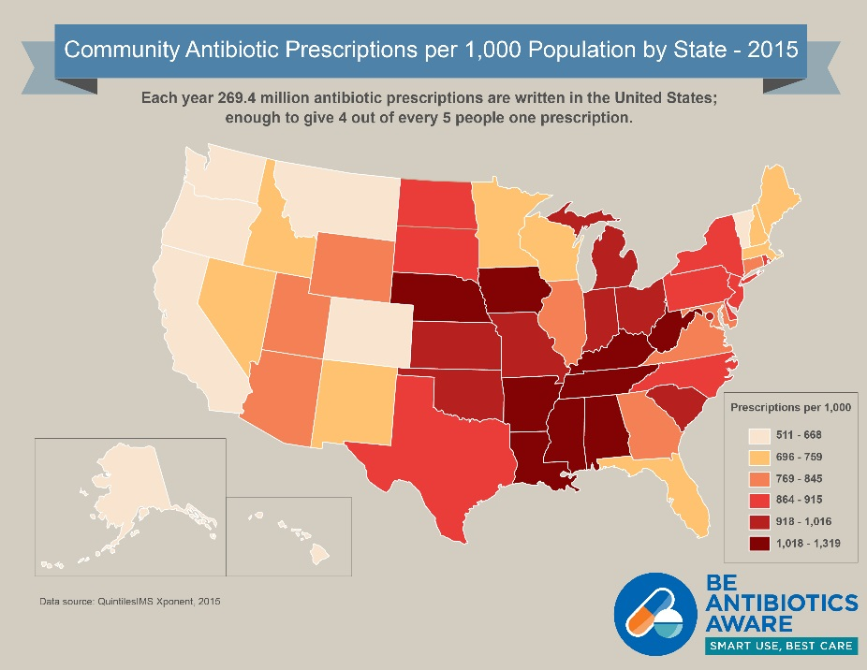
Community Antibiotic Prescriptions per 1,000 population by state, 2011 and 2015
Images from CDC: 2011: https://www.cdc.gov/antibiotic-use/community/images/programs-measurement/usmap-2011.jpg
2015: https://www.cdc.gov/antibiotic-use/community/images/programs-measurement/Community-antibiotic-map-2015.jpg
Notes:
We wanted to understand how antibiotic prescribing varies by region, so we looked at antibiotic prescriptions per 1000 persons of all ages by state in 2010.
We learned that state prescribing rates vary markedly and that some states had more than double the prescribing rate of others. For example, there were 1237 prescriptions per 1000 persons in West Virginia compared to 529 prescriptions per 1000 persons in Alaska.
Interested in exploring data specific to New York. New York does not currently have an all-payer database, so use of Medicaid data was explored.

Slide 32
General Methodology
Methods
  2014 University of Pennsylvania Medicaid national sample analysis
  National Committee Quality Assurance (NCQA) 2013 antibiotic prescribing measures drug lists
2013 NYS Medicaid claims data
  Index visits for acute upper respiratory infections (ARIs)
  Pharmacy claims to identify visits when an antibiotic was prescribed and subsequently filled
Crude and risk-adjusted rates to target intervention
Li P, et al. Factors associated with antimicrobial drug use in Medicaid programs. Emerg Infect Dis. 2014; 20(5): 829-832. https://dx.doi.org/10.3201/eid2005.130493
Notes:
We used a combination of methods (Li paper and drug references from HEDIS NDC lists).
Li Paper was used to select visits to include in analysis.
Drug class was determined using the HEDIS NDC drug lists for the measure “Appropriate use of antibiotics in adults with acute bronchitis”
ICD 9/10 codes summary:
Primary dx: common cold, acute URIs, acute bronchitis
Comorbid conditions: COPD, asthma
Antibiotic appropriate dx: e.g: otitis media, sinusitis, pharyngitis, pneumonia, UTI, etc.
Access to Medicaid data was challenging:
State law limited access and use of the data
Accomplished through collaboration with a different section of the health department with existing permissions; collaborating group needs to do all analysis with primary data
Risk adjustment – initially included visit type (healthcare provider setting (ED, Institutional outpatient, professional outpatient), age, diagnosis).
Later changed to remove visit type

Slide 33
Results
Rates of potentially-avoidable antibiotic use stratified by adult, pediatric population
Initial interventions targeted healthcare providers caring for adults
Maps developed based on provider location
Age Group | Index Visits (N) | Index Visits w/ Antibiotic Prescription Filled (N) | Statewide Observed Rate per 100 Index Visits
Children (Age 3 Months to 17 Years) | 269,424 | 33,257 | 12.34
Adults (Age 18 to 64 Years) | 150,379 | 67,489 | 44.88
Total | 419,803 | 100,746 | 24.00
Notes:
Developed outpatient rates of potentially-avoidable antibiotic use among patients with upper respiratory infections
Initial analysis of 2013 NYS Medicaid outpatient visit and pharmacy claims data.
Established county-level rates for antibiotics filled within four days of outpatient URI visit
Analysis found that prescribing was worse for adults (18 to 64 yrs) vs pediatrics (3 months to 17 years); intervention/outreach would start with providers who would prescribe antibitoics to adults.
Intervention would be focused on providers, so mapping was done by provider zip code.

Slide 34
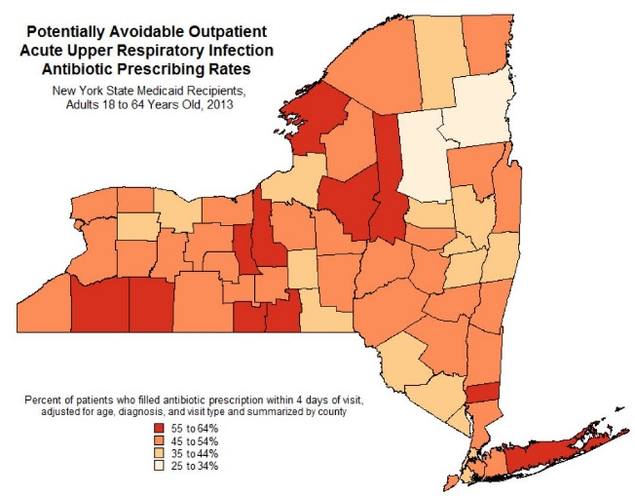
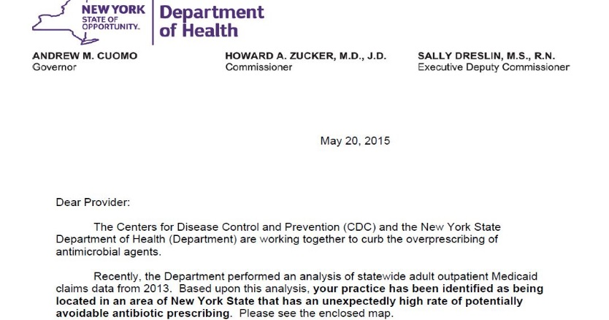
Initial Outreach 2015
Notes:
Targeted healthcare providers in the counties with the highest rates
Focused on prescribing for adults (internal medicine, primary care, family practice, emergency)
Directly mailed a letter and the map to providers in the counties
Requested attention to issue and a call for interested clinicians to be champions to help promote antibiotic stewardship
Additional benefit was the engagement of local health departments in promoting the Get Smart messages and appropriate use of antibiotics

Slide 35
Benefits, Challenges, and Next Steps
Benefits
  Directed initial outreach to adult population
  Engage local health departments
  Does not target individual providers
Challenges
  Access to Medicaid data
  Inherent challenges of claims data
  Specific evaluation of the intervention
Analysis continues
  Maps by year
  Additional conditions (e.g. pharyngitis, otitis media)
Notes:
Benefits:
Analyses indicated that prescribing was worse among adult population & intervention targeted there.
Mapping rates by county of healthcare provider location provided a data point to engage local health departments in efforts to improve outpatient antibiotic use.
Chose to direct outreach to all providers who would be most likely to see patients for acute URI and who could be identified as practicing in the county of interest. Did not single out high prescribers.
Challenges:
Accessing the Medicaid data was overall challenging
ICD 9 to ICD 10 conversion were a challenge with time series analysis; delay in receipt of claims data challenging to do timely analysis to assess intervention.
Mailing was logistically challenging; also received negative feedback from some providers who interpreted the letter from NYSDOH as a personal “nasty-gram”
Challenging to attribute decreases directly to the intervention; many different partners in messaging appropriate use of antibiotics.

Slide 36
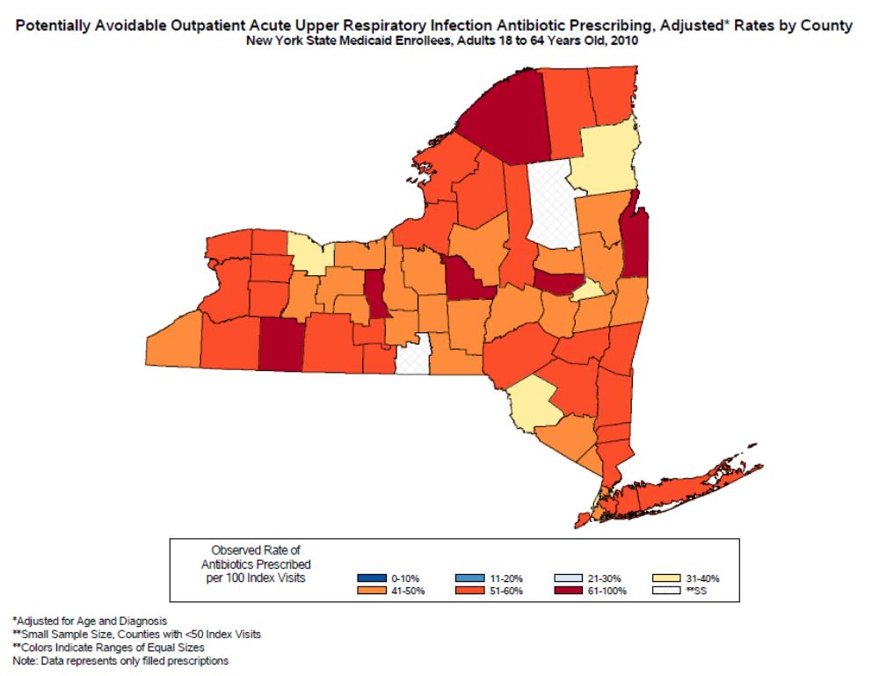
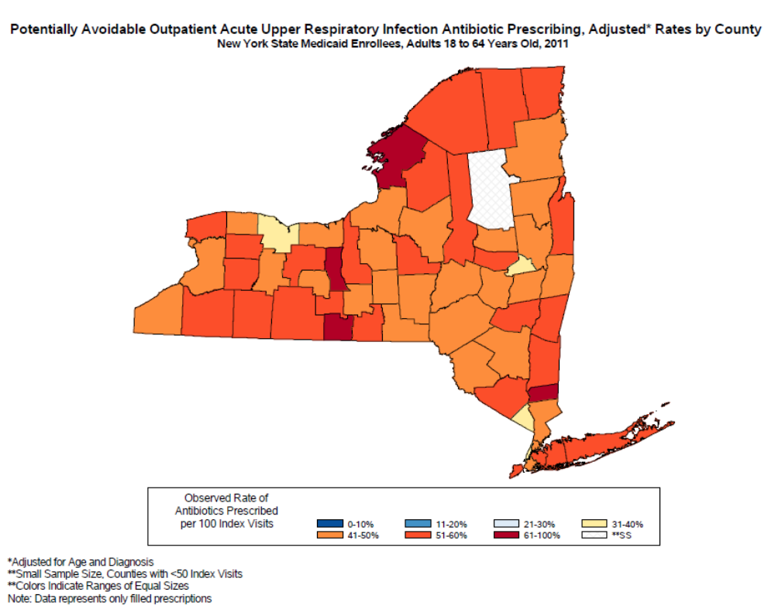
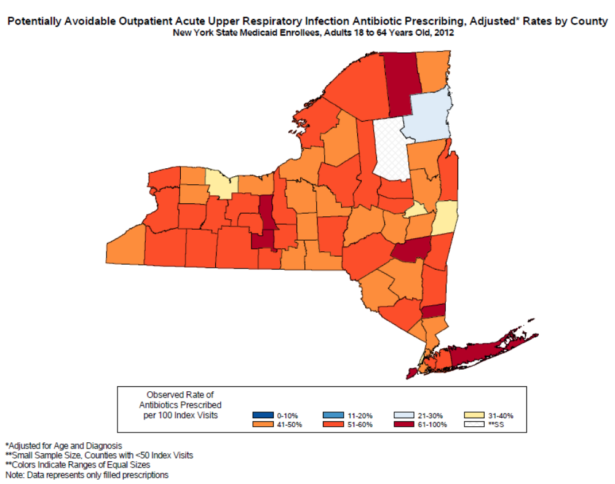
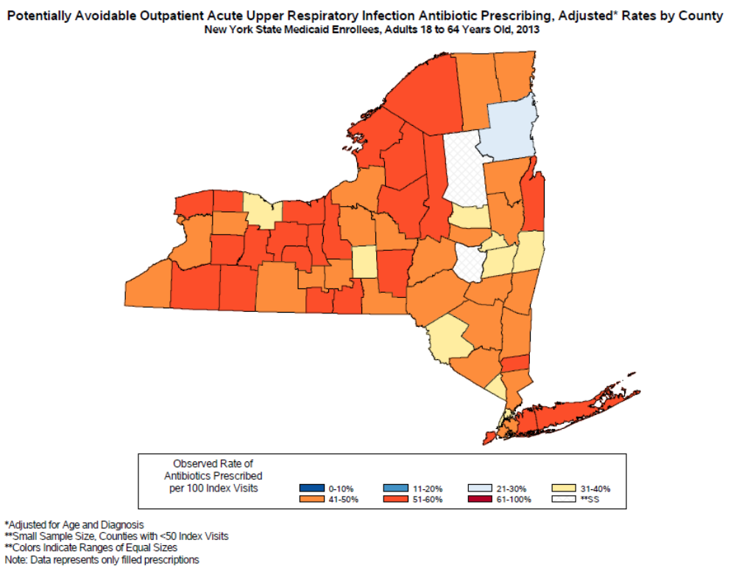
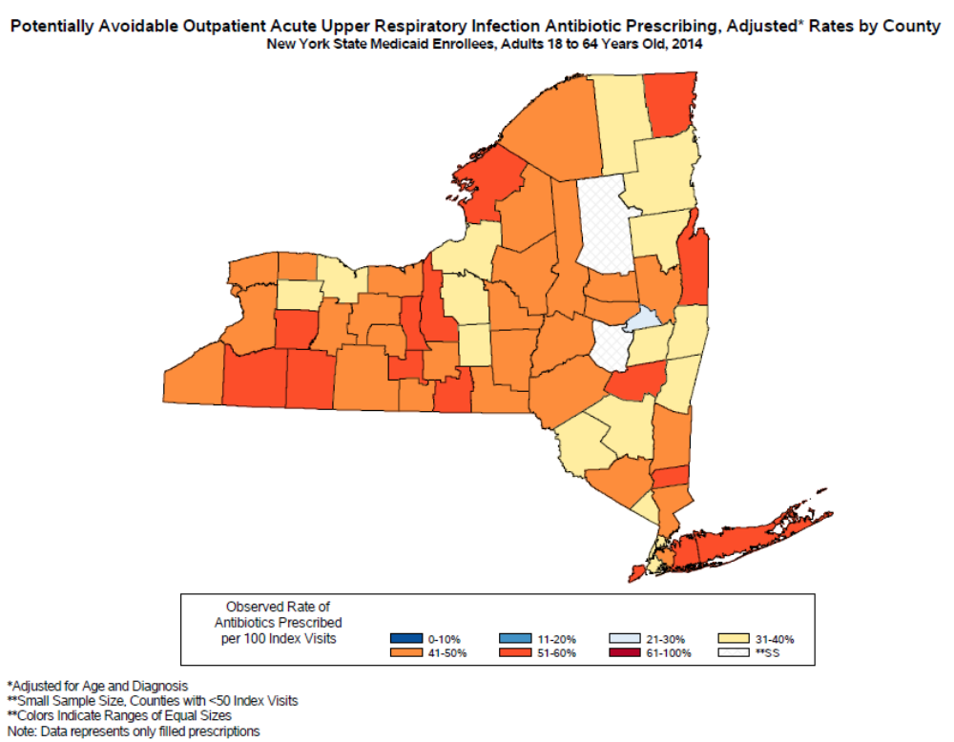
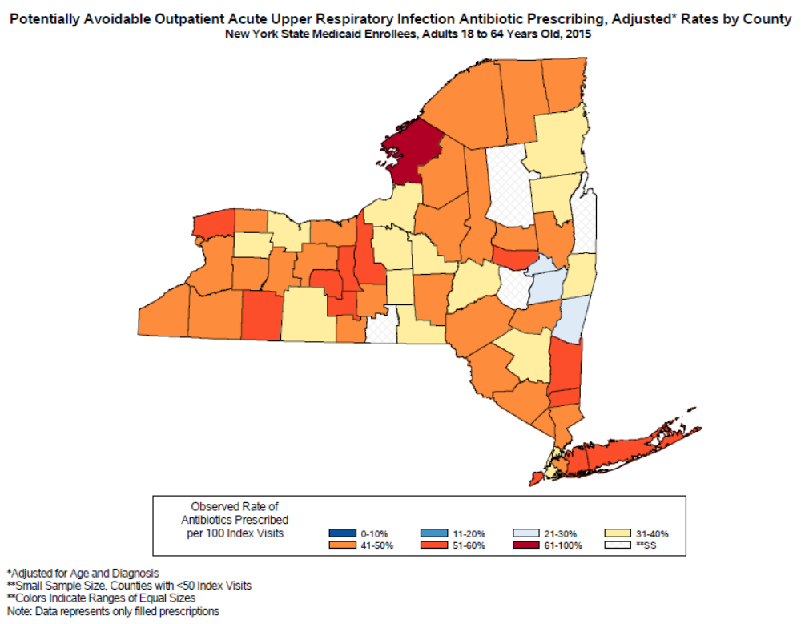
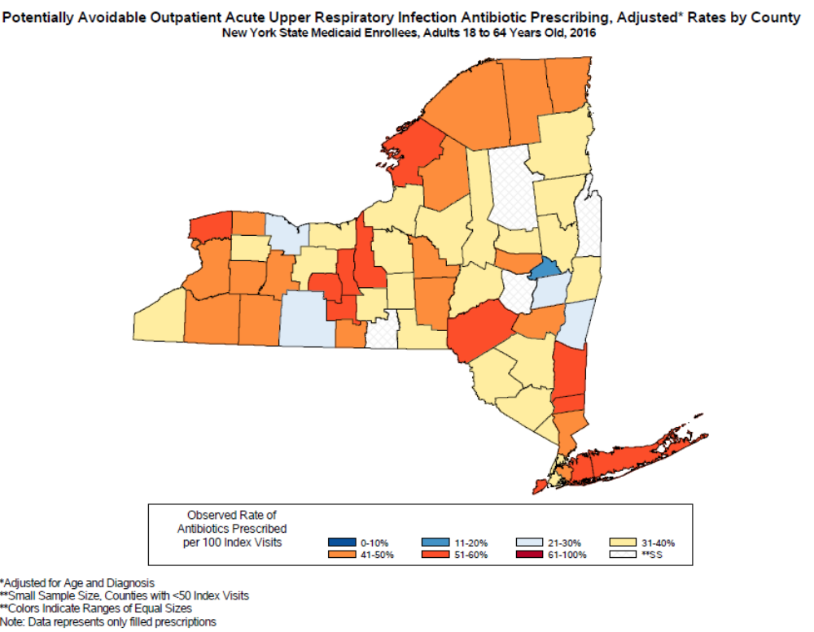
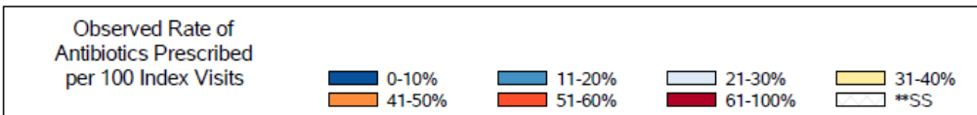
Adult Outpatient Antibiotics for Acute URI, 2010 - 2016
Notes:
Darker = higher rate, lighter to blue = lower rate
Overall have seen some improvement over time

Slide 37
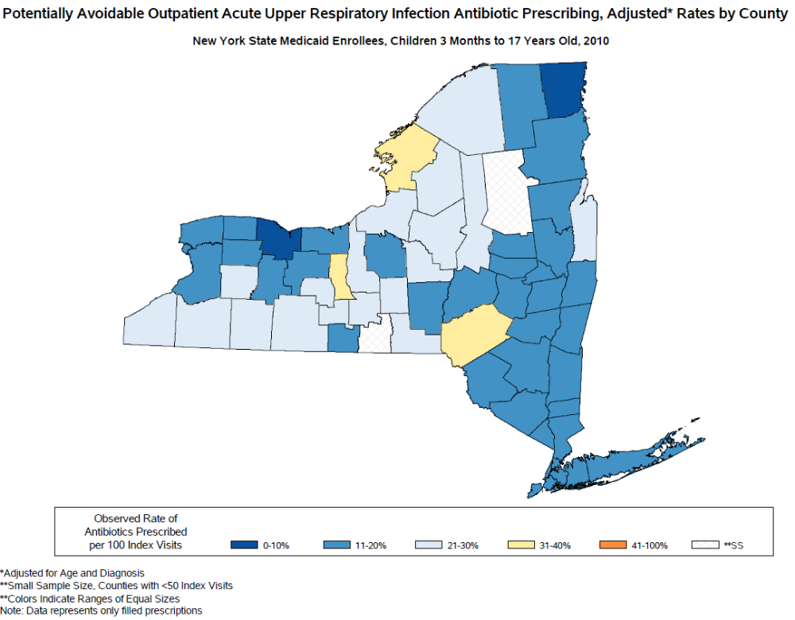
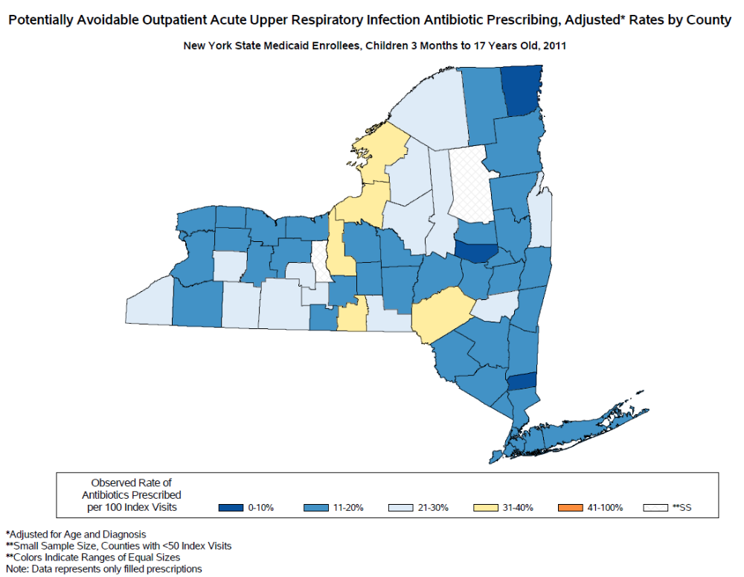
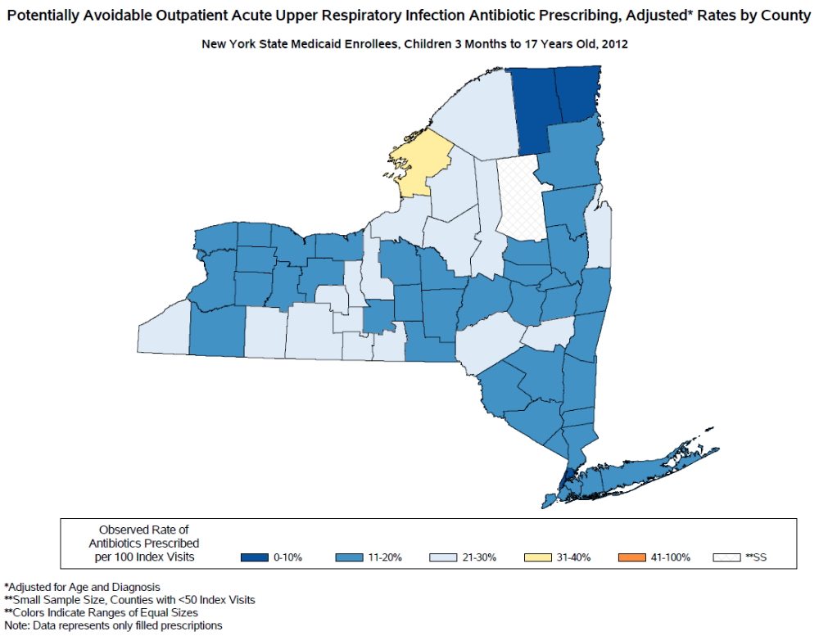
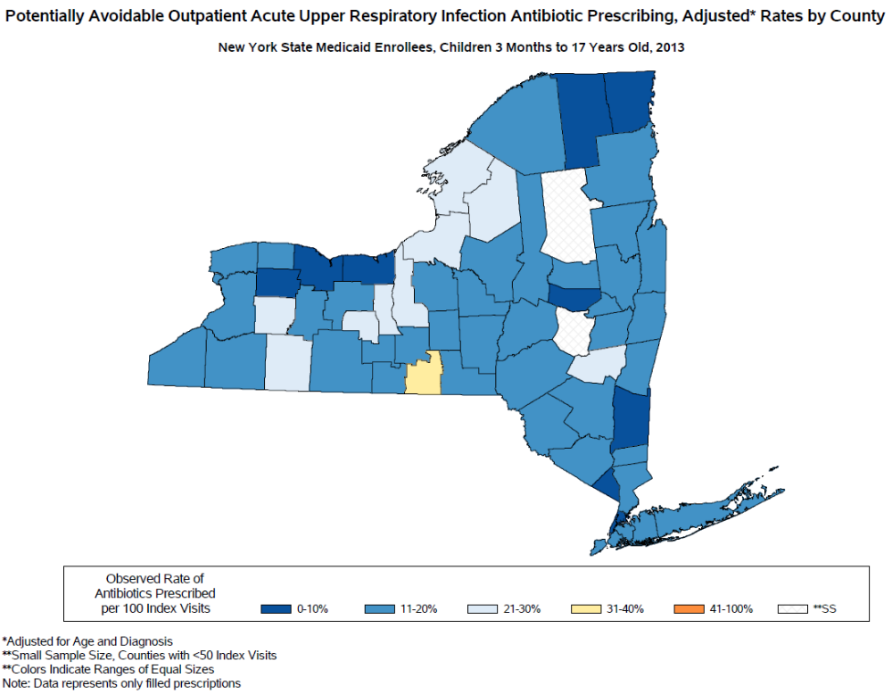
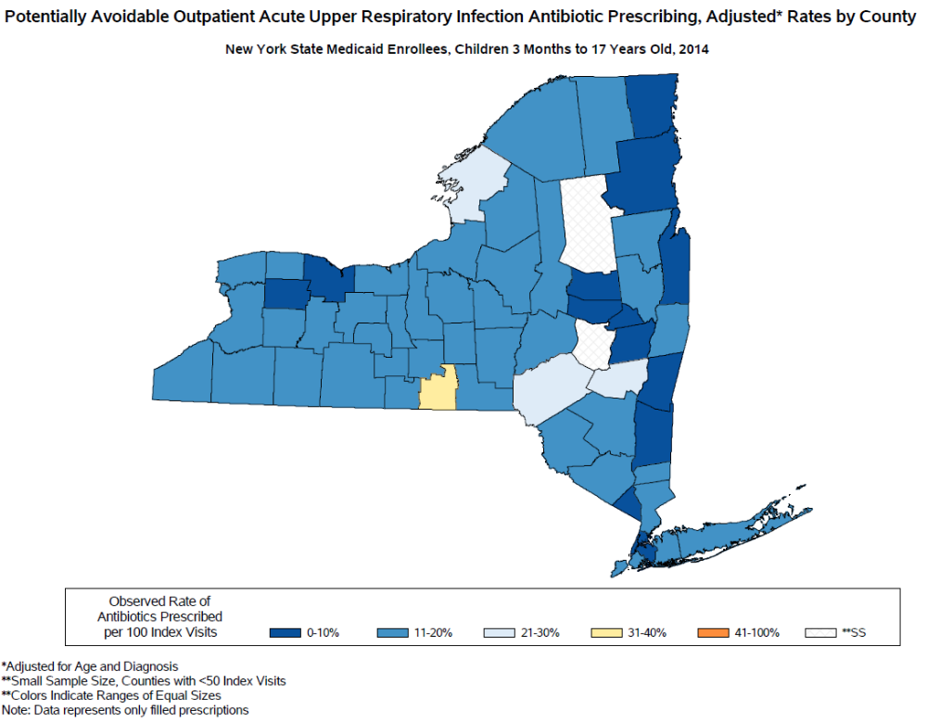
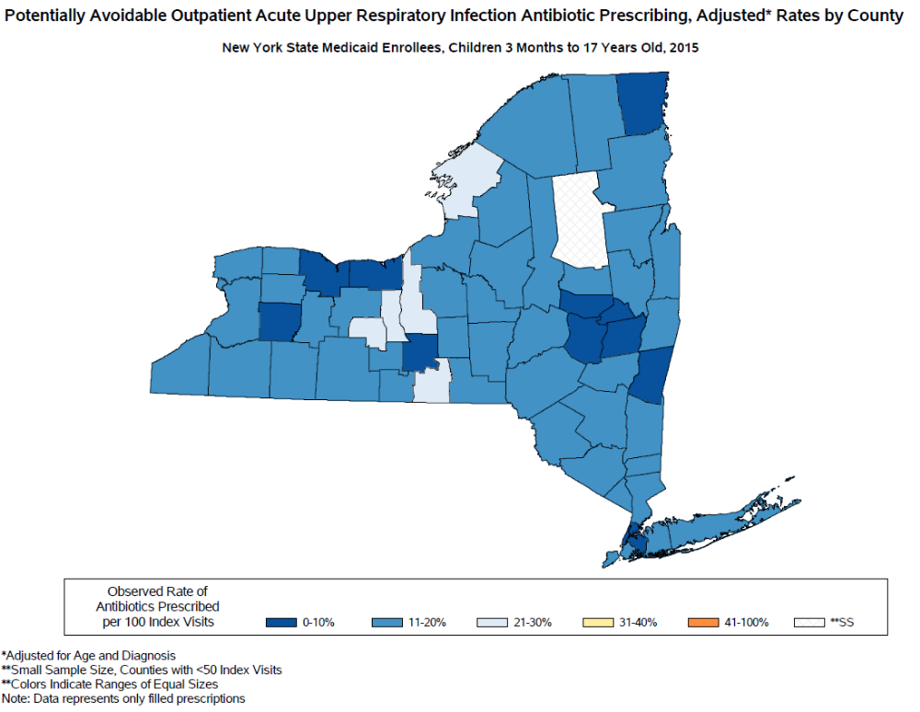
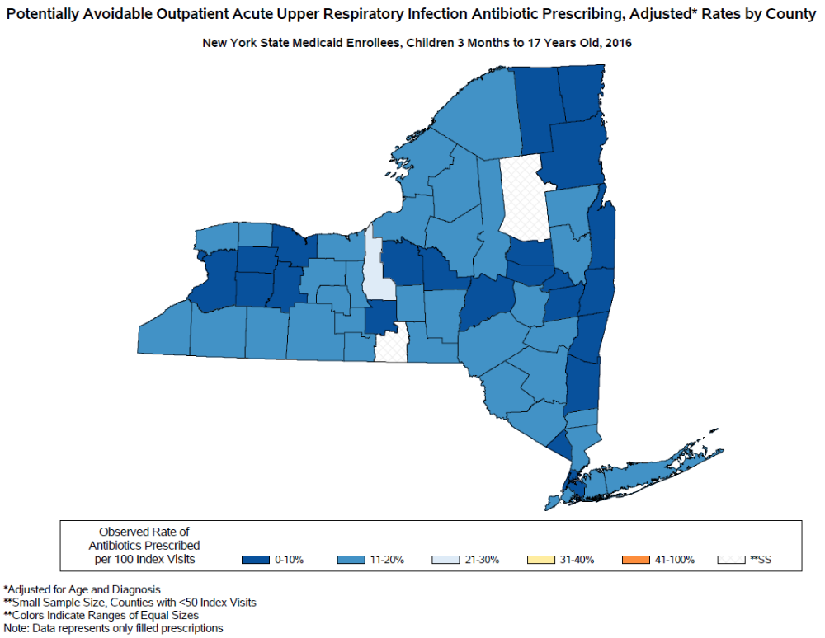
Pediatric Outpatient Antibiotics for Acute URI, 2010 - 2016
Notes:
Yellow/orange – higher rates
Darker blue – lowest rates
Overall have seen improvement at county level

Slide 38
Thank you!
Questions?
NYSDOH Get Smart/Be Antibiotics Aware Team Members:
Office of Public Health, Division of Epidemiology, Bureau of Healthcare-Associated Infections:
Emily Lutterloh, MD, MPH
Valerie Haley, PhD
Sarah Kogut, MPH, CIC
Public Affairs Group:
Mary Beth Wenger
Office of Quality and Patient Safety, Division of Information and Statistics:
Mary Beth Conroy
Tatiana Ledneva
Stephen Goins
Leyla Sehhat

Slide 39
Thank you!
Questions?
NYSDOH Get Smart/Be Antibiotics Aware Team Members:
Office of Public Health, Division of Epidemiology, Bureau of Healthcare-Associated Infections:
Emily Lutterloh, MD, MPH
Valerie Haley, PhD
Sarah Kogut, MPH, CIC
Public Affairs Group:
Mary Beth Wenger
Office of Quality and Patient Safety, Division of Information and Statistics:
Mary Beth Conroy
Tatiana Ledneva
Stephen Goins
Leyla Sehhat

Slide 40
References
Li P, Metlay JP, Marcus SC, Doshi JA. Factors associated with antimicrobial drug use in Medicaid programs. Emerg Infect Dis (Internet). 2014; 20(5): 829-832. https://dx.doi.org/10.3201/eid2005.130493
CDC Be Antibiotics Aware* Website: https://www.cdc.gov/antibiotic-use/index.html

Slide 41
Methods – more info
Setting: outpatient: ED, Institutional Outpatient, Professional Outpatient
Population: Non-dual Medicaid enrollee with at least 60 days (2 months) or eligibility prior to visit and 7 days post visit.
Time Period: January 1, 2013 – December 24, 2013
Age groups: Children 3 months to 17 years, Adults 18 to 64
Diagnosis: primary diagnosis of URI (cold 460, acute URI 465, or acute bronchitis 466) and no secondary diagnoses that might require antibiotics (i.e. otitis media (382), nonsuppurative otitis media (381-381.4), chronic sinusitis (473), sinusitis (461), acute pharyngitis (462), acute tonsillitis (463), acute laryngitis (464), pneumonia (481-486), strep throat (034.0), UTI (559, 595, 597, 599.0), bacterial infections (041), emphysema (492), and chronic bronchitis (491)). Excluded patients diagnosed with COPD (491.20-491.21, 492.0-492.8, 494, 495.0-495.9, 496) or asthma (493) within 1 year prior and 7 days following the index date.
Index Episode: Earliest URI visit in 2013 for a patient that has negative medication history for 30 days prior to episode and no competing diagnosis

Slide 42
Maps
2010

Slide 43
Maps
2011

Slide 44
Maps
2012

Slide 45
Maps
2013
Notes:
2013 map appears different than the version sent to healthcare providers in 2015; no longer adjusting for visit type.

Slide 46
Maps
2014

Slide 47
Maps
2015

Slide 48
Maps
2016

Slide 49
Maps
2010

Slide 50
Maps
2011

Slide 51
Maps
2012

Slide 52
Maps
2013

Slide 53
Maps
2014

Slide 54
Maps
2015

Slide 55
Maps
2016

Slide 56
2018 ELC HAI/AR Grantees’ Meeting
Division of Healthcare Quality Promotion
March 19-21, 2018

