Slide 1
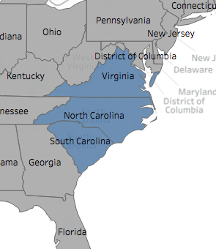
Epidemiology and Surveillance Summary
CDC 2018 Hurricane Florence Response
States reporting data
North Carolina
South Carolina
Virginia
Sources of data
National Syndromic Surveillance Program
Disaster Medical Assistance Teams (DMATs)
U.S. National Poison Data System (NPDS)
Media reporting on storm-related mortality
1400 9.18.2018

Slide 2
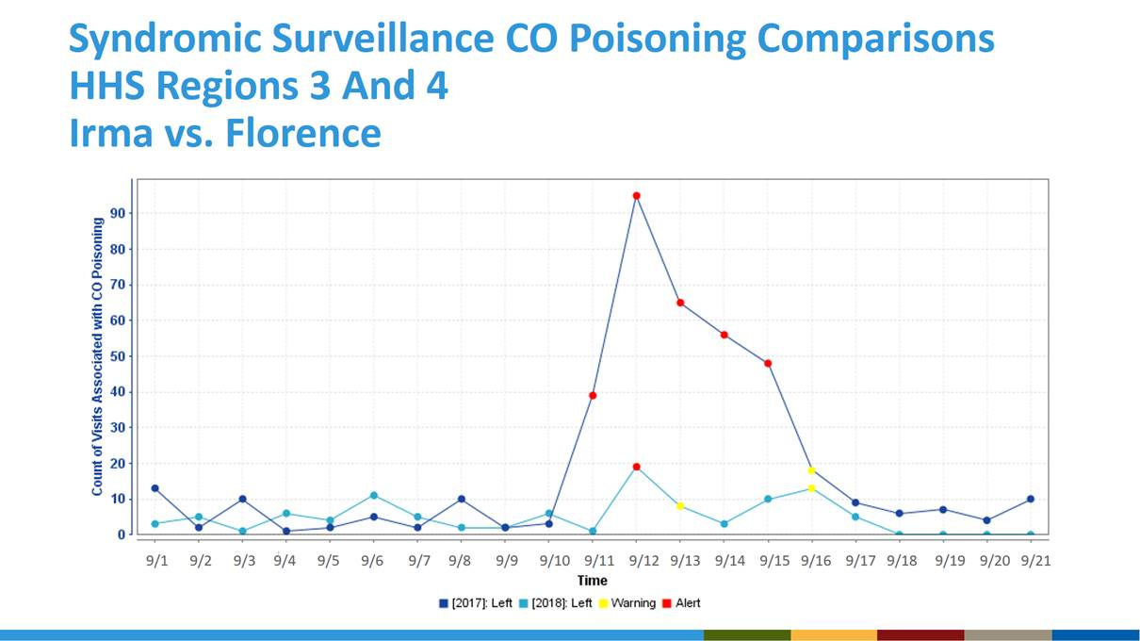
Epidemiology and Surveillance Summary
CDC 2018 Hurricane Florence Response
Summary Syndromic Surveillance from States
CO poisoning, HHS Regions 3 and 4
Irma (2017) and Florence (2018) comparison
Notable Findings
Gas/fume/vapor visits | ↑
Prescription refill visits | ↑
Snake bite visits | ↑
Stress/anxiety visits | ±
Irma
Florence
■ Warning  Alert
1400 9.18.2018

Slide 3
Epidemiology and Surveillance Summary
CDC 2018 Hurricane Florence Response
“Hurricane-related” PCC Exposure Calls
U.S. Poison Control Center (PCC) Data
CDC tracks hurricane-related exposure calls made to any U.S. Poison Control Center (PCC) via active surveillance of the National Poison Data System (NPDS). *Note that PCC calls are not representative of all hurricane-related exposures and inquiries within the jurisdiction but may be indicative of trends from the incident.
1400 9.18.2018
Notes:
PCC data is used within the CDC EOC for situational awareness and to guide communication messages to prevent additional injury, illness, and death.
Active surveillance of Hurricane Florence-related PCC calls is in addition to the routine surveillance CDC conducts on PCC data for anomalous increases in call volumes or clinical effects.

Slide 4
Epidemiology and Surveillance Summary
CDC 2018 Hurricane Florence Response
Storm-related Mortality Tracking (via Media Reports)
CDC tracks possible storm-related deaths using media reports. This information is used within the CDC EOC for situational awareness and to guide communication messages to prevent additional injury, illness, and death. *Note: these deaths do not represent the official Hurricane Florence mortality count for affected states.
1400 9.18.2018
Notes:
All drowning deaths were motor-vehicle related.

