Slide 1
2019-2020 CSTE Mentorship Program
Prospective Mentor Webinar
Wednesday, September 11 at 1:00pm ET
Notes:
Good afternoon everyone. Hi everyone this is Alyaa with CSTE.
Hi everyone thanks for joining the call today and thank you for your interest in CSTE’s mentorship program.
Raise your hand if you’ve already submitted your application.

Slide 2
Housekeeping
If you aren’t speaking, please put yourself on mute
Today’s call is being recorded
Please utilize the chat box feature for questions
Notes:
Today’s call is being recorded.
Use chatbox we will have a good amount of time for q&a

Slide 3
Agenda
Review the 2019-2020 program
Discuss the requirements and expectations of mentors
Address your questions
Notes:
Address your questions and concerns regarding participating as a mentor. We also have Anne Zener, Jon Rosenberg , Cody Custis on the call who have all participated in the program as mentors and have volunteered their time to help answer your questions.
My review of the program should only take about 10 minutes and then we’ll move on to some Q&A with our panel of previous mentors.

Slide 4
Mentorship Program
Our purpose is to provide an opportunity to build relationships and foster shared learning among applied epidemiologists.
Our goal is to promote the exploration of career opportunities in STLT agencies.

Slide 5
Program Components
“Live Events”
  November Orientation
  Webinars focused on professional development
Tasks
  Self-assessment
  Goal-setting
  Professional development navigation
  Leadership values
  Implementation intention
Activities
  “Meet” between mentor and mentee monthly during the program
    Strongly suggest first meeting is by phone or skype
    Can also communicate by email, instant messenger, or skype
  Newsletters will be sent monthly with activities and suggested discussion topics
  Half way point check-in
  Evaluation
    Provide feedback for program improvement
Notes:
We also provide webinars focused on professional development and these are hosted by the early career professionals workgroup. We’ll have one in the fall and potentially 2 in the spring
Implementation intention which will help the mentee plan their professional development beyond the program
So all of these tasks can take place during what we call activities, so we encourage mentors and mentees to meet virtually monthly during the program.
CSTE will send monthly newsletters which may have some discussion topics, articles, it will provide any of the tasks when applicable.
Self-assessment- working style and communication style survey
Goal setting- setting those ground rules for the mentor mentee relationship and expectations for the program
Professional development GPSR – goals, people, stretch, and reflection… so its looking at if you have identified career goals, have people around you that support your development, take on assignments that stretch you to develop in different areas, and whether you built time into your work to reflect on whats working and what isn’t. so a worksheet that allows you to score those areas and see where you can improve.
Values- identifying and reflecting on some of those values that guide you in your work
Implementation – setting goals and laying out that plan for how to continue professional development upon termination of the program.

Slide 6
Mentor Requirements
Mentors must have at least five years of work experience; hold a master’s degree or higher, currently work in the field of public health
Be able to meet with mentee once a month from October – June
  The onus is on the mentee to identify discussion topics
Complete activities and discuss with mentee
Participate in webinars sponsored by the Early Career Professionals Workgroup
Notes:
Broad mentor requirements. 5 years work experience and masters or higher and work in public health. We can be pretty flexible in terms of your employer. State or local… school of public health, or federal partners.
Complete the activities to discuss them with the mentees so that you’re able to engage and compare your responses fromyour different perspectives
Participate in webinars as you are able.

Slide 7
Matching
Based on subject area interests and program expectations
Mentor expertise and strengths will be matched with mentee program goals
Mentors can advise a mentee on a specific project or deliverable
Mentors can work with multiple mentees
Notes:
We match individually based on each application. Program expectations = this year focus on if people are interested in working on a specific project or deliverable together.
We will ask in the application about your expertise and strength not to determine your eligibility but to help match you with the mentees expectations.

Slide 8
Mentees
Early career professionals (e.g. graduated in the last 5 years) or current students
Highly motivated
Clear goals for participating in the mentorship program
Notes:
The mentees to understand who you would be paired with are early career professionals or current student.
We’re looking for mentees who’s application demonstrates a high level of motivation and clear goals for the program.

Slide 9
Mentor Benefits
Building a network outside of your agency
Gain mentoring experience
Get to know a highly motivated epidemiologist

Slide 10
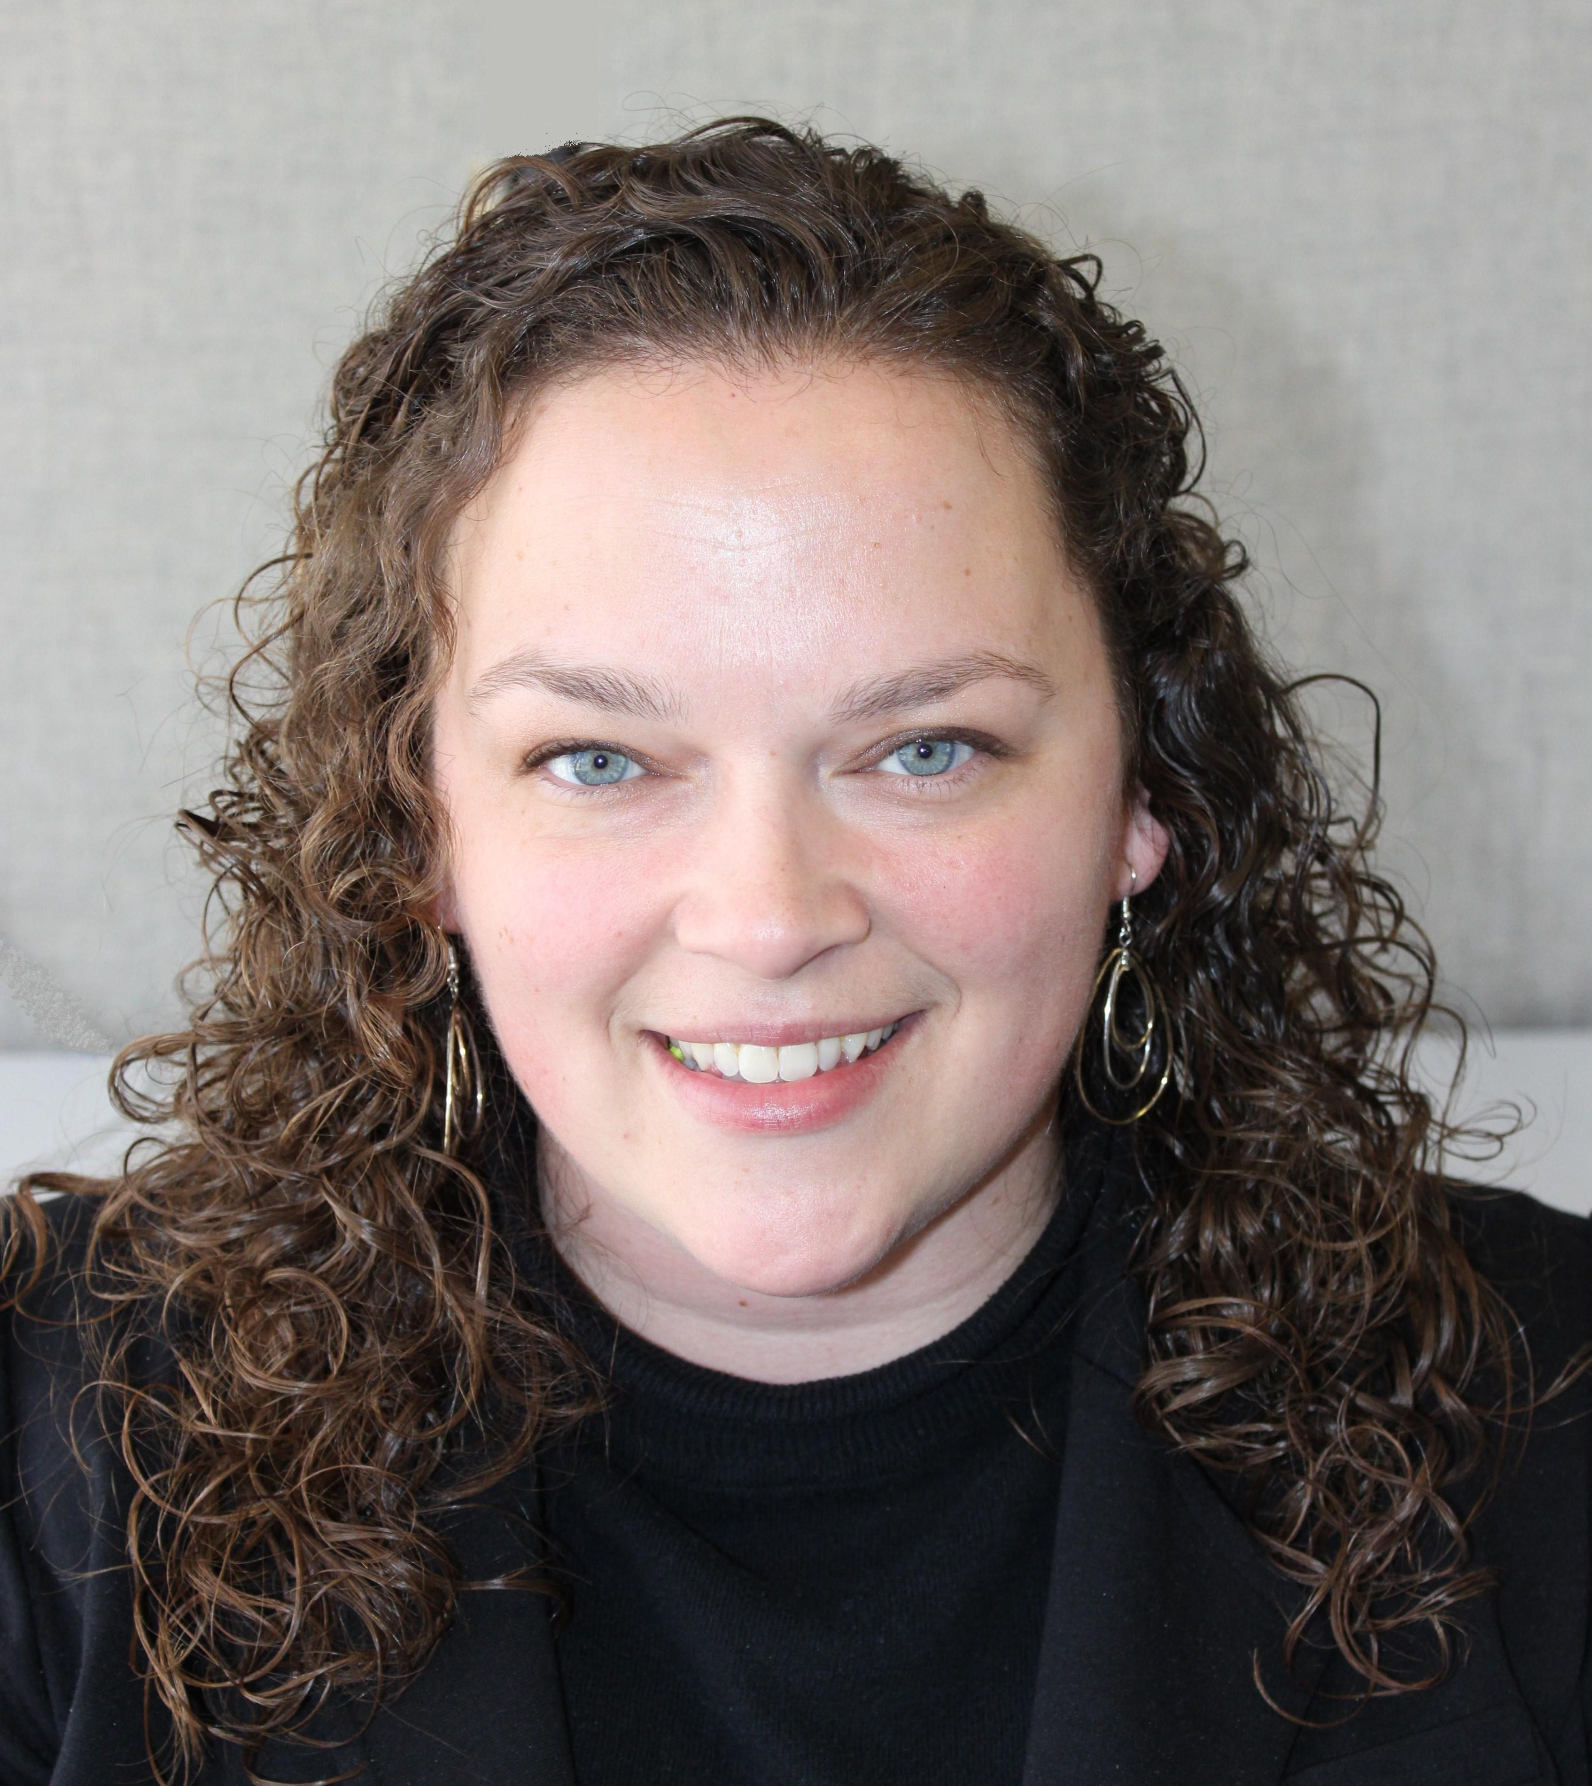
Panelists: Beth Daly, MPH
Work at the New Hampshire Department of Health and Human Services
Subject area: Infectious disease
17 years of experience in public health

Slide 11
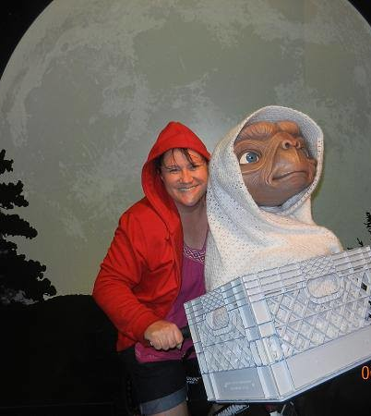
Panelists: Tracy Miller, PhD
Work at the North Dakota Department of Health
Subject area: Mainly Infectious Diseases, but also works in non-ID topics
Over 20 years of experience in public health

Slide 12
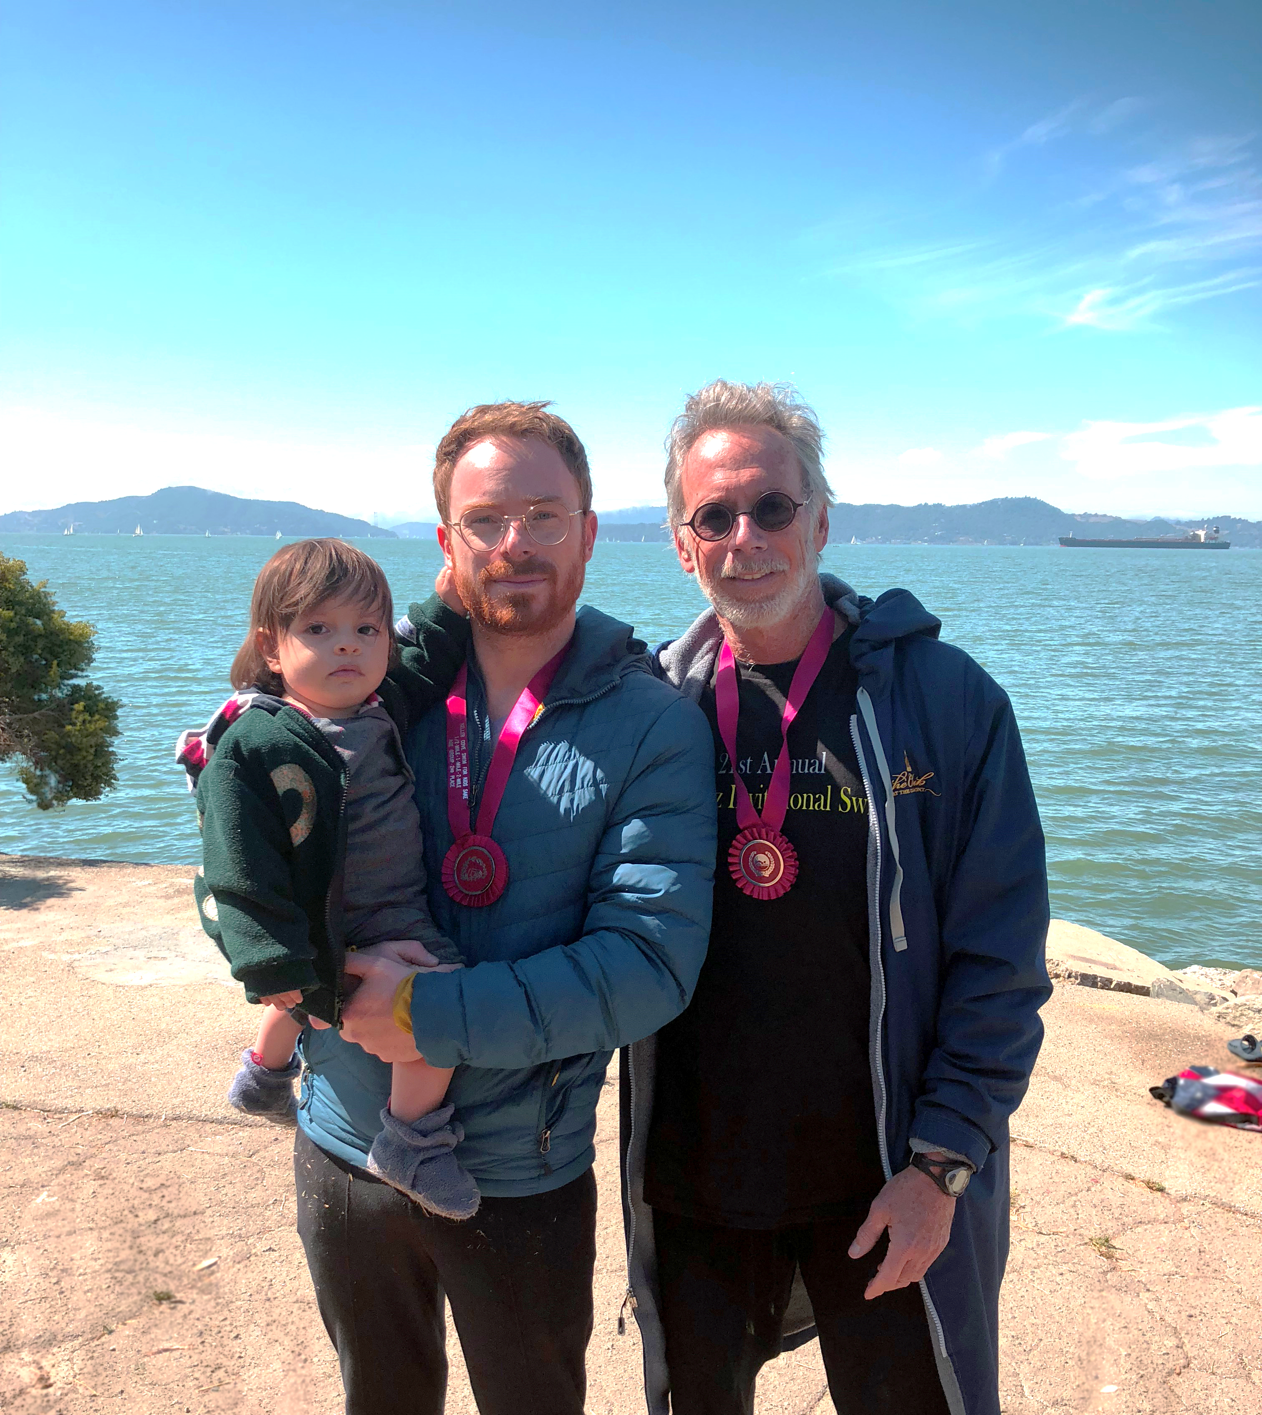
Panelists: Jon Rosenberg, MD
Works at the California Department of Public Health
Subject area: Healthcare-Associated infections
Almost 40 years of experience in public health

Slide 13
Your questions
What questions do you have for us?
How can CSTE support you as mentors during the program?
Any questions, please contact Alyaa Altabbaa (aaltabbaa@cste.org)

Slide 14

Any questions, please contact Alyaa Altabbaa
(aaltabbaa@cste.org)
CSTE National Office
2635 Century Parkway NE, Suite 700
Atlanta, Georgia 30345
770.458.3811
770.458.8516
Notes:
Feel free to send me an email

