Slide 1
2019 CSTE Annual Conference
CE Overview

Slide 2
Why CE?
The educational purpose of the CSTE Annual Conference is to offer professionals and practitioners the opportunity to enhance their knowledge, improve their skills, and exchange information on best practices and strategies in applied epidemiology.

Slide 3
History
Year | Provider | CE Offered | Cost | Eligible Sessions
2015 | NBPHE | CPH | $10 | Entire Conference
2016 | CDC | CME, CNE, CHES, RACE, CPH, CEU | Free | Workshops, Plenaries, & Breakouts
2017 | APHA & NBPHE | CME, CNE, CHES, RACE, CPH | $25 | Workshops & Plenaries
2018 | CDC | CME, CNE, CHES, RACE, CPH, CEU | Free | Workshops & Plenaries

Slide 4
Important Dates
Date | Activity
March 8 | Workshop descriptions due
March 18 | Disclosures for all speakers due
April 17 | Submit application for preliminary review – all confirmed speakers should have all documentation
May 28 | Last day for any speaker changes

Slide 5
Workshops/ Plenaries
Abstract/session description
  Pulling from conference spreadsheet
List of speakers with degrees, title, and employer
  Will be cross checked with biodisclosures
  Add just the name to your session in the conference spreadsheet
Staff are responsible for collecting the forms from their speakers. Workforce Team will contact the presenter directly for any changes to the form. Staff should notify the Workforce Team for any speaker substitutions or changes.

Slide 6
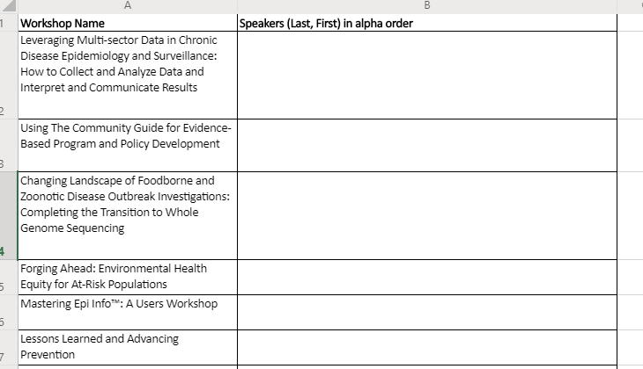
List of Speakers
In the Conference Spreadsheet, add your list of speakers we should receive a form from for your workshop/plenary

Slide 7
Biodisclosures
Planners – CSTE EB members, CSTE Staff Leads, CDC POC
  NEED MD, Vet, CHES, and general contact from CDC as planners
Speakers – plenaries and workshops
  Must have forms for all confirmed speakers by March 18th
    Some flexibility with outstanding speakers through April 17th (1st review)

Slide 8
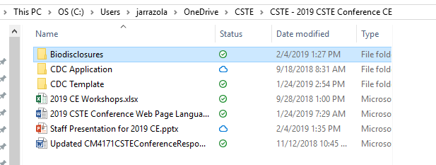
Where are the biodisclosure forms located?

Slide 9
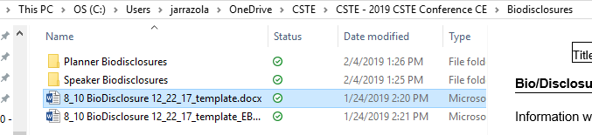
Which form should I use?

Slide 10
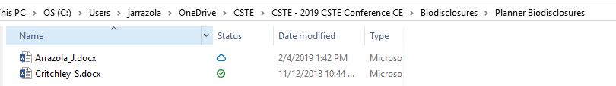
Where should I save the planner forms?
Only submit word files
Files should be named: Last_First Initial

Slide 11
Where should I save the speaker forms?
Only submit word files
Files should be named: Last_First Initial

Slide 12
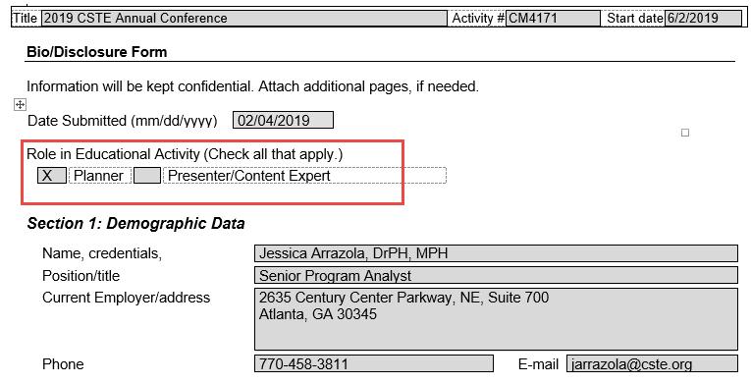
How do I complete the form?
Select the appropriate role; if planner and presenter check both

Slide 13
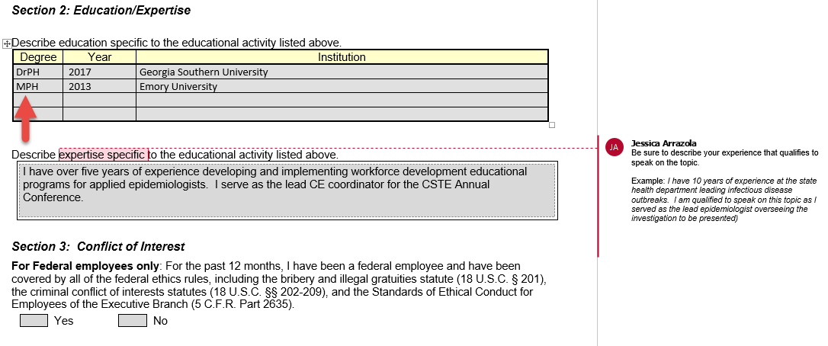
Section 2: Degrees must match those listed under credentials in section 1 and at signature
Section 2: All speakers must describe their expertise as relevant to the presentation
Section 3: Conflict of interest – if a federal employee but not employed for 12 months, they still answer YES

Slide 14
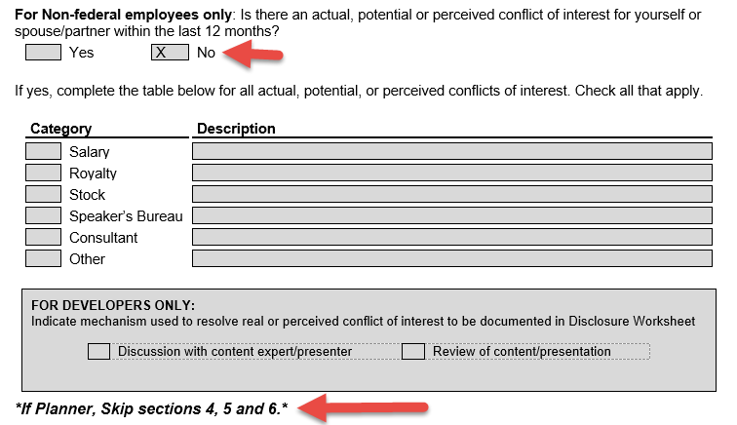
Section 3: Non-fed employees should select “no” unless there is a Conflict of Interest
If planner only – stop here

Slide 15
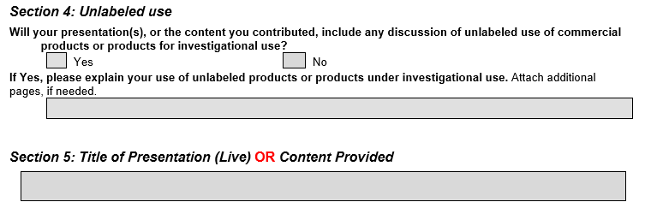
Section 4: 99.9% say no
Section 5: Title of workshop/ Title of plenary presentation

Slide 16
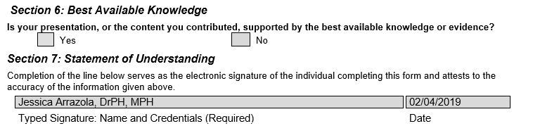
Section 6: “YES” should be selected
Section 7: typed or electronic signatures only; credentials must match section 1 & 2

Slide 17
Questions?
Slides will be posted to basecamp.

