Slide 1


Main finding goes here, translated into plain English. Emphasize the important words.
Non-Cognitive Predictors of Student Success:
A Predictive Validity Comparison Between Domestic and International Students
Non-Cognitive Predictors of Student Success:
A Predictive Validity Comparison Between Domestic and International Students
Title:
Subtitle
AMMO BAR
Delete this and replace it with your…
Extra Graphs
Extra Correlation tables
Extra Figures
Extra nuance that you’re worried about leaving out.
Keep it messy! This section is just for you.
PRESENTER: Leeroy Jenkins
INTRO:
Who cares? Explain why your study matters in the fastest, most brutal way possible (feel free to add graphics!).
METHODS
How did you find this?
Collected [what] from [population]
How you tested it.
Illustrate your methods if you can!
RESULTS
Graph/table with essential results only.
All the other correlations in the ammo bar.
Leeroy Jenkins, author2,
author3, author4, author5, author6, author7, author42
Take a picture to
download the full paper
Notes:
Notes:
In Powerpoint, click View > Guides
Keep text within gutter guides.
Author list: Don’t split names onto two lines (e.g., “Jimmy [break] Smith”). If that happens, use a new line, unless you need the space. Bold the first names of anybody who’s presenting in person.
Intro/methods/result: Do not drop below font size 28, but if you have extra space, jack up the font size until the space is full.
Do not use color in the sidebars except in graphs/figures. It’ll pull attention from the center and slow interpretation for passersby.

Slide 2
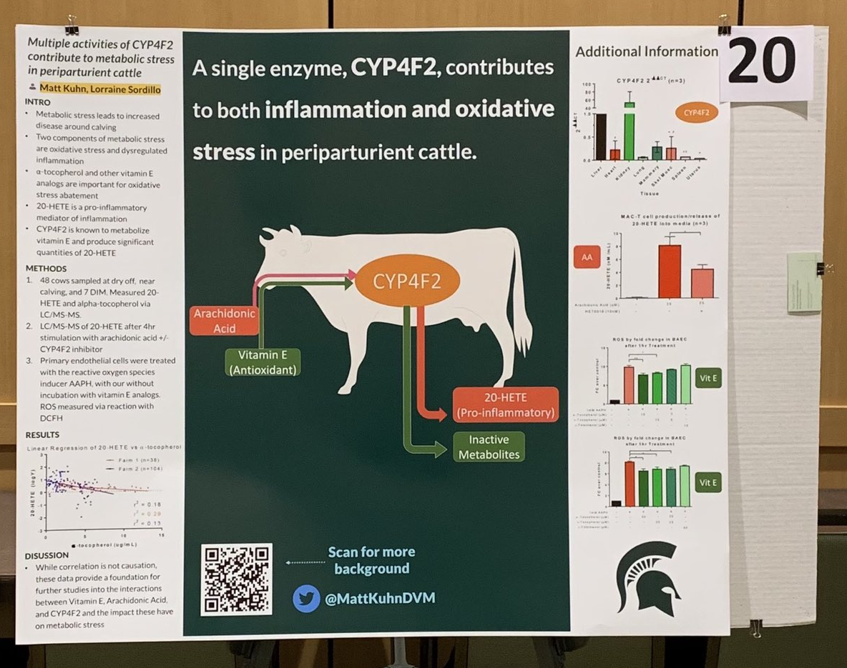
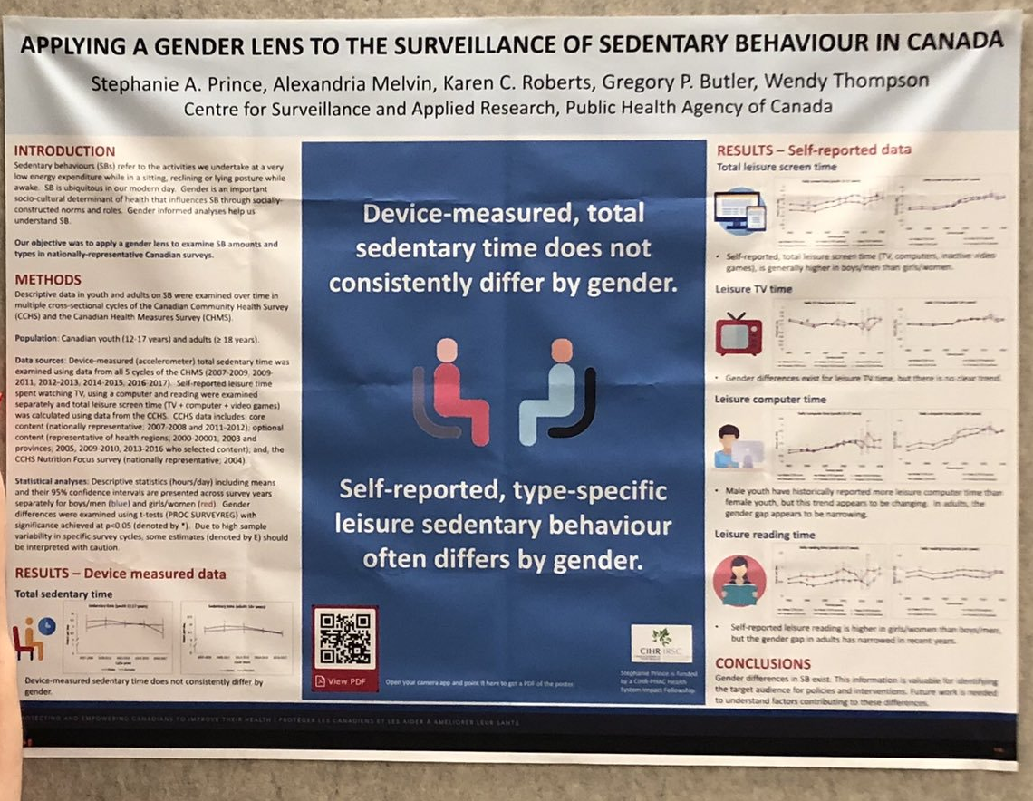

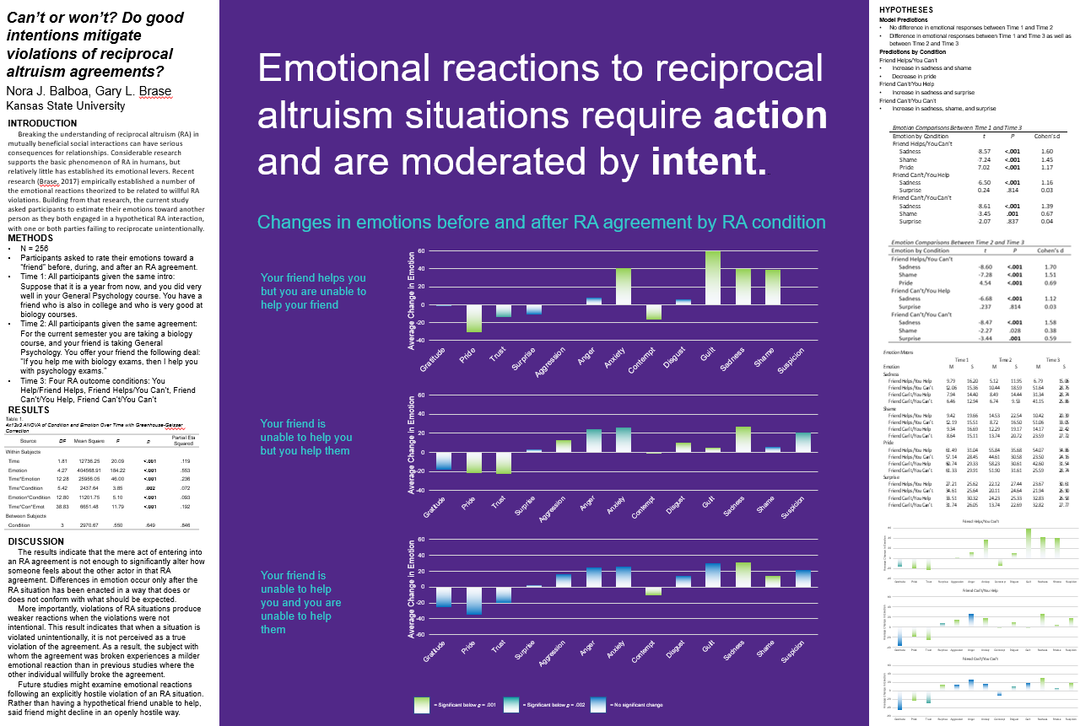

Example donated by @MattKuhnDVM
Example donated by @SPrinceWare
Example donated by @ramya_ramaswami
Example donated by @NoraBalboa
Example donated by @BrzezinskiRafi

