Slide 1
Training: Custom Syndrome Definitions in NSSP ESSENCE
NSSP CoP Syndrome Definition Subcommittee

Slide 2

Training Objective
Receive instruction on creating a custom syndrome query in NSSP ESSENCE, including information on which data sources to use for validation and analysis and tips to limit processing time.
Rasneet Kumar, MPH – Tarrant County Public Health (Texas)
Rosa Ergas, MPH – Massachusetts Department of Public Health
Zach Stein, MPH – ICF Consultant, CDC/NSSP

Slide 3

Syndrome Development Process
Defining the scope and compiling the components
Building and refining an ESSENCE Query
Syndrome evaluation
Notes:
The SD follows a standardized process for creating it’s syndrome definitions. This process has been outlined in detail in this guidance document. The process has 4 steps.
https://prod-knowledge-repository.s3-us-gov-west-1.amazonaws.com/references/SDC_Syndrome%20Definition%20Guidance%20document_FINAL.PDF

Slide 4
Defining the Scope

Slide 5
Scope – Needs are identified
Building a syndrome begins by defining what you want to surveil and why. Considerations and questions you should ask include:
  Public health concern
  Data sources
  Purpose
  Sensitivity versus specificity
  Time frame
It is almost the end of the year and your boss reaches out to you to monitor alcohol related visits during the new year celebrations
Notes:
Public health concern: What is it and what possible ways can it present in syndromic data?
Data sources: Which data sources will you use? Are there specific geographies or facility types that you want to include or exclude? Do data from these locations include the data elements necessary for your syndrome?
Purpose: Will the definition be used for trend analysis or active case detection? Will syndromic surveillance data capture actionable information for the specific public health concern?
Sensitivity versus specificity: Is the aim to capture as many related visits as possible with some “false positives” or include as few false positives as possible, even if it means missing some visits?
Time frame: What time frame would you like information to cover and what time frame do your data cover?

Slide 6
Scope – Needs are identified
Public Health Concern
Is there an increase in alcohol related emergency department visits during new year celebrations? Include both alcohol and new year related keywords and codes in the query
Data Sources
Syndromic surveillance emergency department visits
Purpose
Capture trend overtime in alcohol related visits
Sensitivity versus specificity
A balance of sensitivity and specificity to allow for the most accurate trend
Time frame
Multiple years to evaluate trend over time. Week 34 , 2019 and Week 10, 2020 for evaluation.

Slide 7
Scope – Does it already exist?
Now that we know what we want…Does it already exist??
Knowledge Repository
NSSP ESSENCE CCDD Categories
Ask the community on the Slack Channel or Syndrome Definition Subcommittee
We are looking for anything that is related to the New Year or Alcohol
Nothing related to the new year
NSSP ESSENCE CCDD Categories for alcohol
Potential queries from the community
Notes:
If nothing exists, or only partial syndrome exists then continue to development process

Slide 8
Compiling the Components

Slide 9
Compile – Components of a syndrome
Discharge diagnosis codes:
  International Classification of Diseases, Clinical Modification (ICD CM)
  Systematized Nomenclature of Medicine, Clinical Terms (SNOMED CT).
Key words
  Terms related to the topic of interest can be used to search free text fields, such as patient chief complaint, admission reason, and triage notes to capture records.
Negations
  A query may define discharge diagnosis codes or keywords that should not be identified. These are used to exclude records falsely identified with the query.

Slide 10
Compile – Searching for the components
Literature on relevant signs/symptoms, terms, and diagnosis codes for the outcome of interest
Syndrome case definitions from other sites
Diagnosis code reference guides and tools to determine which code(s) to include/exclude and desired level of specificity
Diagnosis code-positive visits in the syndromic surveillance application, followed by reviewing the resulting records to identify potential keywords present in free text fields(e.g., Chief Complaint, Triage notes, Clinical impression)
Systematic text mining and analysis (e.g., word clustering, chief complaint terms or diagnosis code frequency) of records to identify additional terms to include/exclude once you have an initial list of keywords or codes.
Consulting with subject matter experts on symptomology, discharge diagnosis use and other considerations
Notes:
Text analysis from ICD codes

Slide 11
Compile – Discharge Diagnosis
Things to consider:
Does a discharge diagnosis exist of the condition?
Timeliness of discharge diagnosis
Top level vs. specific code
  e.g., B16 = Acute Hepatitis B vs. B16.0 = Acute Hepatitis B with hepatic coma
4. When to use ICD-9-CM, ICD-10-CM, SNOMED codes
No discharge diagnosis for new year specific query
Alcohol- related: ^[;/ ]Y90^,or,^[;/ ]F10.[12]2^,or,^[;/ ]F10.9^,or,^[;/ ]F10[12]2^,or,^[;/ ]F109^,or,^[;/ ]T51.[09]^,or,^[;/ ]T51[09]^,or,^[;/ ]R78.0^,or,^[;/ ]R780^,or,^[;/ ]291.4^,or,^[;/ ]2914^,or,^[;/ ]980.[09]^,or,^[;/ ]E860.[0189]^,or,^[;/ ]790.3^,or,^[;/ ]305.0^,or,^[;/ ]303.0^,or,^[;/ ]3050^,or,^[;/ ]3030^,or,^[;/ ]980[09]^,or,^[;/ ]E860[0189]^,or,^[;/ ]7903^,or,^[;/ ]25702006^,or,^[;/ ]191802004^,or,^[;/ ]191804003^,or,^[;/ ]21000000^

Slide 12
Compile – Keywords
Things to consider:
Misspellings/ typos
Acronyms and abbreviations
  Which fields are you using?
Clinical vs. lay terms
Local vernacular
1. CDC Alcohol v1
2. Party
3. New Year
4. NYE
6. NY
7. Celebrate
8. Gathering
9. Get Together
10. Club
11. Bar

Slide 13
Building an ESSENCE Query and Refining the Syndrome

Slide 14
Syndrome Evaluation

Slide 15
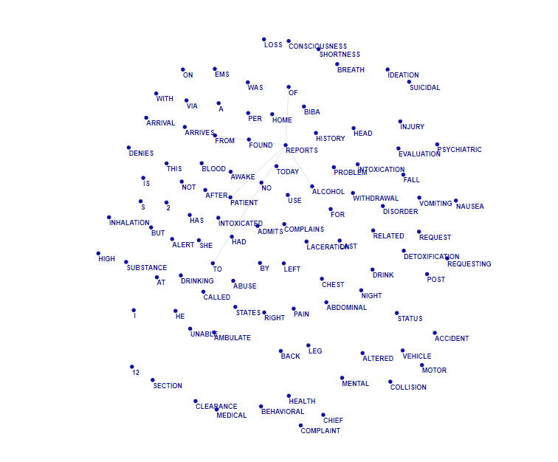
Visit Review – Do these look right?
Text Analysis Tool
ESSENCE Data Details
  Chief Complaints
  Diagnosis Codes
R and SAS Studio for in depth analysis
Example

Slide 16
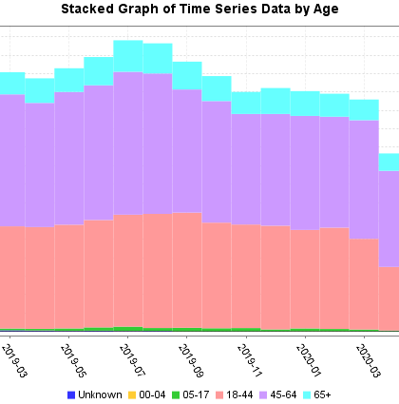
Overview of Results
Trends over time
Demographic distribution
Comparison data sets
Loop back to literature and subject matter experts

Slide 17
Rasneet Kumar rskumar@Tarrantcounty.com
Zach Stein Zachary.Stein@icf.com
Rosa Ergas rosa.ergas@state.ma.us

