Slide 1
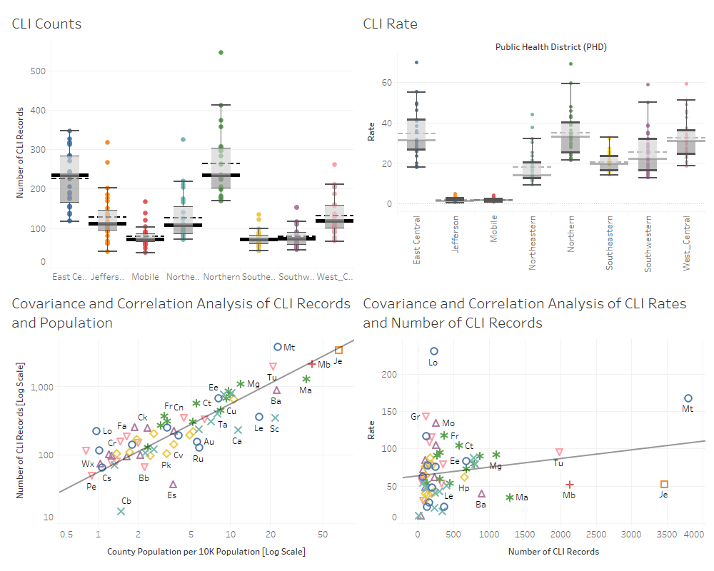
Notes:
ANOVA for CLI counts revealed that the CLI Mean variation is statistically significant
ANOVA for CLI rates revealed that the CLI Mean variation is not statistically significant
The average number of CLI through out the PHD varies. This could be attributed to population, demographics, and/or urbanicity.
Gray Line is the state average of 61
There is a positive covariance between county population and CLI supporting the fact that the two variables change together. There is also a strong association between the two variable having a correlation coefficient of 0.82.
This analysis supports the assumption of a positive linear relationship between the population of the county and the total number of CLI.
Very Weak covariance, Weak correlation between CLI Rate and Count. Maybe some poor positive linear association with each other (0.2). Would need to conduct a multivariate analysis to see if there is a relationship.

Slide 2
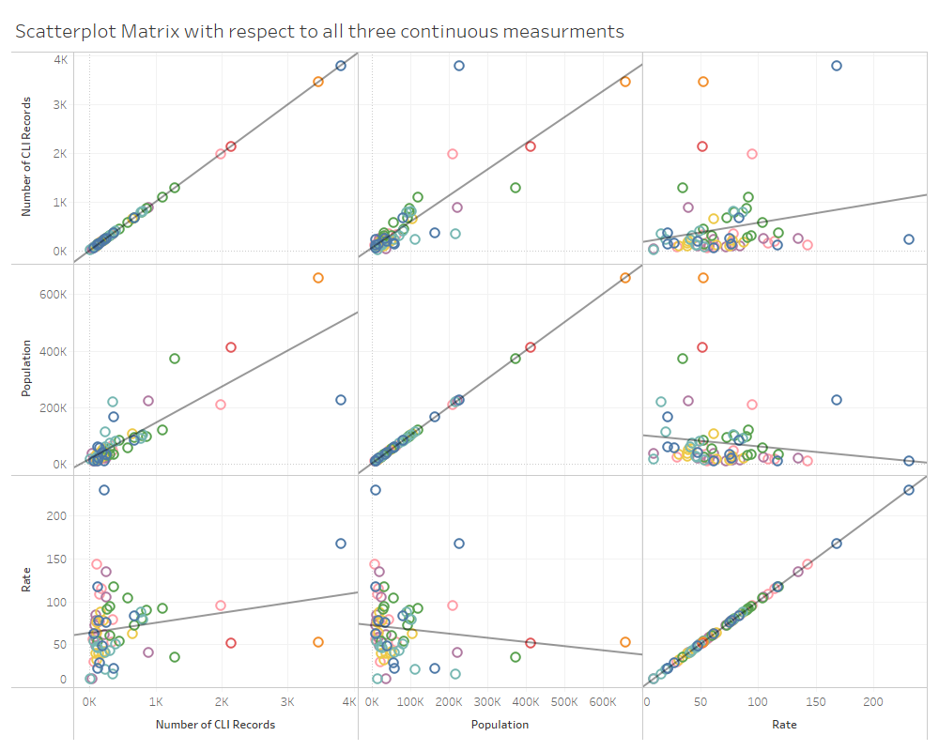
Notes:
We have three numeric continuous variables of interest CLI count, CLI rate, and population. A scatterplot matrix allows us to show the information together in structured more visually pleasing way. Again allowing us to glean at a glance.

Slide 3
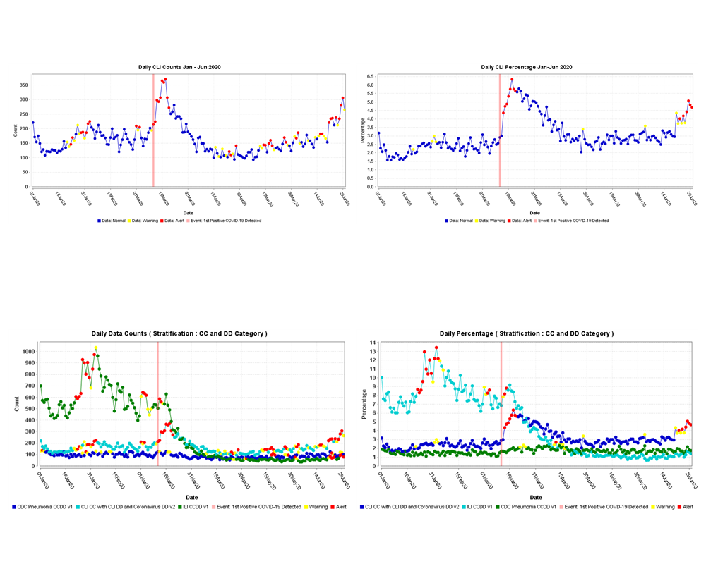
Notes:
ESSENCE default detector algorithm is se to Regression/EWMA1.2. We use theses syndromic surveillance alerts to draw attention and bring awareness to potential outbreaks. For CLI, we see when the first positive CLI case was identified, and the alerts which later appeared.
To take it one step further, we compare alerts to other seasonal syndromes to ensure we are gaging the data in a relative manner. In addition to CLI, AlaSyS uses these ESSENCE alerts to keep awareness of ILI activities during flu season.

