Slide 1
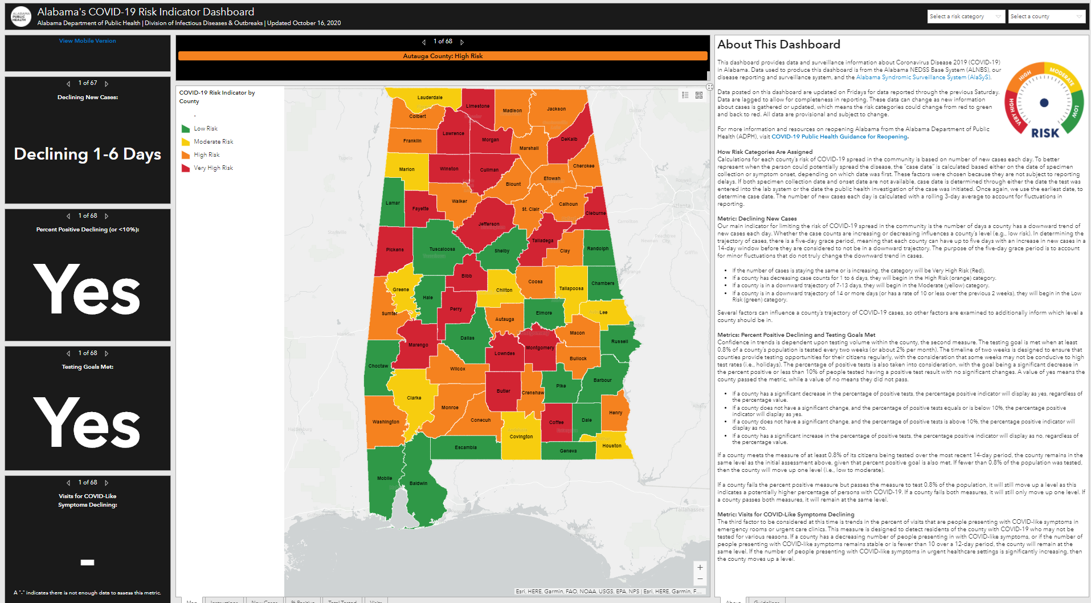
Notes:
COVID-19 Risk Indicator Dashboard*
This dashboard provides data and surveillance information about Coronavirus Disease 2019 (COVID-19) in Alabama. Data used to produce this dashboard is from the Alabama NEDSS Base System (ALNBS), our disease reporting and surveillance system, and the Alabama Syndromic Surveillance System (AlaSyS).
Alabama Department of Public Health (ADPH) is using data and metrics to make recommendations to assist the Governor's Office, partners, and stakeholders across the state in making decisions about safely reopening Alabama. View our COVID-19 Risk Indicator Dashboard (Mobile Version).
*Site Accessed on October 22, 2020

Slide 2
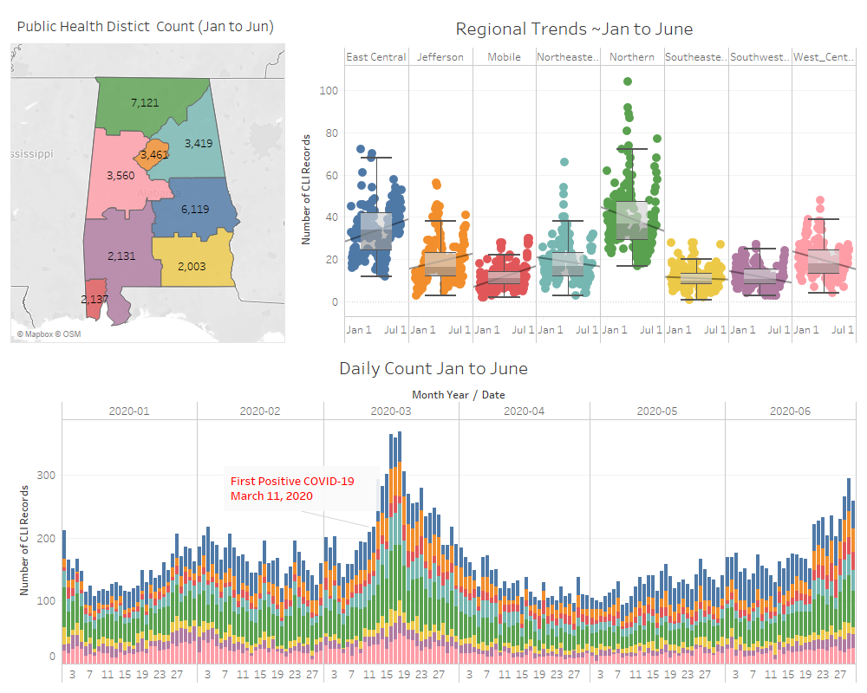
Notes:
What can we Glean at a Glance?
Public Health District Counts and the general trend by district.
Clear spike in CLI observation occurring after the first positive COVID-19 was identified
Possible cases of COVID-19 circulating prior to the identification of the 1st positive case.

Slide 3
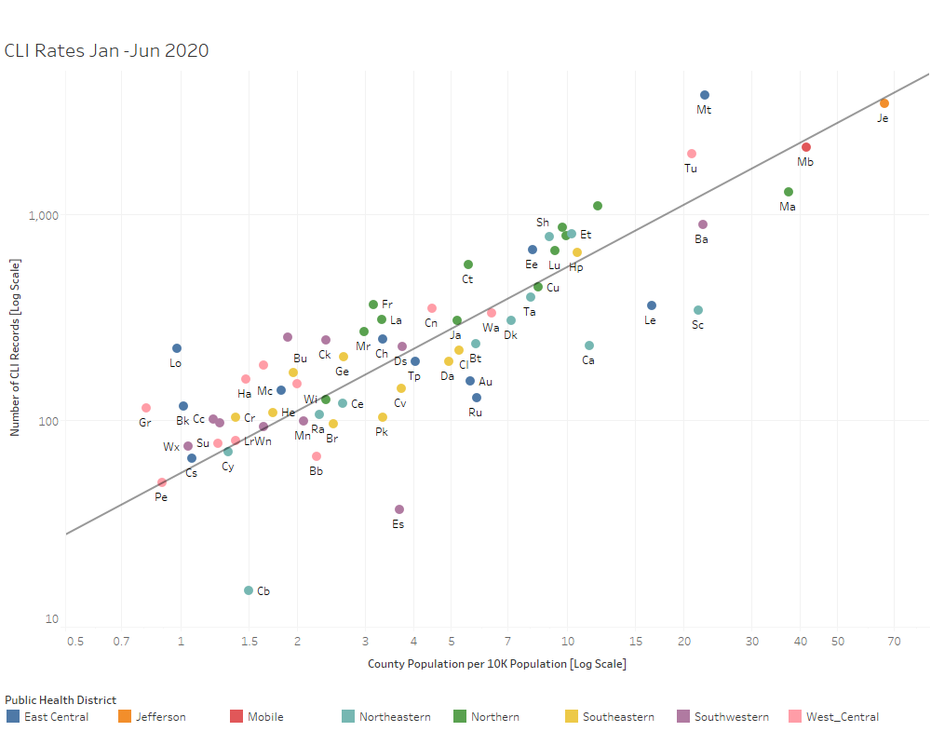
Notes:
What can we Glean at a Glance?
We can quickly determine which counties have the largest populations and which have the smallest. We can reasonably suggest that there is a positive linear relationship between the Total number of CLI in a county and the Population of a county. Gray Line is the state average.
We can see a clear relationship between CLI totals and population size. A county falling on the gray line has the same CLI rate as state average. The eight Public Health Districts are denoted with color. We can see how most East Central District have CLI rates above the state average.

