Slide 1
2020 SyS Symposium Content Delivery Plan

Slide 2
Symposium Track Categories and Topics
Data Sharing
Regional Data Sharing WG Exp. Sharing with: Tribes, Public, other disciplines Integration with other surveillance and programs
Practical Methods and Application
New syndrome definitions and evaluation SyS supporting public health decision making/action Standardizing analytics and presentations Interpreting signals and alerts Recognizing and improving data quality
Innovation
Novel data sources for SyS Novel uses of SyS data How SyS is changing the PH landscape (plenary?) Hype or Bust (eg. social media) Accommodating increased demand for support with limited resources
Training / Hands-on
Intro to BioSense (new) ESSENCE 101 (new) Intro to Community of Practice (new) Shiny R Dashboards (adv.) Integrating BioSense with other tools (adv.)
COVID
Defining and refining the syndrome definition Using SyS data in a national response COVID trends and alerts Intersection with ILI Secondary health impacts NSSP advanced analytic support during a national emergency

Slide 3
Session Build-out- Data Sharing
Track | Session Name | Presentation Type (long-form, short-form, roundtable, workgroup, training) | Presenter Suggestions

Slide 4
Session Build-out- Practical Methods and Application
Track | Session Name | Presentation Type (long-form, short-form, roundtable, workgroup, training) | Presenter Suggestions

Slide 5
Session Build-out- Innovation
Track | Session Name | Presentation Type (long-form, short-form, roundtable, workgroup, training) | Presenter Suggestions

Slide 6
Session Build-out- Training
Track | Session Name | Presentation Type (long-form, short-form, roundtable, workgroup, training) | Presenter Suggestions
Training | Intro to Community of Practice | Training | COP Core Chair, CSTE COP lead, NSSP Training Coordinator
Training | Intro to BioSense Platform | Training | NSSP Program Manager
Training | ESSENCE 101 | Training | JHU APL
Training | Shiny R Dashboard | Training | NSSP SME
Training | Integrating BioSense Data with Other Tools | Training | NSSP and Community SMEs

Slide 7
Session Build-out- COVID
Track | Session Name | Presentation Type (long-form, short-form, roundtable, workgroup, training) | Presenter Suggestions
COVID | SyS during national emergency: COVID experience | Long-form panel | Presentation 1: Presentation 2:
COVID | Response Hotwash | Round Table
COVID | Data Sharing with CDC | Round Table
COVID | Syndrome Definition updates | Round Table
COVID | SyS analysis and utility for COVID response | Round Table

Slide 8
Session Building Blocks
Plenary
<<Topic/Theme>>
<<Format>>
Conc.
<<Topic/Theme>>
<<Format>>
Audience
Plenary (Everyone) OR Concurrent (Breakout)
Delivery
Long-form Panel OR Short-form Panel OR Roundtable OR Workgroup OR Training
Plenary
<<Topic/Theme>>
<<Format>>
Conc.
<<Topic/Theme>>
<<Format>>
Set-up Session
Set up Session
Plenary
<<Topic/Theme>>
<<Format>>
Conc.
<<Topic/Theme>>
<<Format>>
Keynote
<<Topic/Theme>>
<<Presenter>>
Plenary
<<Topic/Theme>>
<<Format>>
Conc.
<<Topic/Theme>>
<<Format>>

Slide 9
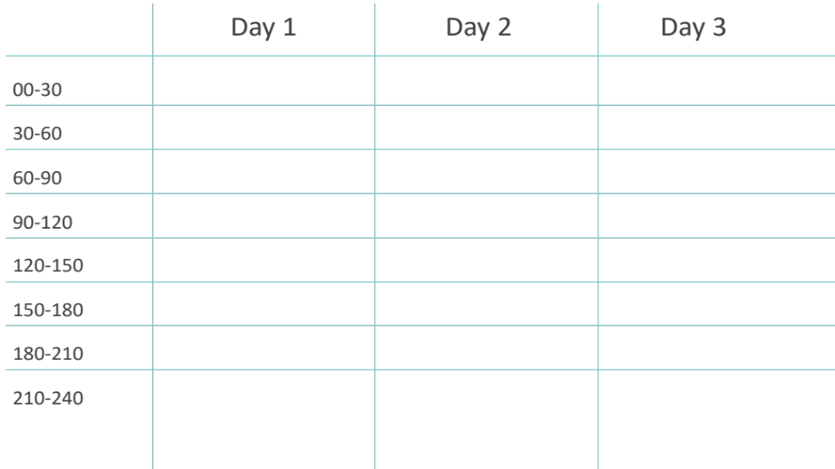
Daily opening, logistics, overview
Daily opening, logistics, overview
Daily opening, logistics, overview
Welcoming Remarks
Keynote
Topic/Theme:
Presenter:
Plenary
SyS in a National Emergency (COVID)
Long-Form Panel
Keynote
Topic/Theme:
Presenter:
COVID RT Hotwash (LL/BP)
COVID RT Data Sharing with CDC
COVID RT Synd. Update
COVID RT Analysis and utility
Town Hall / COP Meeting / Subcommittee Presentations

Slide 11
Day 1
Day 2
Day 3
00-30
30-60
60-90
90-120
120-150
150-180
180-210
210-240

