Slide 1
CSTE Mentorship Program Orientation
Wednesday, November 17th

Slide 2


CSTE Team
Sarah Auer
Megan Wigginton

Slide 3
Objectives
Outline the CSTE Mentorship Program Structure
Describe at least two strategies to facilitate e-mentoring
Describe at least two mentoring best practices
Notes:
So to go over our objectives. We hope that by the end of today’s call you will be able to:
Outline the CSTE Mentorship Program Structure
Describe at least two strategies to facilitate e-mentoring
and
Describe at least two mentoring best practices
We will discuss both best practices for mentoring and for being mentored so that the expectations are clear for everyone participating in the program

Slide 4
Agenda
Program Structure
E-Mentoring
Mentoring Best Practices
Questions
Notes:
So following those objectives, on today’s agenda we will review the program structure, discuss e mentoring and mentoring best practices, and then have some time for questions at the end so please post any questions into the chatbox throughout the webinar and we will get to them at the end.

Slide 5
Program Structure
Notes:
We will start by discussing program structure

Slide 6
Mentorship Program
Background
Purpose
  Provide an opportunity to build relationships and foster shared learning among applied epidemiologists
Goal
  Promote the exploration of STLT career opportunities
Notes:
A little bit about the program background: it was created with the purpose of providing an opportunity to build relationships and foster shared learning among applied epidemiologists with the goal of promoting the exploration of STLT career opportunities.
While everyone is at a different stage in their careers and may have different goals for the program, ultimately we’re hoping everyone can learn a bit more about what its like to work in a health department.

Slide 7
Mentorship Program Structure
9 month program November 2021 through July 2022
  Developed based on lessons learned from our fellowships and the published literature on mentorship
  39 mentors and 52 mentees matched across the country
  This is our largest cohort yet!
Notes:
This is a 9 month program where we start today and we will go through July 2021.
This program was initially developed based on lessons learned from our fellowships as well as the existing literature about mentorship and this is now our 4th mentorship cohort so we’re continuing to adjust and improve the program each year based on feedback from participants.

Slide 8
Stages of Mentoring Relationships
Timing | Stages | Challenge | Activities
Beginning | Initiation and goal setting | Develop rapport | Share background experiences, values, and learning preferences. Identify relationship purpose or goals.
Middle | Cultivation | Learn to collaborate | Select a topic or activity on which to collaborate
End | Separation and redefinition | Reflect and grow | Reflect on lessons learned, identify future professional development needs Transition to relationship that is collegial, friendship, or ad hoc. Check in occasionally to maintain the connection
Adopted from Lunsford, L. (2016). A handbook for managing mentoring programs. (p. 100).
Notes:
This program was also designed thinking about the stages of the mentoring relationship. so we’re hoping that all of you go through these phases of development. Where you start by establishing rapport, by the middle you are learning to collaborate, and at the end you will get the opportunity to reflect and grow based upon the new relationship you’ve built. Throughout the year we will have various activities (which I’ll review in the coming slides) that will help foster that relationship.
Kram (1985) first identified stages of mentoring relationships in her qualitative study of 18 mentoring dyads in a large utility company. She found that mentoring partners moved through four stages in their mentoring relationship: initiation, cultivation, separation, and redefinition
The stages proceed in order but may overlap. Mentoring relationships progress through stages. They are marked by a beginning, middle, and end. Mentors and mentees will benefit from understanding that different tasks are required in each stage.

Slide 9
Program Components
“Live Events”
  November Orientation
  Early career professionals events and webinars
Tasks
  Self-assessment
  Goal-setting
  Professional development navigation
  Leadership values
  Implementation intention
Activities
  “Meet” between mentor and mentee monthly during the program
    Strongly suggest first meeting is by phone or skype
    Can also communicate by email, instant messenger, or skype
  Newsletters will be sent monthly with activities and suggested discussion topics
  Half way point check-in
  Evaluation
    Provide feedback for program improvement
Notes:
So we have several different program components. First we have live events such as today’s orientation.
We also provide webinars focused on professional development and these are hosted by the early career professionals workgroup. If you aren't able to attend the slides and recording will be included in the subsequent monthly newsletter. We will likely have 3 professional development webinars.
We have different tasks which will be highlighted in the newsletters throughout the year which we will go into more detail about in the coming slides.
We also have activities that are highlighted throughout the year with the newsletter.
We encourage you all to meet at least 3 times throughout the program but ideally you would meet monthly. We recommend your first meeting be by phone or video chat so you can really start to establish that relationship. During that first meeting we suggest you discuss your preferred means of communication, whether that be by email, or standing meetings on the phone just so that those expectations for how you’ll communicate are set.
We did ask in the acceptance materials that mentees reach out to mentors to introduce themselves prior to todays webinar, so if you have not done so, please do by the end of this week. And if you are a mentor, please send confirmation to your mentee that you’ve received their email. If you are having trouble connecting with one another please feel free to reach out to me. It could be possible that someone had a typo in the contact information they provided in their application so definitely check with us if you are unable to get in touch with your mentee or mentor.
We will send monthly newsletters and within those newsletters there will be listed activities and tasks for you to complete and discuss with your mentor or mentee as well as suggested discussion topics to give you a starting point if you need guidance in your conversations.
We will also have a halfway point checkin via email to make sure that the program is meeting your needs as well as an evaluation at the end of the program which will be extremely important for us to continue to improve the program.

Slide 10
Self-Assessment
Purpose
  Intended to help mentors and mentees reflect on how they work with others and what they bring to the relationship
Format
  Two brief questionnaires
    Working style
    Communication style
  Independent and self-scored
  Question prompts will be provided to guide discussion once both parties complete
Notes:
Now were going to dive more into the tasks that you will complete throughout the year. The first one is self assessment and this will be sent out in the December newsletter.
This will help you identify what you want to gain from your relationship, what your strengths are and how you can learn from one another. The format of this is two short questionnaires: one about your working style and one about your communication style. You will complete and score them individually and then come together to discuss your results. There will be a discussion guide to help facilitate that conversation.

Slide 11
Goal Setting
Purpose
  Intended to guide mentors and mentees through the process of establishing the mentoring relationship
  Think about what you want out of the relationship but also what strengths you can bring to it
Format
  Independent worksheet
  Some additional questions only for mentees to consider
Mentors and mentees should compare and discuss once complete in order to develop common rules and goals for the relationship
Notes:
The next task will be a Goal setting exercise. This will really help with setting those ground rules for the mentor mentee relationship and expectations for the program. This has an independent worksheet and some additional questions only for mentees to consider, but we ask that mentors discuss the questions with mentees once complete in order to develop common rules and goals for the relationship and for the program overall.

Slide 12
Professional Development Navigation (GPSR)
Purpose
  Maximize professional development
  Helps mentors/mentees identify strengths and areas for improvement in 4 areas of professional development
Format
  Self-scored questionnaire
  Reflection questions
Mentors and mentees should complete the questionnaires and then set time aside to discuss reflection questions surrounding their areas for improvement
Notes:
Next is a professional development navigation tool called GPSR and was new to the program last year. GPSR stands for goals, people, stretch, and reflection… so you will complete a questionnaire that will help you look at if you have identified career goals, have people around you that support your development, take on assignments that stretch you to develop in different areas, and whether you build time into your work to reflect on what is working for you and what isn’t. Like the self assessment, the questionnaire will be completed and scored individually and then the mentor and mentee can discuss the results as a pair.
Goals–charting a direction about where you want to go in work and life
People–surrounding yourself with people who challenge, support and develop you
Stretch–taking on assignments that will stretch you to develop in areas you have targeted for development
Reflection–building moments in your work when you can assess what is working, what isn’t; working, and applying the lessons to future challenges

Slide 13
Values
Purpose
  Identify the values that impact your work
Format
  Short values exercise
  Reflection questions
Mentors and mentees should discuss prioritized values and answer the reflection questions focusing on how those values impact job performance
Notes:
The next task will be values focused. This exercise will help you identify and reflect on some of those values that guide you in your work.
And again, we ask that you complete the worksheet individually and then discuss the reflection questions together.

Slide 14
Implementation Intention
Purpose
  Develop a list of intentions outlining how you will implement the lessons learned in the program in the workplace/your future career
Format
  Independent action planning form
  Can be adapted to fit individual needs
Mentors and mentees should compare and discuss once complete
Notes:
At the end of the program we’ll ask you to complete the Implementation intention exercise which will help you set goals and lay out that plan for how you will continue your professional development upon termination of the program. And this would be the time where you could discuss as mentor and mentee how you will conclude your mentor mentee relationship or perhaps continue informally after the program officially ends.

Slide 15
E-Mentoring
Notes:
So now that we’ve overviewed the program structure we’re going to talk a little about e-mentoring.. Most mentor mentee pairs are virtual so we definitely want to cover best practices for e mentoring

Slide 16
Face-to-Face Mentoring
Advantages
Disadvantages
Stronger bond
Non-verbal communication
Immediacy of response
One mentor
Limited by location and not skill set or need
Notes:
So when we do have in-person mentorship it is easier to form a stronger bond, pick up on those non verbal cues, and typically much easier to get immediate responses, however with in-person mentoring, you are limited by location and now COVID-19.
http://work.chron.com/facetoface-vs-virtual-mentoring-3464.html
Advantages
1.) mentor and mentee are able to form a stronger bond because of the personal nature of the in-person meeting.
2.) They can use non-verbal communication to emphasize and explain main points, instead of having to interpret them through text alone.
3.) The co-worker is also able to get immediate responses to questions, instead of having to wait for the mentor to type a reply.
Disadvantages
1.) In face-to-face mentoring, a co-worker is only able to benefit from the guidance of one mentor, which can limit his growth potential.
2.) Mentors are limited to those in that location, regardless of whether or not their skill sets match her needs.
3.) It can also be challenging to coordinate the schedules of two different people, so it can be difficult to find times to meet regularly.

Slide 17
Virtual Mentoring
Advantages
Disadvantages
Location doesn’t matter
Connect with SMEs
Time efficient
Messaging & written communication
Difficult to build relationship
Lack of accountability
Coordinate communication
Notes:
With e-mentoring, we have pairs matched all across the country and have done our best to match everyone based on program goals and your interests, so e-mentoring does have that benefit, but it can be challenging to build a strong relationship and there is sometimes less accountability when there's no face to face interaction. Additionally is can be hard to coordinate communication across time zones.
http://work.chron.com/facetoface-vs-virtual-mentoring-3464.html
Advantages
1.) In virtual mentoring, location is not involved.
2.) Mentors who can offer specific guidance that a particular employee is looking to find can connect with that person virtually.
3.)Virtual mentoring is very time efficient because there is no travel time involved in getting to meetings, and both people can respond to messages at their own convenience.
Disadvantages
1.) In virtual mentoring, the people involved do not have the opportunity to create a bond built by physically meeting to spend time together. It can be very difficult to build a meaningful relationship through email.
2.) It’s much easier for either party not to take the mentoring relationship seriously because there is little accountability in a virtual setting.
3.) Constraints caused by living different time zones can also make it difficult to get timely responses to questions.

Slide 18
How to Mentor at a Distance
Allow time to build the relationships
Plan ahead
Listen actively and avoid interruptions
Use technology for better communication
Take extra time to understand how business and culture are different where the other person lives
Anticipate needing to manage communication across time zones
Rely more on writing to clarify details not understood in conversation
Notes:
So some tips for how you can mentor at a distance, we encourage you to allow time to build these relationships, so really dedicate that time maybe set a standing meeting to touch base via email or through the phone.
Plan ahead so you have time to complete those tasks we’ve discussed.
Utilize active listening to ensure that you're fully present in your conversations when you are communicating.
You can also leverage technology for your communication, whether that’s video chat or through direct messages on the basecamp website, or if you’re in a group of 3 there are a lot of free conference call tools out there, so definitely utilize those technological resources.
Additionally, take that extra time to understand the business and culture of where each other are right now whether that’s the workplace environment or personal goals of balancing family life. Its important to recognize the context you are both working in.
As I mentioned before make sure you’re aware miscommunications that can happen when you're communicating across time zones.
And lastly, really rely on writing to clarify details not understood in conversation. We are limited in not having that face to face communication so make sure you follow up in emails and clarify any miscommunications.
https://www.micromentor.org/learn-more/mentoring-distance

Slide 19
Mentoring & Coaching Skills
Create an open and supportive climate for discussion
Demonstrate good listening/follow-up skills
Provide constructive feedback and advice
Notes:
Another aspect specifically for mentors but for mentees to consider as well is to create that open and supportive climate for discussion. Its also important to demonstrate good listening and follow up skills and then to provide constructive feedback and advice when appropriate. And sometimes this means actually asking, “do you want advice and feedback or do you just want me to listen” and this goes both ways.
http://www.asha.org/students/mentoring/coach/
1. Create an open and supportive climate for discussion
Seek to develop trust by encouraging open, two-way communications; this often means sharing personal experiences or difficult times you went through so that the mentee knows she or he can discuss tough issues.
Respect the mentee's individuality. Your mentee may or may not have a similar style.
Be patient if your mentee seems unfocused-help her or him focus by presenting and discussing options.
Make it clear that you hope to learn from this experience.
2. Demonstrate good listening/follow-up skills
Most of us need to improve our listening skills; we tend to talk more than we listen and to interrupt people more than we should.
Ask open-ended questions to get your mentee to open up as much as possible (Examples: How did you decide to major in communication sciencesand disorders? What are your longer term goals?)
After you have listened fully to a response, ask good follow-up questions to demonstrate genuine interest. (Example: After you've completed yourinternship, what do you hope to do next to move to the next step?)
If you do not understand something, try to paraphrase it to be sure you understand what the person is trying to say. (Example: So what I thinkyou're saying is that you want to broaden your knowledge of opportunities)
After you've discussed an issue in one conversation, be sure to ask how the situation has progressed next time you write an e-mail or talk.
Don't assume that what worked for you will work for your mentee; rather, try saying something like, "My experience was (xxx). What do you think will work for you?"
3. Provide constructive feedback and advice.
It is important for you to match the degree of openness of your mentee. Do not give negative feedback until you have built a strong relationship and the mentee is ready to receive it.
Give a balance of both praise and constructive feedback on how to improve.
Always focus on behaviors that can be changed (not personality traits!) and behaviors that are appropriate within the organization/field/environment.
Let your mentee set the initial goals and then give feedback and suggestions.
Help your mentee make goals specific and realistic with target dates; monitor progress, help her him or her adapt plans when necessary, and provide ongoing encouragement.
Do problem solving with your mentee when issues/barriers arise. Do not feel that you have to have all the answers but rather help your mentee think through strategies and options.
Consider and discuss additional ways for your mentee to get advice and information he or she needs. Call on other mentors/colleagues when appropriate and try to help your mentee widen his or her network.

Slide 20
Mentoring Best Practices
Notes:
So now just some general mentoring best practices I wanted to review

Slide 21
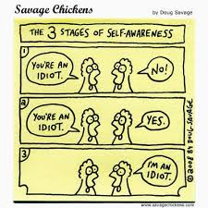
Increase your awareness of yourself and others
Notes:
Incorporating all of those tips we previously mentioned you really want to make sure that your increasing your awareness of yourself and of others. So this comic is just a silly reminder that we really need to better understand where we are and how others perceive us.
*Mentoring and communication
http://www.ohsu.edu/xd/education/schools/school-of-medicine/faculty/mentoring/mentoring-best-practices/communication/index.cfm
You are the instrument through which mentoring happens, both as mentor and mentee. The more you are clear about your own agenda and able to separate out your own thoughts, feelings, and wants from those of your mentor/mentee, the greater the potential for intentional partnership and mutual benefit.
"In each moment you spend in another person's presence, you are communicating that person's importance to you. Are you doing this consciously or unconsciously?" Denise Holmes

Slide 22

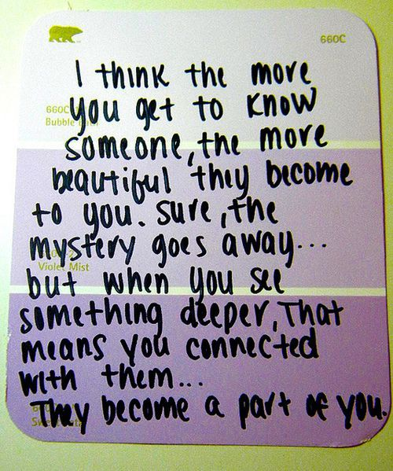
Get curious about the other person’s story
Notes:
Additionally, its important to get to know each other as people. Even though you’re both maybe epidemiologists there's more to you as a person than just your professional life. So we really encourage you to share where you’re coming from and where you’re wanting to go to better develop your relationship.
http://www.ohsu.edu/xd/education/schools/school-of-medicine/faculty/mentoring/mentoring-best-practices/communication/index.cfm
Listening in order to learn something new (rather than to confirm what you already know) is essential to good mentoring. When you get curious about the other person’s story, you open up the possibility of greater connection and value for both parties.
"In order to understand what another person is saying, you must assume that it is true, and try to imagine what it could be true of." George Miller
http://www.dtelepathy.com/blog/wp-content/uploads/2012/10/featureimage.jpg

Slide 23
Barriers to Effective Communication
Defensiveness or premature assumptions
Judgments based on cultural differences or interpersonal relationships
Mixed messages
Notes:
So as mentioned before there are some barriers to effective communication such as defensiveness or premature assumptions, judgements based on cultural differences or interpersonal relationships and mixed messages. So make sure you are approaching this relationship with an open mind and really asking those clarifying questions instead of making assumptions or jumping to conclusions.
http://www.ohsu.edu/xd/education/schools/school-of-medicine/faculty/mentoring/mentoring-best-practices/communication/communication-barriers.cfm
Defensiveness or premature assumptions
Problem: A defensive listener will be less able to "hear" what the speaker is saying. In some cases, instead of listening, a person is thinking about why an interaction is occurring or perhaps preparing a response to a message that he or she hasn't heard. By making assumptions about the speaker and the reasons that a conversation is taking place, the listener keeps him/herself from paying attention to the real message.
Solution: The listener should not presuppose that he or she knows the reason for or the basis of the communication, nor should the listener feel defensive without knowing what is being said. Being open and nonjudgmental will allow the listener to truly hear what is being said.
Judgments based on cultural differences or interpersonal relationships
Problem: This problem goes hand in hand with that of making assumptions. In this case, the problem involves presupposing things about another person based on cultural differences and personal associations. This can result in not hearing a message or misinterpreting the message.
Solution: It's important for the speaker and listener to be open with each other to dispel assumptions and biases. For this to happen, it may be useful to address biases straight on in an open dialogue. By revealing and discussing biases and assumptions, it is possible to minimize their negative impact and thereby communicate more fully and effectively.
Mixed messages
Problem: A conversation that conveys contradictory messages or conflates the intended message with extraneous issues can cause confusion, concern, or resentment.
Solution: Before speaking, people should think carefully about the points to be made. Written talking points can be useful in this regard. If there are multiple messages to convey (perhaps some positive and some negative messages), it may be better to present them on separate occasions or in different environments. Conveying only one message at a time can help avoid confusion and misunderstanding. [ds1]If at all possible, this kind of formatting works best in definition list style. We may want to talk about it. [KWM2]Sure. I'd like to see what it is. I think this is hard to read as it is…

Slide 24
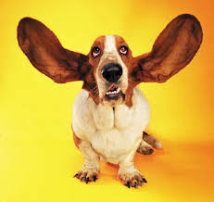
Listen for passion and potential
Notes:
Additionally in your conversations, we encourage you to listen for passion and potential to better understand your goals and expectations as well as to tailor advice and recommendations.
http://www.ohsu.edu/xd/education/schools/school-of-medicine/faculty/mentoring/mentoring-best-practices/communication/index.cfm
Great mentoring means understanding what makes the other person tick, what has brought them to this moment in their career, and where they would like to go next.
"Listening for potential means listening to people as if they have all the tools they need to be successful, and could simply benefit from exploring their thoughts and ideas out loud." David Rock
https://media.licdn.com/mpr/mpr/shrinknp_400_400/p/8/000/234/004/386bf30.jpg

Slide 25
Active Listening Strategies
Maintain eye contact with the speaker while he or she is talking
Avoid distractions
Stop all other activities
Pay attention to what the speaker is saying
Ask for clarification
Summarize what the speaker has said
Pay attention not only to the words but also to the feelings behind the words.
  By referring to the speaker’s feelings “It seems that you are angry about…”, you can make it clear that you understand what the speaker is saying and also understand the speaker’s feelings about the topic.
Notes:
Here are some other active listening strategies. I’ll just highlight a few. Make sure you avoid distractions or multitasking when you're communicating with one another. Ask for clarifications if you're unclear. And really pay attention to not only the words being said but if there are feelings behind those words, this can be much clearer when your in person or talking on the phone but muddled in written communication, so make sure you address any feelings you perceive in an email to ensure that you’re not misunderstanding your mentor or mentee.
http://www.ohsu.edu/xd/education/schools/school-of-medicine/faculty/mentoring/mentoring-best-practices/communication/active-listening.cfm
Active listening is an art that can be learned. Often, when you listen to another person speak, you are listening to some extent but you can also be distracted and engaged in other pursuits –thinking about something else, looking around, typing, listening to others, reading, etc. Sometimes, you assume that you know what the speaker is going to say and you start to formulate a response, rather than paying complete attention to what they are saying in the moment. Active listening involves forgoing all other activities for the time being and giving your full attention to the act of listening to ensure that you understand the speaker's intent as well as the feelings behind the speaker's words.

Slide 26

Share your own crystallized experience
Notes:
Additionally, we really want you to share your experiences and consult from what you’ve learned personally and through the experiences of others, so definitely open up and share from your experiences.
http://www.ohsu.edu/xd/education/schools/school-of-medicine/faculty/mentoring/mentoring-best-practices/communication/index.cfm
One of the pleasures of mentoring is the chance to share one’s own hard-earned experience so that it might be helpful to others coming along a similar path.
"Ecologists tell us that a tree planted in a clearing of an old forest will grow more successfully than one planted in an open field. The reason, it seems, is that the roots of the forest tree are able to follow the intricate pathways created by former trees and thus imbed themselves more deeply. This literally enables stronger trees to share resources with the weaker so that the whole forest becomes healthier. Similarly, human beings thrive best when we grow in the presence of those who have gone before." Parks Daloz
http://www.jokesmania.com/wp-content/uploads/2015/12/share4.png

Slide 27
Discussion Topics
Manage conflict within the office or unit
Career progression
Networking
Influencing others
Managing politics in the office and organization
Newest trends in technology
Time management
Work/life balance
Leadership development
Notes:
As I mentioned earlier, in the newsletters we will mention different discussion topics so here are some examples of potential discussion topics we may cover during the year.

Slide 28
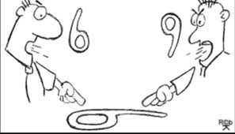
Be aware of your own assumptions
Notes:
As you are working through these discussion topics make sure you are aware of your own assumptions and the unique perspective that you bring to the conversation.
*Mentoring across differences
http://www.ohsu.edu/xd/education/schools/school-of-medicine/faculty/mentoring/mentoring-best-practices/mentoring-across-differences/index.cfm
In the same way that others may have different points of view because of differences in their life experiences, you likely have been shaped by your gender, race, social class, education, generation, geography, and a multitude of other cultural influences. Increasing your awareness of the ways you are a product of your past can help you avoid assuming that others see the world in the same way.
https://media.licdn.com/mpr/mpr/AAEAAQAAAAAAAARRAAAAJDcyZDI3MDk0LWFkYTktNDg1ZS04NTY4LWQ0M2ZmMmYxMTc0Yw.png

Slide 29
Basecamp
A platform for program participants to connect with each other to share resources, ideas, and discussions.
Components
  Campfire
    Sent to everyone in the Basecamp
  Message Board
  To-dos
  Schedule
  Docs & Files
Notes:
So moving on from the tasks, I wanted to quickly review basecamp which is an online community platform that we will be using throughout the program. If you are already in the basecamp, you may have received some notifications today with the a reminder about today’s orientation and todays slides. If you have not yet joined basecamp, the link to join will be sent out with the next newsletter. If you have already joined, feel free to open up basecamp and follow along with me.

Slide 30
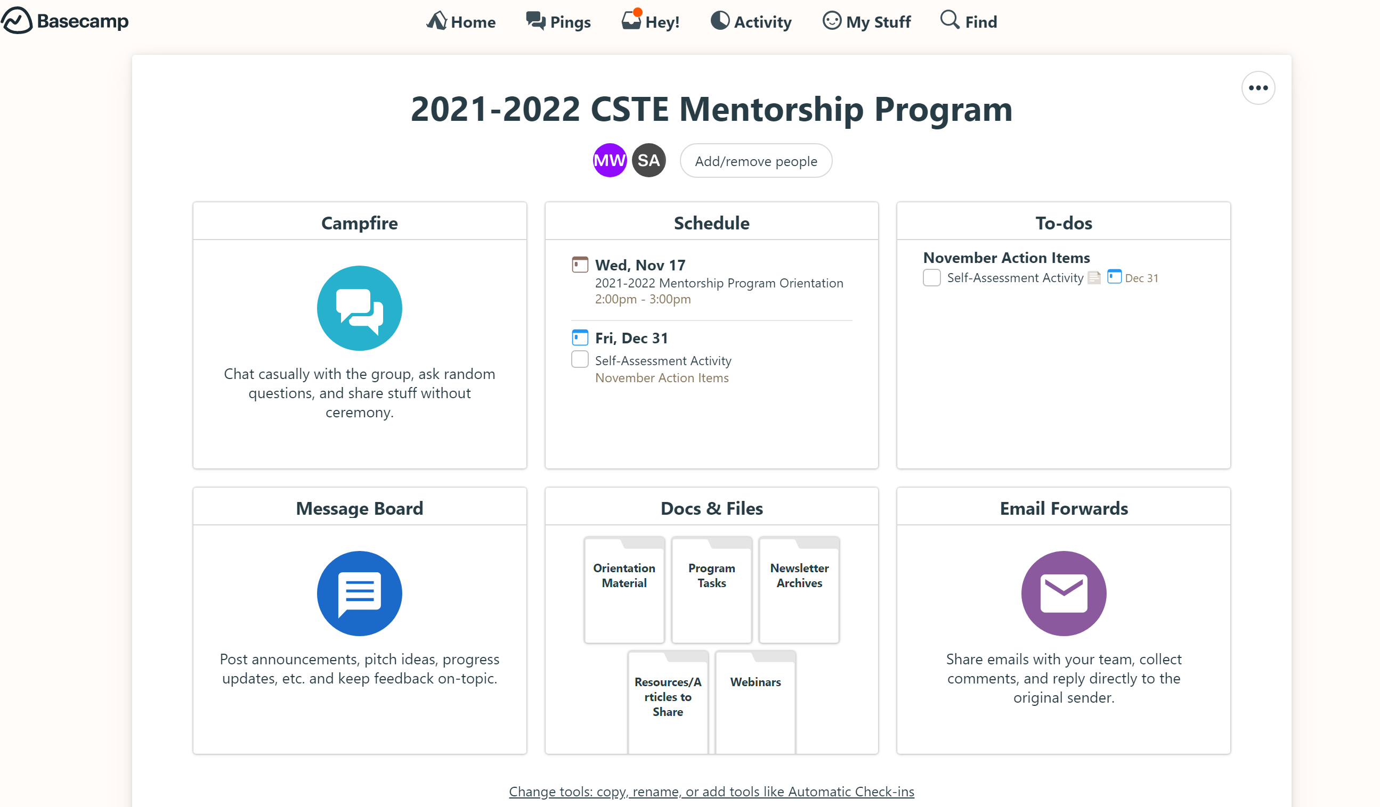
Notes:
So this is what the home page of the basecamp looks like

Slide 36
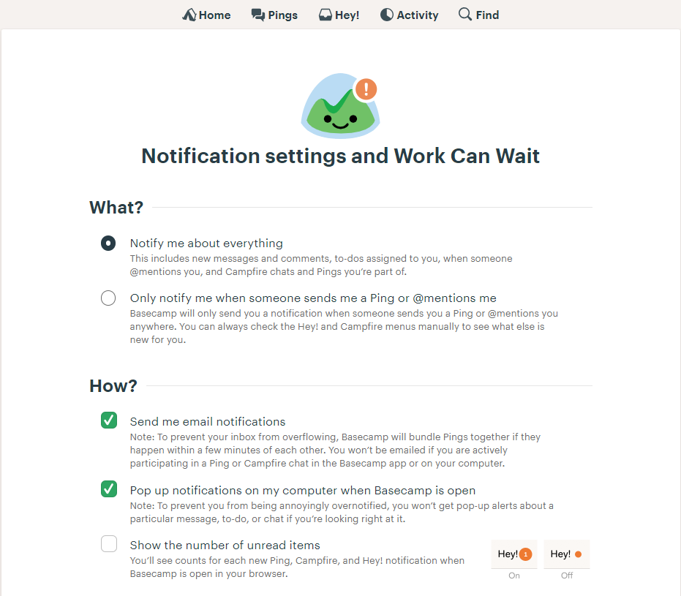
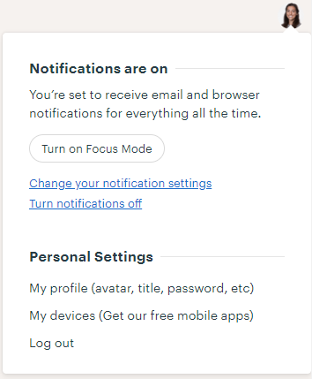
Basecamp
Managing notifications
Step 2
Step 1
Notes:
So basecamp will send you emails any time there is activity on the page and this can be sometimes confusing (for example, you may reply to an email that you think is going to one person but you’re actually posting on the message board). So my recommendation with basecamp is to use the basecamp website, not the emails. It is very easy to just bookmark the page and periodically check the site and its very user friendly when you're on the actual webpage.
So if you are periodically checking the basecamp site, this is how you turn off your email notifications.

Slide 37
Basecamp
Managing notifications
Step 2
Step 1
Notes:
You will click on your picture at the top right of your screen and you will see the drop down menu under step 1. You can select to turn off all notifications or to change your notification settings. If you select change notification settings….

Slide 38
Basecamp
Managing notifications
Step 2
Step 1
Notes:
If you select change notification settings, you’ll be taken to a page that you can see here under step 2. You will see the default is to notify me about everything, and you will want to change it to “only notify me when some sends me a ping or @mentions me” So this means someone is trying you get your attention so it would be good to keep email notifications on for that.

Slide 39
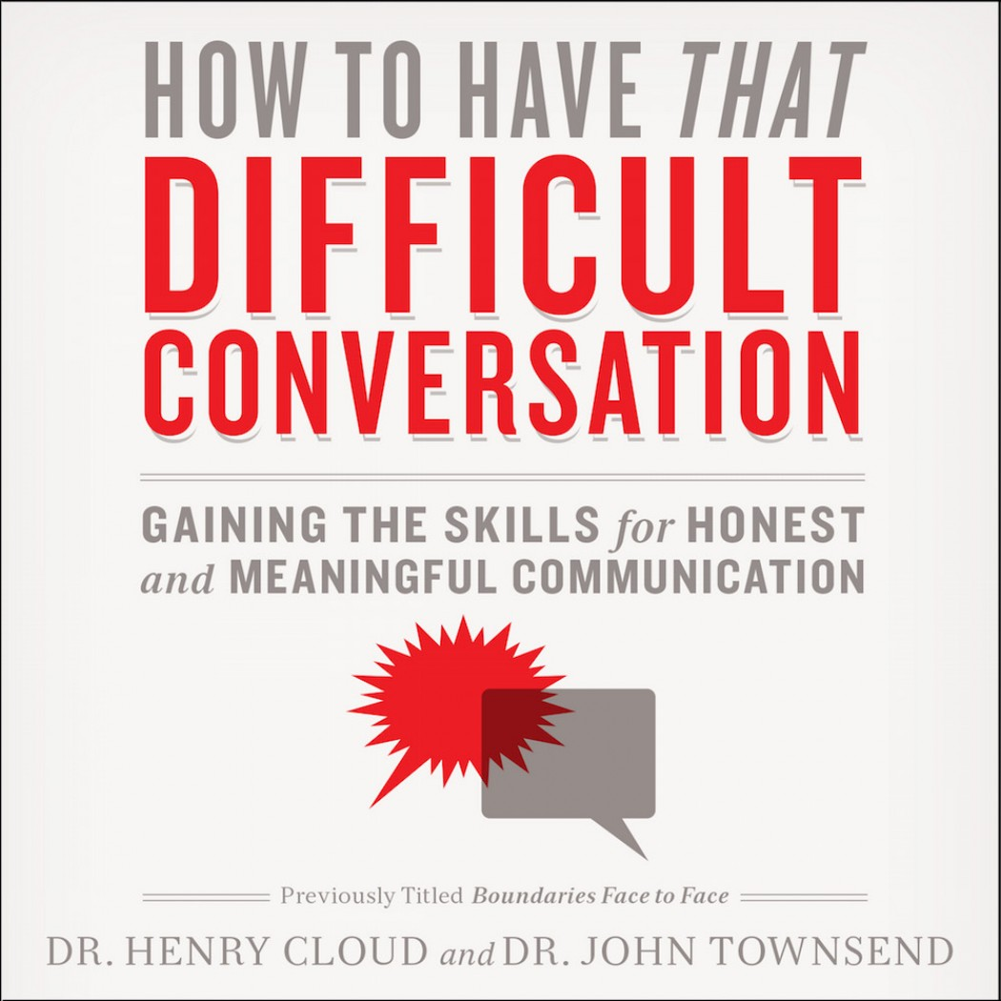

Address differences openly
Notes:
Additionally you'll want to make sure you address any differences openly. We understand you may be put in a situation where you feel it’s a difficult conversation and you don’t know how to respond and that’s fine you’re welcome to consult with me or Symone and we’ll help you work through those differences.
http://www.ohsu.edu/xd/education/schools/school-of-medicine/faculty/mentoring/mentoring-best-practices/mentoring-across-differences/index.cfm
Relationships in which it becomes comfortable to talk about and acknowledge differences have much greater potential value for both mentor and mentee. While it may initially feel uncomfortable to talk about topics such as race, gender, and/or socioeconomic background, the potential for increased understanding and connection makes it worth the risk.
https://adobe99u.files.wordpress.com/2014/07/cringe.jpg?quality=100&w=550&h=273
http://christianaudio.com/media/catalog/product/cache/1/image/1050x1050/170ec19af00183b5e0368529fc2daa2f/9/7/9780310342564.jpeg

Slide 40
If things aren’t going as you expected, what do you do?
What is the challenge?
  Interpersonal or task-oriented
What can you do to improve the situation on your own?
  Did it work? If not, what other options are available?
Let CSTE know about your challenge
  CSTE can only address challenges if we are aware of them
Notes:
So what if things aren’t going as planned. We hope this wont be the case for most participants but we understand that life happens and if your not having a good experience, think about is it an interpersonal or a task-oriented challenge and how could you address it on your own. If you cant address it on your own what other options do you have available? If you challenge is related to the mentorship program definitely let us know as we can only assist you if we are aware of the issue.

Slide 41
FAQs
Are mentors required to attend the webinars sponsored by the Early Career Professionals workgroup?
Will CSTE be available to provide additional support and resources to mentors and mentees if requested?
How can mentors connect to share ideas and resources amongst themselves?
Notes:
I wanted to go over a few common questions I’ve received and then open it up to you all for additional questions, so first…
1. So we encourage both the mentor and mentee to attend the webinar so that you all can discuss the webinar together. Perhaps the mentee has additional questions or maybe the mentor has a different perspective to share than what was shared in the webinar.
2. Yes we are happy to support you as much as we can whether that’s connecting you with other subcommittees through CSTE or other subject matter experts we’ll do what we can to make those connections. Just send that request via email.
3. We will schedule a mentor peer-to-peer call to give mentors a chance to check-in with one another and share strategies or any resources they’ve found useful. So we’ll try to set this up a couple months into the program to give you all a chance to get that mentoring experience first.

Slide 42
Q & A
What questions do you have?
What would you like to discuss with the other mentors and mentees on the phone today?
What else can CSTE provide to support your participation in the mentorship program?
Reminders:
  Complete webinar evaluation as you exit
  Send any questions, comments or concerns to Sarah Auer (sauer@cste.org)
Notes:
So now we have to rest of the time to take questions from you so post any questions you have in the chatbox. You can also post in the chatbox any ideas you have for additional ways CSTE can support you in this program.

Slide 43

CSTE National Office
2635 Century Blvd, Suite 700
Atlanta, Georgia 30345
770.458.3811
770.458.8516
Sauer@cste.org

