Slide 1
2021 CSTE Annual Conference
CE Overview

Slide 2
Why CE?
The educational purpose of the CSTE Annual Conference is to offer professionals and practitioners the opportunity to enhance their knowledge, improve their skills, and exchange information on best practices and strategies in applied epidemiology.

Slide 3
History
Conference Year | Provider | CE Offered | Cost | Eligible Sessions
2016 | NBPHE | CPH | $10 | Entire Conference
2017 | CDC | CME, CNE, CHES, RACE, CPH, CEU | Free | Workshops, Plenaries, & Breakouts
2018 | APHA & NBPHE | CME, CNE, CHES, RACE, CPH | $25 | Workshops & Plenaries
2019 | CDC | CME, CNE, CHES, RACE, CPH, CEU | Free | Workshops & Plenaries
2021 | CDC | CME, CNE, CHES, RACE, CPH, CEU | Free | Workshops & Plenaries

Slide 4
Important Dates
Date | Activity
Jan 14* | Workshop descriptions due
April 2* | Disclosures for all speakers due
May 12 | Submit application for preliminary review – all confirmed speakers should have all documentation
May 28 | Last day for any speaker changes
*There is some flexibility with the deadline for CE purposes

Slide 5
Conference Learning Objectives
Identify at least 3 best practices in applied epidemiology.
Describe at least 3 best practices for surveillance and epidemiology.
Apply at least 2 public health practice skills presented in workshops.
Identify at least 2 strategies and tools to improve public health practice.
Articulate the importance of interdisciplinary collaboration for applied epidemiology.

Slide 6
Workshops/ Plenaries
Abstract/session description
  Pulling from conference spreadsheet
List of speakers with degrees, title, and employer
  Will be cross checked with biodisclosures
  Add just the name to your session in the conference spreadsheet
Staff are responsible for collecting the forms from their speakers. Workforce Team will contact the presenter directly for any changes to the form. Staff should notify the Workforce Team for any speaker substitutions or changes.

Slide 7
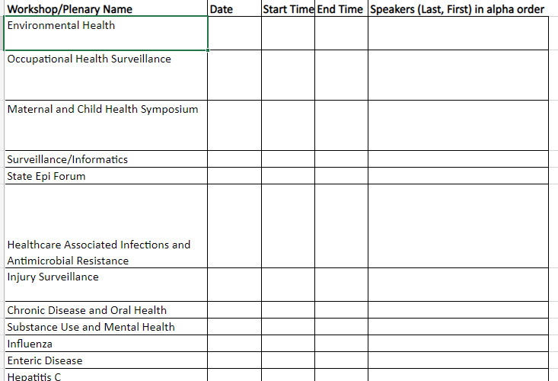
List of Speakers
In the Conference Spreadsheet, add your list of speakers we should receive a form from for your workshop/plenary

Slide 8
Biodisclosures
Planners – CSTE EB members, CSTE Staff Leads, CDC POC
  NEED MD, Vet, CHES, and general contact from CDC as planners
Speakers – plenaries and workshops
  Must have forms for all confirmed speakers by April 2nd
    Some flexibility with outstanding speakers through May 12th (final review)

Slide 9
Where are the biodisclosure forms located?
https://cste.sharepoint.com/:f:/s/csteworkforce/ErAlDIfe2WFEsZyx3JGZqaMBI3Pk30XB6dqUiXv3lBKmRw?e=VzdFej

Slide 10
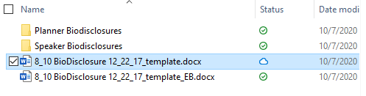
Which form should I use?

Slide 11
Where should I save the planner forms?
Only submit word files
Files should be named: Last_First Initial
https://cste.sharepoint.com/:f:/s/csteworkforce/Ek2tN2OhvPRNjOfCHje8CJ4BKh1ZDjULecy2Agg_cSmXIw?e=Xh9fOG

Slide 12
Where should I save the speaker forms?
Only submit word files
Files should be named: Last_First Initial
https://cste.sharepoint.com/:f:/s/csteworkforce/EstPw4vcRP5Gn36FYq-WzckBhwreLq6CynAQ5kfu44ckfw?e=x8baFA

Slide 13
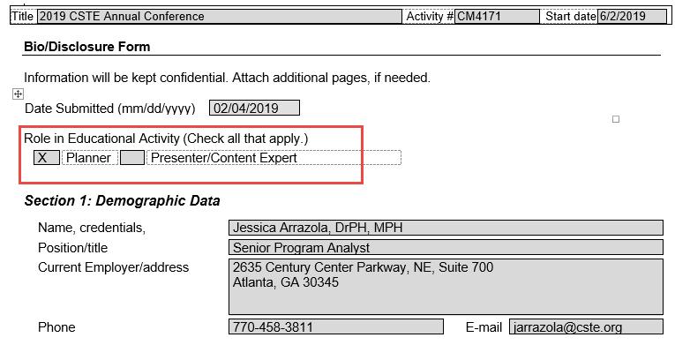
How do I complete the form?
Select the appropriate role; if planner and presenter check both

Slide 14
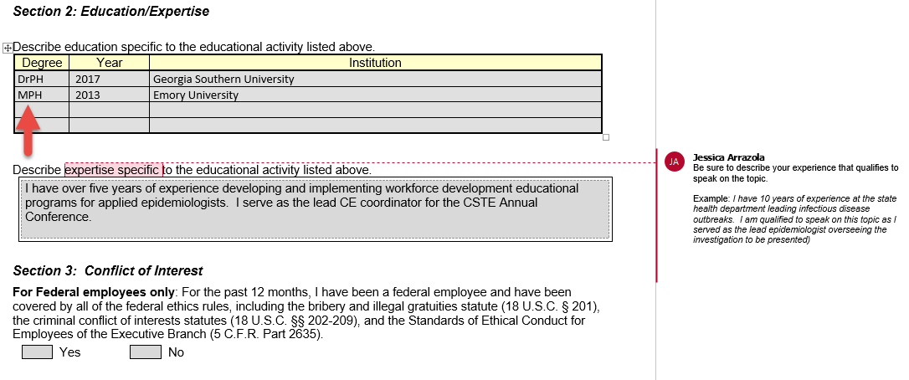
Section 2: Degrees must match those listed under credentials in section 1 and at signature
Section 2: All speakers must describe their expertise as relevant to the presentation
Section 3: Conflict of interest – if a federal employee but not employed for 12 months, they still answer YES

Slide 15
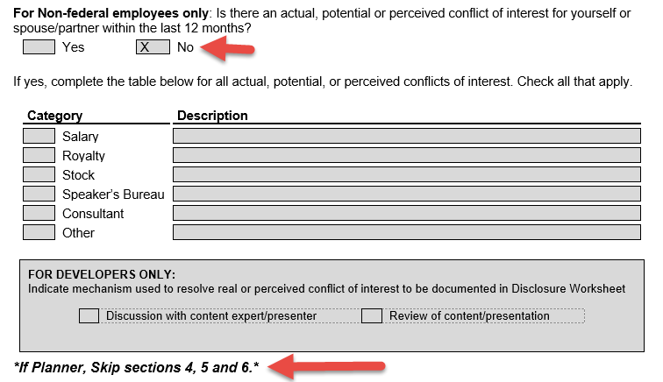
Section 3: Non-fed employees should select “no” unless there is a Conflict of Interest
If planner only – stop here

Slide 16
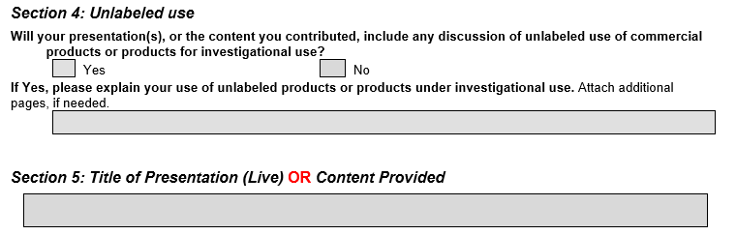
Section 4: 99.9% say no
Section 5: Title of workshop/ Title of plenary presentation

Slide 17
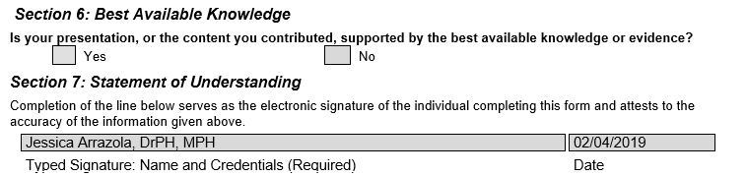
Section 6: “YES” should be selected
Section 7: typed or electronic signatures only; credentials must match section 1 & 2

Slide 18
Questions?
Slides will be posted to basecamp.

