Slide 1
emPOWER in Los Angeles County
2017-Now
Elizabeth Rubin, MPH
Brandon Dean, MPH
May 10, 2022
Los Angeles County Department of Public Health
Health Protection Bureau
Emergency Preparedness and Response Division

Slide 2
Outline
emPOWER overview
LA County use cases
Receiving, processing, and sharing data
emPOWER during COVID

Slide 3
What is the emPOWER initiative?
Federal data initiative
US Department of Health and Human Services
  Office of the Assistant Secretary for Preparedness and Response
    Program Manager: Kristen Finne
  Centers for Medicare and Medicaid Services

Slide 4
Who is in your community and what are their needs? emPOWER helps us to:
Better understand how many individuals are at-risk and rely upon electricity-dependent medical and assistive equipment and healthcare services
Better understand, assess, and mitigate the disaster-induced stress and impact on:
  The LA healthcare system
  Health outcomes (deaths, illnesses, etc.) on at-risk populations of LA

Slide 5
emPOWER Data: Medicare Overview
emPOWER data: Medicare beneficiaries
Medicare insures 55 million Americans
  65+ years, blind, disabled adults, and children
  Dialysis-dependent end-stage renal disease population
  Medicare beneficiaries may reside in personal homes, residential or long term care facilities, assisted living communities, etc.
May 2018 Data

Slide 6
Medicare Overview
1.5 million Medicare beneficiaries reside in Los Angeles County
April 2022 Data

Slide 7
emPOWER Datasets
2 Types of Data Sets:
Unrestricted (De-Identified) Data
HHS emPOWER map
  Publicly available, web-based interactive map
HHS emPOWER Emergency Planning Dataset
  Available through state or local public health authority
  Zip code level counts for the DME services
Restricted (Individual, Identified) Data
HHS emPOWER Emergency Response Outreach Dataset
  Individual names and addresses
  Can only be requested by a public health authority

Slide 8
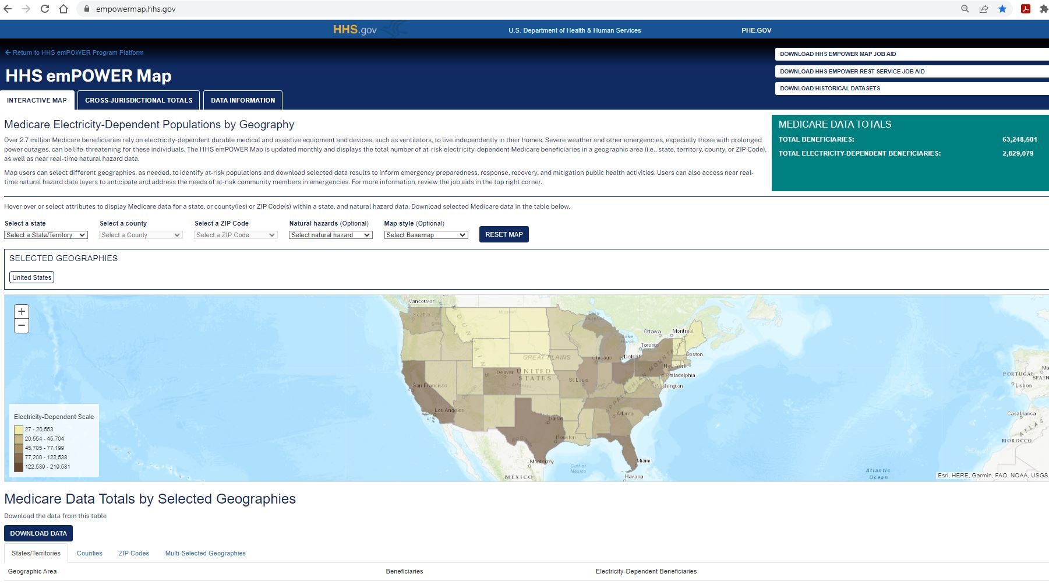
emPOWER Datasets (De-Identified)
HHS emPOWER Map – empowermap.hhs.gov

Slide 9
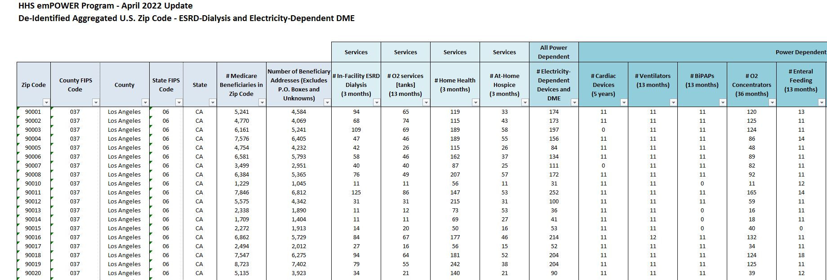
emPOWER Datasets (De-Identified)
HHS emPOWER Emergency Planning Dataset

Slide 10
emPOWER Datasets (Identified)
HHS emPOWER Emergency Response Outreach Dataset
Individual names and addresses
  Approximately 125,000 individuals in LA County Zip Codes
Can only be requested by a public health authority (LA County DPH)
Strict data sharing, tracking, and destruction requirements

Slide 11
emPOWER variables (Identified)
Name
Address
Date of Birth
Type of Medicare Plan (Fee for Service or Medicare Advantage
Medicare/Medicaid Dual Eligibility
Dialysis Facility name, address, and phone number
Home Health Agency name, address, and phone number
Hospice Care Provider, address, and phone number
DME Supplier name, address, and phone number
Oxygen Supplier name, address, and phone number
Recent institutional care facility name, address, and phone number
Yes/No for Services and DME:
Outpatient Dialysis
Oxygen Tank Services
Home health visit
At-Home hospice
Cardiac device
Ventilator
BiPAP
Oxygen concentrator
Enteral feeding tube
IV infusion pump
Suction pump
At-home dialysis
Motorized wheelchair or scooter
Electric bed

Slide 12
LA County use cases

Slide 13
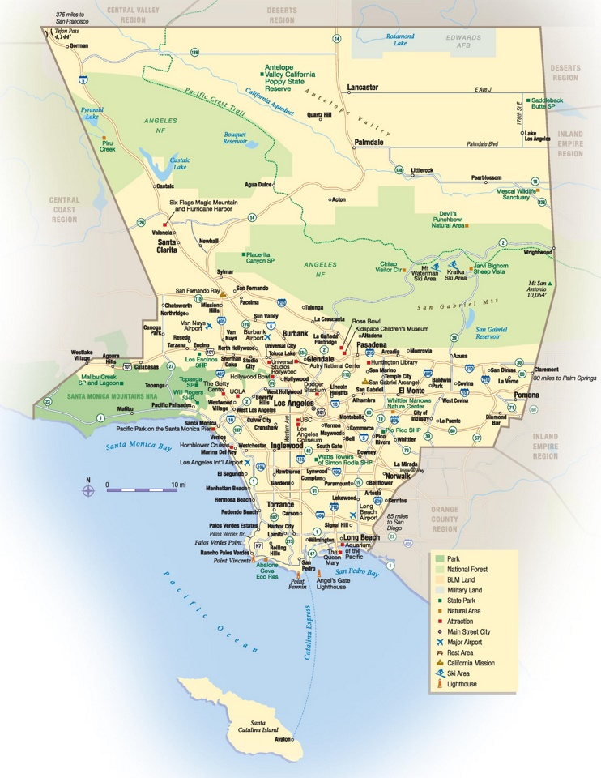
Los Angeles County
4,000 square miles
88 cities
10M+ residents
Urban and Rural
Highly diverse geographically and demographically
70 miles of coastline
Two mountain ranges
Two major ports
Notes:
-83 school districts
-100+ special districts/agencies
-60+ law/fire agencies

Slide 14
A Brief History of LA County Disclosure Requests
First request: December 2017
  Thomas/Skirball/Creek/Rye Wildfires
2018 (3 requests)
  Rain event; Risk of debris flows after wildfires
  Sativa Contaminated Water Incident
  Extreme Heat and Wildfire Conditions
  Public Safety Power Shutoff (PSPS) from electric utility
  Woolsey Fire response and recovery
2019 (3 requests)
  Rain/Debris flows after Woolsey Fire
  PSPS and wildfire conditions
2020 - COVID

Slide 15
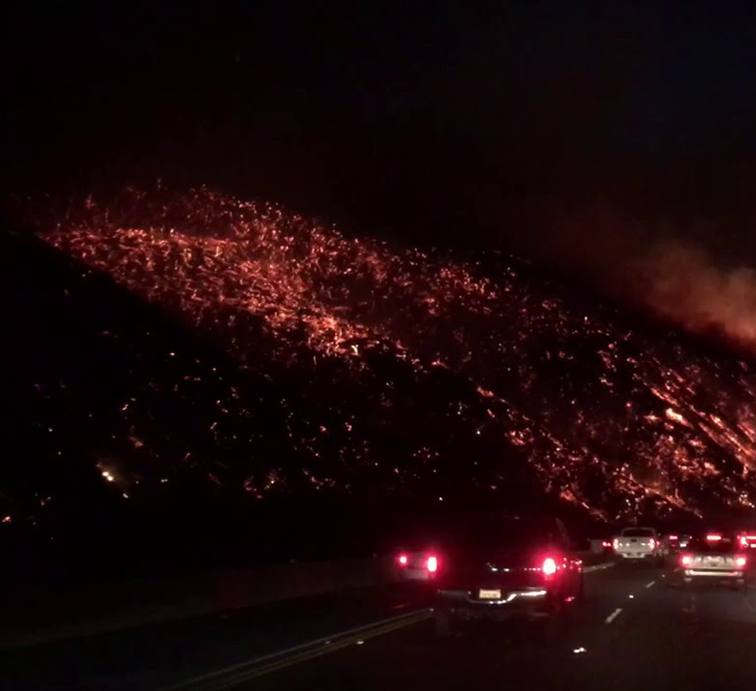
Wildfires
Mandatory/Voluntary Evacuation Areas
Response: Evacuation
emPOWER uses:
Identify emPOWER individuals in mandatory evacuation area
Notify Medical Equipment Providers
Photo courtesy of Brooke Yaeger

Slide 16

Water Contamination
Sativa Water District
Response: Door-to-Door Campaign, Water delivery
emPOWER uses
Identify emPOWER individuals in water district
One household with in-home dialysis and home hospice
Photo by Luis Tosta via Unsplash

Slide 17

Public Safety Power Shutoffs (PSPS)
SoCal Edison (electric utility) Circuits
Response: Home wellness checks; Notify Medical Equipment Providers
emPOWER uses
Identify emPOWER individuals in affected circuits
Contact information for Medical Equipment Providers
Photo by Fre Sonneveld via Unsplash

Slide 18

Receiving, Processing, and Sharing Data

Slide 19

emPOWER Disclosure Request Process
Delegated Authority
Filling out forms
  Cover Letter
  HIPAA Privacy Assurance
  DUA and DUA Addendum
  Request Form
  Secure Portal User Form
Photo by Christa Dodoo on Unsplash

Slide 20

Receipt and Data Processing
Acumen Secure Web Portal Access
  Set up access in advance
  Multiple users
  Keep passwords current
  Remember Download Password
  Csv and xls files
Download and Process Data
  Store locally for quick and secure access
  Internal data processing protocol
Photo by img.ly on Unsplash

Slide 21

Mapping and Sharing
Mapping
- Geocode and clean addresses
Remember HIPAA
  Address search engines
  Is your GIS HIPAA-compliant?
Share density/rasterized maps
Sharing
Minimum necessary data
  # of records
  # of fields
Secure data transfers

Slide 22
Protocols and Data Sharing Documents
Data Tracking Form
Dept Data Use Requirements
Standard Operating Procedure with City of Los Angeles
  Model for other cities
Internal Everbridge alerting protocol
Internal data processing procedure

Slide 23
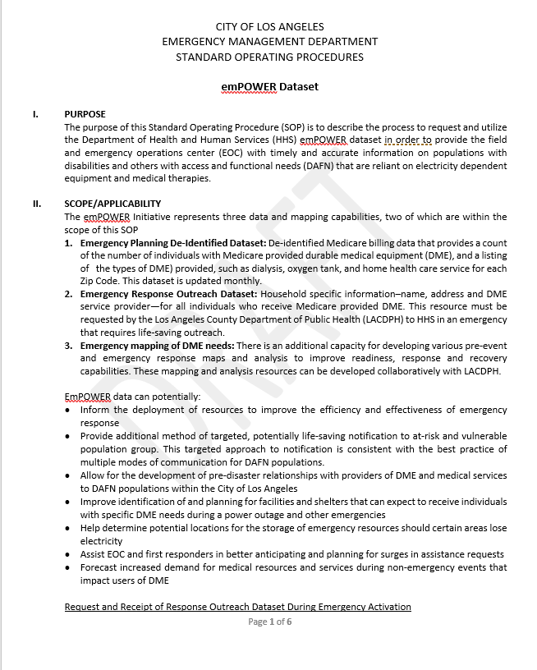
Formalize expectations and timelines for data request
Use/test yearly with City of LA
Formed basis of City of LA request for vaccine operations

Slide 24
COVID-19 Response: Timeline of Outreach (2021)
February
  City of LA makes request (to EPRD) of emPOWER data for Covid vaccine outreach
    Tier 1 Risk (Top 10%)
March
  City of LA begins homebound vaccine outreach
  9 other cities request (and receive) data: Beverly Hills, Glendale, Compton, Sierra Madre, Torrance, Montebello, Santa Monica, El Segundo and Arcadia
April
  5 other cities request and receive data
May – December
  Homebound vaccine outreach operations throughout the County
  December: City of LA: close operations

Slide 25
Thank you
We went to an older lady's house and explained [our purpose].
She said, "thank you." We thought it was a decline. But no, she was in tears because she was so grateful to receive the vaccine. She had adult children who live in the area, but they were all scared of getting Covid and didn't want to risk getting her or themselves infected.
Her brother had passed away in March (2021) of Covid because he didn’t receive a vaccine in time.
She cried and thanked us over and over because we "were like angels," arriving at the perfect time to get her vaccinated. She was 93 years old. This woman's smile and tears of happiness is something I will never forget. I love what we do.”
–Leslye, LAFD Homebound Vaccine Outreach

Slide 26
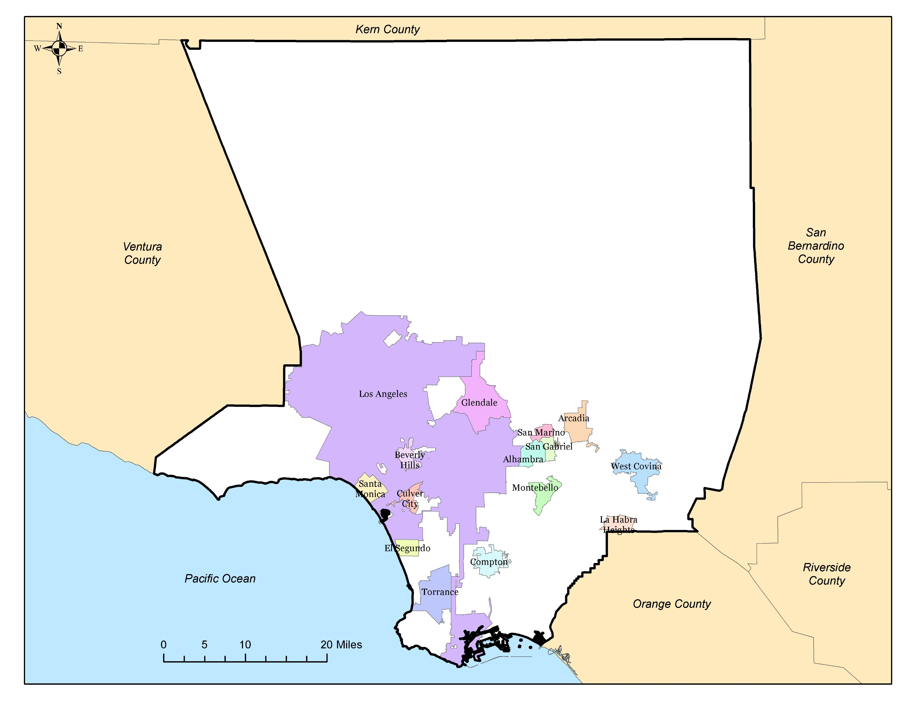
Participating Cities

Slide 27
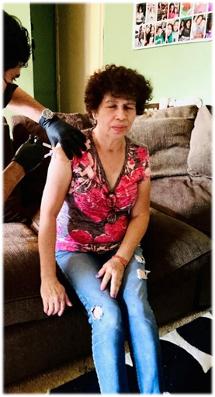
COVID-19 Response: Capacities, Strategies
Different cities, resources & strategies
  Los Angeles: Outreach teams; 30 teams; 5 days/week;
  Glendale and Torrance: Mailers, schedule outreach teams
  Montebello: Partner with fire dept and food bank; home deliveries
  Beverly Hills: Partner with cities “Nurse Outreach” team
  Compton: Direct people to community PODs & pharmacies

Slide 28
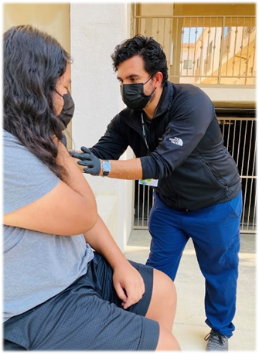
COVID-19 Response
DPH Support
emPOWER used to support and supplement Homebound vaccine efforts
Partner with fire agencies (expanded scopes)
Contacting: Resource intensive
  Phone #s
  Cross-checking other data sets
City of LA
  March - December: Daily operations; Phone and door contacts
  Contacted entire list (~70K)
  Vaccinated ~3% list: ~2,100 people

Slide 29
COVID-19 Response: Partner City Data
City | emPOWER Individuals (highest risk tier) | % Dual Eligible | City | emPOWER Individuals (highest risk tier) | % Dual Eligible
Alhambra | 1,101 | 69.94% | Los Angeles | 69,998 | 72.08%
Arcadia | 518 | 49.23% | Montebello | 1,322 | 67.1%
Beverly Hills | 557 | 30.70% | San Gabriel | 557 | 67.46%
Compton | 3,229 | 64.79% | San Marino | 105 | 17.14%
Culver City | 518 | 53.09% | Santa Monica | 1,045 | 60.0%
El Segundo | 78 | 23.08% | Torrance | 2,003 | 38.54%
Glendale | 4,297 | 86.46% | West Covina | 1,364 | 55.35%
La Habra Heights | 52 | 32.69%
Total High Risk Tier Data for Requesting Cities: 83,820; 70.50% Dual Eligible

Slide 30
Help People Like My Sister
I came across a home with three people living together. Two of them were homebound and in wheelchairs and the other was their caretaker. None of them had been vaccinated yet. I noticed the wheelchair ramp they had by their front porch and I thought of my sister. She had a stroke at the age of 20 and became wheelchair bound; she had a rainbow-colored wheelchair ramp at her home back east.
I explained who I was and the service that we were offering. They thanked me profusely for the opportunity to be vaccinated and for all that we were doing. As we talked, they asked me about the first thing that I did once I was fully vaccinated. I told them how I flew home to Connecticut and hugged my little sister for the first time in more than a year.
On days when I’m sitting in traffic, tired from driving all over, I think about what those people from a month ago must be like right now, having their family members over to their house for the first time in over a year. It’s the best feeling I’ve ever had in my life, and I’m so happy that we’re able to bring hope to the people in this city who need it the most.
–Danny, LAFD Homebound Vaccine Outreach

Slide 31
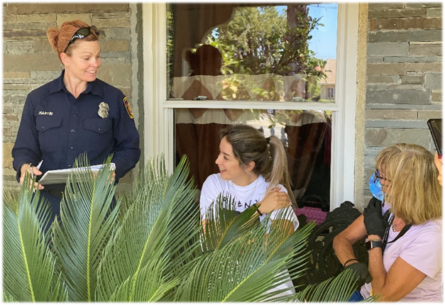
Next Steps
City Engagement
Re-engage with partner cities
“High risk” cities and geographies (fire, flood, debris flow)
  Glendale, Arcadia, La Habra Heights
Develop, exercise and improve SOPs with more partner cities
Phone Number Pilot Project
Access voter data (CDC approval)
Cross-walk with emPOWER
Develop targeted message scripts (Everbridge)

Slide 32
Lessons Learned
Get familiar with your de-identified data, socialize it among partners
Introduce the data to first response community
Build and maintain relationships
Have your legal team look at request package
Seek delegated authority to complete forms
Contact Kristen as soon as you have signs of need
Request the jurisdiction’s entire identified dataset
Deploy staff to EOC to oversee use

Slide 33
Lessons Learned
Identify analysts and get Acumen paperwork completed for data access
Alert your leadership, region, state, and HHS Regional Emergency Coordinator when request is made
Prepare to develop protocols and training for use
Use the data to help people in your communities who may be in need

Slide 34
Acknowledgements
Kristen Finne, HHS ASPR
Stella Fogleman, EPRD Director
Dee Ann Bagwell, EPRD Policy and Planning Unit Director
EPRD Policy and Planning Unit

Slide 35
Questions?
Elizabeth Rubin
erubin@ph.lacounty.gov
Brandon Dean
bdean@ph.lacounty.gov
Thank You!

