Slide 1
Incorporating Climate Related Health Impact Data from SyS into Emergency Preparedness & Response
2022 Disaster Epidemiology Workshop
May 10th, 2022
Notes:
Gabe will introduce herself

Slide 2
Outline & Objectives
What is Syndromic Surveillance (SyS) and where does this data come from?
  What kind of information can be monitored with SyS
  What were the initial objectives & how have they changed?
How can Syndromic Surveillance be utilized for tracking climate associated health impacts?
  Monitoring health impacts associated with climate change and extreme weather
  What are the advantages of SyS as a data source for this purpose?
  Existing tools & future directions
How can Syndromic Surveillance be incorporated into emergency preparedness and response?
  Incorporation of SyS data into a Jurisdictional Risk Assessment
  Situational Awareness & Evidence-based risk messaging
Notes:
Show Reed Timmer Adnover tornado footage to add interest – only 4 injuries (0 fatalities) – KS is no stranger to extreme weather.

Slide 3
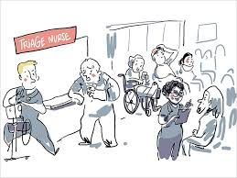
What is Syndromic Surveillance?
Near real time deidentified ED discharge data for the detection and rapid assessment of emerging health threats.
  The ability to search on free-text fields such as Chief Complaint or Triage Notes in addition to Diagnosis Codes allows for the monitoring of ‘syndromes’.
  Data is usually available within 24 hrs of the visit itself and includes demographic variables, admit date/time, etc.
Notes:
This makes this data set particularly valuable for situational awareness since you aren’t looking at old data. It also allows you to explore the circumstance of a visit which is rarely coded. Syndromic Surveillance is a pretty broad term and while I’ll be speaking primarily about healthcare services today (ESSENCE), it could also encompass purchasing patterns, search history, or social media.

Slide 4


History of Syndromic Surveillance
Syndromic Surveillance (SyS) was initially a tool for early identification of outbreaks
  Developed in 2001 in response to bioterrorism
  Has been used for regularly for surveillance of seasonal influenza.
State Adoption More Recently
  KSSP began onboarding in 2012
  Recent CMS requirement for ED data to be sent to Biosense Platform starting 2022 as a part of promoting interoperability
To protect and improve the health and environment of all Kansans
Notes:
Initially, the tool was focused on high-level syndrome based alerts. Nationally, we wanted to know if there was a sudden influx of cases in a specific region. Thus, the primary focus was the early detection of outbreaks. Because of data sharing and governance agreements unique to each sate, those doing national level surveillance do not have access to level of detail seen at the state level unless permission is granted for a collaborative project – and this is usually limited to a specific set of syndromes. The push for more states to adopt syndromic surveillance was slow as initially states had to maintain their own local instance of Syndromic Surveillance data. Data was limited to states in the NE directly affected terrorism concerns following the anthrax letters in 2001. With the creation of the Biosense Platform however, states could work with hospitals to send their data directly to a central platform and meet standardized DQ requirements while maintaining ownership of their data. Coverage has gradually increased over the past decade.
In 2012, KDHE was awarded its first 3-year funding from the CDC. The next several years were heavily focused on increasing the volume of participating facilities. With success, 60% of hospitals were submitting data and 78% of visits were accomplished. Between 2015 and 2019, the value of syndromic surveillance only continued to grow with access to line-level detail at the state level.

Slide 5
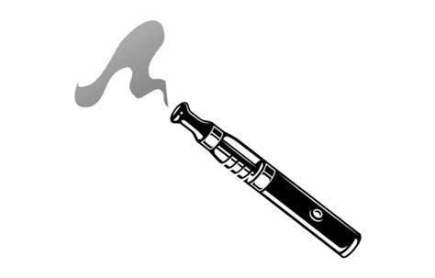
Other Use Cases
Beyond Outbreak Detection, Syndromic Surveillance can be used to monitor a wide variety of public health indicators in near real time including:
Overall trends in ED visit volume
Tracking Respiratory Virus Trends
Reportable Conditions
Suicide Related ED Visits
Drug Overdoses
Injury & Violence Surveillance
Mass Gathering Surveillance
Environmental Health Impacts (Heat, Cold, Air Quality, Weather Events)
Case Finding and Scope Determination for new health threats
  EVALI (Vaping Associated Lung Injury) or MIS-C (Post-COVID Multi-Inflammatory syndrome in kids)
Notes:
Use of Syndromic has expanded to many other program areas besides infectious disease since timely data allows public health to intervene more quickly. For example, during the initial COVID-19 lockdown we saw a significant decline in total ED visits. It was important to know if the pandemic was having any secondary consequences.

Slide 6
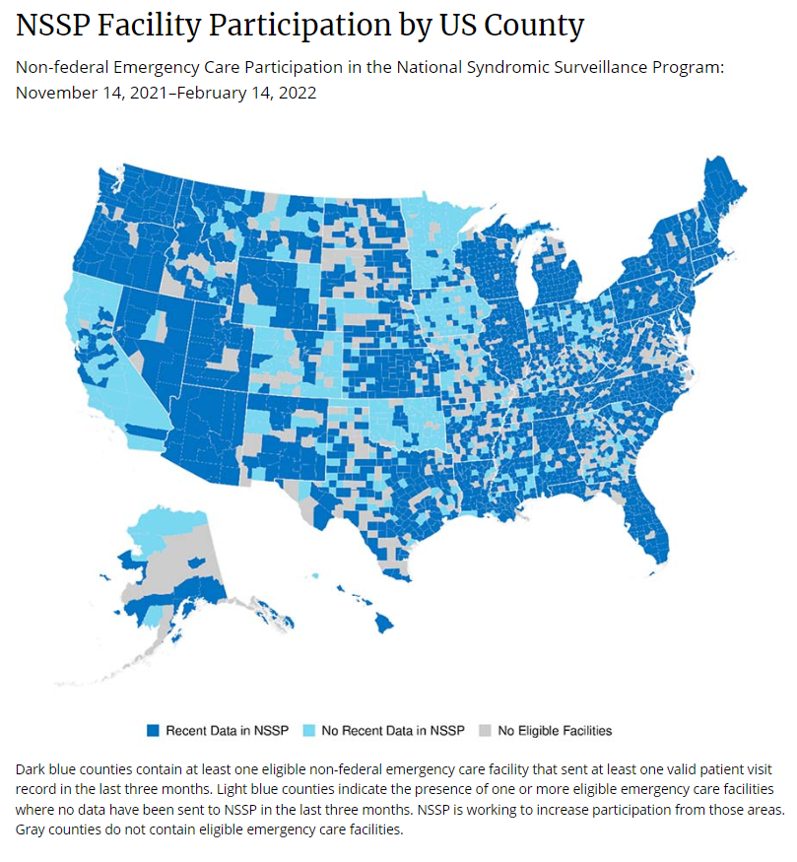
How does it Work?
Some states, like KS, work with hospitals to send data directly to the BioSense platform.
  Other states have their own local instance of Syndromic Surveillance where they collect data before it is sent on the NSSP
Data is still owned by the state
  At the national level, they can only view aggregate level statistics as opposed to the line level data we can see at the state level through an agreement with the hospital association.
  On certain occasions, NSSP or other states may request a data sharing agreement for a particular subset of visits.
Source: https://www.cdc.gov/nssp/participation-coverage-map.html
Notes:
You can see KS has pretty good coverage comparatively. You’ll notice the states who have only just begun onboarding because of the new promoting interoperability requirement. But it is safe to say, knowledge of SyS will be useful no matter where you end up. It’s use is only expanding to become an even bigger part of day to day health department operations.

Slide 7
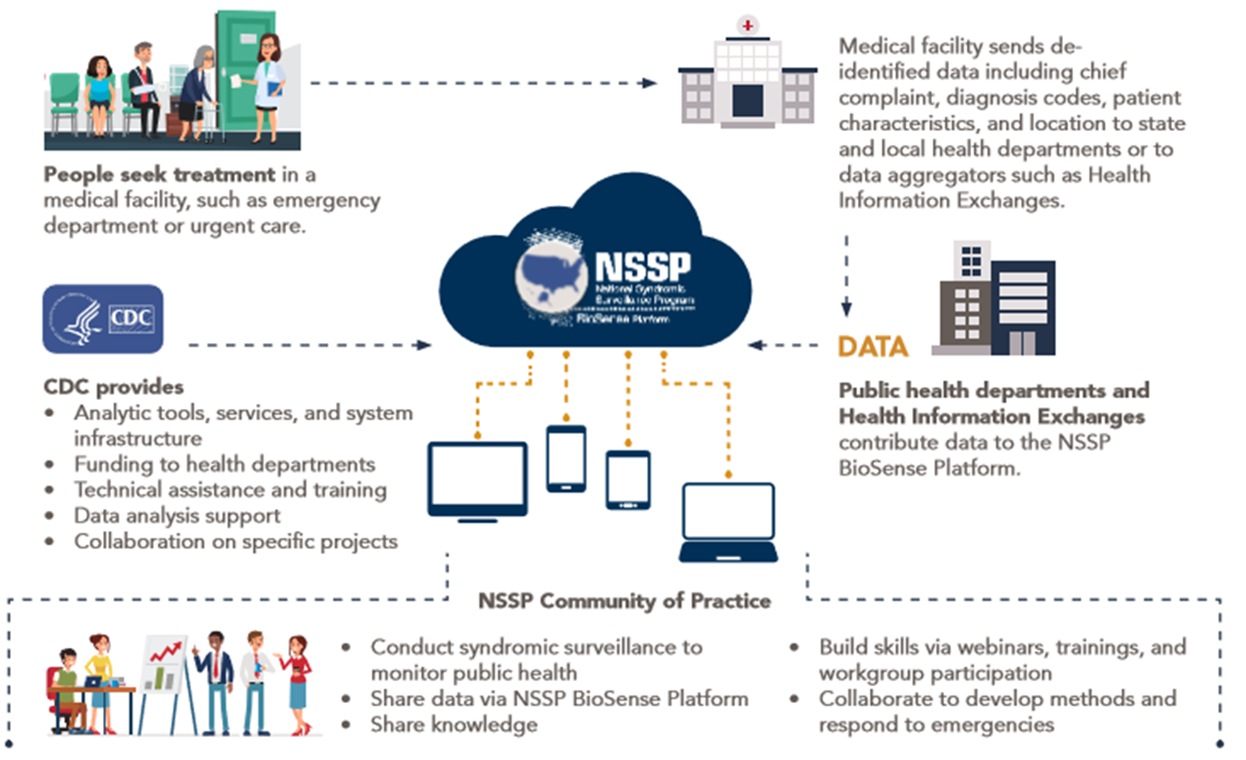
Source: CDC
Notes:
This is just an overview of how data makes it to NSSP and the tools available for analysis. Mention ESSENCE.

Slide 8
What is Disaster Epidemiology?
“The use of epidemiology to assess the short- and long-term adverse health effects of disasters and to predict consequences of future disasters” (CDC).
ESF#8 – Emergency Support Function #8 – Public Health and Medical Services
Why is it important?
  More specific information about disaster impact can help inform preparedness activities.
    Assessing Risk in terms of ESF #8 Capabilities
      Accurately targets preparedness funding
      Allows for timely intervention during an event
      Comprehensive & realistic plans and exercises
      Evidence-based risk messaging
Notes:
Most of us here probably know what disaster epidemiology is but it always important to revisit our goals. More specific information about disaster impact can help inform preparedness and response activities in the following important ways.

Slide 9
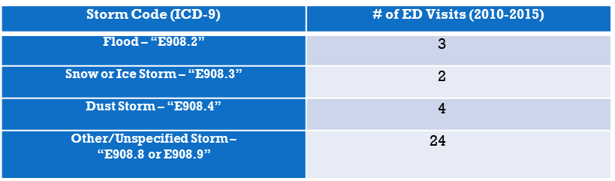
Gaps in the Data
As we know, there are limited data sources for morbidity related to extreme weather events.
Traditional datasets dependent on a diagnosis code have limited reliability:
Syndromic Surveillance can help fill the void – it allows use to query free-text fields like Chief Complaint
Notes:
This has unfortunately not improved with ICD-10 – maybe because events like these cause more indirect injuries.

Slide 10
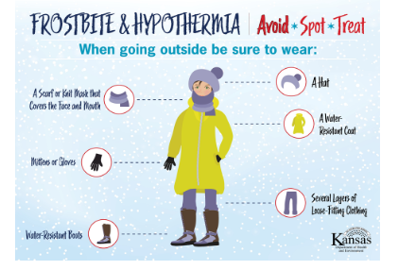
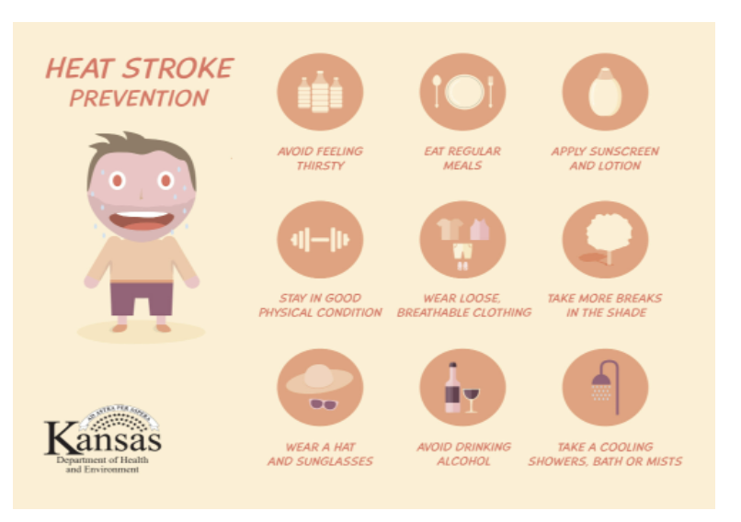
How is Syndromic Surveillance used for EPHT?
Environmental Public Health Tracking:
Cold Related Illness
Heat Related Illness
Air Quality & Asthma
Vector-Borne Disease
Chemical Spills
Snow/Ice Injuries
Wind Related Injuries
Severe Storms/Tornadoes
Carbon Monoxide
Power Outages
Notes:
Show EPHT site – these things can also be monitored over time to see if health impacts related to climate are increasing. These are examples of items in our social media toolkit. Mention Chemical spills and VBDs.

Slide 11
Working Group
KS- Extreme Weather Events Working Group:
Includes:
Syndromic Surveillance, EPHT, and Injury Epidemiologists
National Weather Service
Preparedness
Public Health Educator
Bureau of Health Promotion – Safe Kids
Meets every other month to discuss tracking needs, forecasts, social media campaigns, vulnerable populations, season preparation toolkits etc.
Notes:
At KDHE, something we do is have a bimonthly extreme weather events workgroup. We are no stranger to extreme weather so this helps us prepare for what is coming and put together the aforementioned materials. At the meetings we discuss vulnerable populations, trends, forecasts, and more.

Slide 12
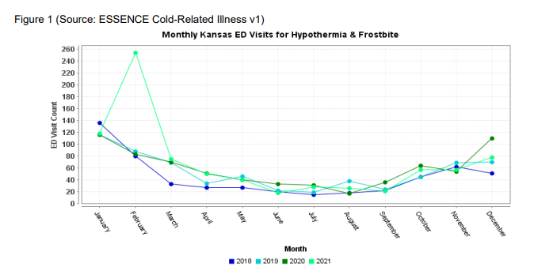
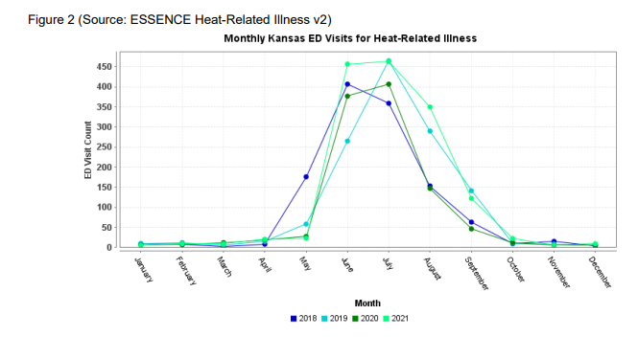
How is Syndromic Surveillance used for EPHT?
2021 was the worst since SyS began for both extreme heat and extreme cold
Notes:
You can see the big spike in cold related illness during the polar vortex last year. There was double the amount of visits we would normally see – and much more than we have seen in a long time. Less obvious, but last year also saw more visits for extreme heat. This is where Essence can be useful for tracking trends over time. It can tell a gripping story. In this way you can see if the impact was out of the ordinary.

Slide 13
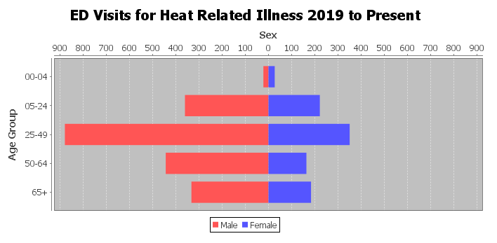
How can Syndromic Surveillance inform campaigns?
Which populations are most vulnerable?
Middle Aged Males working or exercising outdoors, such as postal workers & homeless populations
New definitions are currently being developed in ESSENCE for other vulnerable populations (mobility, visual , hearing, cognitive impairments as well as poverty, and those living alone)
Notes:
In looking at the data details – we could sometimes elucidate the circumstances of heat stress. For example, we saw a few visits by postal workers this past year. This can allow for really targeted interventions. One thing Kansas Does is ask that sanctioned outdoor groups keep a heat stress emergency plan and revisit it yearly. Mention new definitions, might even include occupation categories when we get that data.

Slide 14
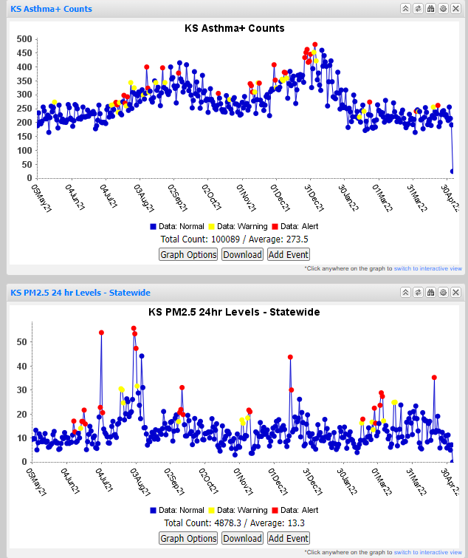
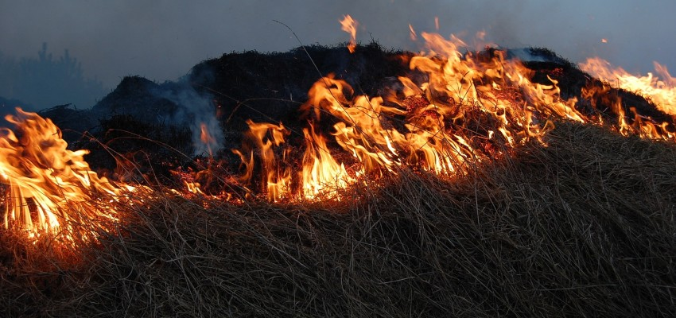
Air Quality and Asthma
We do tend to see peaks in Asthma related ED visits following a peak in PM2.5 levels
  More In depth analysis is needed, but we do put out warnings during prescribed burn seasons. The flint hills usually conducts it’s burning in the spring.
Source: KansasLivingMagazine.com
Notes:
You can see in the graphs on your lefts, that peaks in asthma ED visits tend to follow lower air quality. Our burning season is usually March to May and we usually put out warnings for those with lung conditions during this time, explaining why burning is necessary and how to keep safe.

Slide 15
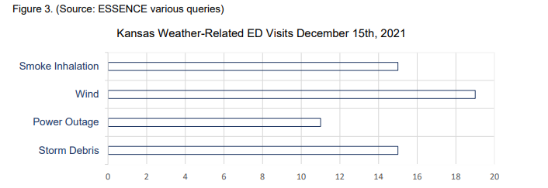
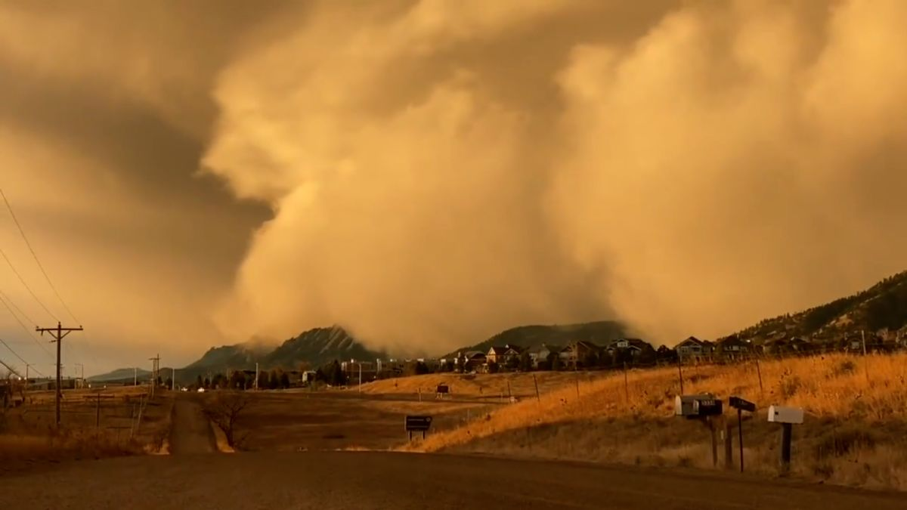
How is Syndromic Surveillance used for EPHT?
Extreme Wind, Dust Storms, Fires & Thunderstorms Dec. 15th 2021
Source: CNN – Tribune, KS
These numbers were provided to the State EOC – At least 60 total related ED visits
Notes:
Last December we had a particularly unusual conglomeration of weather events that led to activation of our state EOC. I was able to provide these numbers for the response effort. This was at the same time we were seeing a rapid rise in COVID-19 cases – making any stress on the healthcare system unwleocme. Wind related injuries included debris to the eyes, wind blowing doors shut on body parts. The wind was even so strong as to blow some people off their porches. We even wondered if tha inhalation of dust and smoke might make people more succeptible to COVID-19.

Slide 16
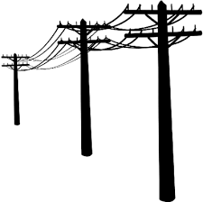
Power Outage Query
Power Outage Injuries:
Falls in the Dark
Electricity Dependent Medical Devices
Carbon Monoxide
All of these queries can be found in the KS – Weather Comprehensive Tab in the MyESSENCE library
Notes:
Will show the extreme weather events tab on ESSENCE. Power outage query is one I developed more recently – thinking of all the different ways to say the power went off. I’ve discovered some interesting things with it. For that particular Dec. 15th event I saw all of these. This is a reminder that ESSENCE data can contribute greatly to situational awareness and risk messaging. Free-text queries are obviously useful but can be very tricky to build. The snow and ice query was a particularly tricky one – had to exclude injuries being iced, feeling like ice, or mention of snow globes. Many words also contain ice like police or voice. I was able to get a pretty good KS definition for this.

Slide 17
Incorporating SyS into Emergency Preparedness & Response
Real time access to data detail helps to enhance Situational Awareness during a disaster.
  We recently conducted an exercise for a radiological event, and as part of that exercise we ‘checked-in’ with syndromic surveillance to make sure there were plans for involvement.
It can be useful not only during an event, but before an event as well:
  Information from previous events can contribute to risk-messaging and realistic plans or exercises.
  Given advantages over traditional morbidity data sources, Syndromic Surveillance can also be used to predict the health impact of future events, and assess or compare risk.
    Recognizing this, Kansas decided to incorporate SyS data into their most recent Jurisdictional Risk Assessment.
Notes:
Mention Atchison chemical spill. In a way, monitoring social media can be a form of syndromic surveillance. I think it is a good idea to incorporate SyS as an integral part of emergency response activities, especially at the state level.

Slide 18
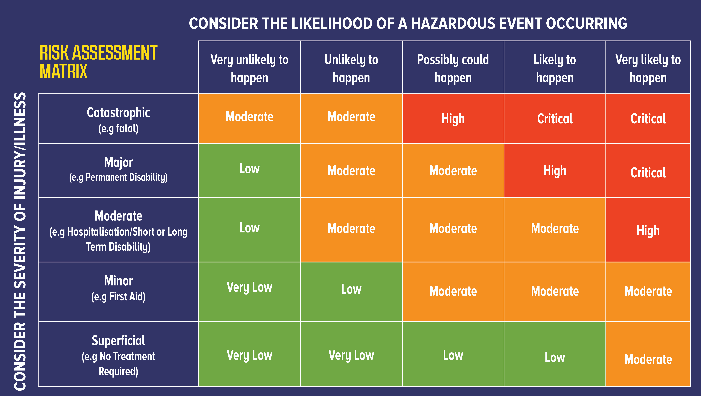
Incorporating SyS data into a Jurisdictional Risk Assessment:
A Jurisdictional Risk Assessment is an important and underutilized tool in emergency preparedness and an integral part of the Public Health Emergency Preparedness cooperative agreement.
  It ranks the potential hazards a specific jurisdiction faces by probability and potential impacts. This helps to prioritize resources and prepare more effectively.
Notes:
This chart is an example of the matrix usually used to rank a jurisdiction’s hazard. As you can imagine – while these risk assessments are supposed to be evidence based –analysis can be flawed due to limited data sources or the trap of using only recent events to assess likelihood. Metrics can be vague and anecdotal or rely on other jurisdictions. Recently, even more things go into the risk assessment including resources strain which has obviously been a big hinderance to COVID-19 response. Mitigation can also reduce risk – and this is a metric which has been explored more lately. For example a tornado will have greater consequence in a place without sirens/basements. A polar vortex will have greater consequence in Texas where there is not as great an understanding of cold weather hazards or how to prepare.

Slide 19
Jurisdictional Risk Assessment: Background & Methods
There has been a push to make this analysis more evidence based – anecdotal assumptions about impact can be flawed.
  Previous JRA’s in Kansas lacked detailed morbidity-related data.
  Traditional data sources for morbidity had limited reliability.
To remedy this, SyS queries in Kansas were developed to capture injury and illness related our top 3 hazards- Tornadoes, Floods, and Winter Storms
  Record-level data was reviewed for accuracy and categorized to describe the specific type of injury and illness related to each hazard in greater detail.
  SyS free-text queries were compared to diagnosis based queries.
Notes:
As we discussed earlier, traditional data sources for morbidity can be flawed. Kansas recognized the potential of SyS to fill this void.

Slide 20


Incorporating SyS data into a Jurisdictional Risk Assessment:
Diagnosis Code alone captured less than 10% of total Medical Impacts detected in ESSENCE. Analysis showed that winter weather had the greatest impact on the healthcare system.
KS Syndromic Data : 2016-2019
 | Diagnosis Code Alone: | Free Text Query: Direct Injuries | Free Text Query: Indirect Injuries
Tornadoes | 12 | 15 | 23
Thunderstorms | 23 | 50 | 30
Floods | 4 | 9 | 29
Winter Weather | 0 | 0 | 752
Notes:
You can see here that not only was diagnosis code missing indirect injuries which is more expected, it was also missing indirect injuries. A direct injury might be someone trapped in flood water for instance whereas mold exposure following a flood or a snake bite would be an indirect consequence. This data also showed that in terms of indirect injury we were greatly underestimating winter weather.

Slide 21
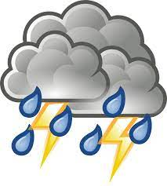
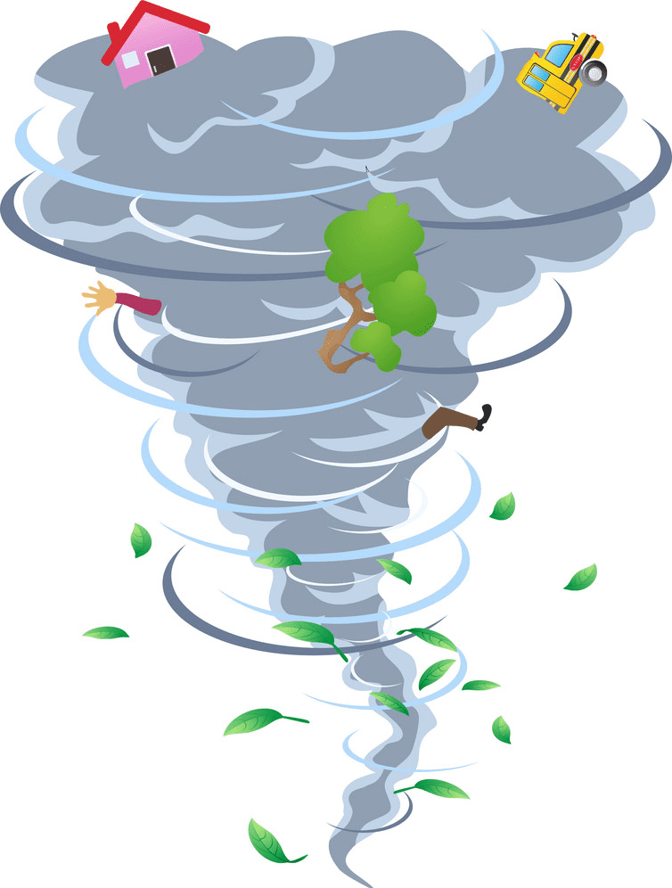
Additional Details for the JRA
Important detail captured in the free-text allowed us to understand the specific hazards associated with each type of severe weather:
Tornadoes & Thunderstorms
36 Lightning strikes
20 Direct storm injuries
18 Mental health or anxiety
9 Storm prep or debris cleanup injuries
8 Hail Injuries
7 Injuries while seeking shelter
6 Migraines
5 CO poisoning due to power outage
Notes:
By analyzing the free-text we are able to really see each of the individual hazards associated with extreme weather events. Listing this information in the JRA can be helpful as Kansas prepares to respond to future events. Some of these things, we have heard of anecdotally and we confirmed. To do this we had a student review line level data and bin the data into different categories.

Slide 22


Additional Details for the JRA
Flooding
9 Mold concerns
7 Injured in flood waters
(2 hypothermia)
5 Cellulitis or rash (3 general illness)
5 Mental health
5 Cleanup
2 Snake bites
Winter Weather
580 Slips/falls
58 Exposure (hypothermia/frostbite)
55 Snow removal (16 cardiac, 7 snow blower)
37 Winter sports (sledding, ice skating, etc.)
7 Motor vehicle accidents
3 Delayed medical treatments

Slide 23
Limitations & Future Directions
Limitations:
It was not always possible to link injury directly to a single event, particularly for winter weather.
Not all record level data is created equal – level of detail differs from facility to facility and provider to provider.
These counts are probably underestimates, particularly for categories like ‘migraine’ or ‘MVC’ which may not always be linked to the weather in a providers note.
Future Directions:
Analyzing identified injury or illness more broadly following a weather event could be valuable. For example – looking at trends in heart attacks after extreme heat or traffic accidents after winter weather. New queries are being developed for disability and vulnerable populations
Developing some sort of population-based risk metric for specific hazards to determine if risk is changing over time.
Event tracking and predictive analytics for future disasters – incorporation of other data sources such as social media.
Notes:
Disability definitions will include mobility, hearing and visually impaired, developmental delay, etc. Other vulnerable populations include homeless (there is a definition for this), poverty, and those living alone or in group homes.

Slide 24
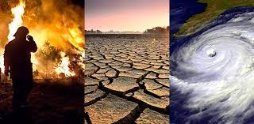
Conclusions
Syndromic Surveillance is probably the best existing tool to identify and understand the health impacts associated with changing climate.
Data can be provided to incident command, be monitored over time, and can even be incorporated into a jurisdictional risk assessment.

Slide 25


Kansas Syndromic: Sharing the ESSENCE
Thank you/Questions
Gabriel Ann Haas, MPH – KSSP Epidemiologist
gabe.haas@ks.gov
Bureau of Epidemiology and Public Health Informatics
Kansas Department of Health and Environment
KDHE.Syndromic@ks.gov
Find more information and resources on our webpage Search ‘Kansas Syndromic Surveillance Program’
To protect and improve the health and environment of all Kansans

