Slide 1
CSTE Disaster Epidemiology Subcommittee
Subcommittee Co-Chairs:
Tess Konen, MPH
Senior Epidemiologist
Minnesota Department of Health
Svetlana Smorodinsky, MPH
Disaster Epidemiologist
California Department of Health
CSTE Support Staff:
Andrew Adams, MPH
Senior Program Analyst
CSTE
Notes:
To bring together various disciplines of epidemiology to collaborate towards improving emergency preparedness and disaster response capacities
Work in emergency preparedness in some capacity
Sharing of lessons learned and expertise in order to build and expand disaster epidemiology field
Includes organizations and federal partners, we identify needs and work to fill those with resources/guidance
This is a cross-sectional subcommittee that enfolds all disciplines of epidemiology that relate to emergency preparedness and through lessons learned and developing guidance documents, we further the field of disaster epidemiology, always trying to add more details and tools to improve.

Slide 2
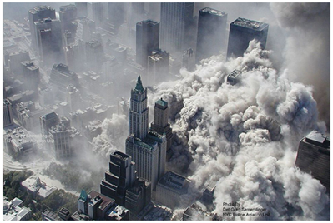
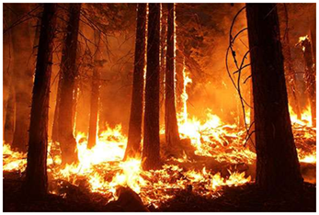
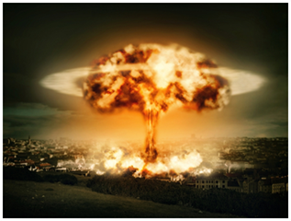
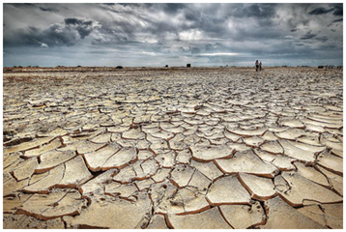
What is disaster epidemiology?
The use of epidemiology to assess the short- and long-term adverse health effects of disasters and to predict consequences of future disasters
Notes:
Disaster epidemiology is the application of epidemiologic methods to characterize the nature and dynamics of the health consequences in a disaster setting. It began with the study of health risks after environmental disasters and is now regarded as a subset of environmental epidemiology.
Increasingly, emergency managers are working with epidemiologists to have data for general situational awareness, to inform decisions and response plans, to allocate resources.
It is part of public health emergency response within the incident command system framework.

Slide 3

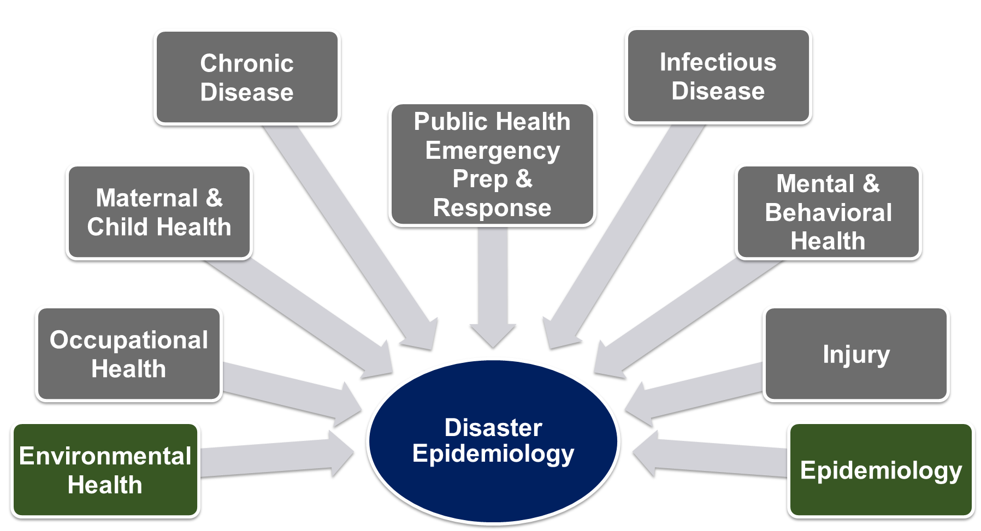
Who is a disaster epidemiologist?
Notes:
Example: Zika response involved MCH, EH, ID, Response, Epi, OccH (integrational epidemiology), making the case for teams made up of experts of various areas.
DE is multi-disciplinary: brings together various topic areas of epidemiology including acute and communicable disease, environmental health, occupational health, chronic disease, injury, mental and behavioral health.
When an incident happens, the SME epidemiologist should be selected
During an infectious disease (ID) outbreak, public health turns to the ID experts
During an environmental disaster, public health turns to EH experts
Knowledge of response to all-hazards
Cross training of epidemiologists is essential – Epi needs to know Emergency Management (ICS and emergency operations) and Disaster Epi
Any epidemiologist can be a disaster epidemiologist
PHEP/EM need to pull the appropriate epi SME for the response
Important for PHEP to meet your epi’s

Slide 4
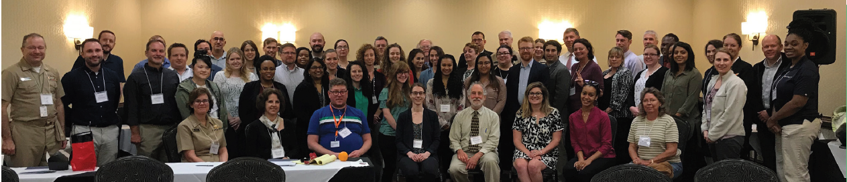
Disaster epidemiology (DE) Subcommittee
Strengthen capacity to respond by integrating DE into the emergency management cycle
Help public health and emergency management leadership understand essential role of DE
Identify common set of capabilities to support collection of epidemiologic data during emergency response situations

Slide 5
CSTE Disaster Epidemiology Subcommittee
Started in 2007
Subcommittee around for 12 years and on the 13th workshop!
495 subcommittee members
  46 states, Washington DC, Puerto Rico and Guam
About 50 active members
Monthly conference calls with technical speakers sharing experiences

Slide 6
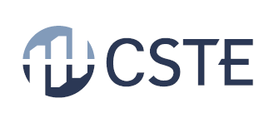
Disaster Epidemiology Subcommittee
2022-2023 Strategic Plan
Mission Statement: To bring together various disciplines of epidemiology to collaborate towards improving emergency preparedness and disaster response capacities and capabilities at local, state, tribal, regional, and national levels following disasters and other emergencies.
Priority Area 1:
Build networking opportunities and enhance the knowledge of disaster epidemiology
Objective 1: Host an annual DE workshop.
Objective 2: Present at regional or national conferences on the work, programs and initiatives of the subcommittee twice a year.
Objective 3: Host 6 webinars, learning moments or training opportunities yearly.
Objective 4: Gather and share tools, methodologies, and evaluation information among jurisdictions. Promote use of tool repository.
Priority Area 2:
Continue to define disaster epidemiology capabilities and its role in the disaster management framework
Objective 1: EM collaboration workgroup will develop EM template to demonstrate value of DE.
Objective 2: Collaborate across disciplines and organizations, including: climate change subcommittee, emergency managers, and academic partnerships.
Vision
Using the power of disaster epidemiology (DE) to improve the public’s health before, during, and after a disaster.
Incorporate disaster epidemiology into Incident Command Structure, include in drills and exercises.
Leverage relationships and expertise among members and partners.

Slide 7
Outreach
NACCHO preparedness summit, Spring 2022
  Disaster Epidemiology 101 and integration with emergency management
  Have presented for last 6 years
  ~100 attendees
PHEP Connects presentation, Winter 2021
American Public Health Association, Fall 2018
  Special Session Title: Disaster Epidemiology: Examples of Epidemiologic Methods Applied to Natural and Man-made Disasters
National Environmental Health Association, Summer 2018
  Environmental Health and Disaster Epidemiology: Tools for Public Health Preparedness, Response, and Recovery

Slide 8
Emergency management collaboration workgroup
Educate our members on emergency management by inviting speakers to present and supporting members in achieving their Emergency Management Certificate.
Outreach to emergency management to educate on the role DE plays in the disaster management cycle by creating DE informational cards on tools and methods.

Slide 9
Disaster epidemiology communities
CSTE Disaster Epidemiology Subcommittee: https://www.cste.org/group/DisasterEpi
CDC Disaster Epidemiology Community of Practice (DECoP): https://www.cdc.gov/nceh/casper/decop-invite.htm
Syndromic Surveillance and Public Health Emergency Preparedness, Response and Recovery (SPHERR) Subcommittee: https://knowledgerepository.syndromicsurveillance.org/spherr-workgroup

Slide 10
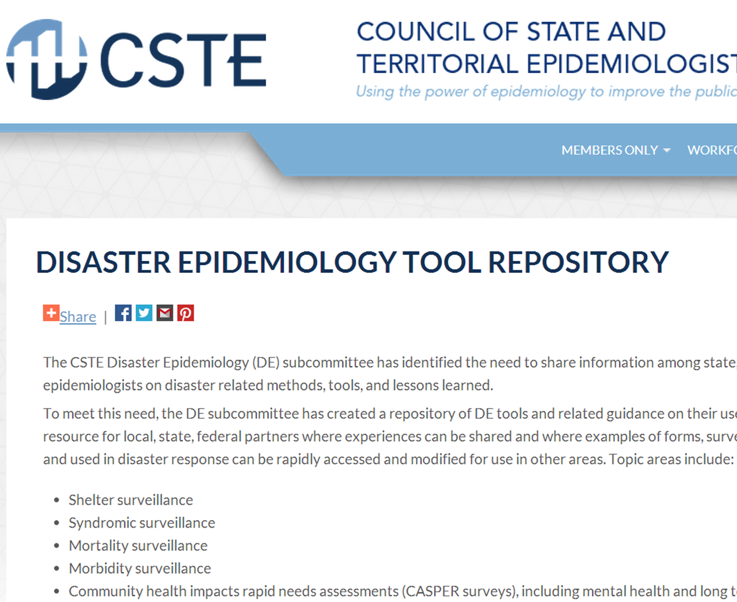
Disaster Epidemiology Tool Repository
Notes:
Other previous work included a seminal AJPH DE role in disaster management cycle article

Slide 11
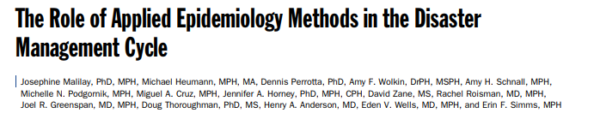
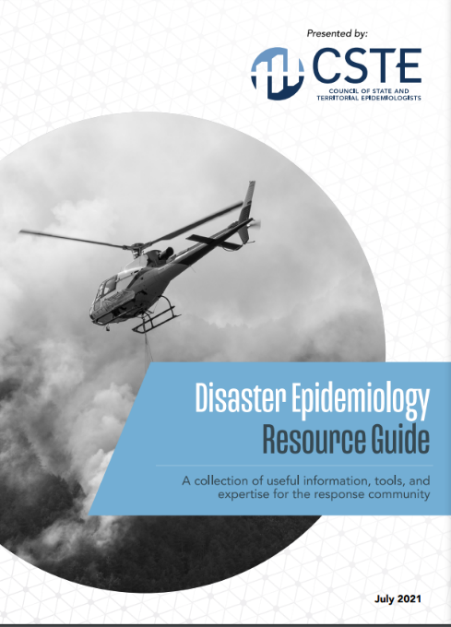
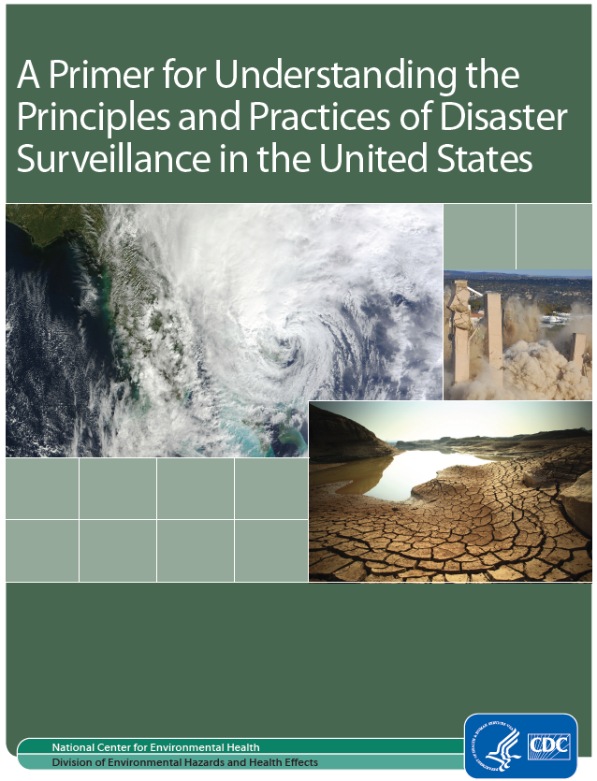
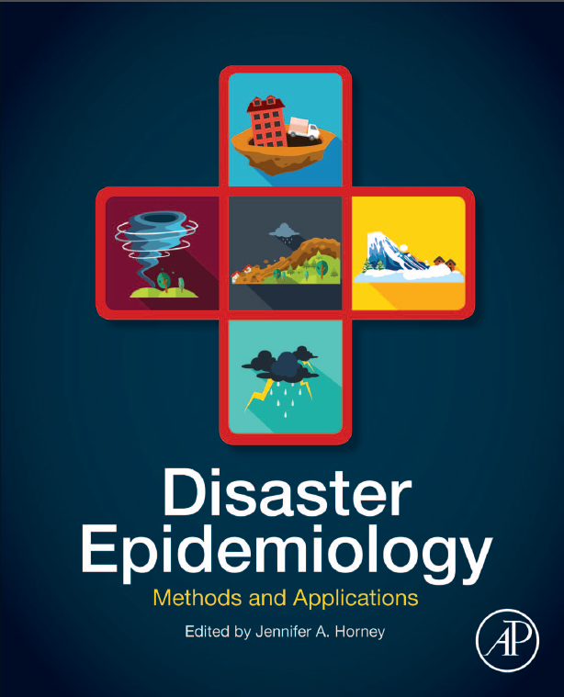
Disaster Epidemiology Resources
Notes:
CSTE DE tool repository: https://www.cste.org/page/epidisaster
NEW DE resource guide: https://cdn.ymaws.com/www.cste.org/resource/resmgr/disasterepi/DE_Resource_Guide_Final_v3.pdf
CDC DE primer: https://www.cdc.gov/nceh/hsb/disaster/Disaster_Surveillance_508.pdf
DE methods and applications by Dr. Jen Horney, teaching classes at U of Delaware

Slide 12

Tess Konen
Senior Epidemiologist
Minnesota Department of Health
Tess.Konen@state.mn.us
Svetlana Smorodinsky
Disaster Epidemiologist
California Department of Health
svetlana.smorodinsky@cdph.ca.gov
Andrew Adams
Senior Program Analyst
Council of State and Territorial Epidemiologists
aadams@cste.org

