Slide 1

Mobility and Remote Sensing Data in Emergencies
Nishant Kishore PhD, MS, MPH
Crisis Ready

Slide 2
Outline
Who am I?
What is mobility data?
How we have used it in the past
CA Wildfire Example

Slide 3
Who am I?
Public Health Analytics and Modeling Fellow at CDC
PhD in Infectious Disease Epidemiology and MS in Biostatistics from HSPH
  Using mobility and remote sensing data as tools in epidemiologic and disaster response
MPH from Emory
  Using call detail records linked with health data to identify geographic hotspots of transmission

Slide 4
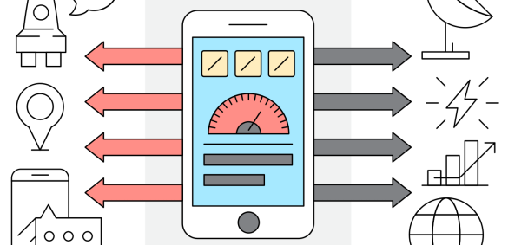

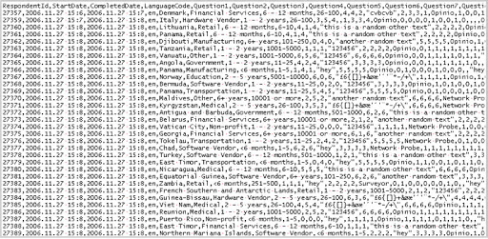
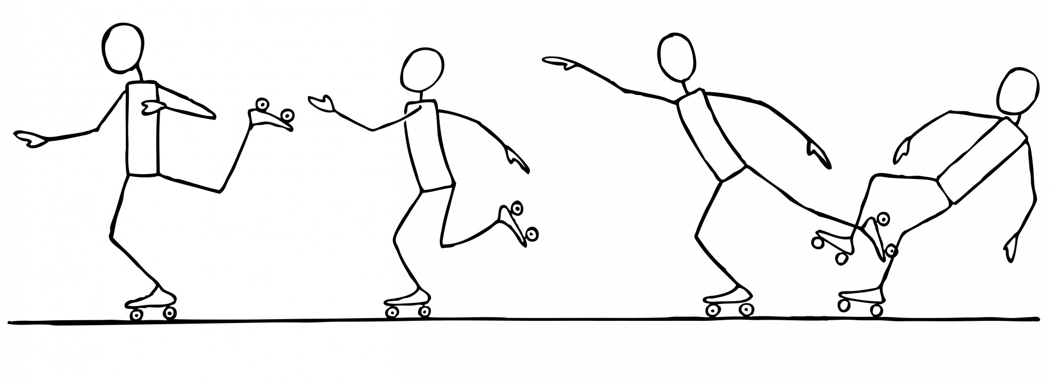



1) Humans move (or don’t)
What is mobility data (non-CDR)
2) An SDK captures some information
3) Raw data is generated and stored by Publisher
f(x)
4) Data is preprocessed, packaged and sold to a Provider
5) Data is often processed again, packaged and sold to an Aggregator
6) Metrics are calculated and compared to some baseline
f(x)
f(x)

Slide 5
How have we used GIS and mobility data in the past?

Slide 6
As aides in conducting household surveys

Slide 7
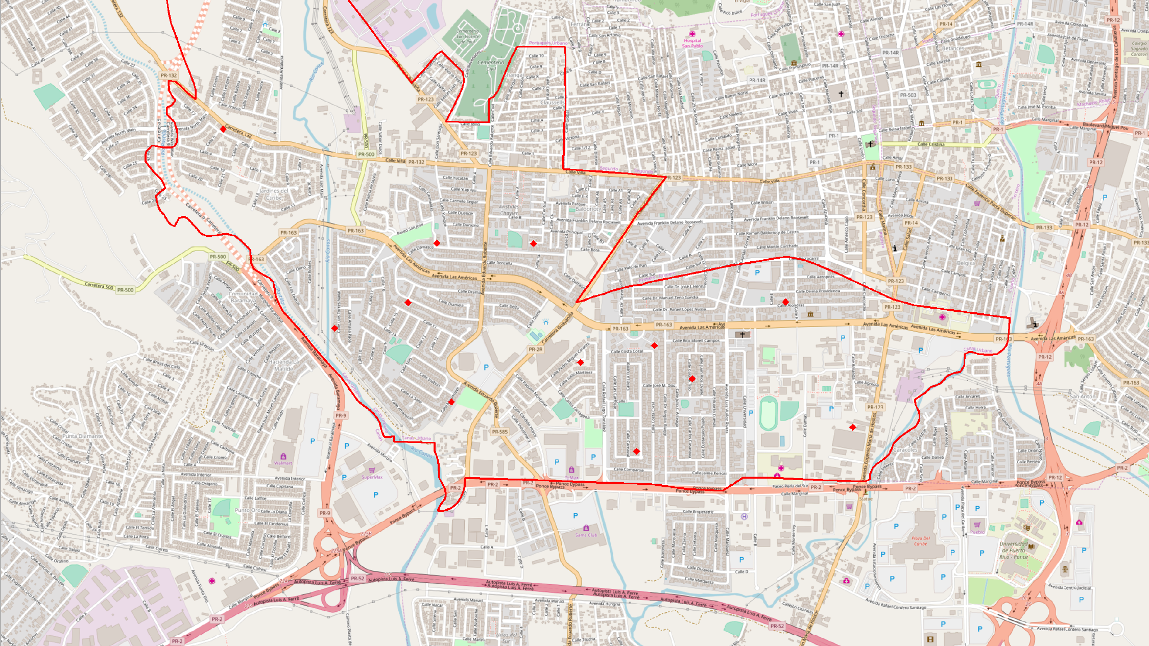
As aides for randomizing household surveys

Slide 8
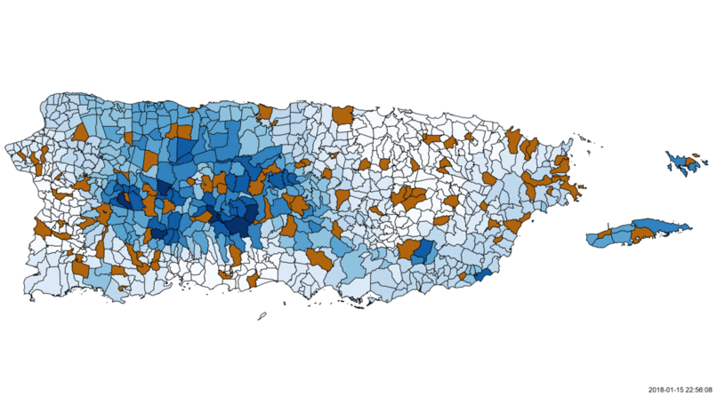

Slide 9
As proxies for changes in human behavior

Slide 10
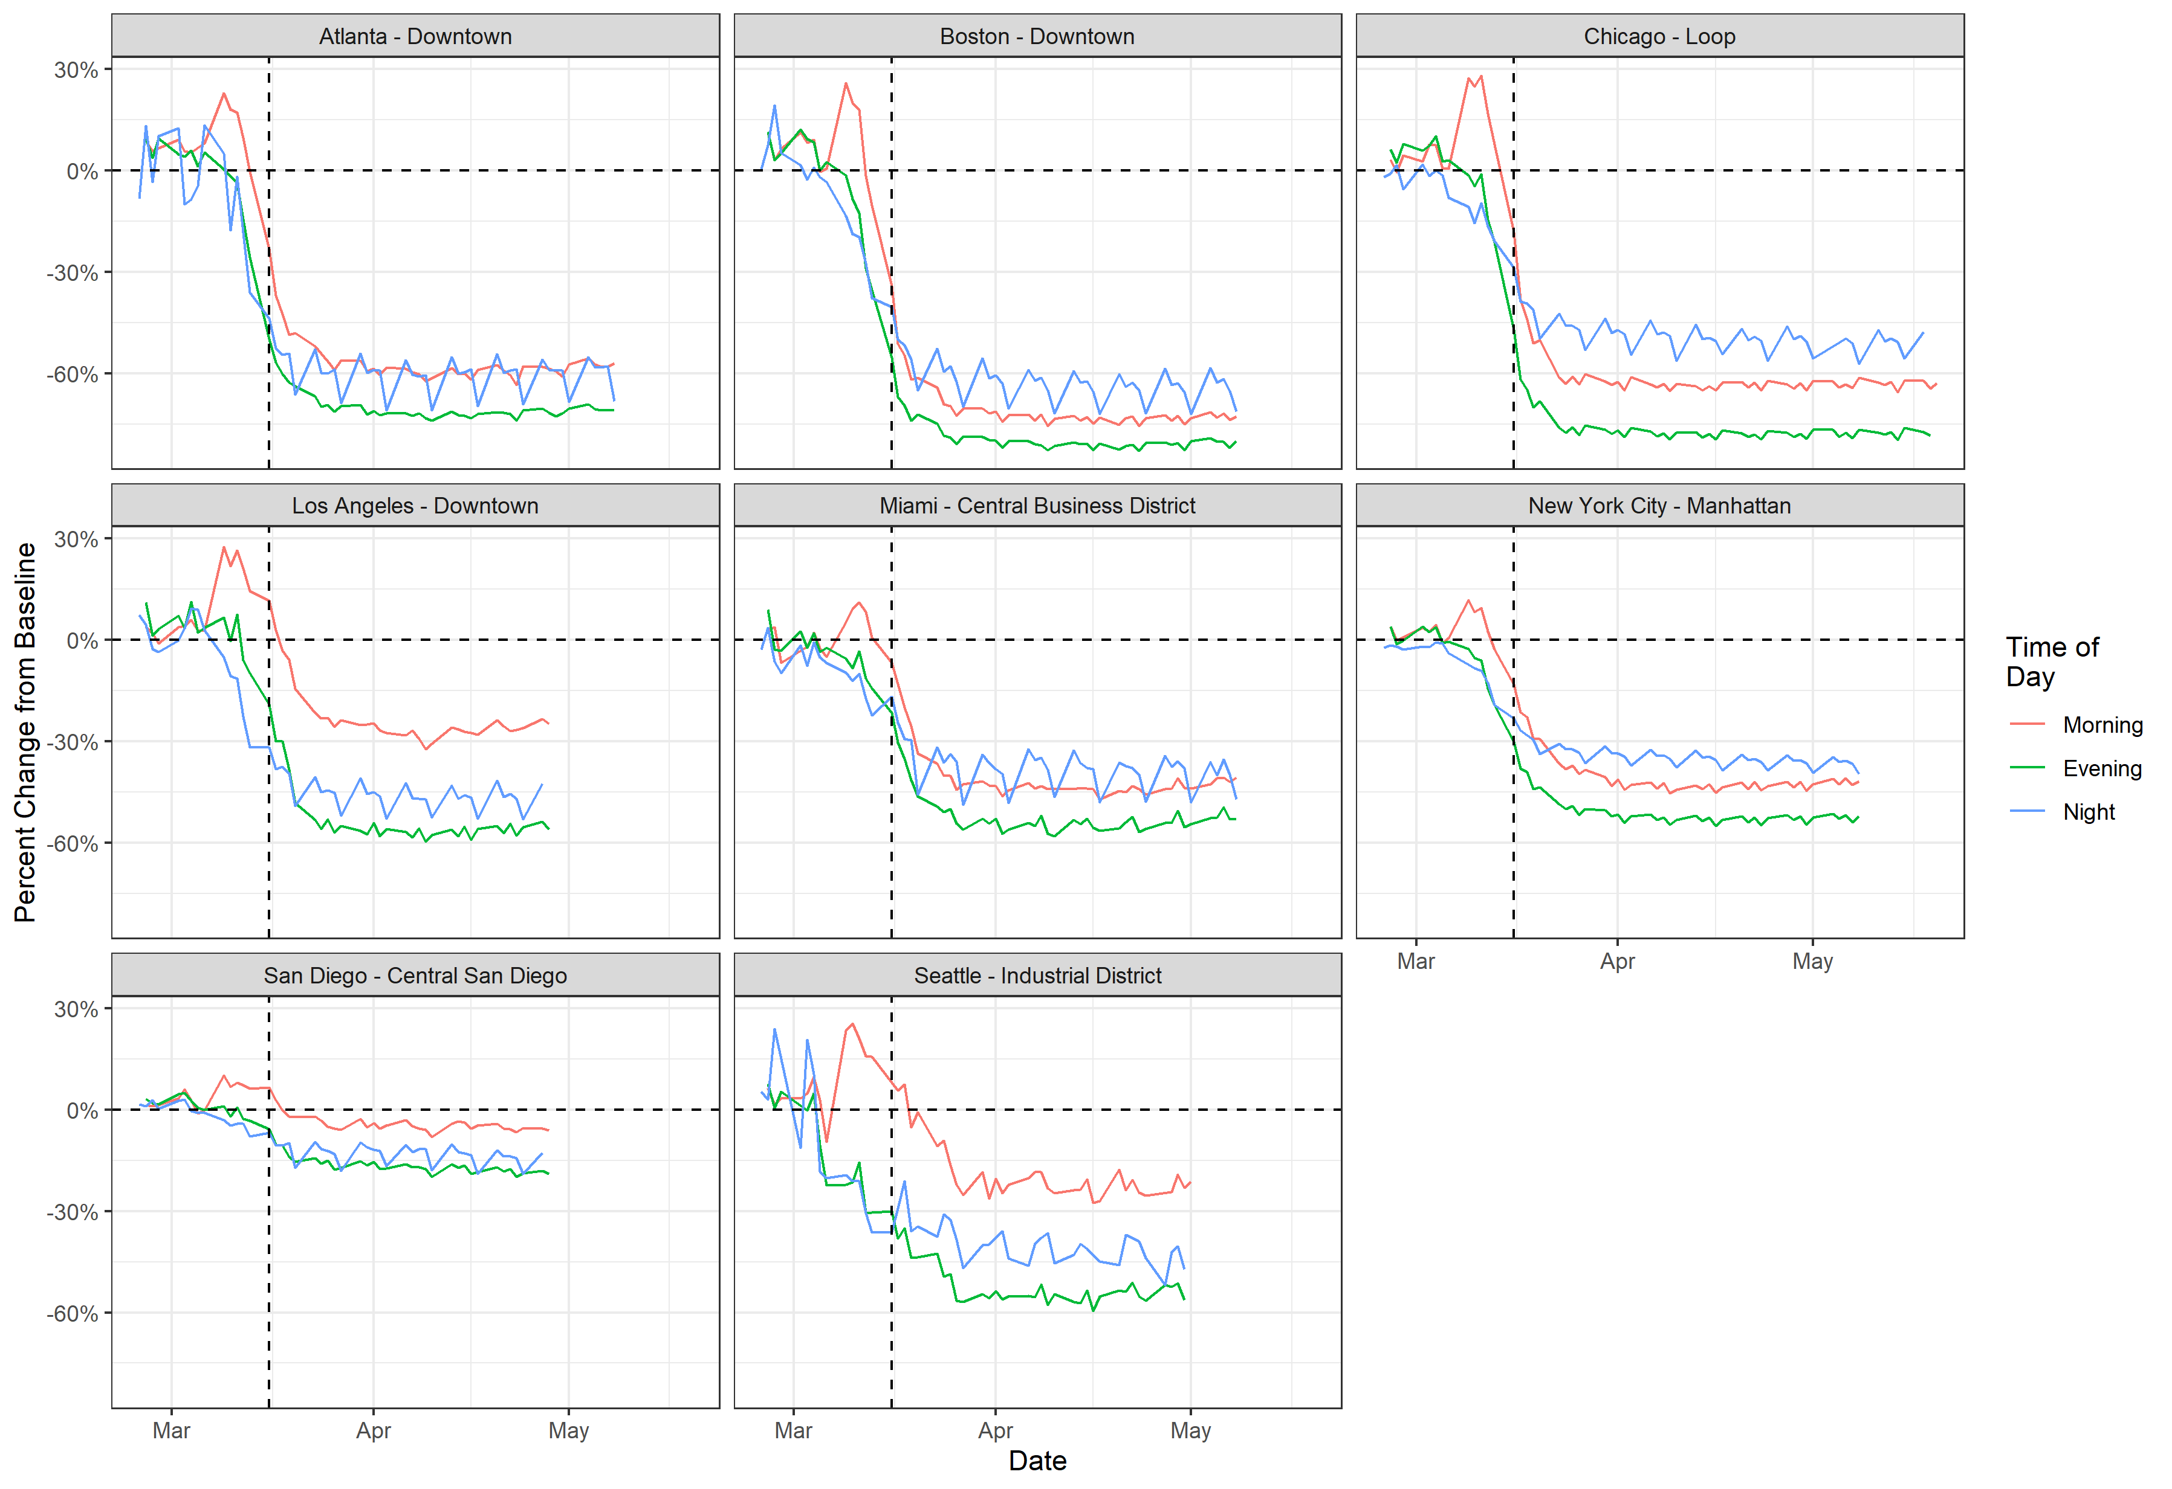

Slide 11
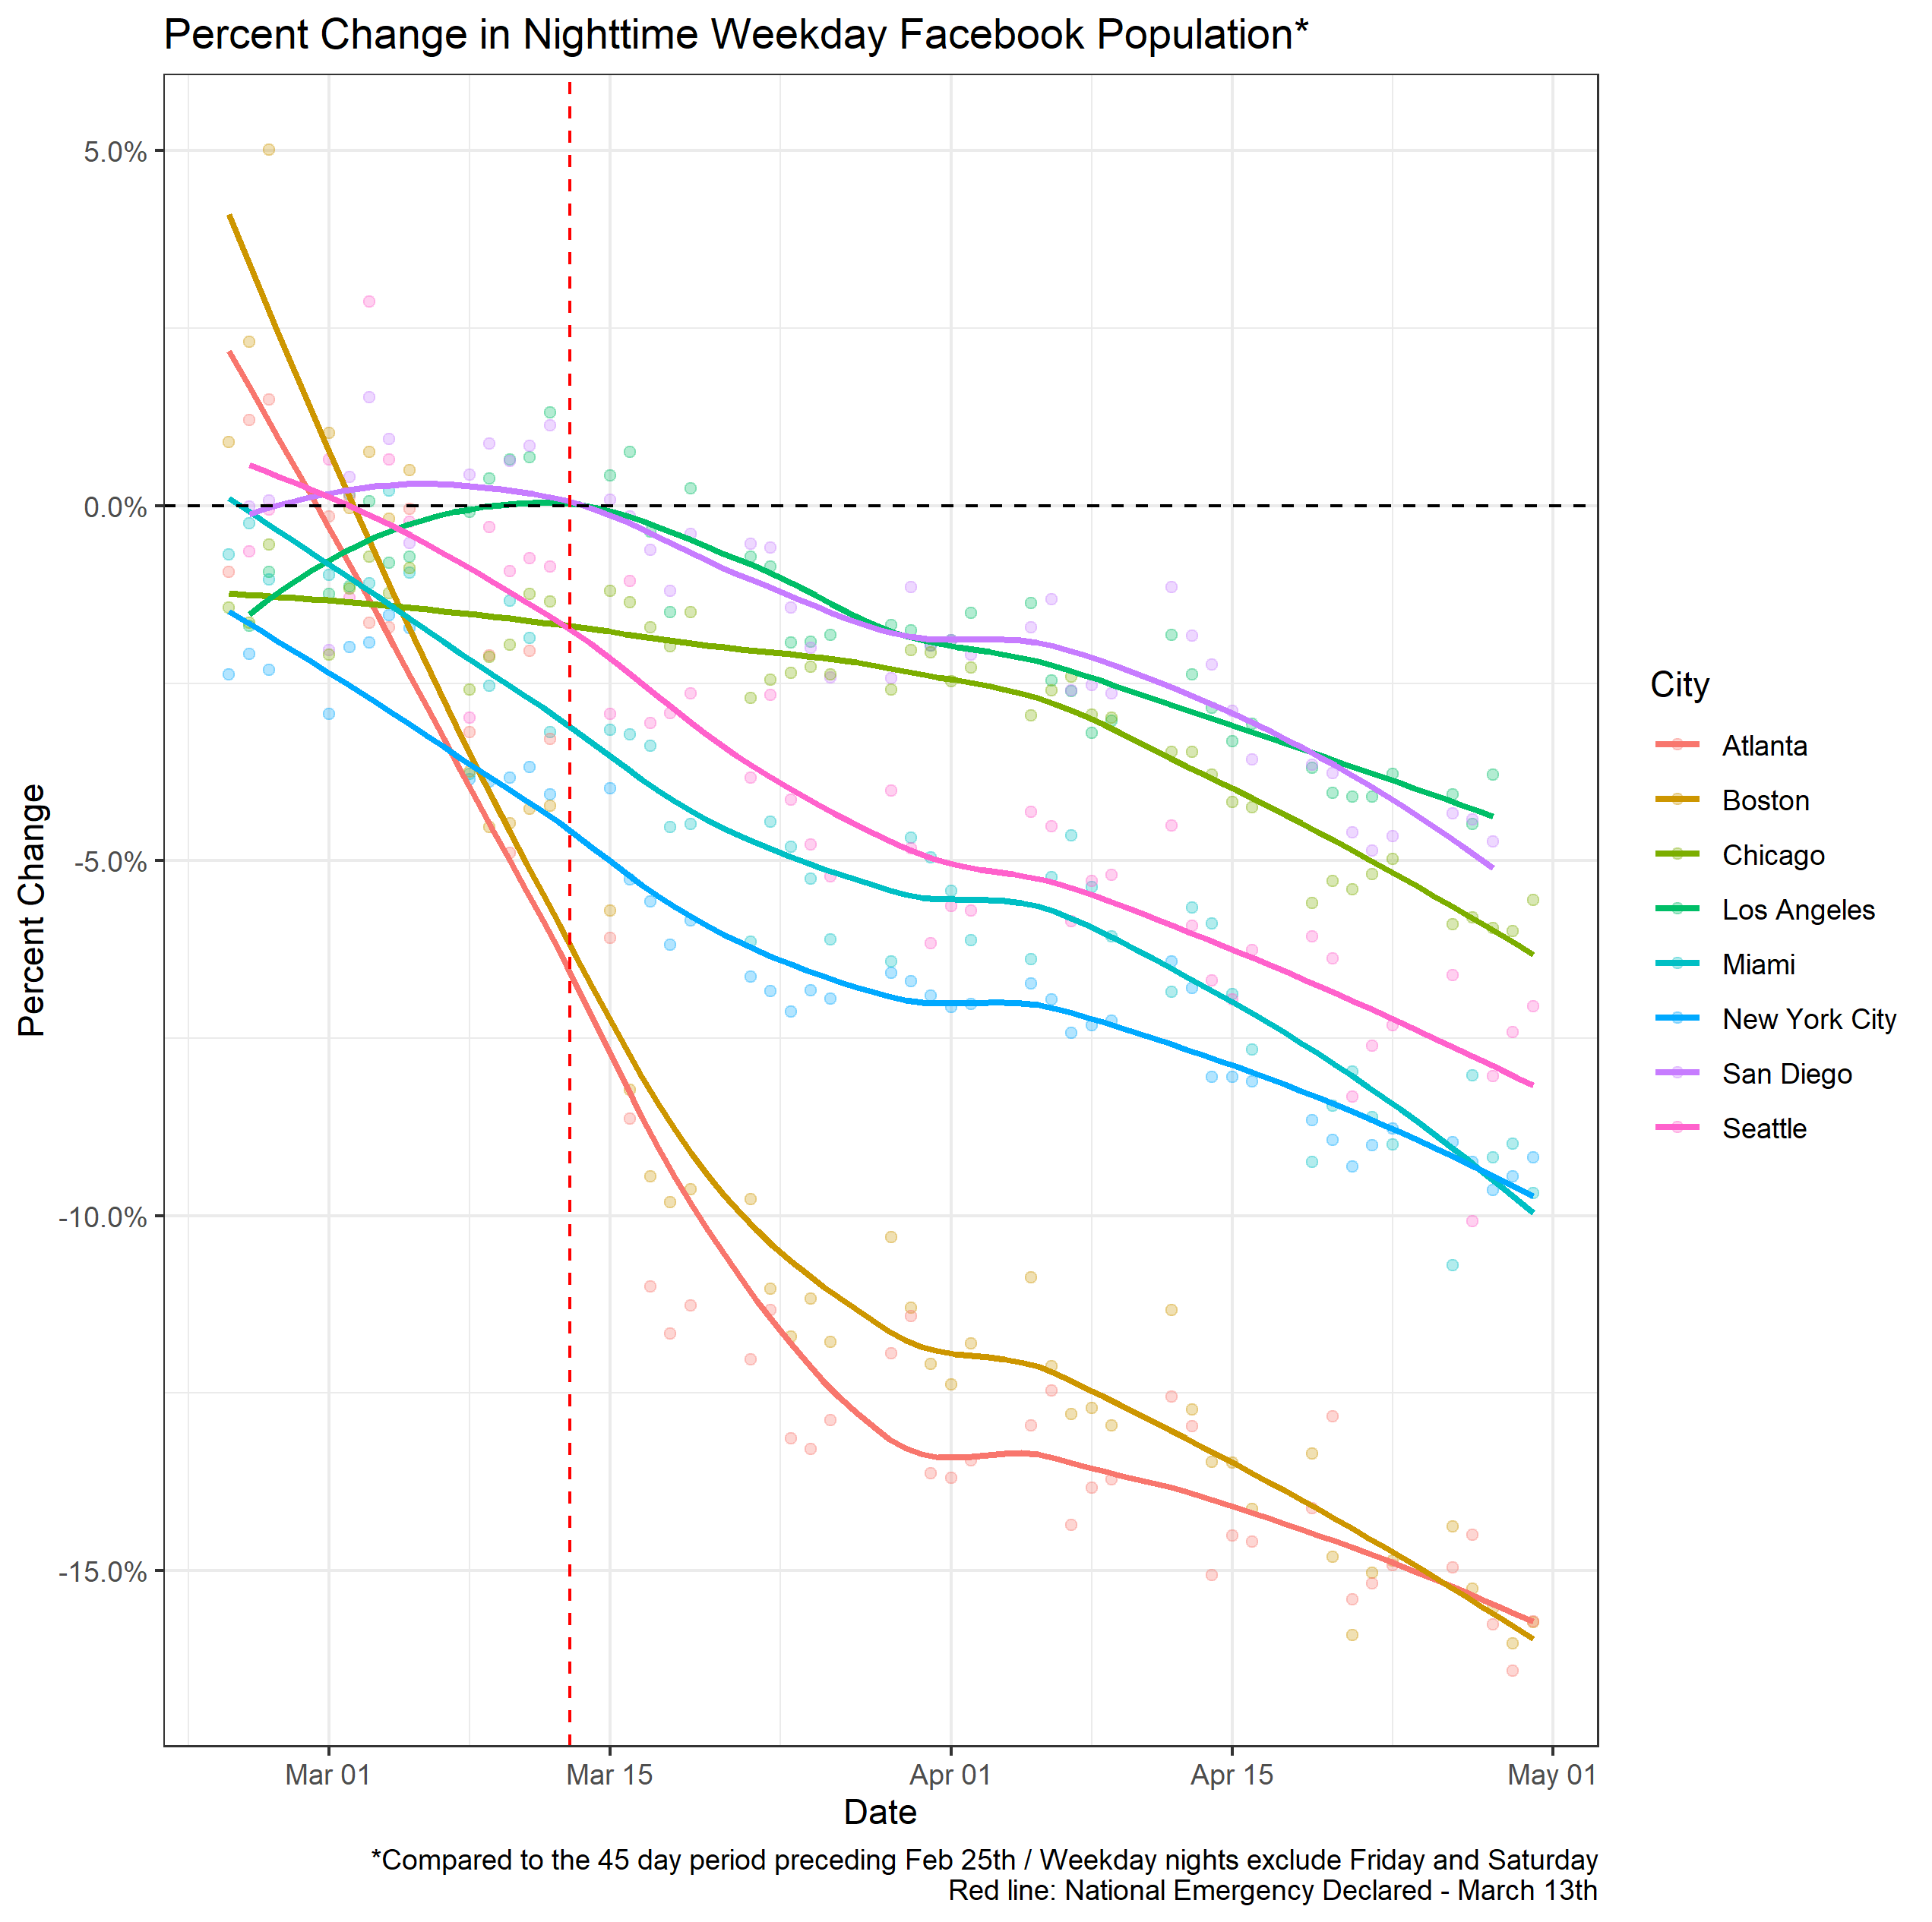

Slide 12
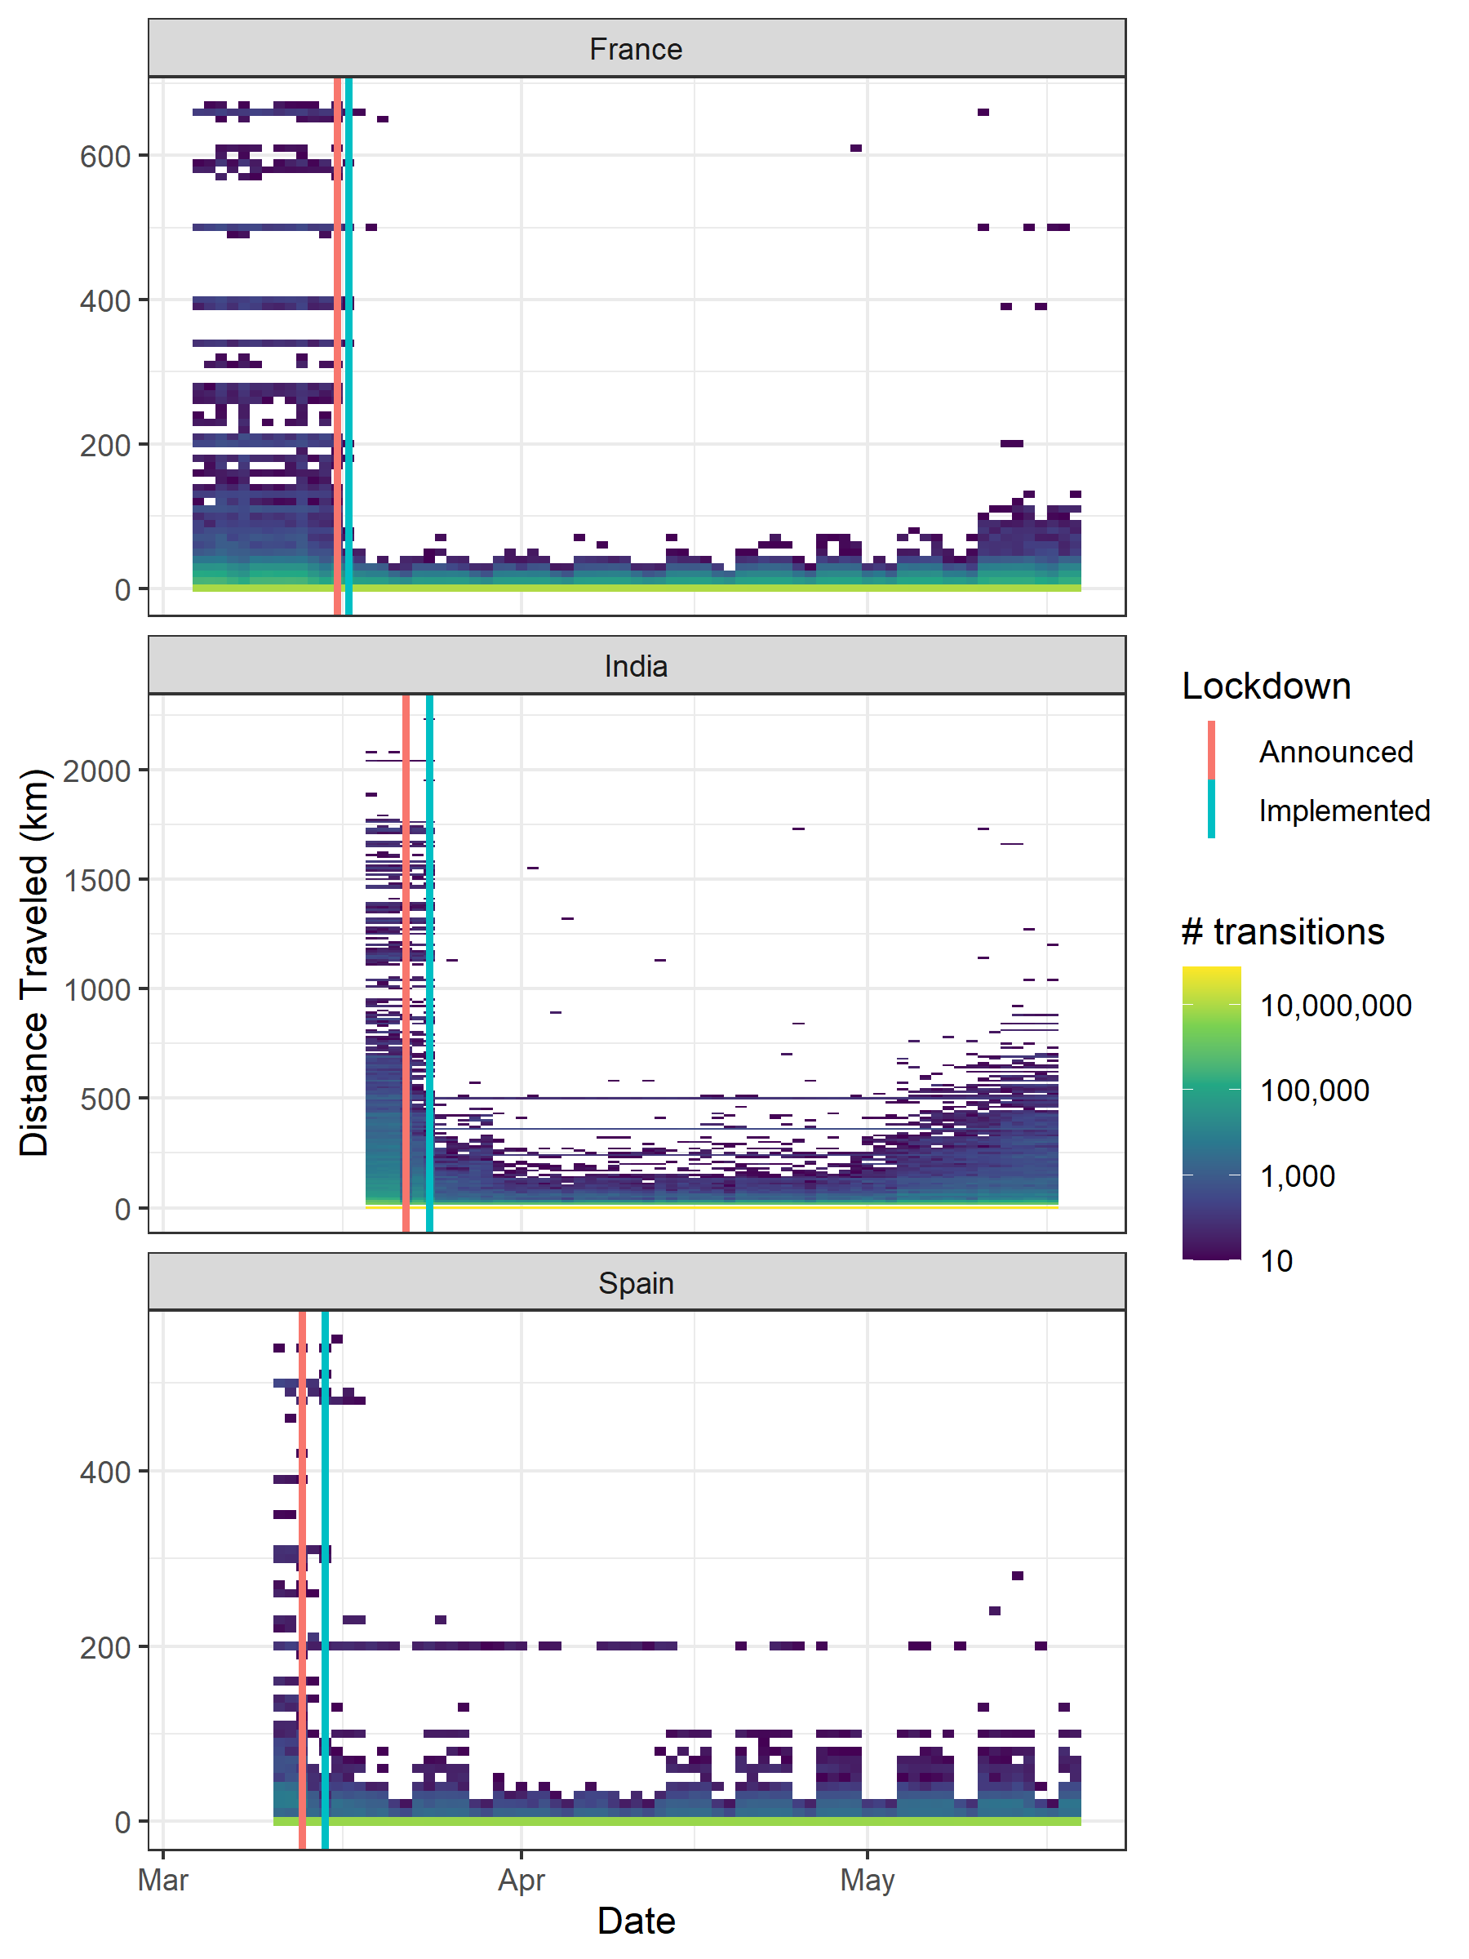

Slide 13
To evaluate risk of exportation/importation from movement

Slide 14
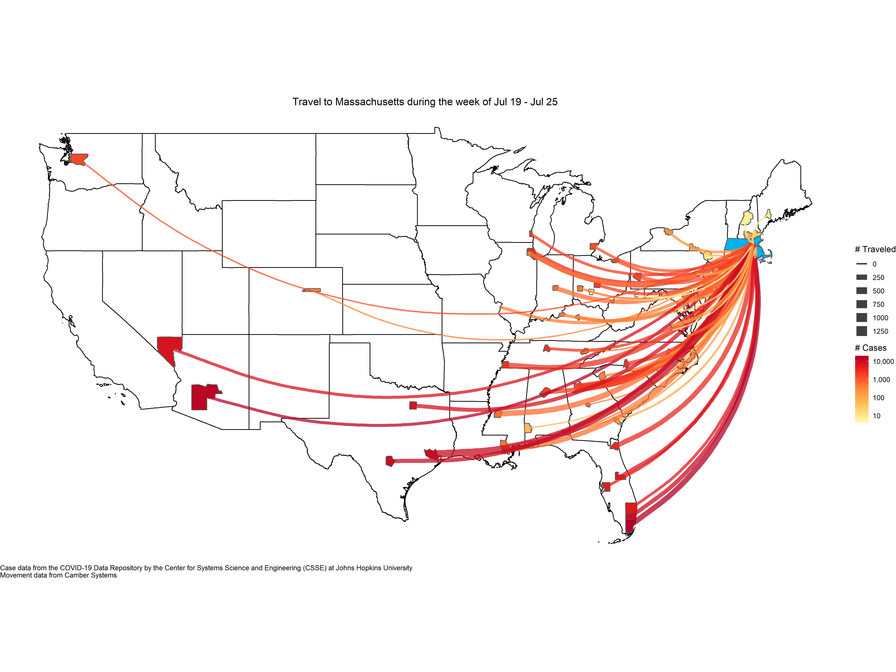

Slide 15
To identify how populations move during disasters

Slide 16
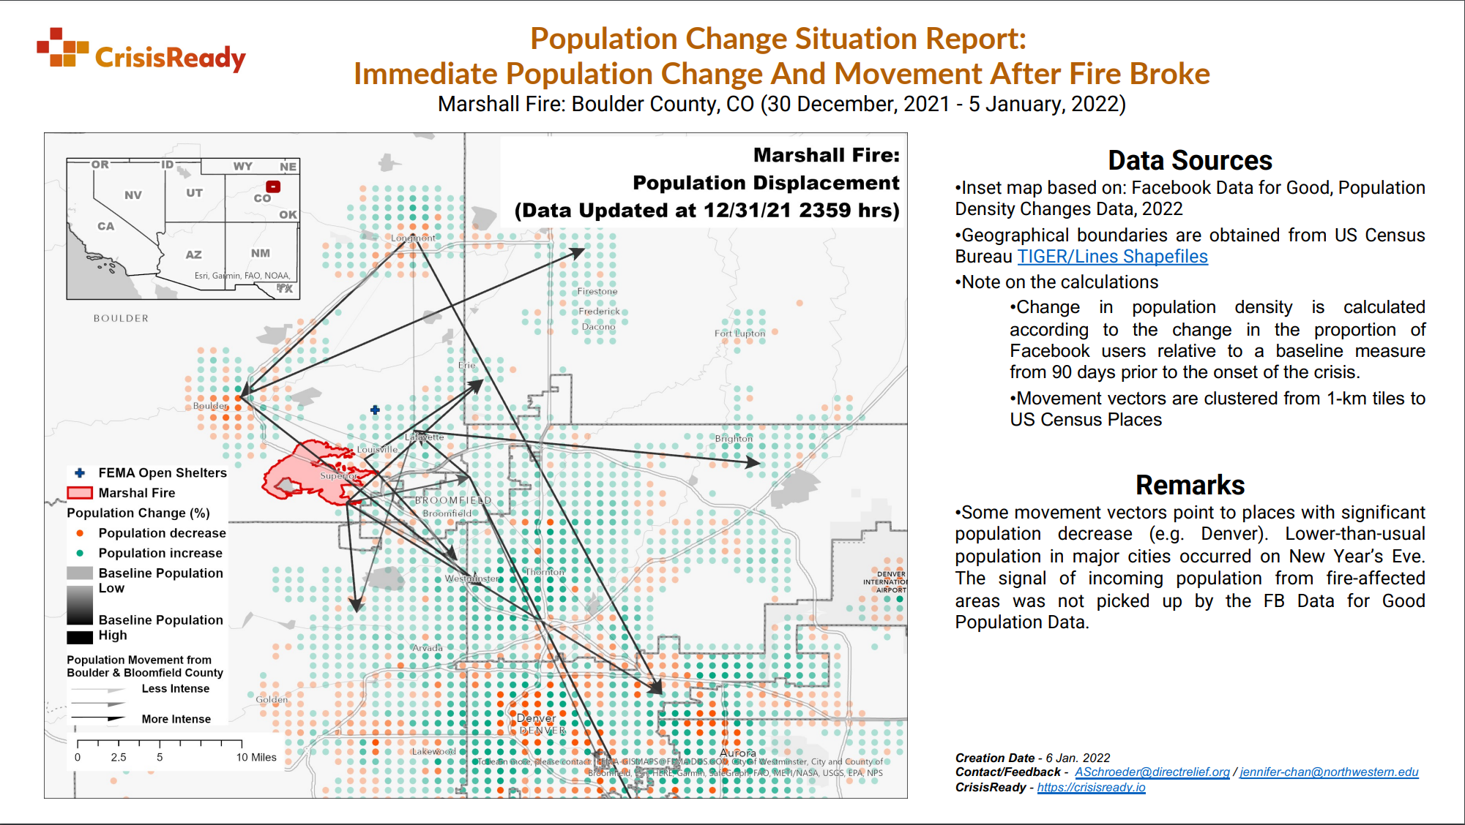

Slide 17
Brief Demo of CA Wildfires Dashboard

Slide 18
Thank you!
www.crisisready.io
nish.kishore@gmail.com

