Slide 1
Environmental Justice Dashboard
CDC’s Environmental Public Health Tracking Network
T.J. Pierce, MPH
Science Team, CDC Tracking Program
EJ Tiger Team Members: Mackenzie Malone, Shannon DeWitt, Jena Losch
CSTE Disaster Epidemiology Workshop 2022
May 11, 2022

Slide 2

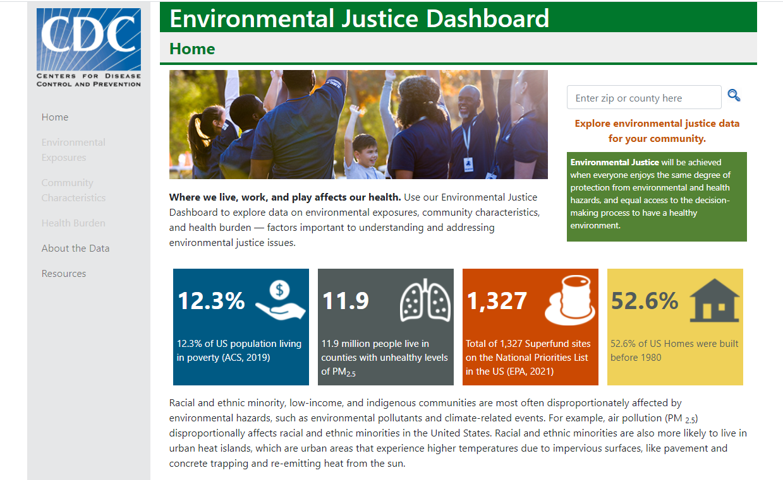
Environmental Justice (EJ) Dashboard
“Environmental Justice will be achieved when everyone enjoys the same degree of protection from environmental and health hazards, and equal access to the decision-making process to have a healthy environment.”
Uses existing Tracking data and infrastructure
Fill gaps in existing tools
Improve access to EJ information by presenting data in ways that accommodate different levels of health literacy and incorporate climate change and health outcome data not available in other tools.
Notes:
Public Health Importance: The EJ Dashboard allows users to identify communities potentially experiencing environmental injustice and to inform policy decisions to achieve environmental health equity in a way that considers health literacy and incorporates climate change data and health outcome data.

