Slide 1

Support & Aid for Everyone (SAFE)

Slide 2
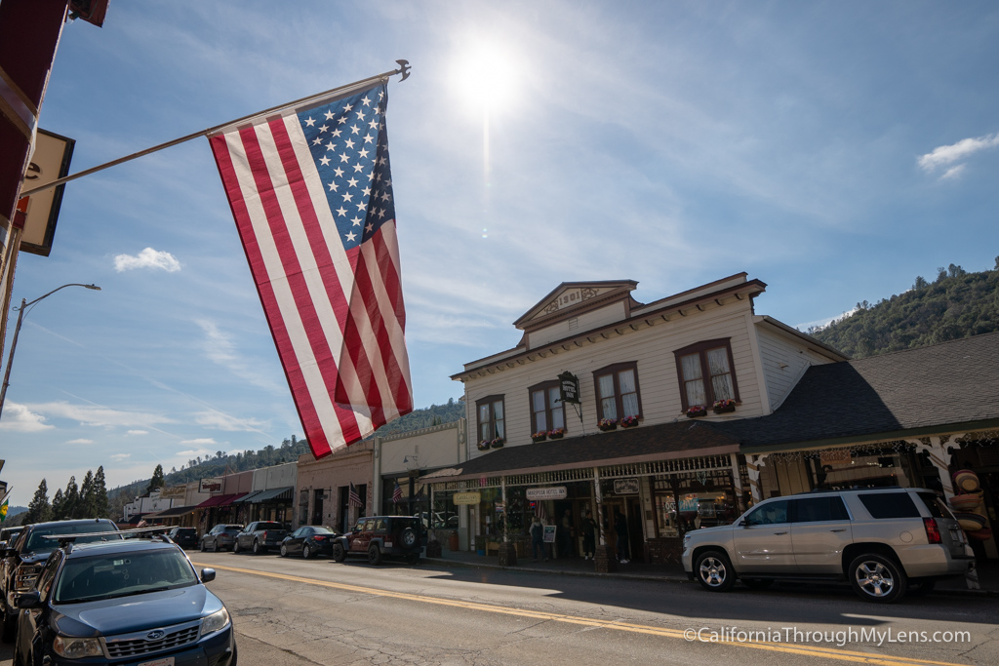
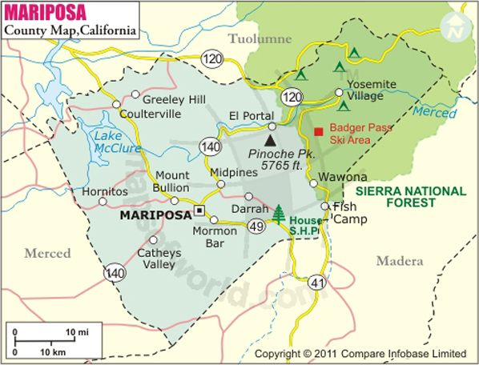
Mariposa County
Population of approx. 18,000
1,463 square miles
Rural and Frontier designations
Wildfires, floods, rockslides, mudslides, windstorms, power outages, pandemic

Slide 3
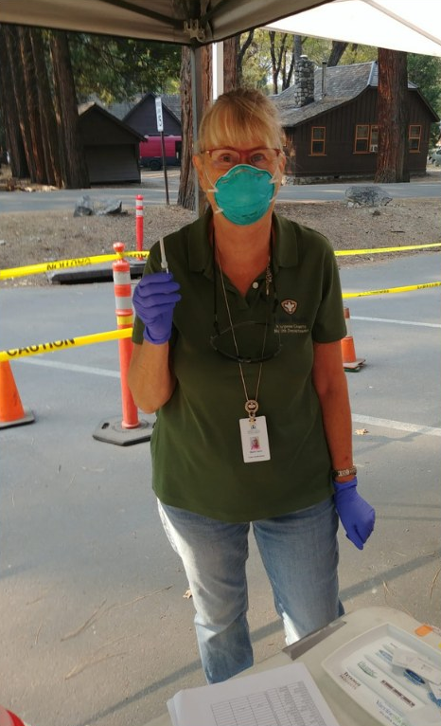
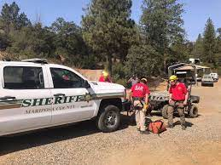
HHSA & Partners
Public Health Branch lives within the Health Division of HHSA
Staff of 22 in PH, 4 PHNs, 2 LVNs, 1 PHEP
Collaborations for SAFE with
  Sheriff’s Office
  GIS specialists
  Search & Rescue
  American Red Cross

Slide 4

Support & Aid for Everyone
The SAFE program was developed to pre-identify individuals in Mariposa County who may need additional assistance during an emergency event or disaster. Pre-identifying and registering these individuals with community outreach will reduce secondary emergencies through preventive efforts.
Program funding in partnership with the Sheriff’s Office ($20,000/year)

Slide 5
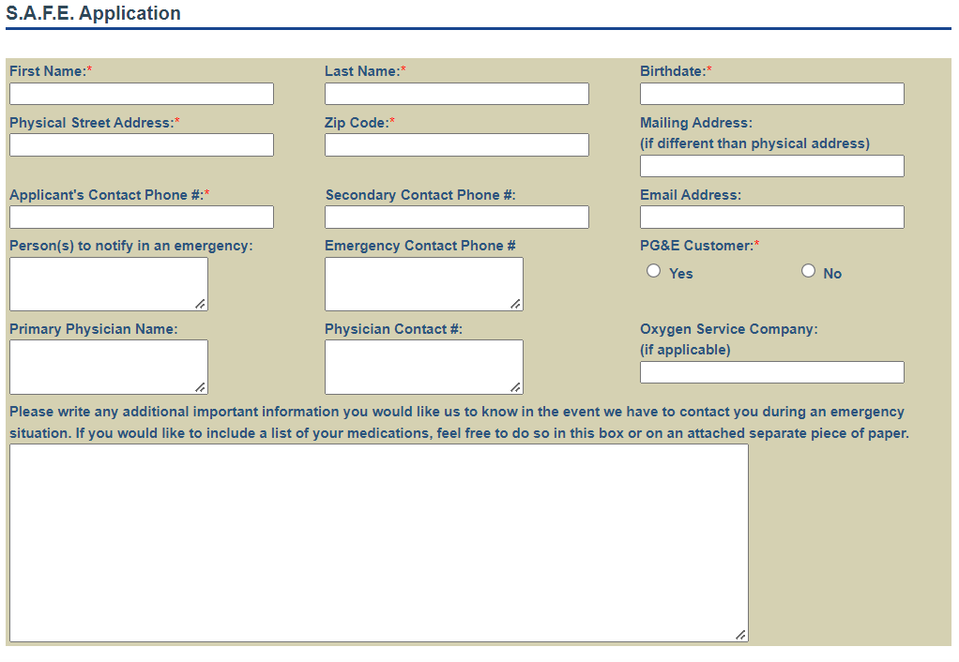
SAFE Program: who we serve
Use electricity for medical equipment
  breathing treatments, refrigerated medications, reading magnifiers
Use supplemental oxygen
Depend on others for routine transportation needs
Need mobility assistance; Use specialized transportation equipment
  wheelchairs, walkers, scooters
Use life-sustaining prescription medications including but not limited to:
  Heart medication, breathing medication, diabetes medication, receive medication by mail
Receive meal delivery service, and/or receive meals/groceries by mail.

Slide 6
SAFE: what we do
During a declared emergency
  Advocacy for specific medical/health needs
  Resource requests for those in evacuation shelters
  Be available in evacuation shelters
Widespread power outage (36+ hrs)
  Contact SAFE clients that rely on electricity for medical equipment
Community isolation due to local disaster
  Contact SAFE clients that rely on food delivery
  Advocate for medical needs to assure health and safety

Slide 7
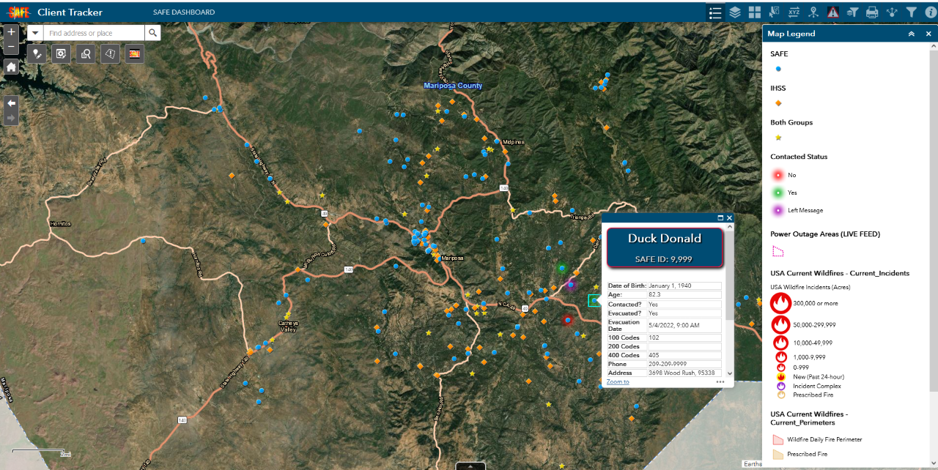

Slide 8
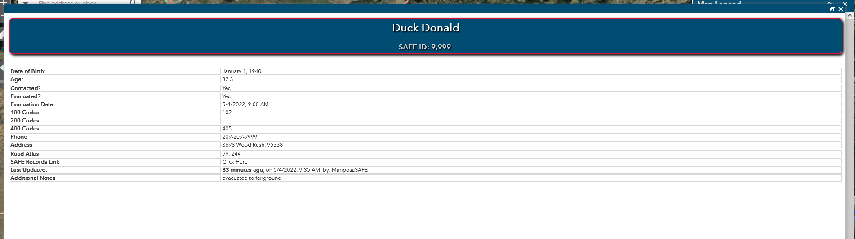

Slide 9
Thank you!
Kristina Allen, PhD
kallen@mariposacounty.org
Marti Fazio, PHN
mfazio@mariposacounty.org

