Slide 1

Automated Reporting & Distribution in R
2:00 PM EST | December 7th, 2022 | 2022 SyS Symposium
Trainers:
Jamison Crawford, MPA – ICF (CDC Contractor)
Jourdan DeVies, MS – ICF (CDC Contractor)
Katharina van Santen, MSPH – ICF (CDC Contractor)

Slide 2
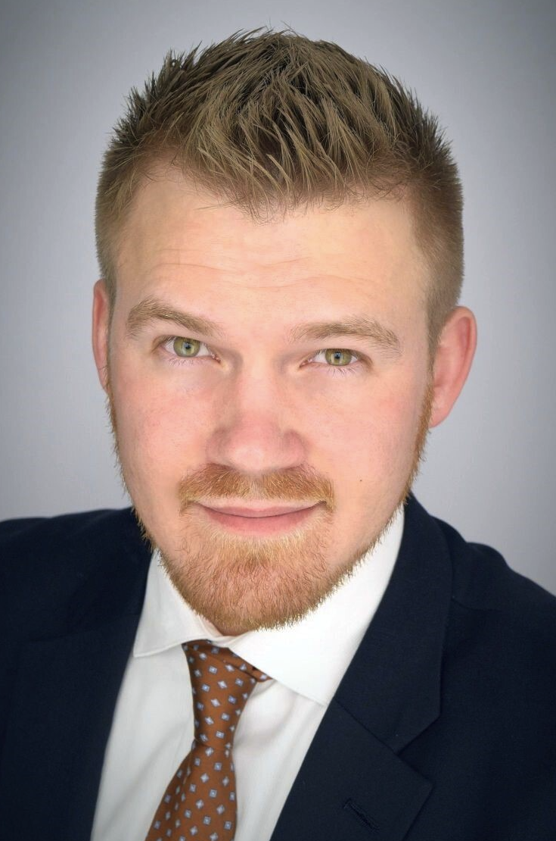
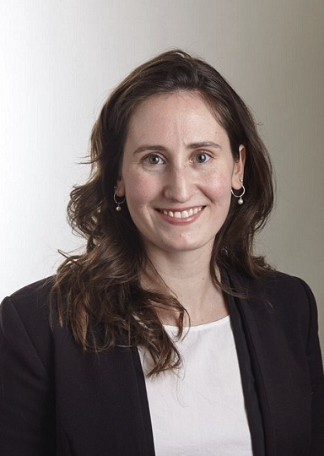
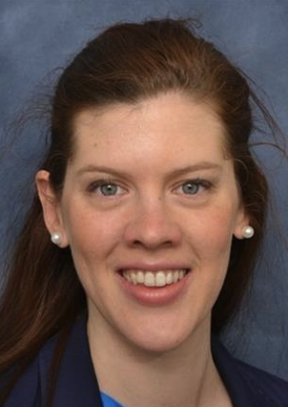
Jamison Crawford, MPA – ICF (CDC Contractor)
Jourdan DeVies, MS – ICF (CDC Contractor)
Katharina van Santen, MSPH – ICF (CDC Contractor)

Slide 3
AUTOMATED REPORTING & DISTRIBUTION IN R
Enhanced Surveillance and Data Quality, Analytics, and Visualization Teams
December 7, 2022
2:00 PM EST

Slide 4
ICF
Presenters
Jamison Crawford, MPA
Jourdan DeVies, MS
Katharina van Santen, MSPH
Doug Wirtz, MS
Presenters & Support Team from ICF to conduct training, facilitate discussion, and answer questions.

Slide 5
Agenda
Introduction
Current NSSP Use Cases
Automation Training & Demos:
  Email Distribution Using R
  R Scripts with cronR
  Custom PowerPoint Slides
Resources
Summary

Slide 6
INTRODUCTION

Slide 7
Automated Reporting & Distribution in R
Learning Objectives
  Provide examples of how report automation is currently used for ESSENCE data
  Email report notifications automatically via R upon report creation in package mailR
  Automate basic report creation in R with custom cadence using R package cronR
  Customize PowerPoint templates using R package officer
Attention: Rigorous Notetakers
  Additional resources and tutorial to be distributed
Notes:
NB: Introduction to be finalized after body content completed and practice data/R Markdown handouts are provisionally established.
Make clear the chat rules for live Q&A:
Chat / Q&A Rules
All questions welcome in chat; 3 mini-Q&As for each segment
Questions answered in order of appearance; major questions may be discussed

Slide 8
CURRENT NSSP USE CASES

Slide 9
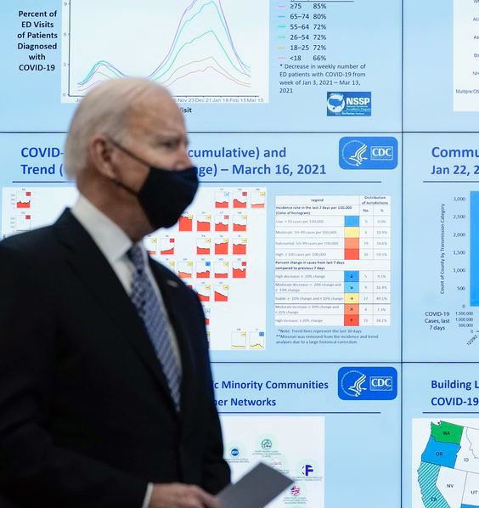
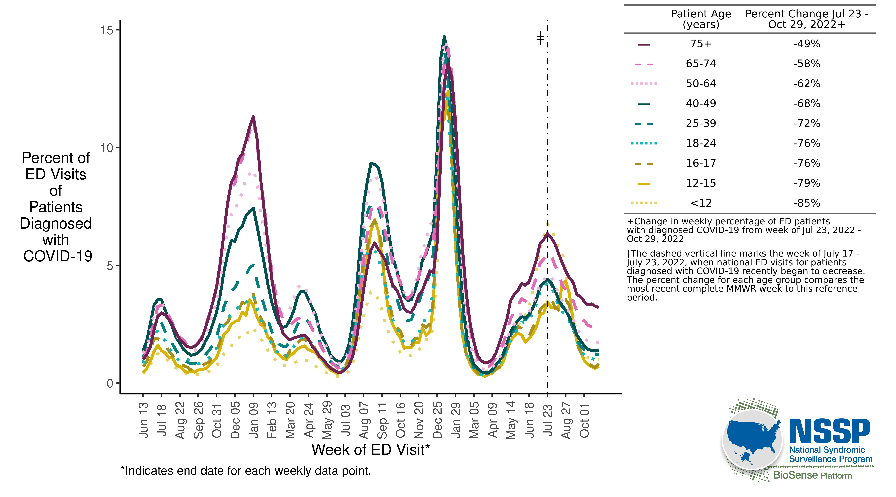
Current NSSP Use Cases
Age-stratified Percent of ED Visits with COVID DD
Notes:
[Katharina] This may be divided up into 2-3 slides in order to show images of the processes. The object is to motivate the audience by revealing how common it is in NSSP, the benefits of current implementation, and how current use cases may relate to their needs.

Slide 10
Current NSSP Use Cases
Automated Dataset Creation
  COVID Discharge Diagnosis and Flu Discharge Diagnosis for CDC and External Partners
Automated Figure and Slide Creation
  Slides for Incident Management for Multiple Outbreaks
Automated Reports
  Mpox Lab Report, Mpox ED Report
Notes:
[Katharina] This may be divided up into 2-3 slides in order to show images of the processes. The object is to motivate the audience by revealing how common it is in NSSP, the benefits of current implementation, and how current use cases may relate to their needs.

Slide 11
Email distribution using R
Automation training & demos

Slide 12
Distributing Report Notifications via Email with R
Email automation may be placed at the end of R scripts or used for error notifications.
Package mailR function send.mail()
Inputs:
Sender and recipient emails
Subject (optional)
Body text
Host name/server address
Attachments (optional)
Notes:
[Jourdan]

Slide 13
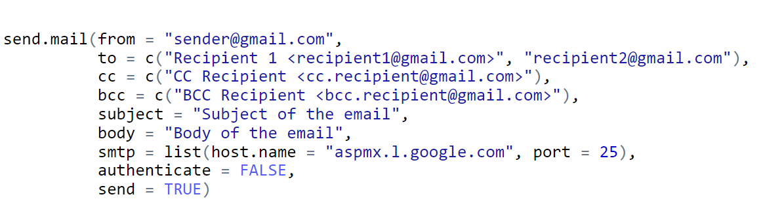
mailR Function
Send an email without authentication.
Notes:
[Jourdan]

Slide 14
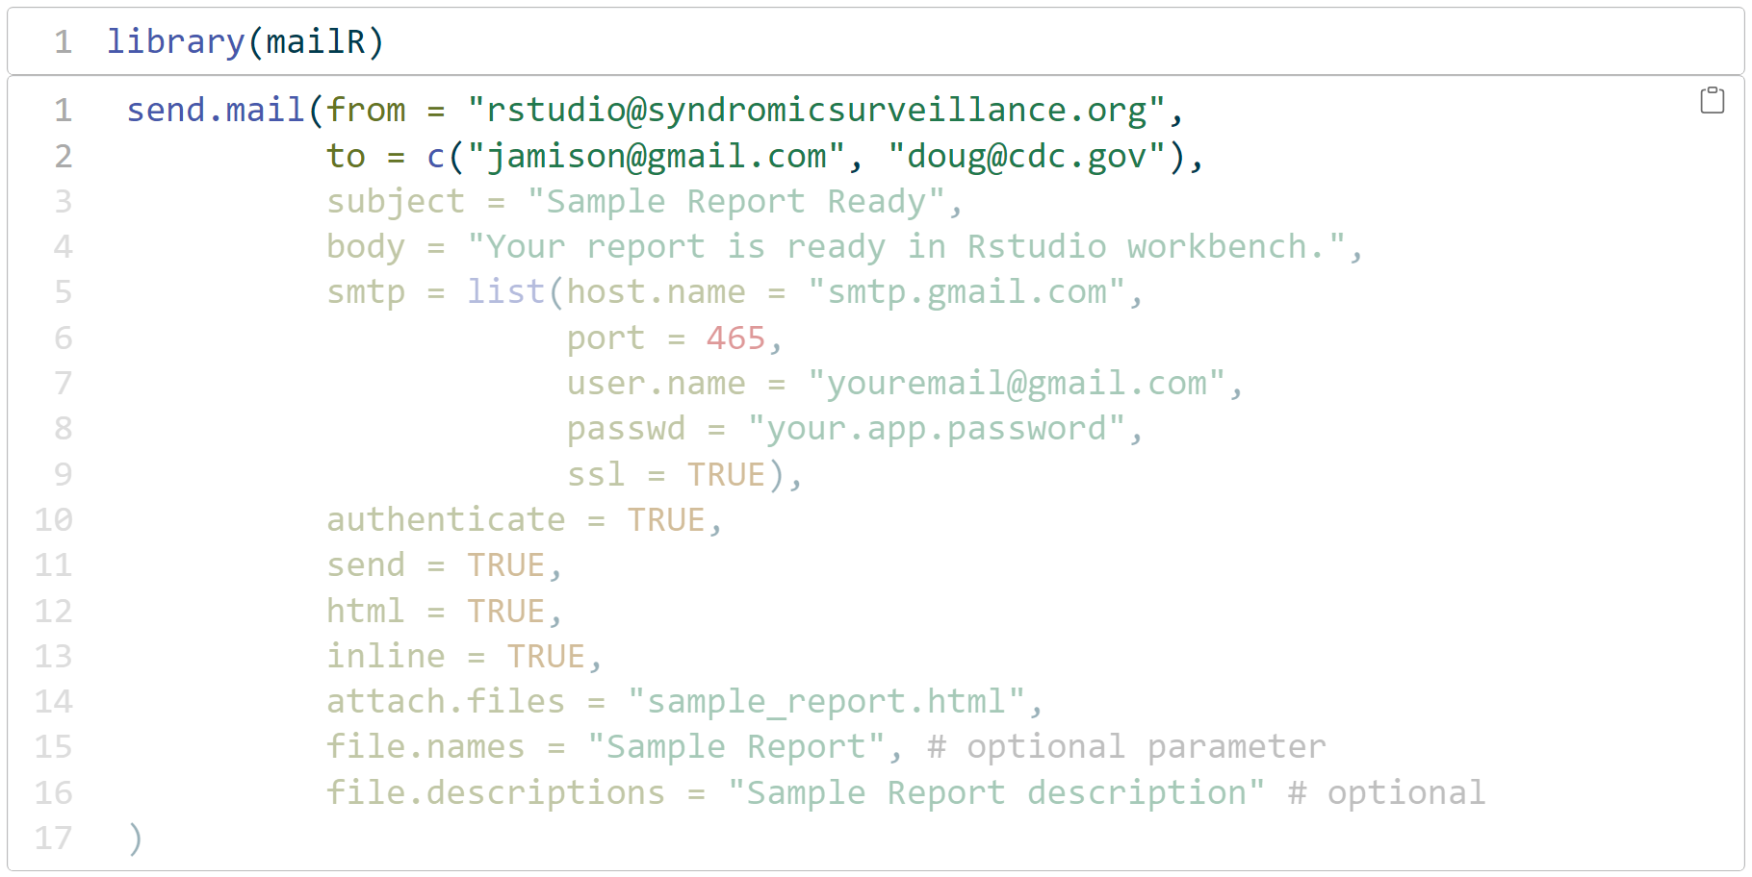
mailR Example
Notes:
[Jourdan]

Slide 15
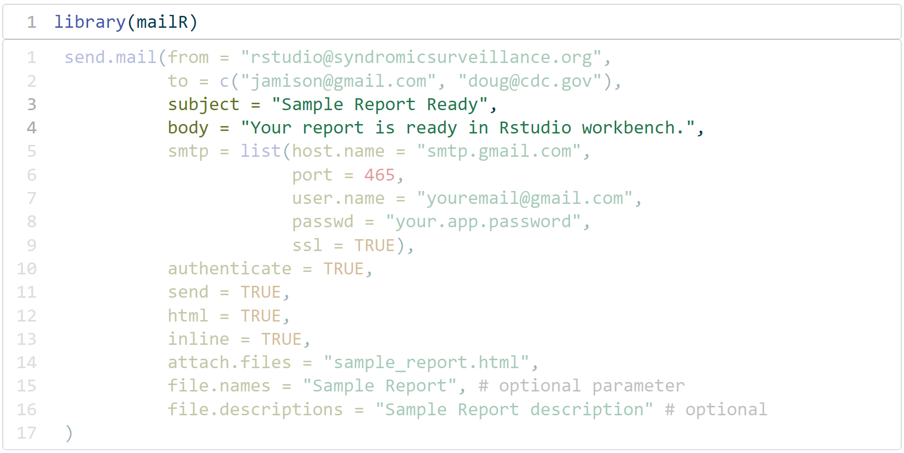
mailR Example
Notes:
[Jourdan]

Slide 16
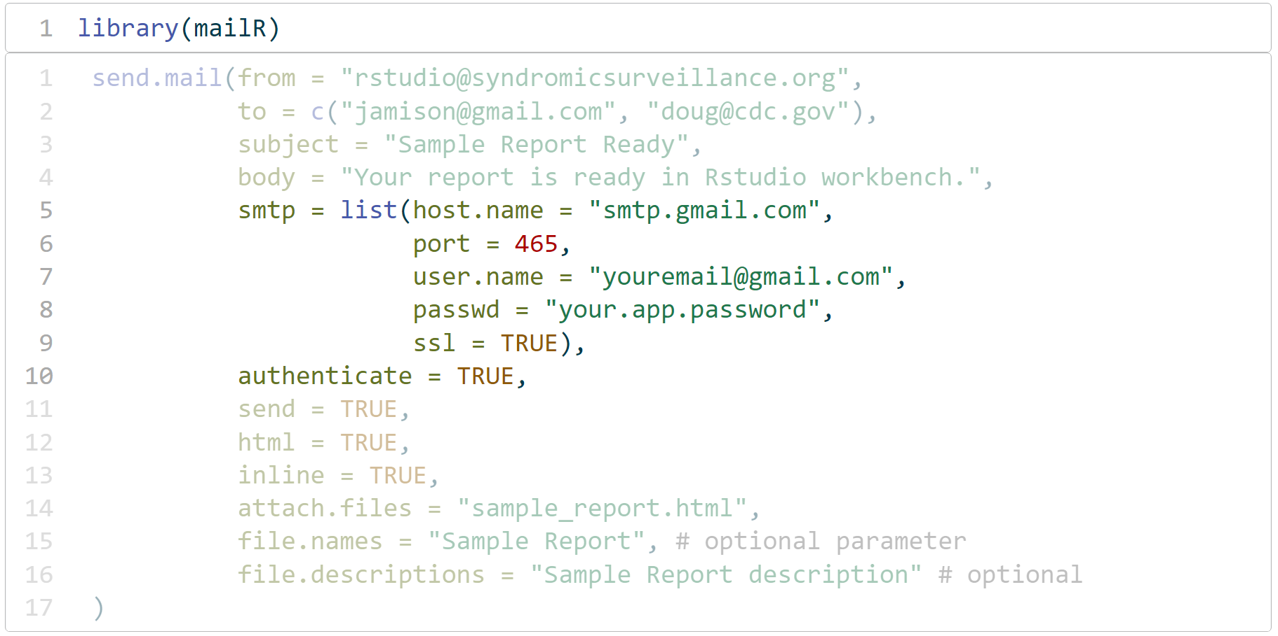
mailR Example
Notes:
[Jourdan]

Slide 17
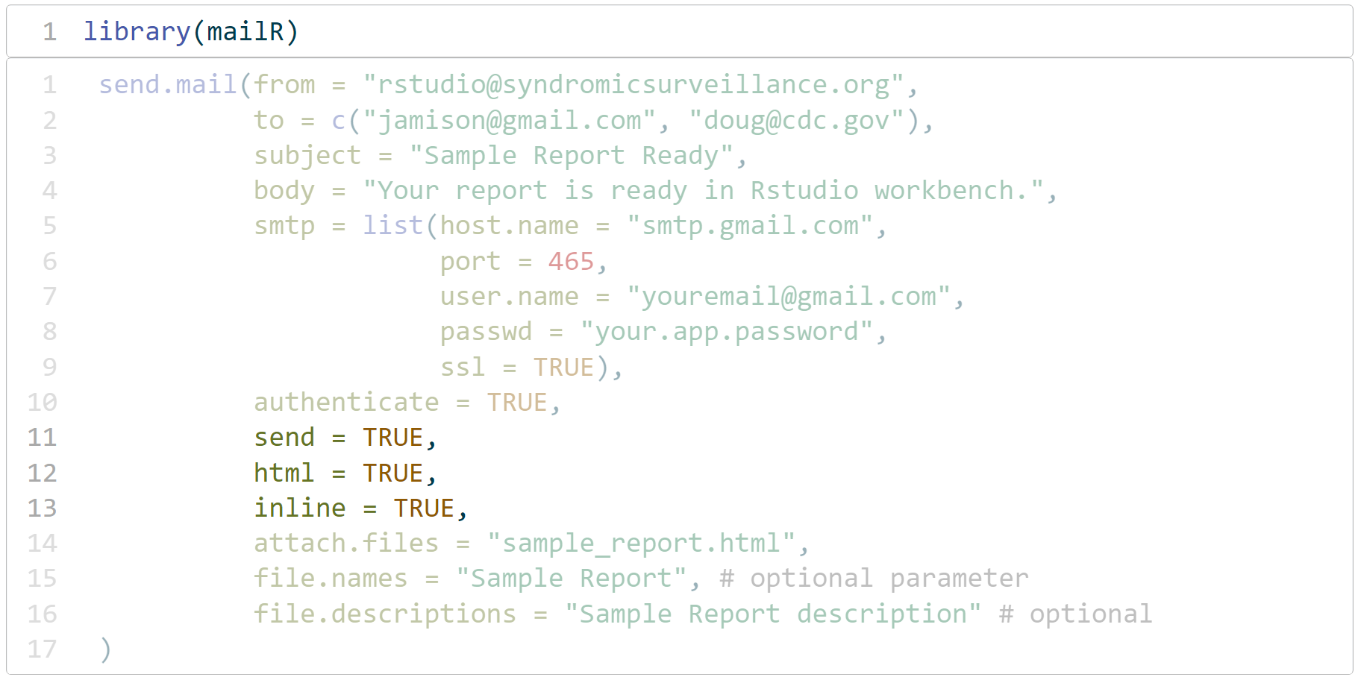
mailR Example
Notes:
[Jourdan]

Slide 18
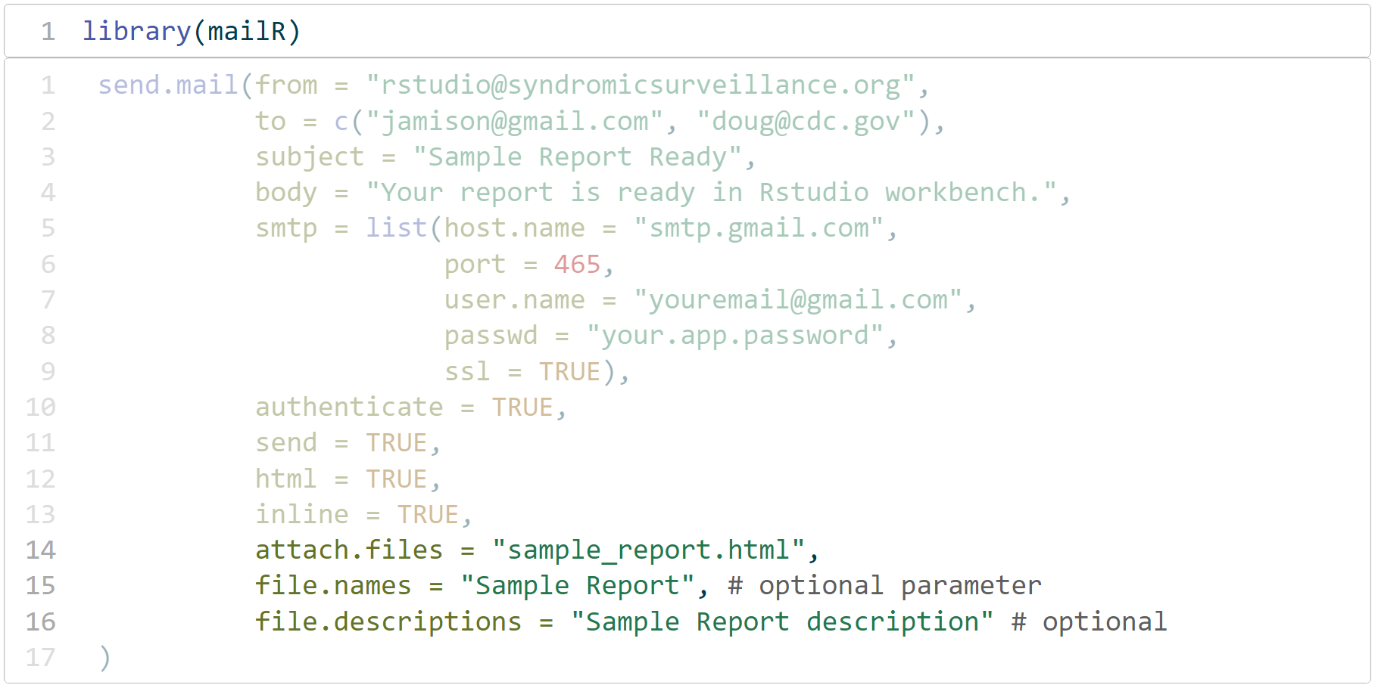
mailR Example
Notes:
[Jourdan]

Slide 19
Primer
Question
It may be better to provide the location of a report in automated emails, rather than including reports as attachments. Why?
Privacy and security concerns
Ensure reports are current
System limitations, e.g., file sizes
All the above
Notes:
NB: This may be converted into questionnaire/survey format using the presentation platform but will require CSTE pre-approval. These slides are included regardless.

Slide 20
Primer
Answer
It may be better to provide the location of a report in automated emails, rather than including reports as attachments. Why?
Privacy and security concerns
Ensure reports are current
System limitations, e.g., file sizes
All the above
Notes:
NB: This may be converted into questionnaire/survey format using the presentation platform but will require CSTE pre-approval. These slides are included regardless.

Slide 21
Email Automation Example
Steps
  Set your file paths and file name for output report
  Set your email parameters for error reports and the report notification (from, to, host, body)
  Create a tryCatch statement
    Try: Try to rmarkdown::render report and send email notification
    Catch: If it fails, send an email with the error message
Notes:
[Jourdan]

Slide 22
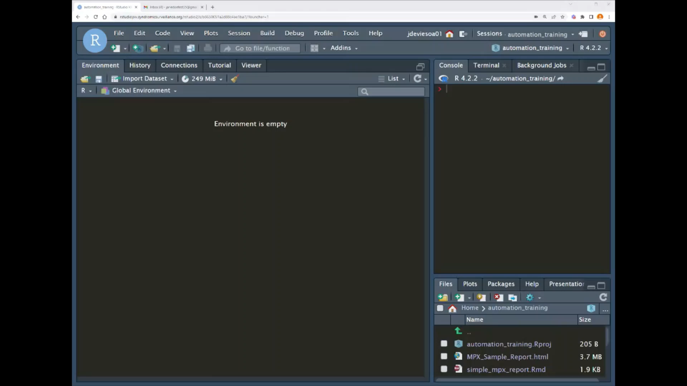

Slide 23
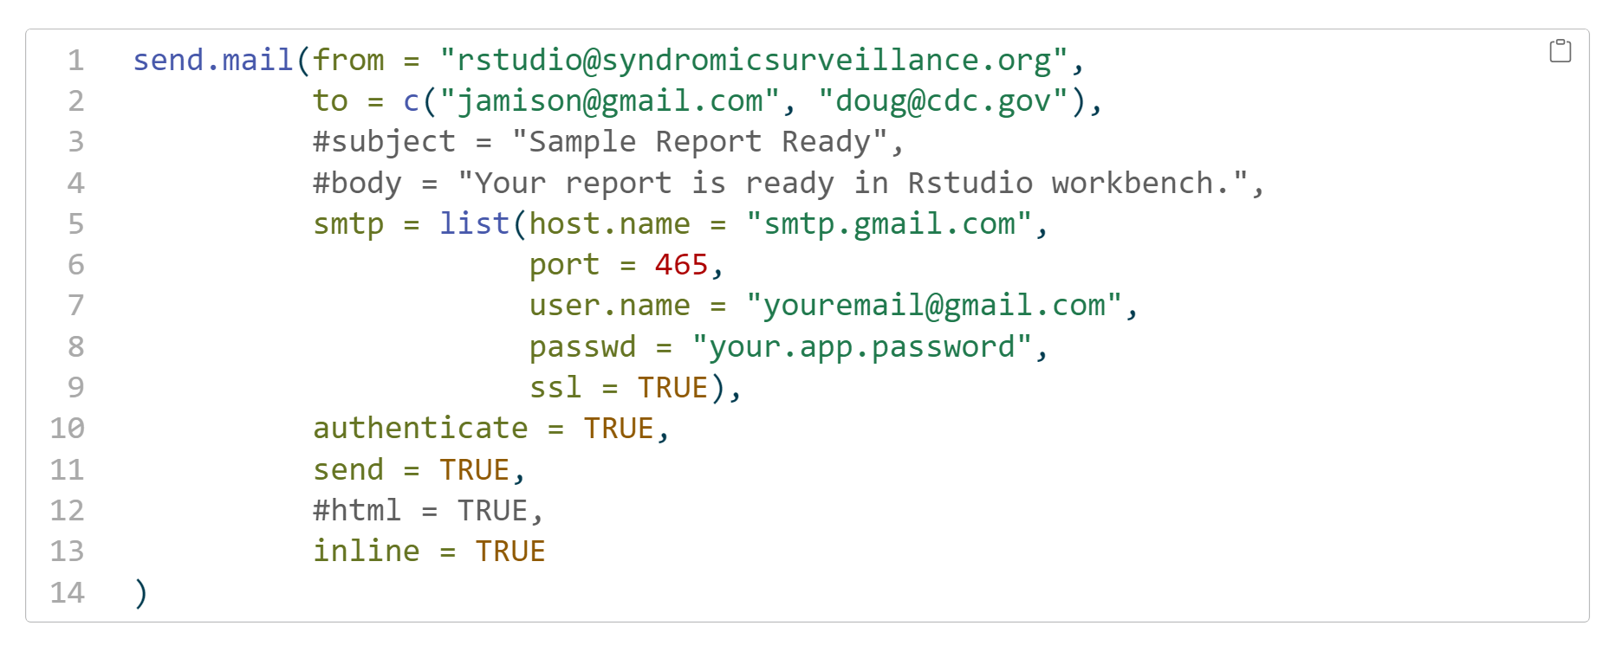
Concept
Checking
Observe the following R code. Which commented out section is needed to ensure successful distribution?
Subject
Body
HTML
All of the above
Notes:
NB: This may be converted into questionnaire/survey format using the presentation platform but will require CSTE pre-approval. These slides are included regardless.

Slide 24
Concept
Checking
Observe the following R code. Which commented out section is needed to ensure successful distribution?
Subject
Body
HTML
All of the above
Notes:
NB: This may be converted into questionnaire/survey format using the presentation platform but will require CSTE pre-approval. These slides are included regardless.

Slide 25
Q&A Segment:
Distributing emails with R

Slide 26
R scripts with cronr
Automation training & demos

Slide 27
Automating R Scripts with cronR
What is Cron?
  Cron is a scheduling tool for Unix-like systems
  Created in 1975 by AT&T Bell Laboratories (creator of S; progenitor of R)
  Used to schedule and run commands or scripts, called jobs
Introducing package cronR
  Designates which R commands or scripts to run
  Specifies frequency or cadence of scheduling
  Allows custom job names and management
Notes:
[Jamison]

Slide 28
Understanding Cron Expressions
What is a Cron Expression?
  5-field character strings specifying job cadence
  Special Characters:
    Spaces ( ) separate fields
    Asterisks (*) indicate no parameter
    Forward Slashes (/) divides time increments by denominator
    Commas (,) and dashes (-) allow 2+ discrete or consecutive values, resp.
Minute (0–59) | Hour (0–23) | Day of Month (1–31) | Month (1–12) | Day of Week (0–6)
* | * | * | * | *
Notes:
[Jamison]

Slide 29

Generating Cron Expressions
Generating expressions with Crontab
  Crontab is an expression generator: crontab.cronhub.io
  Modifying fields will describe cadence in plain language
Notes:
[Jamison]

Slide 30
Concept
Checking
Visit Crontab’s expression generator:
crontab.cronhub.io
What expression will execute a script every Tuesday & Friday at 3:15 PM EST?
15 03 * 2,5 *
15 15 * * 2,5
15 15 * * 2-5
None of the above
Notes:
NB: This may be converted into questionnaire/survey format using the presentation platform but will require CSTE pre-approval. These slides are included regardless.

Slide 31
Concept
Checking
Visit Crontab’s expression generator:
crontab.cronhub.io
What expression will execute a script every Tuesday & Friday at 3:15 PM EST?
15 03 * 2,5 *
15 15 * * 2,5
15 15 * * 2-5
None of the above
Notes:
NB: This may be converted into questionnaire/survey format using the presentation platform but will require CSTE pre-approval. These slides are included regardless.

Slide 32
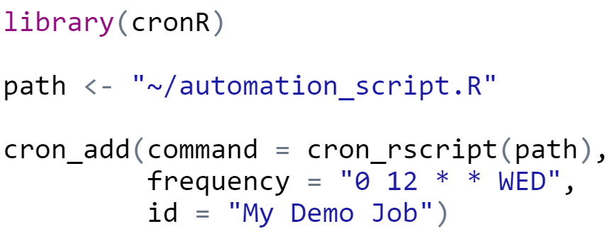
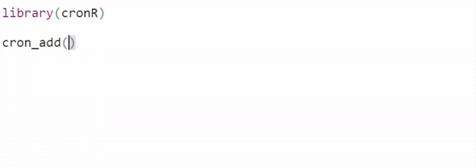
Implementing cronR with Code
cronR jobs may be created manually in consoles or scripts.
  Function cron_add() creates jobs
  Function cron_script() accepts the script path in argument command =
  Argument frequency = accepts Cron expressions but plain language parameters also exist (see left)
  Argument id = names your new job
Notes:
[Jamison]

Slide 33
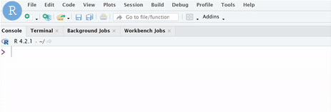
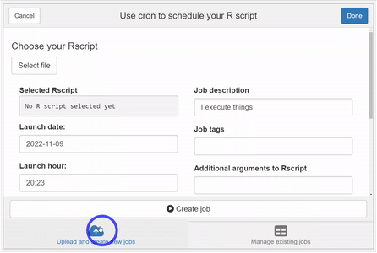
Implementing 'cronR' with RStudio
1
2
Click "Addins"
Select "Schedule R Scripts on Linux/Unix"
Select your parameters in the wizard and click "Create Job"
3
Notes:
[Jamison]

Slide 34
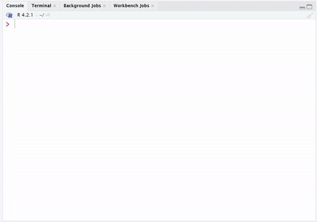
Managing Cron Jobs
Job management functions:
  cron_add() creates new jobs
  cron_rm() removes existing jobs per argument id =
  cron_ls() prints all existing jobs
Note: Adding and removing jobs requires verification with 'Y' or 'N'
Notes:
[Jamison]

Slide 35
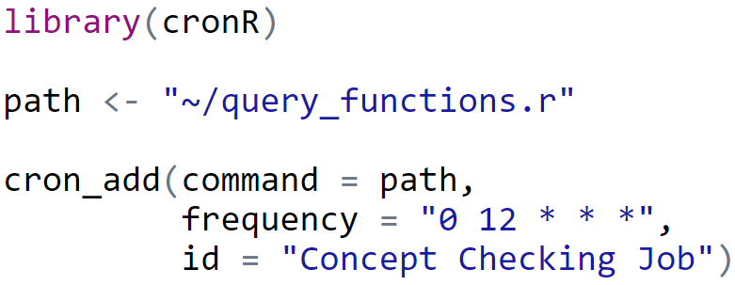
Concept
Checking
Observe the following 'cronR' code. What will result from running the following?
'query_functions.r' will run every day at noon
'query_functions.r' will run every hour in December
"Concept Checking Job" will now print with 'cron_ls()'
None of the above
Notes:
NB: This may be converted into questionnaire/survey format using the presentation platform but will require CSTE pre-approval. These slides are included regardless.

Slide 36
Concept
Checking
Observe the following 'cronR' code. What will result from running the following?
'query_functions.r' will run every day at noon
'query_functions.r' will run every hour in December
"Concept Checking Job" will now print with 'cron_ls()'
None of the above
Notes:
NB: This may be converted into questionnaire/survey format using the presentation platform but will require CSTE pre-approval. These slides are included regardless.

Slide 37
Q&A Segment:
Automating SCRIPTS with 'cronr'

Slide 38
Custom powerpoint slides
Automation training & demos

Slide 39
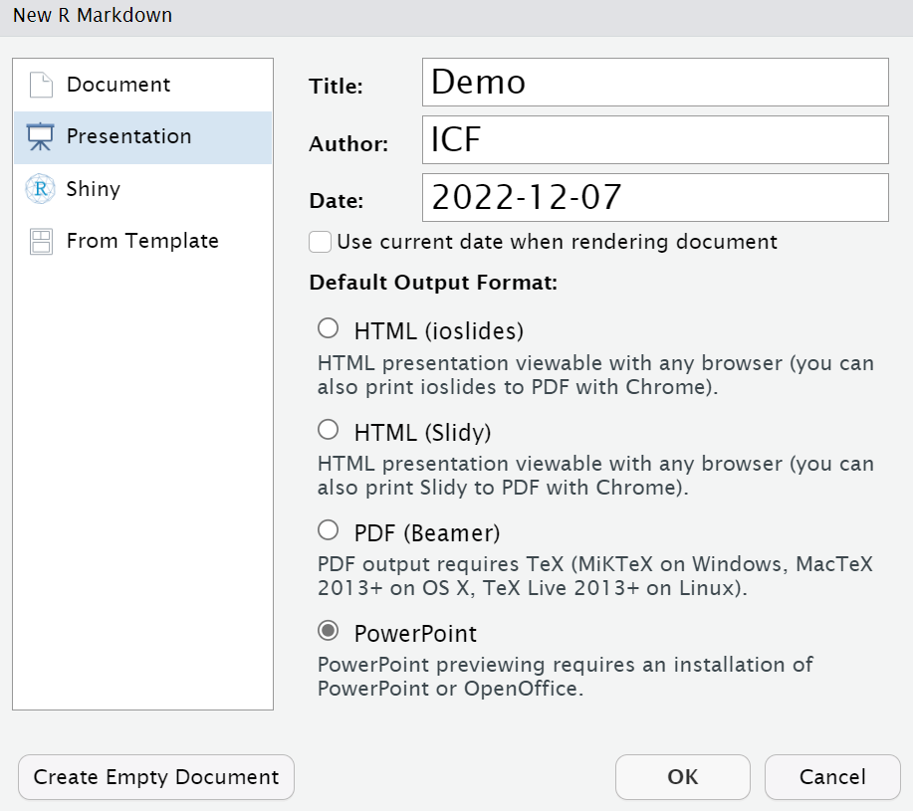
Limitations to Knitting PowerPoint
RStudio suffers from limitations to knittable output.
"Please note that images and tables will always be placed on new slides. The only elements that can coexist with an image or table on a slide are the slide header and image/table caption.
When you have a text paragraph and an image on the same slide, the image will be moved to a new slide automatically."
—R Markdown: The Definitive Guide
Notes:
[Jamison]

Slide 40
Package officer for PowerPoint
Package officer manipulates MS Office products in R.
  Part of the larger officeverse package ecosystem
  Far more customizable Word or PowerPoint output
Typical officer PowerPoint workflow:
  Create a new PowerPoint template
  Designate placeholders for dynamic content
  Read template in R to populate placeholders and output deck
Notes:
[Jamison]

Slide 41
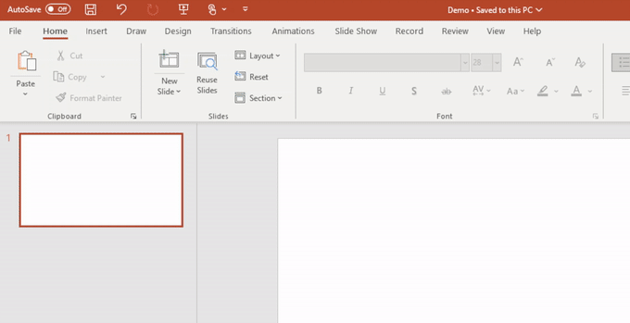
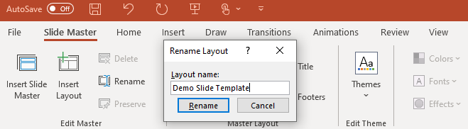
Creating PowerPoint Templates
1
In the "View" tab, select "Slide Master Layout."
  In "Slide Master," select "Insert Placeholder," and choose a content type
  Select a subordinate slide template and "Rename" to more easily identify it in R
2
Notes:
[Jamison]

Slide 42
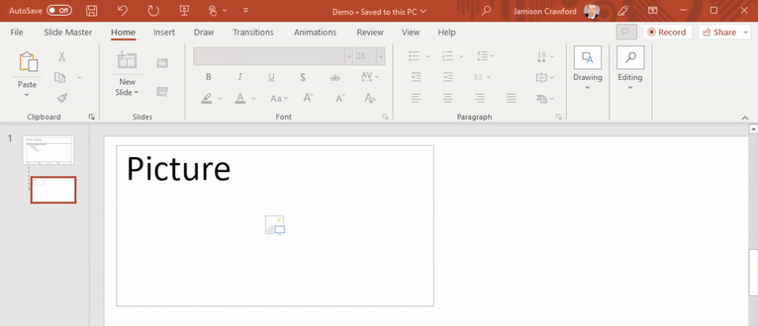
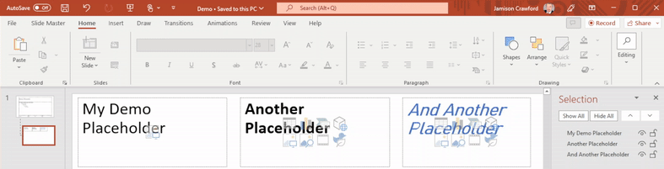
Customizing Placeholders
1
Multiple placeholders can be created, renamed, or imbued with permanent formatting.
Select "Editing," "Select," and "Selection Panes" to list and modify placeholders
Create, rename, and format each placeholder
2
Notes:
[Jamison]

Slide 43
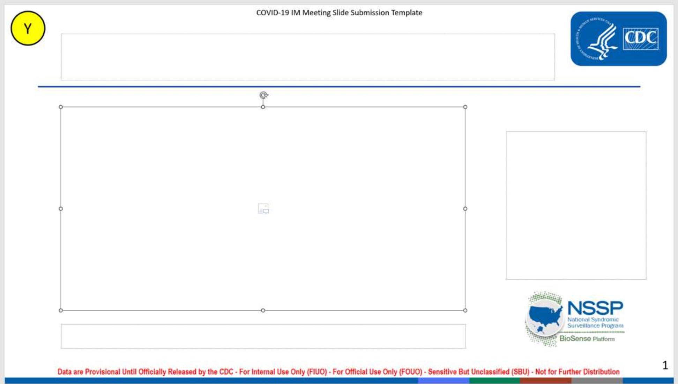
Example: MPX Discharge Diagnosis Codes
This template is used to visualize weekly ED visits with Mpox discharge diagnosis codes. Note the following elements.
1 Master Template
1 Subordinate Template
1 Custom Background
5 Placeholders
Notes:
[Jamison]

Slide 44
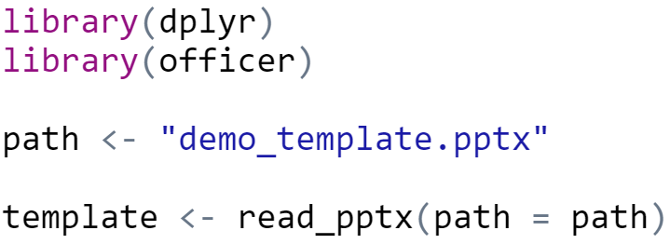
Reading in PP Templates in R
Load package officer; package dplyr is helpful
Use function read_pptx();
path = accepts the .pptx file
1
2
Notes:
[Jamison]

Slide 45
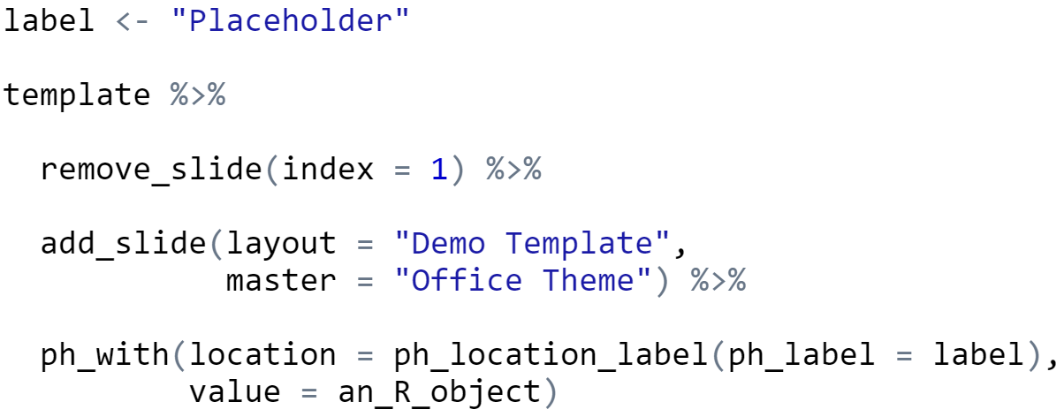
Populating Placeholder Content in R
Initialize template object
Remove first slide with function remove_slide() and argument index = 1
Initialize new slide with add_slide() using layout = and master = template names
Populate placeholders with function ph_with() and ph_location_label()
  ph_label = accepts placeholder name
  value = accepts placeholder content
  print() will copy the slide(s) to your directory
1
2
3
4
Notes:
[Jamison]

Slide 46
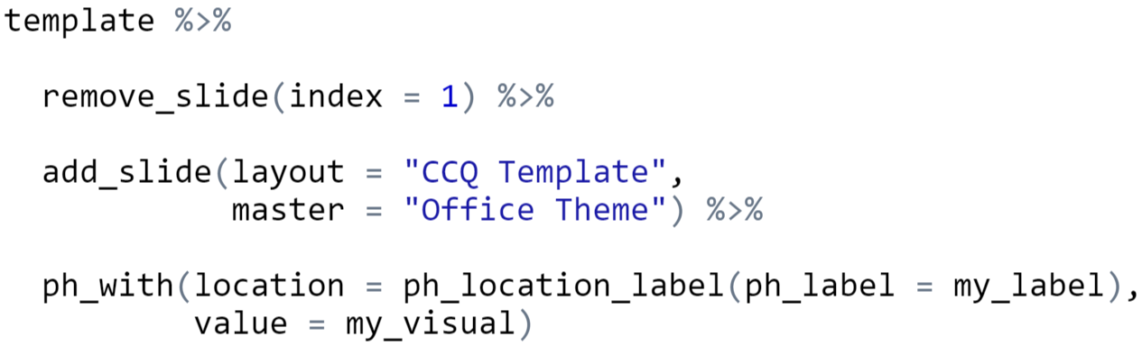
Concept
Checking
Observe the following R code. If executed, what will result as .pptx slide deck output?
Only the placeholder named 'my_label' will appear
All formatting in theme "CCQ Template" will remain
Updated placeholder will depict object 'my_visual'
All the above
Notes:
NB: This may be converted into questionnaire/survey format using the presentation platform but will require CSTE pre-approval. These slides are included regardless.

Slide 47
Concept
Checking
Observe the following R code. If executed, what will result as .pptx slide deck output?
Only the placeholder named 'my_label' will appear
All formatting in theme "CCQ Template" will remain
Updated placeholder will depict object 'my_visual'
All the above
Notes:
NB: This may be converted into questionnaire/survey format using the presentation platform but will require CSTE pre-approval. These slides are included regardless.

Slide 48
Q&A Segment:
Automating Slide Decks

Slide 49
SUMMARY

Slide 50
Reporting & Distribution in R: Summary
Today, we learned:
  Current NSSP applications using automation
  Methods to distribute custom emails and attachments
  How to schedule Cron jobs using expressions and cronR
  How to automate PowerPoint slides with dynamic content
Remember:
  PowerPoint is just one example of the power of automation
  Visit "Resources" slide to continue mastering these techniques
Notes:
NB: Conclusion to be finalized after body content completed and practice data/R Markdown handouts are provisionally established.

Slide 51
Resources
Package 'mailR’
  GitHub: ‘mailR’ Repository
Package 'cronR'
  CRAN 'cronR' Package Documentation
  Crontab: Cron Expression Generator
  GitHub: 'cronR' Repository
Package 'officer'
  CRAN: 'officer' Package Documentation
  GitHub: 'officer' Repository
Notes:
NB: Conclusion to be finalized after body content completed and practice data/R Markdown handouts (resources) are provisionally established.

Slide 52
Thank you!
Special Thanks:
Michael Sheppard
Doug Wirtz
For more information, contact CDC
1-800-CDC-INFO (232-4636)
TTY: 1-888-232-6348 www.cdc.gov
The findings and conclusions in this report are those of the authors and do not necessarily represent the official position of the Centers for Disease Control and Prevention.

