Slide 1
Using R markdown to Develop a Comprehensive, Syndrome-based Dashboard for Public Health Practice in Kansas
Kansas DSTT Team | December 7, 2022
Notes:
Feedback from abstract reviewers:
Great work. My one concern with providing a dashboard for users unfamiliar with ESSENCE is that they also be made acutely aware of the limitations of the data, such as the idiosyncrasies in the way the data are reported by different facilities. I'm hoping the presenters will cover that aspect as well.
LG: should we add limitations of ESSENCE to the overview tab? Most of the users that would be interested in this dashboard are typically aware of the limitations, but wouldn’t hurt to include it in the technical notes section to make sure we say it somewhere
As a non-Epi coder, I find R much more difficult to use than ESSENCE. I'm curious as to how this would be easier for PH staff to use. (response in Purpose slide)

Slide 2
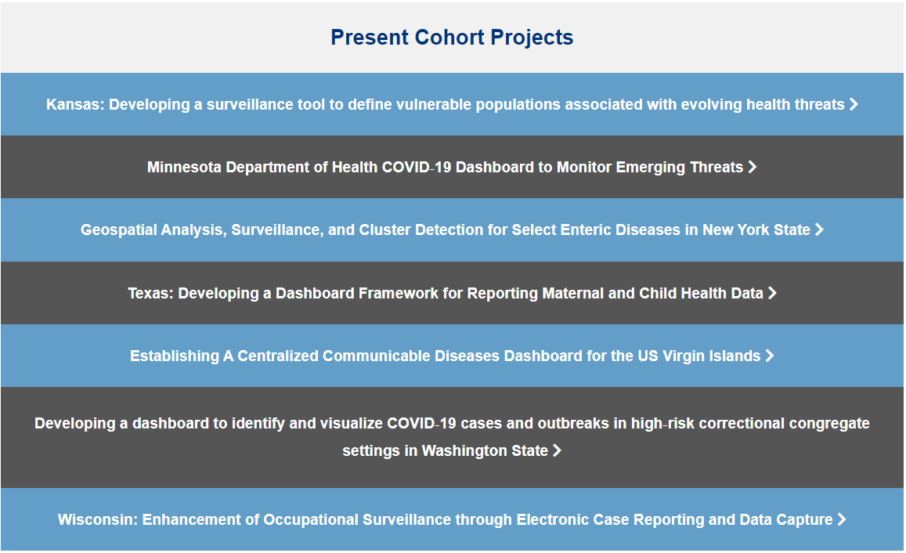
About CSTE's Data Science Team Training (DSTT) Program
Program Overview
Designed to increase the public health work force knowledge of data science and data modernization
Yearly, 12-month program. One team from each jurisdiction is accepted
2nd year cohort - meant to address CDC's data modernization initiative
KS Team Members
Jason Geslois
Lauren Gracy
Gabe Haas
Jade Hodge
Scott Johnston
Danielle Sass – Project Supervisor
Notes:
Jason present
- had access to Coursera courses to use
- had an assigned coach we met with monthly to review our progress
- had membership to basecamp to talk and see what other health depts were also doing

Slide 3
What is ESSENCE?
Electronic Surveillance System for the Early Notification of Community-based Epidemics (ESSENCE)
  Housed under the CDC’s National Syndromic Surveillance Program (NSSP)
Captures 98% of total Kansas Emergency Department (ED) visits within 24 hours of patient admission
ESSENCE allows users to visualize ED visit trends for hundreds of predefined Syndromes
  Raw data processed, calculated fields created, and records combined into a single visit
  Diagnosis codes, ICD9/10 and SNOMED, plus free-text analysis of Chief Complaint are used to categorize patients into Syndromes
Rich data source including 196 fields: patient demographics, diagnosis codes, triage notes, geographic area, smoking status, height/weight, etc.
NSSP’s BioSense Platform includes a Suite of tools to help with data analyses
  Using NSSP’s RStudio Server & ESSENCE Application Programming Interface (API), Syndromic data can be accessed without opening the ESSENCE interface
Notes:
Lauren Present
ESSENCE is a secure web-based query tool for monitoring community health
Intended use by public health and health care providers
OR custom syndromes can be created
ESSENCE tool sits on NSSP’s BioSense platform, which also includes a suite of tools
API = Application Programming Interface = basically allow different services to communicate, a set of directions telling the other service exactly what you want

Slide 4
1. Brainstorming and Determining Measures of Interest
2. Learning R
3. Connecting to ESSENCE API and Creating Graphs
4. Upgrading report to flexdashboard
DSTT Kansas Team Process
Weekly Meetings throughout the year
Explored ESSENCE fields
Looked at other types of analysis/visualization projects
Narrowed down our focus
Collaborated in NSSP RStudio and Github
Used Coursera, KDHE R Users Group meetings and office hours, NSSP contacts, DSTT Coach to learn and develop skills
Connected to the ESSENCE API to directly pull queried data
Initially worked in a Rmarkdown file to create a pdf report
Developed into a flexdashboard – an interactive dashboard that can quickly visualize queried data
Flexible and fast
Notes:
Jason present
First part of year –
new to R
brainstorming project ideas
Project development
Weekly meetings
explored ESSENCE
We started with a series of meetings brainstorming and exploring ESSENCE to identify fields in the data that we were most interested in exploring. Our goal was to develop a tool to allow us to visualize ESSENCE data quickly and have an automated output of demographics/risk factors. Essentially an adaptable code that uses an API to quickly obtain useful visualizations and data from ESSENCE.
The DSTT training gave us access to a variety of Coursera classes and a coach. Through these resources, as well as through meeting with a contact at NSSP, we worked on developing our R skills and how to connect to the ESSENCE data through an API. We met weekly throughout the year and used ESSENCE Rstudio to collectively work on our R code through a shared project file.
The first iteration was to use Rmarkdown to create a PDF report, but the tool was later changed to be a flexdashboard – a html visualization of the different charts and analyses for the ESSENCE queries we choose to select. We wanted it to be usable for anyone by running the R code, even if they aren’t typically familiar with using ESSENCE

Slide 5
Purpose of This Tool
Near Real-Time
Interoperable
Trend detection
Determine populations most affected (Ex: Air-Quality)
Questions we addressed that one might want to ask about the data
  Which age group is most affected?
  Are there disparities in who is presenting to the Emergency Department?
  Where in the state is being most affected and when?
  Are we also seeing an increase in specific diagnosis codes? Ex: Are asthma-related discharge diagnosis codes related to air-quality increasing over time?
  Are there any related syndromes developing alongside the query of interest?
More usability for non/infrequent ESSENCE user
Notes:
Lauren present
Since this tool is tied directly to the ESSENCE data we can rapidly analyze and visualize the data for a variety of outcomes (syndromes) ; there are different visualizations in which users can rapidly glean information. Ex: Some common to epi day-to-day analyses – population characteristics, spatial analysis, and trends to more in-depth analyses to answer a lot of questions about this data from this one tool
A few of the questions answered from this dashboard: Which age group is most affected? Are there disparities related to other characteristics for this type of ED visit? Where in the state is most affected? Can we see if there are increases in related diagnosis codes? (Ex: when we see increasing air-quality visits, are asthma-related visits also increasing?
Answer to feedback from reviewer:
We do not expect the epis we share this with to be expert coders in R. We have done the heavy lifting by creating the dashboard; so all other users need is to get ESSENCE and Rstudio access, install the packages, and knit with their parameters of interest.
It’s easier than ESSENCE because you do not need to click around/create a bunch of different queries/time series/tables etc to find the information you might want. It’s all available at your fingertips with clicking a few buttons.

Slide 6
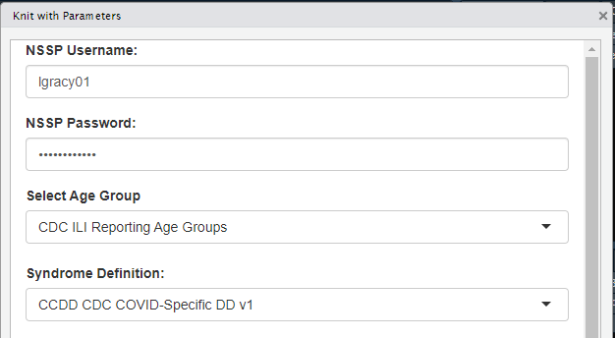
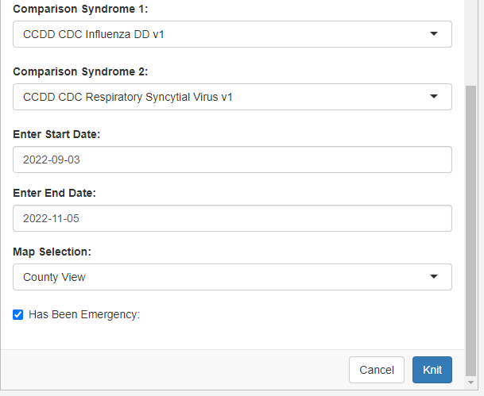
Demonstration
Query Pull Date – Sun – Sat
Use Case 1 – Respiratory
  COVID-19
  Flu
  RSV
Notes:
Jason present
We're going to demo one use cases today, but there's other potential use cases that this might be useful for, so some details may vary depending on your particular use case. And remember this is still our version 1, so we still may have some kinks when we get into it. Now we've already generated the dashboard examples just in case we couldn't get into the system for our presentation and as you see on the right, the first part of this, is the parameter selection menu, before we are going to "run" the document, or as it's called "knit" it. Go into details parameter selection etc.
Order of tabs & who will present demo
> Overview (Lauren)
> Demographic Snapshot (Lauren)
> Trends (Lauren)
> Map Comparison (Jason)
> Map Over Time (Jason)
> Network graph (Jason)
> Increasing terms & codes (Lauren)
> Overlapping Syndromes (Jason)

Slide 7
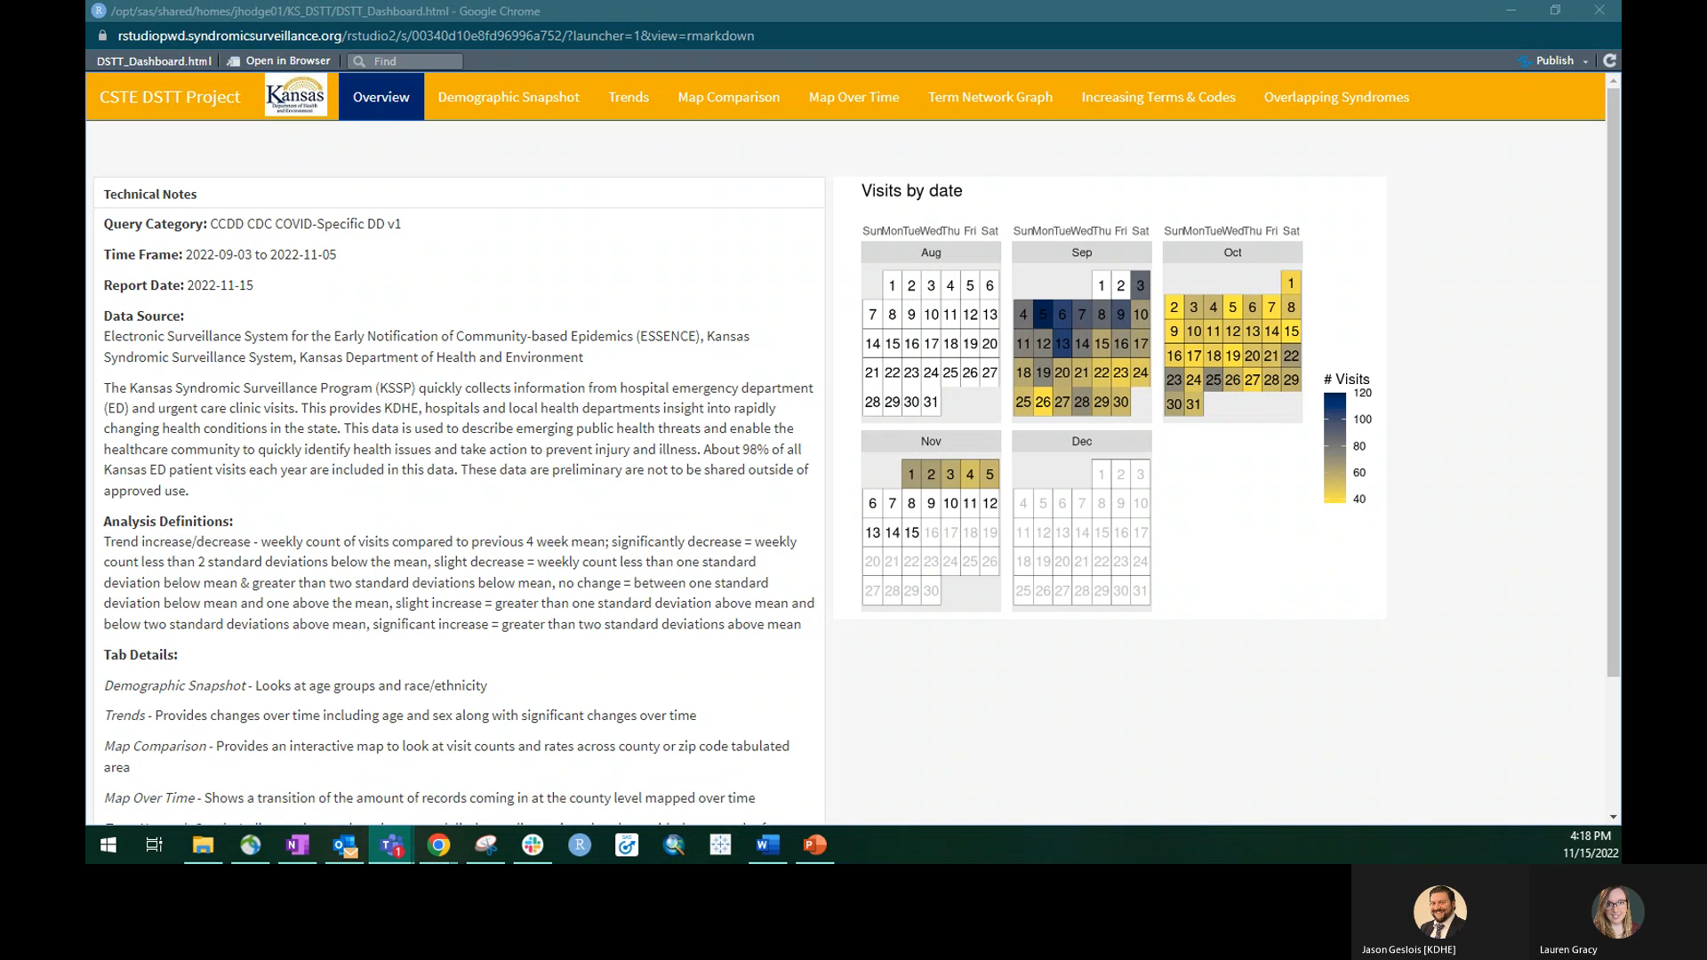

Slide 8
Future
For Other Epis
  Sharing R project for testing additional use cases & requesting feedback on usability and the needs of specific user groups
For Programs
  Sharing data for situational awareness and public health action
For Adding Future Capabilities
  Creating a report version (pdf) for sharing with partners
  Adding ability to type out user designed queries
  Adding predictive analytics and spatial statistics bringing in external data for additional insights
  Assessing additional ESSENCE metrics measuring statewide healthcare quality
Notes:
Jason present
So we plan on working to build out and look into several future potential options, but we’d love to have feedback from others on what best might be useful. Just some examples of what we might be able to do is make it useful to sharing with other epidemiology program areas and the types of queries that are useful to each specific group. Sharing with program areas for situational awareness, and adding additional capabilities such as typed out queries, predictive analytics and spatial statistics, or other healthcare metrics such as overall healthcare quality.

Slide 9
Acknowledgements
Other DSTT Team Members
  Gabe Haas
  Jade Hodge
  Scott Johnston
CSTE Data Science Team Training 2022
  Patric Prado
National Syndromic Surveillance Program
  Michael Sheppard
  Roseric Azondekon
  Lakshmi Radhakrishnan
Kansas Department of Health and Environment
  Danielle Sass
  Jaime Gabel
  John Anderson & the internal R Users Group
Notes:
Lauren present
Thank you to the other members of our team – Gabe Haas, Jade Hodge, and Scott Johnston
The CSTE 2022 Data Science Team Training for the opportunity and trainings to create this project and our Coach Patric Prado for all the guidance throughout the process
The NSSP team for providing a lot of the backbone of this dashboard and assistance early in this process
And our other KDHE staff who helped throughout this last year – Danielle and Jamie for providing oversight of the project, & John Anderson for all his R wisdom and allowing us to show off our progress & get feedback form R users

Slide 10

Thank You/Questions
Contact Info
Jason Geslois Lauren Gracy
Jason.Geslois@ks.gov lauren.gracy@ks.gov
Notes:
Jason present
We thank you for ability to present today and happy to take any questions.

