Slide 1

Incorporating and Modernizing Data In Disaster Epidemiology –
NC Wastewater Monitoring Network
Ariel Christensen
Deputy Director NCWMN & Environmental Epidemiologist
Occupational and Environmental Epidemiology Branch

Slide 2
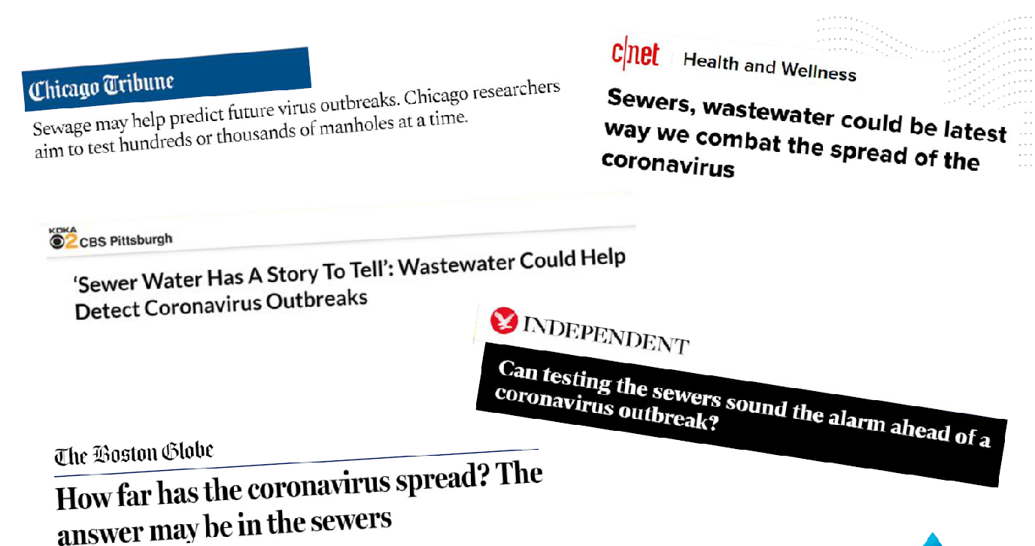
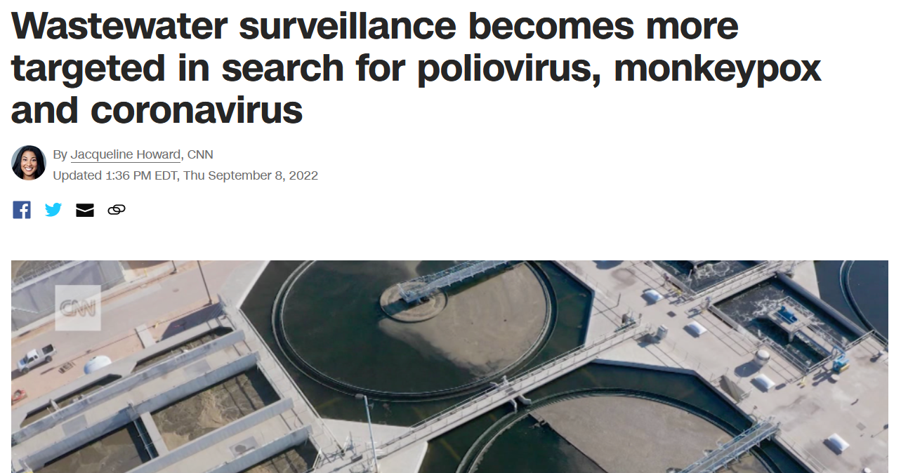
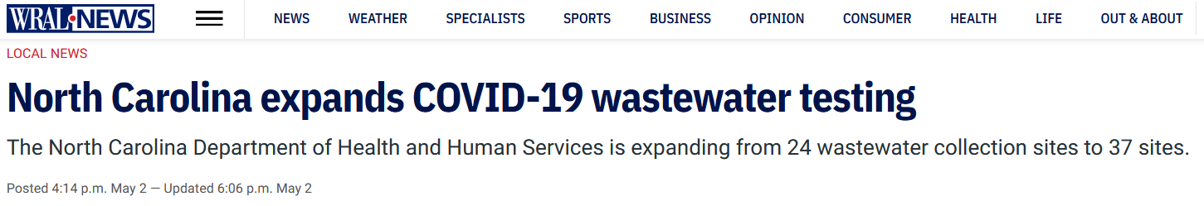
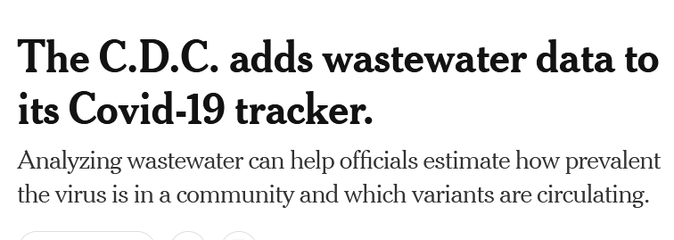
Wastewater Monitoring Makes The News

Slide 3
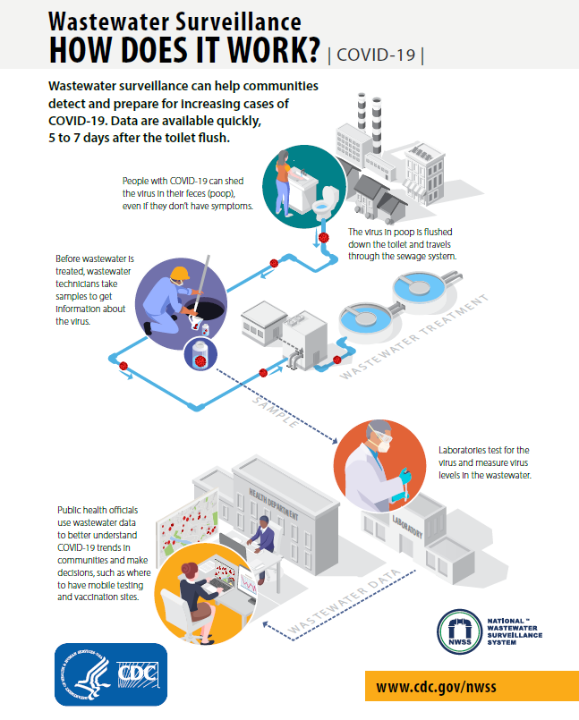
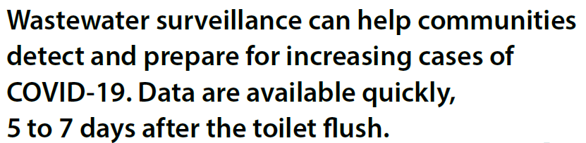

Slide 4
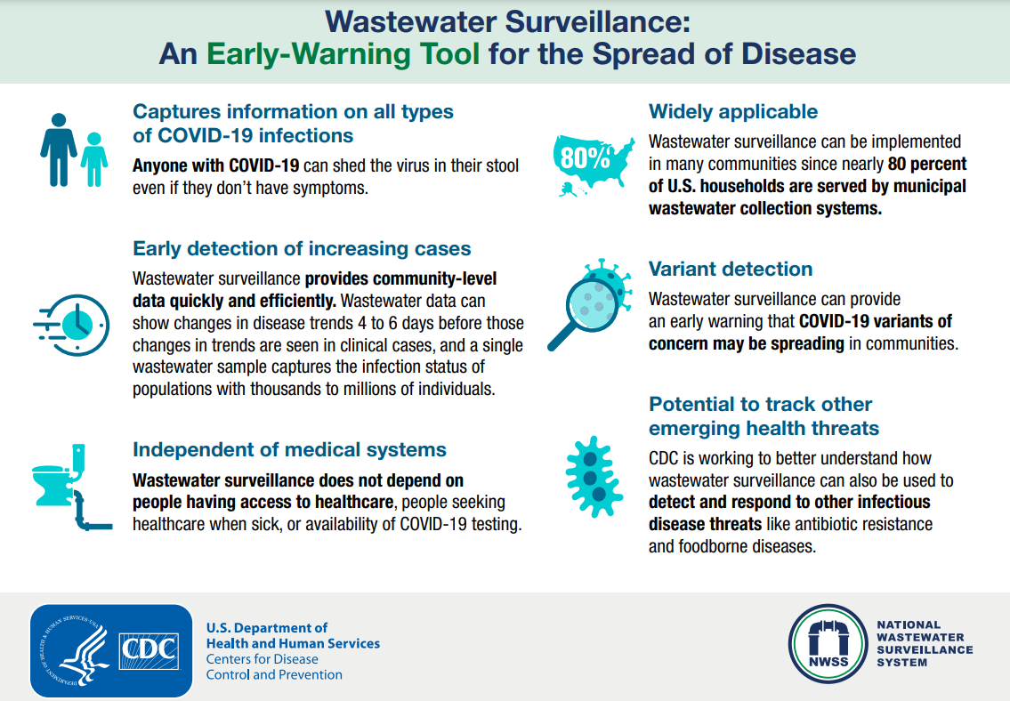

Slide 5

Highlights of WBE in the literature
March 2020–April 2021 (Southern Nevada)
  Next generation sequencing to identify Alpha (B.1.1.7) and Epsilon (B.1.429) lineages in the community up to one month prior to clinical confirmation
  Used wastewater, fecal shedding rates, and seroprevalence data to estimating that ~38% of individuals in Southern Nevada had been infected by SARS-CoV-2 as of April 2021 (compared to only 10% confirmed via clinical testing)
November 2020–March 2021 (Oklahoma)
  Early warning lead-time for an outbreak/increase in cases was higher in areas with larger Hispanic populations and lower in areas with a higher household income or higher proportion of persons aged 65 years or older
  Predicted the number of cases 7-days in advance (accuracy of 81-92%)

Slide 6
Highlights of WBE in the literature
November–December 2021 (California, Colorado, Houston, and New York City)
  Omicron-associated mutations were documented during November 2021, at least a week before the first U.S. case identified via clinical testing on December 1 (MMWR)
January 2021–March 2022 (North Carolina)
  2 separate analyses (submissions in progress) show that at most wastewater sites in NC, wastewater concentrations lead clinical cases by 3–7 days (UNC) and 4–5 days (Mathematica)
Summer 2022 (New York City)
  A case of paralytic poliomyelitis was confirmed in an unvaccinated adult Rockland County; wastewater surveillance revealed evidence of poliovirus transmission in 5 counties → state of emergency was declared allowing additional health professionals to administer poliovirus vaccine

Slide 7
North Carolina Wastewater Monitoring Network
Part of the CDC National Wastewater Surveillance System

Slide 8
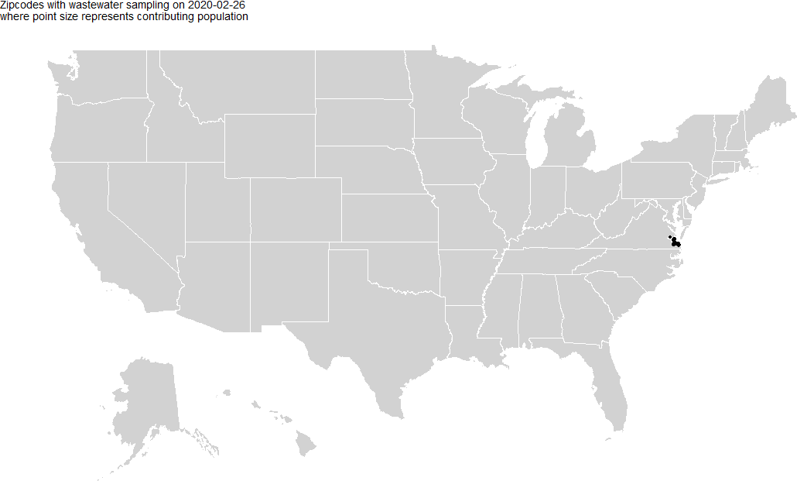
CDC’s National Wastewater Surveillance System Expanding Coverage
  Began with 8 reporting jurisdictions, now 48 NWSS reporting jurisdictions with 1,149 wastewater sampling sites
  Samples Submitted: 75,344 jurisdiction samples, 84,550 total samples (including contract samples)
  Median time from test to submit date July 2021-July 2022 is 3 days
  130,000,000 of the US population covered.

Slide 9
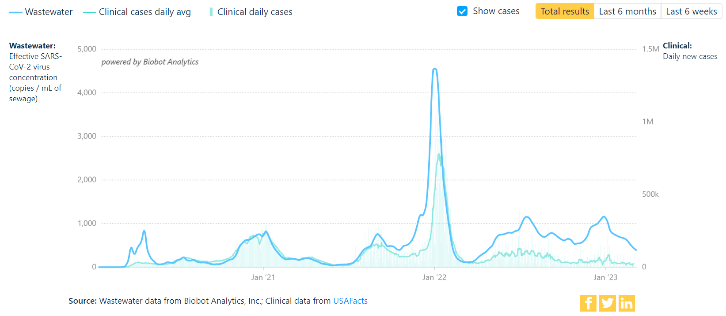
National Wastewater Trends
Omicron BA1
Vaccinations
Delta
Rollout of home testing

Slide 10
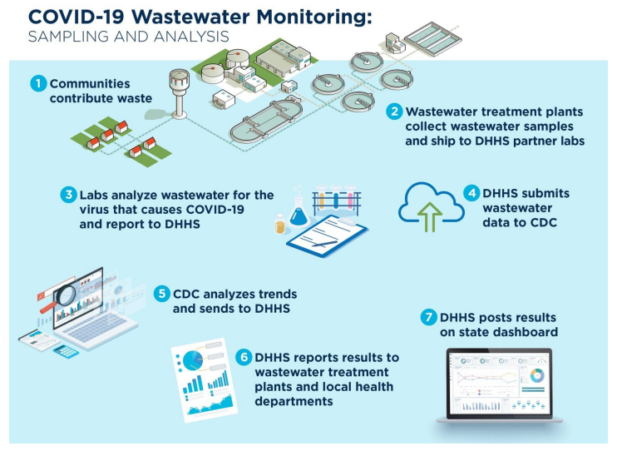
NC Wastewater Monitoring Network Process

Slide 11
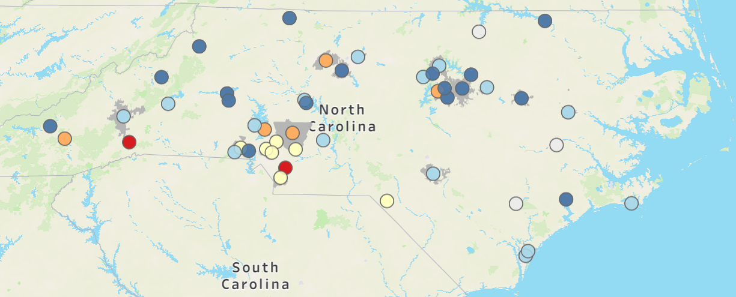

SARS-CoV-2 Wastewater Percentiles
NC Sites (current as of 5/10): 33/50 sites in lowest 2 percentiles
Notes:
Updated. black dots – new region 4 sites!

Slide 12
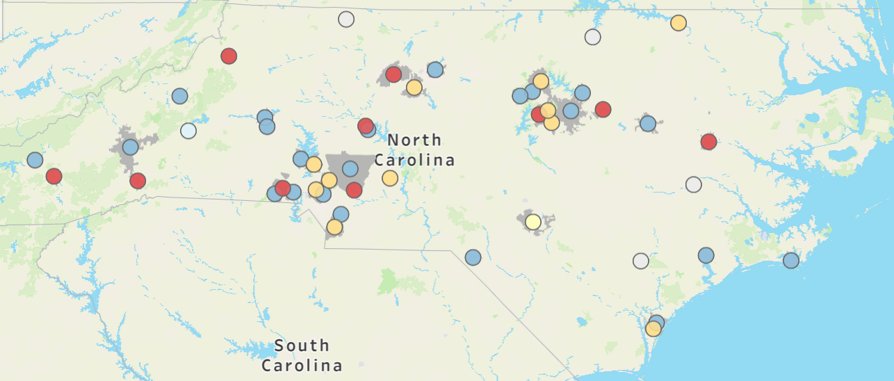
SARS-CoV-2 Wastewater Percent Change
NC Sites (current as of 5/10): 23/50 sites decreasing
Notes:
Updated. black dots – new region 4 sites!

Slide 13
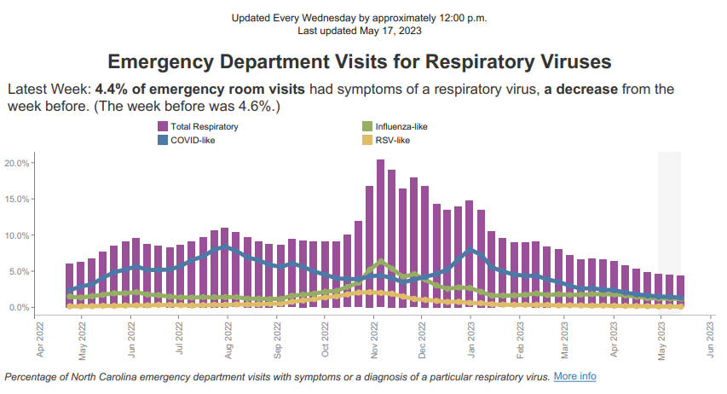
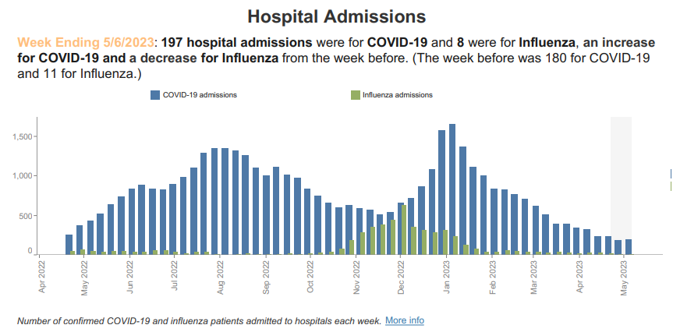
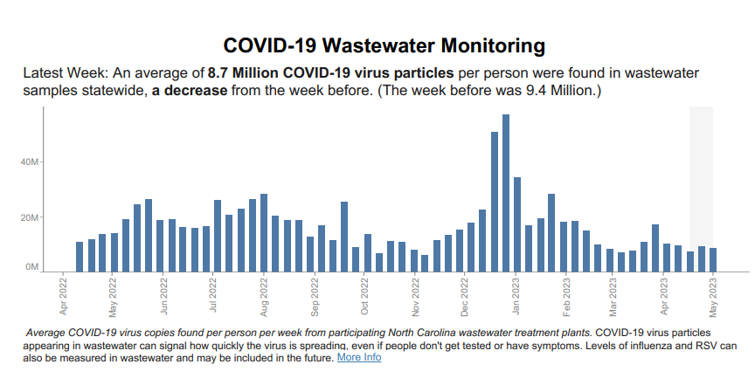
Wastewater monitoring shown on NC Respiratory Virus Summary Dashboard
https://covid19.ncdhhs.gov/dashboard
(Updated Noon Each Wednesday)
This Week: 8.7 Million (down from 9.4)

Slide 14
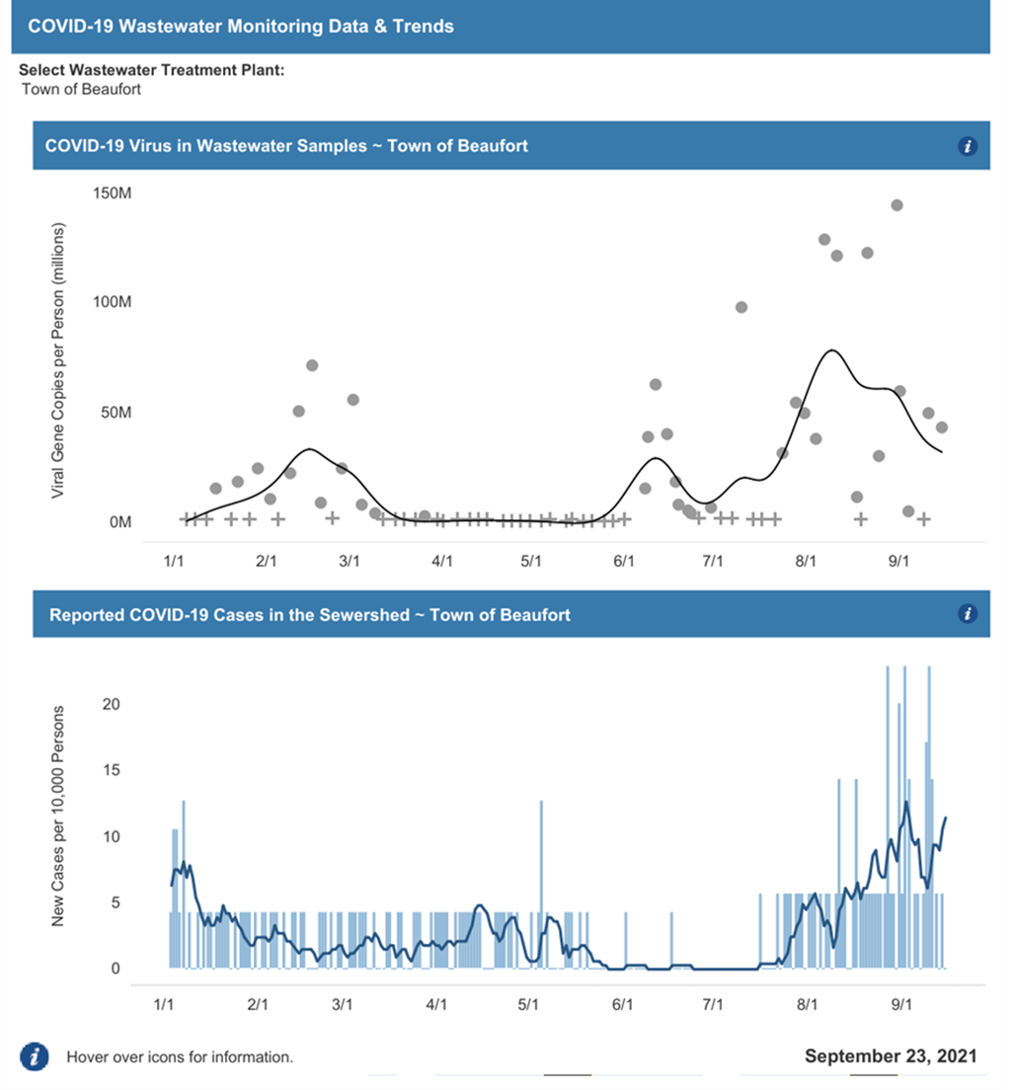
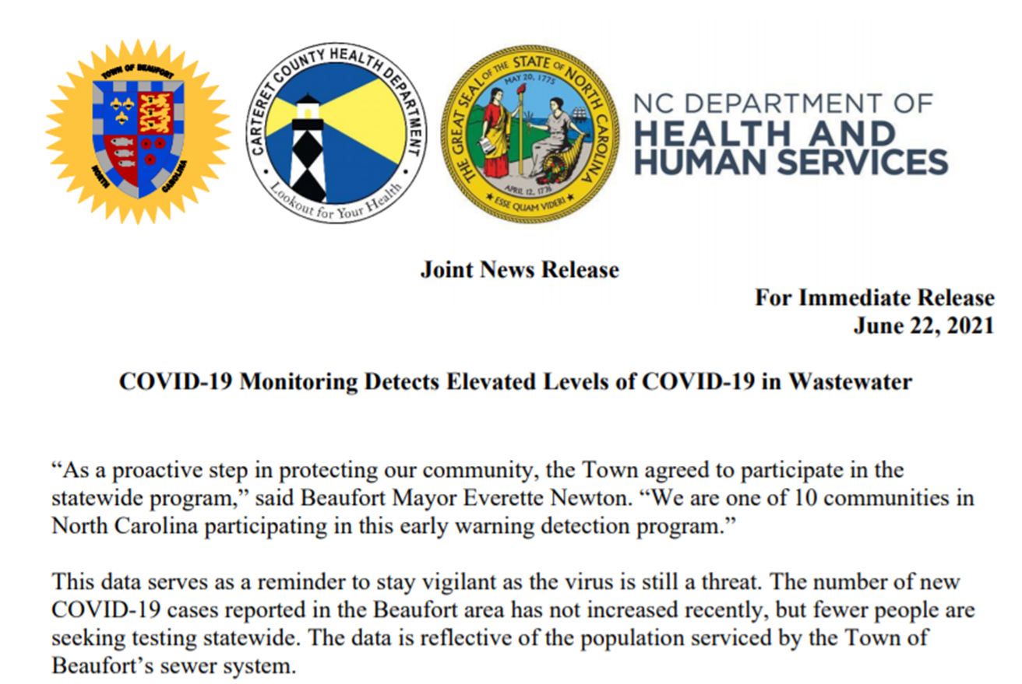
An example of public health action…

Slide 15
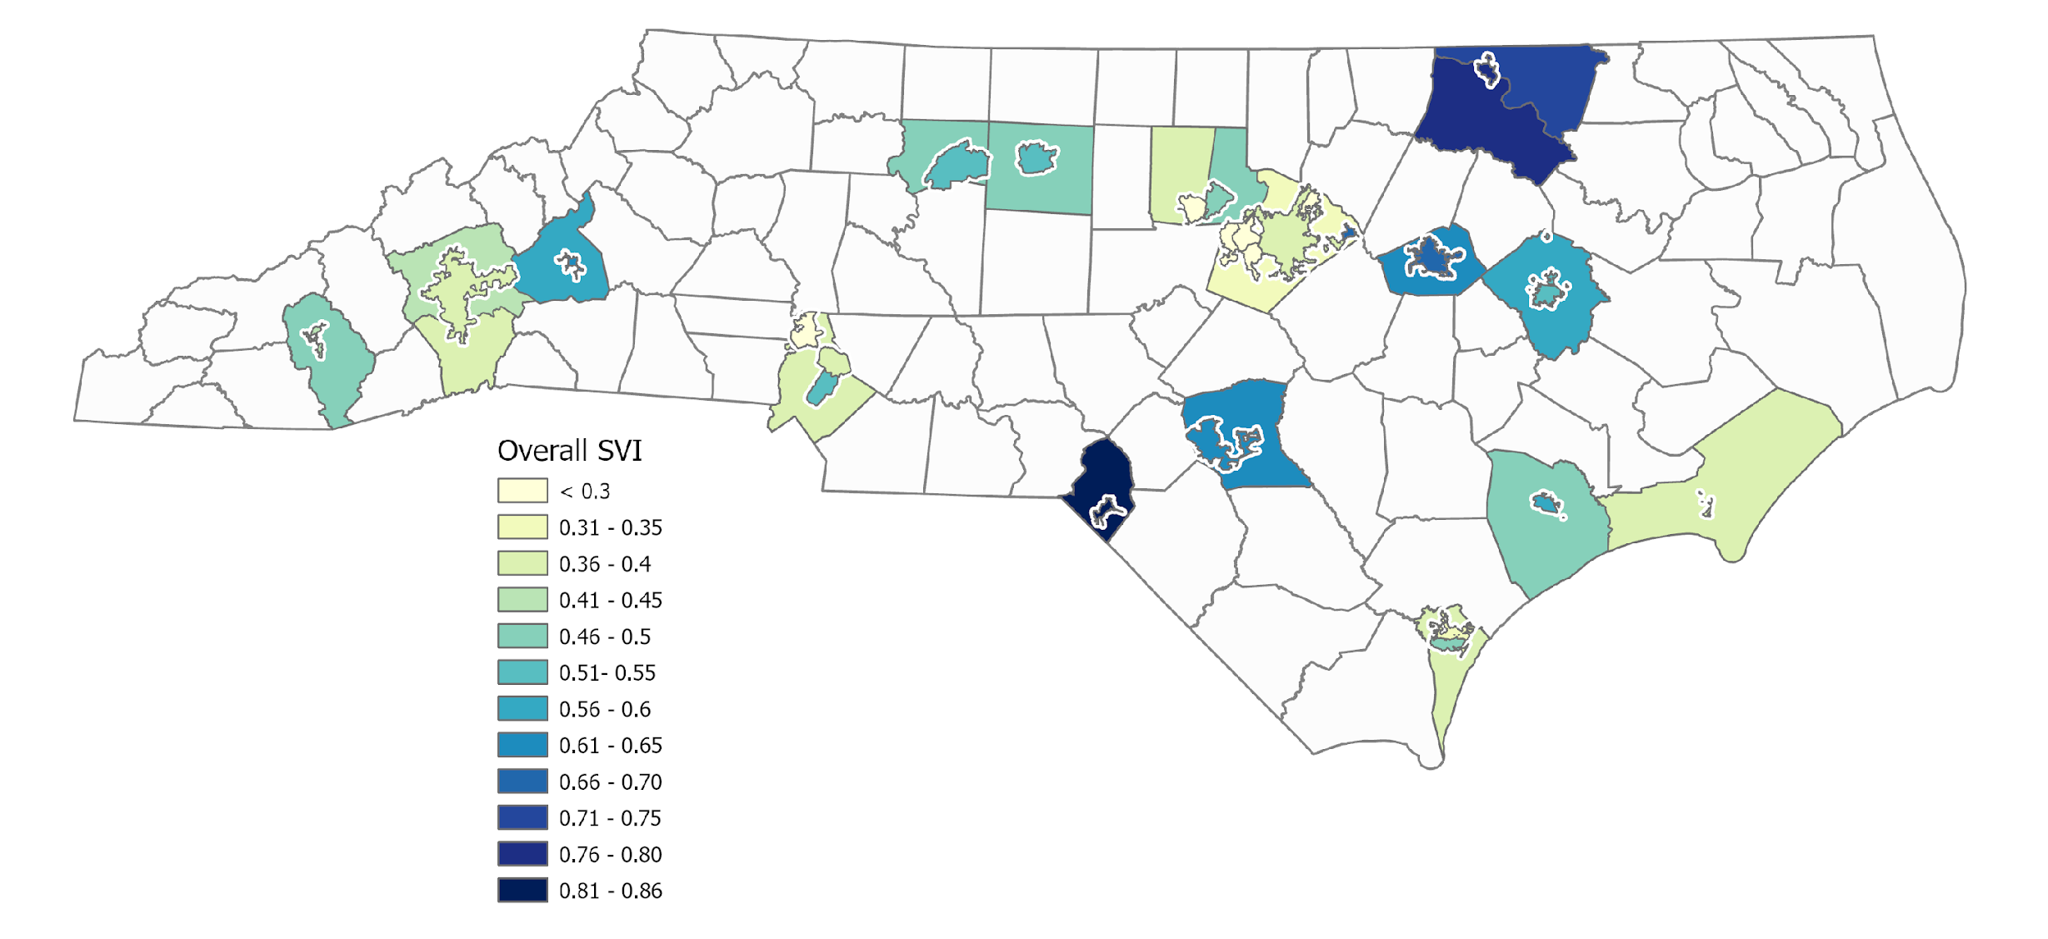
Equity Spotlight: Overall Social Vulnerability Index (SVI)
Similar in monitored sewersheds compared to county populations
Notes:
Socially vulnerable populations are especially at risk during public health emergencies because of factors like socioeconomic status, household characteristics, racial and ethnic minority status, or housing type and transportation. This map shows the overall social vulnerability score in monitored sewersheds and their respective counties. The SVI varies by geographic location which shows that wastewater monitoring is occurring in areas of high and areas of low social vulnerability. The SVI in sewershed populations is similar to the county except in six counties (Orange, Buncombe, Mecklenburg, Wake, New Hanover, and Carteret) In the counties marked A, B, and C, there are multiple monitored sewersheds within the county. In these counties the sewershed population’s social vulnerability is not always the same as the county’s.

Slide 16
NEW
Wastewater Sequencing!
Notes:
Thank you – I am excited to present our findings comparing covid sequencing in wastewater versus clinical samples

Slide 17
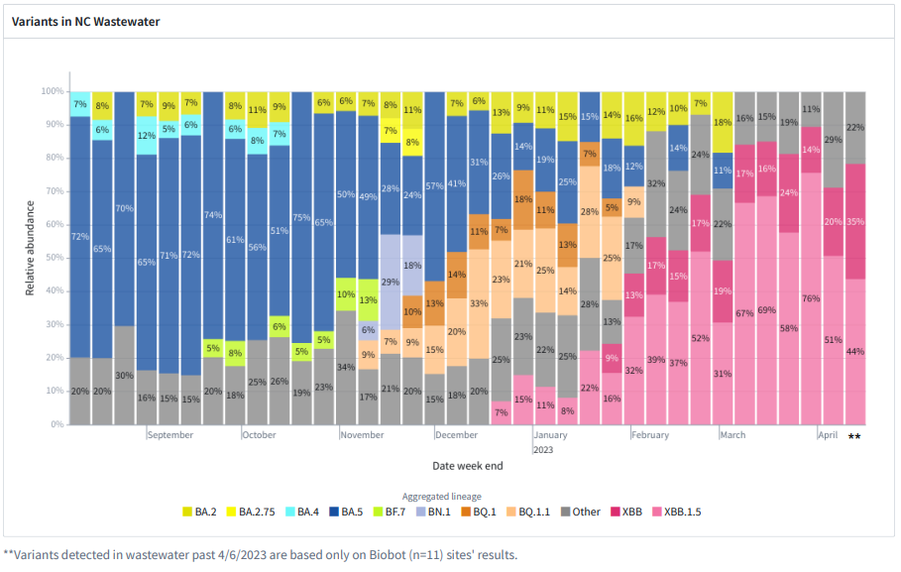
Wastewater Sequencing - SARS-CoV-2 Aggregated Lineages

Slide 18



Conclusions
Variant detection in wastewater tends to lead clinical detection
Correlation between wastewater and clinical identification is not clear cut
Dynamics differ by variant
Notes:
I wanted to start off with an overview of what we found and then I will get into the results themselves. Overall, variant detection in wastewater tended to be earlier than detection among clinical samples. However, the relationship between the wastewater data and clinical data is not straightforward. And as you will see, the dynamics differ between the various variants we studied.

Slide 19
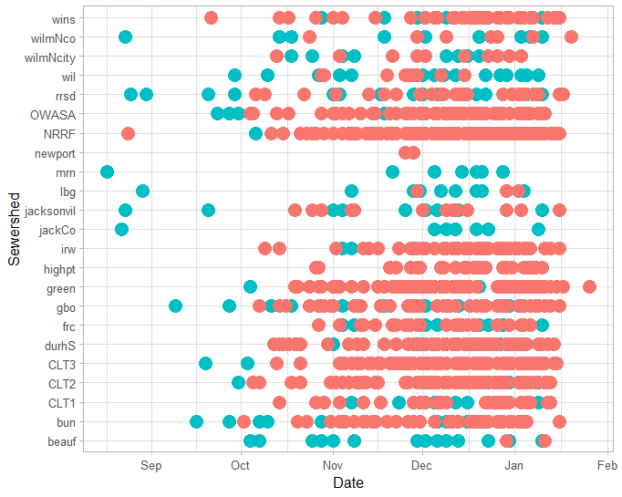
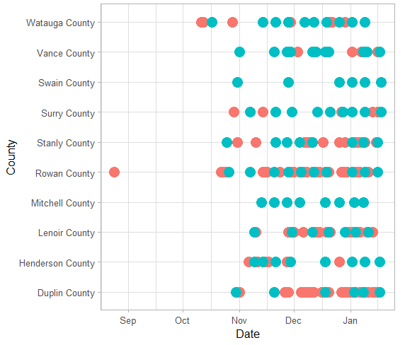
Identification of BQ in wastewater compared to clinical samples ​
NWSS sites
Biobot sites
Clinical identification
Wastewater identification
Notes:
So to start with what we found, these plots have data showing dates of detection for the BQ variant, including BQ.1.1. A dot on the figure represents a day that BQ was identified. A red dot indicates a clinical sample and a blue dot represents a wastewater sample. And on the left is a figure of data from the NWSS sites so the data are aggregated up to the sewershed level. So the clinical data in this figure is only from persons who live in the sewershed that we are sampling. On the right we have data from the biobot sites, and for this figure we needed to aggregate the data up to the county level. So the clinical data represents all persons living in the county from which we drew the wastewater data. So there is a lot going on but you can see that the overall trend is that BQ was detected in wastewater earlier than it was detected in clinical samples, though the pattern differs between the various sites.

Slide 20
Variant identification metrics
Variant​ | Earliest WW detection ​ | Earliest clinical detection​ | Median detection difference (IQR), days​ | Sites with WW but no clinical ID ​
BQ​ | 08-17-2022​ | 08-24-2022​ | -9 (-28 – 8) ​ | 4​
BF.7​ | 08-01-2022​ | 08-22-2022​ | -46 (-76 – -30)​ | 7​
XBB​ | 09-23-2022​ | 10-20-2022​ | -12 (-39 – 23)​ | 2​
Notes:
And lastly I wanted to mention that for all of the variants there were several sites that detected the variant in the wastewater but not in clinical samples. This is important to consider when we think about how representative the data are, and we see that wastewater may be capturing more of the story than clinical samples.

Slide 21
Additional Targets

Slide 22
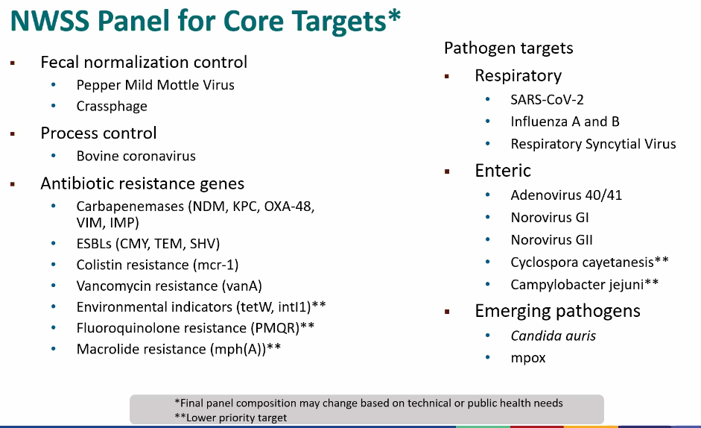
Done/has been done in NC

Slide 23
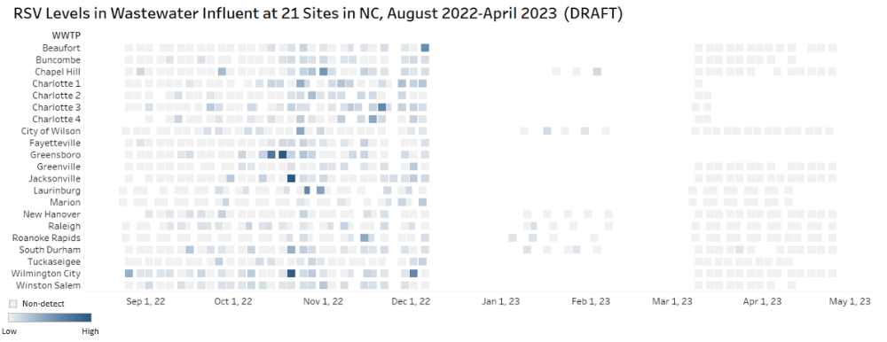
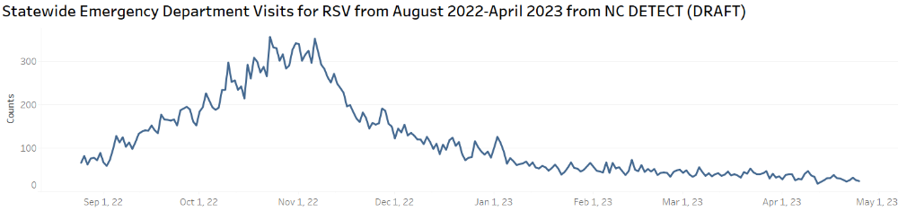
*Preliminary Results

Slide 24
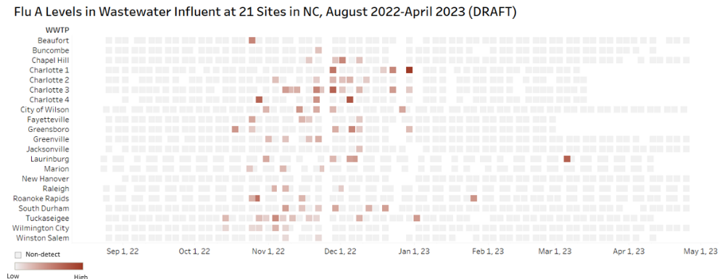
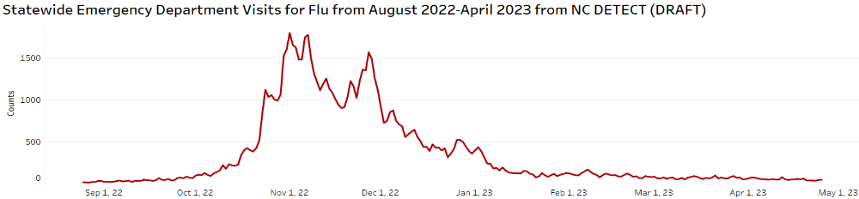
*Preliminary Results

Slide 25
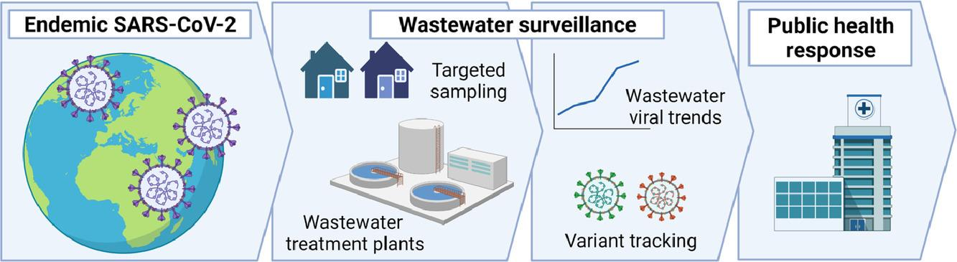
“In an endemic future, the utility of WBS will include:
  Monitoring the trend of viral loads of targets in wastewater for quantitative estimate of changes in disease incidence
  Sampling upstream for pinpointing infections in neighborhoods and at the building level
  Integrating wastewater and clinical surveillance for cost-efficient population surveillance
  Genome sequencing wastewater samples to track circulating and emerging variants in the population”
  Source: https://www.sciencedirect.com/science/article/pii/S0043135422004882

Slide 26
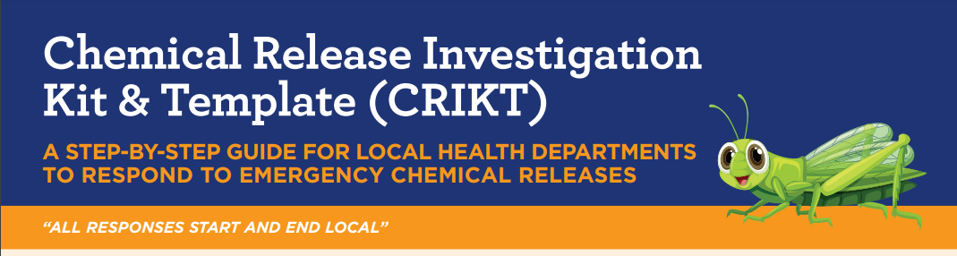
The mission of the
Chemical Preparedness and Response Surveillance program is to promote safer, healthier communities in North Carolina by reducing morbidity and mortality associated with exposures to toxic incidents.
https://epi.dph.ncdhhs.gov/oee/programs/chprs.html

