Slide 1
2020 U.S. Census: Undercount and Its Impacts
Patrick J. Cantwell, U.S. Census Bureau
The Council of State and Territorial Epidemiologists
Disaster Epidemiology Workshop
May 18, 2023
Disclaimer: The views expressed are those of the author and not those of the U.S. Census Bureau.
The data in this presentation have been cleared for release under DRB Numbers:
CBDRB-FY22-136, -137, -216, -218, and -244.

Slide 2
Contents
The census and its post-enumeration survey (PES)
Statistical approach used in the PES
Some coverage results
What could go wrong (with the PES)?

Slide 3
The census and its post-enumeration survey (PES)

Slide 4
What is the decennial census?
Purpose
To provide accurate counts of the U.S. resident population and housing as of April 1, 2020
How are the data used?
To apportion the Congress
For redistricting at various levels
For the allocation of well over $1 trillion in Federal funds
As denominators for many rates, etc.
How is the census taken?
Includes all residents who are citizens and noncitizens
Uses several modes: internet, mail, telephone, in-person follow-up of nonrespondents
History
Conducted every 10 years since 1790
Generally, many lawsuits about whom to count, what methods to use, and how to use the coverage estimates
Notes:
We use the Post-Enumeration Survey to estimate the real number of people in the country. Then we compare that estimated number from the PES to the census to determine if the census counts were too high or low. The Post-Enumeration Survey also gives us information about how many people were correctly counted in the census, missed, or erroneously enumerated. Consistent with our prior practice, we will not be adjusting the census counts for Apportionment or Redistricting based on results from the Post-Enumeration Survey.
The Post-Enumeration Survey is a probability survey where were interviewed people in about 10,000 blocks across the country independently of the census. We then looked for these people in the census to determine who was missed or counted in error.
We are releasing these results today so you can see the strengths, limitations, and errors in the 2020 Census. We have conducted a post-enumeration survey to measure the quality of the census since 1950. These 2020 census coverage estimates help us understand the 2020 Census quality and will inform our plans for the 2030 Census.

Slide 5
What is the decennial census?
1. Rates of cancer, infectious disease incidence, etc.
2. Disaster relief: how many people affected?
Purpose
To provide accurate counts of the U.S. resident population and housing as of April 1, 2020
How are the data used?
To apportion the Congress
For redistricting at various levels
For the allocation of well over $1 trillion in Federal funds
As denominators for many rates, etc.
How is the census taken?
Includes all residents who are citizens and noncitizens
Uses several modes: internet, mail, telephone, in-person follow-up of nonrespondents
History
Conducted every 10 years since 1790
Generally, many lawsuits about whom to count, what methods to use, and how to use the coverage estimates
Notes:
We use the Post-Enumeration Survey to estimate the real number of people in the country. Then we compare that estimated number from the PES to the census to determine if the census counts were too high or low. The Post-Enumeration Survey also gives us information about how many people were correctly counted in the census, missed, or erroneously enumerated. Consistent with our prior practice, we will not be adjusting the census counts for Apportionment or Redistricting based on results from the Post-Enumeration Survey.
The Post-Enumeration Survey is a probability survey where were interviewed people in about 10,000 blocks across the country independently of the census. We then looked for these people in the census to determine who was missed or counted in error.
We are releasing these results today so you can see the strengths, limitations, and errors in the 2020 Census. We have conducted a post-enumeration survey to measure the quality of the census since 1950. These 2020 census coverage estimates help us understand the 2020 Census quality and will inform our plans for the 2030 Census.

Slide 6
What is the post-enumeration survey (PES)?
Purpose
To measure coverage of people and housing units in the decennial census
No intent to adjust the census counts
How are the data used?
To assess the success of the current census
To provide information to improve the coverage of future censuses
How is coverage estimated?
Conduct a survey in sample blocks —independently of the census
Match people in the PES independent survey with enumerations in the census to determine who was missed, who was counted in error
History
Conducted following the census since 1950 with different designs and formats
Notes:
We use the Post-Enumeration Survey to estimate the real number of people in the country. Then we compare that estimated number from the PES to the census to determine if the census counts were too high or low. The Post-Enumeration Survey also gives us information about how many people were correctly counted in the census, missed, or erroneously enumerated. Consistent with our prior practice, we will not be adjusting the census counts for Apportionment or Redistricting based on results from the Post-Enumeration Survey.
The Post-Enumeration Survey is a probability survey where were interviewed people in about 10,000 blocks across the country independently of the census. We then looked for these people in the census to determine who was missed or counted in error.
We are releasing these results today so you can see the strengths, limitations, and errors in the 2020 Census. We have conducted a post-enumeration survey to measure the quality of the census since 1950. These 2020 census coverage estimates help us understand the 2020 Census quality and will inform our plans for the 2030 Census.

Slide 7
Other measures of the population, census error
Census Bureau’s Population Division, vital records (birth, death):
Demographic Analysis, as of April 1, 2020, for U.S., by age and sex
Population Estimates Program, yearly estimates, greater geographic detail (lower levels)
Note: All these measures, including from PES, are estimates; they have their own error.

Slide 8
Statistical approach used in the PES

Slide 9
Statistical approach: “Capture-Recapture” (as in fish)
To conduct a post-enumeration survey (PES), select a sample of census blocks.
(1) Take the census records (enumerations) in those sample blocks. This “capture” is called the census sample.
(2) Independently of census operations, (a) list all the housing units, (b) interview the people, and (c) create a roster of those living there on Census Day (April 1, 2020). This “re-capture” is called the PES sample or independent sample.
Finally, statistically match the people (formally, the data records) between the census sample and the PES sample. A “match” falls in both samples.

Slide 10
Basics of PES estimation
Apply a “dual-system estimator”
Relies on maintaining independence between the two systems: (1) the census enumeration, and (2) the PES
Requires accurate statistical matching (linking) between systems
Does not require that either system cover the whole population

Slide 11
Some coverage results

Slide 12
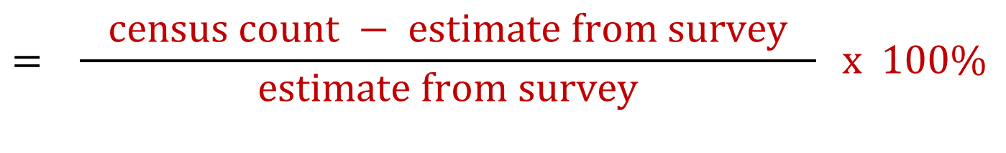
Definition of net coverage error rate (%) in the census
Net coverage error rate (%) is (defined as)
If negative, referred to as % net undercount
If positive, referred to as % net overcount
$$= \frac{ \text{census} \text{count}\text{ − }\text{estimate} \text{from} \text{survey} }{\text{estimate} \text{from} \text{survey}} \text{x}\text{ 100\%}$$
Notes:
.

Slide 13
Coverage of the census in the U.S. (not including Puerto Rico)
2020 Census, United States | Number | Standard error
Census count of population | 323,200,000 ¹ | n/a
Estimate of population from PES | 323,900,000 ¹ | 821,000
Difference | -782,000 | 821,000
Percent difference | -0.24 % | 0.25%
¹ Not including people in group quarters or in Remote Alaska areas.
Numbers are rounded for disclosure avoidance.
Notes:
In addition to releasing a report on census coverage today, we are also releasing a technical document, called a Source and Accuracy Statement that describes many of the possible errors in the PES data. Here is one table based on data in the Source and Accuracy Statement. One major difference between the 2010 and 2020 post-enumeration surveys is the rate of insufficient interviews. These were interviews where we reached a respondent, sometimes a proxy, who answered some questions, but did not provide enough detailed information about anyone in the household for the interview to be used. Nevertheless, despite all the challenges, the PES got completed interviewed from about 83.2 percent of the occupied households we visited.
Today’s Source and Accuracy Statement and future methodology reports will provide a lot of information about the quality of the PES. Overall the Post-Enumeration Survey achieved it’s goal of highlighting some of the strengths and weakness of the 2020 Census data with respect to demographic characteristics. The coverage estimates I discussed today will be helpful in planning for the 2030 Census and I hope they will spawn new innovations and research to improve future census operations.

Slide 14
U.S. total net coverage error rate (%) from 1990 to 2020
90% confidence intervals depicted at edge of bars
Notes:
This graph shows the estimated net coverage error for the past 4 censuses. The vertical lines or whiskers at the end of each bar show the 90% confidence interval, which quantifies the variability of the estimate due to sampling. If the whisker touches the 0 line, we can’t confidently claim there was an undercount or overcount.
The 1990 Census undercounted the population. The 2000 Census overcounted the population. The 2010 and 2020 Census did not have a statistically significant undercount or overcount.

Slide 15
Net coverage error rate by race and Hispanic origin, 2010 and 2020
Race or Hispanic Origin | 2010 | 2020
Total | 0.01* | -0.24*
Race alone or in combination
White | 0.54* | 0.66*
Non-Hispanic White alone | 0.83* | 1.64*
Black or African American | -2.06* | -3.30*
Asian | 0.00* | 2.62*
American Indian or Alaska Native | -0.15* | -0.91*
On Reservation | -4.88* | -5.64*
Native Hawaiian or Other Pacific Islander | -1.02* | 1.28*
Some Other Race | -1.63* | -4.34*
Hispanic or Latino | -1.54* | -4.99*
Census count for race groups:
Used as denominator to estimate rate of disease incidence by race
(or for Hispanic origin)
*For 2020, statistically significant undercounts in red; *significant overcounts in blue.
Notes:
For some groups, undercounts and overcounts by race and Hispanic origin were more pronounced in 2020 than in 2010. The rows highlighted in green show the groups for which there was a significant change from 2010. We saw significant changes for the following groups: Non-Hispanic White, Asian, Some Other Race, and Hispanic or Latino.

Slide 16
Net coverage error rate by race and Hispanic origin, 2010 and 2020
Race or Hispanic Origin | 2010 | 2020
Total | 0.01* | -0.24*
Race alone or in combination
White | 0.54* | 0.66*
Non-Hispanic White alone | 0.83* | 1.64*
Black or African American | -2.06* | -3.30*
Asian | 0.00* | 2.62*
American Indian or Alaska Native | -0.15* | -0.91*
On Reservation | -4.88* | -5.64*
Native Hawaiian or Other Pacific Islander | -1.02* | 1.28*
Some Other Race | -1.63* | -4.34*
Hispanic or Latino | -1.54* | -4.99*
If there is a true census undercount, the estimated epidemiology rate may be erroneously high; and vice versa.
Question: Is this level of net census error acceptable for your use? The user must decide.
*For 2020, statistically significant undercounts in red; *significant overcounts in blue.
Notes:
For some groups, undercounts and overcounts by race and Hispanic origin were more pronounced in 2020 than in 2010. The rows highlighted in green show the groups for which there was a significant change from 2010. We saw significant changes for the following groups: Non-Hispanic White, Asian, Some Other Race, and Hispanic or Latino.

Slide 17
Percent net coverage error by age for children: 1990 to 2020
Age | 1990 | 2000 | 2010 | 2020
0 – 4 | -3.18* | 0.46 | -0.72* | -2.79*
5 – 9 |  |  | 0.33 | -0.10
10 – 17 |  | 1.32* | 0.97* | -0.21
*Net coverage error is statistically significantly different from 0.

Slide 18
Percent net coverage error by age for children: 1990 to 2020
Age | 1990 | 2000 | 2010 | 2020
0-4 | -3.18* | 0.46 | -0.72* | -2.79*
5-9 |  |  | 0.33 | -0.10
10-17 |  | 1.32* | 0.97* | -0.21
*Net coverage error is statistically significantly different from 0.

Slide 19
Percent net coverage error by age and sex: 1990 to 2020
Age and sex | 1990 | 2000 | 2010 | 2020
18-to-29 males | -3.30* | -1.12* | -1.21* | -2.25*
18-to-29 females | -2.83* | 1.39* | 0.28 | -0.98*
30-to-49 males | -1.89* | -2.01* | -3.57* | -3.05*
30-to-49 females | -0.88* | 0.60* | 0.42* | 0.10*
50-and-over males | 0.59* | 0.80* | 0.32* | 0.55*
50-and-over females | 1.24* | 2.53* | 2.35* | 2.63*
*Net coverage error is statistically significantly different from 0.

Slide 20
Percent net coverage error by age and sex: 1990 to 2020
Age and sex | 1990 | 2000 | 2010 | 2020
18-to-29 males | -3.30* | -1.12* | -1.21* | -2.25*
18-to-29 females | -2.83* | 1.39* | 0.28 | -0.98*
30-to-49 males | -1.89* | -2.01* | -3.57* | -3.05*
30-to-49 females | -0.88* | 0.60* | 0.42* | 0.10*
50-and-over males | 0.59* | 0.80* | 0.32* | 0.55*
50-and-over females | 1.24* | 2.53* | 2.35* | 2.63*
*Net coverage error is statistically significantly different from 0.

Slide 21
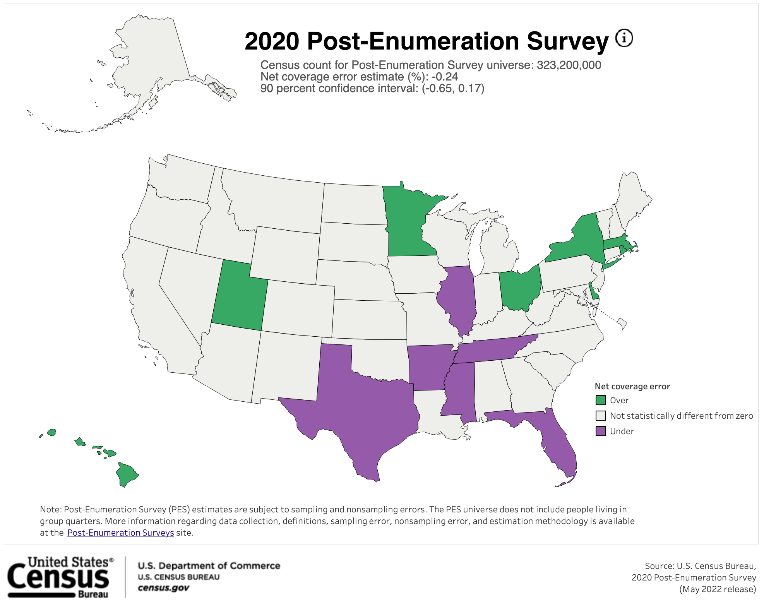
Notes:
Here we see a map showing the states with a statistically significant undercount in purple and states with a statistically significant overcount in green. States without a statistically significant undercount or overcount are in light gray.

Slide 22
States with a net undercount or net overcount
Undercount
Overcount
State | Net coverage error rate (%)
 | Rate | 90% confidence interval
Arkansas | –5.04 | –8.68 to –1.40
Florida | –3.48 | –4.98 to –1.98
Illinois | –1.97 | –3.43 to –0.51
Mississippi | –4.11 | –6.79 to –1.43
Tennessee | –4.78 | –7.26 to –2.30
Texas | –1.92 | –3.27 to –0.57
State | Net coverage error rate (%) | Net Coverage Error Rate
 | Rate | 90% confidence interval
Delaware | 5.45 | 0.81 to 10.09
Hawaii | 6.79 | 4.03 to 9.55
Massachusetts | 2.24 | 0.50 to 3.98
Minnesota | 3.84 | 2.24 to 5.44
New York | 3.44 | 1.89 to 4.99
Ohio | 1.49 | 0.39 to 2.59
Rhode Island | 5.05 | 2.70 to 7.40
Utah | 2.59 | 0.57 to 4.61

Slide 23
States with a net undercount or net overcount
Undercount
Overcount
State | Net coverage error rate (%)
 | Rate | 90% confidence interval
Arkansas | –5.04 | –8.68 to –1.40
Florida | –3.48 | –4.98 to –1.98
Illinois | –1.97 | –3.43 to –0.51
Mississippi | –4.11 | –6.79 to –1.43
Tennessee | –4.78 | –7.26 to –2.30
Texas | –1.92 | –3.27 to –0.57
State | Net coverage error rate (%) | Net Coverage Error Rate
 | Rate | 90% confidence interval
Delaware | 5.45 | 0.81 to 10.09
Hawaii | 6.79 | 4.03 to 9.55
Massachusetts | 2.24 | 0.50 to 3.98
Minnesota | 3.84 | 2.24 to 5.44
New York | 3.44 | 1.89 to 4.99
Ohio | 1.49 | 0.39 to 2.59
Rhode Island | 5.05 | 2.70 to 7.40
Utah | 2.59 | 0.57 to 4.61
For each state, the confidence interval provides a sense of the variability of the estimate.

Slide 24
So, what could go wrong with the PES?

Slide 25
Some effects of the pandemic on the PES
Delay in field data collection for the census, then for the PES
  Increases potential for recall bias
  Increases number of movers
Increase in household nonresponse
Increase in characteristic nonresponse
  Greater difficulty matching people from census to PES
  Upward bias in estimates

Slide 26
References
General reference to Census Bureau’s website on PES:
https://www.census.gov/programs-surveys/decennial-census/about/coverage-measurement/pes.html
  G series of memoranda (results)
  J series of memoranda (methods)
Thank you for listening!
patrick.j.cantwell@census.gov

Slide 27
Additional Slides

Slide 28
STOP!

Slide 29
Method behind the PES: capture-recapture

Slide 30
Statistical approach: “Capture-Recapture” (as in fish)
Everyone can be placed into 1 of 4 cells |  | Recapture: Enumerated in PES ?
 |  | YES | NO | Total
Capture: Enumerated in Census ? | YES | N₁₁ (matches) | N₁₂ | N₁₊
 | NO | N₂₁ | N₂₂ | N₂₊
 | Total | N₊₁ | N₊₂ | N
Yellow shading means number is unknown.
Notes:
@@@ Each person has to fall into one of the 4 shaded cells in the middle of the table.

Slide 31
If the two enumerations are conducted independently . . .
Compare rates down the column |  | Enumerated in PES ?
 |  | YES | NO | Total
Enumerated in Census ? | YES | N₁₁ (matches) | N₁₂ | N₁₊
 | NO | N₂₁ | N₂₂ | N₂₊
 | Total | N₊₁ | N₊₂ | N
Yellow shading means number is unknown.
Notes:
@@@ If you look at the first column, shaded in red, you see the number of P-Sample people who match to the census, N11, and . . . If we can assume independence between . . .

Slide 32
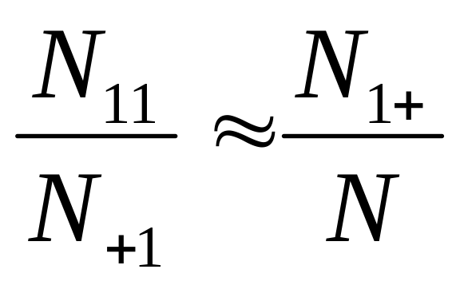
PES “dual-system estimator”
If we can assume that the PES enumeration is independent of the census enumeration, then . . .

Slide 33
PES dual-system estimator
If we can assume that the PES enumeration is independent of the census enumeration, then . . .
Four numbers: 3 known (or estimated), 1 unknown ( N ).
Solve for N.

Slide 34
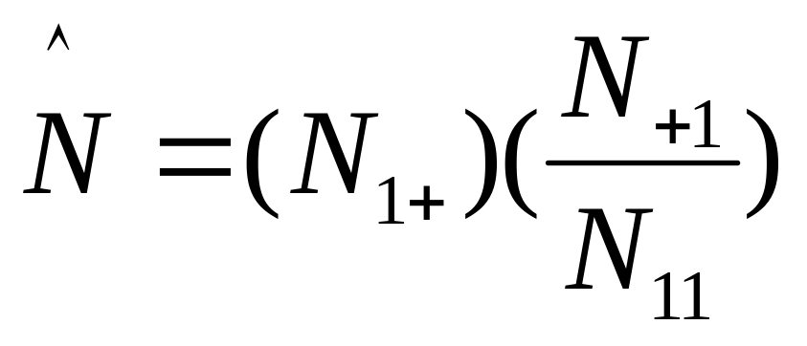
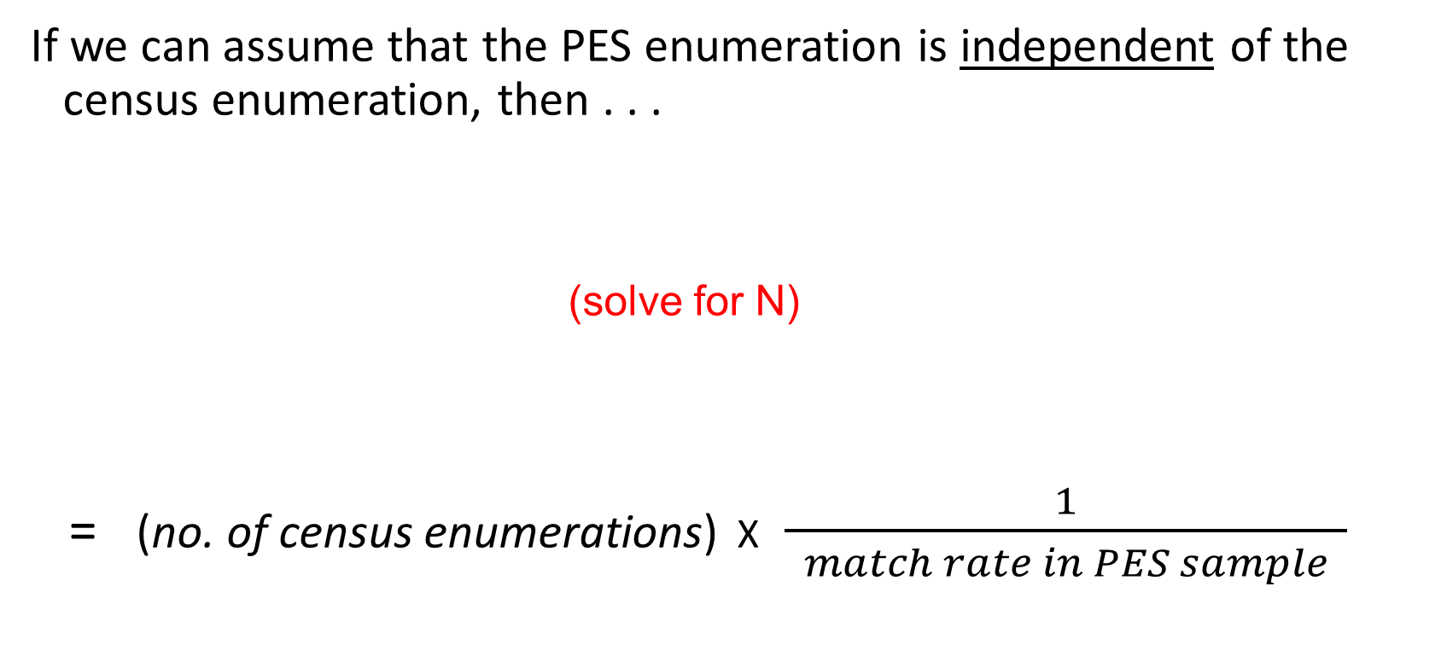
PES dual-system estimator
If we can assume that the PES enumeration is independent of the census enumeration, then . . .
(solve for N)
= (no. of census enumerations) X$\frac{1}{ match rate in PES sample }$

Slide 35
From net coverage to components of coverage
Net coverage error | % | Std. Error
Dual-system estimate | -0.24 | 0.25

Slide 36
Components of coverage for the census count
Components of the census count | % | Std. error
Census count | 100.0 | X
Correct enumerations | 94.4 | 0.04
Erroneous enumerations | 2.2 | 0.04
Due to Duplication | 1.6 | 0.04
For other reasons | 0.6 | 0.03
People without sufficient info for matching | 3.4 | X
Net coverage error | % | Std. Error
Dual-system estimate | -0.24 | 0.25
X means not applicable.

Slide 37
Components of coverage for the PES estimate
Components of the census count | % | Std. error
Census count | 100.0 | X
Correct enumerations | 94.4 | 0.04
Erroneous enumerations | 2.2 | 0.04
Due to Duplication | 1.6 | 0.04
For other reasons | 0.6 | 0.03
People without sufficient info for matching | 3.4 | X
Components of the population estimate | % | Std. error
Dual-system estimate | 100.0 | X
Correct enumerations | 94.2 | 0.24
Omissions | 5.8 | 0.24
Net coverage error | % | Std. Error
Dual-system estimate | -0.24 | 0.25
X means not applicable.

Slide 38
From net coverage to components of coverage
Component of Census Coverage | Estimate | Standard Error |  | Percent | Standard Error
Census Count | 323,200,000 | 0 |  | 100.0
Correct enumerations | 305,100,000 | 145,000 |  | 94.4 | 0.04
Erroneous enumerations | 7,167,000 | 145,000 |  | 2.2 | 0.04
Due to duplication | 5,170,000 | 129,000 |  | 1.6 | 0.04
For other reasons | 1,997,000 | 88,000 |  | 0.6 | 0.03
Whole-Person Census Imputations | 10,850,000 | 0 |  | 3.4 | 0.00
Estimate of Population from the PES | 323,900,000 | 821,000 |  | 100.0
Correct enumerations | 305,100,000 | 145,000 |  | 94.2 | 0.24
Omissions | 18,800,000 | 819,000 |  | 5.8 | 0.24
Net Coverage Error | -782,000 | 821,000 |  | -0.24 | 0.25

Slide 39
Net coverage error rate by race and Hispanic origin, 2010 and 2020
Race or Hispanic Origin | 2010 | 2020 | Significant difference between 2010 and 2020?
Total | 0.01* | -0.24*
Race alone or in combination
White | 0.54* | 0.66* | No
Non-Hispanic White alone | 0.83* | 1.64* | Yes
Black or African American | -2.06* | -3.30* | No
Asian | 0.00* | 2.62* | Yes
American Indian or Alaska Native | -0.15* | -0.91* | No
On Reservation | -4.88* | -5.64* | No
Native Hawaiian or Other Pacific Islander | -1.02* | 1.28* | No
Some Other Race | -1.63* | -4.34* | Yes
Hispanic or Latino | -1.54* | -4.99* | Yes
*For 2020, statistically significant undercounts in red; *significant overcounts in blue.
Notes:
For some groups, undercounts and overcounts by race and Hispanic origin were more pronounced in 2020 than in 2010. The rows highlighted in green show the groups for which there was a significant change from 2010. We saw significant changes for the following groups: Non-Hispanic White, Asian, Some Other Race, and Hispanic or Latino.

Slide 40
Challenges and innovations in the 2020 PES
Problems, and improvements to address them
Increased household nonresponse: noninterview adjustment
Increased characteristic nonresponse, leading to upward bias in estimates: changed the adjustment for correlation bias
Synthetic (model) bias: changed the estimation models for estimating state totals

Slide 41
Household nonresponse

Slide 42
Problem: Increased household nonresponse in the PES
Interview Outcome | 2010 |  |  |  | 2020
 | Number | Percent |  |  | Number | Percent
Total Occupied Housing Units | 145,000 | 100.0 |  |  | 137,000 | 100.0
Interview | 140,000 | 96.6 |  |  | 114,000 | 83.2
Noninterview | 5,300 | 3.7 |  |  | 23,000 | 16.8
Numbers are rounded for disclosure avoidance.
Notes:
In addition to releasing a report on census coverage today, we are also releasing a technical document, called a Source and Accuracy Statement that describes many of the possible errors in the PES data. Here is one table based on data in the Source and Accuracy Statement. One major difference between the 2010 and 2020 post-enumeration surveys is the rate of insufficient interviews. These were interviews where we reached a respondent, sometimes a proxy, who answered some questions, but did not provide enough detailed information about anyone in the household for the interview to be used. Nevertheless, despite all the challenges, the PES got completed interviewed from about 83.2 percent of the occupied households we visited.
Today’s Source and Accuracy Statement and future methodology reports will provide a lot of information about the quality of the PES. Overall the Post-Enumeration Survey achieved it’s goal of highlighting some of the strengths and weakness of the 2020 Census data with respect to demographic characteristics. The coverage estimates I discussed today will be helpful in planning for the 2030 Census and I hope they will spawn new innovations and research to improve future census operations.

Slide 43
Problem: Increased household nonresponse in the PES
Interview Outcome | 2010 |  |  |  | 2020
 | Number | Percent |  |  | Number | Percent
Total Occupied Housing Units | 145,000 | 100.0 |  |  | 137,000 | 100.0
Interview | 140,000 | 96.6 |  |  | 114,000 | 83.2
Noninterview | 5,300 | 3.7 |  |  | 23,000 | 16.8
Interview not conducted | 2,300 | 1.6 |  |  | 4,900 | 3.6
Interview not sufficient | 3,000 | 2.1 |  |  | 18,500 | 13.5
Numbers are rounded for disclosure avoidance.
Notes:
In addition to releasing a report on census coverage today, we are also releasing a technical document, called a Source and Accuracy Statement that describes many of the possible errors in the PES data. Here is one table based on data in the Source and Accuracy Statement. One major difference between the 2010 and 2020 post-enumeration surveys is the rate of insufficient interviews. These were interviews where we reached a respondent, sometimes a proxy, who answered some questions, but did not provide enough detailed information about anyone in the household for the interview to be used. Nevertheless, despite all the challenges, the PES got completed interviewed from about 83.2 percent of the occupied households we visited.
Today’s Source and Accuracy Statement and future methodology reports will provide a lot of information about the quality of the PES. Overall the Post-Enumeration Survey achieved it’s goal of highlighting some of the strengths and weakness of the 2020 Census data with respect to demographic characteristics. The coverage estimates I discussed today will be helpful in planning for the 2030 Census and I hope they will spawn new innovations and research to improve future census operations.

Slide 44
Noninterview adjustment in the PES
Nonresponse adjustment typically tries to involve (1) characteristic(s) to be estimated, and (2) unit’s propensity to respond
In past decades, used a cell-based approach to reweight addresses
In 2020, modeled response propensity based on variables known for every address; defined 5 groups, from lowest to highest response propensity
Within propensity groups, spread weights of nonresponding addresses onto responding cases

Slide 45
Characteristic nonresponse

Slide 46
Problem. Increased characteristic nonresponse
Rates of missing data in the 2020 and 2010 PES sample (unweighted)
Year | Percent of people with imputed characteristics |  |  |  |  |  | % with ≥ 1 imputed characteristic
 | Relationship | Age | Sex | Race | Hispanic origin | Tenure
2020 | 1.9 | 11.4 | 1.7 | 5.8 | 3.7 | 3.7 | 15.7
2010 | 0.9 | 4.5 | 0.9 | 1.9 | 1.6 | 2.0 | 6.6

Slide 47
Problem: Increased characteristic nonresponse
Rates of missing data in the 2020 and 2010 PES sample (unweighted)
Year | Percent of people with imputed characteristics |  |  |  |  |  | % with ≥ 1 imputed characteristic
 | Relationship | Age | Sex | Race | Hispanic origin | Tenure
2020 | 1.9 | 11.4 | 1.7 | 5.8 | 3.7 | 3.7 | 15.7
2010 | 0.9 | 4.5 | 0.9 | 1.9 | 1.6 | 2.0 | 6.6

Slide 48
Problem: Increased characteristic nonresponse
Rates of missing data in the 2020 and 2010 PES sample (unweighted)
When characteristics are missing — especially age and sex — it’s more difficult to statistically match the PES records to census records
Year | Percent of people with imputed characteristics |  |  |  |  |  | % with ≥ 1 imputed characteristic
 | Relationship | Age | Sex | Race | Hispanic origin | Tenure
2020 | 1.9 | 11.4 | 1.7 | 5.8 | 3.7 | 3.7 | 15.7
2010 | 0.9 | 4.5 | 0.9 | 1.9 | 1.6 | 2.0 | 6.6

Slide 49
Problem: Increased characteristic nonresponse
Rates of missing data in the 2020 and 2010 PES sample (unweighted)
When characteristics are missing — especially age and sex — it’s more difficult to statistically match the PES records to census records
Estimated rate of matches between “captures” is artificially low; therefore, PES estimate is artificially high
Year | Percent of people with imputed characteristics |  |  |  |  |  | % with ≥ 1 imputed characteristic
 | Relationship | Age | Sex | Race | Hispanic origin | Tenure
2020 | 1.9 | 11.4 | 1.7 | 5.8 | 3.7 | 3.7 | 15.7
2010 | 0.9 | 4.5 | 0.9 | 1.9 | 1.6 | 2.0 | 6.6

Slide 50
Adjustment for correlation bias

Slide 51
Change the adjustment for correlation bias
Aside: Another source of data on U.S. pop is “demographic analysis” (DA) data — records from births, deaths, migration in and out of U.S.
Strongest estimate from DA is sex ratio: male/female, by age group
In past, PES estimates of male totals in some age groups were too low due to “correlation bias”
We increased PES male totals until PES sex ratio equaled that of DA
But, in 2020, we saw problems with PES estimates in both directions:
  correlation bias → low male totals
  missing characteristics, lower match rates → high male and female totals

Slide 52
Change the adjustment for correlation bias (cont.)
Reconsider our adjustment for correlation bias
Instead of adjusting PES totals of males upward, leaving females constant, we devised a new adjustment
Increased PES male totals, while decreasing PES female totals, so that, within age group:
  PES sex ratio equals that of DA
  PES estimate of { males + females } is not changed (desirable)
Improve PES estimates of males and females, and retain the total

Slide 53
Synthetic bias

Slide 54
Synthetic (model) bias in PES estimates
Our “synthetic” estimation models are applied at the unit level — to each census enumeration
Synthetic error: difference between the (true) population total and the estimate calculated from the synthetic models using the full population
If we don’t include variables for a domain, an estimate for that domain is susceptible to synthetic (model) bias--difficult to measure
Conflict: We want to estimate many (small) domains (e.g., races, states), but including too many variables increases the variability of the models

Slide 55
Changing the model to eliminate synthetic (model) bias
In the past, we estimated some small domains — states, large counties and cities — without those indicator variables; we accepted the synthetic bias, attempted to measure it and mean-squared error
Solution: In the 2020 PES, we included variables for every domain considered for estimation; accepted a slight increase in variance
No need to estimate synthetic bias; estimated standard errors

Slide 56
Census: no. of correct enumerations. PES sample: match rate
Only want to include census enumerations that are complete and correct |  | Enumerated in PES ?
 |  | YES | NO | Total
Enumerated in Census ? | YES | N₁₁ (matches) | N₁₂ | N₁₊
 | NO | N₂₁ | N₂₂ | N₂₊
 | Total | N₊₁ | N₊₂ | N
The 11 cell contains people matched or linked between the census and the PES.
Notes:
@@@ If you look at the first column, shaded in red, you see the number of P-Sample people who match to the census, N11, and . . . If we can assume independence between . . .

Slide 57
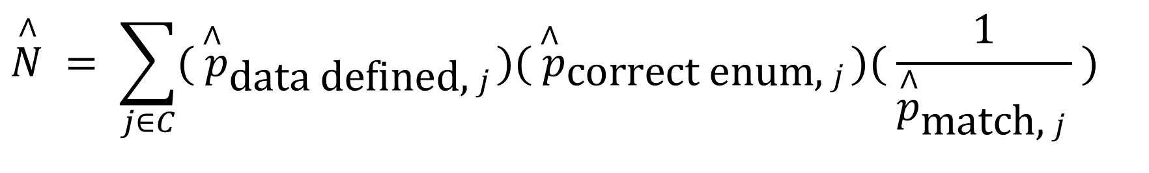
PES unit-level estimator, in terms of probabilities
For each person j in the census (C), estimate probabilities, p, of several concepts in dual-system estimation:
data defined: sufficient information for statistical matching
$$\overset{∧}{N} = \sum_{j∈C}{({\overset{∧}{ p}}_{\text{d}\text{ata} \text{d}\text{efined}\text{, }j})({\overset{∧}{ p}}_{\text{corr}\text{ect} \text{enum}\text{, }j})( \frac{1}{{\overset{∧}{p}}_{\text{match}\text{, }j}} )}$$

Slide 58
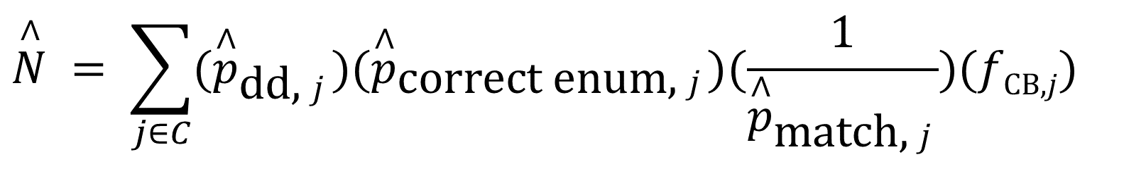
Final form of PES dual-system estimator
Solution: Based on a person’s characteristics, apply a correction factor f_{CB,j} that adjusts for (a) correlation bias and (b) the lower match rate.
dd, data defined: sufficient information
for statistical matching
$$\overset{∧}{N} = \sum_{j∈C}{({\overset{∧}{p}}_{\text{dd}\text{, }j})({\overset{∧}{p}}_{\text{corr}\text{ect} \text{enum}\text{, }j})(\frac{1}{{\overset{∧}{p}}_{\text{match}\text{, }j}})(f\text{CB}\text{,}j)}$$
correction factor

