Slide 1

Environmental Response: Train Derailment in East Palestine
Kristen Dickerson PhD, MSN, MPH, RN, MLT (ASCP)
State Epidemiologist
Ohio Department of Health
Gene Phillips MPH, MBA, REHS
Chief, Bureau of Environmental Health and Radiation Protection
Ohio Department of Health
Sara Margrey, DVM, MPH
State Public Health Veterinarian
Ohio Department of Health
June 25, 2023
CSTE Workshop: Environmental Health | Elevating Surveillance for Environmental Health Topics
Notes:
State of Ohio brand fonts:
_Serifa (bold and Roman), for display and headline copy. If unavailable, Georgia is alternative.
_Univers (bold and Roman), primarily as body copy. If unavailable, Arial is alternative.

Slide 2
Objectives
Background.
Timeline.
Environmental sampling.
ACE Survey.
Lessons learned.

Slide 3
Agencies Involved
Unified Command
U.S. Environmental Protection Agency Columbiana County Emergency Management Agency
Village of East Palestine Norfolk Southern Corporation
Cooperating and Assisting Agencies
Federal Emergency Management Agency
U.S. Department of Agriculture
Ohio Emergency Management Agency
Ohio Department of Health
Ohio River Valley Water Sanitation Commission
Pennsylvania Department of Environmental Protection
Beaver County Emergency Agency
Pennsylvania Emergency Management Agency
Pennsylvania Department of Health
Pennsylvania Department of Agriculture
Ohio Department of Agriculture
West Virginia Department of Environmental Protection
Poison Control Centers

Slide 4

Incident Timeline
8:54 p.m.
1:00 p.m.
Governors of Ohio and Pennsylvania ordered an evacuation.
Emergency operations moved to high school, outside the 1-mile radius.
In East Palestine, Ohio, near the Pennsylvania border, Norfolk Southern train derails and fire begins.
ODH began reviewing and providing recommendations for a re-occupancy plan and FAQ document for evacuated residents.
U.S. EPA contacted ODH requesting confirmation of air monitoring comparison values for community monitoring in response to the incident.
ODH staff consults ATSDR on comparison values as there is limited information for some compounds involved in the incident.
February 4
February 5
February 7
February 3
February 6
February 8
Residents within 1-mile asked to evacuate.
Local health districts were informed.
17 monitors and one roving monitor – no detections.
Residents are permitted to return to their homes.
5:00 a.m.
A meeting between ODH, ATSDR, and US EPA.
Ohio EPA – surface water sampling
US EPA – air monitoring
Elevated levels only at the incident site but odors reported in town
4:40 p.m.
Firefighters fall back to base.
Vinyl chloride cars start to heat up; concern increased for heating vinyl chloride tank cars.
Vent and burn conducted for vinyl chloride tank cars.
ODH began learning of concerns about the failure of venting of some rail cars.

Slide 5
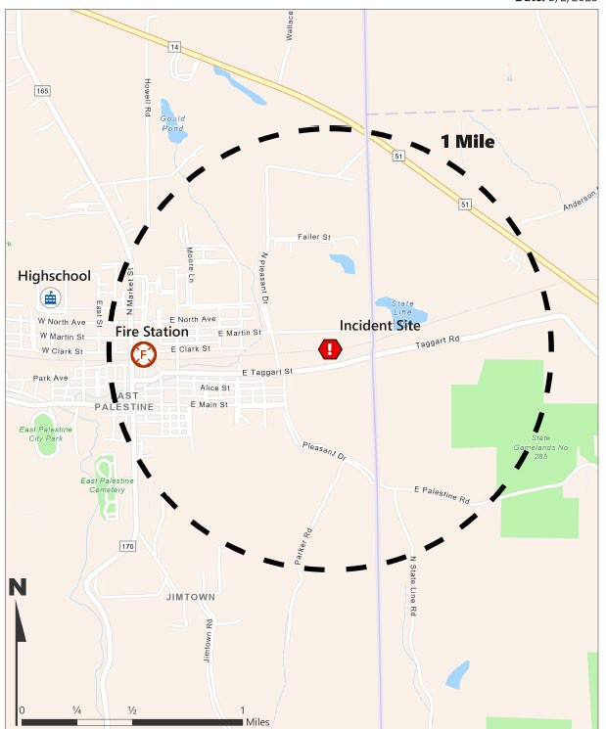
Incident Layout

Slide 6
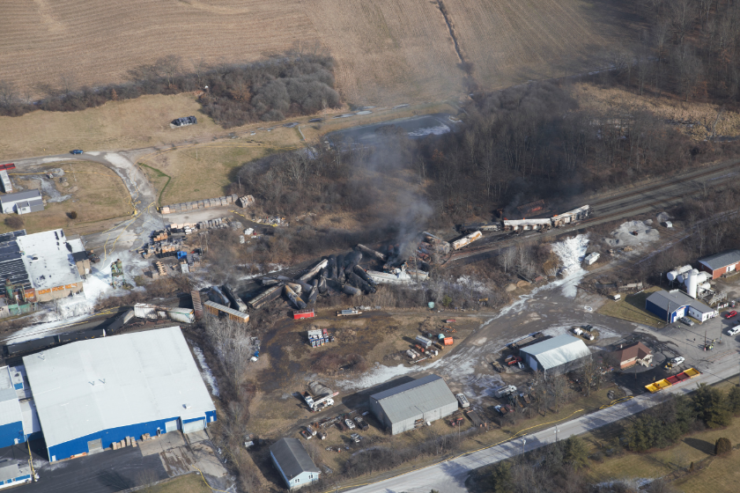
Train Content List
11 cars contained hazardous materials
Vinyl Chloride (5).
Ethylene Glycol (1).
Butyl Acrylate (1).
Isobutylene (1).
Ethyl-hexyl Acrylate (1).
Benzene residue within recently emptied cars (2).
An aerial view of the Norfolk Southern freight train derailment in East Palestine, Ohio captured on February 5. (Source: NTSB)
                Source: NTSB Issues Investigative Update on Ohio Train Derailment

Slide 7


Train Content List
11 cars contained hazardous materials
Ethylene Glycol
Butyl Acrylates
Isobutylene
Ethyl-hexyl Acrylate
Vinyl chloride
Benzene residue within recently emptied cars
Icons are creative commons licensed.

Slide 8
Timeline
Feb. 9 and forward:
  ODH began reviewing and providing consultation on Private Drinking Water System sampling. No related detections to date.
  As part of the re-occupancy plan, residents were provided an option to have home indoor air tested for chemicals of concern.

Slide 9
Timeline
Feb. 9 and forward:
  Handheld PID (photoionization detectors) devices were used, and no compounds were detected in most homes.
  Environmental samples were still below thresholds, odors were still present in town.

Slide 10
Air Monitoring
Equipment used for air monitoring:
    AreaRAE PID, AreaRAE Sensor, MutliRAE PID, SPM Flex etc.
In March:
  The Trace Atmospheric Gas Analyzer (TAGA) was brought in to monitor ambient air.
  TAGA is a self-contained mobile laboratory capable of real-time monitoring of outdoor air or emissions.

Slide 11
Confounding Factors
There were multiple compounds released in multiple media.
There was limited health data for some compounds.
There was limited time to develop sampling plans with Quality Assurance Program Plans (QAPP).
The public wanted definitive answers amid all these factors.

Slide 12
Epi-Aid Request
February 17, 2023
ODH requests an Epi-Aid.
  Assist with the development, implementation, and analysis of an ACE investigation. Key areas for evaluation include responder safety and health, community health of people and pets, and hospital preparedness.
  Assist with determining the need for ongoing health surveillance.
  Guide use of the current syndromic surveillance system to support response efforts across the state.
  Assist with review of environmental sampling results and interpretation of compounds without existing comparison values.
PADOH signs on in concurrence for a joint Epi-Aid.
Notes:
ODH was receiving concerns about health impacts in the area. We began looking at syndromic surveillance and poison control center data and saw an increase in complaints in the area for a number of reasons. It was determined that an ACE survey would be an appropriate assessment tool to collect data to inform further public health action and make recommendations to the community

Slide 13
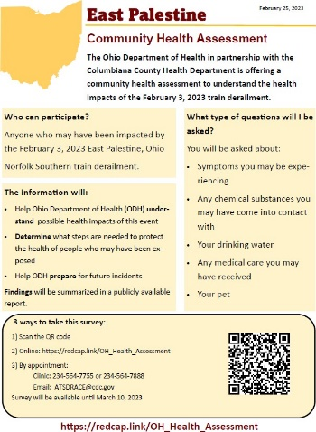
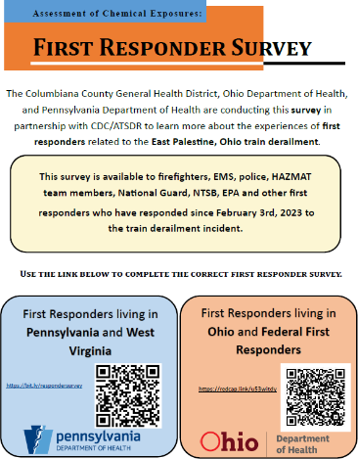
ATSDR's Assessment of Chemical Exposures (ACE)
Objective: To develop, implement, and analyze an
ACE investigation.
Key areas for evaluation include:
  Community health of people.
  Health of pets and livestock.
  Responder safety and health.
  Agricultural safety concerns.
Assisted with determining the need for ongoing health surveillance.
Guided use of the current poison control center and syndromic surveillance system to support response efforts across the state.
Assessment of Chemical Exposure (ACE) Program | ATSDR

Slide 14
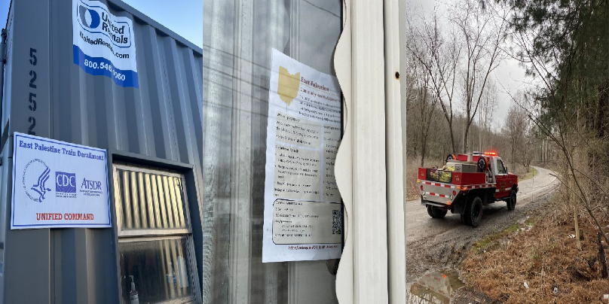
Methods
East Palestine Health Clinic
Opened on February 21.
ACE survey completed by clinicians.
Referrals.
Door-to-door efforts
Began on February 25.
Flyer.
Responder Survey
Town Hall meeting March 4.
Launched March 5.
Photos courtesy of the ACE team
Notes:
Surveys may have been self administered online from 25-Feb through 31-Mar.

Slide 15

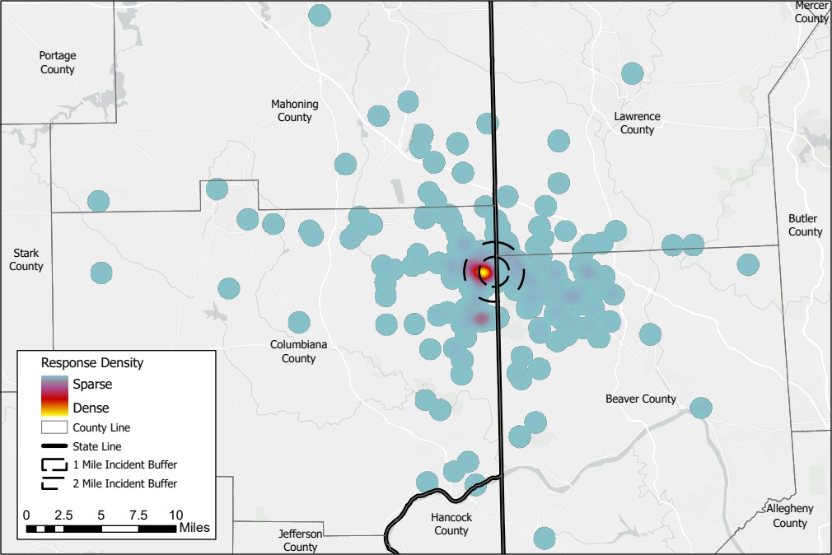



Results
704 surveys completed
Notes:
Map of Survey Responses

Slide 16
Demographics
92%
63%
96%
93%
18 years or older
Female
White
Non-Hispanic

Slide 17
Evacuation
52% reported being in the 1-mile radius.
69% reported being in the 2-mile radius.
54% of all participants evacuated.
37% reported being asked to evacuate.

Slide 18
Top Concerns
Headache – 74.5%.
Anxiety – 61.4%.
Fatigue/tiredness – 53.2%.
Coughing – 53.0%.
Irritation/Pain/Burning eyes – 49.8%.
92% of all survey participants reported at least one new or worsening physical health symptom since the incident.

Slide 19
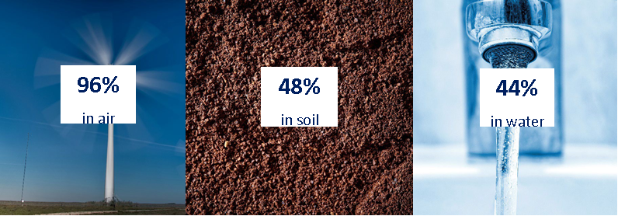
Information and Exposures
First learned about the incident
28% from others.
23% from TV.
Receiving information after the incident
49% from TV.
27% from social media.
88% of participants believed they were exposed to hazardous substances.
88% of participants reported smelling and odor.

Slide 20
Healthcare
44% of participants reported receiving medical care as a result of the incident.
  On or after day six.
Health Clinic
  Set up to assist community members.
  Partnership.
  Became a standing health center.

Slide 21
Reported Needs and Concerns
Quality and safety of environment.
Long term health effects.
Financial concerns.
Assurance of long-term testing.
Assistance with cleaning.

Slide 22
Train Derailment in East Palestine, Ohio:
A One Health Approach to the ACE Survey

Slide 23



Pets
Livestock and Diagnostics
Wildlife
Notes:
In addition to the number of agencies that were named earlier, the three primary departments in Ohio that focused on the impact on animals include the Ohio Department of Health, which addressed questions and consideration for pets and companion animals;
the Ohio Department of Agriculture, who assisted with directing livestock concerns to the Ohio State University Extension Office and arranged the of testing and diagnostics of animals that have died in the East Palestine area;
and the Ohio Department of Natural Resources, who was the primary contact for wildlife concerns.
For this presentation – I will elaborate on the Ohio Department of Health’s consideration for the impact on pets.

Slide 24




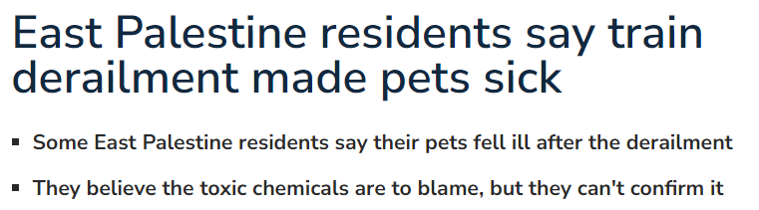
Concerns for animals arose quickly after the incident.
USA Today: East Palestine train derailment killed more than 43,000 fish and animals officials say
Washington Post: Ohio Train Derailment Animal Deaths
NewsNation:East Palestine residents say train derailment made pets sick
CBC: Estimated animal death toll from Ohio trian derailment
Notes:
The concern for animals arose quickly after the incident, highlighting the importance of considering animals in environmental responses.
Coverage of the incident was quick and many concerns started to arise about the safety of resident’s pets and livestock.

Slide 25
Pets and Livestock ACE Survey
Notes:
Without data, a story is just a myth.
And without a story, data is just numbers.
So we sought to bring light to these news stories and enhance the community ACE Survey with two very simple questions regarding pets to see if this story could use the additional data to bring light to the circulating questions and concerns regarding animal health as a result of the East Palestine train derailment.

Slide 26
Learning from the Past to Guide the Future
CDC ATSDR and One Health Office resources and past experiences from other disasters provided a great starting place.
Be aware of what questions you are trying to answer.
Organize questions into categories to assist with analyzing data.
Utilizing branching logic to maximize conclusions made.
Make questions objective.

Slide 27
Initial Community ACE Survey
Pet and Livestock ACE Survey
Built from previous resources.
Addition of livestock questions.
Developed in collaboration with Pennsylvania.
Detail-driven.
Assess pet exposure.
Determine if pets had new or worsening symptoms.
Notes:
The initial community Ohio ACE survey was implemented at the health assessment clinic. This initial commmunity survey had two questions related to pets to understand pet exposure in the area and if owners were seeing signs of new or worsening symptoms in their pets since the derailment.
Some initial preliminary data showed that >50% of respondents had pets and of those, more than half had pets with new or worsening symptoms.
Based on initial data from this survey, we decided to move forward with a more robust Pet and Livestock ACE survey.
This survey was designed from previous resources, such as the survey designed for the Chemtool Fire. With agreement from our department of agriculture, additional questions for livestock were added. These questions were designed with collaboration with Pennsylvania’s Department of Health in hopes of being able to combine our data for analysis.
Lastly, our survey was designed based on feedback from CDC’s previous experiences implementing these surveys. Questions were designed to be detail-driven and formatted in a way to maximize quantitative data.

Slide 28



Pet and Livestock ACE Survey Administration
Health Assessment Clinic
Door-to-Door Survey Administration
Follow-up Phone Interviews
Notes:
Initial ACE surveys were administered at the health assessment clinic beginning February 21st.
The Pet and Livestock ACE survey was finalized March 1st and was administered during door-to-door administration
Follow-up phone calls were administered starting March 10th to the individuals who completed the initial ACE survey but did not receive the Pet and Livestock survey
All survey results were completed by March 31st.

Slide 29


Pet and Livestock ACE Survey Results
314
13
53%
Surveyed with Pets
Pet deaths
Evacuated Pets
Notes:
Of the Ohio ACE survey respondents, there were a total of 314 people who mentioned they had pets.
53% of those surveyed said they had pets in the 2-mile radius and evacuated with their pets
Though much of the data is still under analysis, the most commons symptoms reported for pets was respiratory or gastrointestinal in origin: vomiting, diarrhea, eye and nasal discharge, sneezing and inappetence, just to name a few.
Additionally, most respondents did not seek veterinary care for their patients, most often due to mild or resolving symptoms, financial constraints, or inability to get an appointment.
Lastly, 13 people reported pets who died after February 3rd, two of which sought veterinary care. Please note that reports of pet deaths were reported individually not by household, meaning that some pets could be counted multiple times and that deaths may be clustered in one household. Further analysis of this data of this data is ongoing and will be published later in time.

Slide 30
“How does this impact my pets?”
“Is my dog safe to go outside?”
“Can my animals drink from outdoor containers?”
“How can I decontaminate my pets?”
“Were can I take my pet to be evaluated?”
“There have been reports of dead animals, what do I need to know about my pets?”
“My pets have been sick, what do I do?”

Slide 31

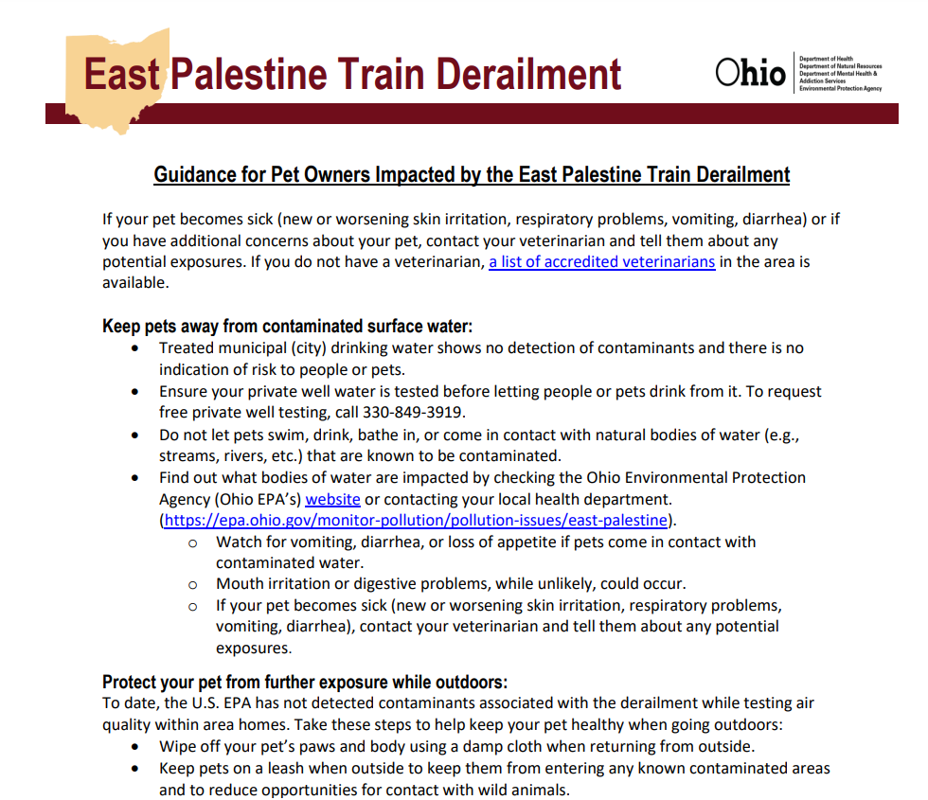
Guidance documents for pet owners.
Lists of accredited veterinarians in the surrounding counties.
Healthcare provider presentation.
Guidance Documents: https://ema.ohio.gov/media-publications/east-palestine-derailment-info/information-resources/information-resources
Notes:
In addition to the ACE survey, guidance documents were developed to address some of the ongoing questions community members were having about how to keep their pets safe.
To accompany these guidance documents, a list of accredited veterinarians in the surrounding area was provided for owners who were seeking veterinary care
Additionally, brief guidance was provided to healthcare providers to provide quick recommendations in the case their patients brought concerns of their pets to their primary care provider.

Slide 32
First Responders
212 Surveys Completed
58% reported being a firefighter.
98% non-Hispanic White.
88% male.
Median Age: 39 years.
67% reported inhaling harmful chemicals.
89% reported “Never” using a mask or respirator.
Top Symptoms
  Stuffy nose/sinus congestion – 26.4%.
  Runny nose – 25.0%.
  Increased congestion/phlegm – 21.7%.
  Burning nose or throat – 20.3%.
  Hoarseness – 15.1%.
Notes:
The survey collected information on demographics, occupational characteristics, health outcomes and healthcare use, resource needs, social behaviors, personal protective equipment (PPE) use, decontamination procedures, and training. The survey was open March 5th to March 31st.
Over half of responders identified as a firefighter (58%). Most reported being non-Hispanic white (98%) and male (88%). The median age was 39 (IQR: 20) years. Two hundred sixty-one (78%) responders reported inhaling potentially harmful chemicals/substances with smoke reported most frequently (67%). Many (77%) reported not knowing or being unsure of which chemicals/substances they were exposed to. A high percentage of responders (89%) selected “Never” using a mask or respirator during the incident. Approximately 48% self-reported at least one new or worsening of a physical symptom.

Slide 33
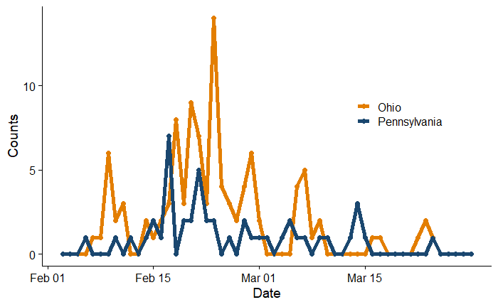
Poison Control Center Data
PCCs were a valuable partner in this response.
150 coded calls.
Highest in the third and fourth week of February.

Slide 34
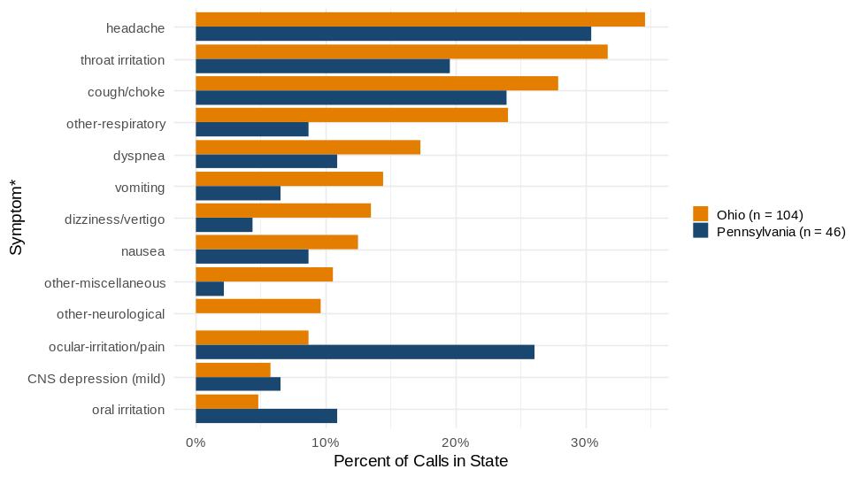
Poison Control Center Data
Analysis of symptoms reported.
Patients often reported more than one symptom.
Consistent with what was reported in the ACE.

Slide 35
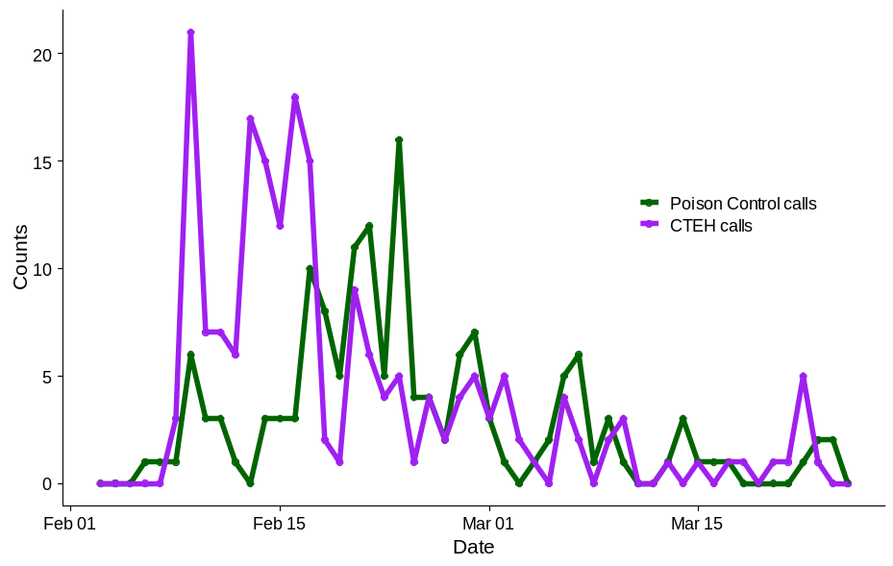
CTEH hotline calls
Center for Toxicology and Environmental Health (contractor).
199 calls.

Slide 36
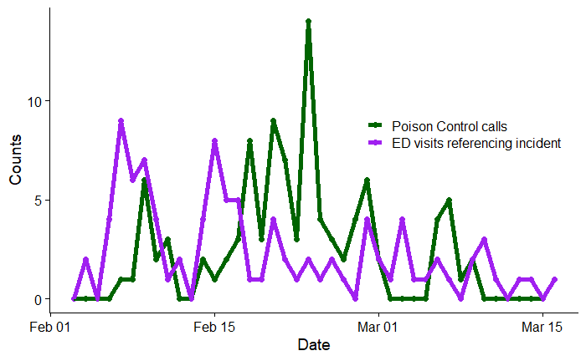
Syndromic Surveillance
Chief complaints/admit reasons.
Increase in codes after the derailment.
97 visits related to incident.

Slide 37
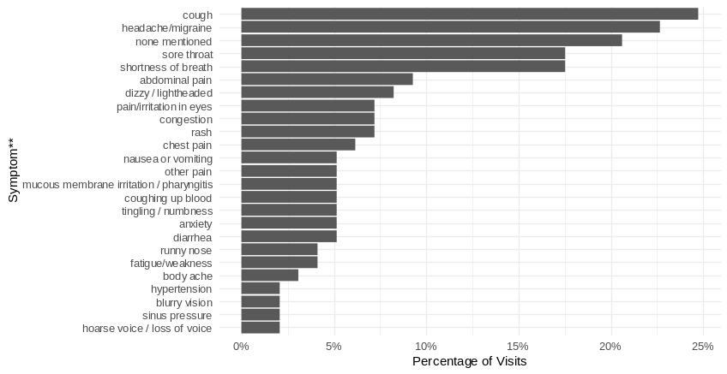
Syndromic Surveillance
Symptom distribution.
Often presented with more than one symptom.
Most common symptoms reported were cough, headache, sore throat, and shortness of breath.

Slide 38
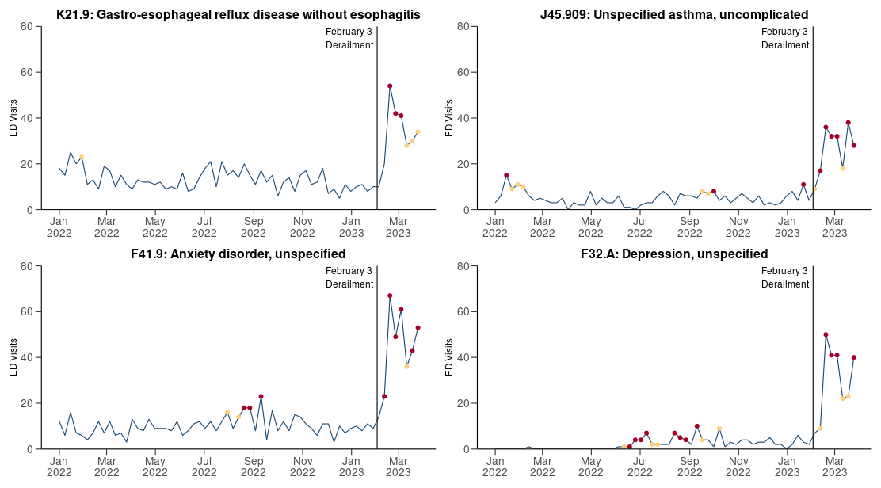
Syndromic Surveillance
Looked for increases in codes that occurred after the derailment.
Several codes increased.
  GERD.
  Asthma.
  Anxiety disorder.
  Depression.

Slide 39
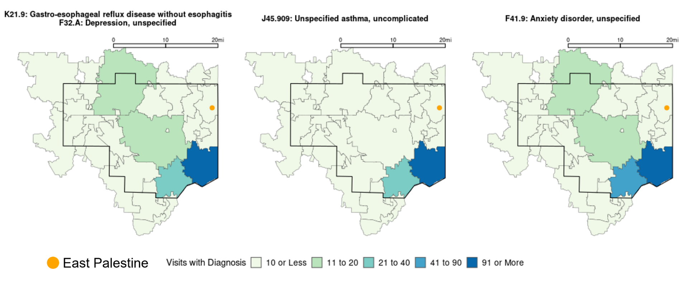

Syndromic Surveillance

Slide 40
Syndromic Surveillance
Symptom distribution.
Often presented with more than one symptom.
Most common symptoms reported were cough, headache, sore throat, and shortness of breath.

Slide 41
Syndromic Surveillance
Looked for increases in codes
that occurred after the
derailment.
Several codes increased.
  GERD
  Asthma
  Anxiety disorder
  Depression

Slide 42
Syndromic Surveillance

Slide 43
Conclusion
Data across sets is consistent.
Mild to moderate.
Consistent with irritant exposures.
Improvement is occurring.
Mental health effects are consistent with other environmental disasters.

Slide 44
Lessons Learned
In-person interaction with the public.
Trusted community members.
The use of stand-up health clinics/resource centers.
Multiple ways to measure health outcomes.
Geospatial analysis.
Measuring and interpreting exposure variables.
Inter-agency collaboration.
Early, timely, and coordinated inter-agency
communication.
Notes:
In-person interaction with the public proved insightful to the understanding of survey data and improved participation.
Having trusted community members accompany the team on door to door visits facilitated improved community buy-in, increased comfort levels on both sides, and improved efficiency.
The use of stand-up health clinics/resource centers gave more recognition to ACE assessments and facilitated access to resources.
Having multiple ways to measure health outcomes (self-report, assisted self- report, Poison Control Center, syndromic, hotlines) put in perspective symptoms reported.
Symptoms being reported appear to be mild to moderate and are consistent with irritant exposures; improvement and resolution of these symptoms would be generally expected after exposure ceases and time elapses.
Geospatial analysis assisted identification of areas underrepresented by survey participation and was especially helpful given the vulnerability of the community after the incident.
Measuring and interpreting exposure variables in the health survey are challenging in a multi-exposure environmental event.
Inter-agency collaboration is crucial in environmental public health emergencies which require expertise from a variety of specialists.
Early, timely and coordinated inter-agency communication and collaboration among health departments, multi-jurisdictional entities at the local, state and federal levels through an established unified command are critical in public health emergencies.

Slide 45
Lessons Learned
Incorporate One Health into various response plans and consider implications early and often.
Consider Animal Health Assessment Clinic.
Build interagency relationships before the disasters – improves communication flow.
Consider animal data early during surveys.
Consider data analysis process when developing questions.
Notes:
Its important to incorporate One Health into your agency or organization’s response plans and consider the implications of One Health early and often. We experienced this firsthand with unclear written policies for which agency will cover the responsibility of pets, which can delay initial preparedness and response. With environmental responses such as this, it is easy to make the tie from the environment to humans, but its important to not forget that last pillar needed for true One Health considerations.
When considering a human health assessment clinic, it is also important to consider the community’s need for an animal health assessment clinic. We collaborated with the Ohio Veterinary Medical Association to consider the implementation of such a clinic. With limited resources available on short notice, we were unable to offer this as a community resource, though there was a need for it. For the future, we hope to be able to identify the resources needed for such a clinic in the face of other environmental responses.
If not developed yet, I would recommend building those interagency relationships now as this will improve the communication flow when you are in the midst of the response. Often clear, and quick communication is needed and establishing those relationship and expectations early can help when decisions are needed to be made on a quickened timeline.
One thing I wish we were able to implement earlier was the incorporation of the Pet and Livestock ACE survey questions earlier in the response. Implementing these at the same time the original community ACE survey was distributed, would have cut down on time and work needed to do follow-up phone interviews. We waited in part, to see if such a survey was needed, but it may be better to consider such a survey earlier and have it ready, even if you don’t need it.
In the aftermath, we have run into some snags with combining Ohio and Pennsylvania Pet and Livestock ACE survey data. Due to the quick turnaround needed to implement these surveys, we were unable to align our questions exactly – which has added some difficulty to our data analysis. If working across state borders, this is certaintly something to consider.

Slide 46
Recommendations
Engage community leaders.
Convene an after action debrief.
Consider the use of an emergency alert system.
Improve coordination of multi-agency workgroups.
Develop a plan for effective communication.
Assist clinical providers.
Consider pets’ wellness and safety.
Investigate further health impacts.
Enhance Preparedness efforts.
Notes:
Engage community leaders (fire, police, church, educators, etc.) in outreach strategies
Convene an after action debrief to analyze and improve procedures for emergency response communications
Consider the use of an emergency alert system and community-based drills for all disasters, including environmental events
For trust and accountability, improve coordination of multi-agency workgroups across affected jurisdictions
Develop a plan for effective communication with community members to meet their needs
Create a trusted space to consolidate public information (e.g. Health Department or Fire Department website)
Extend communication to other platforms (social media, local TV, telephone)
Provide environmental test results from multiple websites in an easy to understand format
Include the plan for long-term testing of environmental media as needed (e.g. soil, water, and air)
Publicize available resources as needed(e.g. health clinic, mental health, bottled water, etc.)
Continue to monitor community needs and resource allocation, including health services at local clinics to assure needs are being met
Assist clinical providers in identifying and supporting affected communities, including veterinarians
Consider pets’ wellness and safety when requesting evacuation and assessing health risks
Engage with Federal, State and local Agricultural agencies to ensure needs are met
Investigate further health impacts
Consider reviewing medical records of exposed individuals
Consider follow-up ACE survey (in 6 to 12 months)
Evaluate whether additional epidemiologic study is warranted
For ED + Poison Control Center data:
Continue monitoring changes among the 4 identified diagnostic codes showing increasing visits
Use anomaly detection dashboard to identify potential future increases in other diagnostic codes
Further develop capacity for integrating emergency department and Poison Control Center data feeds for future chemical exposure events
Build capacity with the Regional Poison Control Centers in anticipation of future events.
Overall, responders self-reported inhaling potentially hazardous chemicals/substances and a large proportion reported never wearing a mask. A lack of timely information about the contents of the train cars led to a delay in implementing appropriate PPE measures. Our findings suggest a need for stronger exposure mitigation efforts during chemical spills. Preparedness efforts should enhance communication between the rail company and emergency response agencies to ensure a prompt exchange of information regarding hazardous materials onboard derailed trains. This includes implementing protocols for rapid identification and sharing of safety data sheets (SDS). Public health practitioners can encourage the use of robust iterative safety plans to assess possible on-going exposures during chemical incidents that protect responders.

