Slide 1
Baselines and Thresholds
Data Management Training
Amsterdam, Netherlands
November 7-11, 2016

Slide 2
Objectives
Overview
  What is a baseline/threshold
  Reasons: situational awareness, outbreak detection/response, determining the severity of current season
  Types of baselines and the questions they answer
  Examples
    US ILI baseline
    US P&I mortality baselines and thresholds
    Outbreak detection algorithms

Slide 3
Baselines and Thresholds Overview
Baseline: Typically refers to a rate of disease (i.e. ILI or SARI) that is expected. Or, the highest level of activity in the expected range. This can mean that values above a baseline are above what is expected (e.g. in the absence of influenza, or for that particular time).
Threshold: Sometimes referred to as the epidemic threshold. Values above the threshold indicate epidemic periods.
These terms are often used interchangeably, to mean a proportion or number above what is expected.

Slide 4
Baselines Overview
Based on historic data, baselines represent the expected level of activity.
  Point of reference for evaluation of activity outside the norm (i.e. above baseline is above what is expected)
  Baselines can be used to detect changes in incidence of disease activity

Slide 5
Why are baselines important?
Situational Awareness
  Baselines allow public health to explain the current situation in terms of what the expected is.
  May allow public health official to determine the start and end of the influenza season.
  May help public health officials determine the severity (i.e. SARI or mortality baselines) or intensity (% positive or consultations for ILI) of the current epidemic
Outbreak detection
  May help public health officials determine areas with increased influenza activity (i.e. regional baselines)
Activity outside the norm can act as a trigger for public health action
  Sending messages to the public that the influenza season has begun.
  These messages could be tailored to specific areas or specific persons given the extent of an outbreak.
  Help in allocation of resources (i.e. antivirals, vaccine, clinicians)
  Help in guiding clinical decisions

Slide 6
Data Used for Baselines
Different baselines may be determined using different parameters for different types of surveillance systems (e.g. ILI vs. SARI)
Examples:
  Number of ILI consultations
  Proportion of all consultations that are due to ILI
  Number of SARI admissions
  Proportion of all admissions that are due to SARI
  Number (or percent) of influenza positive specimens

Slide 7
Data Considerations
Stable data is important (or having a way to correct for instability)
  Reported consistently and in a timely fashion (i.e. same case definition and same sites over multiple years)
    More important if using counts
    Missing sites or newly added sites can change the trends without differences in disease activity
    Using percentages or proportions can help to correct for minor instability in the data (e.g. a physician who doesn’t see any patients for a week)
      Will not correct for changes in the case definition
Baselines use historic data to calculate what is normal. If something within the data collection methods changes, then the calculated baseline may no longer be accurate.

Slide 8
Counts vs. Percentages
Percentages (proportions, ratios) might be used to correct for shifts both in numerator and denominator activity (e.g. health care utilization and in disease activity)
Proportions may also help to clarify/magnify an outbreak signal
Percentages are useful where number of cases recorded are very large or a denominator is known
An average number of cases (average count) may be used where denominators are not known, or cases are rare
Counts require very stable data, while proportions are more forgiving with limited historical data
Notes:
Setting up a surveillance system takes a long time and a lot of work. Once it’s finished and is running routinely, it may seem like a well-oiled machine that can run itself. But it doesn’t. Assessing a system allows the opportunity to assess the

Slide 9
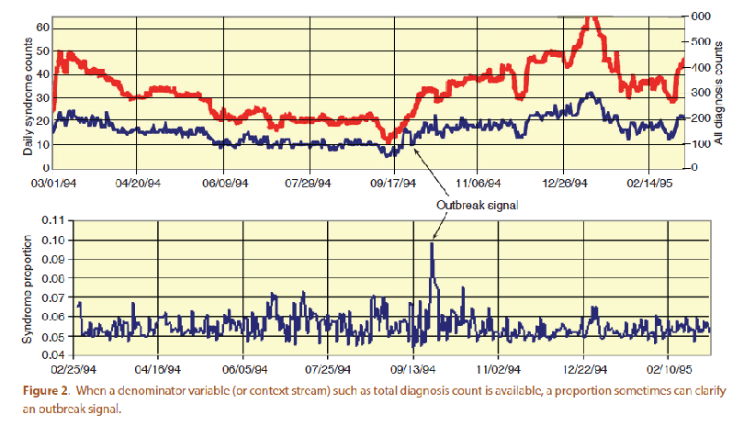
Example: Counts vs. Proportions
Burkom, et al. Developments in the Roles, Features, and Evaluation of Alerting Algorithms for Disease Outbreak Monitoring, Johns Hopkins APL Technical Digest, 2008

Slide 10
Data Needs Continued…
Significant historic data
  3-5 years of historic data are needed
  Less if using CUSum or other outbreak detection methods that do not use as much historic data

Slide 11
Establishing Baselines
Baselines can be difficult to establish
  Rely on very stable data collected over a long period of time, or a way to correct for instability.
    Determining an ILI baseline is difficult in tropical areas, or areas with many different causes of ILI
The type of baseline calculated is dependent on planned use
  Indicate start of influenza season, or show values outside of what is expected in the absence of influenza
  Comparison of this week’s value with the expected value
  Outbreak indicator

Slide 12
Methods for establishing thresholds
Visual inspection of graphical data
  E.g. Watts 2003
Means/percentiles
Shewhart charts
  Hashimoto 2000, Steiner 2010
Cumulative Sum (CuSum)
  O’Brien 1997, Cowling 2006, Kuang 2012
Exponentially Weighted Moving Average (EWMA)
  Steiner 2010, Kuang 2012
Regression
  Serfling, Cowling 2006, Cooper 2009, US Mortality (Andrews)
Time Series
  Cowling 2006
Moving Epidemic Method (MEM)
  Vega 2012

Slide 13
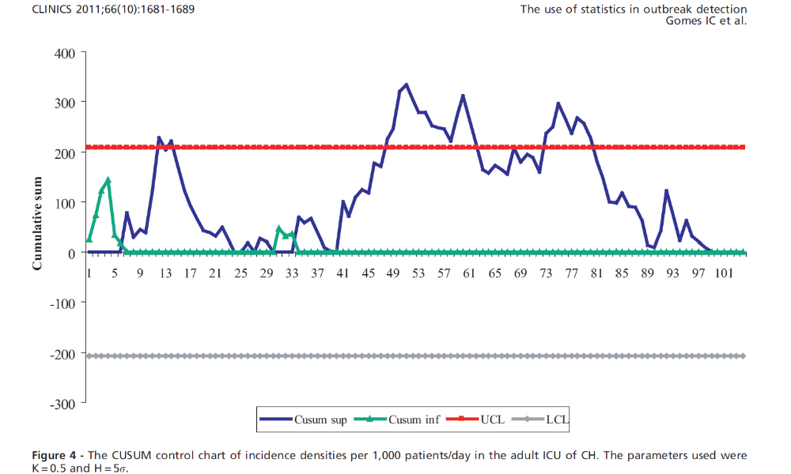
Example of CuSum

Slide 14
Baseline Use Example 1
To detect the start of the influenza season: (Seasonal threshold) the level of activity that signals the start of the influenza season. When the weekly rate exceeds this baseline it is assumed that sustained community transmission of influenza is occurring.
Example: U.S. ILINet baseline
  Methods: averaging of non-influenza time periods from historic seasons.
    Non-flu weeks are defined as those that contribute <2% of the total influenza positives for the entire year.
    Average of #ILI consultations/total consultations (weighted by state population) for non-flu weeks plus 2 standard deviations for the past 3 years.

Slide 15
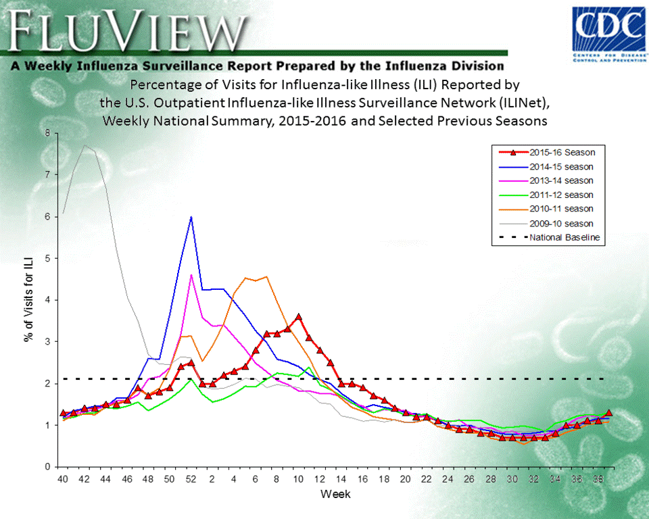
National Baseline
Outbreak/Epidemic Activity

Slide 16
Baseline Use Example 1
Example: U.S. ILINet baseline
  Things that are needed to calculate this type of baseline
    Defined seasonal peaks (in laboratory positive influenza cases) that can be selected based on the above or similar methodology (areas without typical seasonal peaks can you still select time frames when influenza activity was higher?)
      If the number of laboratory positives are too erratic (i.e. try using a 3 week moving average. This could be due to batching of influenza samples or tests (i.e. does the % positive change from 10% to 1% back to 10%).
    A set of consistent (or relatively consistent) data for at least 3 years
      There are ways to control for inconsistencies but it makes the methodology much more difficult.
    For ILI data you will need the total ILI and total consultations for the entire timeframe.

Slide 17
Determining Influenza vs. Non-Influenza Weeks

Slide 18
Baseline Use Example 2
To determine whether the level of activity is above what is normal for this time of year.
  Example: US Mortality Surveillance baselines and thresholds
  Methods: Seasonal baseline is calculated using a periodic regression model that incorporates a robust regression procedure applied to data from the previous five years.
    An increase of 1.645 standard deviations above the seasonal baseline is considered the “epidemic threshold”
    Percentage of deaths due to P&I are compared with seasonal baseline and epidemic threshold values calculated for each week
    Values above the threshold are excess P&I (i.e. the percent of deaths due to P&I are in excess of what we would normally expect this time of year in the absence of influenza).

Slide 19
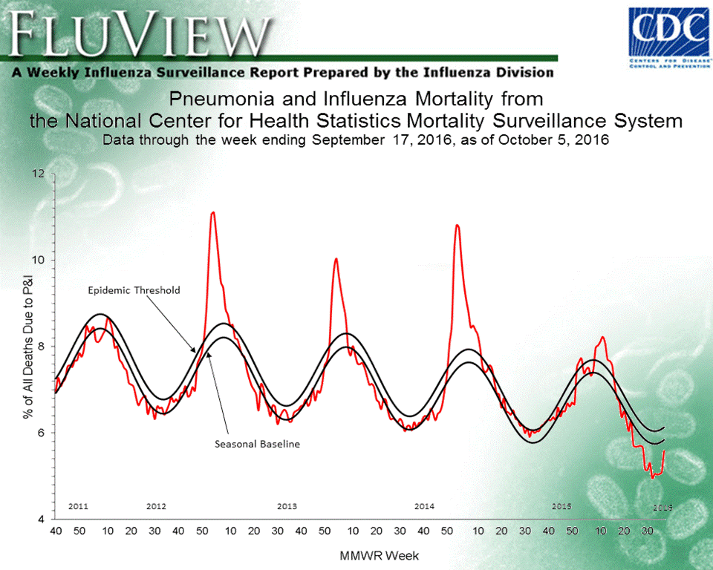

Slide 20
Baseline Use Example 2
Example: U.S. Mortality Surveillance Baselines and Thresholds
  Things that are needed to calculate this type of baseline
    Defined seasonal peaks (in mortality data)
    A set of consistent (or relatively consistent) data for at least 5 years
    Software that can help you in creating a model

Slide 21
WHO Baseline Example
To determine whether the level of activity is above what is normal for this time of year.
This method allows for a cyclical baseline/threshold without complicated regression modeling.
Method:
  Determine what an average season is (timing and magnitude) and average weeks after aligning peaks
  Example using US ILI data

Slide 22
Raw Data

Slide 23
Centered on Median Peak (Week 3)

Slide 24
Defining Alert Threshold
1.65 Standard deviations above the mean for each week.
Other important values to look at are the values at the peak during:
  Highest previous season
  Lowest previous season

Slide 25
Example Results

Slide 26
Static vs. Cyclical
Static (flat)
  Does not change with changes in seasonal patterns found in data
  Uses mean data for a specified period of time (may be for a whole year, may be for only period when surveillance is conducted)
  May be used to detect beginning of influenza season, peaks in activity
Notes:
Setting up a surveillance system takes a long time and a lot of work. Once it’s finished and is running routinely, it may seem like a well-oiled machine that can run itself. But it doesn’t. Assessing a system allows the opportunity to assess the

Slide 27
Static vs. Cyclical
Cyclical (seasonal)
  Good for data with regular seasonality; cyclical changes in baseline reflect seasonal pattern of disease activity
    Distinguishes disease related increases with normal seasonal increases in a syndrome (e.g. pneumonia)
  Different methods used:
    US Mortality surveillance uses a robust regression model
    Other methods include averaged weekly means (moving average) to reflect changes in data over time (e.g. average over previous four weeks determines expected average for current week)
Notes:
Setting up a surveillance system takes a long time and a lot of work. Once it’s finished and is running routinely, it may seem like a well-oiled machine that can run itself. But it doesn’t. Assessing a system allows the opportunity to assess the

Slide 28
Baseline Use Example 3
Outbreak detection algorithms (such as cusum or variants)
  Will alert public health to increases in indicators over the past few weeks (i.e. will alert when activity is starting to increase) and could alert the beginning of an epidemic period, or unusual activity.
    Method: Average of the previous 9 weeks (minus the 2 most recent weeks) plus 3 standard deviations. This can also be used for count or proportion data.
    Essentially flags weeks that are consistently increasing over the past weeks.

Slide 29
Percentage of Visits for Influenza-like Illness (ILI) Reported by
the U.S. Outpatient Influenza-like Illness Surveillance Network (ILINet),
Weekly National Summary, 2015-2016

Slide 30
Types of Baselines
Outbreak detection algorithms
  Do not require the extensive historic data that other methods require. Only require consistency within the time period used to calculate the values.
  Does not provide a measure of “elevated” activity over what has been historically seen, but shows an increasing trend in data.
    Activity may still be elevated above historic levels but decreasing (this method will not pick out those weeks)

Slide 31
Individual Site vs. Aggregated Site Baselines
Baselines may be calculated for individual sites, to monitor activity in particular locations, or may use data compiled from all surveillance sites
  In locations with few sites, individual baselines help control for non-reporting sites, regional variation within a country, or relative representativeness of sites of the national or regional populations
  In locations with many sites, data aggregated from all sites might be the best way to set a baseline
  Aggregations at sub-national (i.e. regional, state, provincial level) can also be helpful
    Influenza activity might vary drastically by site especially in tropical countries.

Slide 32
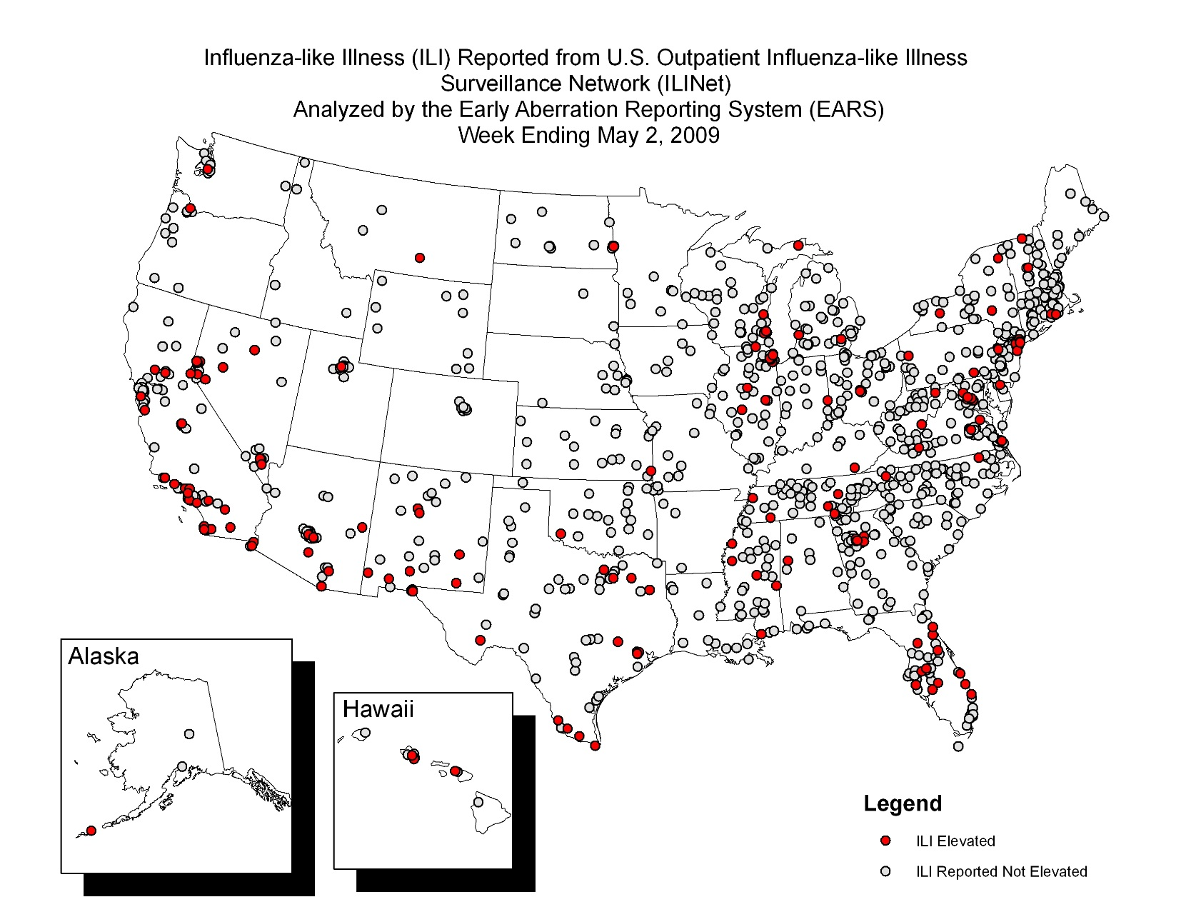
Outbreak Detection Algorithm at a Site Level, ILINet

Slide 33
Interpretation Using Baselines
Baselines may be calculated with an upper and lower bound for expected values (US mortality as an example)
  Common bounds are +/- approximately two standard deviations from the weekly mean
  Upper bounds may be described as an epidemic threshold; activity over the upper bound may indicate unusual or outbreak activity
Figures enable easy comparison of current activity with the mean activity observed in the past (e.g. on a week-to-week or month-to-month basis)
  This figure may also help identify further analysis needs based on change in observed trends or other aberrations
Notes:
Setting up a surveillance system takes a long time and a lot of work. Once it’s finished and is running routinely, it may seem like a well-oiled machine that can run itself. But it doesn’t. Assessing a system allows the opportunity to assess the

Slide 34
Interpreting Data
Knowing your data is key to interpreting:
  Time series data may show anomalies associated with holidays, long weekends, etc.
    Interpretation of those anomalies is dependent on the data analyst’s knowledge of trends not accounted for in the detection algorithm
Baselines may be influenced by changes in:
    Data collection methods
    Provider participation
    Changes in case definitions
    Changes in population/health care use

Slide 35
Summary
Baselines and epidemic thresholds helpt to understand the significance of increased influenza activity
  When to know if a spike in activity is a real spike
  An indicator that activity is unusual or outside the norm
  When to know a flu season has begun
  An indicator for public health action
Graphical representation of current surveillance data compared with baseline data provides a meaningful snapshot to public health practitioners, policy makers, and others regarding current activity

Slide 36
References
Burkom, et al. Developments in the Roles, Features, and Evaluation of Alerting Algorithms for Disease Outbreak Monitoring, Johns Hopkins APL Technical Digest, 2008
Cooper DL, et al. Can syndromic thresholds provide early warning of national influenza outbreaks? J Public Health. 2009;31(1):17-25.
Cowling BJ, et al. Methods for monitoring influenza surveillance data. Int J Epidemiol. 2006;35(5):1314-21.
Hashimoto S, et al. Detection of epidemics in their early stage through infectious disease surveillance. Int J Epidemiol. 2000;29(5):905-10.
Kuang J, et al. Epidemic features affecting the performance of outbreak detection algorithms. BMC Public Health. 2012;12(1):418.
O'Brien SJ, Christie P. Do CuSums have a role in routine communicable disease surveillance? Public Health. 1997;111(4):255-8.
Steiner SH, et al. Detecting the start of an influenza outbreak using exponentially weighted moving average charts. BMC Med Inform Decis. 2010;10.
Vega T, et al. Influenza surveillance in Europe: establishing epidemic thresholds by the Moving Epidemic Method. Influenza Other Respi Viruses. 2012.
Watts CG, et al. Establishing thresholds for influenza surveillance in Victoria. Aust N Z J Public Health. 2003;27(4):409-12.
World Health Organization. WHO Global Surveillance Standards for Influenza. Geneva: Global Influenza Programme, Surveillance and Monitoring team, World Health Organization, 2012.

Slide 37
Thank you!
Questions?

