Slide 1
An Overview of Estimating
Influenza Disease Burden
Francisco Palomeque, MPH
Influenza Division
Centers for Disease Control and Prevention
Atlanta, US
National Center for Immunization & Respiratory Diseases
Influenza Division

Slide 2
DEFINING BURDEN of DISEASE

Slide 3
Burden of Disease (BoD) Pyramid
Influenza
Death
Severe Disease
2500
Mild disease
Asymptomatic infection
77,500
2,000,000 influenza infections each year
We would like to know the exact number of infections and their clinical outcome every year
Except for extremely rare diseases with no asymptomatic carriage, we NEVER have this information
1,500,000
420,000

Slide 4

What is the burden of disease?
At it’s most basic level it is simply a proportion or rate of disease containing a numerator and a denominator
Examples:
These rates are essential to making informed decisions about resource allocation including vaccination and treatment
Proportion of influenza-like illness (ILI) with influenza = $\frac{Flu positive ILI}{Total ILI with test results}$
Influenza incidence = $\frac{Cases of influenza}{100,000 persons}$

Slide 5
Why Estimate Influenza-Associated Disease Burden?
Reliable estimates needed from low and middle income countries to provide a better understanding of the impact of influenza and populations at risk
Estimates could enable governments to make evidence based decisions while allocating resources and planning intervention strategies to limit the spread of the disease and minimize associated costs
To identify target populations for influenza vaccine studies
To provide support for the development of influenza vaccine policy

Slide 6
Surveillance Data and Relative Burden
ILI and severe acute respiratory illness (SARI) surveillance give us the following:
  Total number influenza positive
  Total number tested
Every country should be able to use these data to produce a relative burden estimate:
Relative burden estimates are useful to understand relative importance of a disease and impact on the health system
Proportion ILI/SARI that are influenza positive = $\frac{Total ILI/SARI influenza positive}{Total ILI/SARI tested}$

Slide 7
Exercise: Relative Burden of Disease
What relative burden of disease estimates can be readily obtained from ILI/SARI surveillance sites?
  Proportion ILI/SARI that are influenza positive
  Proportion of outpatient visits/hospitalizations that are influenza positive
  SARI case-fatality rate/proportion

Slide 8
INFLUENZA DISEASE BURDEN Estimation WITH POPULATION DENOMINATORS

Slide 9
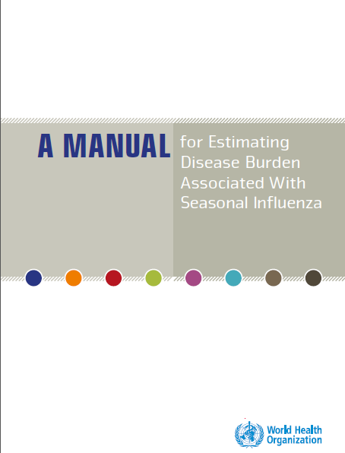
WHO Burden Manual
Purpose:
  Provide standardized tool for estimating influenza-associated disease burden using Severe Acute Respiratory Infection (SARI) or Hospital-based Surveillance Systems
Link:
  WHO: A Manual for Estimating Disease Burden Associated with Seasonal Influenza

Slide 10
Objectives of WHO Burden Manual
Identify data sources
Assess quality and suitability of data
Estimate disease burden due to influenza-associated respiratory infections
Interpret results in the context of the limitations imposed

Slide 11


Population-Based Influenza Disease Burden
ILI/SARI surveillance can be used to measure morbidity and mortality from influenza
Morbidity is the incidence of illness in a population
Mortality is the frequency of deaths in a population
Incidence rate = $\frac{\# of new illness episodes}{\# of persons under surveillance}$
Hospitalization rate = $\frac{\# of new hospitalizations}{\# of persons under surveillance}$
Mortality rate = $\frac{\# of deaths}{\# of persons under surveillance}$
Case – fatality rate (proportion) = $\frac{\# of deaths}{\# of illness episodes}$

Slide 12
Essential Data Requirements: Hospital-Based SARI Surveillance System
Minimum data requirements:
  Ideally at least three years of robust surveillance data is required
  Summarized by month and sentinel site:
    SARI cases within catchment area or their proxy (e.g., ICD-10 J00-99)
    SARI cases tested for influenza virus
    SARI cases positive for influenza virus
    New hospital admissions to wards with SARI patients
    Population in the catchment area
Ideally, these data will be stratified by age group
  WHO Recommended Age Groups: 0 to < 2 years, 2 to < 5 years, 5 to < 15 years,15 to < 50 years, 50 to < 65 years, ≥ 65 years

Slide 13
General Approach to Estimating Burden Using Surveillance Data
Step 1: Determine number of ILI/SARI cases positive for influenza (numerator) – surveillance data
  Need also total ILI/SARI visits, total ILI/SARI specimens tested
Step 2: Adjust for health utilization patterns among the ill
Step 3: Determine denominator data for catchment population of sentinel site(s)
Step 4: Calculate annual incidence rate of influenza associated ILI/SARI using formula to adjust data appropriately

Slide 14
Defining the Number of Cases (Numerator)
Sampling
  Many surveillance sites do not enroll all ILI/SARI cases
  Total ILI/SARI cases may/may not be recorded
  Total outpatients/admissions with a respiratory diagnosis could serve as a proxy for ILI/SARI
Bias
  Many outpatient URI diagnoses may not meet ILI criteria
  Many respiratory admissions could be for exacerbation of chronic issue (TB, COPD, asthma, etc.)
  Patients presenting on evenings/weekends may be more/less ill
  Clinicians may refuse to swab severe cases (worry about harming)
  Specimen collection technique may vary considerably

Slide 15
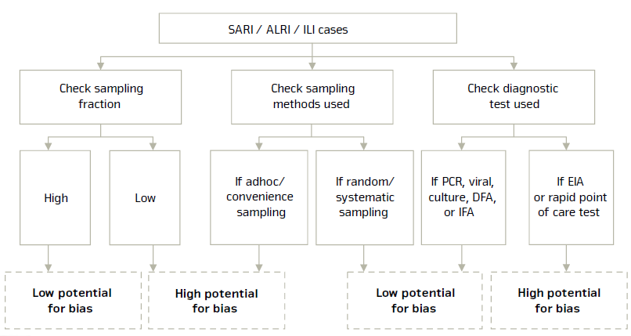
Assessing for Bias Resulting from Case Selection

Slide 16
Defining Population Under Surveillance (Denominator) Catchment Population for Sentinel Sites
Catchment population:
  Number of individuals living around the sentinel site who would seek care at the sentinel site if they were ill
  Serves as denominator in influenza-associated hospitalization rate calculations
Challenging to estimate:
  Not all residents of catchment area will seek care at sentinel site
  Data on health care utilization may not be available
Two main options for estimating catchment population where it is not otherwise known:
  Health Administrative Survey (HAS)
  Healthcare Utilization Survey (HUS)

Slide 17
Understanding Health Facility Utilization
Knowing the population of the catchment area and the proportion of health facility patients coming from that catchment area is the first step towards understanding rates of disease
The next step is to understand health facility utilization
  Hospital Admission Survey (HAS)
    Visit all health facilities that admit patients from the catchment area and count the total number of hospitalizations
    Then count the total number of hospitalizations for residents of the catchment area at these facilities
  Health Utilization Survey (HUS)
    Random selection of households or villages
    Questionnaire to determine where they seek care for ILI/SARI

Slide 18
Obtaining Rate of Influenza Related Hospitalization
X
X
X
=
Number Influenza Positive / Total Number Specimens Collected for given time period (at least one year of SARI surveillance data)
This formula gives you the proportion influenza positive from surveillance site
All SARI cases for the same time period (from surveillance data)/ Total Inpatients Visits (can be restricted to wards conducting surveillance)
Proportion who were hospitalized for a severe respiratory infection (from HUS survey data)
Population for surveillance/HUS catchment area (population census)
This number divided by 100,000 = Rate
Number of Influenza Related Hospitalizations for the Catchment Area
Notes:
If surveillance sites and HUS are representative to the geographic and demographics of the population, these estimates can be generalized to the population.

Slide 19
Exercise 1. Health facility A
Health facility A (HFA) is located in a rural district and serves a catchment area of 100,000 people
  It is the only health facility that hospitalizes patients from this district (no private providers, no other hospitals)
  The district is separated from other districts by mountains to the east and a river to the west
In 2013, there were 5000 hospitalizations at HFA
  2000 respiratory hospitalizations
  500 SARI tested for influenza, and 50 (10%) were positive
What is the rate of influenza-associated hospitalization in the catchment area of HFA?

Slide 20


Exercise 1. Health facility A (HFA)
Population: 100,000
5000 hospitalizations at HFA
  2000 respiratory hospitalizations
  500 SARI tested for influenza, and 50 (10%) were positive
2000 respiratory hospitalizations $×$ 10% influenza-positive = $\sim 200 influenza−associated hospitalizations$
Rate = $\frac{\sim 200 influenza−associated hospitalizations}{100,000 population}$

Slide 21
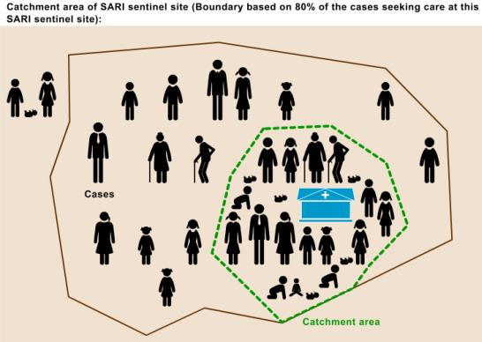
Example 1. Single facility serving catchment area
Catchment area population underestimates population accessing care at facility

Slide 22
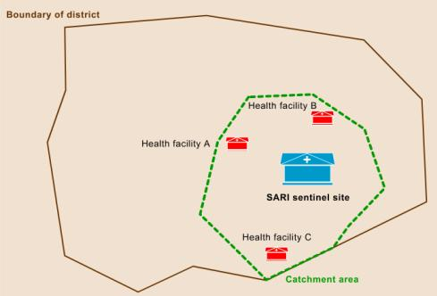
Example 2. Multiple facilities serving catchment
Catchment area population may overestimate population accessing care at facility

Slide 23
Exercise 2. Health facility B (HFB)
Health facility B is located in a semi-urban district and serves a catchment area of 100,000 people
  There are 2 other health facilities in the district that admit patients (one public, one private)
  HFB reports that 20% of hospitalized patients come from outside the catchment area
In 2013, there were 5000 hospitalizations at HFB
  2000 respiratory hospitalizations among catchment residents
  500 SARI tested for influenza, and 50 (10%) were positive
What additional information do you need to determine the rate of influenza-associated hospitalization in the catchment area of HFB?

Slide 24
Exercise 2. Health Facility B
Additional data needs
  Number of respiratory admissions from the catchment area population at other health facilities in the district
  Number of respiratory admissions from the catchment area population at facilities outside of the district
Let’s assume the following
  There were 2000 respiratory admissions from the catchment area population at the other health facilities in the district
  There were 1000 respiratory admissions from the catchment area population at health facilities outside of the district

Slide 25


Exercise 2. Health Facility B
Catchment area population: 100,000
Respiratory hospitalizations
  2000 at HFB
  2000 at other HF in district
  1000 at HF outside district
  10% influenza-positive
Rate = $\frac{5000 × 10\% flu positive}{100,000 population}$
= $\frac{500 flu−associated hospitalization}{100,000 population}$

Slide 26
Calculation of adjusted SARI admission rates
Four main steps
A. Define the catchment area of sentinel facility
B. Calculate crude SARI admission (incidence) rate for catchment area
C. Define adjustment factor, adjusting for health seeking in other facilities than sentinel facility
D. Calculate adjusted SARI hospitalization rate for sentinel hospital

Slide 27
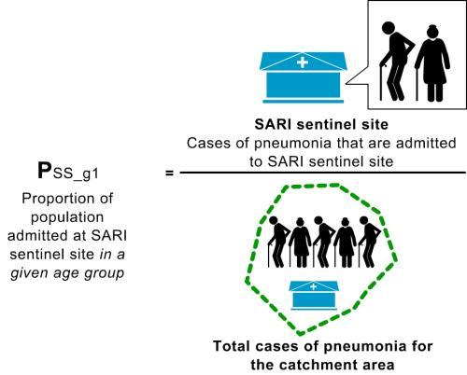
Calculate the proportion of pneumonia patients
ICD -10 codes: J9-J18 in each age-group

Slide 28
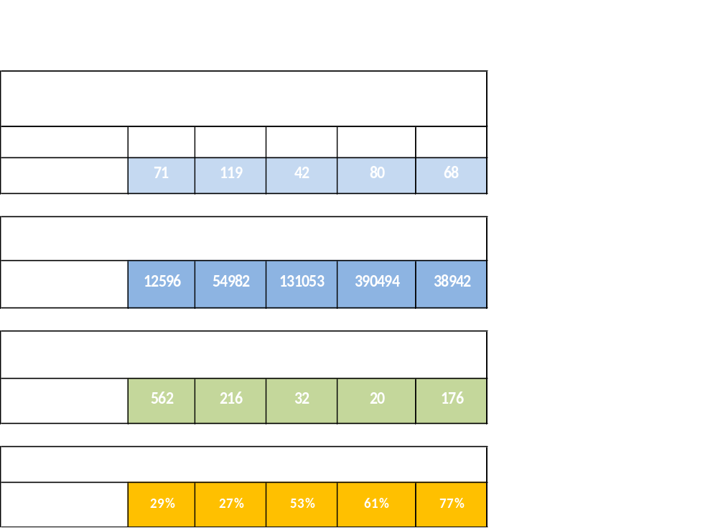
Calculation of adjusted SARI admission rate

Slide 29
Exercise 3. Health Facility C
Health facility C is located in an urban district and serves a catchment area of 100,000 people
  It is one of 12 hospitals in a city of over 2 million people
  50% of hospitalized patients come from outside the catchment
In 2013, there were 5000 hospitalizations at HFC
  2000 respiratory hospitalizations (1000 from catchment)
  500 SARI tested for influenza, and 50 (10%) were positive
What additional data do I need to determine the rate of influenza-associated hospitalization in the catchment area of HFC?

Slide 30
Exercise 3. Health Facility C
Additional data needs
  Too many health facilities and too many admissions to collect data on residence of every hospital admission
  Perform a health utilization survey to determine the proportion of catchment area residents with respiratory hospitalization who are hospitalized at HFC
Let’s assume the following
  Health utilization survey shows that 33% (1/3) of catchment area residents with respiratory hospitalization are hospitalized at HFC

Slide 31


Exercise 3. Health Facility C
Population: 100,000
Respiratory hospitalizations
  1000 at HFC = 33% of all respiratory hospitalizations
  3000 respiratory hospitalizations in catchment population
  10% influenza positive
Rate = $\frac{3000 × 10\% flu positive}{100,000 population}$
= $\frac{300 flu−associated hospitalization}{100,000 population}$

Slide 32
Catchment area: Are you only including patients coming from catchment area?

Slide 33
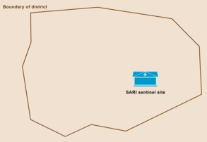
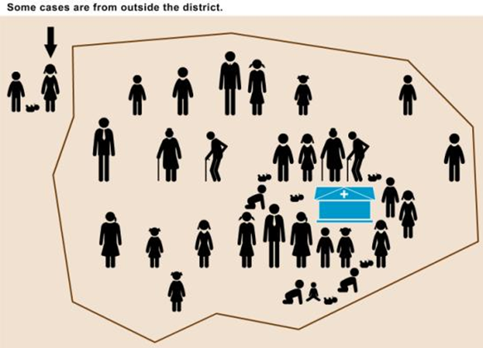
Validating actual catchment area of sentinel site
Step 1
Make a map of area of sentinel facility
Identify administrative divisions in catchment area
Identify lowest administrative division for which population data are available
Step 2.
4. Identify residential addresses of all SARI patients
5. Prepare a spot map;
indicating where patients live on map

Slide 34
Catchment area of sentinel site
Step 3 Identify area where majority of cases seeking care at sentinel site reside (e.g. ≥80%)
This is catchment area of sentinel site (marked by a green dashed line).
Boundary based on the lowest administrative unit for which population data are available
Step 4.
Obtain age-gender stratified population data for this area from
census or municipal records

Slide 35
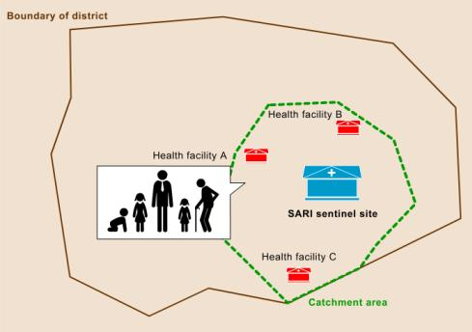
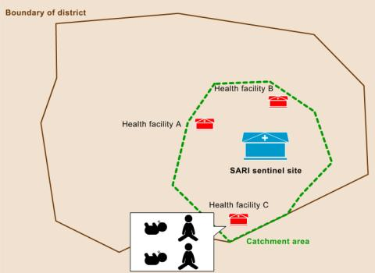
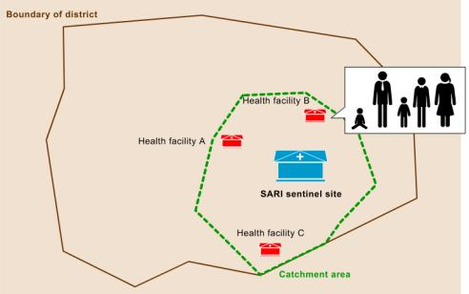
Calculating Total Pneumonia cases in catchment area by age-group
For each facility in area: count number of patients within catchment area who were hospitalized with pneumonia
Do this for every age group
Source data: Hospital discharge register or similar data source
Sentinel site

Slide 36
Exercise 4. Health Facility D
Health facility D is located in an urban district and the catchment population is unknown
  It is one of 12 hospitals in a city of over 2 million people
In 2013, there were 5000 hospitalizations at HFD
  2000 respiratory hospitalizations
  500 SARI tested for influenza, and 50 (10%) were positive
What additional data do I need to determine the rate of influenza-associated hospitalization at HFD?

Slide 37
Exercise 4. Health Facility D
Additional data needs:
  Catchment population estimate
Without an estimate of population served by the health facility it is difficult to determine a rate of disease
Can still provide relative disease burden estimates
Could potentially apply that relative disease burden estimate to district administrative data, but may not be reliable due to differences in clinical practice

Slide 38
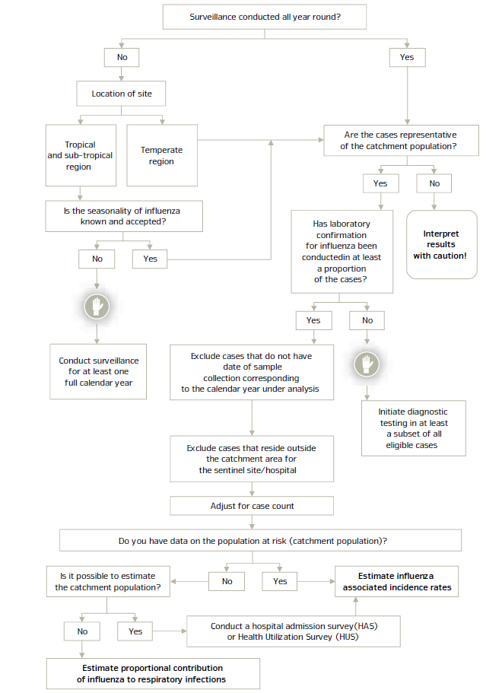
Flow chart outlining the key steps in influenza disease burden estimation

Slide 39
Other Challenges in Estimating BoD
Challenging to understand whether or not the surveillance site is “representative”
Clinician biases may impact which patients are tested for influenza
Differences in case definitions
  This is why we request all countries to adopt the new WHO standard case definitions for ILI and SARI
Variability in risk factors for severe influenza
  HIV prevalence
  Age distribution

Slide 40
Summary
Burden of disease is a rate or proportion with a numerator and a denominator
Surveillance data alone can be used to provide relative burden of disease estimates without additional data
Numerator: The strategy for sampling ILI/SARI cases should be understood and potential biases assessed
Denominator: Determining population denominator can be challenging, but assumptions about care seeking and proportion flu-positive can produce meaningful results

Slide 41
Thank you!
For more information please contact Centers for Disease Control and Prevention
1600 Clifton Road NE, Atlanta, GA 30333
Telephone: 1-800-CDC-INFO (232-4636)/TTY: 1-888-232-6348
E-mail: cdcinfo@cdc.gov Web: http://www.cdc.gov
The findings and conclusions in this report are those of the authors and do not necessarily represent the official position of the Centers for Disease Control and Prevention.
National Center for Immunization & Respiratory Diseases
Influenza Division

Slide 42
Determining proportion of population actually visiting sentinel site:
Correcting for health care seeking in other health care facilities in catchment area?
How to do this?

Slide 43
Health Administrative Survey (HAS)
Facility-based survey:
  Uses hospital registries or administrative datasets to identify respiratory or pneumonia hospitalizations and where they reside
  Compares information between hospitals to determine proportion of respiratory hospitalizations occurring at sentinel site
Allows you to:
  Define or validate the catchment population for sentinel site
  Determine proportion of individuals living in catchment area seeking care at the sentinel site if they were ill
  Generate parameters to adjust for health care seeking behavior
Approach is outlined in WHO Burden Manual

Slide 44
Hospital Admission Survey (HAS)
Identify all other health facilities in the catchment area of the sentinel site
Collect data on pneumonia – (ICD-10 codes: J9-J18) proxy for SARI – admission for all health facilities including sentinel site
Divide the number of pneumonia cases from your sentinel site over all pneumonia cases in the catchment area
This figure gives the proportion of the population in the catchment area that seeks health care for pneumonia in the sentinel sites – a proxy for health care seeking
Multiply population size of total catchment area with this population adjustment fraction to obtain an adjusted population denominator

Slide 45
Correcting for health care seeking in other health care facilities in catchment area
  Health care utilization survey (HUS)
  Perform population–based survey
  Collect information on which health care facilities population goes for specific respiratory symptoms
  Identify fraction of population that visits sentinel site
  Multiply this population adjustment fraction with population data
  Intensive and costly
Other ways to find this information?

Slide 46
Healthcare Utilization Survey (HUS)
Population-based survey:
  Administered to a random sample of representative households
  Collects information regarding historic health care use for specific respiratory problems
Allows you to:
  Define or validate the catchment population for sentinel site
  Identify proportion of the population seeking care at sentinel site
  Generate parameters to adjust for healthcare seeking behavior
Approach must be adapted to individual settings

Slide 47
Health Administrative Survey (HAS)
Pros | Cons
Cheaper and less time consuming compared to HUS | Does not account for referral hospitals use outside catchment area Difficult if there are a large number of health care facilities in catchment area
Healthcare Utilization Survey (HUS)
Pros | Cons
More robust than other approaches | Time intensive and costly compared to HAS Relies on recall of participants

Slide 48
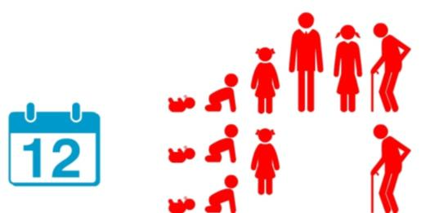
EXTRA SLIDES: Validating case count of influenza
Step 1. Obtain case counts of influenza-associated SARI for a calendar year in catchment area
Adjust for:
  1.1. Catchment area:
    Only include patients coming from catchment area
  1.2 Proportion of population visiting sentinel site:
    Calculate proportion of population in catchment area that visits sentinel site

Slide 49
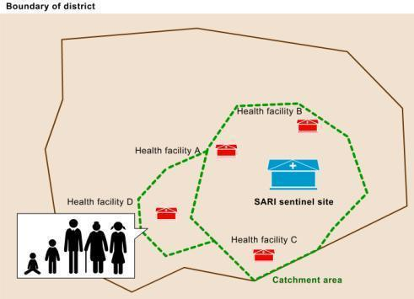
Need to extend catchment area?
If health facility lies just outside border of catchment area, but is attracting many patients from within catchment area, then this facility needs to be included in the survey and catchment area needs to be extended

Slide 50
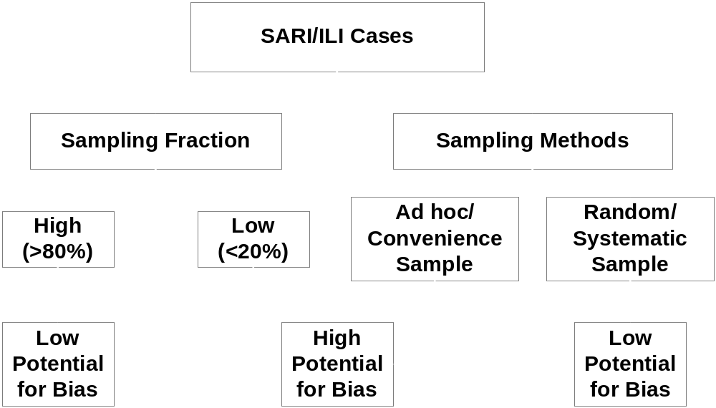
Assessing for Bias Resulting from Case Selection

