Slide 1
Descriptive Epidemiology & Routine Analyses: Summarizing Data by Groups/Type/Location
Dhara Shah, MPH
Council of State and Territorial Epidemiologists (CSTE)
Advanced Data Management & Analysis for Influenza
Amsterdam, Netherlands
November 7 – 11, 2016
Notes:
Demo summarizing, prep data for use in open epi demo during risk factors
Pivot table guide w/their data
Include rates

Slide 2
Surveillance Strategy
Strategic planning
Determine “research question” (e.g. what type of reporting you want to do, why)
Determine data needed to answer question
Implementing surveillance
Set up surveillance sites, train staff
Identify patients, collect data, specimens
Analysis
Descriptive statistics/epidemiology: numbers, frequency distributions, rates, proportions
Simple cross-tabulations with measures of association
Design data collection forms
Manage data: enter, transfer, edit
Interpreting & Reporting
Stratified analysis; multivariate, as needed
Interpret appropriately
Evaluate relationships
Report as appropriate

Slide 3
Objectives of Descriptive Epidemiology
Evaluate trends in health and disease
  Frequency and distribution of disease
    Comparisons between subgroups, regions, etc.
    Use measures of frequency: counts, rates
Situational awareness
Provide information for planning, policy development
Identify problems to be studied in greater detail (example: correlations between a potential risk factor and a specific outcome)
Notes:
This is when we start talking about descriptive epidemiology – the analysis we do to answer these questions. And these are the things that we’ve talked about covering in our reports. How are we going to do this?

Slide 4
Descriptive Analysis
Descriptive analysis of health outcomes by person, place and time are valuable and effective on their own: weekly reporting, situational awareness, etc.
Reports are full of descriptive analysis – stratification by age groups, sex, underlying conditions, location that give us clues to patterns
Can also be the first step to provide valuable clues to etiology, patterns of disease, etc. that might lead to more analysis of associations – lead to generation of research hypotheses: in short, can suggest associations for further consideration
Question: what types of analyses will be most important in your country? What are the best ways to use your surveillance data? What was the purpose in collecting all of this data?
Notes:
We’ve spent the first part of this course talking about the flow of collecting our data, standardizing what data we will collect, how we will collect that data and how we will manage it. Once the data has been collected, cleaned, and is ready for analysis, we need to think about how it will be analyzed, what the analysis will be used for, what questions we need to answer to convey the messages we’ve identified as priorities. These analyses can be the ones we put into the monthly reports to identify influenza activity, and also into the annual report explaining trends over the prior year, compared to previous years, trends by population group (age, sex, at-risk groups, etc.), over time, by place, etc.

Slide 5
Elements of Descriptive Epidemiology
Time
  Do disease patterns differ based on the time of year?
    Seasonality
Person – disease does not occur entirely at random
  Do disease patterns differ based on a persons age or sex?
  Are certain groups of people more susceptible to complications of disease?
Place
  Do disease patterns differ based on geographic location?
Combinations of Time, Place and Person
  i.e. age groups over time, stratified by location, etc.
Notes:
The core elements of descriptive epidemiology include the following, and we will move on to how to develop the graphs we can use to illustrate these analyses, and portray them in an easily digestible format for our target audiences.

Slide 6
Time
Temperate climates usually have flu season during the fall/winter months
Tropical climates have a less predictable flu season (i.e. may have several peaks throughout the season, and they may vary dramatically among regions of a country)
Differences in patterns are important
  Temporal patterns are often different during an epidemic or pandemic
Notes:
Example: Vietnam, where northern patterns of circulation differ quite significantly from southern patterns. Vietnam is a very long country. Similarly, Thailand has distinct zones with differing climate patterns between the north and the southern part of the country.

Slide 7
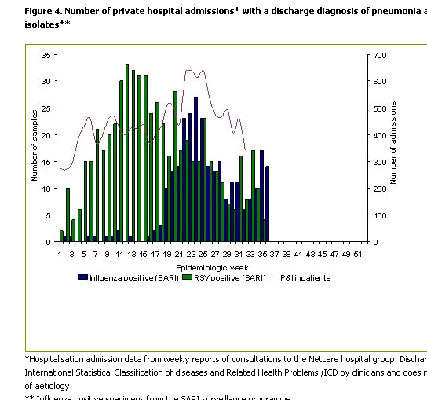
Number of private hospital admissions with a discharge diagnosis of pneumonia and number of samples (South Africa)
Notes:
The weekly report puts together quick snapshots of activity:
Used by clinicians to know what to expect in their clinics
Used by public health officials to identify when they need to take action/respond to unusual situations

Slide 8
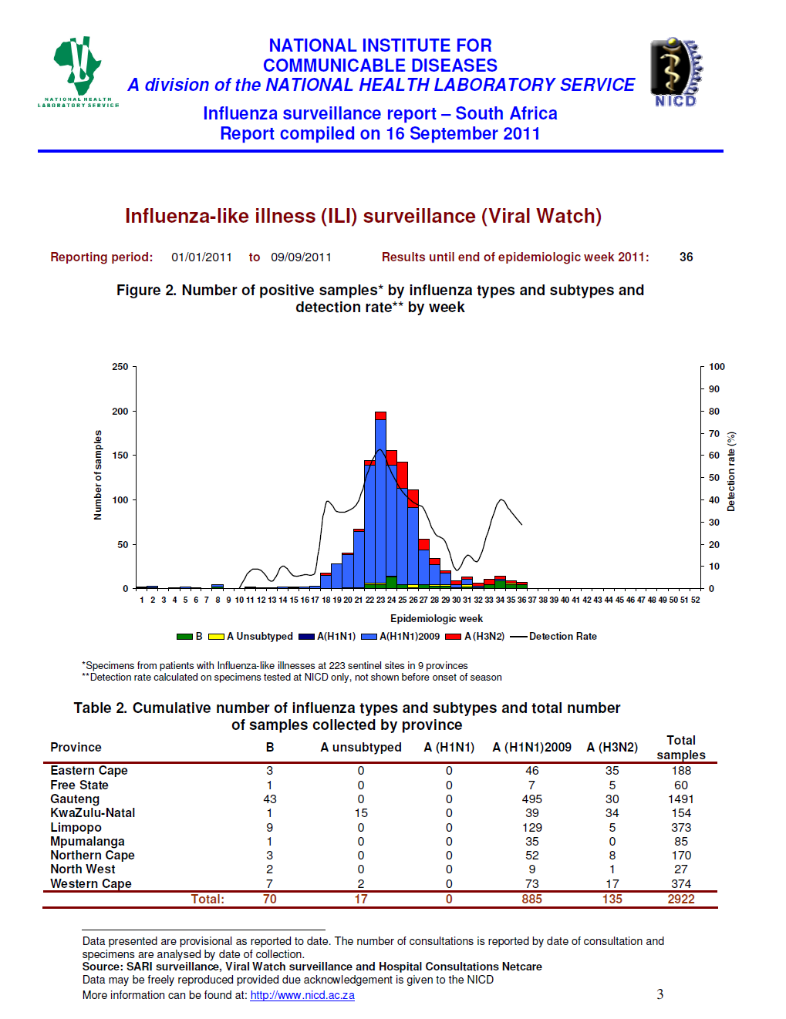
Weekly ILI Virologic Reporting: South Africa
Notes:
Weekly updates on number of ILI samples gives a quick, visual update on activity.
No need to do in-depth data analysis in order to understand the weekly activity and make decisions based on current situations

Slide 9
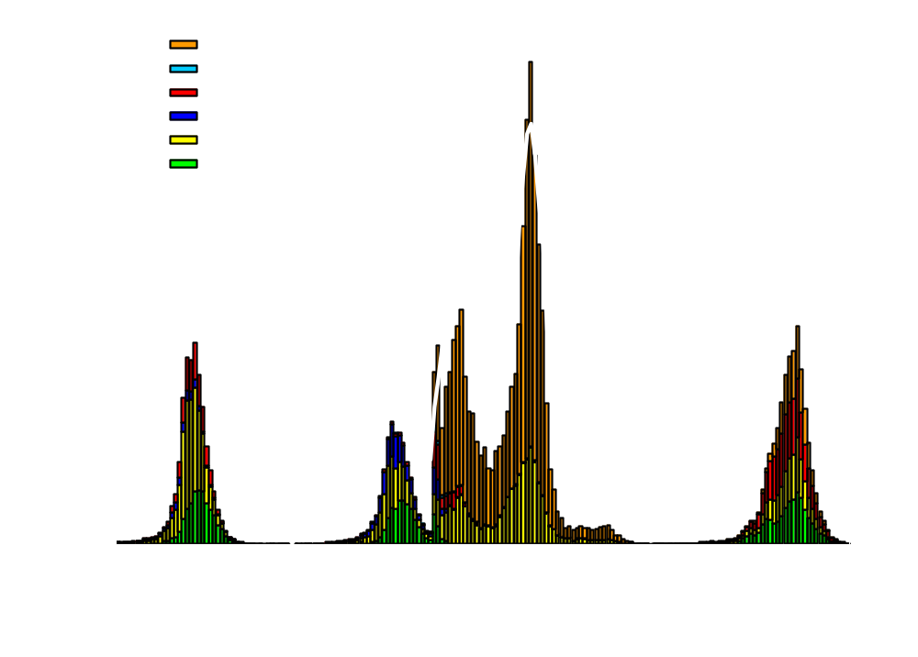
Influenza Positive Tests Reported to CDC by U.S. WHO/NREVSS Collaborating Laboratories, National Summary,
2007-08 through 2010-11
Number of Positive Specimens
Percent Positive
Notes:
We can compare that ILI data with influenza positive tests, both to see how different viruses are circulating from year to year, and to gain an understanding of how those ILI patterns match to positive influenza virus circulation.

Slide 10
Possible Reasons for Changes in Trends
Artifactual
  Errors in numerator due to:
    Changes in the recognition of disease
    Changes in the rules and procedures for classification of causes of death
    Changes in the classification code of causes of death
    Changes in accuracy of reporting age at death
    Errors in the denominator due to error in the enumeration of the population

Slide 11
Possible Reasons for Changes in Trends (cont.)
Real
  Changes in age distribution of the population
  Changes in survivorship
  Changes in incidence of disease resulting from
    Genetic factors
    Environmental factors

Slide 12
Person
Do certain characteristics make a person more susceptible to infection or complications due to infection?
  Demographic data:
    Young vs. elderly vs. bi-modal peaks
    Gender: women vs. men
    Underlying conditions/risk factors
Notes:
Gaining this understanding can help to understand who is at risk and how we should plan resources accordingly – e.g., priority groups for vaccination and oseltamivir use, in circumstances of limited supply or great cost.

Slide 13
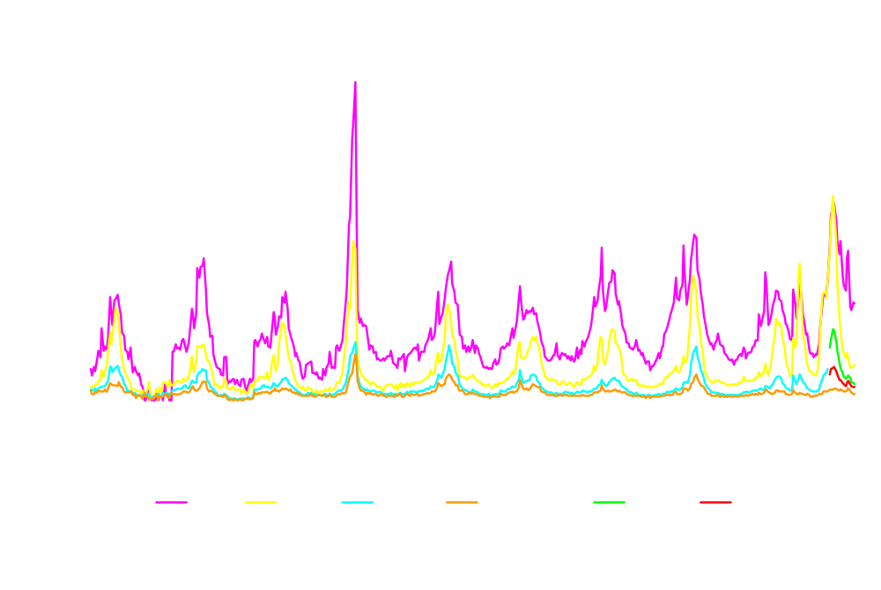
Percentage of Visits for ILI Reported by the U.S. Outpatient Influenza-like Illness Surveillance Network (ILINet), National Summary 2000-01 through 2009-10 by Age Group data as of week ending 20 February, 2010
Notes:
This is a good representation of how we can look at more than one element at the same time – patterns among age groups over time.
For nearly every week of every year since 1998, except during the 2009 H1N1 pandemic, the age group with the greatest proportion of visits due to ILI was 0-4 years followed by 5-24 years, 25-64 year olds, and 65 years and older
For two continuous weeks during the spring wave (weeks 20 and 21) and five weeks during the fall wave (weeks 35-37, 39, and 42) the 5-24 year old age group had the highest proportion of visits due to ILI

Slide 14
SARI Cases Screened and Tested by Age Groups, South Africa, 2009-2010
5000
68.7% Enrollment Rate
100
4500
90
4000
80
3500
70
3000
60
2500
50
Number of Cases
Percent Tested
No Of SARI Cases Screened
2000
No. of SARI Cases Tested
40
1500
Percent tested
30
1000
20
500
10
0
0
0 - 4
5 -9
10 -14
15 - 24
25 - 34
35 - 44
45 - 54
55 - 64
65+
Age Groups in years
Notes:
Shows proportion of cases selected for testing by age group. Can help determine if particular age groups are preferentially selected for testing. Helps to understand bias in surveillance data.
Can also be done for SARI

Slide 15
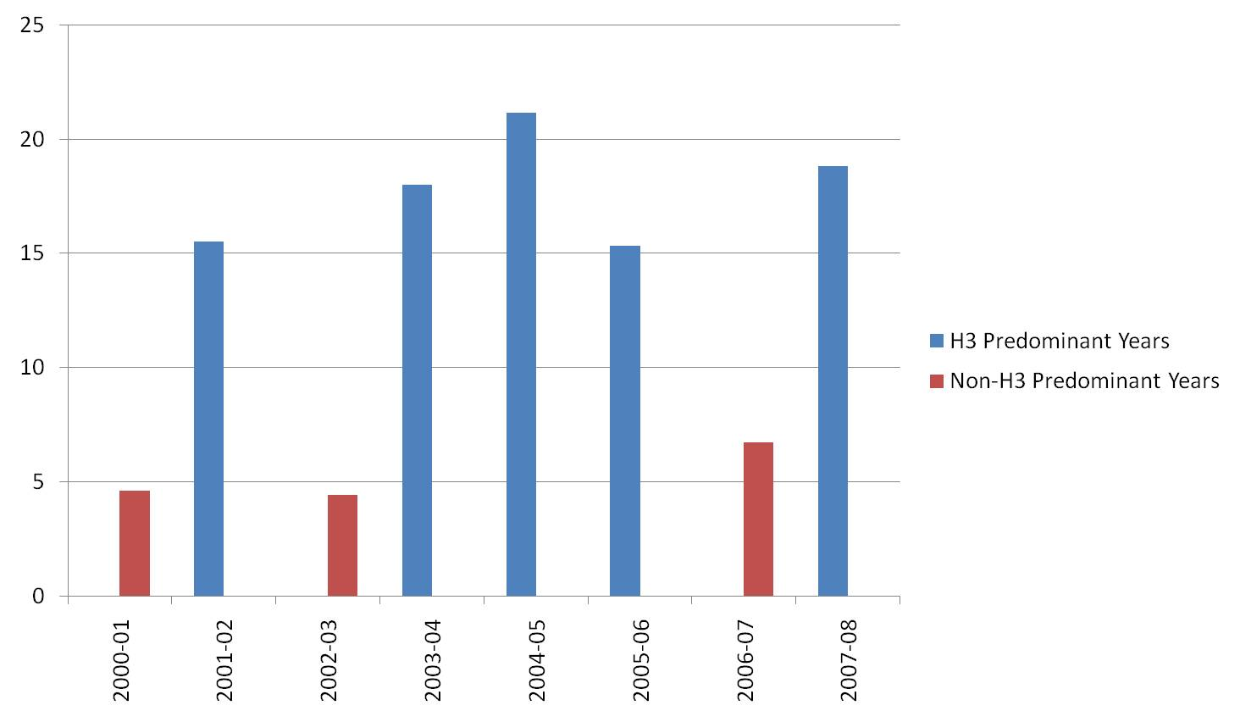
Influenza A(H3N2) predominant and non- predominant seasons , individuals aged >64
Notes:
This chart shows that there is a much higher proportion of individuals positive for influenza during H3 predominant years, indicating a more severe season, than during non-H3 predominant years. It helps us understand the severity of H3N2 compared with other subtypes. If we consider this trend when we can see a season is going to be an H3 predominant year, this can help with planning for the remainder of the season.

Slide 16
Standard Underlying Conditions
Pregnancy
Chronic respiratory disease
Asthma
Diabetes
Chronic cardiac disease
Chronic liver disease
Chronic renal disease
Chronic neurological or neuromuscular disease
Immunodeficiency
Hematological disease
Notes:
Update for SAGE

Slide 17
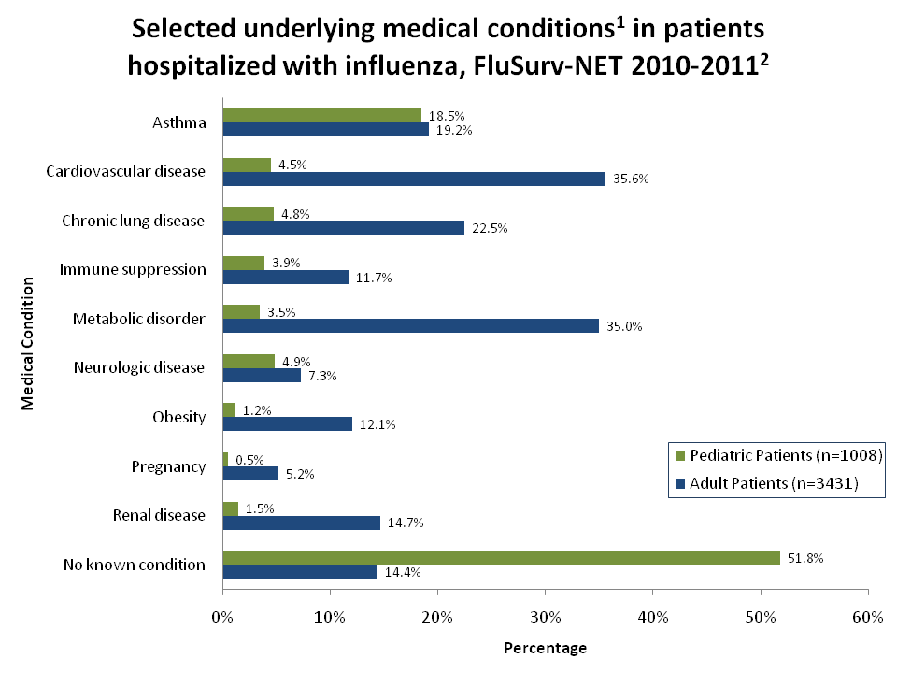
Notes:
This chart shows us in a simple graphical format what the most common underlying medical conditions are among hospitalized patients, stratified by pediatric patients and adults. We can see that a common condition is asthma, while cardiovascular disease is much more prevalent among hospitalized adults.
Introduce how this can be taken farther – comparing two proportions and p-value? E.g. for asthma: Difference0.7 %95% CI-2.1537 to 3.4161Chi-squared0.248DF 1Significance levelP = 0.6188 – not significant. For metabolic disorder: Difference 31.5 % 95% CI29.4227 to 33.4309Chi-squared384.668DF 1Significance levelP < 0.0001

Slide 18
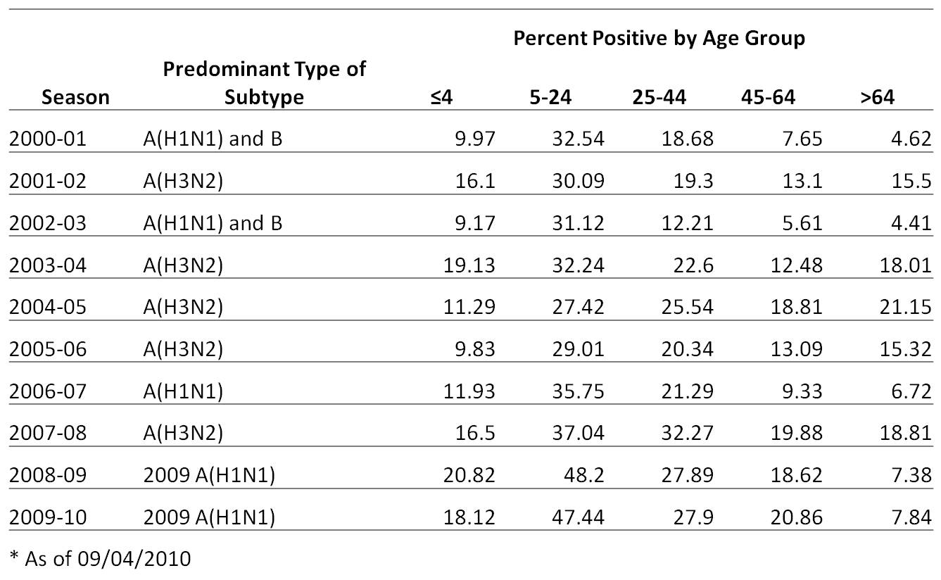
Predominant virus type and percent positive
Notes:
Table can also give us a quick look at different elements of the descriptive epidemiology of our data. We can see again here patterns by age and season, and the predominant circulation type and subtype. In situations where the numbers themselves convey the most information or are easiest to understand, tables can be really useful. Again, this is data stratified by a number of elements, giving us a good description of activity and trends.
-- pivot table to summarize

Slide 19
Place: Are things different or worse in one area vs. another
Visualization of place information can be in
  Maps
  Graphs
  Tables
Place can be defined in different ways depending on what the question is you are asking and available information
  Geographic (region, state, county, city, or site level)
Notes:
While graphs and tables are simple to produce with everyday software, maps generally require GIS software. This software requires extra licenses, and often has a steep learning curve. Free programs such as EpiInfo, however, have built-in GIS capability. Bonus: EpiInfo is free.

Slide 20
Distribution of SARI Cases by Province and Hospital, South Africa 2009-2010
Province | Hospital | Total Patient Admitted | Total SARI visits “N (%)” | Total SARI sampled “N (%)” | No. Influenza Positive/No. Tested (% Flu +)
Gauteng | CHBH | Data Pending for 2010 | 8360 | 5966 (71.3) | 508/5966 (8.5)
KwaZulu Natal | Edendale | 8050 | 576 (7.2) | 374 (64.9) | 26/374 (7.0)
North West | Klerksdorp | 1009 | 188 (18.6) | 91 (48.4) | 14/91 (15.4)
North West | Tshepong | 3206 | 323 (10.1) | 294 (91.0) | 31/294 (10.5)
Mpumalanga | Mapulaneng | 6387 | 529 (8.3) | 507 (95.8) | 56/507 (11.1)
Mpumalanga | Matikwane | 8341 | 748 (9.0) | 512 (68.4) | 59/512 (11.5)
 | Total | 26993 | 10724 | 7744 (72.1) | 694/7744 (9.0)
Notes:
Shows percent positive of ILI by hospital/clinic.

Slide 21
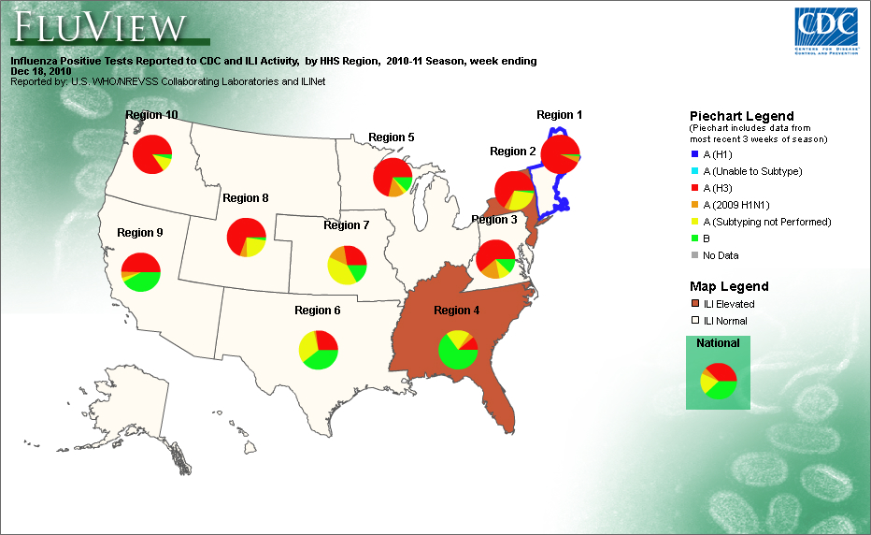
Notes:
Virus circulation often differs by region in the US. For example in region 4 you can see that during the week displayed here Influenza B viruses were predominant, but in the other regions Influenza A H3 were predominant. So here we can stratify data and convey these differences in terms of proportions and by location.

Slide 22
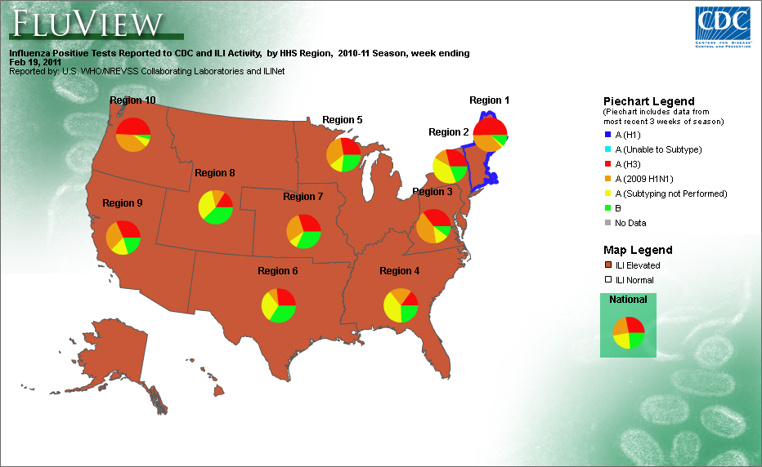
Notes:
By the week shown in this map virus circulation patterns had changed and 2009 H1N1 started to be more predominant in some regions.

Slide 23
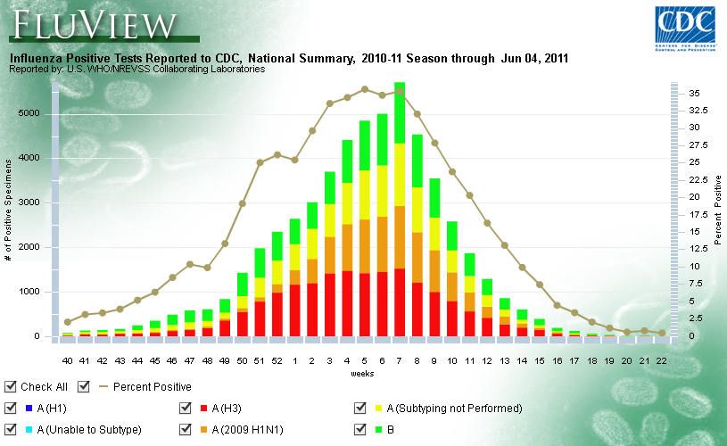
Notes:
Here you see the national picture, with co-circulation of all viruses throughout the season…but when looked at a smaller regional level

Slide 24
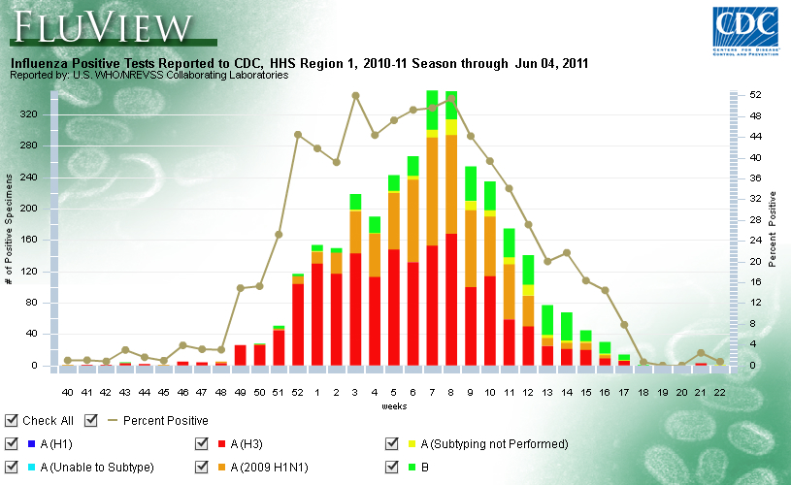
Notes:
You see a much different picture with influenza A H3 viruses dominating until later in the season, when 2009 H1N1 and influenza B viruses began to circulate.

Slide 25
Methods of Analysis Matter
Different messages result from different types of analyses:
  Counts: very easy to obtain; can be misleading
  Proportions: simple, clear, efficient analysis
    Using a denominator (population, total visits, total specimens) as appropriate makes data easier to interpret
  Rates: frequency of defined events in specified population for given time period
    Rates allow comparisons between two or more populations of different sizes or of a population over time
Measures of association provide a better understanding of the importance of the risk factor
Notes:
Consider the method of analysis when designing data collection & management. Make sure your sites are collecting denominators so you can do this. I have seen many, many systems where the analysis does not include a denominator, and the understanding of activity is SO much different when seen as a proportion. See example on following slide.
Counts are very easy to present, but can be misleading. Receiving simply a count of cases from a site from week to week might convey incorrect trends – counts might go up while patient visits go down because staff have more time for surveillance. A better measure of activity is proportion – always have a sense of what ILI/SARI activitiy is compared with total outpatient/inpatient activity. A good measure to estimate a population proportion over a specified period of time is an incidence rate. Incidence rates may be used to look at the annual incidence of influenza, or the seasonal incidence rate. The denominator might the total population under surveillance, or the total population covered by the site, depending how your system is set up.

Slide 26
Example: Incidence Rates
In a study of 2390 women between 16 and 49 years of age admitted to hospital for SARI, it was found that 482 were influenza positive in a one year period.
482/(2390/ 100,000) = 20,167
Therefore, there are influenza positive 20,167 per 100,000 women admitted to hospital in a one year period
Notes:
There is a rate of 20,167 influenza positive cases per 100,000 hospital admissions in women 16 to 49.

Slide 27
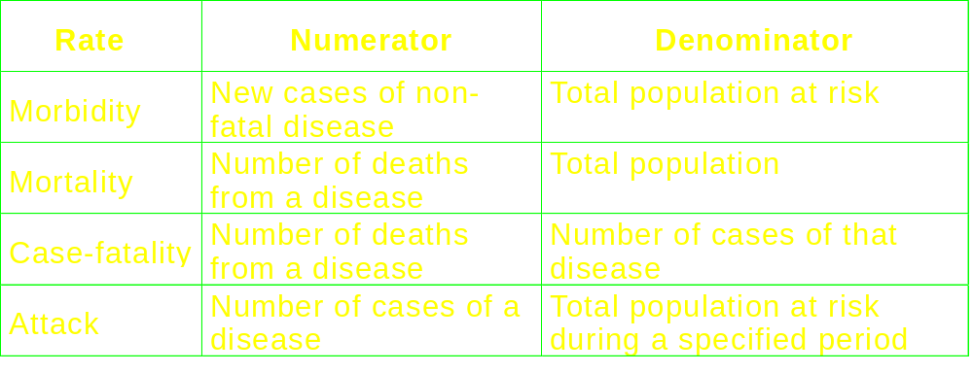
Types of Incidence Measures

Slide 28
Rates Commonly Used in Epidemiology
Crude
  For total population, not adjusted to reflect contributions of different age groups to total (e.g. annual cancer mortality rate)
Category specific
  Based on the number of persons in the category and the number of cases in that group (e.g. age-specific cancer mortality rate)
Age adjusted
  More appropriate comparisons when differences in age distribution may mask real differences in the condition of interest

Slide 29
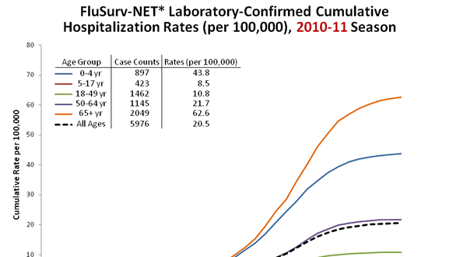
FluSurvNet – Cumulative Rate of Influenza Hospitalizations, 2010-11

Slide 30
Conclusions
You can learn a lot by looking at differences in disease in terms of simple descriptives
  What are the normal patterns of disease?
  Disease patterns will often differ based on differences in person and place
Changes in normal patterns occur during major epidemics or pandemics
Your methods of analysis make a big difference in interpretation
Notes:
From here we will go on to some examples of how to summarize data by groups and make graphical representations like those presented.

Slide 31
Conclusions
  Your analysis will depend on your data and the message you want to convey
    These are critical considerations when you develop your database
    Develop a plan first
  None of the examples shown include complex analysi
    Counts
    Percent
    Cumulative rate
  These simple analyses allow for effective presentation of data, whether in one week or for the whole year

Slide 32
Conclusions
  Simple analysis requires upfront preparation
    Receipt of data requiring little or no cleaning
    Streamline as many tasks as possible
      Easy data entry or upload
      Predefined queries
      Graphic templates
  Remember that surveillance systems are built over time
    Constantly monitor your data
    Make improvements as needed to fine tune your analysis

Slide 33
Thank you!
Questions?

