Slide 1
Risk Factors and Analysis
Training Course on Advanced Data Management & Analysis for Influenza
Data Management Training
Netherlands, Amsterdam
November 7-11, 2016
Notes:
- SAGE risk groups
Statistics produced include the Fisher and mid-p exact tests, chi squares, odds ratio, maximum likelihood odds ratio estimate, risk/prevalence ratio (relative risk), risk difference, and etiologic fractions with confidence limits produced by several methods, with stratified analysis
How to interpret the results
OpenEpi demo
More interpreting results

Slide 2
Risk

Slide 3
Types of Risk
Absolute risk = incidence rate
Relative risk
Attributable risk
Odds ratio
Notes:
First a few words on risk and the four main types of risk used in epidemiology.

Slide 4
Types of Risk
Absolute risk = incidence rate
Relative risk
  Ratio of absolute risk between two groups (e.g. ratio of two incidence rates)
  Measures strength of association between exposure and disease
  Depends on incidence data
Attributable risk
Odds ratio

Slide 5
Types of Risk
Absolute risk = incidence rate
Relative risk
Attributable risk
  Measures proportion of disease that can be attributed to exposure
  AR population = population incidence rate – incidence rate unexposed
  AR exposed = incidence rate exposed – incidence rate unexposed
Odds ratio
Notes:
Attributable risk is not generally something we measure with influenza.

Slide 6
Types of Risk
Absolute risk = incidence rate
Relative risk (RR)
Attributable risk (AR)
Odds ratio (OR)
  Compares the odds of an event between two groups using a ratio
    Not the same as a risk ratio

Slide 7
Risk Factors

Slide 8
Introduction
Data on risk factors for influenza-associated severe disease are key to guide targeted influenza vaccination interventions.
This is particularly important in resource-limited setting where influenza vaccine availability is limited.

Slide 9
What is a risk factor?
A primary goal of observational epidemiology is to assess the strength, direction and shape of relationships between risk factors (exposures) and disease outcomes using appropriate statistical methods.
In epidemiology, a risk factor is a variable associated with an increased risk of disease or infection.
  The probability of an outcome usually depends on an interplay between multiple associated variables.
In many SARI surveillance systems, information about a number of potential risk factors and about outcomes is recorded
  In order to make maximum use of this data, an understanding of the association of risk factors with severe outcomes
    Help to effectively plan prevention & intervention

Slide 10
Is a risk factor the cause of a disease?
Risk factors or determinants are correlational and not necessarily causal, because correlation does not imply causation.
For example, being young cannot be said to cause measles, but young people are more at risk as they are less likely to have developed immunity during a previous epidemic.

Slide 11
How are risk factors/disease determinants identified?
Epidemiology employs a range of study designs to identify risk factors/determinants of diseases.
To identify risk factors you need two factors:
  Outcome of interest (e.g. influenza infected patients who die/survive)
  Exposure (e.g. pregnancy, underlying illness)
Surveillance data describing exposures allows analysis of associations without specific studies

Slide 12
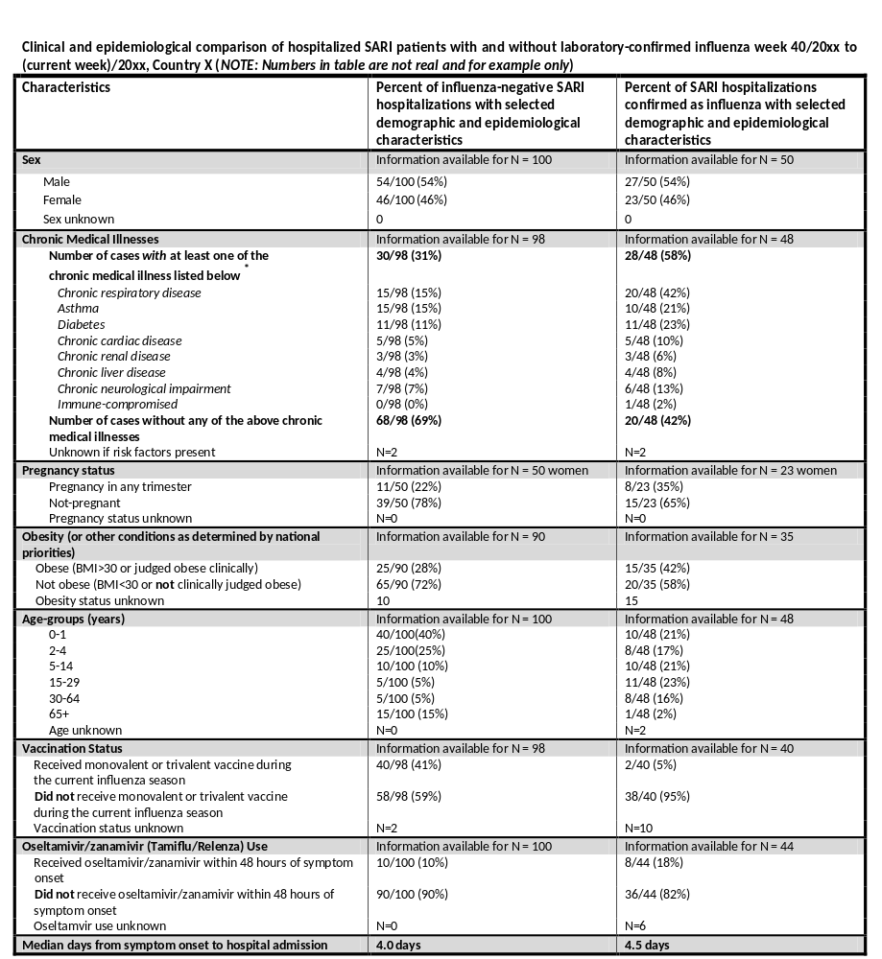
How are risk factors/disease determinants identified? (… continue …)
Notes:
WHO has developed a standardized list of pre-existing medical illnesses or co-morbid conditions that include both known and suspected risk factors
for severe influenza disease. You may chose to expand your variables (risk factors) collected to account for local variations in demographics or patterns of chronic illness.

Slide 13
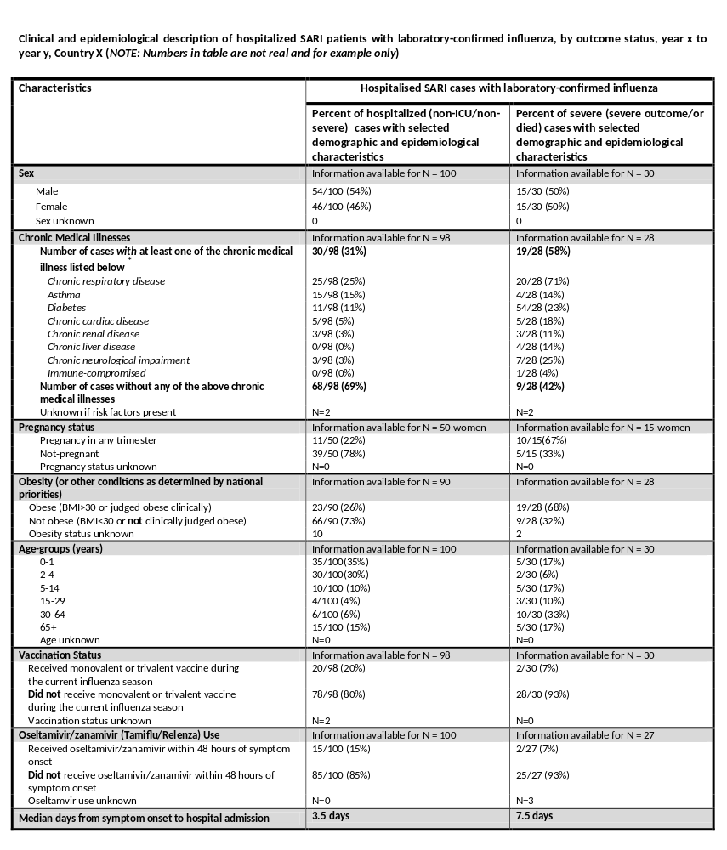
How are risk factors/disease determinants identified? (… continue …)

Slide 14
How can I identify risk factor/disease determinant?
The chances of something happening (disease outcome) can be expressed as a risk or as an odds
            Risk = describes the probability with which a disease outcome will occur
              Risk in exposed = a/(a+b)
            Odds = the ratio of the probability that an outcome will occur to the probability that the outcome will not occur
              Odd in exposed = A/B
Outcome (Influenza patients
that died)
+
-
+
A | B
C | D
Exposure
(HIV infection)
-
Notes:
Determining Risk or Odds alone does not help determine whether an exposure increases the chances of outcome amongst the exposed population…

Slide 15
How can I identify risk factor/disease determinant?
To determine whether an exposure increases, decreases, or has no effect on a disease outcome, measures of association are calculated
Common measures of association between “risks” and outcomes are:
  Odds Ratios (OR): can be calculated for case-control and cohort studies
  Relative Risk (RR): can be calculated for cohort studies
Notes:
In the case of surveillance, we can consider our data akin to a cohort study and analyze our data as such. An OR/RR of 1 indicates that there is a 1 to 1 chance that the outcome of interest will occur in the exposed and unexposed group. If the RR is >1.0, the exposure appears to be a risk factor for the outcome (disease, death, hospitalization – whatever your outcome is).
The odds ratio (OR) is one of a range of statistics used to assess the risk of a particular outcome (or disease) if a certain factor (or exposure) is present. The odds ratio is a relative measure of risk, telling us how much more likely it is that someone who is exposed to the factor under study will develop the outcome as compared to someone who is not exposed.
A statistical test helps us to determining whether there is a true difference between the groups (OR & RR), or if there is just a random variation in our population. A statistical test is a method to take decisions on the result of an experiment
In statistics, a results is defined statistically significant if it is unlikely to have occurred by chance alone according to a predefined threshold probability, the significance level
If a test of significance gives a p-value lower than or equal to the significance level, the null hypothesis is rejected. Such results are referred to as “statistically significant” (at the p = 0.05 level, etc.)

Slide 16
Interpreting OR/RR of a Disease
If OR/RR = 1
  Exposure is not related to disease
If OR/RR > 1
  Exposure is positively related to disease (risk factor)
If OR/RR < 1
  Exposure is negatively related to disease
A statistical test is used to assess if there is a statistically significant difference of the OR/RR value to 1.
Notes:
A statistical test is used to assess if there is a statistically significant difference of the OR/RR value to 1.
A OR/RR value of 1 means that there is no difference in “risk” for the outcome of interest in the exposed and unexposed group.

Slide 17
What is a statistical test?
A statistical test is a method of making decisions using data, whether from a controlled experiment or an observational study (not controlled).
In statistics, a result is called statistically significant if it is unlikely to have occurred by chance alone, according to a pre-determined threshold probability, the significance level (e.g. α: 0.05).
Notes:
The results of our statistical tests will help us to interpret our results – whether they are due to chance or whether they are truly significant.

Slide 18
How is a statistical test implemented?
We start with a research hypothesis of which the truth is unknown.
The first step is to state the relevant null (H₀) and alternative hypotheses (H_{A}).
Decide which test is appropriate, and stating the relevant test statistic T.
Compute from the observations the observed test statistic T and the associated p (probability) value.
Compare the computed p value to a reference p value (usually 0.05 – 5%) to accept or reject the null hypothesis.
If the p value of the test is lower than the reference value the H₀ is rejected.

Slide 19
How is a statistical test implemented? (Example)
Hypothesis
Influenza prevalence in hospitalized patients:
Non pregnant women: 100/1000 = 10%
Pregnant women: 30/200 = 15%
Question:
Is the influenza prevalence in hospitalized pregnant women different than the prevalence in pregnant women?
H₀: p₁ = p_{2 ;} p₁ - p₂ = 0
H_{A}: p₁ = p_{2 ;} p₁ - p₂ = 0
Reject H₀ if p (test) is < α: 0.05
Test results:
Z (test statistic): 0.119
p value: 0.037
0.037<0.05 → Reject H₀

Slide 20
Odds Ratio

Slide 21
What is an Odds Ratio?
The Odds Ratio (OR) is a measure of effect size, describing the strength of association or non-independence between two binary data values.
  E.g. It compares the odds of exposure among those with the outcome of interest with odds of exposure among those without the disease
Outcome (Influenza patients
that died)
+
-
+
A | B
C | D
Exposure
(HIV infection)
-
OR=(A/C)/(B/D)=AD/BC
Notes:
The OR compares the odds of exposure among those with the outcome to the odds of exposure among those without the outcome. It does not compare the incidence of outcome between the two groups. The odds of exposure (e.g. HIV infection) among those who died in this two by two table is simply the odds of HIV infection for the group that died (a/c) divided by the odds for the group that did not die (b/d).
The idea is that if a disease is causally related with an exposure (the risk factor), then the odds in the diseased group (in this case patients that died) will be higher than the corresponding odds in the non-diseased group. In a case where there is no association, the OR will be 1.0. If the exposure is actually protective against the outcome, the OR will be less than one.

Slide 22
Example of OR Calculations
Outcome
(Influenza patients
that died)
Outcome
(Influenza patients
that died)
+
-
+
-
+
200 (A) | 150 (B)
50 (C) | 100 (D)
+
200 (A) | 180 (B)
98 (C) | 100 (D)
Exposure
(HIV infection)
Exposure
(Gender)
-
-
OR=(A/C)/(B/D)=(AD)/(BC)
OR=(A/C)/(B/D)=(AD)/(BC)
OR=(200/50)/(150/100)=2.7
OR=(200/100)/(180/98)=1.1
p<0.001 (significant; α: 0.05)
p<0.474 (not significant; α: 0.05)
Notes:
In the example on the left, the odds that patients who died were positive for HIV infection with 2.7 times greater than the odds that patients who lived were positive for HIV infection. This association was deemed statistically significant at the .05 level.
The example on the right let’s say that gender+ is female, gender- is male. This example shows us that the odds of women dying were 1.1 times greater than the odds for men dying. When tested at the p0.05 level, this association is not statistically significant.
The probability of dying in HIV infected cases is 200/350 (total HIV) =0.5714, whilst the probability of surviving is 150/350=0.428. So the odds is (200/350)/(150/350)=1.34
When you calculate the odds for non-HIV infected patients: (50/150)/(100/150) = 0.5
The OR then is: 1.34/0.5 = 2.7. This OR is greater than 1. One would also need to check the 95% CI.
The OR is extensively used in the literature, however most people find it difficult to interpret odds ratios. Is is much easier to interpret relative risks. And the nice thing is that we can interpret OR by pretending they are Relative risks because when the event is rare (here dying of flu) risks and odds are very similar.

Slide 23
Bivariate Analysis
One of the simplest forms of quantitative analysis
  Determine empirical relationship between two variables
Used to test simple associations and causality
Common bivariate analyses include percentage tables, scatterplots or correlation coefficients
Notes:
Bivariate analysis is one of the simplest forms of the quantitative (statistical) analysis. It involves the analysis of two variables for the purpose of determining the empirical relationship between them.
Bivariate analysis can be helpful in testing simple hypotheses of association and causality – checking to what extent it becomes easier to know and predict a value for the dependent variable if we know a case's value on the independent variable.
Bivariate analysis can be contrasted with univariate analysis in which only one variable is analysed. Furthermore, the purpose of a univariate analysis is descriptive. The major differentiating point between univariate and bivariate analysis, in addition to looking at more than one variable, is that the purpose of a bivariate analysis goes beyond simply descriptive: it is the analysis of the relationship between the two variables.
Common forms of bivariate analysis involve creating a percentage table, a scatterplot graph, or the computation of a simple correlation coefficient.^{[1]} The types of analysis that are suited to particular pairs of variables vary in accordance with the level of measurement of the variables of interest (e.g., nominal/categorical, ordinal, interval/ratio). Bivariate analysis is a simple (two variable) variant of multivariate analysis (where multiple relations between multiple variables are examined simultaneously).^{[1]}

Slide 24
Example: Association risk factor and severe outcome death, chi square test (n=300)
 | OR (95% CI) | p-valueª
Age (0-15, 15+) | OR= 7.006 (2.086 - 23.53) | p=0.001
Pre-condition (N/Y) | OR= 6.287 (2.151 - 18.37) | p=0.000
>2 underlying conditions (N/Y) | OR= 2.819 (1.294 - 6.139) | p=0.014
Immune (N/Y) | OR= 2.998 (1.169 - 7.689) | p=0.039
Liver (N/Y) | OR= 4.589 (1.465 - 14.38) | p=0.016
Obesity (N/Y) | OR= 2.397 (1.062 - 5.406) | p=0.056
Influenza type (A/B) | OR=0.238 (0.071 - 0.802) | p=0.022
(A(H3N2) / A(H1N1)pdm09) | OR=16.43 (2.190 - 123.3) | p=0.001
Antiviral treatment (N/Y) | OR=2.123 (1.023 - 4.409) | p=0.063

Slide 25
How to assess significance of association (OR) of multiple “factors” to the outcome?
Multivariate analysis is used for this purpose.
Logistic regression provides adjusted OR for multiple “predictors” (factors) in the model.

Slide 26
How to assess significance of association (OR) of multiple “factors” to the outcome?
Consider possible confounders (other risk factors for outcome, factor related to the risk factor)
Adjust for confounding by stratification or multivariate analysis to assess the true effect – logistic regression provides adjusted OR for multiple factors in the model
The explanation of logistic regression is outside the scope of this training
Source: Stefano Tempia
Notes:
OR are the main output from a logistic regression analysis.
The odds ratio is the primary measure of effect size in logistic regression and is computed to compare the odds that membership in one group will lead to a case outcome with the odds that membership in some other group will lead to a case outcome. The odds ratio (OR) is defined as the odds of being a case for one group divided by the odds of being a case for another group. An odds ratio of 1 indicates that the odds of a case outcome are equally likely for both groups under comparison.

Slide 27
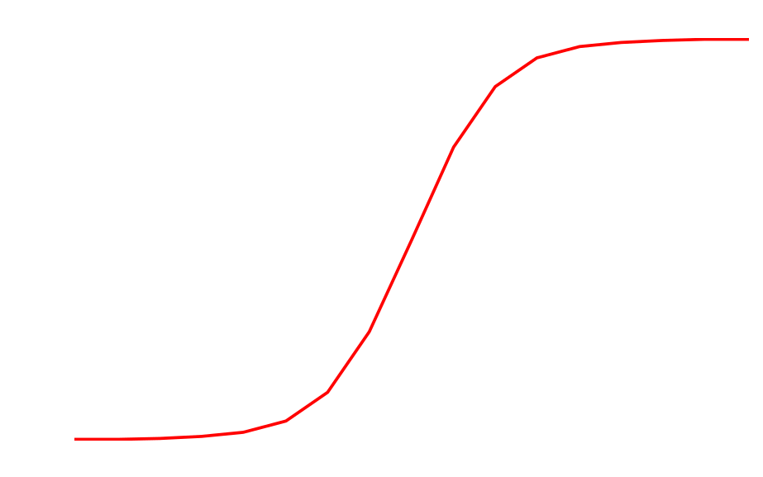

What is logistic regression?
Logistic regression models the relationship between a set of risk factors (X_{i}) and the disease outcome (Y)

Slide 28
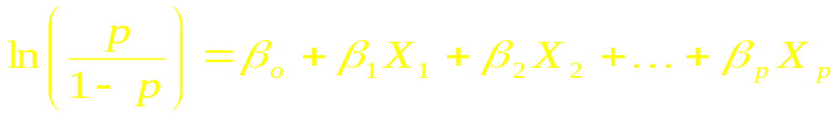
What is logistic regression? (cont)
Multiple Logistic Regression Model
The parameter estimates (β_{i}) can be used to calculate the odds ratio associated the variables in the model.
These odds ratios are adjusted for the other variables in the model.

Slide 29
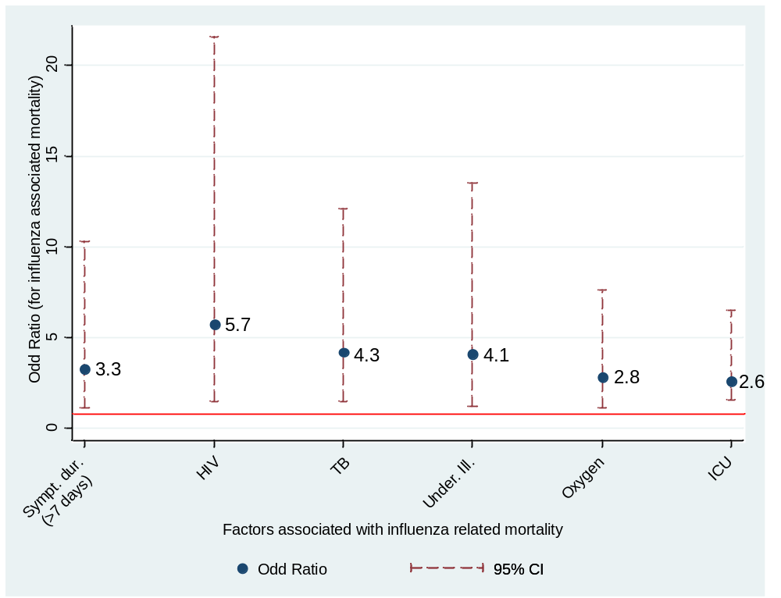
Multivariable Logistic Regression Analysis (example)
Factors associated with in-hospital influenza-related mortality, SARI Surveillance Programme, South Africa, 2009-2011 (preliminary results)

Slide 30
Relative Risk

Slide 31
What is Relative Risk?
The Relative Risk (RR) is the risk of an event (or of developing a disease) relative to exposure.
Relative risk is a ratio of the probability of the event occurring in the exposed group versus a non-exposed group.
Relative risk (RR) = Risk in exposed
Risk in non-exposed
Relative risk measures the size of the effect on disease rates of the risk factor, and measures the strength of association between the exposure (risk factor) and the outcome (disease)
Notes:
The RR is the ratio of two incidence rates – the IR in the population of interest divided by the rate in a comparison population. e.g. we are relating the incidence of an outcome in those with and without a risk factor.
In other words, RR measures the likelihood of getting the disease if you are exposed relative to those who are unexposed; compares incidence of disease among exposed with incidence of disease in unexposed

Slide 32
What is a Relative Risk?
RR can be calculated only if the population at risk is known (e.g. cohort studies)
  e.g. All influenza patients that died and all influenza deaths among patients with HIV
Below is a 2x2 table illustrating the categories for evaluation – exposed, unexposed, positive outcome (death), negative outcome (survival)
Outcome
(Influenza patients
that died)
A/(A+B)
+
-
RR=
+
A | B
C | D
C/(C+D)
Exposure
(HIV infection)
-
Notes:
RR Formula = incidence in those with the risk factor = a/(a+b); incidence in those without the risk factor = c/(c+d). RR =a/(a+b)/c/(c+d).
OR Formula = cross product ratio = ad/bc

Slide 33
Example of RR Calculations
Outcome
(Influenza patients
that died)
Outcome
(Influenza patients
that died)
+
-
+
-
+
250 (A) | 170 (B)
55 (C) | 100 (D)
+
200 (A) | 210 (B)
150 (C) | 100 (D)
Exposure
(HIV infection)
Exposure
(Sympt. <4 days)
-
-
RR=(200/420)/(55/155)=1.3
RR=(200/410)/(150/100)=0.8
p<0.001 (significant; α: 0.05)
p<0.005 (significant; α: 0.05)
Notes:
The p-values help us to determine whether there is a true difference between the two groups, or just a random variation.

Slide 34
What factors cause severe outcome?
Mild illness
Antiviral treatment
vaccinated
Severe illness
Age patient
Virus type
Co-morbidity
Question:
Are the identified factors independent risk factors??

Slide 35
How to assess significance of association (RR) of multiple “factors” to the outcome?
Multivariable analysis is used for this purpose.
Log-Binomial, Poisson, Negative Binomial (et.) regression provide adjusted RR for multiple “predictors” (factors) in the model.
The explanation of these regression models is outside the scope of this course
Notes:
Its possible to use a logistic model to obtain a RR estimate
Other methods for calculating RR include Log-Binomial, Poisson, Negative Binomial (et.) regression provide adjusted RR for multiple “predictors” (factors) in the model. Cox regression

Slide 36
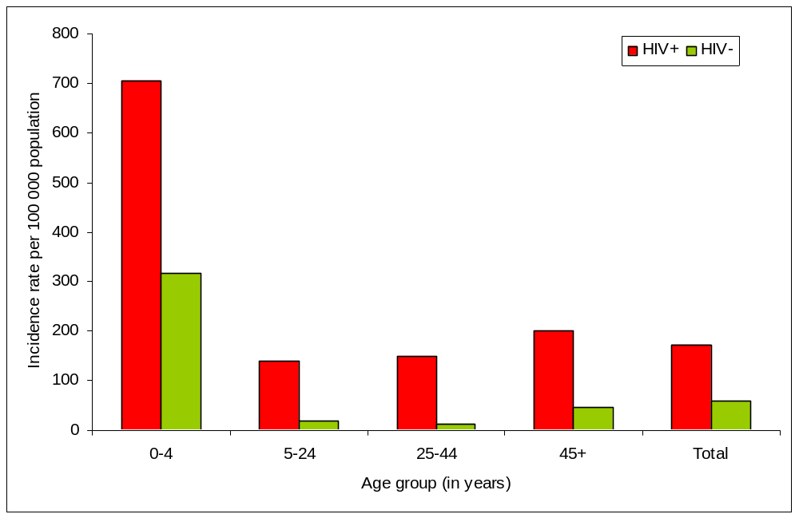
Example of RR calculations
RR: 2.2
RR: 4.3
RR: 4.8
RR: 8.0
RR: 11.1
Incidence rate per 100 000 population by age group and HIV status, SARI Surveillance Programme, Soweto, South Africa, 2009 (Preliminary results)

Slide 37
Interpreting Results
The p-values help us to determine whether there is a true difference between the two groups, or just a random variation
The p-value is a measure of the compatibility of the data and the null hypothesis

Slide 38
Thank You!

