Slide 1

Pandemic Influenza Severity Assessment
(PISA)
COURSE
Global Influenza Programme (GIP) World Health Organization Geneva, Switzerland
www.who.int
Notes:
Welcome to the PISA learning course. We hope you enjoy the following modules. The first module is an introduction to the Pandemic Influenza Severity Assessment, otherwise known as PISA. If you have not done so already, please go through the first module before starting this second module. The second module is an introduction to the PISA methodology.

Slide 2
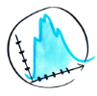

PISA MODULE B: Methods
About the module
Learning objectives
Choosing parameters
Threshold setting
PISA Module B: Methods
Notes:
Before we get started, here is brief outline of this module. The following slides will describe this module, review the learning objectives and give an introduction to choosing data sources and parameters to use for PISA. Lastly, an introduction to influenza threshold setting will be presented.

Slide 3
PISA MODULE B: Methods
About the module
WHAT
SUBJECT
NEXT STEP
Second learning module on PISA (WHO framework for assessing severity of an influenza epidemic or pandemic)
Methodology used in conducting an influenza severity assessment
Subsequent modules will further describe the three indicators identified
PISA Module B: Methods
Notes:
This module is the second learning module on PISA. This module presents the basic methodology used in conducting an influenza severity assessment. Subsequent modules will go into further detail on the doing assessments of the three indicators used in PISA.

Slide 4
PISA MODULE B: Methods
Learning objectives
CHOOSING PARAMETERS
THRESHOLD SETTING
Understand threshold setting methods
Understand criteria for choosing parameters
PISA Module B: Methods
Notes:
By the end of this learning module, you should understand the important criteria for choosing parameters to use for PISA, and understand the basics of threshold setting methods for influenza data.
This learning module is accompanied by an action plan to help you get started with choosing parameters and threshold setting. More details will be given at the end of the presentation.

Slide 5
PISA MODULE B: Methods
Choosing parameters
Notes:
The next few slides will review PISA terminology, the indicators and important characteristics of parameters.

Slide 6
PISA Terminology
Data sources
Data
Parameters
Indicators
weekly # flu samples collected
weekly # samples flu-positive
weekly ILI patient visits
proportion ILI
% positive
composite of proportion ILI*%positive
universal surveillance
special studies
modelling
sentinel syndromic surveillance
transmissibility
seriousness of disease
impact
Notes:
This diagram illustrates some terminology used in PISA. Data sources are coming from surveillance systems or other studies from which data is obtained. For example, from a sentinel syndromic surveillance source, data on the weekly number of patients visiting their doctors for influenza-like illness can be obtained. This data, combined with the total weekly number of doctor visits, can be used to calculate the ILI proportion parameter. This parameter is one that can be used to inform the indicator transmissibility.

Slide 7

PISA Indicators
(1) TRANSMISSIBILITY
Routine surveillance parameters:
Weekly ILI cases, as a proportion of total visits, or incidence rates
Product of weekly ILI rates and weekly percentage positivity
The ease with which the virus transmits from person to person
PISA Module B: Methods
Notes:
As a review, there are 3 indicators used in PISA. The first is transmissibility.

Slide 8

PISA Indicators
(2) SERIOUSNESS OF DISEASE
Of people with influenza infections, the proportion who are severely sick/dying
Hospital-based surveillance parameters:
Cumulative death: hospitalization ratio
Cumulative ICU: hospitalization ratio
SARI:ARI or SARI:ILI ratios
PISA Module B: Methods
Notes:
The second is seriousness of disease.

Slide 9

PISA Indicators
(3) IMPACT
Hospital-based surveillance or vital statistics (e.g. death records):
Weekly number/proportion of SARI cases, with percentage of SARI cases that are influenza positive
Weekly excess P&I or all-cause mortality (ideally stratified by age)
Weekly number of confirmed influenza cases admitted to ICU or hospital
School and work absenteeism
The impact on society or healthcare system
PISA Module B: Methods
Notes:
And the third is impact.

Slide 10
PISA Parameters
Indicators are derived from parameters of virological, epidemiological, and clinical sources
Parameters are based on data collected routinely by established surveillance systems
Each country has unique surveillance systems and must choose parameters based on the data collected in their country

Slide 11
PISA Parameters
Criteria:
  Indicative of influenza activity
    At least a subset of samples should be laboratory tested for influenza viruses;
  Reliable
    Come from a surveillance system that is stable over time/changes are well-documented
  Timely
Historical data must be available; and
Denominators should be available to calculate representative proportions or rates

Slide 12
PISA MODULE B: Methods
Threshold setting
PISA Module B: Methods
Notes:
The rest of the module will review influenza threshold setting.

Slide 13
Using Influenza Surveillance Data
1. Comparing current activity and timing to previous years
Baseline or average epidemic curve
the usual level of influenza activity, which varies over time
2. Detecting periods of increased activity (e.g. start of seasonal epidemic or atypical activity)
Thresholds
levels of activity that indicate the start of a season or an unusually high season
PISA Module B: Methods
Notes:
Two main objectives of influenza surveillance are:

Slide 14
Thresholds
SEASONAL THRESHOLD
INTENSITY THRESHOLDS
Influenza activity level which indicates the epidemic (or season) has begun or ended:
  For example, if the weekly rate exceeds the seasonal threshold
    Sustained community transmission
    ILI more likely to be due to influenza
Must be set low enough to provide early warning, but high enough to avoid false signals
Defining activity levels of influenza parameters:
  For transmissibility, also known as intensity thresholds
  Allow for comparisons over time and across countries
Threshold qualitative descriptions:
  No activity/below seasonal threshold
  Low/Moderate/High/Extraordinary
PISA Module B: Methods
Notes:
In the next slide, there will be a graphical demonstration of these concepts.

Slide 15
Extraordinary
High
ILI
Moderate
Low
Seasonal or epidemic threshold
PISA Module B: Methods
Weeks
Notes:
Threshold setting allows for defining the start of the season (seasonal or epidemic threshold) and intensity levels.
For example, if we take a typical curve of ILI activity by week, we can calculate the seasonal or epidemic threshold as a fixed value. Levels of activity below this threshold could be defined as below the seasonal or epidemic threshold.
Similarly, different levels of intensity could be calculated. This would allow for dividing the increasing levels of activity into qualitative categories such as low, moderate or high or even extra-ordinarily high.

Slide 16
How to establish thresholds
SEASONAL or EPIDEMIC THRESHOLD
INTENSITY THRESHOLDS
The moving epidemic method (MEM)
Virological threshold (% positive)
Change of a parameter value over consecutive weeks
Combination of criteria
MEM
2. WHO method
3. Country-specific approaches (empirical or statistical)
PISA Module B: Methods
Notes:
We will focus on two types of thresholds. The first is a seasonal or epidemic threshold. There are several methods available for determining this threshold.
For example, a doubling of a parameter over 2 consecutive weeks…
We will review the background behind these calculations but keep in mind there are tools available for doing the calculations.

Slide 17
Moving Epidemic Method (MEM)
MEM Method Step 1
MEM Method Step 2
MEM Method Step 3
For each season, determine the epidemic period (and pre-and post-epidemic periods)
Calculate seasonal threshold using historical data
Calculate intensity thresholds using historical data
Notes:
The moving epidemic method using data from past seasons to determine the timing and duration of the seasonal epidemics, the seasonal threshold and the intensity thresholds. There are 3 basic steps which I will detail in the following slides.

Slide 18
Threshold setting: MEM
MEM Method Step 1
For each season, determine the
epidemic period
pre-epidemic period
post-epidemic period
ILI
Pre
Post
Epidemic period
Weeks
PISA Module B: Methods
Notes:
The first step in the MEM method is to determine the epidemic period and then the pre- and post-epidemic periods. These periods are graphically represented in the image on the right.

Slide 19
Threshold setting: MEM
MEM Method Step 1a: calculate the maximum accumulated rates percentage
Cumulative rates percentage
ILI
Weeks
Number of weeks
PISA Module B: Methods
Notes:
First, in order to determine the epidemic period, the data from each season is converted to cumulative rates percentage curves by the number of weeks.

Slide 20
Threshold setting: MEM
MEM Method Step 1b: calculate the slope of the MAP curves
Maximum accumulated rates percentage (MAP)
Slope of MAP
Slope parameter
Number of weeks
Optimal epidemic periods
Number of weeks
PISA Module B: Methods
Notes:
The next step is to identify how many weeks are contributing to the maximum accumulated rates percentage curves. There are several methods in MEM to calculate the timing of the epidemic. The default method is using a fixed slope parameter or value. By looking at the slope of the MAP curves for each season, the optimal epidemic periods for each season are identified as the number of weeks when the slope reaches this fixed value (the slope parameter). The corresponding number of weeks is the optimal epidemic period for each season.

Slide 21
Threshold setting: MEM
MEM Method Step 1c: use the slope parameter to determine the start and end of the epidemic period
ILI
Pre
Post
Epidemic period
Epidemic period
start
Weeks
end
PISA Module B: Methods
Notes:
Finally, the start week and end week of the epidemic period for each season are determined. The points along the curve can now be classified as pre-epidemic, epidemic, or post-epidemic. The data points in each period can now be labelled as pre-epidemic (in green), epidemic (purple) or post-epidemic rates (yellow).

Slide 22
Threshold Setting: MEM
MEM Method Step 2
Pre-epidemic
Calculate seasonal threshold using historical data
  Upper limit of the one-sided 95% confidence interval of the arithmetic mean of n highest pre-epidemic values of all historic seasons, where n=30/seasons
Seasonal threshold
PISA Module B: Methods
Notes:
The epidemic threshold is calculated using upper limit of the one-sided 95% confidence interval of the arithmetic mean of the 30 highest pre-epidemic values evenly split among the historical seasons. When more seasons which are included in the analysis, the calculation of the seasonal threshold will be less influenced by fluctuations before the season.
The arithmetic mean is used as there is less variation from season to season in the pre-epidemic data points.

Slide 23
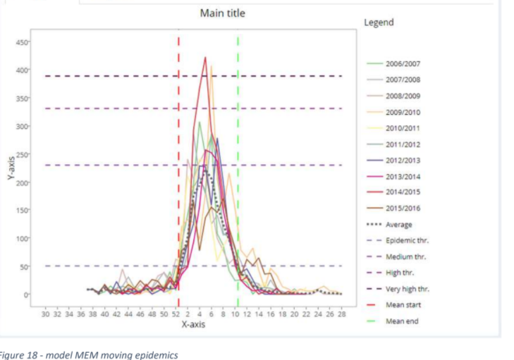
Threshold Setting: MEM
MEM Method Step 2
Calculate seasonal threshold using historical data
  Example output from MEM
PISA Module B: Methods
Notes:
This is an example output from MEM showing the multiple years of data and the calculated epidemic threshold indicated by the arrow.

Slide 24
Threshold Setting: MEM
Epidemic
MEM Method Step 3
Calculate intensity thresholds using historical data
97.5% CI
90% CI
  Upper limit of the one-sided confidence intervals at three different levels of the geometric mean, n highest epidemic values of all historic seasons, where n=30/seasons
40% CI
Geometric mean
Seasonal threshold
PISA Module B: Methods
Notes:
The geometric mean is calculated using the 30 highest epidemic values evenly split among the historical seasons.
The geometric mean is used as there is more variation from season to season in the epidemic data points.
The one-sided confidence intervals of the geometric mean are then used as the intensity thresholds.
The low intensity range of activity is between seasonal threshold and the 40% confidence interval, seen in yellow.
The moderate intensity range of activity is between the 40% and the 90% confidence intervals, seen in orange.
The high intensity range of activity is between the 90% and the 97.5% confidence intervals, seen in red.
The extraordinary intensity range of activity is above the 97.5% confidence intervals, seen in purple.

Slide 25
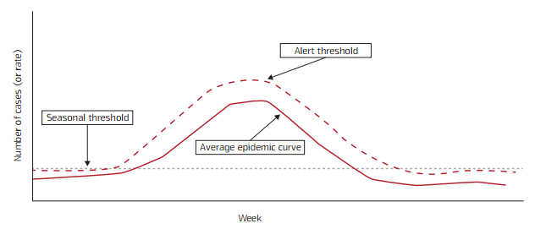
Threshold setting: WHO method
Definitions
Average Epidemic Curve:
  Usual level of influenza activity occurring in a typical year
Seasonal Threshold:
  Influenza activity level that signals the start and end of the annual influenza season
Alert Threshold:
  the level above which influenza activity is higher than most years
PISA Module B: Methods
Notes:
The WHO method determines the average epidemic curve, or baseline, as well as thresholds, as pictured in the image on the right.

Slide 26
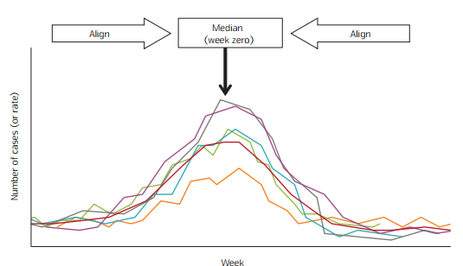
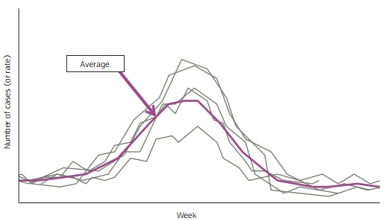
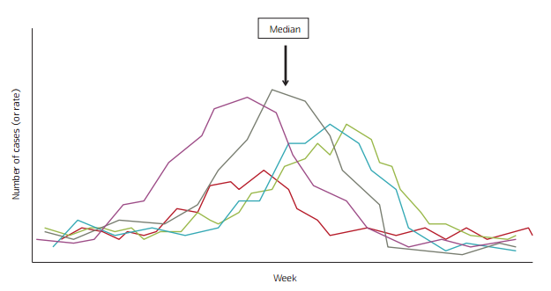
Threshold setting: WHO method
Average epidemic curve
1. Identify median week of peak activity
A 3-week average can be used to calculate the median for each week
2. Align previous years’ data so that peaks align on median week
3. Calculate an average for each week
PISA Module B: Methods
Notes:
To determine the average epidemic curve, first the median week of peak activity from historical seasons is determined. A 3-week average can be used to calculate the median for each week to smoothen the curve.
Next, the previous years of data are aligned so that the peaks all occur in the median week (week zero).
Finally, using the aligned curves, an average is calculated for each week.

Slide 27
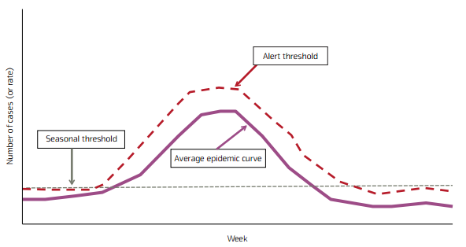
Threshold setting: WHO method
Determining the Seasonal Threshold
Method 1
  Visual inspection of several years of data to determine the point or threshold where activity is consistently higher than normal random variation in off-season activity
Method 2
  Calculate annual median amplitude for the data being plotted
    year-round data must be available
PISA Module B: Methods
Notes:
To determine the seasonal threshold, there are 2 methods. The first is to visually inspect the data and to identify an appropriate threshold. Or, the median amplitude of year-round data can be used as the threshold.

Slide 28
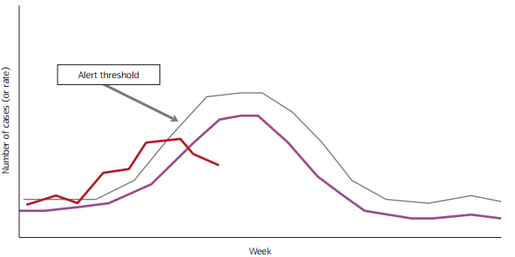
Threshold setting: WHO method
Determining the Alert Threshold
Calculate the mean for each week
Determine upper and lower 90% confidence intervals (CIs) around the mean of each week
The upper 90% CI will define alert threshold
Can also use the 40% and 97.5% CIs for intensity levels
PISA Module B: Methods
Notes:
To determine alert thresholds, calculate the mean for each week. The confidence intervals around the means can be used to define varying intensity levels.
The image on the right shows the mean for each week in purple and the alert threshold in grey. The current season’s data is in red.

Slide 29
PISA MODULE B: Methods
Action 1: Choosing parameters
Review the background.
Complete Table 1:
  List available parameters available in your country/surveillance system.
  Fill in the rest of the fields with the characteristics of each parameter.
Rank the above parameters based on the criteria if multiple parameters are available.
PISA Module B: Methods
Notes:
Upon completion of this module, the next step is to work on your action plan. The document is available for you to begin planning what parameters to use for PISA and how to set thresholds.

Slide 30
PISA MODULE B: Methods
Action 2: Threshold setting
Review the background.
Complete Table 1:
  For the available parameters you listed in Table 1, note if you already set seasonal and/or intensity thresholds.
Consider which threshold methods you might want to use.
PISA Module B: Methods

Slide 31
PISA MODULE A: Introduction
  THANK YOU FOR YOUR ATTENTION
PISA Module B: Methods

Slide 32
Baseline vs Threshold
Using influenza surveillance data
Baseline (or average epidemic curve):
the usual level of influenza activity, which varies over time during the influenza season and the off-season
Describes the timing and relative severity of the current season compared to previous ones.
Threshold:
a level of activity that indicates the occurrence of a specific situation such as the start of a season or an unusually high season (more detail in next slide)
PISA Module B: Methods
Notes:
Surveillance standards
Any animation or slides that we can adapt from the Surveillance standards training?
We will focus on thresholds in this module, not baselines.

Slide 33
Threshold Setting
MEM method
Data cleaning
  Data is cleaned and validated
  Historical data available for at least five surveillance seasons
  Weekly rates estimated for at least 33 weeks in every season (week 40 of year 1 to week 20 of year 2)
  Number of reporting sites, population, and surveillance system remained stable over time
PISA Module B: Methods
Notes:
Check labeling steps; make data cleaning a preparation not a step

Slide 34
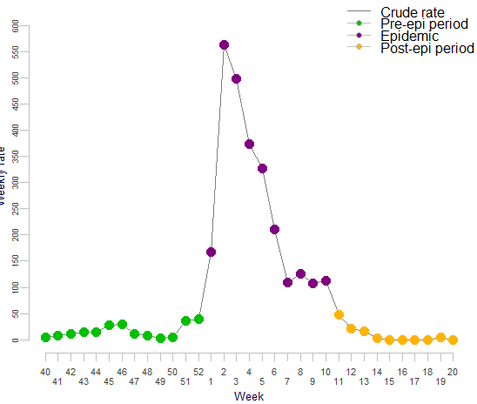
PISA Threshold setting
MEM Method Step 1
2. Determine the epidemic period
Pre-epidemic period: weeks before the epidemic period
Post-epidemic period: weeks after the epidemic period
PISA Module B: Methods
Notes:
Minimum number of consecutive weeks with the maximum accumulated rates percentage (MAP)
The change in the percentage from one week to the next is used to determine the optimum number of weeks in each season.
The optimum level is when the incremental change is below the predefined criteria

Slide 35
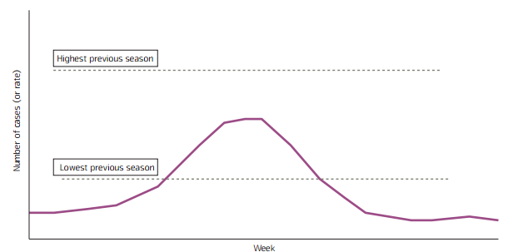
Threshold setting: WHO method
Determining the Alert Threshold
Method 1
  Display the highest and lowest seasons and the range, excluding exceptional events (e.g. pandemic)
PISA Module B: Methods

