Slide 1

Pandemic Influenza Severity Assessment
(PISA)
COURSE
www.who.int

Slide 2
PISA MODULE A: Introduction
About the module
WHAT
AUDIENCE
NEXT STEP
This is the first in a series of learning modules on the WHO framework for assessing the overall severity of an influenza epidemic or pandemic.
This course introduces the concept of influenza severity assessment to those that may not be familiar with it.
After completing this course, interested participants should enrol in the in-depth PISA training modules as these courses become available.
PISA Module A: Introduction

Slide 3
PISA MODULE A: Introduction
Learning objectives
WHAT
WHY
Understand what influenza severity is and what influences severity.
Understand why assessing influenza severity is important.
WHEN and HOW
INDICATORS
Understand when and how to assess influenza severity.
Be able to describe the three indicators used to assess severity.
PISA Module A: Introduction

Slide 4
PISA MODULE A: Introduction
Who should take this course?
Public health professionals working on influenza surveillance, at national and subnational levels
Policy makers
PISA Module A: Introduction

Slide 5
PISA MODULE A: Introduction
Why is assessing influenza severity important?
Provides information on the
Timing
Urgency
Intensity
Scale
of the response.
PISA Module A: Introduction

Slide 6
PISA MODULE A: Introduction
Why did WHO develop an influenza severity assessment tool?
Previous influenza pandemics
Preparedness efforts for a severe pandemic
Difficulties to assess severity and adapt control measures in during 2009 pandemic
PISA Module A: Introduction

Slide 7
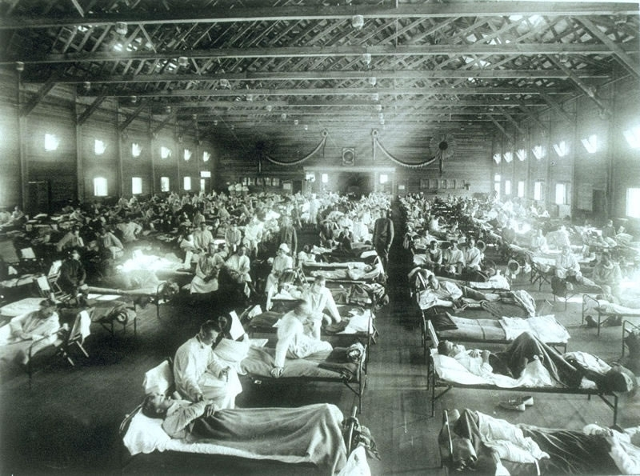
1918: A(H1N1)
Image of patients in the USA, 1918 [Source: National Museum of Health and Medicine, Armed Forces Institute of Pathology, Washington, DC. Image number NCP 1603]
PISA Module A: Introduction
PISA Module A: Introduction

Slide 8
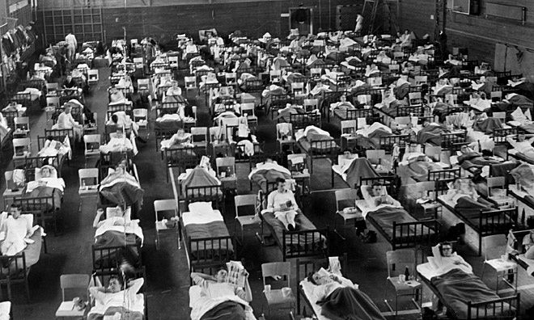
1957: A(H2N2)
Image of patients in Sweden, 1957 [Source: Public domain]
PISA Module A: Introduction

Slide 9
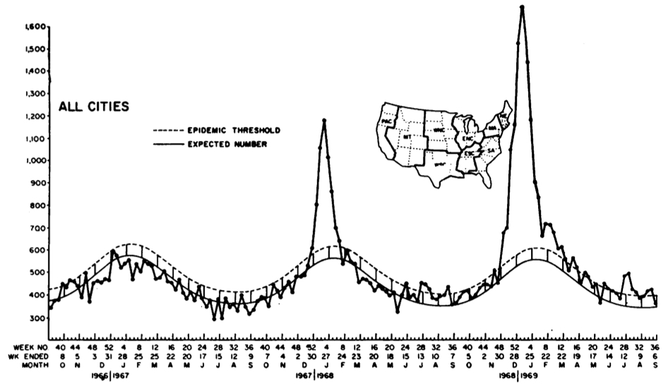
1968: A(H3N2)
Image of cases of influenza A(H3N2) in the USA. [Source: Sharrar, RG. National Influenza Experience in the USA, 1968-69 Bull Wld Hlth Org, 41, 361-366]
PISA Module A: Introduction

Slide 10
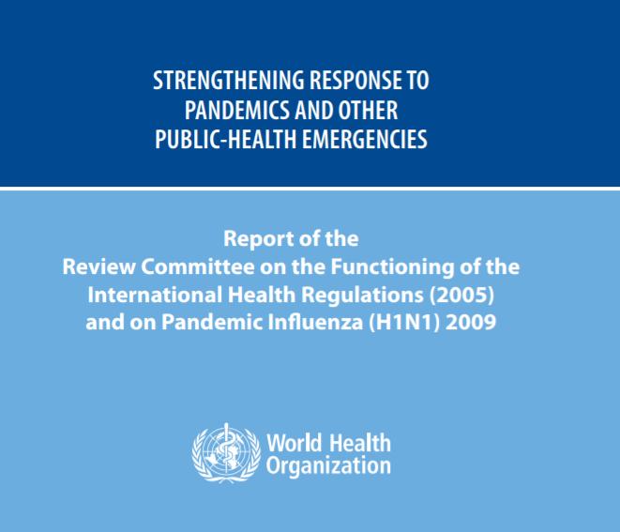
IHR review committee (2011)
Severity assessment:
Use a “basket of indicators”
Use during seasonal influenza to be better prepared
PISA Module A: Introduction

Slide 11
PISA MODULE A: Introduction
What is PISA?
WHAT
OUTPUTS
PISA is a tool that provides an evidence-based method for the comparison of current influenza activity to previous influenza seasons.
PISA results can be communicated to the public and policy makers.
PISA Module A: Introduction

Slide 12

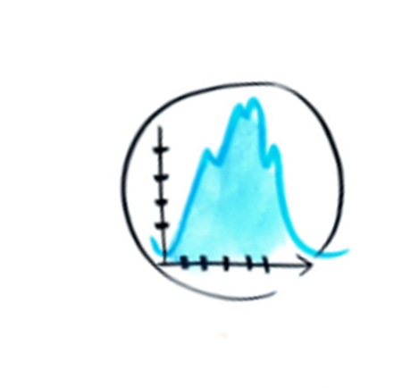

PISA MODULE A: Introduction
When is PISA used?
NOW!
PANDEMIC
By applying, evaluating and refining tools to measure severity every year, WHO and Member States can be better prepared to assess severity in the next pandemic.
Ideally, on a weekly basis, after the beginning of the pandemic.
PISA Module A: Introduction

Slide 13

PISA Indicators
TRANSMISSIBILITY
The ease with which the virus transmits from one person to another.
PISA Module A: Introduction

Slide 14
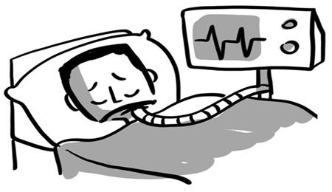
PISA Indicators
SERIOUSNESS OF DISEASE
Of people with influenza infections, the proportion who are really severely sick or are dying.
PISA Module A: Introduction

Slide 15

PISA Indicators
IMPACT
The impact on society or the healthcare system.
PISA Module A: Introduction

Slide 16
PISA MODULE A: Introduction
Next steps
POST-TEST
DISCUSSION BOARD
ACTION PLAN
Test your knowledge by taking the quiz upon finishing the introduction.
Post a question or point of discussion on the discussion board linked with the module.
Enrol in the subsequent modules and begin formulating an action plan to implement PISA.
PISA Module A: Introduction

Slide 17
PISA MODULE A: Introduction
  THANK YOU FOR YOUR ATTENTION
PISA Module A: Introduction

