Slide 1
Modernizing National Case Definitions—Ehrlichiosis and Anaplasmosis:
Evaluating Current Trends and Gaps in Surveillance
Nicolette Bestul, MPH
Epidemiologist
Rickettsial Zoonoses Branch
CSTE VBD Sub-Committee
August 5, 2022
Notes:
Hi! My name is Nicolette Bestul, I’m an epidemiologist and the surveillance lead on the Epidemiology Team with the Rickettsial Zoonoses Branch and today I will be going over some of the discussion held at the CSTE conference as well as some additional work our team has done since.

Slide 2
Background: Anaplasmosis & Ehrlichiosis
Notes:
To begin, I will do an overview of human anaplasmosis and ehrlichiosis.

Slide 3
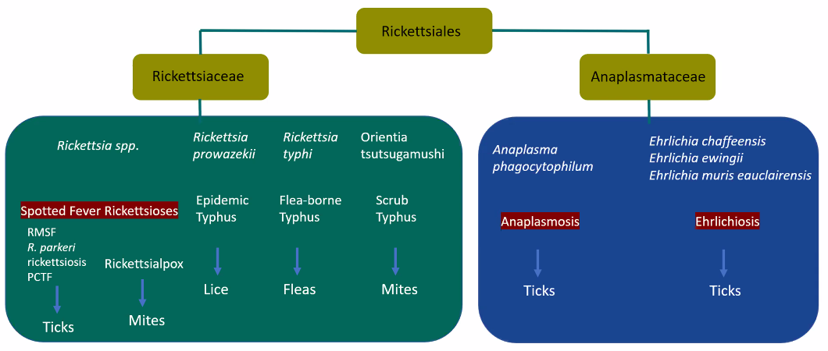
Notes:
Ehrlichiosis and anaplasmosis are emerging tickborne diseases caused by closely related pathogens in the family Anaplasmataceae. In the United States, three pathogens are known to cause human ehrlichiosis: Ehrlichia chaffeensis, E. ewingii, and E. muris eauclairensis. Anaplasmosis is caused by infection with the bacterium Anaplasma phagocytophilum.
Therefore, there is notable cross-reactivity using serologic testing and there are some commercial PCR assays used for diagnostic purposes which don’t differentiate between members of the genus Ehrlichia and Anaplasma.

Slide 4
Clinical Description
  Common initial signs and symptoms:
    Fever, headache, malaise, myalgia, chills, nausea, vomiting, and diarrhea
    Rash
      Rare for anaplasmosis, more common for ehrlichiosis
    Mild anemia, thrombocytopenia, leukopenia, and elevated hepatic transaminases
Notes:
These pathogens typically cause an acute febrile illness with headache, myalgia, sometimes accompanied by nausea, vomiting, and diarrhea. Rash is a rare sign of anaplasmosis but occurs in 1 in 3 of adults and 2 in 3 children with E. chaffeensis ehrlichiosis. Patients with ehrlichiosis and anaplasmosis often experience mild anemia, thrombocytopenia, leukopenia, and mild to moderate elevations in hepatic transaminases.

Slide 5
Ehrlichiosis and Anaplasmosis Timeline
E. chaffeensis
Human monocytic ehrlichiosis (HME)
1987
1992
E. ewingii (canine)
1999
E. ewingii (Humans)
2009
E. muris-like agent (EMLA)
EMLA classified as E. muris eauclairensis (EME)
2017
Human granulocytic ehrlichiosis (HGE)
1994
E. phagocytophila, E. equi, and human granulocytic ehrlichiosis reclassified as A. phagocytophilum
2001
First provisional surveillance case definition created (HME/HGE)
1996
1999
Ehrlichiosis designated as nationally notifiable
2008
Most recent case definition
Ehrlichiosis case definition created with three subcategories
2000
Notes:
-The first case of ehrlichiosis, was noted in 1987
-A provisional case definition was not created until 1996, and ehrlichiosis was made nationally notifiable in 1999
-Additionally, in 1999 ewingii was reported as causing human disease but was not included in the 1999 ehrlichiosis case definition or the 2000 update which created three subcategories; human granulocytic ehrlichiosis, human monocytic ehrlichiosis, and other unspecified human ehrlichiosis
In 2001 multiple organisms were reclassified as Anaplasma phagocytophilum. This change, and the addition of e. ewingii, was noted in the 2008 case definition in which four subcategories were created
Anaplasma phagocytophilum infection
Ehrlichia chaffeensis infection
Ehrlichia ewingii infection
Undetermined ehrlichiosis/anaplasmosis
The subcategories created in 2008 are still used today for surveillance.
Ehrlichia muris-like pathogen was identified in 4 patients from Wisconsin and Minnesota in 2009. This pathogen was renamed in 2017 to Ehrlichia muris eauclairensis, after the city where the 1st initial case was identified.
As you can see from both the timelines above, case definition changes lag behind the discovery of new pathogens and historically are driven by these discoveries.
--------------------------
In 1996 a provisional case definition was created so that states, if they chose to do so, could report ehrlichiosis cases.
In 1999: anaplasmosis, though known as HGE at the time, and E. chaffeensis ehrlichiosis, HME, were designated as nationally notifiable under the common category of “ehrlichiosis”
In 2000: ehrlichiosis case definition created with three subcategories:
In 2008
Removed
-----------------------------------
The first recognized cases of anaplasmosis were identified in patients from Wisconsin and Minnesota in 1994. At the time, the disease was called human granulocytic ehrlichiosis. After a few years it was recognized that human granulocytic ehrlichiosis, Ehrlichia phagocytophilia (phago-cyto-fI-LA), and Ehrlichica equi were all the same etiologic agent. These three conditions were all reclassified as Anaplasma phagocytophilium in 2001.

Slide 6
Burden: Anaplasmosis and Ehrlichiosis
Notes:
Now I’ll do a quick overview of the burden of anaplasmosis and ehrlichiosis

Slide 7
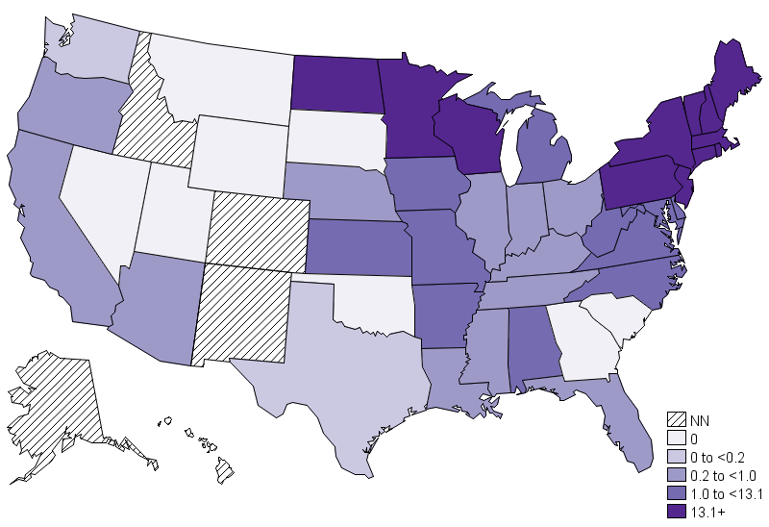
Human Anaplasmosis Geographic Distribution
  Most cases reported from the upper midwestern and northeastern US
  Cases more than doubled from 2,782 in 2013 to 5,655 in 2019
  VT, PA, and ME all increased by over 1000% since previous surveillance period
Annual incidence (per million population) of reported anaplasmosis – United States, 2019. (NN = Not Notifiable).
Source: Epidemiology and Statistics | Anaplasmosis | CDC
Notes:
Anaplasmosis is most frequently reported from the upper midwestern and northeastern United States, which corresponds with the distribution of the blacklegged tick. Seven states (Vermont, Maine, New Hampshire, Minnesota, Massachusetts, & Rhode Island) report 70% of all cases.
Cases more than doubled from 2,782 in 2013 to 5,655 in 2019.
The incidence rate for Vermont, Pennsylvania, and Maine increased by over 1000% since the previous reporting period (2008-2012, 2013-2017)
State 2008-2012 Inc 2013-2017 Inc Diff in Inc (%)
Vermont 7.6 271.23 3568.81682
Pennsylvania 0.3 3.63 1209.644824
Maine 19.1 226.07 1183.587559
California 0.01 0.11 1074.070704

Slide 8
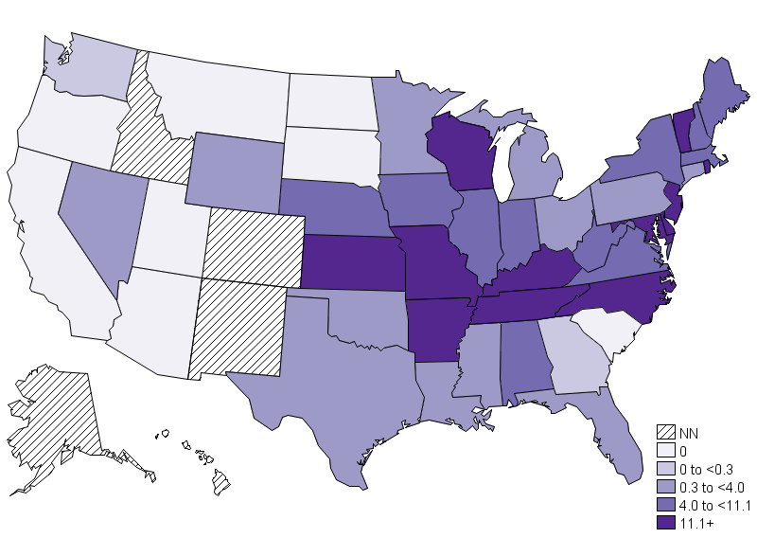
E. chaffeensis Ehrlichiosis Geographic Distribution
  Most frequently reported from the southeastern and south-central United States
  RI, WV, and LA all increased by over 500% since previous surveillance period
Annual incidence (per million population) of reported Ehrlichia chaffeensis ehrlichiosis – United States, 2019. (NN = Not Notifiable).
Source: Epidemiology and Statistics | Anaplasmosis | CDC
Notes:
Cases of ehrlichiosis are most commonly reported from the southeastern and south-central United States. The vast majority of the ehrlichiosis cases reported to CDC are attributable to chaffeensis.
In 2019, four states (Missouri, Arkansas, North Carolina, and New York) accounted for nearly half of all reported cases of E. chaffeensis ehrlichisosis. E. ewingii distribution overlaps with E. chaffeensis.
Ehrlichiosis cases by EME have ONLY been found in patients living in Minnesota and Wisconsin, or among those with travel history to either of the two states.
Since the previous surveillance summary, 2008-2012, Rhode Island, West Virginia, and Louisiana all saw percentage increases 500% and more.

Slide 9
National Trends
  Ehrlichia chaffeensis
    1.5-fold increase
    42% PCR-confirmed vs 26% previously
    1.3% positive serology other than IFA
  Ehrlichia ewingii
    5-fold increase
    100% PCR-confirmed (due to current case definition)
  Ehrlichia muris eauclairensis
    400% increase in PCR-confirmed cases
  Anaplasma phagocytophilum
    4.5-fold increase in incidence
    75% PCR-confirmed vs 37% previously
    Only 1% positive serology other than IFA
Notes:
In support of the concerns from these states, the epi team and I conducted analysis of RZB’s surveillance data to see if there were any trends that stood out. The following are a few highlights of what was found.
All four etiologies saw an increase in incidence since 2008. Additionally, PCR usage has been on the rise, especially for anaplasmosis. Other than IFA, serology usage is limited.
Anaplasmosis has experienced a 4.5-fold increase in incidence since 2008.
75% of cases are PCR confirmed (2013-2017 avg) versus 37% previously (2008-2012 avg).
Only 1% positive serology other than IFA.
Since 2008, E. chaffeensis incidence has increased 1.5-fold.
42% PCR-confirmed vs 26% previously
1.3% positive serology other than IFA
Since 2008, E. ewingii incidence has increased 5-fold, with 100% of cases being PCR confirmed due to the current case definition.
Anaplasmosis/ehrlichiosis undetermined
EME has increased 400%

Slide 10
Current Case Definition
Notes:
In order to discuss possible changes, we first need to look quickly at the current case definition

Slide 11
Surveillance Case Definition: Anaplasmosis & Ehrlichiosis
  Clinical evidence:
    Any reported fever and one or more of the following:
    headache, myalgia, anemia, leukopenia, thrombocytopenia, or any hepatic transaminase elevation
  Laboratory evidence:
    Confirmed
      Fourfold change in IgG antibody titer in paired serum samples, OR
      Detection of DNA by PCR assay, OR
      Demonstration of antigen in a biopsy/autopsy sample by IHC methods, OR
      Isolation in cell culture
    Supportive
      Serologic evidence of elevated IgG or IgM by IFA, ELISA, or dot-ELISA, OR
      Identification of morulae in the cytoplasm of neutrophils or eosinophils by microscopic examination
Notes:
The current surveillance case definition for ehrlichiosis and anaplasmosis, which is now 14 years old, requires both clinical and laboratory evidence to be included as a case. The clinical evidence includes any reported fever and one or more of the following signs listed on the slide.
Laboratory evidence is broken into two categories confirmed and supportive. The diagnostic tests can also be seen on the slide

Slide 12
Case Definitions: Anaplasmosis & Ehrlichiosis
  Case Classification
    Confirmed
      A clinically compatible case that is laboratory confirmed
    Probable
      A clinically compatible case that has supportive laboratory results
  Exceptions
    E. ewingii cases can only be reported as confirmed as molecular detection methods are required
    Human ehrlichiosis/anaplasmosis undetermined cases can only be reported as probable
Notes:
Cases are classified into four categories; however, CDC only collects confirmed and probable cases. A confirmed case is clinically compatible, and laboratory confirmed. A probable case is clinically compatible and has supportive lab evidence.
One exceptions to this criteria is E. ewingii ehrlichiosis, which can only be reported as a confirmed case as molecular methods are required for detection. The second exception is the human ehrlichiosis/anaplasmosis undetermined category. Cases reported in this category can only be reported as probable due to the current case definition.

Slide 13
Undetermined Ehrlichiosis/Anaplasmosis
  The undetermined ehrlichiosis/anaplasmosis category has been used as a catchall for ehrlichiosis and anaplasmosis surveillance
  There are a few reasons a case would be reported as undetermined
Equal titers for Anaplasma and Ehrlichia
PCR-positive EME result
Genus-level PCR/serology results
Notes:
The undetermined ehrlichiosis/anaplasmosis category is used as a catchall for disease surveillance. There are a few reasons a case would fall into this subcategory including:
They have equal titers for more than one etiologic agent (titers equal for anaplasma and ehrlichia)
They have genus-level PCR or serology results (i.e. positive for ehrlichia, but no speciation done)
They were PCR positive for ehrlichia muris eauclariensis
This poses a few challenges as very little epidemiologic evidence can be gathered from the undetermined category.

Slide 14
Diagnostic and Surveillance Challenges
Notes:
Next, I will discuss work I and others have done to investigate the challenges surrounding these diseases

Slide 15
Diagnostic
Cross-reaction among Ehrlichia species
Accurate diagnosis, using serology, requires paired serum samples
IgM antibodies, morulae visualization, ELISA, and dot-ELISA alone are unreliable
BUT…
Widely available, sensitive, and specific PCR assays
Notes:
Based on the assembled data, team discussions, and literature reviews several challenges were identified with the current case definition. First we’ll look at diagnostic difficulties.
1. Antibodies to closely related species of Ehrlichia can cross-react with multiple antigens; therefore, serologic assays cannot definitively distinguish between species.
4. Antibodies can persist for months or years following infection making a single elevated serum sample not confirmatory. Even though these results are not confirmatory, the majority of reported serology results are from single elevated titers, and not from paired samples.
2. IgM antibodies alone are unreliable indicators of incident infection
1. Lack of specificity of morulae visualization
3. Lack of reliability of ELISA and dot-ELISA
With widely available, sensitive, and specific assays like PCR, such techniques may no longer be suitable for standalone diagnostics.

Slide 16
Additional Surveillance Challenges
Lack of utility of the undetermined category
Genus-level PCR-positive cases as well as EME cases categorized in undetermined as probable
Fallout due to clinical criteria
Notes:
Looking at some of the additional surveillance challenges
1. There is currently a lack of utility of the undetermined category for epidemiological purposes.
2. PCR positive cases of EME can only be classified as undetermined ehrlichiosis/anaplasmosis cases, and cannot be confirmed, only probable.
3. Genus-level PCR positive cases can only be classified as undetermined ehrlichiosis/anaplasmosis cases, and cannot be confirmed, only probable.
1. Anaplasmosis shares the same clinical criteria with ehrlichiosis which inhibits changes to the clinical criteria overtime. And as we’ll discuss shortly, there’s evidence of fallout due to the current clinical criteria

Slide 17
EME vs Non-EME PCR-Positive Cases by Year of Onset, 2008-2017
Notes:
Looking a little deeper at the undetermined PCR-positive cases, from 2008-2012, the average proportion of EME cases was 9%, from 2013-2017 the proportion increased to 46%.
-------------------------------
Looking a little deeper at the 24% undetermined PCR-confirmed cases, an average of 7% were labeled as EME. Since EME does not have an actual category, this may be an underrepresentation.
If we look at the percentage of EME cases by year of disease onset we see that EME makes up a notable portion of the undetermined PCR positive cases each year.

Slide 18
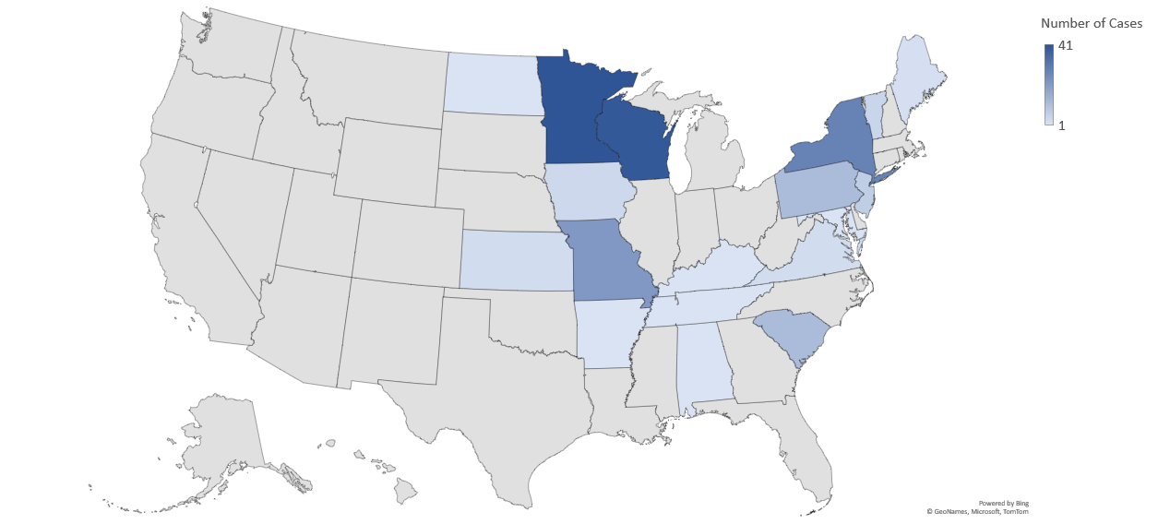
Undetermined Anaplasmosis/Ehrlichiosis Cases, NNDSS, 2019
Notes:
Looking at the most recent data we have, we see WI and MN representing a majority of the undetermined cases, in large part due to the increase of EME reporting

Slide 19
State Trends
  In December 2021, the state of Maine compiled data from 8 jurisdictions
  Analyzed PCR-positive anaplasmosis results that did not meet criteria to be considered a case.
Table 1: Laboratory confirmed anaplasmosis cases by case classification, 2016 - 2021
Jurisdiction | Total distinct individuals with lab confirmation of anaplasmosis, Mean (range) | Percentage of individuals with lab confirmation classified as Confirmed | Percentage of individuals with lab confirmation classified as Suspect | Percentage of individuals with lab confirmation classified as Not a Case
CT | 146 (80 - 296) | 100.0 (100.0 - 100.0) | … | …
ME | 637 (390 - 906) | 82.6 (77.4 - 86.7) | 0.5 (0.0 - 1.3) | 16.8 (13.3 - 21.3)
NH | 200 (99 - 347) | 79.4 (73.7 - 84.4) | 8.8 (5.0 - 16.5) | 8.6 (5.6 - 13.0)
NJ | 131 (102 - 190) | 65.1 (50.5 - 75.9) | 15.8 (4.3 - 30.3) | 18.5 (13.8 - 22.2)
NYC | 93 (41 - 162) | 62.1 (53.7 - 72.2) | 1.4 (0.0 - 3.0) | 33.1 (8.6 - 43.3)
RI | 121 (102 - 152) | 61.6 (51.8 - 67.6) | 38.4 (32.4 - 48.2) | …
VT * | 453 (185 - 914) | 64.6 (0.5 - 91.9) | 24.6 (0.0 - 99.0) | 10.6 (0.4 - 14.9)
WI ** | 437 (253 - 757) | 85.0 (77.6 - 90.3) | 3.7 (0.4 - 9.4) | 11.4 (8.9 - 13.3)
* Anaplasmosis lab reports during 2020-2021 were classified as "suspect" due to COVID-19 pandemic-related staffing shortage ** Due to COVID-19 response, no data QA was completed for 2019 data; QA not yet finalized for 2021 data
Data from: Parag Mahale, former EIS officer, State of Maine
Notes:
In December 2021 the RZB epi team was contacted by a few states regarding trends in their anaplasmosis cases.
Maine reported seeing a substantial percentage of PCR-confirmed individuals, some hospitalized, that did not meet the clinical criteria to be considered a case
Analysis from cases in Maine reported from 2016 – 2021 showed that 16.8% of individuals with PCR-confirmed anaplasmosis were classified as not a case. Other results can be seen here.
NOTES:
A more in-depth analysis of 79 PCR-confirmed anaplasmosis classified as not a case from January 1, 2021 – October 31, 2021 showed that:
67 (84.8%) reported one or more clinical criteria, but no fever
56 (70.9%) reported two or more clinical criteria, but no fever
11 (13.9%) were hospitalized for their illness

Slide 20
Table 2: Lab-confirmed anaplasmosis reports classified as not cases for surveillance (2016-2020)
MMWR year | Lab confirmed reports classified as “Not a case”, N | Clinical information available, N | Individuals with lab confirmation with ONLY fever as the clinical criteria* N | Individuals who were afebrile, but other clinical info unknown, N | Individuals with lab confirmation who had 1+* clinical criteria**, but no fever N | Individuals with lab confirmation who had 2+ clinical criteria**, but no fever N | Individuals with lab confirmation who had 1+ lab abnormality***, N | Individuals with lab confirmation who had other symptoms not included in the clinical criteria, N
2016 | 118 | 107 | 23 | 25 | 46 | 8 | 8 | 13
2017 | 135 | 117 | 13 | 26 | 61 | 17 | 13 | 17
2018 | 143 | 75 | 15 | 17 | 30 | 7 | 5 | 13
2019 | 191 | 87 | 18 | 18 | 33 | 3 | 5 | 18
2020 | 127 | 108 | 25 | 24 | 34 | 4 | 3 | 25
* Category also includes data where it was known that case was afebrile and had another symptom in the clinical criteria, but unknown how many
**Clinical criteria include fever, headache, myalgia, anemia, leukopenia, thrombocytopenia, elevated hepatic transaminases
***Lab abnormalities include anemia, leukopenia, thrombocytopenia, and elevated hepatic transaminases
Notes:
Being afebrile was the most commonly reported reason for being classified as Not a Case.

Slide 21
Possible Changes

Slide 22
  Ehrlichiosis
    E. chaffeensis
      Confirmed by species-specific PCR
    E. ewingii
      Confirmed by species-specific PCR
    EME
      Confirmed by species-specific PCR
    Ehrlichia unspeciated
      Confirmed: PCR pan-ehrlichia, other molecular methods, IHC, or seroconversion in IgG by IFA
      Probable: single positive IFA IgG serology
  Anaplasmosis
    A. phagocytophilum
      Confirmed: PCR, IHC, or seroconversion in IgG by IFA
      Probable: single positive IFA IgG serology
  Update clinical criteria to include more symptoms and have the criteria be “Fever or chills plus one other symptom”
Notes:
Following internal and external discussions, we put together some recommendations for new case categorizations.
Instead of having one case definition with 4 subcategories, we propose creating two separate case definitions for Ehrlichiosis and Anaplasmosis. This would allow for more flexibility in the future if the clinical criteria or laboratory criteria needs to be changed for one of the diseases and will better depict the epidemiology of these conditions.
The ehrlichiosis case definition would have 4 subcategories, including a new subcategory for EME.
For a case reported as one of the first three ehrlichiosis subcategories, patients will need to have species-specific PCR performed. This is not too dissimilar from the current case definition where EME and ewingii require species-specific PCR.
The ehrlichia unspeciated category would consist of confirmed and probable cases, unlike the first three subcategories.
The anaplasmosis case definition would have one category that would be broken into confirmed and probable laboratory evidence.
If a patient has equal titers for ehrlichia and anaplasma the state would utilize the clinical diagnosis and epidemiology to decide to report the case either as an ehrlichiosis case or anaplasmosis case, or both if the state truly believes the patient to be co-infected.
The clinical criteria for each case definition could also be updated to provide a more appropriate clinical spectrum.
---------------
Why split into two and not into 5, because ehrlicha share several common symptoms..-Note for self
Even if serology seroconverts, it is not species specific-note for self

Slide 23
Roundtable CSTE 2022
Notes:
After putting together the data, and our recommendations, our next step was to host a roundtable discussion at the 2022 CSTE conference.

Slide 24
Key Objectives
Discuss updating the case definition categories to define the epidemiology of individual disease where species specific molecular assays are available
Evaluate the potential impact of fever as a required clinical criterion
Discuss the benefits and limitations of lab-only reporting
Notes:
The key objectives for our roundtable discussion were:
Discuss updating the case definition categories to define the epidemiology of individual disease where species-specific molecular assays are available.
Evaluate the potential impact of fever as required clinical criterion
Discuss the benefits and limitations of lab-only reporting.

Slide 25
Roundtable Feedback
Disease Burden
Provider Knowledge/Practice
Notes:
There were a few direct challenges that were mentioned by state representatives during the roundtable discussion.
Disease burden was an overarching theme. States in the NE mentioned that anaplasmosis incidence is extremely high and puts a large burden on state staff to investigate every reported case.
Provider knowledge/practice was another overarching challenge.
Some representatives, specifically from the NE mentioned that providers often screen patients without symptoms or exposure history. Some providers would also prescribe doxycycline prophylactically, leading to no symptoms being reported. MENTION CE
In some areas, serology remains the primary diagnostic method, and that the proposed changes to the case definition would impact their state significantly.

Slide 26


Percent of PCR testing, A. phagocytophilum & E. chaffeensis, CRFs, 2008-2017
>60% PCR
40-60% PCR
<40% PCR
Notes:
Based on this feedback we wanted to take a quick look at what PCR testing looked like from 2008-2017.
We used supplemental case report form data reported to CDC with symptom onset year from 2008-2017. I looked at diagnostic methods used for A. phagocytophilum and E. chaffeensis reporting. E. ewingii was excluded due to the fact that molecular methods are required for diagnosis.
This map groups states by percentage of PCR testing out of all diagnostic methods among reported cases. Overall the high incidence anaplasmosis states utilized PCR more often, however, we noticed that many of the states with a high incidence for anaplasmosis had a low percentage of PCR-confirmed ehrlichiosis cases and vice versa
Group 1 states <40% PCR
Group 2 States >=40% <=60% PCR
Group 3 states >60% PCR

Slide 27
Next Steps
  Form a working group
    Created Basecamp (link in chat to join)
  Assess changes to lab and clinical criteria
    What would be gained? Lost?
    Lessons learned from lab-only reporting of Lyme disease?
    New RZB EIS officer will be looking into lab data to assist with this research
  Encourage a deep dive into ehrlichiosis and anaplasmosis suspect and non-cases
Notes:
After the CSTE conference, the next step for our team is to put together a working group to address the ehrlichiosis and anaplasmosis case definitions.
The working group will have an emphasis placed on recruiting epidemiologists from high-incidence anaplasmosis and ehrlichiosis states.
As we examine the different lab and clinical criteria, we aim to address what could be gained or lost from making these changes. We also hope to learn from our BDB colleagues' experience with lab-only reporting for Lyme disease.
We have a new EIS officer, and she will be looking into lab data to better assist with this research.
We are encouraging states to do a deep dive into their ehrlichiosis and anaplasmosis cases, similar to what Maine has already done.
An emphasis is placed on ehrlichiosis, as we want to ensure both conditions have representation in the data for this working group.
----------------------------------------------------------------------------
After the CSTE conference our team is putting together a working group to address the ehrlichiosis and anaplasmosis case definitions.
Our goal is to include high incidence anaplasmosis and ehrlichiosis states to help formulate the new case definition.
Our hope is that states can do a similar deep dive into their not a case data like what Maine did to better inform discussions on clinical criteria for anaplasmosis.
Weakness of this analysis is just focused on anaplasmosis, will need ehrlichiosis data.

Slide 28
Table 5: Medical record review of 79 PCR-confirmed anaplasmosis reports classified as “Not cases” for surveillance, 1/1/21-10/31/21
Characteristics | Number (%)
Clinical criteria* in CSTE definition
Only fever as the clinical criteria | 5 (6.3)
1+ clinical criteria, No fever | 67 (84.8)
2+ clinical criteria, No fever | 56 (70.9)
Any 1+ symptom AND 1+ lab abnormality** | 48 (60.8)
Only other symptoms not included in clinical criteria | 7 (8.9)
Any symptom (including other symptoms not included in clinical criteria) AND 1+ lab abnormality | 55 (69.6)
Other symptoms, not part of clinical criteria
Fatigue/weakness | 32 (40.5)
Malaise | 29 (36.7)
Chills | 23 (29.1)
Nausea | 19 (24.1)
Arthralgia | 14 (17.7)
Rash | 8 (10.1)
Vomiting | 8 (10.1)
Laboratory findings (N = 61)
Anemia | 29 (47.5)
Thrombocytopenia | 40 (65.6)
Leukopenia | 33 (54.1)
Hepatic transaminitis (N = 58) | 41 (70.7)
Time from symptom onset to seeing a provider in days, median (IQR) | 2 (1-4) days
Clinical course
Complications | 3 (3.8)
Immunosuppressive condition | 12 (15.2)
Hospitalization for illness | 11 (13.9)
Notes:
We will be putting the data shells on the Basecamp for you to utilize. This is an example of the deep dive that Parag was able to do, these iterative data are not captured in published literature and would be very helpful in making these decisions to change clinical criteria.

Slide 29
Acknowledgements
Parag Mahale, MBBS, PhD, MPH, former EIS officer for Maine
State and local health department partners
RZB Epi team
Notes:
I would like to acknowledge Parag Mahale, State and local health department partners, and the RZB Epi team for their support before and at the roundtable and as we look to the future.

Slide 30
Selected References
Aguero-Rosenfeld ME, Donnarumma L, Zentmaier L, Jacob J, Frey M, Noto R, Carbonaro CA, Wormser GP. Seroprevalence of antibodies that react with Anaplasma phagocytophila, the agent of human granulocytic ehrlichiosis, in different populations in Westchester County, New York. J Clin Microbiol. 2002 Jul;40(7):2612-5.
Buller RS, Arens M, Hmiel SP, et al. Ehrlichia ewingii, a newly recognized agent of human ehrlichiosis. N Engl J Med 1999;341:148–55.
Dahlgren, F. S., Heitman, K. N., Drexler, N. A., Massung, R. F., & Behravesh, C. B. (2015). Human granulocytic anaplasmosis in the United States from 2008 to 2012: a summary of national surveillance data. Am J Trop Med Hyg, 93(1), 66.
Dawson JE, Fishbein DB, Eng TR, Redus MA, Greene NR. Diagnosis of human ehrlichiosis with the indirect fluorescent antibody test: kinetics and specificity. J Infect Dis 1990;162:91–5.
Dumler JS, Madigan JE, Pusterla N, et al. Ehrlichioses in humans: epidemiology, clinical presentation, diagnosis, and treatment. Clin Infect Dis 2007 Jul 15;45 Suppl 1:S45–51.
Johnson DK, Schiffman EK, Davis JP, et al. Human infection with Ehrlichia muris-like pathogen, United States, 2007-2013(1). Emerg Infect Dis 2015 Oct;21(10):1794-1799.
Marshall GS, Jacobs RF, Schutze GE, Paxton H, Buckingham SC, DeVincenzo JP, Jackson MA, San Joaquin VH, Standaert SM, Woods CR; Tick-Borne Infections in Children Study Group. Ehrlichia chaffeensis seroprevalence among children in the southeast and south-central regions of the United States. Arch Pediatr Adolesc Med. 2002 Feb;156(2):166-70.
Nichols KH, Dahlgren FS, Drexler NA, Massung RF, Behravesh CB. Increasing incidence of ehrlichiosis in the United States: a summary of national surveillance of Ehrlichia chaffeensis and Ehrlichia ewingii infections in the United States, 2008–2012. Am J Trop Med Hyg 2016;94:52–60.
Walls JJ, Aguero-Rosenfeld M, Bakken JS, Goodman JL, Hossain D, Johnson RC, Dumler JS. Inter- and intralaboratory comparison of Ehrlichia equi and human granulocytic ehrlichiosis (HGE) agent strains for serodiagnosis of HGE by the immunofluorescent-antibody test. J Clin Microbiol. 1999 Sep;37(9):2968-73.

Slide 31
Selected References, cont.
Bakken, Johan S., and Dumler JS. Human granulocytic anaplasmosis. Infect Dis Clin North Am 2015:341–355.
Gelfand JA, Vannier E. Ehrlichia chaffeensis (human monocytotropic ehrlichiosis), Anaplasma phagocytophilum (human granulocytotropic anaplasmosis) and other ehrlichiae. In: Mandell GL, Bennett JE, Dolin R, editors. Mandell, Douglas, and Bennett’s Principles and Practice of Infectious Diseases. 6th ed. Philadelphia, PA: Churchill Livingstone; 2005. p. 2310–2318.
Hamilton, R., Pandora, T. R., Parsonnet, J., & Martin, I. W. (2021). Clinical Decision Support Trees Can Help Optimize Utilization of Anaplasma phagocytophilum Nucleic Acid Amplification Testing. Journal of Clinical Microbiology, 59(9), e00791-21.
Leikauskas, J. A., Read, J. S., Kelso, P., Nichols Heitman, K., Armstrong, P. A., & Kwit, N. A. (2022). Anaplasmosis-Related Fatality in Vermont: A Case Report. Vector-Borne and Zoonotic Diseases.
Turbett, S. E., Anahtar, M. N., Pattanayak, V., Azar, M. M., Coffey, K. C., Eng, G., ... & Branda, J. A. (2020). Use of routine complete blood count results to rule out anaplasmosis without the need for specific diagnostic testing. Clinical Infectious Diseases, 70(6), 1215-1221.
Weil, A. A., Baron, E. L., Brown, C. M., & Drapkin, M. S. (2012, March). Clinical findings and diagnosis in human granulocytic anaplasmosis: a case series from Massachusetts. In Mayo Clinic Proceedings (Vol. 87, No. 3, pp. 233-239). Elsevier.

Slide 32


Slide 33
National surveillance data (2008–2017)*
Ehrlichiosis and anaplasmosis cases
N= 34,689
Ehrlichia chaffeensis N=9,210
Ehrlichia ewingii N=180
Anaplasma phagocytophilum N=24,217
Undetermined ehrlichiosis and anaplasmosis N=1,123
Confirmed n=3,446
Probable n=5,764
Confirmed n=176
PCR n=3,339
Fourfold IgG by IFA n=103
Paired IgG by IFA but less than fourfold or not in time limits n=514
Culture only n=3
IHC + morulae n=1
Single elevated IgG by IFA only n=4,851
Single elevated IgM by IFA only n=282
Other serology (EIA/ELISA, etc) n=115
PCR n=176
Confirmed n=15,096
Probable n=9,121
Probable n=1,123
Equivalent serology n=826
PCR n=271
Morulae only n=2
Paired IgG by IFA but less than fourfold or not in time limits n=493
Single elevated IgG by IFA only n=6,910
Single elevated IgM by IFA only n=396
Other serology (EIA/ELISA, etc) n=597
Morulae only n=725
PCR n=15,044
Fourfold IgG by IFA n=34
Culture only n=2
IHC only n=16
Fourfold IgG n=22
Other n=804
Morulae n=26
*Unpublished data from CDC case report forms

Slide 34
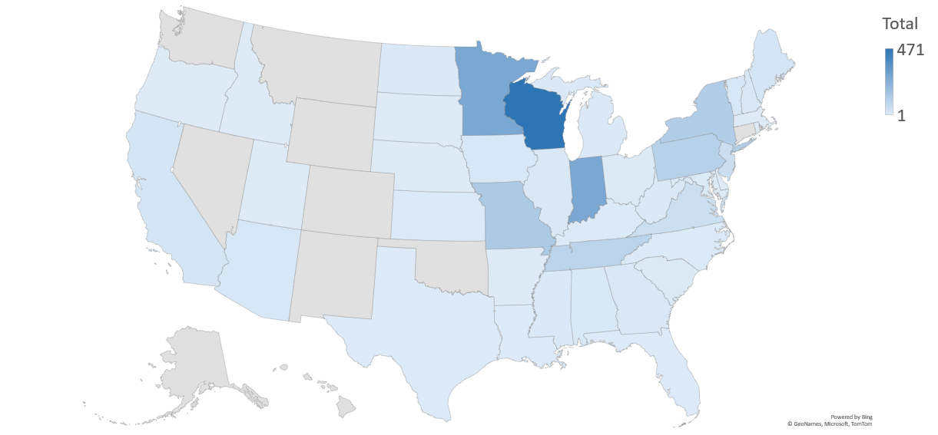
Undetermined Anaplasmosis/Ehrlichiosis Cases, NNDSS, 2008-2017
Notes:
Examining National Notifiable Disease Surveillance System or NNDSS data, we can see trends by state.
Most undetermined anaplasmosis/ehrlichiosis cases reported via NNDSS from 2008-2017 were reported from Wisconsin, Minnesota, Indiana, and Missouri. Wisconsin and Minnesota are the two states where EME is found.
Indiana experienced an issue with their case reporting during this time and a substantial portion of their anaplasmosis/ehrlichiosis cases were inaccurately reported as undetermined. This issue has since been fixed.

Slide 35

States where <25% of E. chaffeensis cases were PCR-confirmed, 2008-2017
Notes:
Taking a more in-depth look, I examined PCR testing out of all diagnostic methods used during the same 2008-2017 timeframe, but just for E. chaffeensis.
States in blue PCR testing made up less than 25% of all diagnostic methods used in that state for classification of E. chaffeensis cases. It’s interesting to note that some states in the NE that utilized very high proportions of PCR testing for A. phagocytophilum (such as MAINE with 84.1%), actually utilized PCR testing very rarely (such as 8.3% in Maine), at least during this time period, for E. chaffeensis reporting.
-----------
Both anaplasma and ehrlichia circlulating in the blood at similar rates, awareness, frequency of testing, test avail. ehrlichia may not be top of mind in Maine.

Slide 36

States where <25% of A. phagocytophilum cases were PCR-confirmed, 2008-2017
Notes:
Next, I examined PCR testing out of all diagnostic methods used for Anaplasma phagocytophilum with symptom onset from 2008-2017.
Again, states in blue PCR testing made up less than 25% of all diagnostic methods used in that state for classification of A. phagocytophilum during the time period of interest. Notably states with a high burden of ehrlichiosis cases did not readily utilize PCR testing for anaplasmosis.
After examining these maps, several states in the southeast did not utilize PCR testing for either of their ehrlichiosis or anaplasmosis cases. We will have to analyze more current data to determine if there is any change to this trend and if targeted education would assist with this.

