Slide 1
Key Concepts and Terminology in Public Health Informatics
CSTE Applied Informatics Team Training
Kelley G. Chester, DrPH, MPH
February 13, 2018

Slide 2
Agenda
Defining Public Health Informatics
Business Process Analysis Basics
The Informatics Savvy Organization
Important Topics in Public Health Informatics
Questions
Upcoming Webinars

Slide 3
Learning Objectives
By the end of the training participants will be able to:
Define public health informatics
Discuss the value proposition for public health informatics
Define business process analysis
Describe the role of business process analysis in public health informatics
Describe an informatics-savvy organization
Describe the role of standards relevant to informatics projects and public health information systems
Discuss contemporary topics in public health informatics, such as Meaningful Use, electronic lab reporting, and electronic case reporting

Slide 4
Defining Public Health Informatics

Slide 5
Poll
Currently, how comfortable are you in explaining what public health informatics is to the decision makers in your organization?
Very Comfortable
Comfortable
Neither or Not Sure
Uncomfortable
Very Uncomfortable

Slide 6
Foundational Concepts
Public Health is an Information Business

Slide 7
Foundational Concepts

Slide 8
Foundational Concepts
What is Informatics? To put it simply...
Informatics is the science of information and
computer information systems

Slide 9

Foundational Concepts
Computer Science
Research & Learning
Practice
Informatics
Information Technology
Information Science

Slide 10
Foundational Concepts
Public Health vs. Healthcare Informatics
Public health informatics is the systematic application of knowledge from multiple disciplines, notably information and computer science, to the data management and reporting requirements of public health.
Health informatics is the interdisciplinary study of the design, development, adoption, and application of IT-based innovations in healthcare services delivery, management, and planning.

Slide 11

Foundational Concepts
Information Technology is the foundation…
  The application of computers and telecommunications equipment to store, retrieve, transmit and manipulate data
Informatics involves translation…
  Turning data into information for decision making

Slide 12
Foundational Concepts
How is Epidemiology different from Informatics?
Epidemiologists study and analyze of the distribution and determinants of health and disease conditions.
Informaticians assist in turning data and information into knowledge that public health professionals, including Epidemiologists, can use to make decisions. Informaticians work across all areas of public health.

Slide 13

The Value Proposition for Informatics
Informatics in has been relegated to “pushing the broom” at the end of the parade.

Slide 14
Poll
Does your agency have a separate informatics office or informatics program outside of the Information Technology (IT) department?
Yes
No
I Don’t Know

Slide 15
Business Process Analysis Basics

Slide 16
What is the Business of Public Health
Q. What is the “business” of health and public health?
A. The activities you do to provide the services that meet the health objectives of the individuals communities you serve.

Slide 17
What is a Business Process
Q. What is a business process?
A. A set of activities and tasks that logically group together to accomplish a goal or produce something of value for the benefit of the organization, stakeholder, or customer.

Slide 18
What is a Business Process
Q. How are business processes relevant to information systems?
A. Information systems support the work you do, so we first need to understand how it is done.

Slide 19

What is Business Process Analysis
Business process analysis is the logical understanding of how the work of public health is accomplished.
BPA answers the question:
“How do we do our work
now?”

Slide 20
Business Process Redesign
Business process redesign occurs when processes are overhauled to achieve specific goals and improve efficiency.
Business process redesign answers the question: How should we do our work?

Slide 21
Defining Requirements
Information system requirements describe how information systems can support our work.

Slide 22
Business Process Analysis Tools
Task Flow/Work Flow Diagrams
Graphical tool that shows the activities of the process in a linear fashion

Slide 23

PHII’s Collaborative Requirements Development Methodology
PHII (a program of the Task Force for Global Health)
  The Collaborative Requirements Development Methodology™ (CRDM) approach to business analysis
  http://www.phii.org/crdm/
  Development of system requirements
  Identification of Systems – buy or build

Slide 24
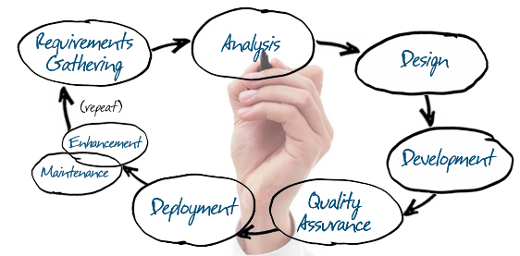
The Role of Business Process Analysis

Slide 25
The Informatics-Savvy Organization

Slide 26
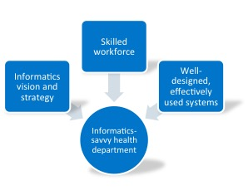
The Informatics-Savvy Organization
An overall vision and strategy for how it uses information and information technology as strategic assets
A skilled workforce
Well-designed and effectively used information systems

Slide 27
The Informatics-Savvy Organization
“Building an Informatics-Savvy Health Department: A Self-Assessment Tool” (Public Health Informatics Institute)
Based on a Capability Maturity Model
Informatics assessment tools and resources available from PHII:
  http://www.phii.org/infosavvy
  http://phii.org/informatics-savvy-health-department-resources

Slide 28
Capability Maturity Model
Optimized – Focus on process improvement
Stage 5
Measured – Processes are measured and controlled
Stage 4
Stage 3
Defined – Processes are defined and standardized for the organization
Stage 2
Managed – Processes are dependent on individuals and are not standardized
Stage1
Initial - Processes are not repeatable, poorly controlled, and reactive

Slide 29
Poll
Has your organization completed a formal informatics self-assessment like PHII’s Informatics-Savvy Self Assessment?
Yes
No
I Don’t Know

Slide 30
Important Topics in PHI

Slide 31
Important Topics in Public Health Informatics
Informatics Standards
  Standards provide a common language and set of expectations that enable interoperability between systems and/or devices.
Examples
  Logical Observations Identifier, Names and Codes (LOINC)
  Systematized Nomenclature of Medicine - Clinical Terms (SNOMED CT)
  Health Level 7 (HL7)

Slide 32
Important Topics in Public Health Informatics
HL7 initially developed to serve the needs of clinical care of individual patients
There is a demonstrated the need for standards-based exchange of population-based health information
  Public health and environmental monitoring
  Food safety activities and disease control
  Outbreak detection
  Coordinated response

Slide 33
Important Topics in Public Health Informatics
HL7 Standards Examples:
  Provider reporting to birth defect registries
  Reporting to public health cancer registries
  Electronic submission of electronic initial public health case reports
  Vital records death reporting
  Electronic laboratory reporting to public health

Slide 34
Important Topics in Informatics
Electronic Laboratory Reporting (ELR) involves the transmission of laboratory data to a public health agency
  Notifiable Diseases
  Most (if not all) jurisdictions in the US have the capacity to receive reports from laboratories

Slide 35
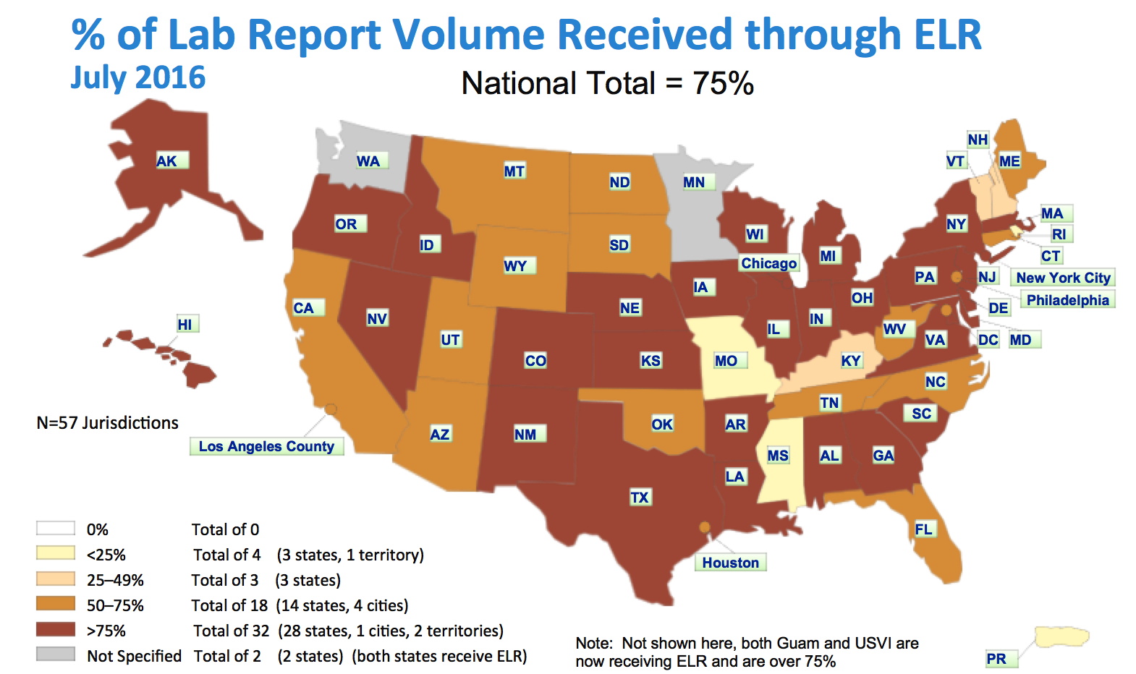
Important Topics in Public Health Informatics

Slide 36
Important Topics in Public Health Informatics
Meaningful Use is using certified electronic health record (EHR) technology to:
  Improve quality, safety, efficiency, and reduce health disparities
  Engage patients and family
  Improve care coordination, population, and public health
  Maintain privacy and security of patient health information

Slide 37
Important Topics in Public Health Informatics
Meaningful Use Public Health Options
  Cancer Registry
  Electronic Laboratory Reporting
  Immunization Registry
  Syndromic Surveillance
  Specialized Registry
    i.e. birth defects registries, chronic disease registries, and traumatic injury registries etc.
  Electronic Case Reporting

Slide 38
Important Topics in Public Health Informatics
Electronic Case Reporting (eCR) is the automated process of electronically reporting cases of public health importance from clinically-based EHRs to public health agencies for integration into disease surveillance

Slide 39
Discussion – Case Scenarios

Slide 40
Case Scenario
Scenario #1: The leadership in your organization has allocated funding to purchase a new disease surveillance information system. You are asked to lead the project for your program. What are some of the activities and first steps that you would recommend to your leadership and your IT department?

Slide 41
Case Scenario
Scenario #2: As a program leader, you recognize that there are many areas of the agency collecting similar data. All of this data is stored in many disparate systems. As a leader you would like to see data shared across the programs to reduce inefficiencies. What are some of the first steps that you would take to make this happen?

Slide 42
Questions

Slide 43
Upcoming Webinars

Slide 44
Thank You

