Slide 1
Communicating the Value of Public Health Informatics
CSTE Applied Informatics Team Training
Kelley G. Chester, DrPH, MPH
May 8, 2018

Slide 2
Agenda
Discuss the principles of effective communication
Define and communicate for technical and non-technical audiences
Discuss the essentials of a good elevator speech
Example talking points from the Frameworks Institute Report
Discuss knowledge overlaps and gaps and how to communicate and engage with stakeholders

Slide 3
Learning Objectives
By the end of the training participants will be able to:
Describe basic principles for effective communication
Define informatics effectively to technical and non-technical audiences
Describe how informatics can assist in addressing public health problems
Utilize talking points or an elevator speech to communicate value of informatics
Apply communications principles for engaging stakeholders involved in informatics projects

Slide 4

Communication Principles

Slide 5
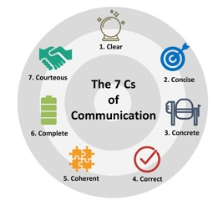
Seven Principles for Effective Communication

Slide 6

Effective Communication
Effective communication is a connection between people that allows for the exchange of thoughts, feelings, and ideas, and leads to mutual understanding

Slide 7
Poll
My organization communicates in an effective manner...
Always
Sometimes
Rarely
Never

Slide 8
Defining Informatics
for Technical and Non-technical Audiences

Slide 9
Participant Response
In the chat box please type a response to the following:
“What are some of the key terms or phrases that you would use to define or describe public health informatics?”

Slide 10
Defining Public Health Informatics
Terminology that we can use to describe or define PHI:
Information
Creating and managing technology
Data collection
Data packaging
Information flow
People
Cross-cutting or multidisciplinary

Slide 11
Participant Response
In the chat box please type a response to the following:
“What are some of the key terms or phrases that you would use to define or describe why public health informatics is valuable?”

Slide 12
Why is Public Health Informatics Valuable
Terminology or phrases that we can use to describe the value of PHI:
Supports improved decision making
Enables effective monitoring and surveillance
Assists with improving population health

Slide 13
What Distinguishes Public Health Informatics
Why is PHI different from other disciplines of public health:
Navigates the needs and goals of diverse fields
Draws important connections across public health
Key function is translation

Slide 14

Explaining Technical Information to Non-Technical Audiences
Know your audience
No acronyms, jargon or buzzwords... Speak plainly
Watch your audience
Make your audience feel comfortable
Use a whiteboard

Slide 15

Elevator Speeches

Slide 16
Essentials for a Good Elevator Speech
Be brief
Be clear
Make it specific to your audience
Highlight the benefits
Identify the problem and your solution
Make a compelling call to action
Extend the invitation to continue the conversation

Slide 17
The Frameworks Institute Report
Frameworks Institute Report¹ was designed to answer four key questions
What are the features of public health informatics that experts want to be able to communicate?
How do public health professionals think about public health informatics?
What are the primary challenges of communicating about public health informatics?
What can communicators do to address these communications challenges and build better understanding of and support for public health informatics?
Frameworks Institute (2017). Reframing Public Health Informatics: A FrameWorks Communications Toolkit. Washington, DC.
http://frameworksinstitute.org/toolkits/informatics/

Slide 18
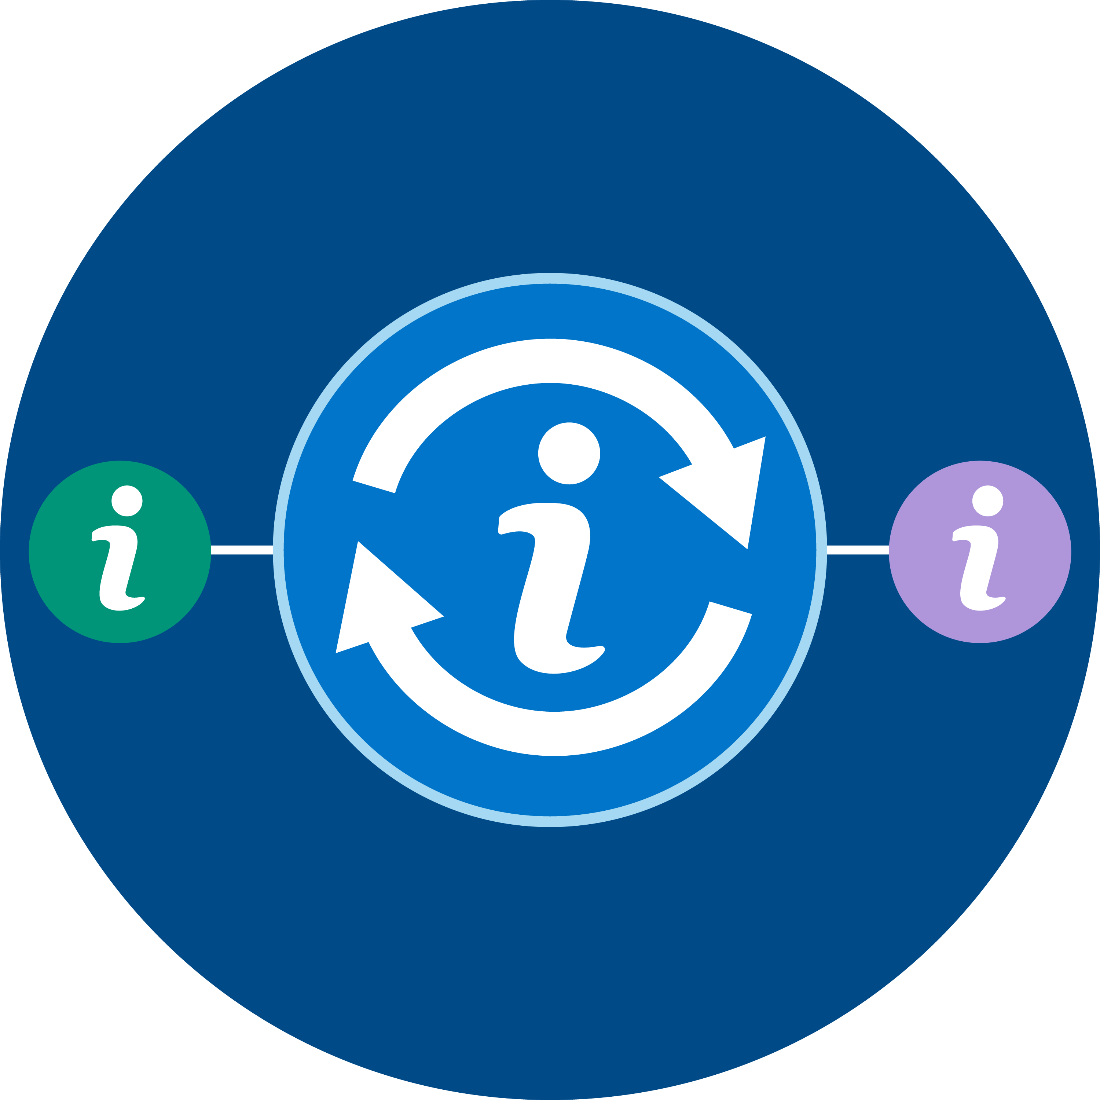


Example Talking Points/Elevator Speeches
Use these key messages to help build the public health field’s understanding of and support for informatics.
Public Health Information Translation
Public Health Data
Logistics
Public Health Knowledge
Architects

Slide 19
Public health informatics is the science of determining accurate, efficient ways to translate among public health subfields’ many data “languages” to make them interpretable and usable across sectors.
What is Public Health Informatics?

Slide 20
Public health informatics runs the logistics of public health data, designing complex systems that, like global shipping logistics, transmit data “packages” securely, to the correct place, and on time.
What is Public Health Informatics?

Slide 21
Public health informatics is a field that designs the blueprints for the complex data systems that keep information secure, usable, and responsive to public health’s needs. Informaticians are like knowledge architects of public health -- the information systems they build account for function, and local contexts.
What is Public Health Informatics?

Slide 22
Engaging Stakeholders
Knowledge Overlaps and Gaps

Slide 23
Knowledge Overlaps/ Communication Opportunities
Public health informatics is about both data and technology
Data need to be gathered and managed with practical goals in mind
Integration of data systems is crucial

Slide 24
Knowledge Gaps/ Communication Challenges
Generate an understanding of informatics as a scientific field of practice and expertise
Help professionals understand the informatician’s critical role in making information systems work more effectively
Emphasize the complexity of users’ needs and show how public health informatics, as a social science, plays a key role in addressing these needs and solving problems

Slide 25
Knowledge Gaps/Communication Challenges
Develop and use a consistent term for informatics professionals that can facilitate talk about the field of public health informatics and the professionals who do this work
Explain how public health informatics can overcome complex challenges to integrate information systems
Make the work of public health informaticians clear and concrete

Slide 26
Open Discussion
There is a new individual in your organization who is new public health. Your leadership has asked you to give a brief one-on-one introduction to informatics in your organization to this individual.
What would you say?

Slide 27

Questions

Slide 28
Preparing for the Workshop at the Annual Conference
The day will be structured around a case study scenario in which you will be asked to design an informatics-based solution that addresses the scenario
You do NOT need to prepare any documentation for the workshop
There will be reading materials for you to consider ahead of time
You will have the opportunity to select your top preferences for a case scenario before the workshop
Jessica, Amanda, and I will divide the participants up into groups based on their preferred case scenario

Slide 29
Thank You
See you at the Annual Conference

