Slide 1
CSTE AITT Case Study Workshop
Kelley G. Chester, DrPH, MPH
CSTE Annual Conference
June 10, 2018

Slide 2
Agenda
Welcome and Logistics
Linking Population Health to Public Health and Public Health Informatics
Case Study Introduction
Critical Success Factors for Informatics Projects
Wrap-Up

Slide 3

Learning Objectives
Describe the concept of population health and its linkage to public health and public health informatics
Describe critical success factors for informatics projects
Apply communications principles for engaging stakeholders at all levels for informatics projects
Create a matrix of critical success factors for an informatics solution for a public health case study

Slide 4
Learning Objectives
Discuss the role of business process analysis for designing an informatics solution for public health issues or problems
Define a process and functional requirements for an informatics solution for a public health case study
Outline an evaluation approach based on an existing framework for an informatics solution for a public health case study

Slide 5

Ice Breaker

Slide 6
Linking Population Health to Public Health and Public Health Informatics

Slide 7
What is Population Health
Population Health is...
The health outcomes of a group or individuals, including the distribution of such outcomes within the group¹.
The field of population health includes the study of:
Health Outcomes
Patterns of Health Determinants
Policies and Interventions
1. Kindig, D., & Stoddard, G. (2003). What is Population Health? American Journal of Public Health, 93(3), 380-383.

Slide 8
Defining the Population
The population of interest can be defined in many ways:
Geographic regions
Other groups
  Employees at a particular organization
  Ethnic groups
  Disabled persons
  Prisoners
  Etc...

Slide 9

Focus on Health Outcomes
Health outcomes are changes in health that result from measures or specific healthcare and public health investments or interventions.
Population health has an increased focus on health outcomes and on determining the degree of change that can be attributed to interventions.

Slide 10
Determinants of Health
Medical care
Public health interventions
Social environment
  Income, education, employment, social support, culture
Physical environment
  Urban design, clean air and water
Genetics
Individual behavior

Slide 11
Population Health and Public Health
Public Health
“The science and art of preventing disease, prolonging life, and promoting health through organized efforts and informed choices of society, organizations, public and private, communities, and individuals.”
Population Health
“The health outcomes of a group of individuals, including the distribution of such outcomes within the group.”

Slide 12
Population Health and Public Health Alignment

Slide 13
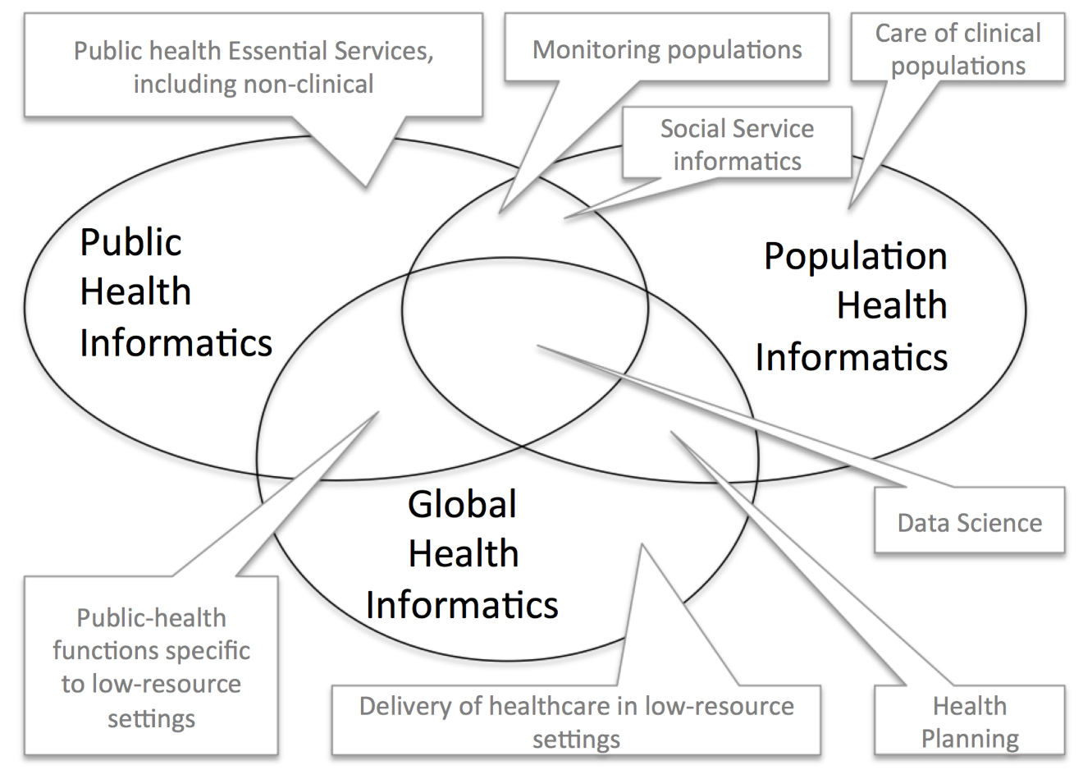
Where Does Informatics Fit In²
2. Massoudi, B. L., Chester, K. G. (2017). Public Health, Population Health, and Epidemiology Informatics: Recent Research and Trends in the United States. IMIA Yearbook of Medical Informatics, 26(1), 241-247.

Slide 14
Public Health 3.0 Key Components³
Enhanced Leadership and Workforce
New Partners
Accreditation
Technology, Tools, and Data That Matter
New Metrics of Success
Funding
3. DeSalvo, K., O'Carroll, P. W., Koo, D., Auerbach, J. M., & Monroe, J. A. (2016). Public Health 3.0: Time for an Upgrade. American Journal of Public Health, 106(4), 621-622.

Slide 15
Case Study Introduction

Slide 16
Improving Notifiable Disease Case Reporting with Local Healthcare Partners

Slide 17
Utilizing Data to Combat Emerging Population Health Threats

Slide 18

Critical Success Factors for Informatics Projects

Slide 19
Critical Success Factors for Informatics Projects
Leadership
Project Governance
Project Management
Stakeholder Involvement
Organizational and Technical Strategy
Technical Support and Coordination
Financial Support and Management
Policy Support
Evaluation

Slide 20
Break

Slide 21
Critical Success Factor 1: Leadership
An executive sponsor assures that the project’s goals are aligned with the overall agency strategy and garners support from other senior-level decision makers.
Effective executive sponsors:
Provide ongoing direction
Have a passion for the project
Willing to devote a significant amount of time and effort to ensure success

Slide 22
Critical Success Factor 2: Project Governance
Projects should be governed by a steering committee that has representation from all key stakeholder groups
The steering committee is charged with giving strategic direction and supporting the project

Slide 23
Critical Success Factor 3: Project Management
Key values for effective project managers:
Leadership Skills
Problem Solving
Effective Communication
Cultural Awareness
Optimism
Credibility
Digitally-Savvy
Knowledge of other Frameworks

Slide 24
Critical Success Factor 4: Stakeholder Involvement
Frequent and quality communication with stakeholders and stakeholder involvement during the course of a project contribute to its credibility and effectiveness.
Effective communication can influence the perception, reception, and ultimately, the success, of the project.

Slide 25
Time for Lunch

Slide 26
Critical Success Factor 5: Operational and Technical Strategies
Organizational and technical strategies should involve input from all key stakeholders and be based on well-defined business processes.

Slide 27
Context Diagram Example⁴
4. Public Health Informatics Institute. (2008). Taking Care of Business: A Collaboration to Define Local Health Department Business Processes. Decatur, GA: Public Health Informatics Institute.

Slide 28
Critical Success Factor 6: Technical Support and Coordination
The business analyst acts as a bridge between the program and technical staff.

Slide 29
Task Flow Diagram Example

Slide 30
Break

Slide 31
Critical Success Factor 7: Financial Support and Management
The true costs of implementing informatics projects is often underappreciated by leadership and political bodies who allocate funding.
To address this issue, public health agencies often need to pursue different funding streams to accomplish their goals.

Slide 32
Critical Success Factor 8: Policy Support
Executive sponsors must increasingly take on the role of keeping policy makers informed about the policies and procedures to protect health information and the creation of effective information systems.

Slide 33
Critical Success Factor 9: Evaluation
Ultimately evaluation helps to inform policy by assessing the effect of informatics projects on population health outcomes.

Slide 34
CDC Six-Step Evaluation Framework⁵
5. Centers for Disease Control and Prevention. Framework for program evaluation in public health. MMWR 1999;48 (No. RR-11). Https://www.cdc.gov/eval/framework/

Slide 35
Case Study Discussion and Workshop Wrap-Up

Slide 36
Thank You

