Slide 1

Boston’s Informatics Workforce Strategy
May 18, 2018

Slide 2

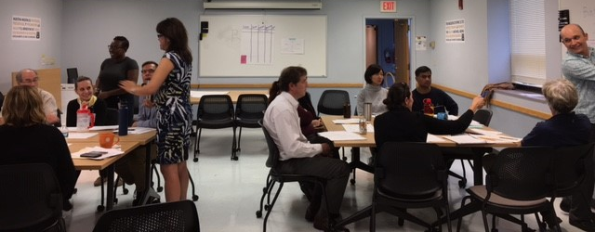

Slide 3
boston’s aitt Objectives
Offer informatics 101 training to all staff and track participation across programs & job classifications.
Develop an informatics training addendum to the BPHC 2017‐2019 Workforce Development Plan.
Meet the BPHC 2015-2018 Strategic Plan objective of ensuring there are two trained staff in each bureau. *Use Team Learning Stipend to offer technical training.

Slide 4
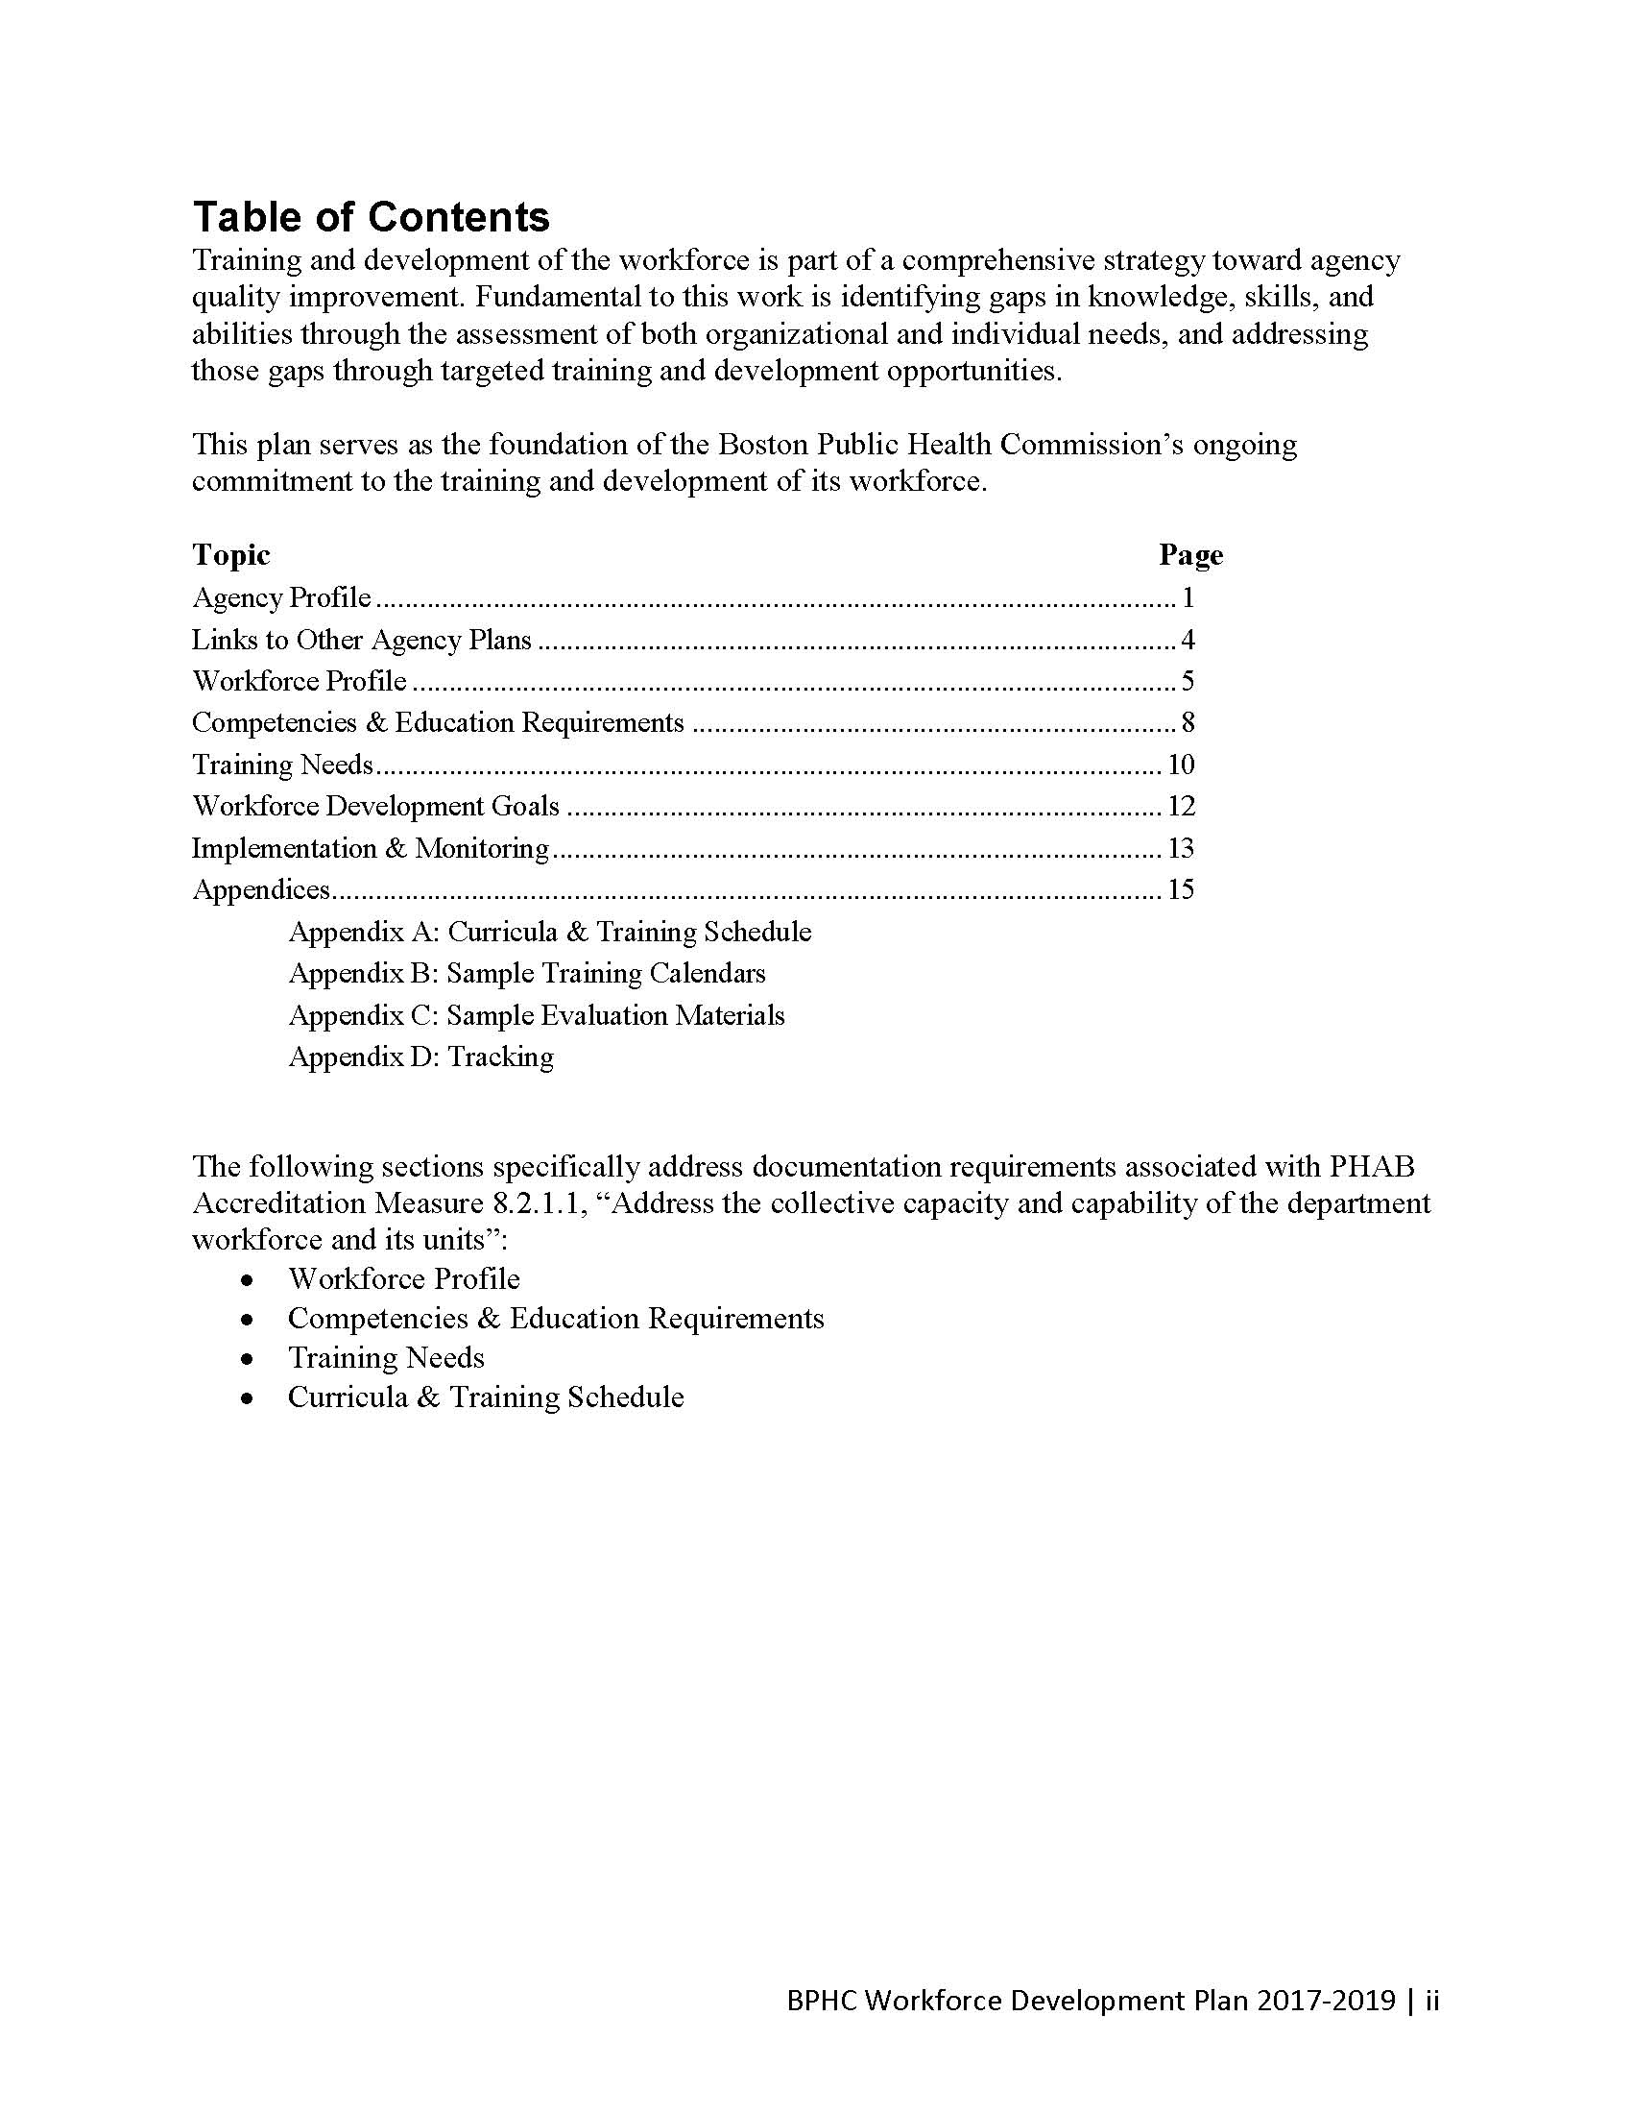

Notes:
http://intranet.bphcad.local/informatics

Slide 5
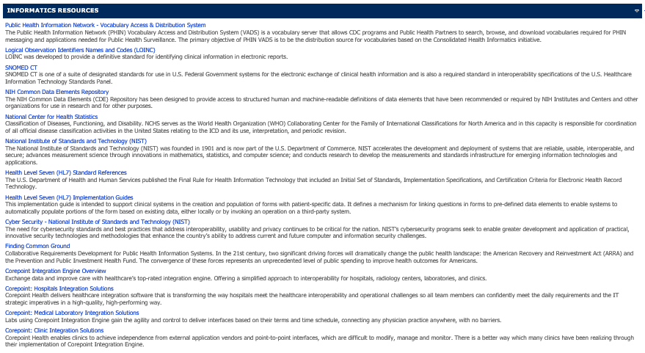
Building an Informatics resource library

Slide 6
Our challenge
To target & tailor training resources, we aim to develop an informatics self-assessment tool for staff at different levels (e.g., end users, data managers, decision-makers).
Core question: How do we develop a meaningful tool for use by staff with varying levels of competency and need?

Slide 7
Questions for you
How do you define an informatics-savvy workforce? Informaticians, IT, Epi, others? Everyone?
What approach has your organization taken to develop an informatic-savvy workforce?
How would you engage different levels of staff to determine your organization’s training needs?
What questions would you want to ask non-informaticians about their informatics-related learning needs?
How might you apply your organization-level assessment of learning needs to individual staff?
Do you have suggestions for items to include in our tool box?

