Slide 1
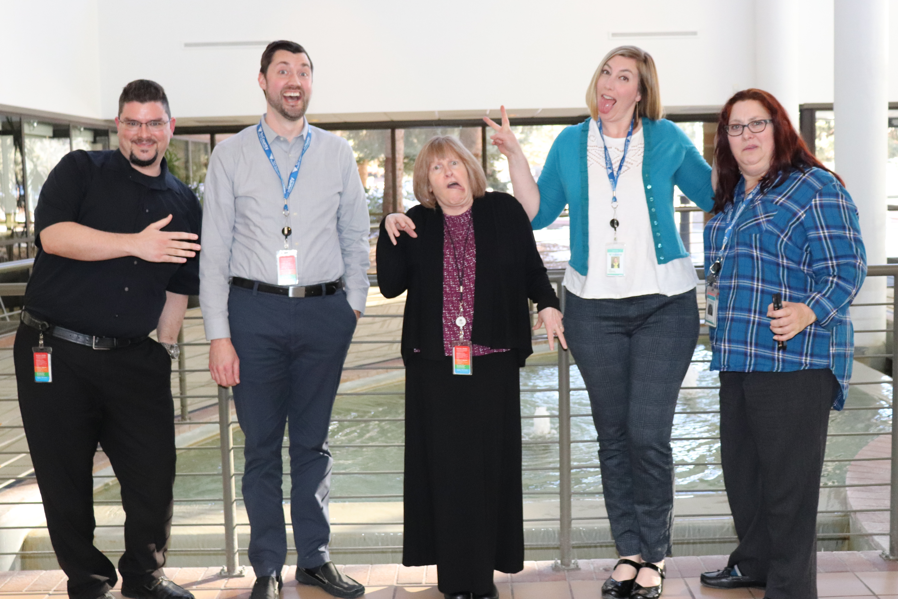

Peer to peer
Adaptive Challenge
March 20, 2019 | Tri-County team
Jordan Luke, Ryan Smith, Alyson Shupe, Kelly Weidenbach, Holly Adams

Slide 2
Adaptive Challenge – Case Presentation
Challenge / problem we face:
  Our challenge is to continue momentum for developing an informatics infrastructure and processes in a large local public health agency following restructuring and building on the work of the current Informatics Governance Group (IGG).

Slide 3
Adaptive Challenge – Case Presentation
Major players:
  The Informatics Governance Group (IGG) is comprised of senior level staff representing each division in the department and is staffed by the IT Manager and Informatics, Epidemiology and Health Planning Manager. We expanded this group to include Informatics Specialists from various divisions.
  Agency leadership is unsure of empowering an autonomous group with decision-making authority and fiduciary responsibility for information systems.
Proposed actions:
  Develop standardized processes for the planning, implementation, maintenance, and monitoring of information systems that are consistently applied and followed across the agency.
  Determine agency-wide priorities for system implementation and budgeting.

Slide 4
Adaptive Challenge – Case Presentation
Stakes and interests:
  Agency restructuring resulted in a new Planning and Information Management Division which centralized analytic and IT staff. Two new positions have been added: Division Director and Informatics Project Manager.
  There are four large information systems planned for deployment in the next 2 years: EHR, Enterprise Financial System, Document Management System, and Performance Management System.
  There is no “informatics budget”, established authority, or criteria for prioritizing systems.
  Staff have change fatigue and previous implementation failures have resulted in low morale. An EHR was purchased but scrapped before implementation and a recent HIRS was rolled out without planning and adequate training.

Slide 5
Adaptive Challenge – Case Presentation
What advice is needed/wanted by our group:
  How do we convince Agency Senior Leadership that standardized policies and procedures for system planning, purchasing, and implementation are needed?
  What elements are most critical for accomplishing this work under the auspices of an Informatics Strategic Plan?
  How do we promote the current structure (IGG) to become an autonomous decision-making body for this work?

