Slide 1

Technical Challenge:
Evaluating Maryland HIV Reporting Laboratories
Maryland HIV Surveillance Team:
Alyssa Arey, James Carrier, Molly Gribbin, Veronica Hart, Trevor Hsu
CSTE AITT Peer-to-Peer Presentation – April 24, 2019

Slide 2
MISSION AND VISION
Prevention and Health Promotion Administration
MISSION
The mission of the Prevention and Health Promotion Administration is to protect, promote and improve
the health and well-being of all Marylanders and their families through provision of public health
leadership and through community-based public health efforts in partnership with local health
departments, providers, community based organizations, and public and private sector agencies, giving
special attention to at-risk and vulnerable populations.
VISION
The Prevention and Health Promotion Administration envisions a future in which all Marylanders and
their families enjoy optimal health and well-being.

Slide 3
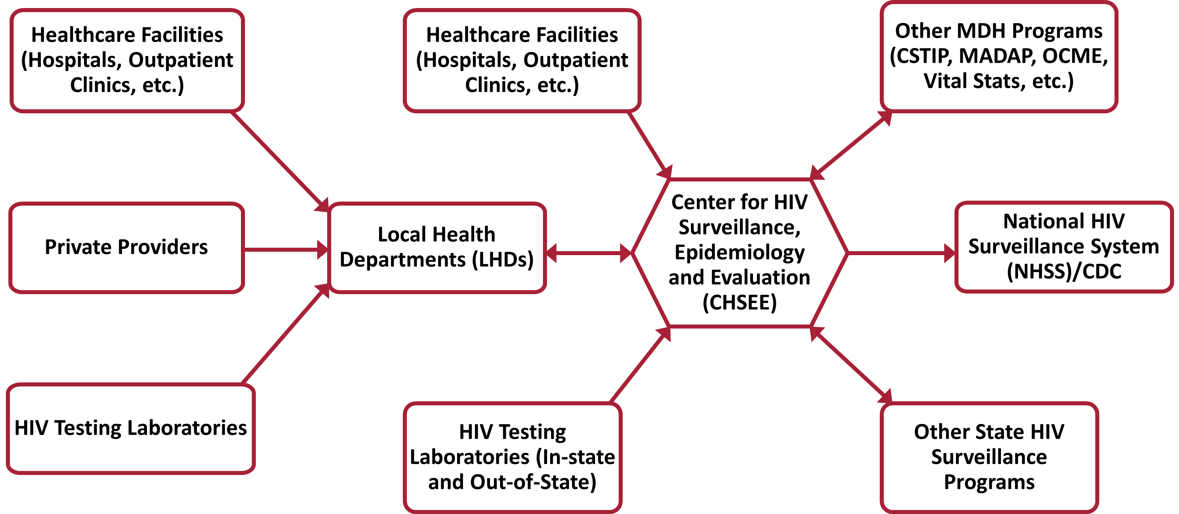
Background
MDH HIV Surveillance receives ~30,000 HIV lab reports monthly from 39 facilities
We receive ELR data either directly from facilities via sFTP folders or extracted via NEDSS
Despite an extensive ELR monitoring and QA process, prior HIV projects have uncovered instances of unreported HIV laboratory data

Slide 4
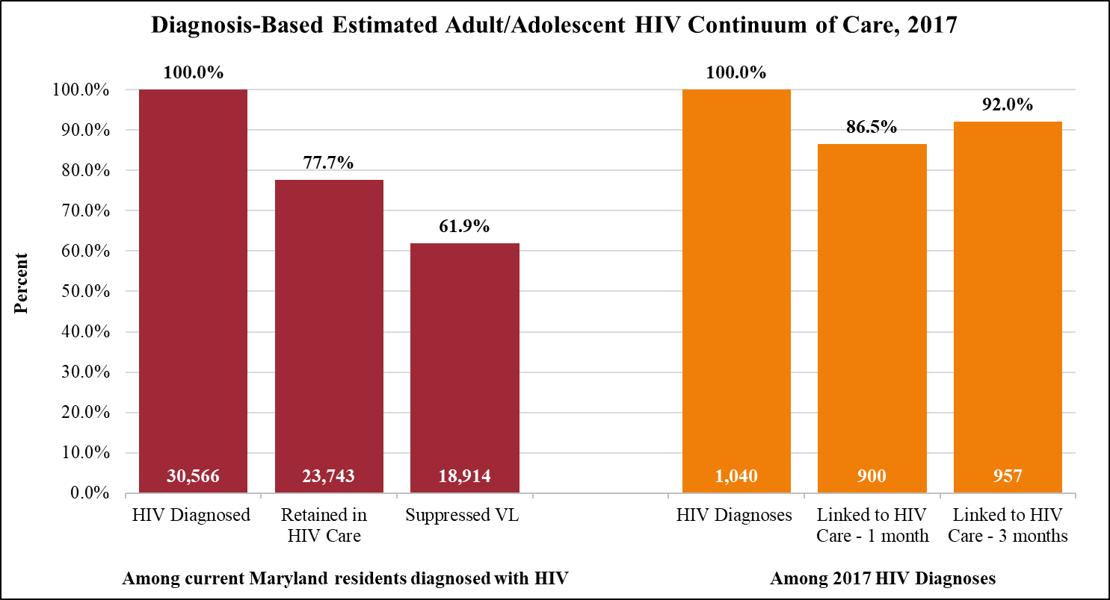
Challenge
Additional reporting gaps may continue to exist unbeknownst to us
Particular concern is the underreporting of undetectable viral loads

Slide 5
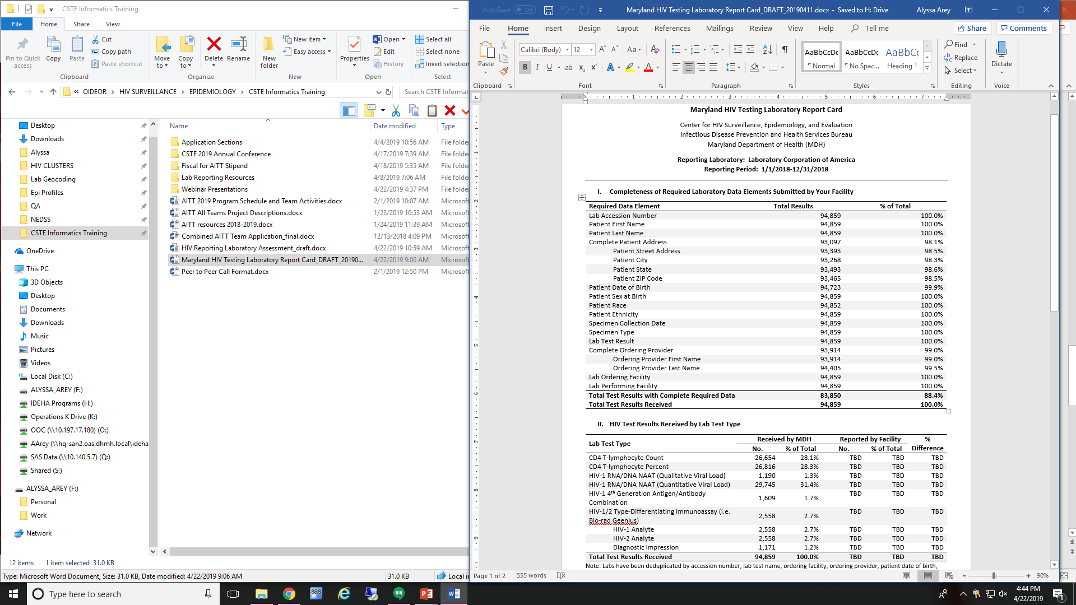
Plan of Action
CDC has requested that HIV surveillance programs create laboratory “report cards” to evaluate reporting data quality
Facilities complete a brief assessment survey on the types and quantity of HIV lab tests they performed
Compare assessment responses with the data we received from their facility
Generate lab report cards, which will also include stats on how their numbers compare to similar facilities

Slide 6
Major Players
Primary stakeholders:
CDC
  Encouraging states to evaluate HIV reporting labs on a routine basis
Reporting facilities
  Already report on many diseases to MDH, additional time/burden to complete the initial assessment without incentivizing the lab report cards
Maryland HIV surveillance
  Want to optimize eHARS data completeness, but also want to preserve relationships with reporting facilities and be cognizant of their burden by creating a product that is sustainable and as least burdensome as possible
Other stakeholders:
HIV/STI partner services and linkage to care staff (at MDH and at local health depts)
HIV prevention staff
HIV care providers
Persons living with HIV or getting HIV care in Maryland

Slide 7

MDH Interests
Identify sources of missing data and resolve systematic HIV reporting gaps
Improve eHARS data completeness to better accurately depict the local HIV epidemic in Maryland
Increase HIV program efficiency and effectiveness, by prioritizing or designing programs based on improved eHARS data
Hidden issues:
Additional challenges in data that is auto-reported via HL7 to MDH NEDSS
More facilities are transitioning to NEDSS reporting, so ELR QA team must thoroughly monitor lab report changes

Slide 8
Group Discussion
Have you evaluated data quality/completeness from your reporting facilities or programs?
How do we get buy-in for our reporting facilities to complete the initial laboratory assessment?
Advice on how to reconcile with our reporting facilities any discrepancies we may discover during this evaluation?
Any suggestions to minimize project burden for reporting facilities?

Slide 9
Maryland Department of Health
Prevention and Health Promotion Administration
Center for HIV Surveillance, Epidemiology and Evaluation
https://phpa.health.maryland.gov/OIDEOR/CHSE/
9

