Slide 1
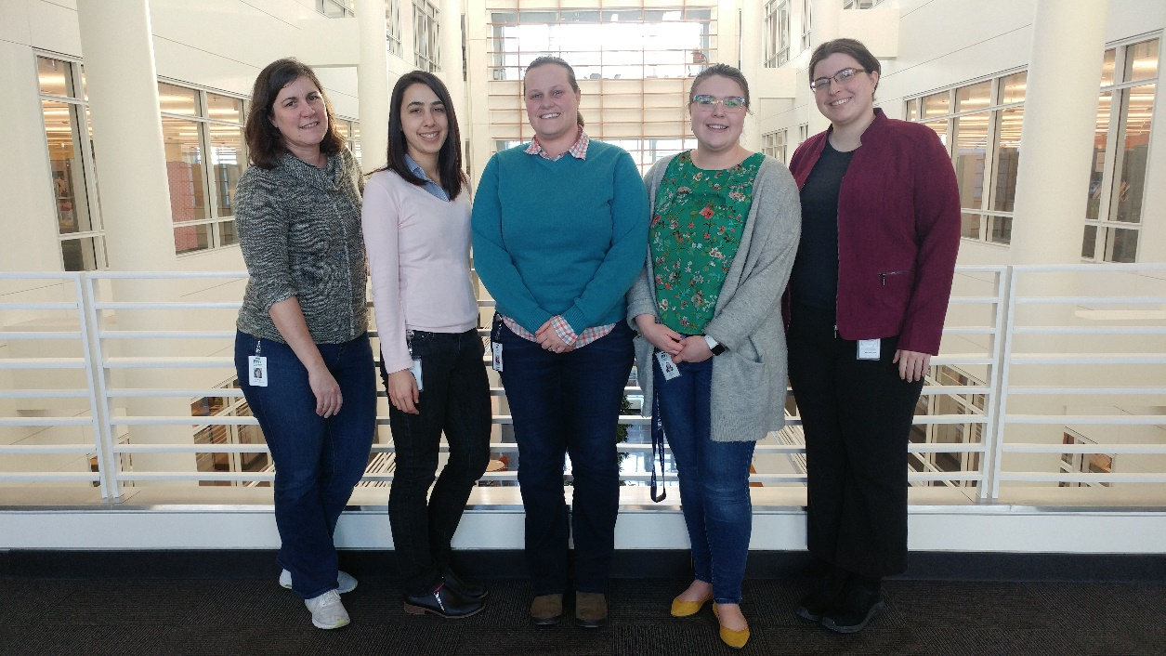

Peer-to-Peer: Technical Challenge
April 24th, 2019
Minnesota Department of Health
Kathy Como-Sabetti, Ann Kayser, Sarah Solarz, Sarah Boneske, Hanna Chakoian

Slide 2
AITT Project Discussion
The Minnesota Electronic Disease Surveillance System Operations Unit (MEDSS Op) is seeking to help the Active Bacterial Core Surveillance (ABCs) program area standardize their lab audit process with the assistance of Electronic Laboratory Reports (ELRs)
  Lab audits are conducted differently by lab facilities and across MDH program areas
MEDSS Ops also wants to develop a prototype dashboard of data quality to monitor electronic laboratory messages
  The technical challenge is related to this goal

Slide 3
Technical Challenge: Case Discussion
MEDSS is a database that stores and receives data from multiple outside partners (labs, hospitals)
  Used by infectious disease, lead, newborn screening programs
The state of Minnesota has centralized IT (MN.IT)
MEDSS Ops works in the Infectious Disease Epidemiology, Prevention and Control Division

Slide 4
Project Plan
Steps for ELR lab audit:
  Extract HL7 files from a database of ELR messages
  Run through R code to break down messages and extract simple statistics by facility
    Extraction of 25-50 fields by facility (11 files)
  Save the simple statistics to monitor changes over time
  Create data visualization of data quality

Slide 5
Problems
MEDSS Op Objective: Identify accessible long-term storage solution for ELR QA reports to detect trends and changes
Direct access to databases housed by MN.IT has been limited and MEDSS Ops does not have the ability to write into a database
Project is a proof of concept
Cost of a new database

Slide 6
Questions for the Group
What would be a good way to build the proof of concept and save outputs daily without a MN.IT sponsored database?
What are some storage solutions for long term use and access?
Which areas would be the easiest parts of the process to automate?
What are some of the most important types of data to visualize for the following major players?
  MEDSS Ops team, MDH Leadership, Laboratories, MDH Program Staff

Slide 7

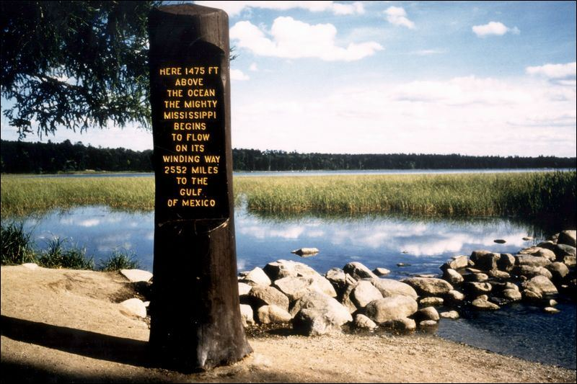




Thank You!

