Slide 1
CSTE Applied Informatics Team Training Ignite Presentation Part 1
July 9, 2019 2:00pm-3:30 ET

Slide 2

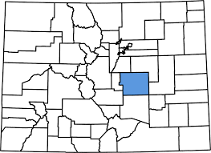

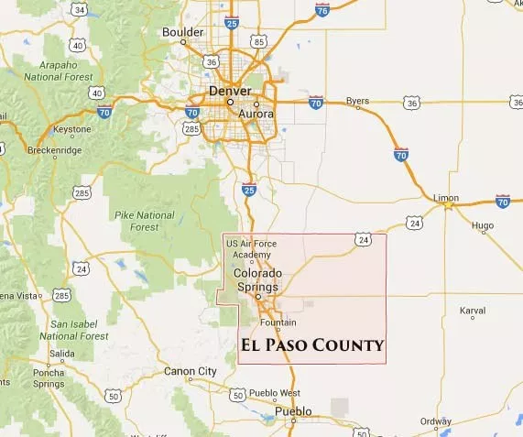
2019 AITT Ignite Presentation
El Paso County, CO Team
Presented by: El Paso, Colorado Team:
Marigny Klaber, Carey Boelter, Haley Zachary
Mike DeRose and Helen Harris
To: 2019 CSTE AITT Cohort
Date: July 9th, 2019

Slide 3
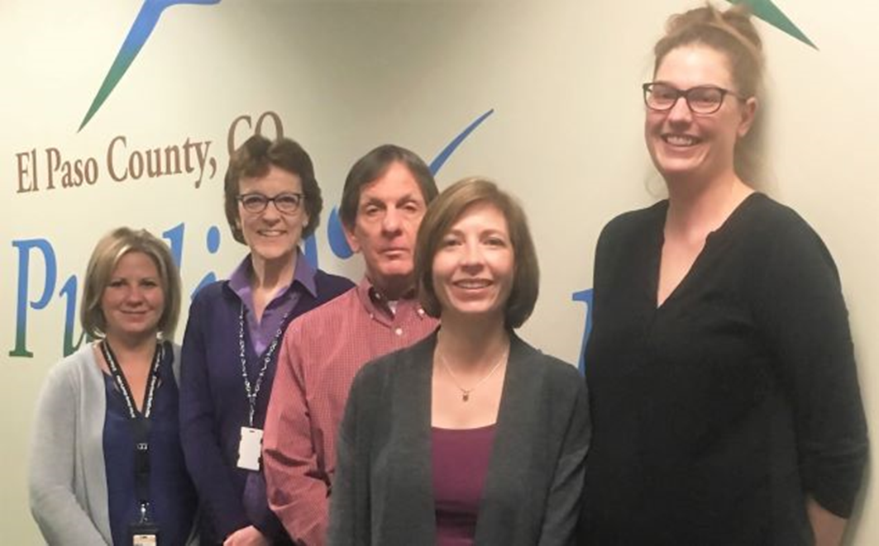
El Paso County, CO AITT Team
Notes:
From the left:
Carey Boelter – El Paso County Sheriff’s Office – Program Manager of the Co-Responder Program
Helen Harris – El Paso County Public Health Population Epidemiologist
Mike DeRose – El Paso County Public Health Data Analyst
Marigny Klaber – Regional Epidemiologist
Haley Zachary – Communicable Disease Epidemiologist

Slide 4

AITT Project Goal
Notes:
Build informatics capacity to address data access and system integration gaps for the El Paso County Sheriff’s Office Co-Responder Program

Slide 5
El Paso County Co-Responder Program
Photo Source: Gazette.com
Notes:
Policing approach that pairs a specially trained law enforcement officer with a mental health clinician to respond to mental health related calls.
Team name is BHCON for Behavioral Health Connect
The daily duties and responsibilities of the BHCON team include responding to crisis 911 calls, taking referrals from other EPSO deputies to respond to identified individuals, and completing follow up visits and/or phone calls to individuals previously contacted by BHCON. BHCON team members also participate in facilitating CIT and MHFA training for EPSO personnel and other local law enforcement agencies. BHCON team members work collaboratively with local psychiatric care providers and emergency departments to ensure appropriate care for those contacted by BHCON.

Slide 6
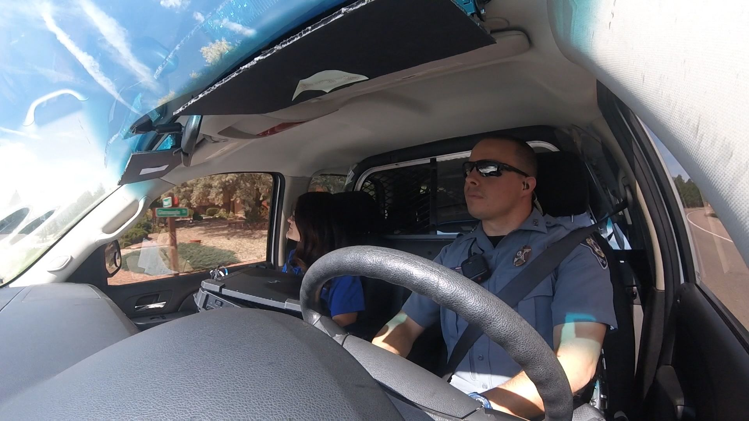
BHCON Goals
Notes:
The goals of the BHCON unit include:
Provide crisis intervention response to individuals experiencing a mental health emergency
Prevent unnecessary incarceration and/or hospitalization of mentally ill individuals by connecting them with appropriate care in the least restrictive environment
Facilitate the return of law enforcement units to patrol activities and emergency vehicles back into rotation
Support increased training to deputies on improved law enforcement responses to behavioral health calls through Crisis Intervention Training (CIT) and Mental Health First Aid (MHFA)
Promote an information campaign for families, friends, neighbors and communities about mental health awareness, decreasing the stigma of mental illness and encouraging individuals to seek help
Provide not only response, but also follow-up, to ensure a continuum of care and access to resources

Slide 7
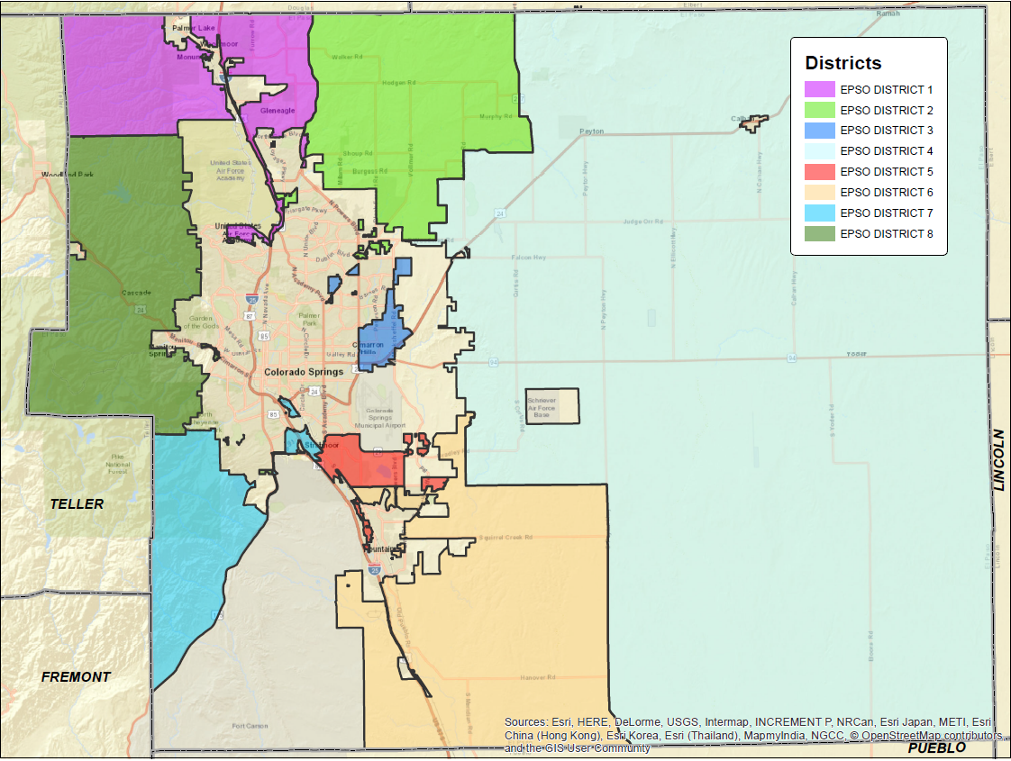
El Paso County Sheriff's Office District
Notes:
Talk about the area excluded/covered by EPSO Co-Responder Unit – Define by color
2100 square miles
Team covers 8 districts and assists several other municipalities such as Monument, Manitou, Calhan and Fountain
Serving a Population of 701,283
All with one team working 10 hours, 4 day/week

Slide 8
Most Valued Co-Responder
Achievements
Notes:
Operations data was collected from Go-Live on 7/1/2018 to inform continuous program improvements and overall evaluation
7/1/2018 through 5/31/2019 (11 months) shows our single Co-Responder Unit actively responding to:
504 calls that came into 911 dispatch
Average age 36 years
Just over half male (56%)
Racially and ethnically aligning with our overall population proportions

Slide 9
Co-Responder Call Types
Notes:
Call Types
Check the Welfare: 911 Caller reports someone may be suicidal or having a crisis
Disturbance: 911 Caller reports individual is causing some sort of problem/situation
Referrals: BHCON team contacted directly by law enforcement, fire, agency or community member to respond to an individual
Other: Harassment, Domestic Violence, Suspicious Incident

Slide 10
Co-Responder Dispositions
Notes:
Dispositions
Treat in Place: Individual treated in place and provided resources
M1: Individual presents as danger to self or others or gravely disabled and mandated to 72 hold for psychiatric treatment
Arrest: Individual arrested on new charge or warrant
Other?

Slide 11

Why Does This Matter?
Notes:
Why does this project matter – what have we learned by using it as our AITT project?
1. The Co-Responder Program has informed a future-state interoperability that could be applied to all public health programs
2. The need for data-sharing across agencies to improve outcomes for EPC residents

Slide 12
Co-Responder-Informed Model
EHR
Social determinants of health
Health care providers and hospitals
Infectious diseases
Environmental health
Public safety
EPCPH data
Military
MH/SUD
Notes:
These data may be collected by individual agencies, including:
EHR
Environmental Health
BH and medical providers
Infectious diseases
Law enforcement and public safety
And when shared in a formalized manner across multiple agencies are more powerful in aggregate than individually

Slide 13

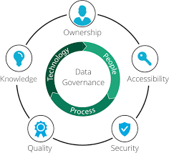
Notes:
However, with caution.
During our Adaptive Problem presentation of our project in April, our AITT peers made 2 helpful recommendations:
The need for data governance when managing data across different agencies, and
The benefits of formalizing the partnerships sharing the data related to the Co-Responder Program

Slide 14
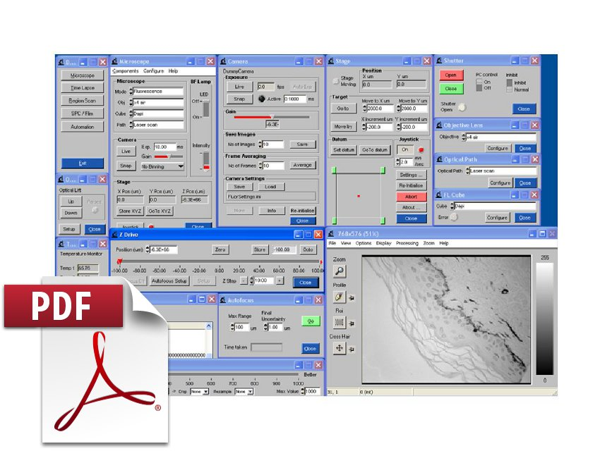
Most Valued AITT Program Achievements
Notes:
During the program the team identified gaps in data collection, standards, and integration between systems for the Co-Responder Program
We reviewed data fields collected and identified data collection discrepancies between systems used by the El Paso County Sherriff’s Office Co-Responder Team

Slide 15
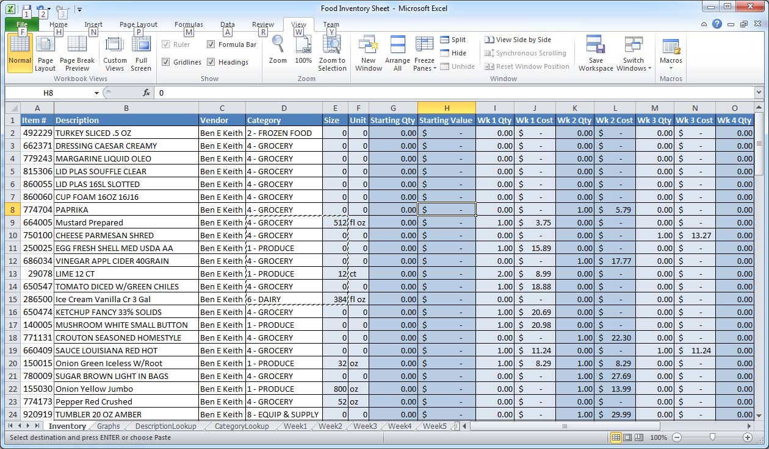
Integrating Multiple Datasets
Notes:
Determined the need for a data dictionary for multiple data collections systems within the Sherriff’s Office in order to find common data fields;
Attempted to integrate patient records between 2 user groups using the same vendor software (EPSO and CARES)
The current software is not a viable option moving forward based on lack of interoperability and data standards

Slide 16

Our Most Valued AITT Program Achievements
Notes:
The AITT program helped identify the need for data governance and we have begun the groundwork; understanding the need for policies and procedures for data acquisition, maintaining data quality and thinking about the end-use of the data, why is it needed and how will it help?

Slide 17

EPCPH Data Governance Workgroup
Strategic Initiatives and Development Officer
Emergency Preparedness Epi
Global Health Epidemiologist
Data Analyst
Communicable Disease Epi
El Paso County IT
Operations
Communications
Public Health Planners
Notes:
We have selected the data governance community and convened a preliminary workgroup consisting of epidemiologists, data analysts, operations, communication, planners, and information technology.
Current actions are to incorporate lessons learned in the AITT program to determine further actions at EPCPH including creating policies and procedures for sharing and storing the data, and assigning roles and responsibilities for the data to the individuals involved

Slide 18

Infrastructure, Resources and Best Practices
Notes:
We have completed our inventory of current data infrastructure and resources:
Existing software/hardware
Staff roles and capacity
Identified best practice programs and impending processes needing improvement
We are in our infancy but up-and-running

Slide 19

Next Steps for Co-Responder: AITT and Beyond
Notes:
Our next steps for the Co-Responder program are to include lessons learned and to evaluate the operational successes and effectiveness.
It will be important to identify additional key data points, and to build the capacity to collect that information.
We have determined the need to replace the software used in the Co-Responder Program with a more accurate and flexible product that provides interoperability with other systems.

Slide 20
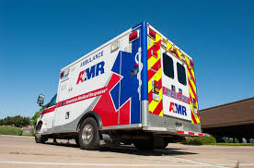
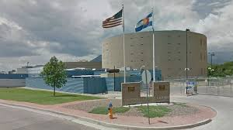
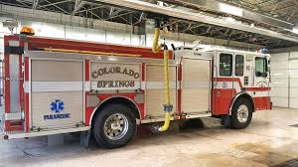
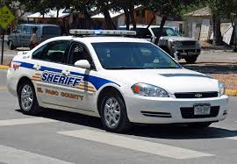
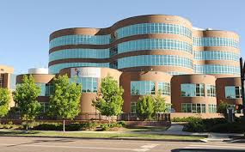

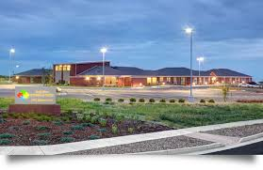
Next Steps: Co-Responder Data Integration
Notes:
Key to success for behavioral health response and continuity of care is to be able to link all services with on medical record that is patient-based.
This will require the integration of several different data collection systems; behavioral health responder teams, law enforcement, hospitals, behavioral health facilities, and pre-hospital/ambulance.
To start connect the 2 different behavioral health responder data collection tools; then the next step will be to connect all sheriff's office data collection systems.

Slide 21

Next Steps – Data Governance
Notes:
Next steps for data governance will be to:
Continue developing Data Governance community
Identify gaps in partner participation and formalize existing partnerships
Create and document draft project plan
What issues exist that need resolution?
What data exists to answer these problems?
Who collects the needed data?
How will this data be shared?
Gather information regarding data acquisition agreements, data storage requirements, data analytics and appropriate ways of releasing data (both to partners and the public).

Slide 22
Q&A for Team El Paso

Slide 23

Merlin Calls the SHOTS
Florida Division of Disease Control and Health Protection AITT Team

Slide 24



Project goal
Notes:
Add medical and RE to Merlin

Slide 25
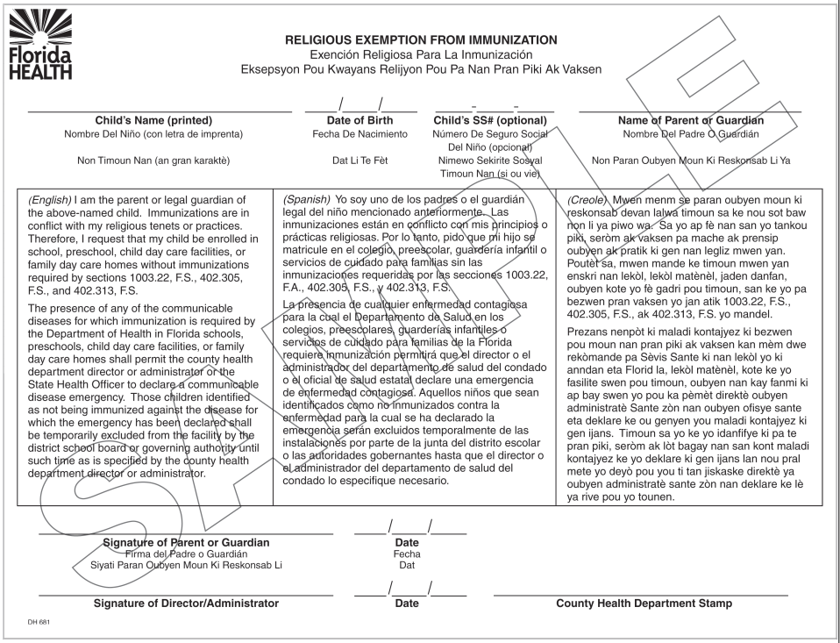
All REs are recorded in Florida SHOTS.

Slide 26
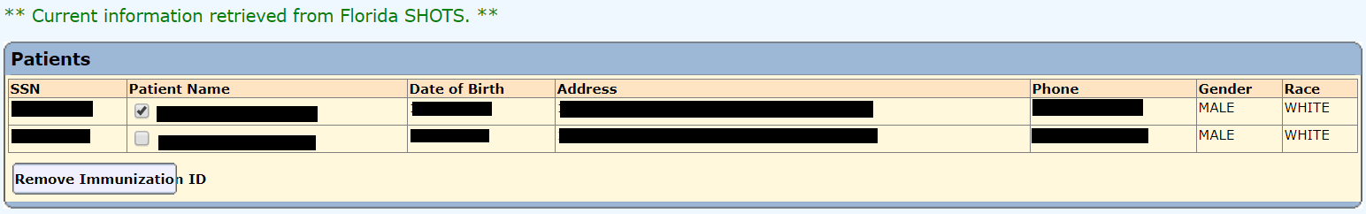
Merlin users choose the best match in Florida SHOTS.
Notes:
Current interoperability

Slide 27
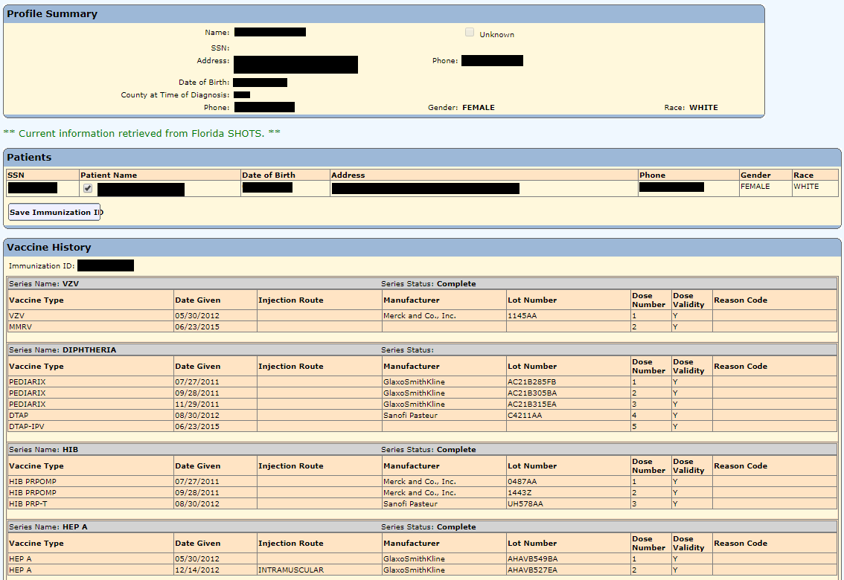
Vaccination data are available at the profile level.
Notes:
Current interoperability

Slide 28
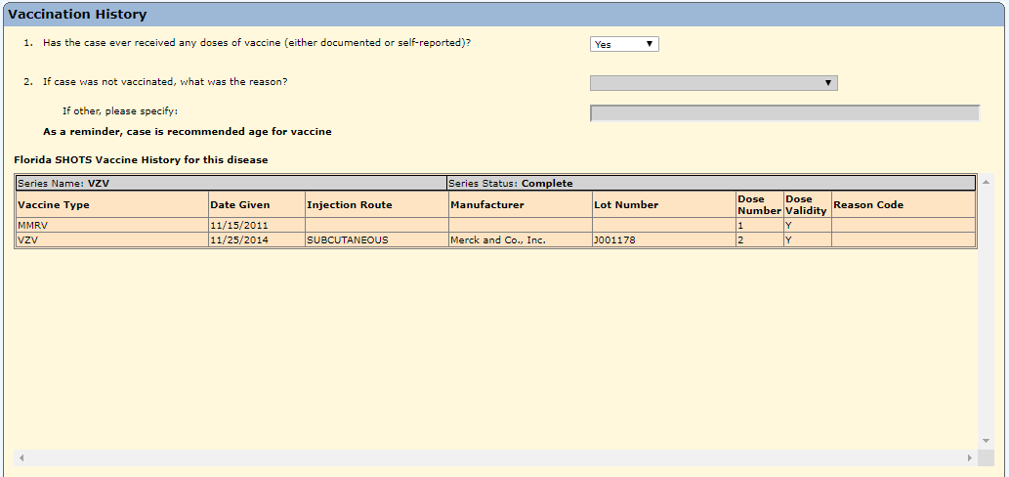
Only relevant vaccines are displayed in the extended data.
Notes:
Current interoperability: vaccine control built into extended data

Slide 29

Regular communication with partners
Notes:
Biweekly meetings with team, monthly meetings with SHOTS

Slide 30

Planned approach for religious exemptions
Modify current HL7 message from Florida SHOTS
Notes:
Can use RXA 18 to record refusal reason

Slide 31

Planned approach for contraindications
Create new HL7 message from Florida SHOTS
MSH|^^^^ghsddhjrjs|||
PID||^^DOE^John^^||
Medical contraindications
Notes:
Current message doesn’t have an applicable field

Slide 32
Anticipated changes to the profile
Religious Exemption: Y/N
Religious Exemption Date Issued
Contraindication: Y/N
Notes:
Approach: designed how Merlin will look; add info to profile vaccine history

Slide 33

Anticipated changes to the extended data
2. Does the case have a religious exemption in Florida SHOTS? Y/N
3. Does the case have a contraindication in Florida SHOTS? Y/N
Notes:
Approach: Extended data logic question RE y/n

Slide 34
Current status of religious exemptions
Modification of current messages should be complete within the next few months
Notes:
Changes in leadership and other competing priorities

Slide 35
Current status of contraindications
New messages planned for later this year
Notes:
Changes in leadership and other competing priorities

Slide 36

Accomplishments
Continued to build a good relationship with Immunization Section
Notes:
Good relationship has lead to collaboration on other projects
https://thenounproject.com/term/shaking-hands/66686/ by Marco Galtarossa

Slide 37

Accomplishments
Team has gained a better understanding of Florida SHOTS and how it relates to Merlin
Prepared for inclusion of new information in Merlin
Merlin Team Library of Knowledge
Notes:
https://thenounproject.com/search/?q=adding%20to%20book%20case&i=2380315 created by Prosymbols

Slide 38

Next steps
Still a priority
Continue to work on messages
Testing phase
Notes:
https://thenounproject.com/search/?q=testing&i=2390394 created by Eucalyp

Slide 39

Next steps
Training for county health department epidemiologists
Survey to gather feedback and make improvements

Slide 40

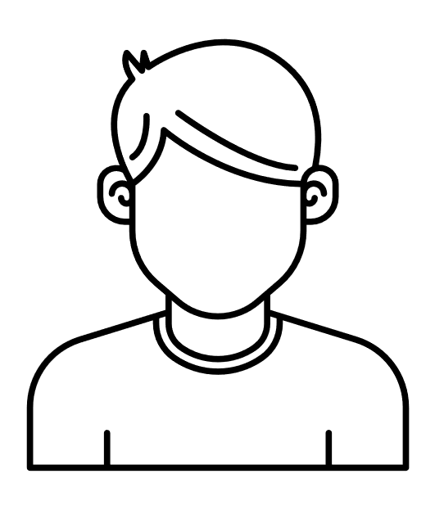
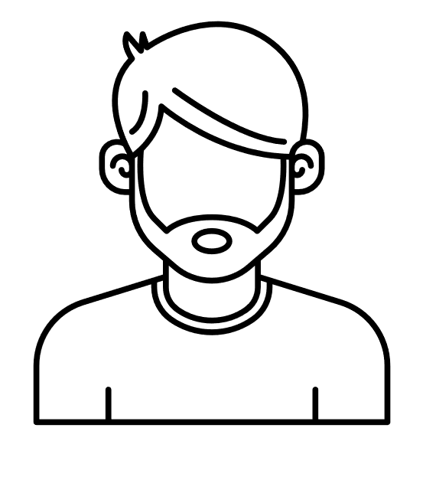
Next steps
Addressing the issue of multiple matching Florida SHOTS profiles
?
Merlin Profile
Florida SHOTS Profiles
Notes:
https://thenounproject.com/search/?q=man%20with%20beard&i=1470350 by Edwin PM
https://thenounproject.com/term/hairstyle-man/1470318/ by Edwin PM

Slide 41
Lessons learned
Continuing a project can be just as challenging as starting a new one.
Flexibility is important when outside forces cause delays.
Notes:
Doesn’t mean it’s easy if one step of the process is already done

Slide 42
Thank you!
Florida Division of Disease Control and Health Protection Team
Amy, Katie, Mwedu, Heather, and Kim

Slide 43
Q&A for Team Florida

Slide 44
Virginia Department of Health:
Ignite Presentation for AITT
July 9, 2019
Rebecca Early
Kyle Girone
Sara Gowda
Ben Klekamp
Jessica Mawdsley
Notes:
Virginia Department of Health’s Ignite Presentation
We’ll be discussing our Rabies Data Management Project

Slide 45
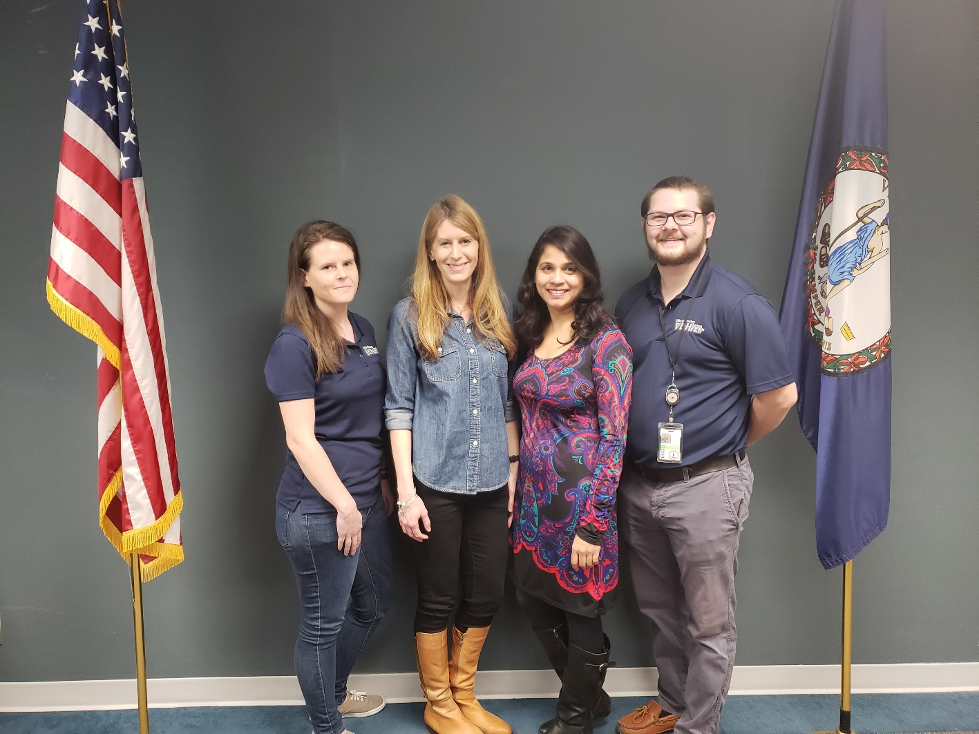
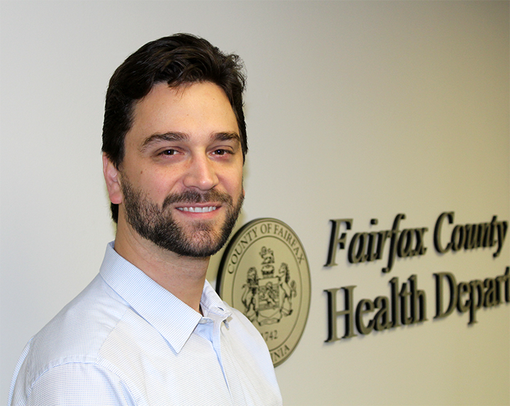
The Virginia – Fairfax Team
L to R: Ben, the Fairfax Seal
L to R: Jessica, Rebecca, Sara, Kyle
Notes:
Members of the team are split between Central Office and Fairfax
Members from Central Office include and are shown in the photo on the left, and going left to right-
Jessica Mawdsley – VEDSS Coordinator
Rebecca Early – VEDSS Manager
These two are involved in daily operations of the surveillance system, and overseeing ELR onboarding
Sara Gowda – Messaging Manager
She’s certified in HL7, and is key to transforming the file from Fairfax to desired specifications
Kyle Girone – Data and Surveillance Specialist, Vector-borne/Rabies
He’s the subject matter expert and stakeholder, and helped develop requirements for rabies data management
And for Fairfax County Health Department –
Ben Klekamp - Communicable Disease Epidemiology Manager
He oversees the technical work done by Fairfax to generate the file needed by VDH

Slide 46
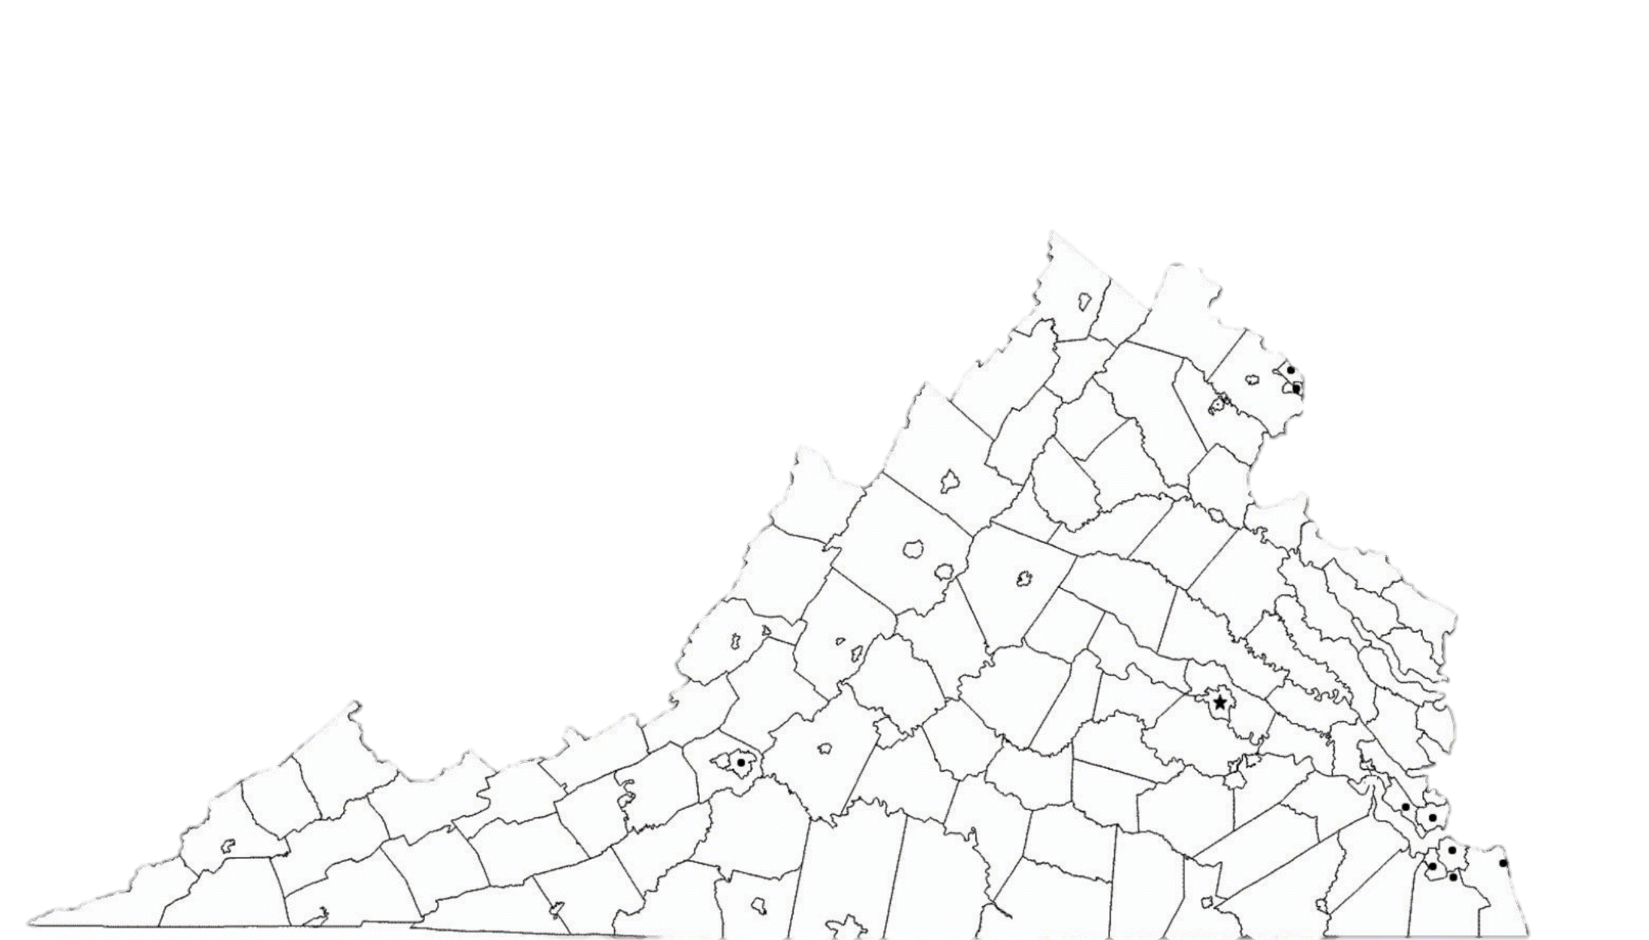

Rabies in VA Background
Rabies endemic
2 public health labs: Richmond & Fairfax
Real-time rabies results desired
Notes:
Animal rabies is endemic throughout Virginia
From 2009-2018, the average number of animals per year tested positive was 487.
We have 2 public health labs: Richmond & Fairfax
Richmond being the state lab, Fairfax being a jurisdictional lab
Richmond is already sending animal rabies results daily to stakeholders
Fairfax is paper-based currently, so inefficient as a process, resulting in manual entry
Stakeholders want more real-time rabies results – including VDH, CDC (APHL)

Slide 47
Rabies in VA Background (Cont.)
~12% of the 3,348 animals tested in 2018
Fairfax Lab
  Greatest percentage of tested animals
  Not part of established ELR process
Notes:
Fairfax Lab is unique – located in most populous area of state
Performs tests for surrounding jurisdictions
And has greatest percentage of tested animals
Yet, it’s not part of established ELR process
Results are entered into Microsoft Dynamics, rather than the laboratory’s lab information system (LIS)
Currently, Kyle is entering these results manually

Slide 48


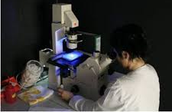
Project Goals
Tackle issue of disparate data systems
Make the data flow downstream!
Fairfax Co Health Lab
VDH
APHL (CDC)
48
Notes:
So the basic goal of the project was to transition Fairfax animal rabies results from paper-based reporting to electronic reporting
We were tackling disparate data systems
These include the Fairfax with MicroSoft Dynamics system (where results are entered), a new environmental health database for tracking bites and follow-up (EHD), and CDC receiving data through APHL
We needed to ensure the data was flowing downstream!

Slide 49
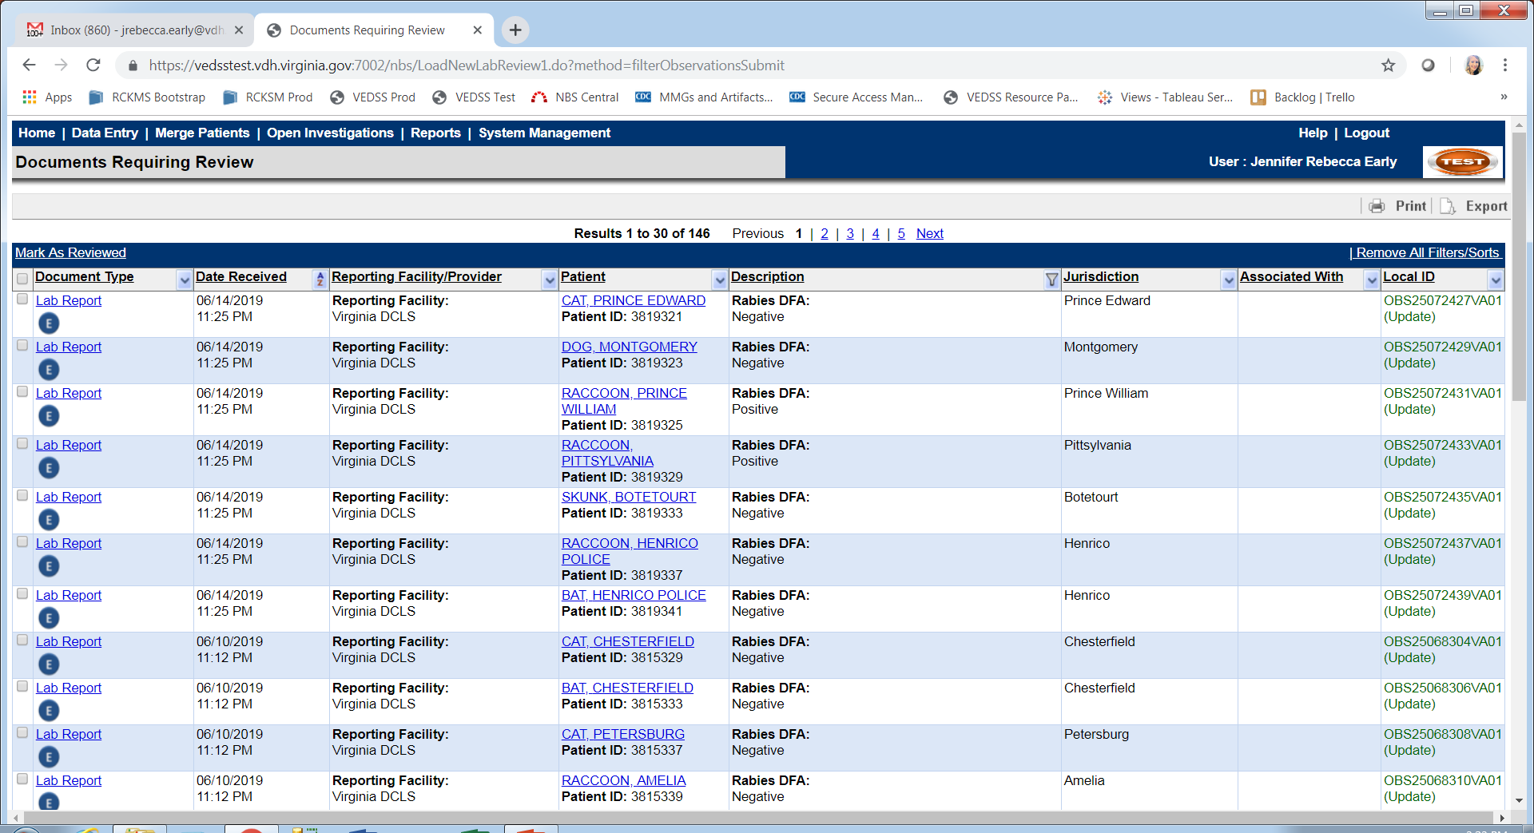

Project Goals
Use VEDSS?
Notes:
Another project goal was exploring management of animal rabies testing data through our statewide surveillance system, the Virginia Electronic Disease Surveillance System (VEDSS), which is why Rebecca and Jessica were involved
VEDSS automatically consumes ELRs, and seemed like a possible home for rabies animal data
Currently, DCLS rabies data is consumed in the VEDSS Test environment, as we were interested in evaluating it use
We want to be able to manage the data more easily, as central office also had to tackle an Annual Reconciliation for our 35 health districts
VEDSS seemed like the place to do this, and is used by other states for rabies data management, so we wanted to evaluate it.

Slide 50
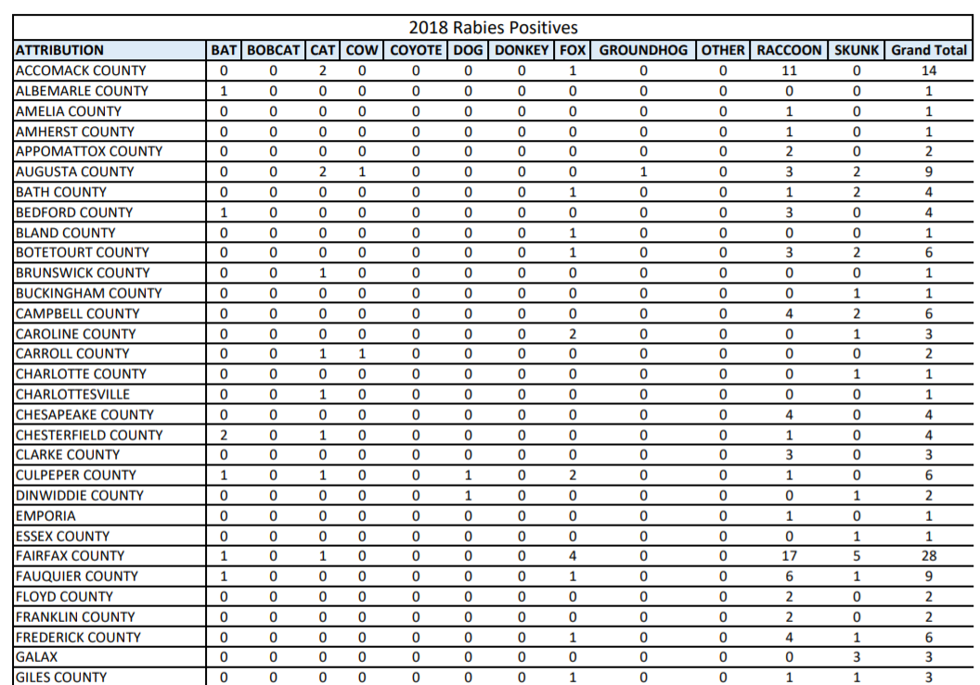
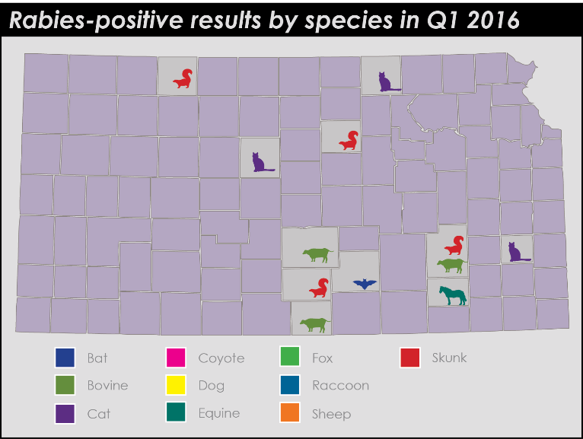
Project Goals
Example from Kansas State Vet Lab
Notes:
We wanted to also create a roadmap for what we ultimately wanted to do with the data
We had a concept that we basically wanted to go from a table (what’s on the external VDH webpage) to dynamic visualizations (for example, positive results by county, with species)

Slide 51
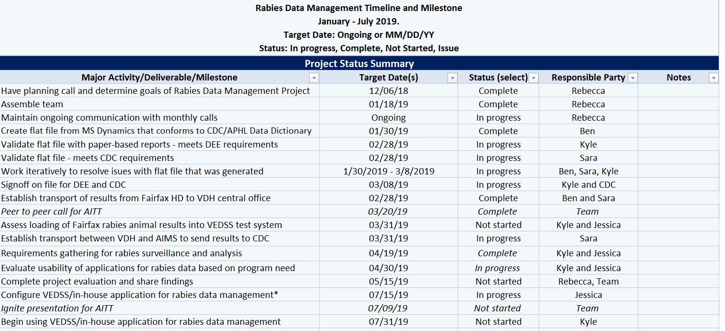
Timeline
Notes:
This was our initial timeline for accomplishing these goals, and it definitely shifted over time, due to competing priorities, and as we discovered new aspects of the project

Slide 52

Where are we now
Accomplishments:
Local export of data from Fairfax
[MEETS REQUIREMENTS]
Notes:
So where are we now?
Our accomplishments include a local data export that satisfies CDC and VDH central office
The file is still being modified currently
Our Messaging Manager, Sara Gowda, was actually in an accident in mid-June, so the last, small pieces for this export are on hold, but we are very close.

Slide 53
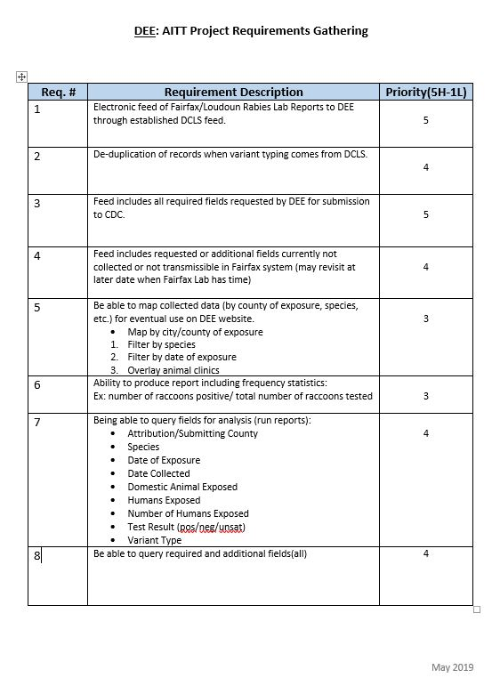
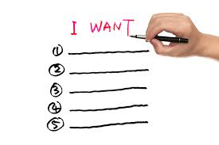
Where are we now
Requirements Gathered
Notes:
Another accomplishment was the list of requirements for data management, in order to determine whether we were going to use VEDSS or another system, and what we wanted to do with the data
We wanted to Dream Big
What did ultimate data management look like?
Kyle and Jessica developed Requirements Gathering document to distinguish wants and needs and stakeholder levels for these needs, and also consulted with the State Vet Epi
We touched on this during our peer to peer call – do we share data with the public? What do our district epidemiologists want?
The result of these consultations is a list of requirements.

Slide 54
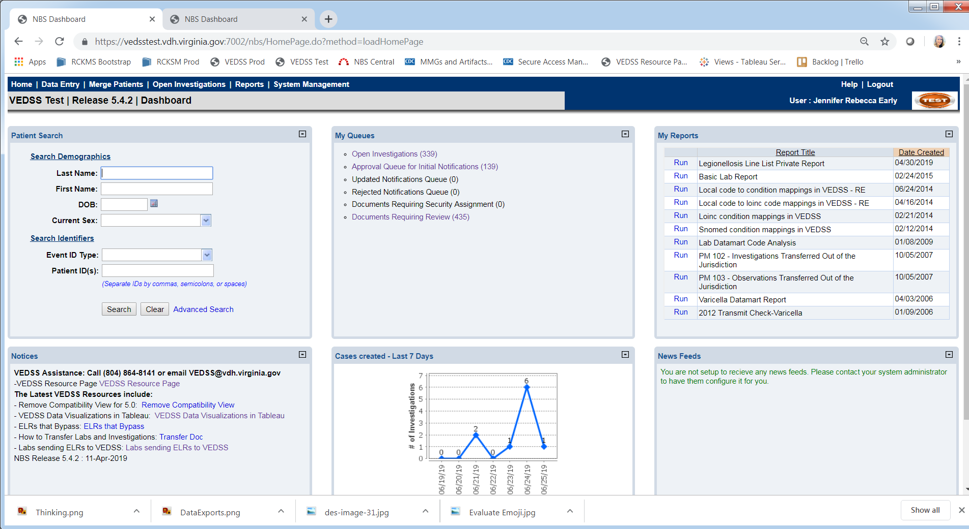

Where are we now
Notes:
We have come to a decision not to use VEDSS for rabies data management, but to pursue using the Environmental Health Database, a new system that is coming on board
This is because using the new environmental health database will prevent redundancy in terms of not importing ELRs into 2 systems, only one.
Were we to use VEDSS, we would potentially have the reconcile the data in 2 places
There are still several unknowns with the new system, but we are pursuing a super user access in order to view and edit data across jurisdictions
Knowing more about the environmental health database points to need for more of an informatics governance for VDH, and knowing more about other systems across the agency.

Slide 55
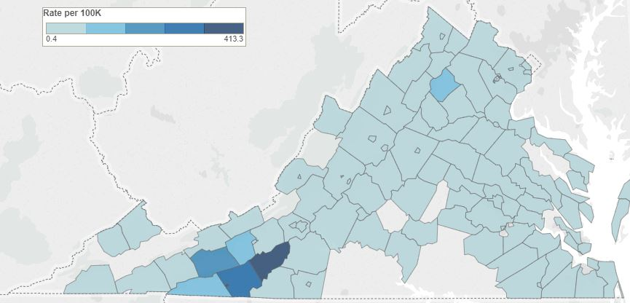

Where we are now
Know to develop internal and external dashboards
OOOOOOOOO
*EXAMPLE*
ahhhhhhh
Notes:
We do want to develop internal and external dashboards, which will facilitate knowledge sharing
And potentially help convince the public to have their animals vaccinated
Ultimately saving the lives of humans and animals

Slide 56



Methods and Approach
Regular Communication
Notes:
What were our methods and keys to success?
Communication is always a significant key to success
We discussed project and action items needed for each person during group calls following AITT trainings, during check-in calls, additional calls as needed, and email.
The project manager, Rebecca, pinged us regarding assignments due and what needed to be done, and provided summaries
Team members always reached out if they needed anything

Slide 57
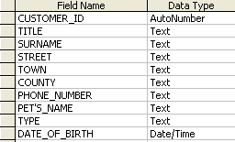
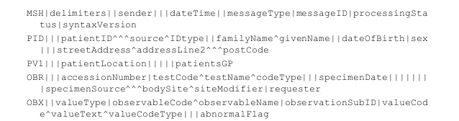
Methods . . .continued
Notes:
Fairfax generated sample file
Conformance with CDC specs, DEE expectations
Fairfax and VDH technical staff:
Ensured conformance with CDC specs
Working to meet DEE expectations on fields
Transformed flat file to HL7

Slide 58

Methods. . .continued
Received input from data collectors and users
Notes:
Developed requirements for data management
Consulted informatics, epidemiologist(s)
Assessed VEDSS and EHD for data needs

Slide 59

Moving the Project Forward
Transition Fairfax rabies results to weekly ELR reporting in July
Notes:
Finalize the changes to the rabies file once Sara returns
Transition Fairfax rabies results to weekly ELR reporting in July, but may be August just based on Sara’s availability

Slide 60


Forward.. continued
Training on new database
Notes:
Training is needed for new environmental health database to assess its use
Sara/Kyle - we know the excel file generated will import successfully into EHD?
Request and assess enhancements such as the superuser role

Slide 61

Forward.. continued
Use for annual reconciliation – 2020?
Notes:
Use for annual reconciliation
Current process is time consuming and involves contacting each of the 35 districts individually, requesting them to validate and return updated spreadsheets.
Data flow to facilitate Tableau visualizations

Slide 62

Forward.. continued
Notes:
Data flow to facilitate Tableau visualizations

Slide 63

Questions?
Notes:
Questions?

Slide 64
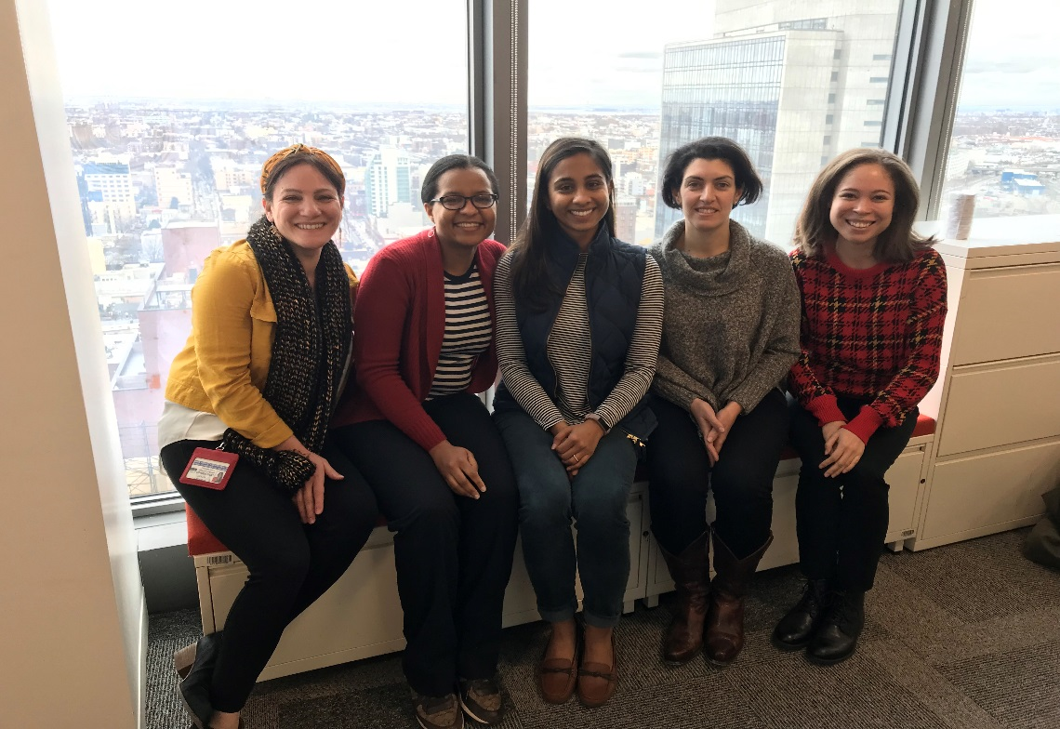
CSTE Ignite Presentation
New York City Team
July 9, 2019
From left to right: Jessica Klajman, Jacinthe Thomas, Kalani Thaler, Angela Merges, and Kayla Hutchings

Slide 65


Design and Implement a
New Health Services Information System

Slide 66
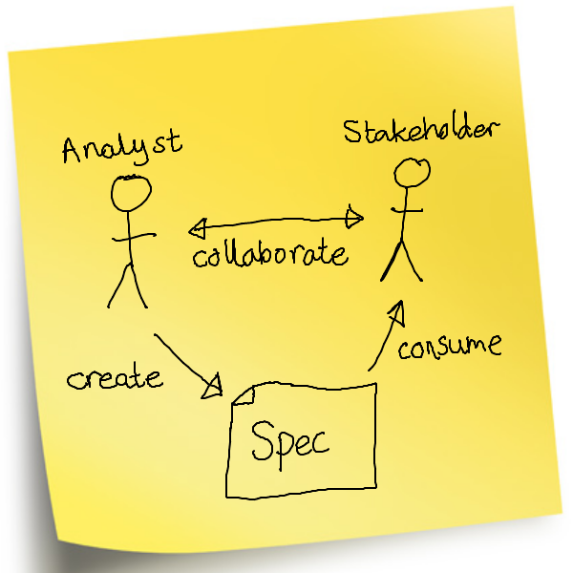

System Design

Slide 67
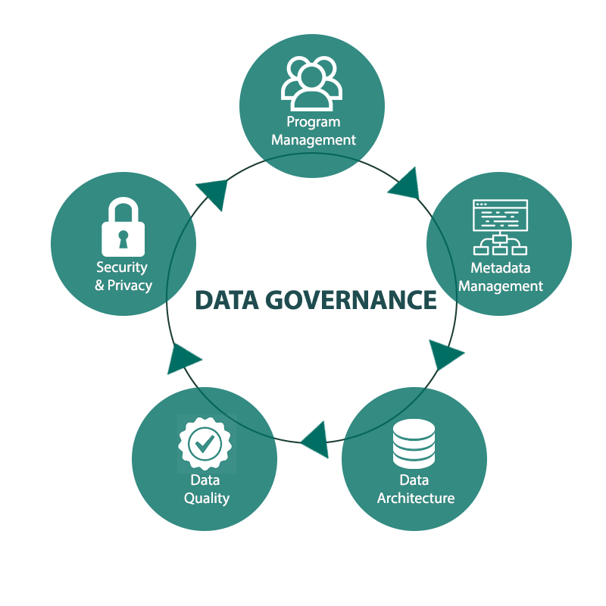
Data Governance

Slide 68

Stable Taxonomy

Slide 69


Word Salad

Slide 70
Standardized Taxonomy and Definitions
Data Anarchy
Data Governance
Def. A
Program A:
Mental Health
Program A:
Mental Health
Health
Education
Def. B
Health Education
(single definition)
Program B:
Harm Reduction
Program B:
Harm Reduction
Health
Education
Def. C
Program C:
Patient Navigation
Program C:
Patient Navigation
Health
Education

Slide 71

Sweet Rewards!

Slide 72

Less Data Cleaning

Slide 73

Greater Data Integrity

Slide 74

Functional Specifications

Slide 75

Fragmented Widget-Driven Model

Slide 76

Holistic Client-Centered Model

Slide 77

Data Security
Notes:
Permissions based on agency, role, and rights to see only programs they work on.
Also, which data elements are visible, specifically PHI, is also configurable.

Slide 78

Contract Administration

Slide 79

Keeping it Moving

Slide 80

Next Steps for Data Governance
Notes:
Data governance: need to come up with rules. Who is going to be involved. How will final decisions be made going forward –so that it’s not the squeakiest wheel that gets the grease, but the one that sticks to the guiding principles.

Slide 81
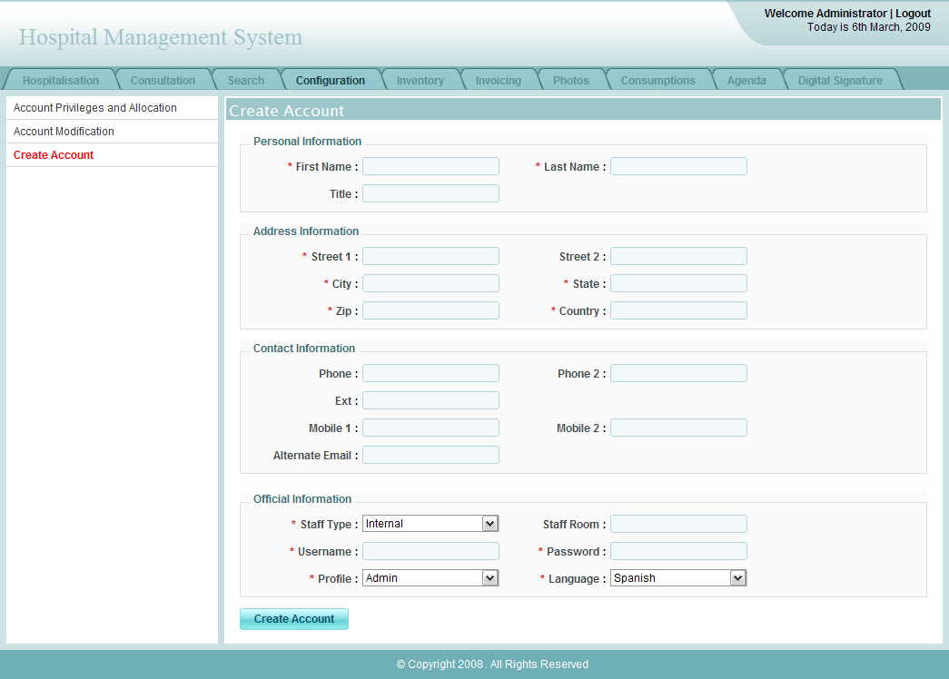
Next Steps for Functional Specs

Slide 82

Stakeholder Bi-Monthly Meetings and Retreat
Notes:
Goals/agenda of rA retreat in the fall to present from both work groups. (get more details on the agenda)
Continue meeting weekly.
Functional specs:
Navigation
How the user will move from one interface to another.
Emphasis on ease of use.
Configured Instruments
Sets of data elements that can be set up by administrator without programming.
Allow the system to flexibly meet the needs of tomorrow as well as today.

Slide 83


Slide 84
Maryland Department of Health Opioid-related Informatics Team
Jessica Acharya, Casey Lyons, Carly Babcock, Matt Foley, Aya Watanabe
July 9, 2019

Slide 85


Informatics Project Goal
Governance
DATA
DATA
DATA
DATA
DATA
DATA
Notes:
Develop a data governance framework and centralized warehouse for the MD opioid response
- access to timely data sharing and guide future policy and programs

Slide 86
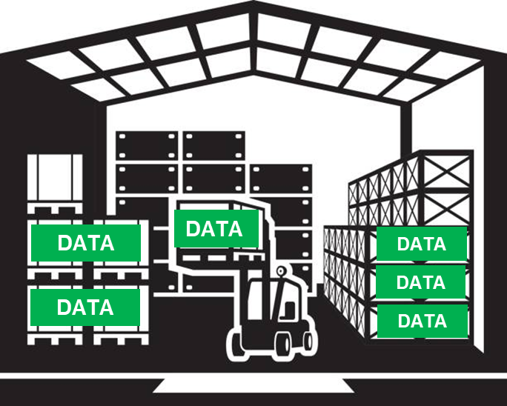


Project Status - Accomplishments
Governance
Warehouse
Recommendations
Disseminate
FINAL REPORT
DATA PARTNERS
Notes:
Created a detailed plan – data governance, centralized warehouse, recommendations for leadership, dissemination

Slide 87


Project Status - Accomplishments
DATA
PARTNERS
Funding
Notes:
Secured funding to start the project through federal grants
This was initiated before the AITT program started

Slide 88
Project Status - Accomplishments
DATA
PARTNERS
Notes:
We are currently between objectives 1 and 2

Slide 89
Project Status – How We Got Here
?
Objective 1
Objective 2
Objective 3
Objective 4
FINAL REPORT
DATA
Notes:
IN LOOKING AT HOW WE GOT HERE
The 1st step was identifying datasets that could be used to inform final report:
Rx history
Opioid overdoses (fatal/nonfatal)
Patients in SUD/OUD treatment (includes court-ordered treatment)
Demographics
Insurance

Slide 90
Project Status – How We Got Here
?
Objective 1
Objective 2
Objective 3
Objective 4
FINAL REPORT
PARTNERS
IK
Notes:
ONCE WE IDENTIFIED DATA OF INTEREST – WE HAD TO FIGURE OUT WHO HAS IT
A number of internal and external state partners have the information we are interested in for this project
Institutional knowledge of team members was important for identifying a comprehensive list

Slide 91
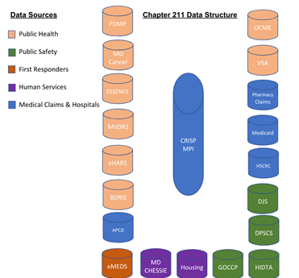
Project Status - How We Got Here
Notes:
SOME OF OUR Internal partners include – PDMP, Medical Examiner, Vital Statistics, Syndromic Surveillance, Medicaid

Slide 92
Project Status - How We Got Here
Notes:
External partners – EMS- emergency medical services, Housing, Juvenile Services, Corrections

Slide 93
Project Status – Next Steps
Objective 1
Objective 2
Objective 3
Objective 4
FINAL REPORT
Develop Policies
DATA PARTNERS
IC
Notes:
AFTER INDENTIFYING DATA AND STATE PARTNERS WE STARTED TO CREATE DATA GOVERNANCE FRAMEWORK
Big step with a lot of parts to it – requires development of policies/procedures
This is where we will see more informatics capacity being built

Slide 94
Project Status - Next Steps
Objective 1
Objective 2
Objective 3
Objective 4
FINAL REPORT
DATA PARTNERS
Coordinate data across partners
Notes:
Requires:
Stakeholder buy-in (internal/external)
Signed DUAs in place
The existence of data silos and lack of well-established programs and policies for sharing data across state programs makes coordination among data units difficult
So there is no standardized process in place- this makes creating a timeline challenging

Slide 95
Project Status - Next Steps
Objective 1
Objective 2
Objective 3
Objective 4
FINAL REPORT
DATA PARTNERS
Coordinate data across partners
Standardized approach for data needs/quality
Notes:
As mentioned before, there is no standard for sharing data
Something that is agreed upon by all the different data stewards/leadership

Slide 96
Project Status - Next Steps
Objective 1
Objective 2
Objective 3
Objective 4
FINAL REPORT
DATA PARTNERS
Coordinate data across partners
Standardized approach for data needs/quality
Security and accessibility
Notes:
Upholding these will help to maintain the integrity of data elements

Slide 97
Project Status - Next Steps
Objective 1
Objective 2
Objective 3
Objective 4
FINAL REPORT
HIE
DATA PARTNERS
Notes:
NEXT STEP IS BUILDING A DATA WAREHOUSE (Parts of these happen concurrently – that is why we are in between)
Some of the visualization of this began before the AITT program and was fleshed out as the plan was developed
We worked with our state health information exchange (ALREADY ESTABLISHED) to see how it could become the centralized data warehouse

Slide 98
Project Status - Next Steps
Objective 1
Objective 2
Objective 3
Objective 4
FINAL REPORT
HIE
DATA PARTNERS
Data format
Notes:
ANOTHER COMPONENT OF BUILDING A DATA WAREHOUSE IS - Understanding what format the data is in
We will share data questionnaire with stewards (asks about the specific data elements as well as the structure of the dataset and any potential caveats)
This will also help to inform analysis

Slide 99
Project Status - Next Steps
Objective 1
Objective 2
Objective 3
Objective 4
FINAL REPORT
HIE
DATA PARTNERS
Data format
Analysis plan
Notes:
Time taken to analyze depends on a number of factors (how much data, how clean, who is doing it)
Want to prevent duplication of efforts
Analysis results will help to paint the picture of opioid overdoses in MD
Is analysis something that can be done in-house?
How long will it take?
Is someone already collecting this data?

Slide 100
Project Status - Next Steps
Objective 1
Objective 2
Objective 3
Objective 4
FINAL REPORT
HIE
DATA PARTNERS
Data format
Analysis plan
Linkage of datasets
Notes:
Because of the number of datasets this will be challenging…the HIE has a master pt index that will help to streamline this process

Slide 101
Project Status - Next Steps
Objective 1
Objective 2
Objective 3
Objective 4
FINAL REPORT
HIE
DATA PARTNERS
Data format
Analysis plan
Linkage of datasets
Long-term storage
Notes:
This will require keeping current with changes in health IT and electronic data storage standards
I suspect there may be some current state policy on this that can be revised

Slide 102
Project Status – Next Steps
DATA
PARTNERS
Funding
Notes:
TO CONTINUE THE PROJECT BEYOND THE FIRST STEPS OF BUILDING DG and DW - Dedicated funding is needed to ensure that data collected meets the needs of end users and results in creation of the final report

Slide 103
THANK YOU!
Jessica Acharya
Casey Lyons
Carly Babcock
Matt Foley
Aya Watanabe
Questions? Send us an email: carly.babcock@maryland.gov

Slide 104
Q&A for Team Maryland

Slide 105
New Mexico Team for the CSTE’s AITT
Lois Haggard
Joseph Bareta
Brooke Doman
Sarah Shrum Davis
Gwendolyn Gallagher
Ignite Presentation
July 9, 2019

Slide 106
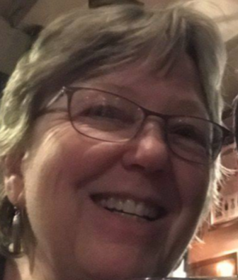


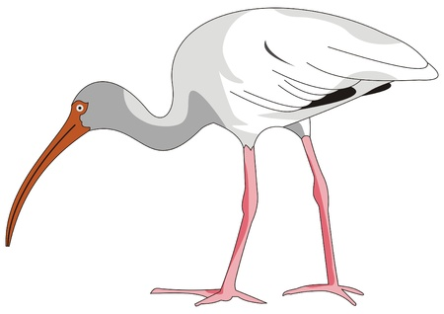

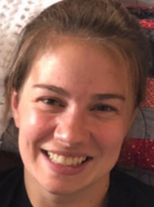

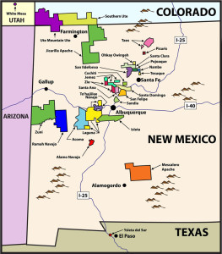
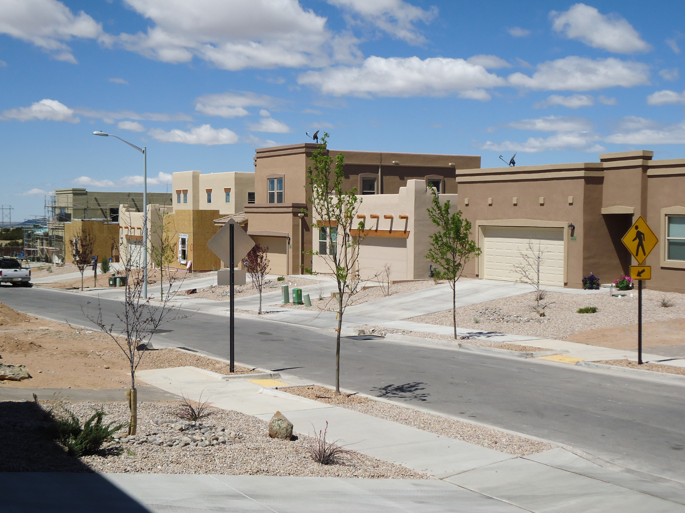

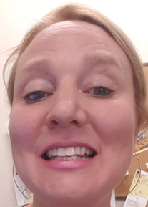
Diverse AITT Team
Infectious Disease Epidemiologists
Indicator-based Information System (NM-IBIS) Manager
Tribal Epidemiologist
Community
Epidemiologist
Notes:
Our team includes Joseph Bareta and Sarah Shrum Davis from Infectious Disease, Gwendolyn Gallagher who works with communities, Brooke Doman who works with our tribal partners, and Lois Haggard who manages our NM-IBIS web query system.

Slide 107
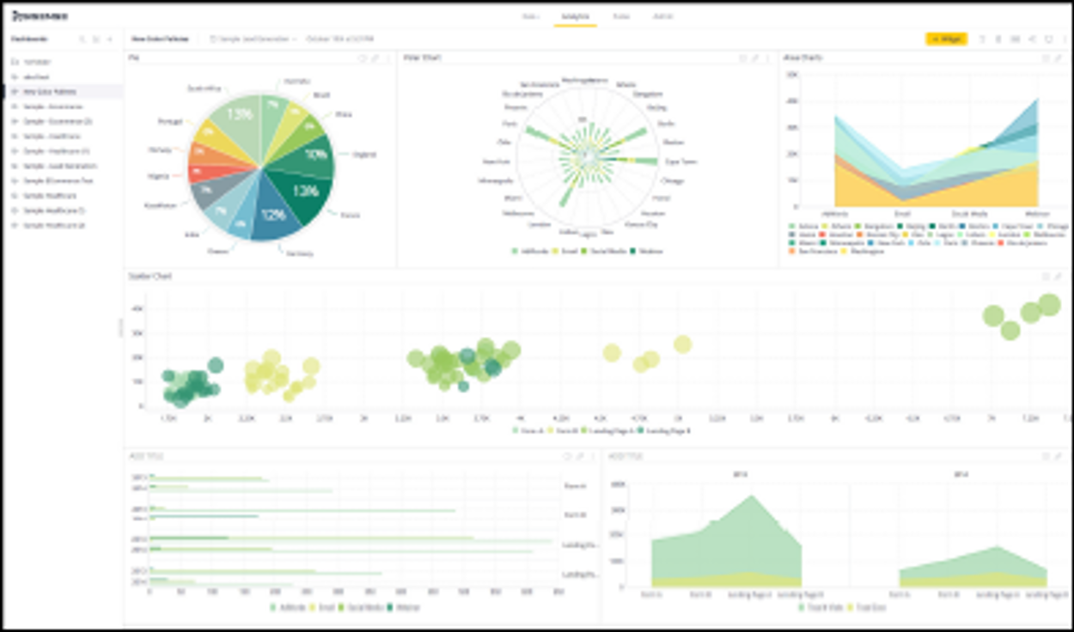
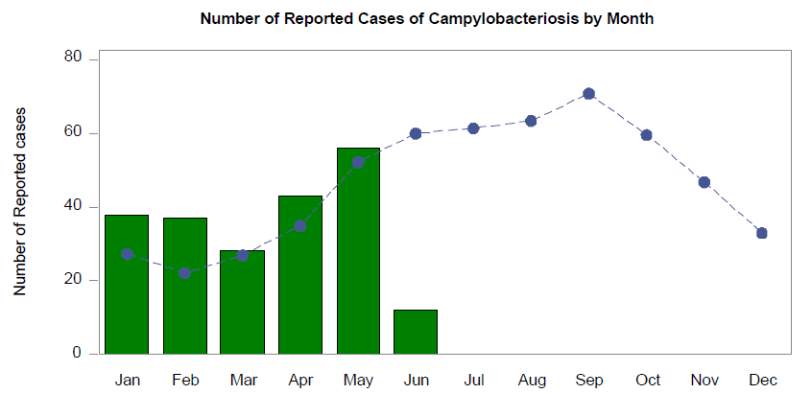
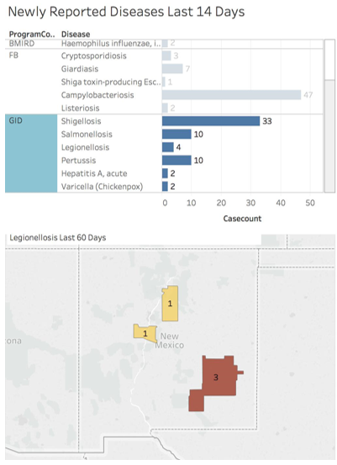
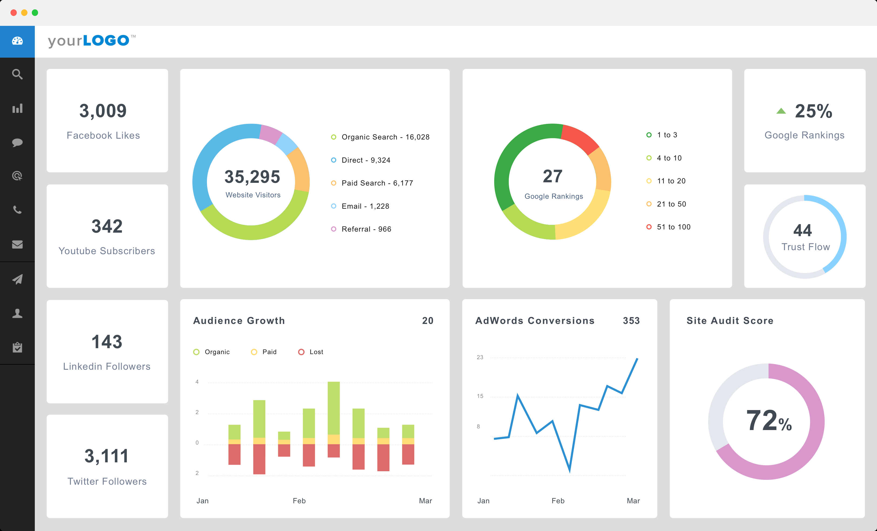

Goal: Data Dashboard for Infectious Disease
?
Notes:
One of our goals is to produce a web-based interactive dashboard for timely dissemination of notifiable conditions data. It should provide useful, meaningful and actionable information to infectious disease practitioners.

Slide 108



Training Courses
Notes:
We selected training courses to help us understand the steps that would result in a terrific dashboard for our stakeholders. Those trainings included Stakeholder Engagement, Business Analysis, Collaborative Requirements Development, and I.T. Lifecycle Fundamentals.

Slide 109













Stakeholder Engagement
Notes:
Stakeholder Engagement will help us understand which stakeholders to involve, what information they need, and how they would like to receive it. We think a data dashboard is the answer, but we may find out something different after interviewing them.

Slide 110

Business Process Analysis
Notes:
Business analysis will help us understand the progression of data to information from the data’s source through the various workflows involved in the practice of infectious disease prevention and control.

Slide 111

Collaborative Requirements Development
Notes:
Collaborative Requirements Development will show us how best to work with our stakeholders to design a tool that is both feasible given our data and resources, and one that will provide the information that is needed at the right time and in the right formats to be useful.

Slide 112






Lifecycle Fundamentals
Notes:
Finally, Lifecycle Fundamentals will give us a structure to organize our work with our stakeholders and software developer so that we can produce the best possible results.

Slide 113





Notes:
One of the more challenging aspects of the analysis step will be deciding whether to use one of our existing tools that will be more sustainable versus going with a new tool that might offer better response to user requirements. We think assessing those trade-offs could be tricky.

Slide 114

Goal: Advance DOH Informatics Vision and Roadmap for the Future
People
Data
Systems
Notes:
Receipt of the AITT award shed light on the need for informatics development at the department. So an additional goal of our project was to lay the groundwork for development of an informatics vision and roadmap for the future.

Slide 115


Informatics Self-assessment for NMDOH
Notes:
We decided that conducting the PHII informatics capacity self-assessment would foster awareness and better understanding of the role of informatics in the department, potentially getting the informatics ball rolling.

Slide 116

Notes:
At a day-long retreat, our team guided 23 DOH staff through the assessment tool and discussed data governance, planning, staff training, and whether our systems are well-designed and effective.

Slide 117

Vision, Strategy and Governance
ASD – Administrative Services Division
ERD – Epi & Response Division
ITSD – Information Technology Services Division
PHD – Public Health Division
SLD – Scientific Laboratory Division
Notes:
The group included representatives from 5 major divisions in our department. They reported that they had made individual, ad hoc attempts at developing informatics strategies, data governance, and system documentation.

Slide 118

Skilled Workforce
Notes:
Having a skilled workforce and HR positions to support informatics was identified as a weakness throughout the department. This issue will receive emphasis in our final recommendations.

Slide 119

Effectively Used and Well-Designed Systems
Notes:
With the exception of some administrative functions like HR and contracts, the group thought we had some good, well-designed systems, but that we lacked funding and good strategies for improvement.

Slide 120

Notes:
We received valuable input on the formation of an informatics steering group. During the retreat, group members expressed a desire to have DOH program staff on the steering committee.

Slide 121



Notes:
Our team is working collaboratively to produce a report of the retreat that includes the survey responses and our notes from the group discussion. We plan to involve our I.T. staff and the retreat group members in review of the report before it is presented to senior leadership.

Slide 122

Notes:
We will also work collaboratively with group members on the report conclusions and recommendations which will capture the key points that will drive the department toward a strategic informatics plan.

Slide 123

Engage
Apply
Sustain
Advocate
Notes:
Going forward, we’d like to continue to Engage I.T. staff, stakeholders, and senior leadership, Apply what we have learned to advance DOH informatics projects, Sustain dashboard & informatics capabilities, and Advocate for public health informatics as department priority.

Slide 124


Notes:
Thus far, the topic of informatics has been met with enthusiasm by both DOH leadership and staff. We are encouraged and plan to move the topic forward while we seem to have some good momentum.

Slide 125
Q&A for Team New Mexico

Slide 126
Maryland HIV Surveillance
MARYLAND DEPARTMENT OF HEALTH
Maryland HIV Surveillance Team
Prevention and Health Promotion Administration
Center for HIV Surveillance, Epidemiology and Evaluation
July 9, 2019

Slide 127
MISSION AND VISION
Prevention and Health Promotion Administration
MISSION
The mission of the Prevention and Health Promotion Administration is to protect, promote and improve
the health and well-being of all Marylanders and their families through provision of public health
leadership and through community-based public health efforts in partnership with local health
departments, providers, community based organizations, and public and private sector agencies, giving
special attention to at-risk and vulnerable populations.
VISION
The Prevention and Health Promotion Administration envisions a future in which all Marylanders and
their families enjoy optimal health and well-being.

Slide 128

Maryland HIV Surveillance Team

Slide 129
Electronic Laboratory Reporting (ELR) Process
Healthcare Facilities
(Hospitals, Outpatient Clinics, etc.)
Healthcare Facilities (Hospitals, Outpatient Clinics, etc.)
Other MDH Programs (CSTIP, MADAP, OCME, Vital Stats, etc.)
Center for HIV Surveillance, Epidemiology and Evaluation (CHSEE)
Private Providers
Local Health Departments (LHDs)
National HIV Surveillance System (NHSS)/CDC
HIV Testing Laboratories
HIV Testing Laboratories (In-state and Out-of-State)
Other State HIV Surveillance Programs

Slide 130

Quality Assurance (QA) Process

Slide 131
QA Process

Slide 132
Monthly HIV ELR Volume
114% increase in ELR volume

Slide 133
AITT Project
HIV
Laboratories
Laboratory Assessment
Internal Data
eHARS
Laboratory Report Card

Slide 134
Goals
Assess Completeness
Evaluate Reporting
Enhance Collaboration
Create Feedback Loop

Slide 135


Tools

Slide 136
Timeline
Contact information
Stakeholders

Slide 137
Timeline
Contact information
Stakeholders
Report Card Indicators

Slide 138
Timeline
Contact information
Stakeholders
Report Card Indicators
Laboratory assessment

Slide 139
Timeline
Contact information
Stakeholders
Report Card Indicators
Laboratory assessment
Distribution

Slide 140
Timeline
Contact information
Stakeholders
Report Card Indicators
Laboratory assessment
Distribution
Internal Analyses

Slide 141


HIV Reporting Laboratory Assessment

Slide 142


HIV Reporting Laboratory Assessment

Slide 143
Moving Forward
Extract data from eHARS for report cards
Share report cards with labs
Evaluate process to improve for 2020
Assess changes over time for improvements

Slide 144

Maryland HIV Reporting Laboratory Report Card

Slide 145
Maryland Department of Health
Prevention and Health Promotion Administration

Slide 146
Q&A for Team Maryland

