Slide 1
CSTE Applied Informatics Team Training Ignite Presentation Part II
July 17, 2019 2:00pm-3:30 ET

Slide 2

Ignite Presentation
July 17th, 2019
Minnesota Department of Health
Kathy Como-Sabetti, Ann Kayser, Sarah Solarz, Sarah Boneske, Hanna Chakoian
Notes:
Hello, my name is Sarah Boneske, and I will be presenting for the informatics team for the infectious disease unit at the Minnesota Department of Health. Other members on my team include, from left to right, Kathy Como-Sabetti, Ann Kayser, Sarah Solarz, myself, and Hanna Chakoian

Slide 3
EIP handed us the project
Art courtesy of: http://images.clipartpanda.com/key-clipart-9c4eLkyyi.svg
Notes:
The Emerging Infections Program at MDH handed our informatics team “the keys” to a project they were working on to fulfill their grant audit; they wanted us to determine a more efficient way to audit laboratories for missing reportable results

Slide 4
Initial assessment
Clip art elements courtesy of: https://vignette.wikia.nocookie.net/clubpenguin/images/7/7f/Sleepingbag.PNG/revision/latest/scale-to-width-down/2000?cb=20150317211140, http://images.clipartpanda.com/tent-and-campfire-clipart-campfire_02.gif, https://clipartix.com/wp-content/uploads/2016/05/Image-of-clip-art-tents-8-tent-clipart-3-clipartoons.png
Notes:
So then we decided to plan and create a packing list for the trip we were about to embark on – our team assessed the current issues that EIP was experiencing with the lab audit process and gathered opinions on what EIP would want at the end of this project.

Slide 5
Understanding the current situation
Clip art elements courtesy of: https://vignette.wikia.nocookie.net/clubpenguin/images/7/7f/Sleepingbag.PNG/revision/latest/scale-to-width-down/2000?cb=20150317211140, http://images.clipartpanda.com/tent-and-campfire-clipart-campfire_02.gif, https://clipartix.com/wp-content/uploads/2016/05/Image-of-clip-art-tents-8-tent-clipart-3-clipartoons.png
Notes:
After an initial team meeting, we were able to cross some things off our packing list, including two meetings with the program staff, identifying partners to contact, and creating validation code for ELRs (electronic laboratory reports)

Slide 6
More partnerships
Clip art courtesy of: media.istockphoto.com/vectors/cute-raccoon-waving-vector-cartoon-illustration-vector-id611876910?k=6&m=611876910&s=612x612&w=0&h=DUampJKe-9N13lbKR1TvdITTDFy9G0r7WOwzMSkmOMo, www.bestcoloringpagesforkids.com/wp-content/uploads/2015/01/Free-Printable-Mosquito-Coloring-Pages.jpg, http://www.clker.com/cliparts/Y/y/O/m/O/O/blue-fish-hi.png, http://www.goodlookingloser.com/images/Thumbnails/Horse-clip-art-cartoon.jpg
Notes:
Using what we’ve learned through our work in the CSTE AITT course, we want to create a division level solution, instead of a single program level solution. We wanted to ensure that all program areas would be represented through this process. The animals here represent the differences between MDH program areas.

Slide 7
Map out possible solutions
Map courtesy of: http://1.bp.blogspot.com/-DztsF0ghmtE/T3r-Y1M-VPI/AAAAAAAAAss/-hYbi2iORz8/s1600/usa-map-region.gif
Notes:
Before we set out on our trip, we needed to review where we were and where we are going. We decided to research what other states have attempted to do for streamlining their ELR quality audit process. We looked at North Carolina, Tennessee, and Utah, as they have already put together presentations on similar issues.

Slide 8
Starting from the source
Picture courtesy of: https://media-cdn.tripadvisor.com/media/photo-s/01/67/ca/27/itasca-state-park.jpg
Notes:
Similar to the path of the great Mississippi River, we started our process looking specifically at EIP’s audit process at the head waters. Just like the Mississippi River, we could not ignore other tributaries, or program areas, along the way since they all flow into one common area, the Gulf of Mexico.

Slide 9
Streamline
Map courtesy of: https://www.terrain.org/wp-content/uploads/2015/09/mississippi-river-system.jpg
Notes:
Using this idea as our foundation, our ultimate goal as we set out on the water is to streamline the lab audit process for the EIP group and other MDH infectious disease programs using ELRs, analyzing report load and quality along the way

Slide 10
Portaging
Picture courtesy of: https://www.outwardbound.org/lib/image/manager/2016_Course_Title_Page_Photos/VETS/Boundary_Waters_Canoeing_for_Veterans/2-canoes-portaging-Asa-Fields_WebEdit.jpg
Notes:
Sometimes, heavy lifting was required, and we portaged our way through some important requirements before we could move forward down the river. This included identifying the stakeholders, scheduling meetings with folks that have busy work days, and understanding how R could assist us

Slide 11
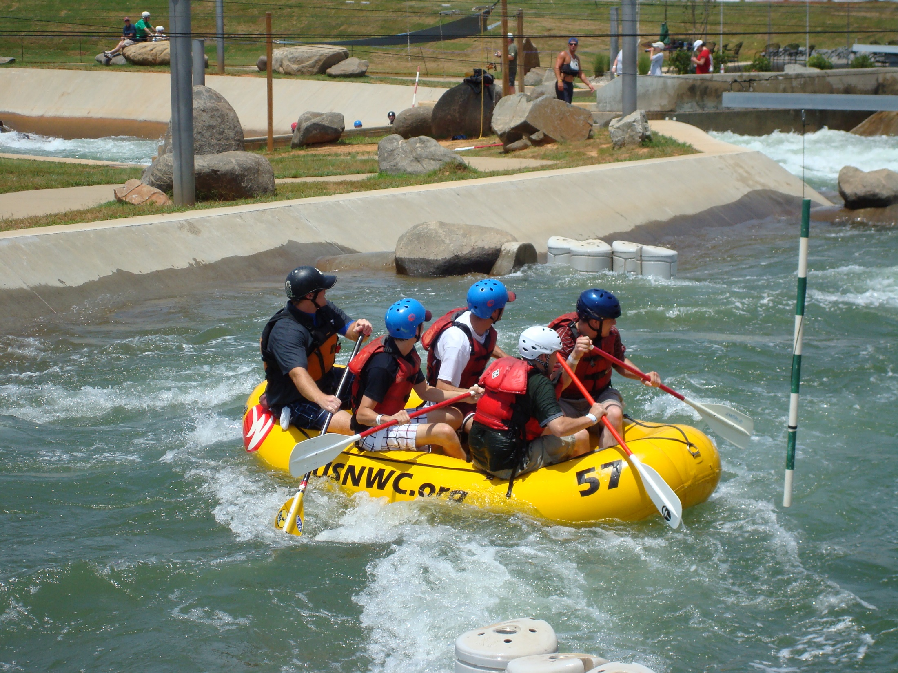
Rapids
Photo courtesy of Ann Kayser
Notes:
We had some rapids ahead of us. Collecting the business requirements was a little rough since each program area saw the audit a little differently. They came up with some solutions that would meet their requirements, and highlighted potential problems for our team

Slide 12
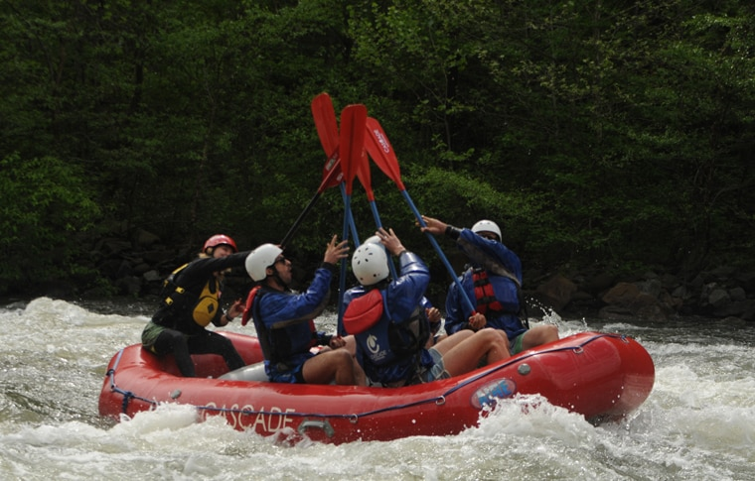
Rapids again
Photo courtesy of: https://cascadeoutdoors.com/wp-content/uploads/2017/04/PaddleHi-5@gallery-1.jpg
Notes:
We encountered further rapids along the way. Our team met to discuss the R code that would be needed to validate the ELR messages once we started receiving them from facilities. This meeting revealed some issues in our plan.

Slide 13
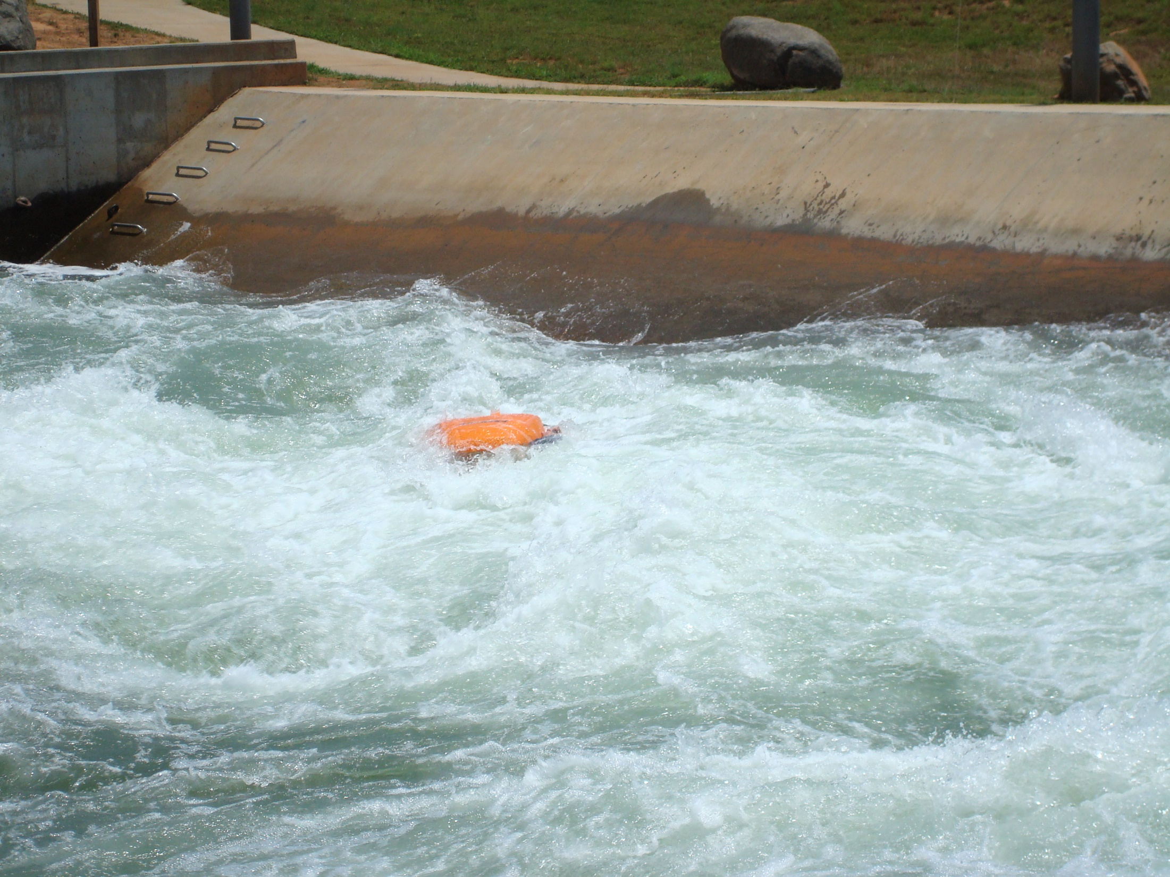
Overboard
Photo courtesy of Ann Kayser
Notes:
We realized we were going a little “overboard” with what we wanted to accomplish, and scope creep set in. During a team meeting where we were designing the end product, one of our team members raised concerns about feasibility all at once, and we were able to use this advice to break our end product into a tiered output.

Slide 14

Assessment
Picture courtesy of: https://i.pinimg.com/736x/b5/4d/b4/b54db4e015f2d176094f7e67e5827c48.jpg
Notes:
After getting our canoe turned back over, our team regrouped and met to determine where in the process we were now. We reviewed what we needed to do to move forward, and adjusted our plans for the future of the project.

Slide 15
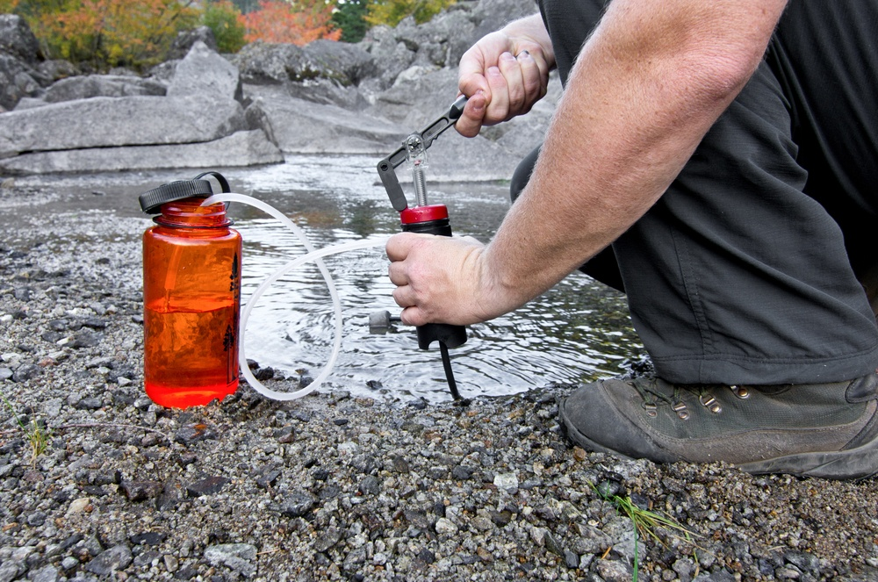
Filter our data=
Photo courtesy of: https://theoutdoorland.com/wp-content/uploads/2016/04/Best-Survival-Water-Filter.jpg
Notes:
We refilled our water bottles, and made sure to filter the water, or rather, the information we had received up to this point. We siphoned through all the information that we had gathered to determine the “good” from the “bad”, leaving us with clear water containing the good ideas for this project

Slide 16

Work so far 1
Photo courtesy of: https://media.istockphoto.com/photos/pov-of-couple-paddling-red-canoe-on-turquoise-lake-picture-id827619542?k=6&m=827619542&s=612x612&w=0&h=ozz1uPi7Qk59P9GmV0hcGuOE5DKIxoL5x1hukZEr3Gc=
Notes:
Now we have some smooth paddling down the river, making quite a bit of progress along the way. We have finished our internal meetings, gathering 5 program areas two times and effectively collaborating together.

Slide 17
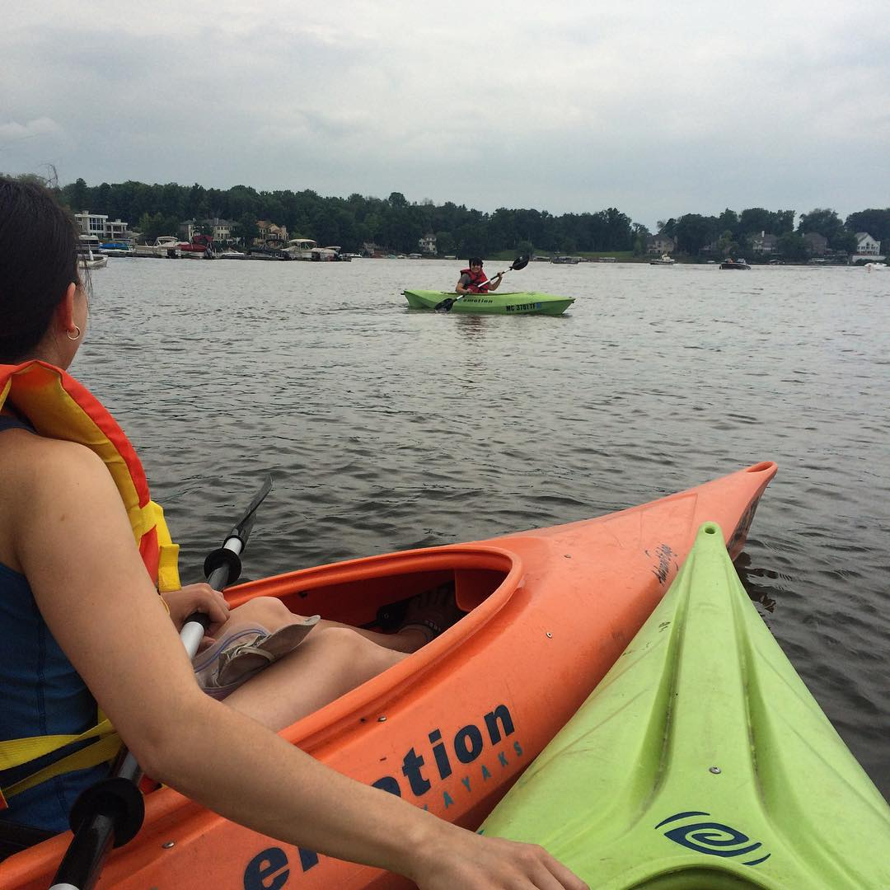
Work so far 2
Photo courtesy of Ann Kayser
Notes:
We worked on coming up with common solutions, including those besides lab audits, and now want to move on to testing the ELR validation process and determining how to present the information. Our R code is in progress, and our variable lists set is being created.

Slide 18
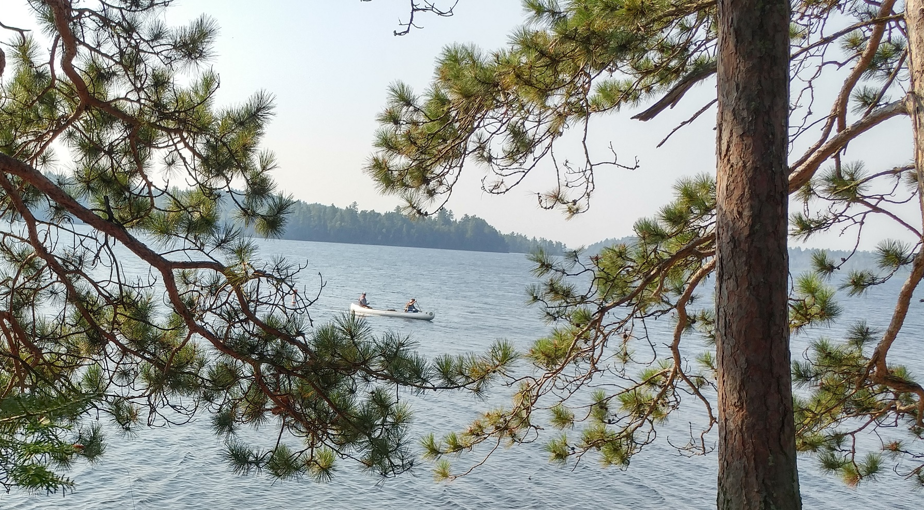
Work so far 3
Photo courtesy of Ann Kayser
Notes:
Through this process, we have built higher credibility with the EIP program area, and they are more open to change and different ways of completing lab audits

Slide 19
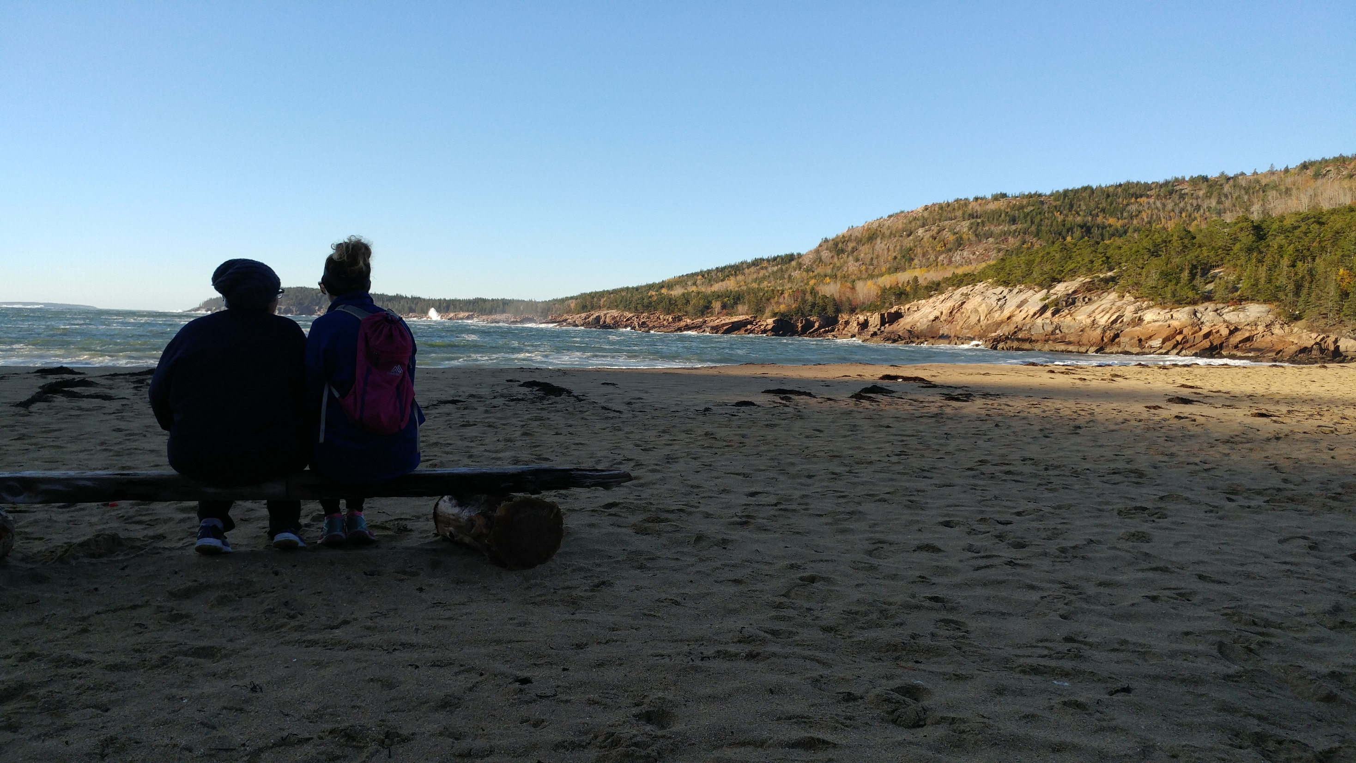
Pause for a rest
Photo courtesy of Ann Kayser
Notes:
So now we are pulling off the river to camp and rest. We’re setting up meetings with external partners to determine how they collect lab audit information for MDH. We also want to determine the preferred method for ensuring all reports are sent in the future.

Slide 20
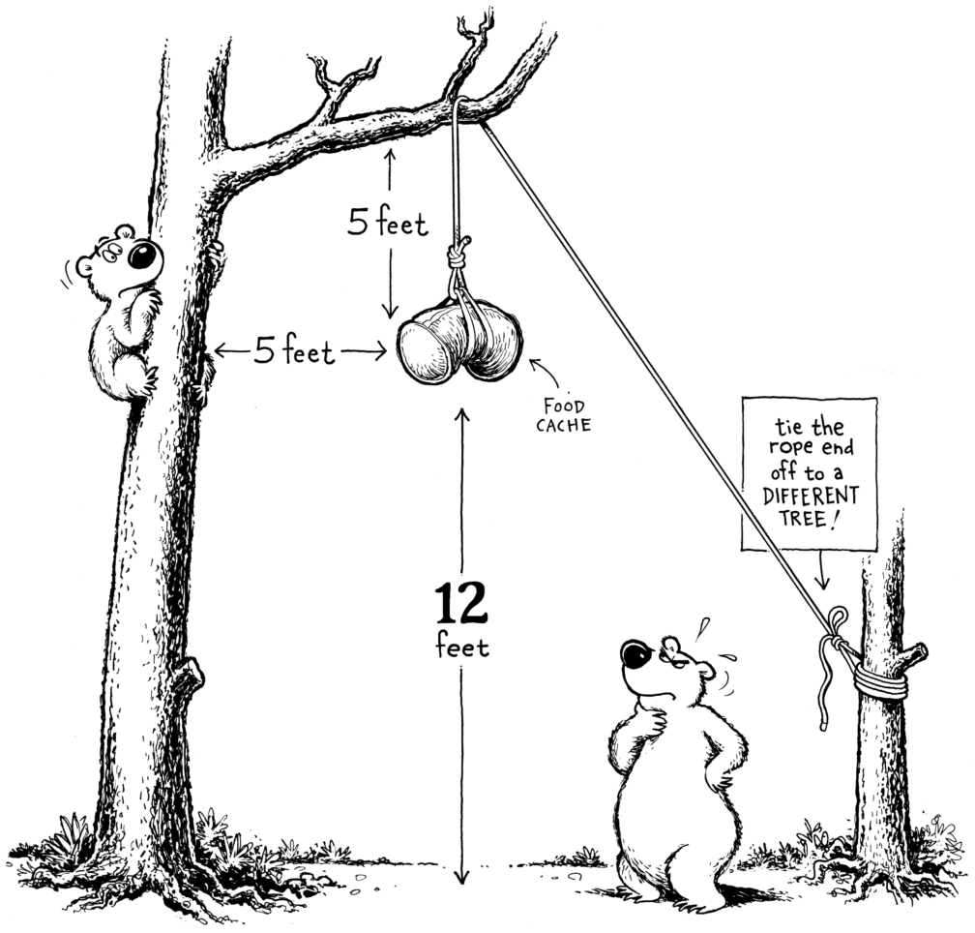
Security
Photo courtesy of: https://andrewskurka.com/wp-content/uploads/clelland-bear-hang-1008x964.png
Notes:
While setting up camp, we have to be careful about data security, similar to hanging a bear bag. Our team needs to discuss and plan where and how we want to store the data, so it is accessible to the correct people with the appropriate frequency.

Slide 21

Pause for partners and plans
Photo courtesy of: http://1.bp.blogspot.com/-0hmOyu6hTAo/VXYfUUfoCTI/AAAAAAAAC_0/Hiy4P45oumI/s1600/solstice%2Bfire%2B072.jpg
Notes:
We continue to move forward with planning, but have stopped to sit around the campfire while we wait for a good time to work with external partners. It is a good opportunity to reevaluate our overall goal and set a plan to build, test and request feedback once we are further along. Thank you for listening to our presentation!

Slide 22
Q&A for Team Minnesota

Slide 23
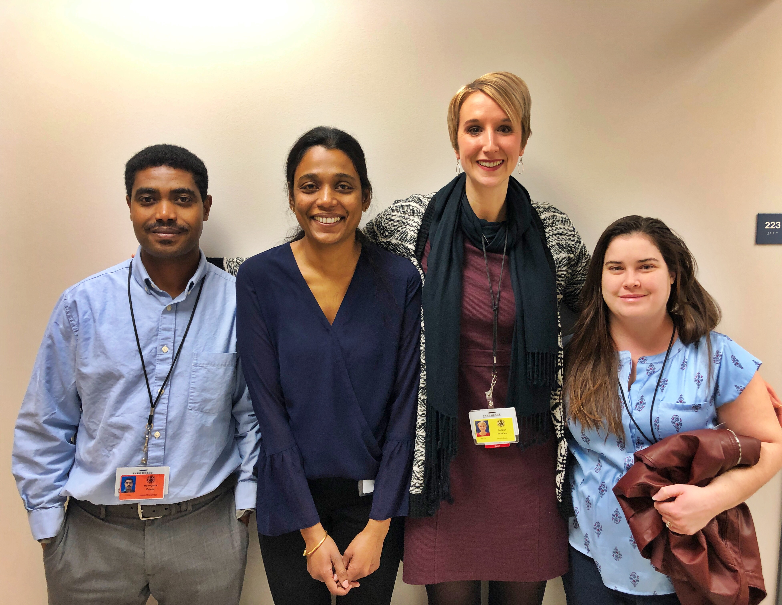
Unified Government Public Health Department
AITT- Ignite Presentation July 17, 2019
Team:
Juliann Van Liew
Elizabeth Groenweghe
Hepsi Swarna
Hunegnaw Zeleke

Slide 24
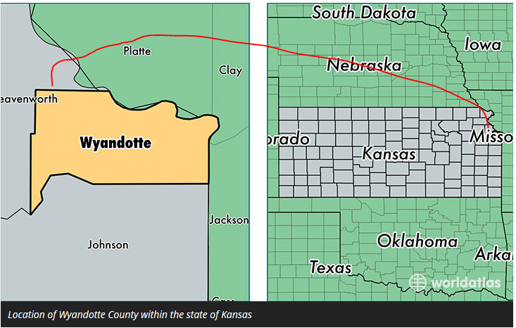
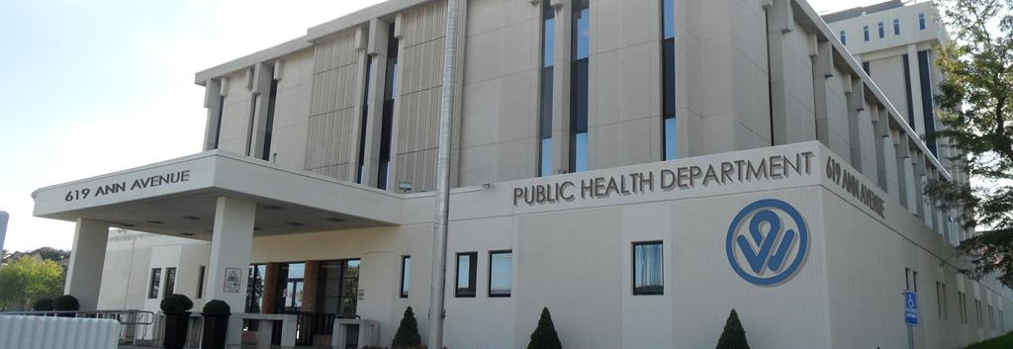
UG Health Department

Slide 25


Assessing barriers to care

Slide 26

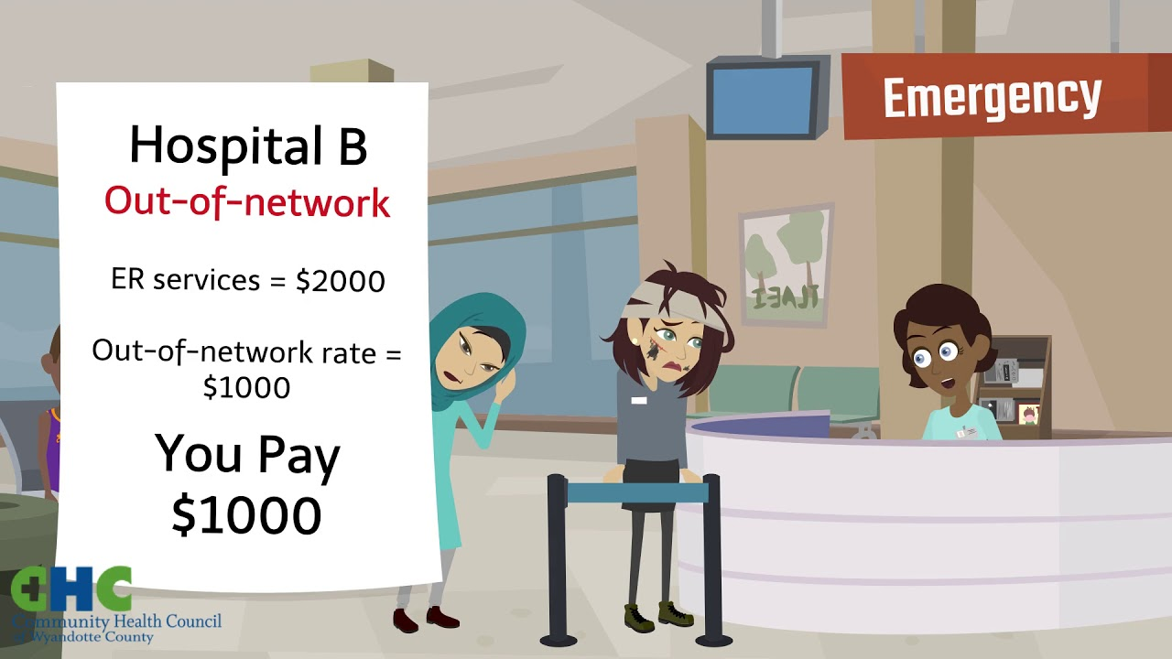

Barriers to care cont.…d

Slide 27
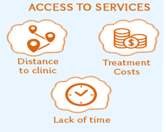
Barriers to care cont.…d

Slide 28
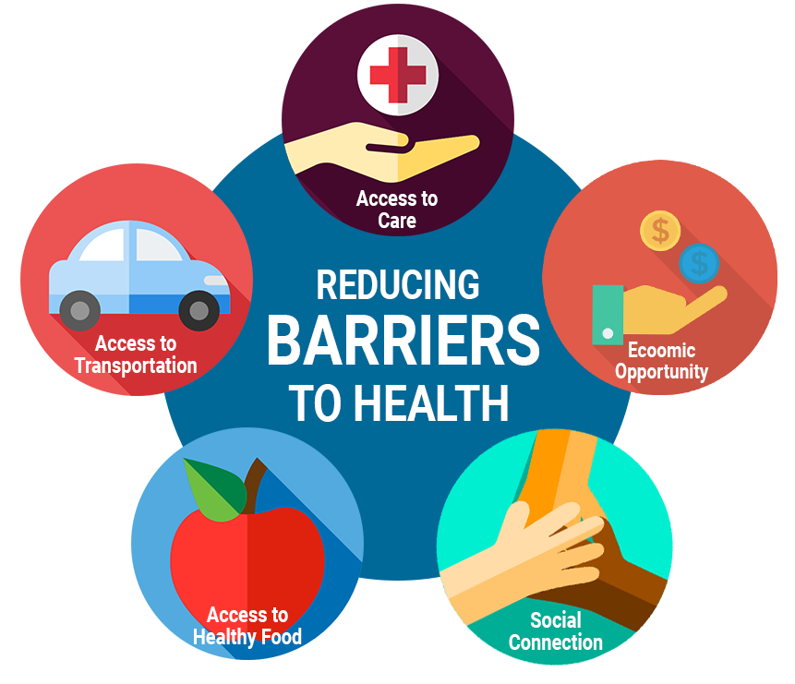
Project Goal

Slide 29



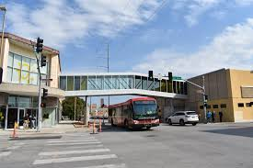
Accomplishments

Slide 30


Accomplishment cont.…d
Results

Slide 31

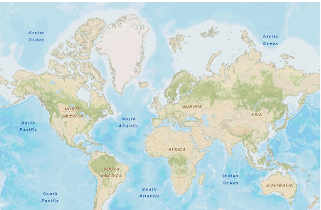
Accomplishment cont.…d

Slide 32


Method/approach used

Slide 33
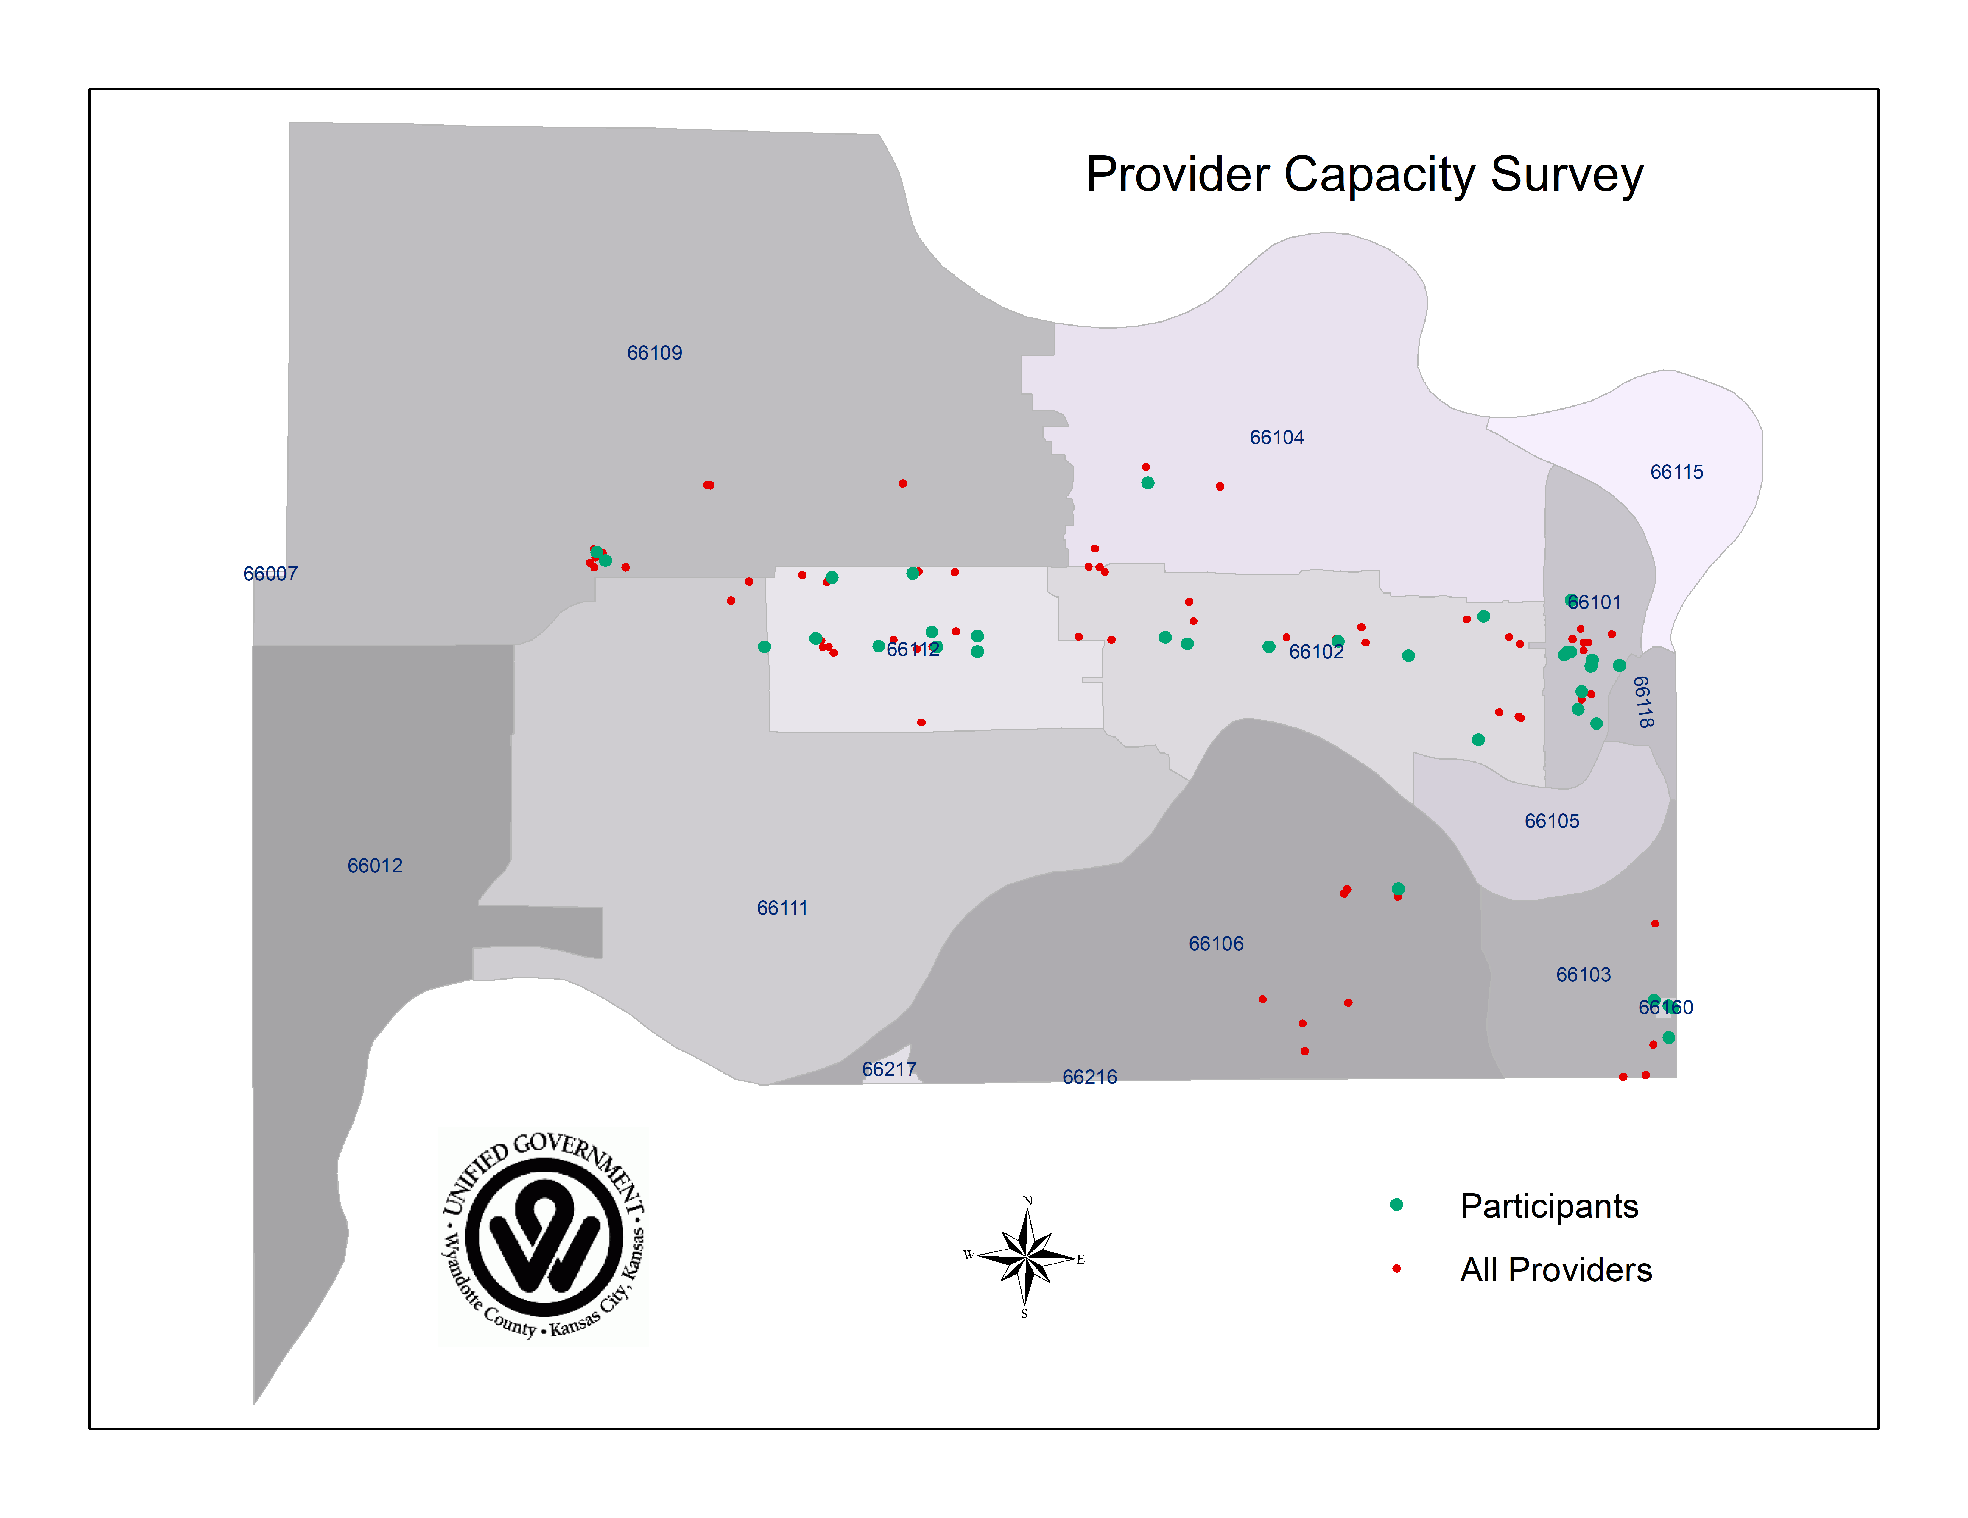
Method/approach used cont.…d

Slide 34
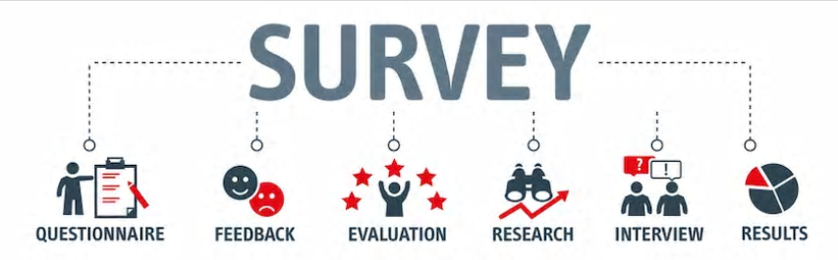
Method/approach used cont.…d

Slide 35


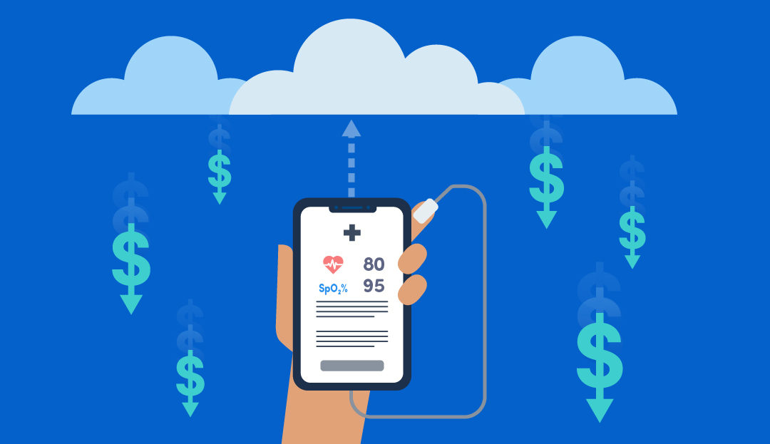


Moving forward

Slide 36
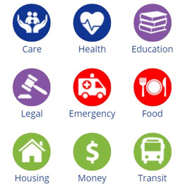

Moving forward cont.…d

Slide 37

Moving forward cont.…d

Slide 38
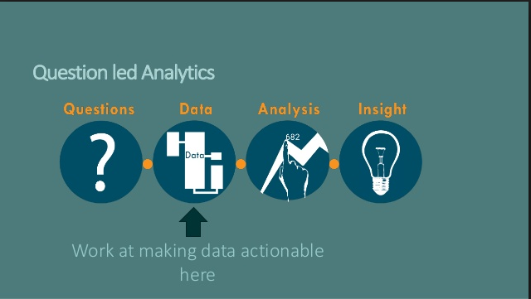
Moving forward cont.…d

Slide 39
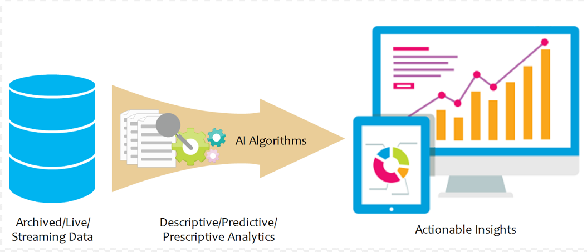
Moving forward cont.…d

Slide 40
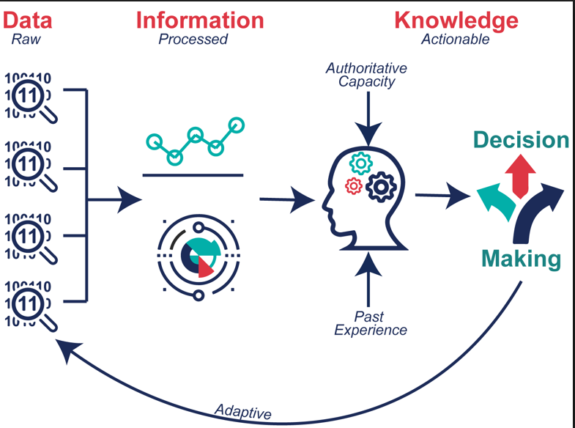
Moving forward cont.…d

Slide 41
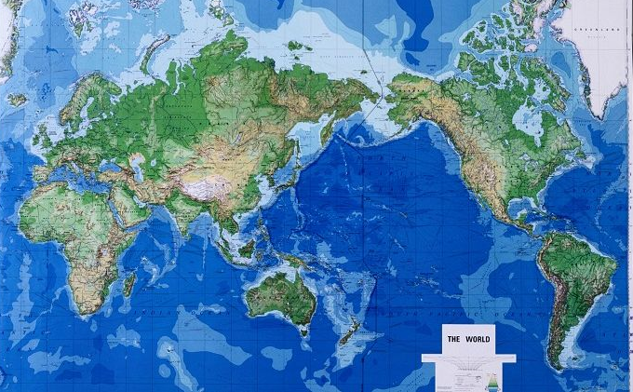
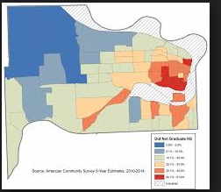
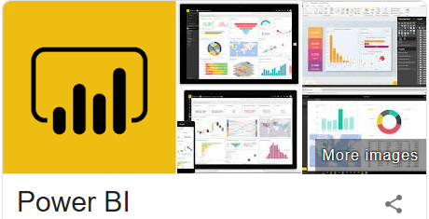
Moving forward cont.…d

Slide 42



Slide 43
Q&A for Team Kansas

Slide 44
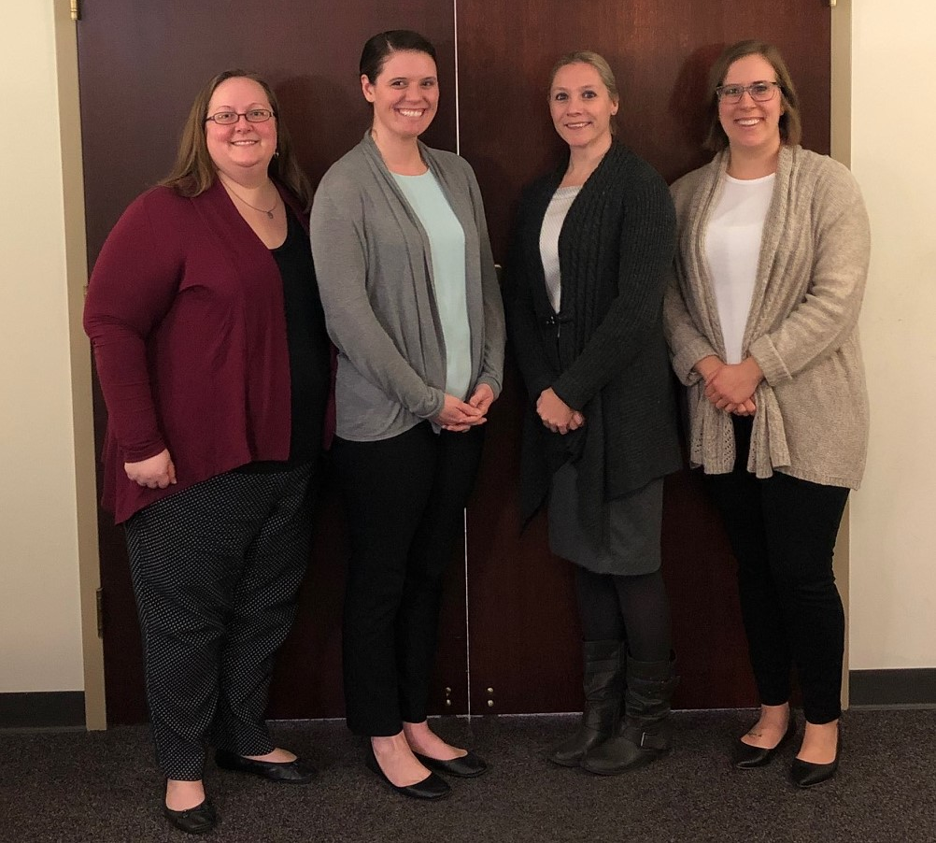
Florida HIV Surveillance Program
AITT Ignite Presentation
7/16/2019
Notes:
Reportable Diseases, HIV, and Drug Resistance Testing

Slide 45
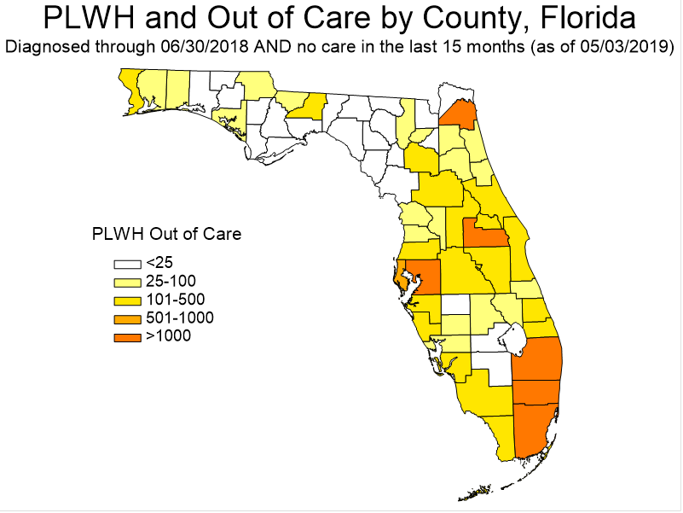

Slide 46
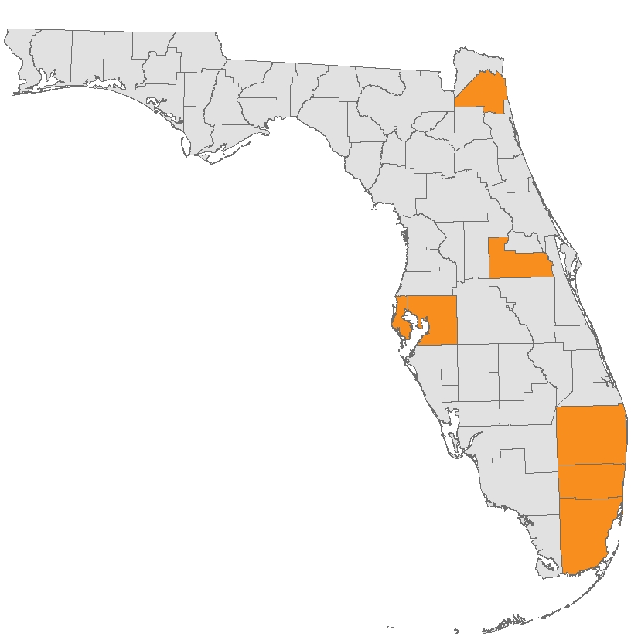

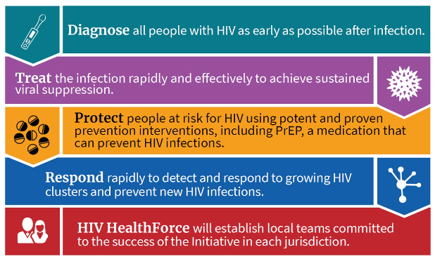

Slide 47

Prioritization
Needed
Notes:
Patient care/viral suppression

Slide 48
HIV Surveillance Data
Vital Statistics
HIV Integrated Data System
Patient Care Data
Medicaid Data

Slide 49

Identify
Notes:
Prioritization

Slide 50
Out of Care
43%

Slide 51
Community
Individual
Notes:
Community /Individual

Slide 52




Slide 53
Analysis & Design
Deployment
Evaluation
Planning & Requirements
Implementation & Testing

Slide 54

Prioritize
Recent
Contact

Slide 55



Model

Slide 56

Literature
Review

Slide 57

Business
Case

Slide 58



Slide 59

Go Team!

Slide 60

Team
Strengths

Slide 61
July 2019

Slide 62
Principal Components
Analysis
Housing Variable
Socioeconomic Status Variable

Slide 63

HIV Surveillance
Prevention
Patient Care

Slide 64
Q&A for Team Florida

Slide 65

The Public Health Vault: A Model for Flexible and Agile Data Collection and Use
Team Santa Clara: Harry Martin, Leticia Ortiz, Mandeep Sidhu,
Patrick Anderson, Wen Lin
Notes:
Hi this is Patrick Anderson and I am the surveillance officer with the Santa Clara County Department of Public Health Infectious Diseases and Response Branch. I am here to talk to you about the Public Health Vault. Ill be joined by Team Santa Clara.

Slide 66
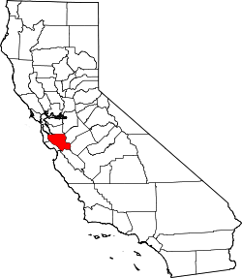
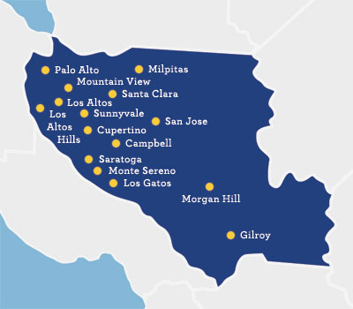

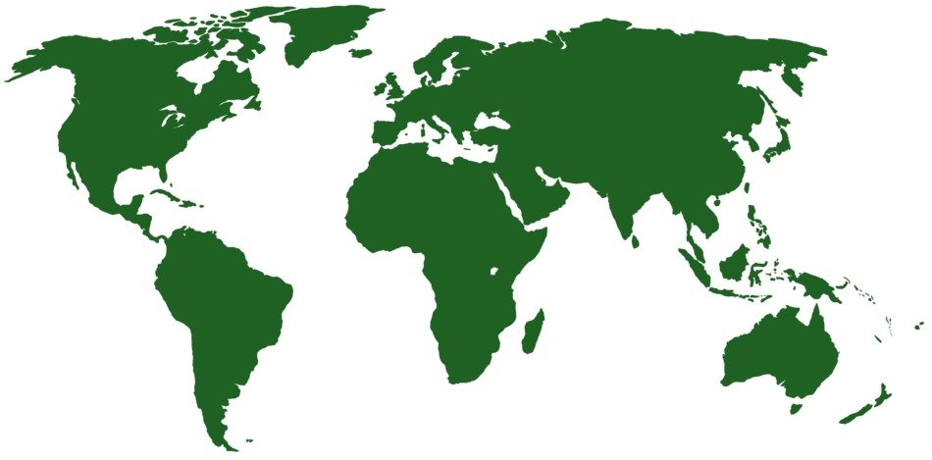
Where Is Santa Clara County?
66
Notes:
The County of Santa Clara, also known as Silicon Valley, is located at the southern end of the San Francisco Bay, and encompasses approximately 1,300 square miles.
We are the 6th largest county in CA with a population of over 1.9 million residents of which over 1/3 are foreign born.

Slide 67


In The Beginning
67
T-2020
Notes:
In early 2018 the Santa Clara Valley Health & Hospital System launched the Transformation 2020 initiative. The Population Health Domain was created to innovate community to clinic care coordination. Funding was allocated to design the Public Health Vault.

Slide 68
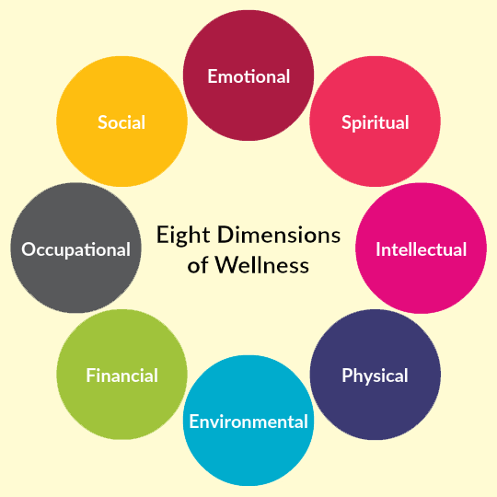



What Is The Vault?
68
Notes:
The Public Health Vault is a multi-year project to create a data warehouse, to proactively examine, understand and provide the power to address the factors that shape the health and well-being of the people who live and work in Santa Clara County.

Slide 69
Built In Phases
69
Collect
Link
Expand
Notes:
Phase 1 collected data for prediabetes and diabetes using a single hospital electronic health record.
Phase 2 consists of harvesting claims data which will be linked with the clinical data.
Phase 3 will consist of harvesting data from the remaining targeted data sets using a standard process.

Slide 70
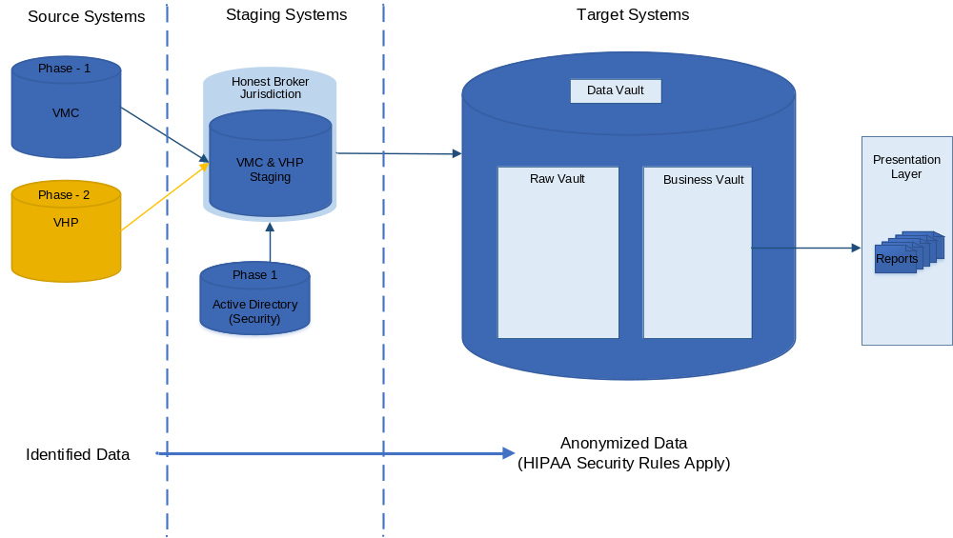
Where We Are Today
70
Notes:
We are collecting data from our county hospital system and are in negotiations with our County Health Plan. We developed a staging area that contains the honest broker environment and have built the vault environment where data will be moved and accessible via the presentation layer

Slide 71
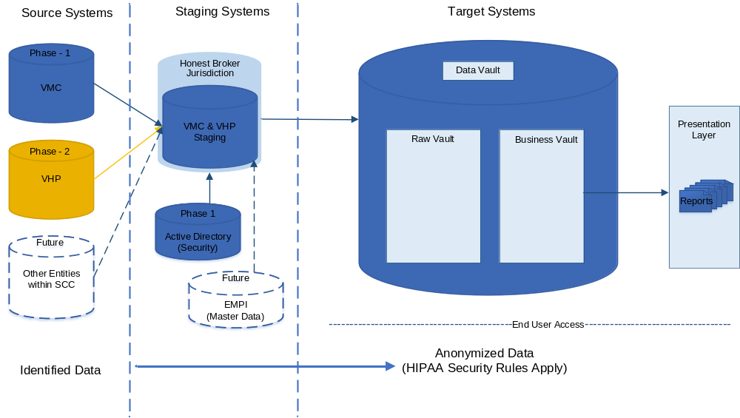
Where We Are Going
71
Notes:
Going forward we will work on incorporating more data sets from sources within Santa Clara County in addition to building out more data accessibility in the business vault. In addition we will move toward using an Enterprise Master Person Index for identity resolution

Slide 72

Accomplishment 1 Honest Broker/Staging
Notes:
Our first accomplishment was the development of he honest broker staging environment, where source records are stored with protected and sensitive information.
Minimum necessary information is loaded from the sources as changes are detected and a history of the source elements is kept.

Slide 73
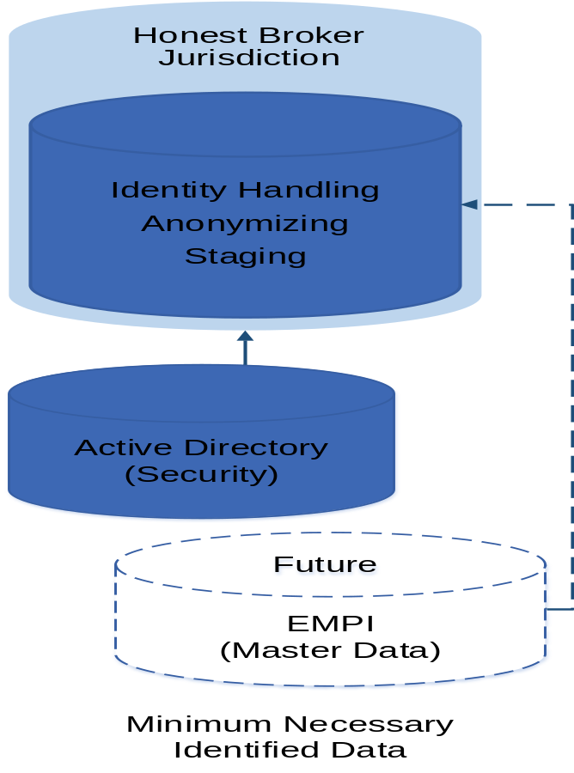
Accomplishment 1 Honest Broker/Staging
73
Notes:
The honest broker serves as the staging area for data elements that can be scaled individually as new data sources are added.
It will be used for identity matching from all source systems and eventually the Enterprise Master Person Index.
Reconciliations will be feed back to the source systems.

Slide 74
Accomplishment 1 Honest Broker/Staging
PAT_ANON_XREF
PAT_MRN | PAT_ANON_KEY | PAT_SYS_ID | ENTITY_NAME
XXXXXXXXX | VMC00000164 | XXXXXXXX | VALLEY MEDICAL CENTER
XXXXXXXXX | VMC0573DEFA | XXXXXXXX | VALLEY MEDICAL CENTER
XXXXXXXXX | VHP02E2D079 | XXXXXXXX | VALLEY HEALTH PLAN
XXXXXXXXX | VMC012B4B3C | XXXXXXXX | VALLEY MEDICAL CENTER
Notes:
The anonymizing process assigns an anonymous key to each patient record and stores the crosswalk to source patient identifier in the Honest Broker. These records can be unmasked if necessary making the patient identity available for use by source system data stewards.

Slide 75
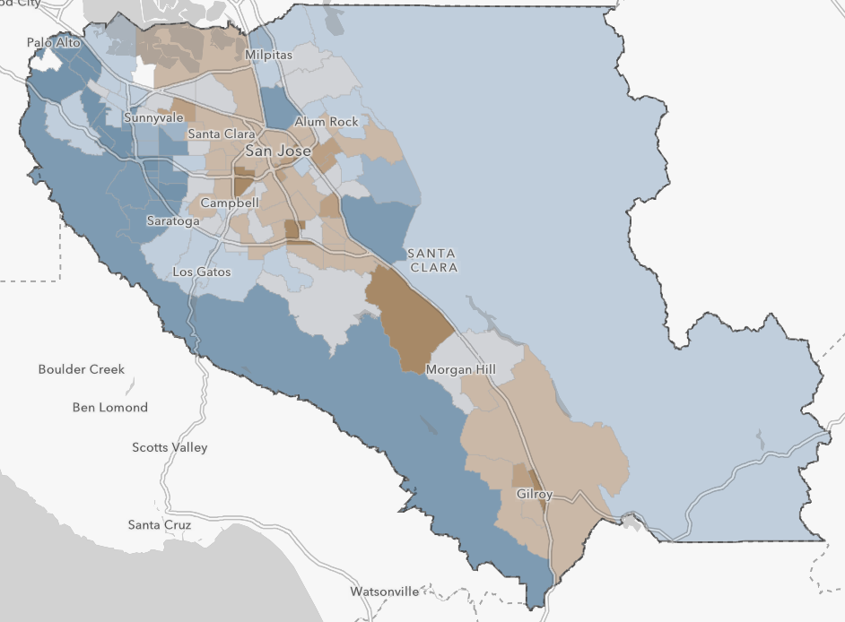
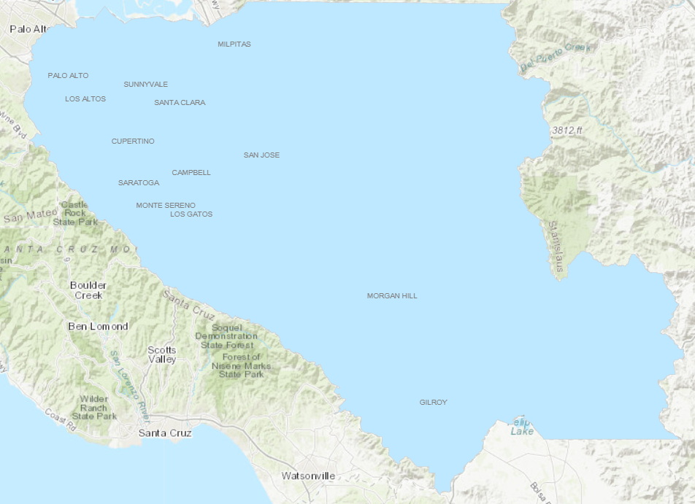
Accomplishment 2 GIS Capabilities
75
Spatial disparities:
Identify areas of high need
8% of adults have diabetes
Notes:
Census geo-coding, without storing address, is another accomplishment. Without this we would have been limited in our ability to identify areas of high need as demonstrated by these maps. This information is valuable for program planning, resource allocation and prevention program implementation.

Slide 76
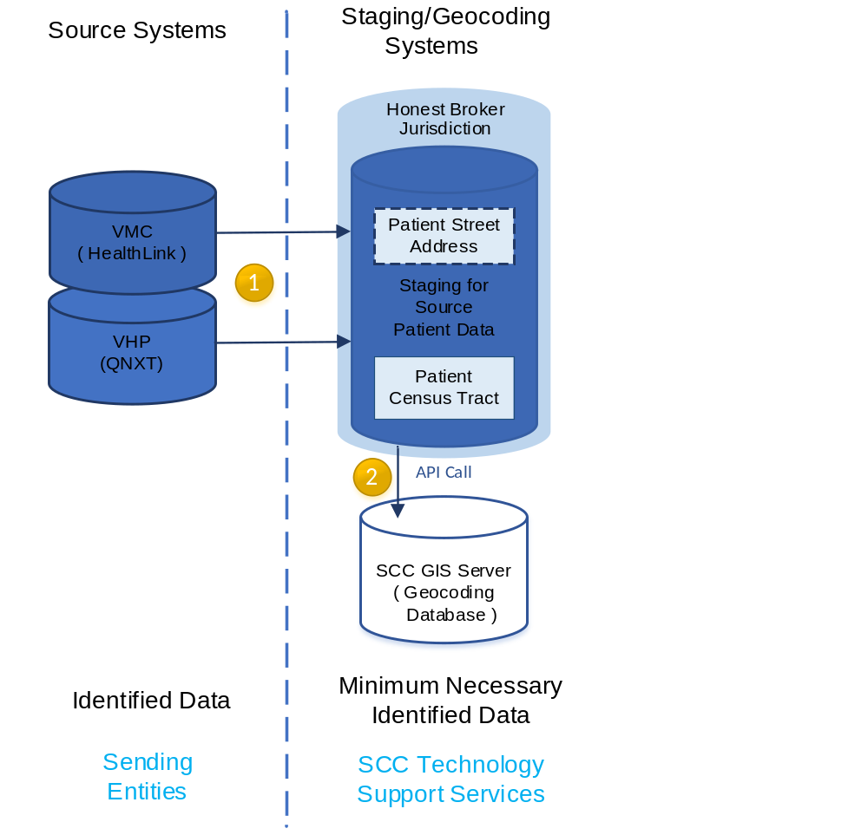
Accomplishment 2 GIS Capabilities
76
Notes:
To develop the Census Tract Geocoding Process we had to get approval from the Health and Hospital System Compliance Officer
The Patient data is loaded from the source systems to the Honest Broker server with street address
the Patient street address is then sent to County GIS Server for geocoding

Slide 77
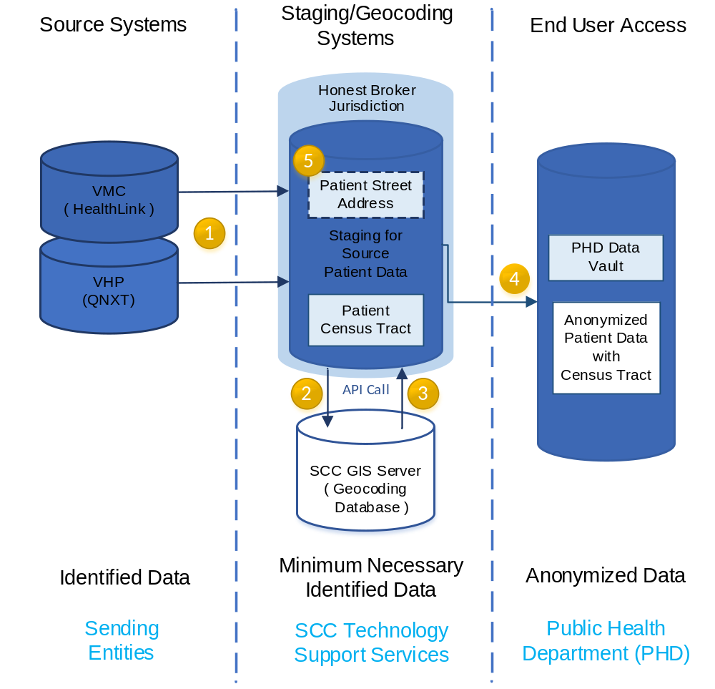
Accomplishment 2 GIS Capabilities
77
Notes:
the GIS Server sends the Patient Census Tract back to Honest Broker server
the Census Tract is then linked back to the patient record, which is then anonymized, and loaded to the Vault
Patient street address is dropped from Honest Broker server after a short retention period.

Slide 78
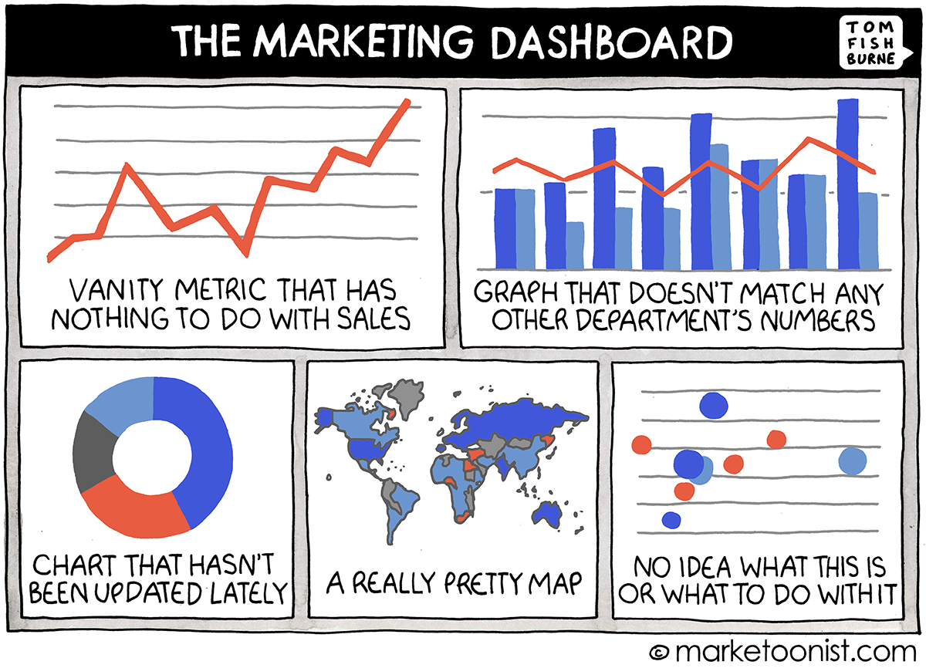
Accomplishment 3 Data Visualization
78
Notes:
Now that we have all this data we needed to do something with it. One of our requirements was development and presentation of metrics associated with prediabetes and diabetes in a user friendly manner using common tools already owned by the county. We chose Tableau to develop a set of dashboards

Slide 79
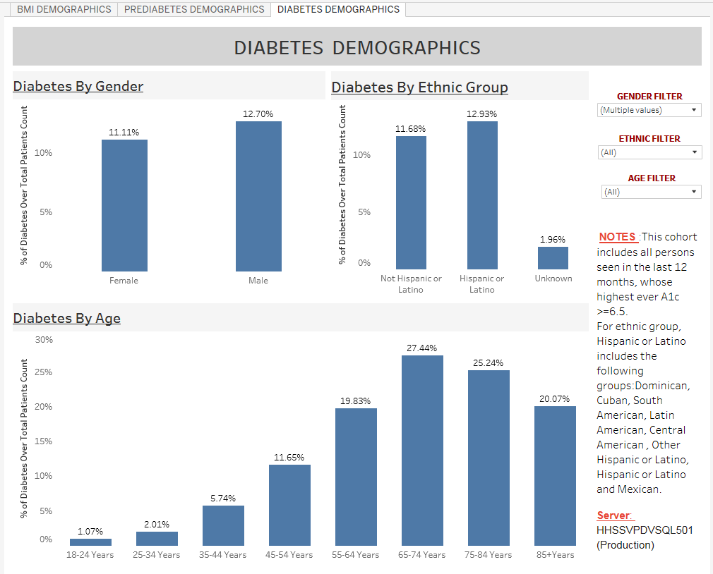
Accomplishment 3 Data Visualization
79
Notes:
Part of the initial validation was the development of three dashboards displaying Body Mass Index, prediabetes and Diabetes, for the hospital, during the last 12 months, broken down by gender, ethnic group and age group. The race categories still need to be worked out.

Slide 80
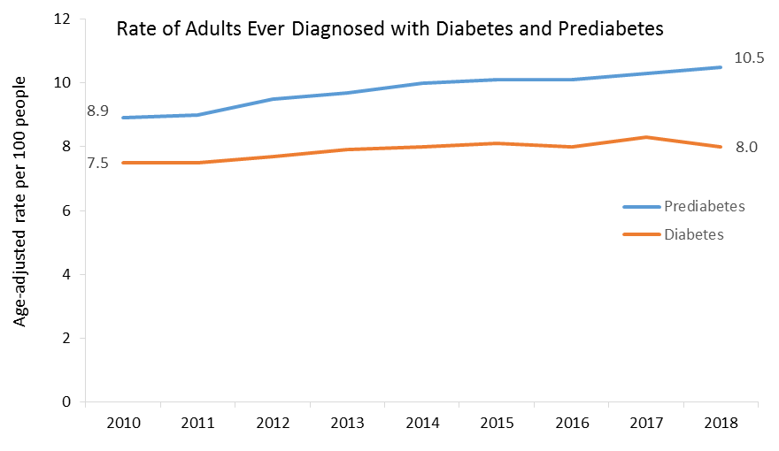
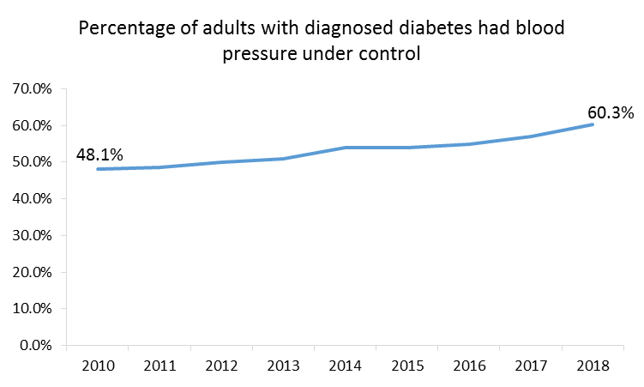
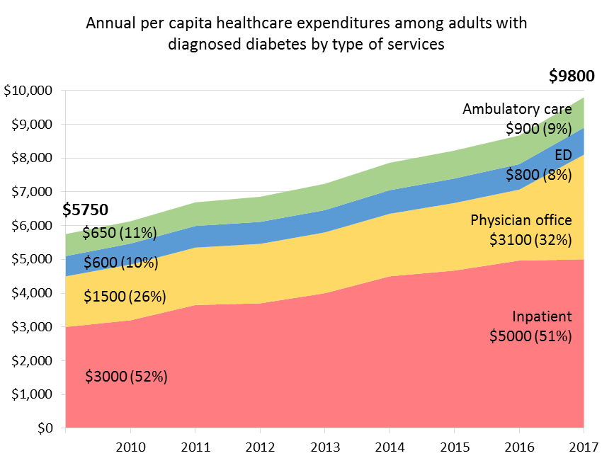
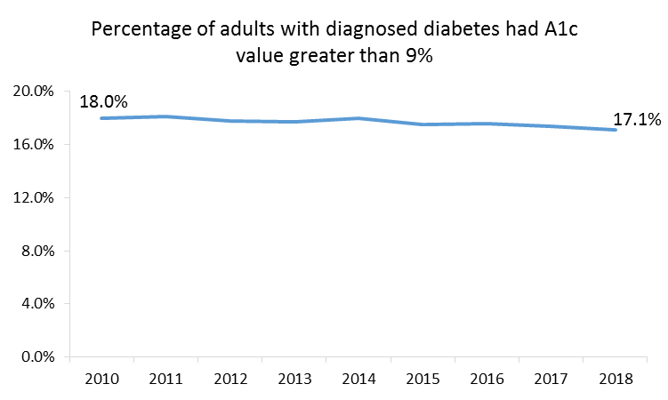
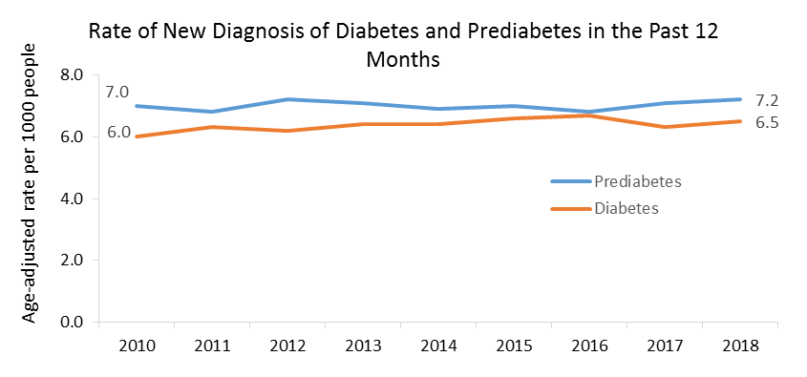
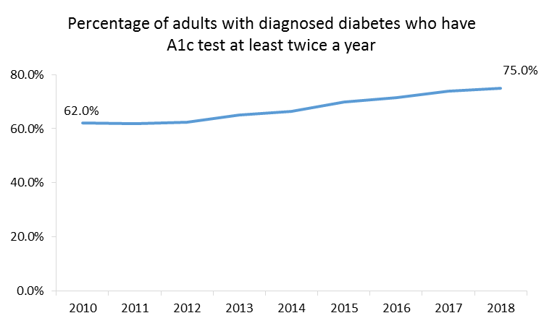
Accomplishment 3 Data Visualization
80
Notes:
Next steps will be to add a few more data elements so that we can monitor trends of prevalence and incidence of diabetes and prediabetes, and track if diabetes patients receive proper treatment and case management. We will also estimate overall cost and healthcare expenditures for patients with diabetes.

Slide 81
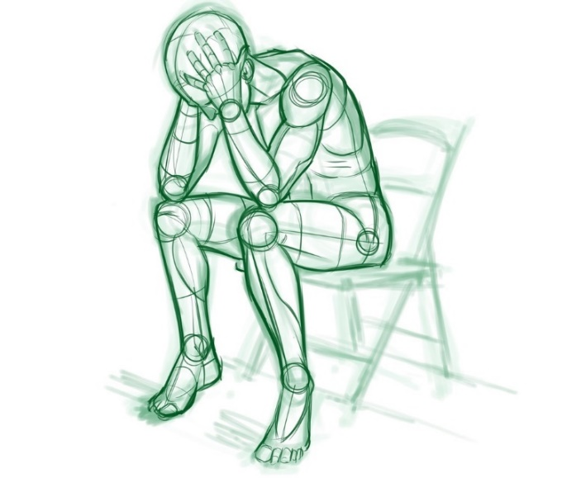
Challenges
81
Resources
Privacy and Security
Notes:
Two of our biggest challenges included Resources, which included bringing on team members with the right skills at the right time.
AND
Privacy and Security. We worked with the compliance officer and the legal team to ensure we were following all rules and regulations regarding privacy and security.

Slide 82

Next Steps
82
Notes:
We will complete the onboarding of the county health plan data. Then link this data to the clinical data where applicable. In addition we are using lessons learned to develop a standardized onboarding process for other clinical and non clinical data sets.

Slide 83








Possible Data Sets
Notes:
Other data sets may include the California Immunization Registry, The Ca reportable disease information exchange also know as CalREDIE, Emergency Medical Service Data, CalTrans, Air Quality Control, vital records, Poison control and WIC.

Slide 84

The End
Notes:
In closing I would like to thank you for your time. This experience has allowed us to not only hear about other projects that are going on around the Country but also has given us insight into how we can better pursue or goal of implementing the Santa Clara County Public Health Vault

Slide 85
Q&A for Team Santa Clara

Slide 86



Tri-County
Informaniacs

Slide 87

Develop Informatics-Specific Strategic Plan for TCHD

Slide 88

Developed a vision statement with eight (8) goal statements and four (4) focus areas
In a relationship with Informatics

Slide 89





Focus Areas
1.) 2.)
3.) 4.)

Slide 90


Goal 1: Goal 2: Governance Structure
Goal 3:
Accountability
Authority
Decision Making

Slide 91



Goal 4: Manageable Work Loads Goal 5:
Goal 6: Cutting Edge
Informatics

Slide 92


Goal 7: staff have basic informatics skills required for their job duties.
Goal 8: Resources are available to support informatics planning, software, and systems acquisition.

Slide 93

Our Top Three Accomplishments
Three of Our Accomplishments
reat

Slide 94

Developed our Strategic Plan

Slide 95

Notes:
Aligned our Informatics-Specific Strategic Plan with the Agency-Wide Strategic Plan where “Up-to-date technology and information systems” have been called out as an agency priority.

Slide 96


Notes:
We used the training stipend to host half-day training for department leadership, epidemiologists, informaticians, and other change leaders on informatics project management and change management.

Slide 97


Notes:
The slalom training will also yield a project management/change management tool kit (under development) for TCHD to use in the future.

Slide 98




Our team used NACCHO’s Strategic Planning Guide to develop an informatics-specific strategic plan.

Slide 99

Notes:
We used a pre-existing, internal informatics governance workgroup to work through the NACCHO Strategic Planning Guide steps, and then did work on refining our product with our smaller AITT group.

Slide 100

Formalize informatics goals as agency priorities
Notes:
How will we continue to support our project without AITT? We are integrating our informatics-specific strategic plan into the agency’s over-arching strategic plan, which further formalizes informatics goals as agency priorities.

Slide 101

The implementation of the strategic plan is set to begin in September 2019.

Slide 102


Notes:
The agency is hiring an Informatics Project Manager, who will take ownership over much of this work. We are continuing to build capacity in this area.

Slide 103


Notes:
We will use the toolkit and other knowledge we gained on project management and change management to further develop and formalize our internal processes.

Slide 104

Notes:
One of the tools is a template for a Gant chart showing the timing of the phases for change management

Slide 105

THANK YOU!

Slide 106
Q&A for Team Tri-County

Slide 107

REDCap Implementation at Columbus Public Health
Columbus Public Health Office of Epidemiology
CSTE AITT Ignite Presentation
July 17, 2019

Slide 108

Background
How to improve data processes?

Slide 109


Background

Slide 110




Project Goal
Notes:
Implement REDCap

Slide 111

Project Goal: Data Security

Slide 112

Project Goal: Data Efficiency

Slide 113

Project Challenges
Do I have to use REDCap?
But my program needs help too!
I really don’t like change.
What happened to Survey Monkey?
My data is fine the way it is.

Slide 114

Project Challenges
Notes:
About CPH programs/data needs
Here is some important background on the structure of Columbus Public Health. There are 6 divisions: Population Health, Addiction Services, Neighborhood Health, Family Health, Environmental Health, and Clinical Health. We work in a centralized office of Epidemiology, which is housed in the Population Health Division. Programs consult us on a variety of topics including data management, evaluation, survey design, pre and post testing.

Slide 115



Methods: Staff Learning

Slide 116

Methods: Information Exchange
CSTE Annual Conference
HPIO Community Forum
Notes:
Informatics Ideas, Methods, Training

Slide 117



Methods: Program Engagement
Notes:
Meetings with programs to understand program needs, system requirements, etc.

Slide 118

Accomplishment:
Illness Questionnaire
Notes:
Our first REDCap project was replacing our existing foodborne illness complaint survey (we call it the “illness questionnaire”), which is used to gather data such as illness symptoms and restaurant exposures. This transition has resulted in efficiencies in collecting and sharing data.

Slide 119

Implications: Data Efficiency
Notes:
Improvements include:
Automated alerts for new survey responses
Reduction in the number of steps and personnel in the data sharing process
Elimination of our dependence on Department of Technology to update the previous Illness Questionnaire

Slide 120

Accomplishment:
Safe Sleep Ambassador Survey
Notes:
Buy-in from sleep & SSA survey in REDCap

Slide 121

Implications: Data Quality
Notes:
User case study; improved data reporting and participant follow-up

Slide 122

Accomplishment:
Department-Wide Open House
OPEN HOUSE
Notes:
REDCap Open House

Slide 123

Implications: Program Buy-In
Notes:
Additional programs willing to use REDCap

Slide 124

Next Steps: Administration
PROTOCOL:
How to Get Your REDCap Project Started
----
A Guide for Columbus Public Health Employees

Slide 125

Next Steps: Training Others

Slide 126

Sustainability: Super Users
Notes:
Train the trainer (passing of the baton to REDCap super users within CPH)

Slide 127
Q&A for Team Columbus

Slide 128



Public Health R Informatics Capacity (PHRIC)
Arizona Department of Health Services
Phoenix, Arizona
Sarah Gieszl, MHS
Amy Lai, MPH
Sara Chronister, MPH
Notes:
We are the team from Arizona Department of Health Service, the public health authority for the State of Arizona
As you can see here, everyone was thrilled to have their pictures taken for this slide.
Our project is Public Health R Informatics Capacity or PHRIC

Slide 129

SAS
Excel
Tableau
Notes:
Like many other state health agencies, ADHS primarily uses a combination of SAS, Excel and Tableau for our data management, analysis and visualization
While these serve their purpose well, they are all proprietary and separate softwares which can create inefficiency in workflow for data analysts and costs the agency money to purchase licenses.

Slide 130

???
Notes:
Our interest is in exploring and promoting a single software that can integrate data management, analysis, and visualization into one platform for data analysts to use

Slide 131

Notes:
We have chosen to focus on promoting the use of R.
R is a free, open-source software language that has been growing steadily as a data science tool over the last decade and has recently started to establish roots in the public health data community

Slide 132

Notes:
Among the many advantages of R are
Robust online user community,
Fast run-time for analysis using packages like the ones shown here
its cost effectiveness and
its impressive visualization, reporting, and dashboarding capabilities

Slide 133

Notes:
Our first goal was to create a comprehensive training package for public health data analysts who are familiar with SAS to learn R so they could use it as part of their normal workflow
Because R has a robust online user community, we wanted to build on the examples of other successful software tutorials, training packages, and resources

Slide 134





Notes:
Here are some of the resources (most free, some paid) that we utilized.
The goal was not to re-invent the wheel, but to put the right resources in the wheelhouse for someone to be able to learn what they need in an efficient and effective way.

Slide 135
Notes:
We wanted to use our existing code in SAS and Tableau to translate to R what we think public health analysts would need in the training package.
Our differences in knowledge, experience, and skills in R, SAS, and Tableau enabled us to guide a comprehensive training package for the new R user.

Slide 136


Notes:
The data sources we used were from MEDSIS, Behavioral Risk Factor Surveillance system, and the National Syndromic Surveillance Program BioSense Platform
All of these are used throughout the agency on a daily basis

Slide 137

Notes:
We created an outline of the 10 most important topics in coding, analysis and visualization that would be versatile between R and SAS
This would serve as the outline for both the assessment and the training package.

Slide 138

Notes:
Our online assessment test was designed to compare knowledge of R prior, during, after the training package development.

Slide 139

Notes:
Instead of emphasizing code, learners are asked to recognize concepts and terms in the correct context.
The reason for this is that code can always be referenced, however concepts should be understood so the users are capable of searching for contextually correct solutions and apply it to their coding problems.

Slide 140

26%
Notes:
Two of our team members did not know R prior to the course
They have shown an average of 26% improvement in their R knowledge assessment at the mid-point of the training compared to the beginning of the training

Slide 141

Notes:
It was important to choose a format for our training that would be flexible for our team and useful for future learners
A working draft of our training has been created using R with a package called bookdown which allows us to edit, update, and publish so we know what it looks like along the way.

Slide 142

Notes:
This is the Data Cleaning (Part 1) page of our training package as an html document, so you can see what the final product looks like
The best part is how easy it is to integrate free text with code and results, make changes to the document, and publish it for others to use.

Slide 143

Notes:
This is our online learning workspace, called RStudio Cloud, which is designed as an online classroom space where training participants can access assignments throughout the training and be able to get help from R trainers within a single platform.

Slide 144

Notes:
Before the end of our project we need to
Incorporate data science and informatics concepts, principles, tips, and best practices into the training package

Slide 145

Practice Data:
MEDSISID | MORBIDCD | MORBID | MORBSPC | RECCLAS | BINATIO | GENDER | R1FACIL | R1ORGTYP
Notes:
We also need to
Finish creating practice data sets for participants to use without having to worry about HIPPA violations for the training
Finish creating assignments for training participants to complete

Slide 146

https://gph.is/Z0Goc1
Notes:
The final step before pushing the training out to a larger audience will be to
Identify a small group of participants to pilot the training program and incorporate their feedback before finalizing the training

Slide 147
Notes:
We are looking forward to making the final training package available to anyone at ADHS (and potentially county and other partners) to improve their R and informatics capacity.

Slide 148
Q&A for Team Arizona

Slide 149
BUILDING PUBLIC HEALTH INFORMATICS CAPACITY
Tennessee Department of Health
2019 CSTE AITT Ignite Presentation
Notes:
Our program has encountered challenges with recruiting and retaining informatics staff, so our goal with this project was to develop strategies for building informatics capacity. This was the original picture taken of our group at the beginning of this project and we have increased our capacity with the addition of two new staff that have joined since January. Angelique Harding and Amanda Hoffer. In addition to the new staff, we were able to assess informatics capacity and create and provide informatics training for our divisional staff. However, we also identified some opportunities that would move this goal forward in the future.
Presentation Outline:
Where we are now with our project and some accomplishments
How we got here
How we will continue to support this project and next steps moving forward

Slide 150
STATUS – Identified Informatics Needs
Notes:
First, what is the current status of our project.
As mentioned, we completed our objectives of creating and delivering trainings for program sustainability. But in this process, we identified divisional informatics needs that still need to be addressed, data management/governance issues, and quite a few other areas of improvement.

Slide 151
STATUS – Ongoing Needs Assessment Prep
Notes:
So, since that first needs assessment and training is complete, we’re now planning for new and enhanced TOOLS AND PROCESSES FOR AN ONGOING INFORMATICS NEEDS ASSESSMENT and have incorporated these into our ELC GRANT activities. We are aiming to evaluate opportunities for further improvement of communication and training.

Slide 152
STATUS – Integrated Efforts Between Programs
SSI
TB
EP
FOOD
HIV
STD
HAI
HEP
Notes:
This periodic needs assessment requires integrated efforts between all our programs and divisional leadership investment. We’re hoping performing this at consistent intervals will continue to identify opportunities for further increasing informatics capacity, help bridge organizational knowledge gaps, and improve inter-program relationships.
Examples of so far:
-Met with leadership to discuss how to better facilitate communication with our IT and information was shared with IT (STS group).
-Our program will be meeting with data governance group to discuss how to incorporate our needs into overall data governance plan.
-Leadership coordination of inter-program projects/facilitating communication between programs – WGS data integration into ELR with SPHL, MMG implementation, communication of non-ELR reporting issues

Slide 153
ACCOMPLISHMENT – Needs Assessment
Notes:
So next, we will be highlighting some of our accomplishments.
Our first accomplishment of this project was conducting an informatics needs assessment within our division. This was something we wanted to do for a few years now but did not have the capacity within our team to take on the extra work or follow up on the outcome of the assessment. It involved assessing known gaps and what we want to learn, conducting a focus group with key staff from each program, analyzing the data, identifying feasible action items, organizing action items into a training plan to track progress.

Slide 154
ACCOMPLISHMENT – Training Materials
Notes:
We also developed informatics training materials as a part of this project which are currently posted on SharePoint for our programs to download and review. These materials can be given to new employees as a part of onboarding. This was one of the slides included in the training presentations. We have been wanting to do this for some time but this project really gave us the extra push to develop these materials.

Slide 155
ACCOMPLISHMENT – Renewed Interest
Curious
Employees
Notes:
Another accomplishment with our project was…
Our programs expressed a lot of interest in the trainings we delivered, and many of the trainings we coordinate within our team. For example, SQL, Tableau, LOINC, and SNOMED trainings.

Slide 156
HOW – Informatics Focus Group
Policies & Procedures
Data Tools & Resources
Data System Access
Training
Notes:
Somewhat redundant, but what steps lead us to where we are now…
One of the ways we accomplished our goals was by conducting a focus group which identified four themes:
Clarification on informatics policies and roles and responsibilities
Tools to aid the programs in carrying out their job functions
Access to systems
And training on how to query or use these systems

Slide 157
HOW – Easy to Understand Materials
Notes:
Another way we accomplished our goals was by creating training materials that were easy to understand. We broke the trainings up into smaller segments so that it wasn’t too heavy on informatics concepts and jargon.

Slide 158
HOW – Survey to Gauge Understanding
Notes:
We also developed a survey to gauge understanding of informatics concepts. The survey was sent to our weekly surveillance meeting attendees. After reviewing the survey results, we have a better idea of what gaps there are in informatics knowledge and the work we do in our program.

Slide 159
SUSTAINABILITY– Annual Needs Assessment
Notes:
How do we plan to sustain these efforts?
We plan to conduct the needs assessment on a yearly basis to identify activities our program needs to address. This assessment has been incorporated into ELC grant activities and will expanded in collaboration with our State Lab (Epi-Lab).

Slide 160
SUSTAINABILITY – Training Plan
Notes:
We intend to address the gaps & wants identified through the needs assessment through a training plan with action items that are feasible and that leverage existing opportunities within the division to implement activities. For example, using an existing division-wide meeting to provide training or informatics updates.

Slide 161




SUSTAINABILITY– Training Materials
We can help!
Sorry, we are not able to help.
Inaccurate ELR result
  Information reported by non-ELR laboratory
Notes:
Our team created three 30 minutes trainings that encompassed our teams’ job responsibilities‘ which can be easily adapted and updated as roles and responsibilities change or are added. This is an example slide from the training that listed our teams responsibilities and is a great way for our department to understand each team member’s role.

Slide 162

SUSTAINABILITY– Annual Training
Notes:
We also plan to update and repeat (”rinse and repeat”) our trainings on informatics knowledge on a yearly basis so we can provide current informatics education to new staff and continue to enrich the knowledge of our current department employees. This also allows us to modify and alter to make them effective each time we.

Slide 163

SUSTAINABILITY – Surveying Division
Notes:
We will continue to survey our division to capture changes in knowledge and needs as they evolve using the pre-post evaluation as a starting point and also using feedback from needs assessment as well as staying attuned to repeated requests/issues reported to us. This will help us keep up with what the rest of our division is working on or needs from an informatics standpoint, while also anticipating needs before they arise so we can create new guidance and training.

Slide 164

NEXT STEPS – Hire a Director
Notes:
Finally, where do we go from here?
Our most pressing need at this moment for the future is hiring a surveillance systems and informatics director for our program. Having a director would allow us to have our own informatics champion in our division.

Slide 165

NEXT STEPS – Working with State Lab
Notes:
It will be essential to work more closely with our state lab moving forwards with the new ELC grant. The lab and our informatics work will go hand-in-hand, so communication and teamwork will be vital. We currently have regular meetings with them for ELR but will need to be expanded to work more closely together.

Slide 166

NEXT STEPS – Working with OIA
Notes:
Another future step we plan on taking is more communication and teamwork with the Office of Informatics and Analytics (or OIA). They are a separate division, but a lot of work can overlap. This AITT opportunity created connections with colleagues in OIA, so we can work together on their informatics strategic plan.

Slide 167

NEXT STEPS – Make Informatics Less Daunting
Notes:
Lastly, continuing the dialogue about why informatics is important to everyone’s work in public health by facilitating clear communication with our internal partners (aka state/local epis) and capitalizing on opportunities to educate and collaborate with disease program staff on informatics projects and activities.

Slide 168

CONCLUSION
Notes:
Lastly, we just want to say that we know this issue of informatics capacity is not unique to our health department. However, this project has given us the space and motivation to take a hard look at gaps in our work and knowledge within our division and identify steps to make progress toward building capacity. We also truly valued the consistent collaboration and variety of discussion that occurred within our team during this process. All that being said, we are aware there is more work ahead.

Slide 169
Q&A for Team Tennessee

Slide 170

Thank you all for your participation in the AITT program!
CSTE National Office
2635 Century Parkway NE, Suite 700
770.458.3811
770.458.8516
aaltabbaa@cste.org

