Slide 1
Data Release Workgroup
Friday March 2, 2018: 3 – 4pm

Slide 2
Agenda
Roll call
Proposed activities
Proposed deliverables
Time expectations
Example: Published analysis of data suppression practices across jurisdictions for STD data sent to the HHS
Next meeting
Questions

Slide 3
Activities
Conduct assessment of jurisdictional approaches related to release and suppression policies for aggregate data
Develop guidance for jurisdictions
Develop suggested language for release and suppression
Develop electronic data request form for external parties
Others?
Notes:
3

Slide 4
Deliverables
Assessment of jurisdictional approaches to release and suppression policies for aggregate data
Repository of sample jurisdictional release agreements for aggregate data
Sample release and suppression guidelines for aggregate data
Sample aggregate data request form
Others?

Slide 5
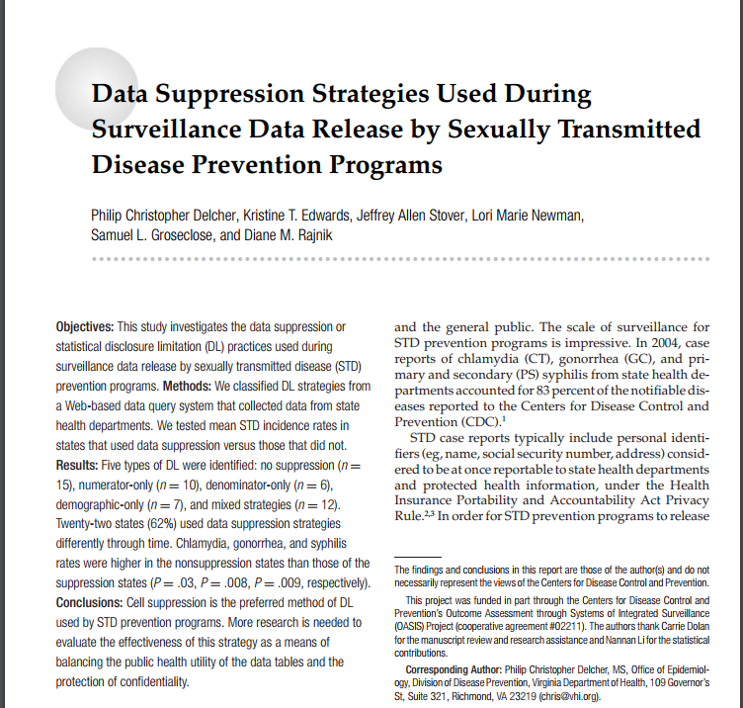
Published analysis of data suppression practices across jurisdictions for STD data sent to the HHS
Delcher, P., Edwards, K., Stover J., et. al., Data Suppression Strategies Used During Surveillance Data Release by Sexually Transmitted Disease Prevention Program. J Public Health Management Practice, 2008: 14(2), E1-E8.

Slide 6
Background
In 2003 and 2005, the HHS’s Office on Women’s Health (OWH) requested data from the 50 states, DC, and NYC to populate a web-based data query system – “Quick Health Data Online”
Counts for CT, GC, and Syphilis at the state and county level, by race/ethnicity and sex were requested
The identified suppression strategies: cell suppression, numerator-only, denominator-only, demographic-only, and mixed
Delcher, P., Edwards, K., Stover J., et. al., Data Suppression Strategies Used During Surveillance Data Release by Sexually Transmitted Disease Prevention Program. J Public Health Management Practice, 2008: 14(2), E1-E8.

Slide 7
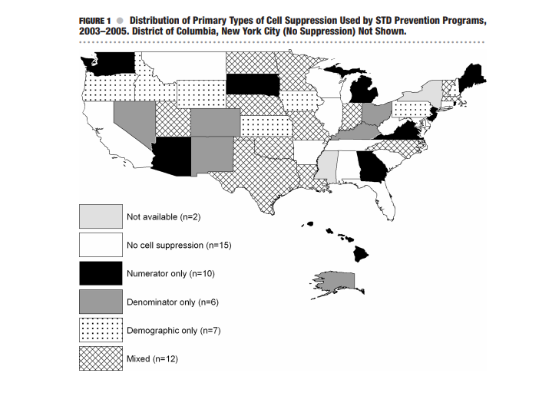
Distribution of Cell Suppression Practices
Delcher, P., Edwards, K., Stover J., et. al., Data Suppression Strategies Used During Surveillance Data Release by Sexually Transmitted Disease Prevention Program. J Public Health Management Practice, 2008: 14(2), E1-E8.

Slide 8
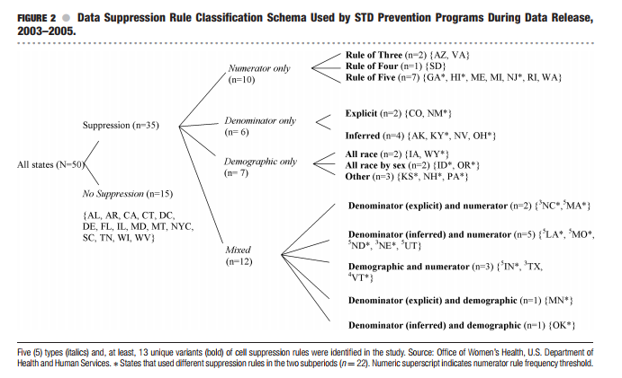
Delcher, P., Edwards, K., Stover J., et. al., Data Suppression Strategies Used During Surveillance Data Release by Sexually Transmitted Disease Prevention Program. J Public Health Management Practice, 2008: 14(2), E1-E8.

Slide 9
Conclusions
35 of the 50 states used a cell suppression practice to report their data
Multiple strategies were used, but the “Rule of 5” was used most often
States with higher incidence rates of STDs were less likely to use cell suppression
Suppression practices varied over time even within the same health department
Delcher, P., Edwards, K., Stover J., et. al., Data Suppression Strategies Used During Surveillance Data Release by Sexually Transmitted Disease Prevention Program. J Public Health Management Practice, 2008: 14(2), E1-E8.

Slide 10
Next meeting
Start gathering data release and suppression policies from jurisdictions

Slide 11
Questions

