Slide 1
Small Numbers Standards
Washington State Department of Health
June 22, 2018

Slide 2
Introduction
Historically, guidelines have been available with recommendations for small numbers presentation
Challenges
  Inconsistency across programs
  Staff unable to articulate rationale
  Confusion about recommendations
Environment & Technology changes
  Increasing granularity of data presentation
  Improved data linkage with minimal information

Slide 3

Privacy
Public Right to Know

Slide 4
Summary of Standard
Developed to protect privacy
Applies to publicly released aggregate data
Population data:
  Suppress all non-zero counts less than 10, and rates based on these counts
Survey data:
  if ≥ 80% of population surveyed – treat like population data
  if < 80% surveyed –
      unequal weights – no suppression
      equal weights – suppress or aggregate if numerator is not zero and is less than 10

Slide 5
Exceptions
Annual state or county counts, or rates/proportions based on such counts may be presented if count is 1-9, if no further stratification
Facility or provider specific data may be shared back for QI purposes
Case by case exceptions
  Public health threats
  Emergencies

Slide 6
Recommendations for statistical reliability
Flag unstable rates if relative standard error is greater than 25% and less than upper limit established by program. Suppress above upper limit.
Aggregate data to minimize instability and/or suppression.
Include confidence intervals to indicate stability of estimates

Slide 7
DOH Data Presentation for the Public – Small Numbers Standard
For estimates > 0:
Do the data come from a survey?
NO¹
YES
≥ 80% of population surveyed
< 80% of population surveyed
Check people in the numerator
(n)
Check Weighting
n ≥ 10
0 < n < 10
Equal Weights²
Unequal Weights³
NO SUPPRESSION
SUPPRESS or AGGREGATE⁴
Check people in the numerator (n)
NO SUPPRESSION
For estimates = 0:
n ≥ 10
0 < n < 10
Display “0” as count and estimate with confidence interval⁵
NO SUPPRESSION
SUPPRESS or AGGREGATE⁴
¹ Examples include birth data, CHARS data, linked death data, notifiable conditions reports
² Examples include Healthy Youth Survey
³ Examples include Behavioral Risk Factor Surveillance System, Pregnancy Risk Assessment System
⁴ Exceptions include annual state- or county-specific counts or rates with no stratification.
⁵ 95% Poisson confidence interval for 0 is 0 to 3/n.

Slide 8
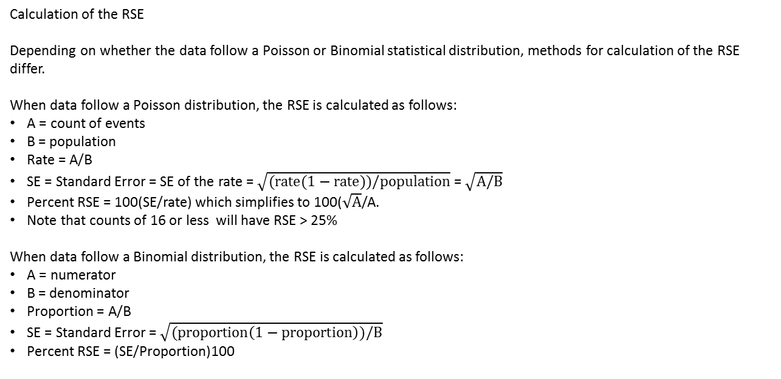
DOH Data Presentation for the Public – Reliability Recommendation
Check Relative Standard Error
RSE < 25%
RSE ≥ 25%
Display Estimate
Display Estimate with cautionary note
Calculation of the RSE
Depending on whether the data follow a Poisson or Binomial statistical distribution, methods for calculation of the RSE differ.
When data follow a Poisson distribution, the RSE is calculated as follows:
A = count of events
B = population
Rate = A/B
SE = Standard Error = SE of the rate = $\sqrt{(rate(1−rate))/population}$ = $\sqrt{A/B}$
Percent RSE = 100(SE/rate) which simplifies to 100($\sqrt{A}$/A.
Note that counts of 16 or less will have RSE > 25%
When data follow a Binomial distribution, the RSE is calculated as follows:
A = numerator
B = denominator
Proportion = A/B
SE = Standard Error = $\sqrt{(proportion\left(1−proportion\right))/B}$
Percent RSE = (SE/Proportion)100

Slide 9
Challenges
Standard is how we choose to present data; still subject to public disclosure
Differences in ‘data culture’ across programs
How do we conduct secondary suppression?
Some historic data does not adhere to standards
Cross agency youth survey without agreement across agencies
What is confidential? Direct and indirect indicators?
Training and keeping analysts informed

Slide 10
Contact
Cathy Wasserman, PhD MPH
State Epidemiologist for Non-Infectious Conditions
Washington State Department of Health
360-236-4246
cathy.wasserman@doh.wa.gov
Small Numbers Standards Document and Graphic:
https://www.doh.wa.gov/Portals/1/Documents/1500/SmallNumbers.pdf
https://www.doh.wa.gov/Portals/1/Documents/1500/SmallNumbersGraphic.pdf

