Slide 1
Integrated AR Data Flow

Slide 2
ELR AR Data Flow

Slide 3
PUBLIC HEALTH CASE REPORTING – PAPER PROCESS

Slide 4
PUBLIC HEALTH CASE REPORTING – ELECTRONIC PROCESS

Slide 5
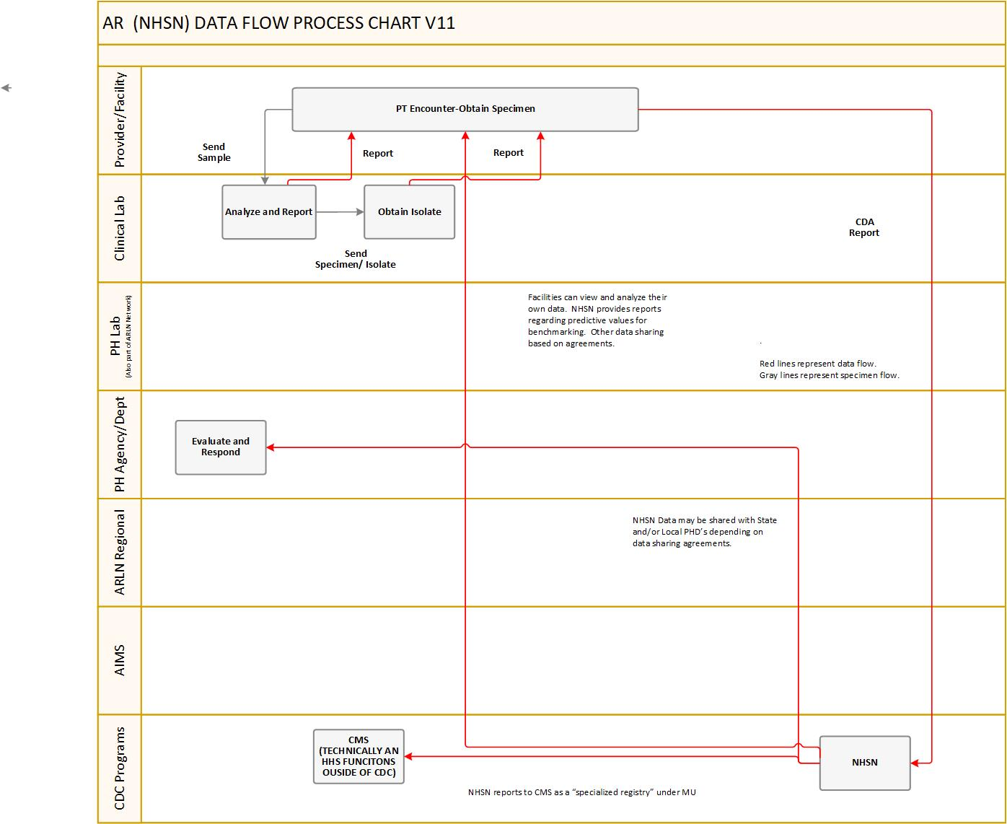
NHSN AR Data Flow

