Slide 1
CSTE/CDC/APHL Antimicrobial Resistance Surveillance Task Force
ARSTF Quarterly Call
Wednesday, February 28, 2018
4:00-4:30pm ET

Slide 2
Agenda
Roll call
Staffing and chairs of the Task Force and Workgroups
Progress on the Strategic Map
Timeline for Task Force and Workgroup through June 30th
Proceedings from the December In-person meeting
Assessment plan
Data Flow Diagram
Opportunities to participate
Other, further discussion
Adjourn

Slide 3
Current Leadership, staffing
Task Force Co-chairs
  Dan Pollack – CDC
  Pete Shult – APHL
  Rich Melchreit – CSTE
Work Group Chairs
  Lab
    Pete Shult – APHL, Wisconsin SPHL
    Kelly Wroblewski – APHL
  Informatics
    Patina Zarcone – APHL
    Zints Beldavs – Oregon Health Authority
Staff
  Brooke Beaulieu – CSTE
  Kelly Wroblewski – APHL
  Rich Melchreit – CSTE

Slide 4
Progress on Strategic Map

Slide 5
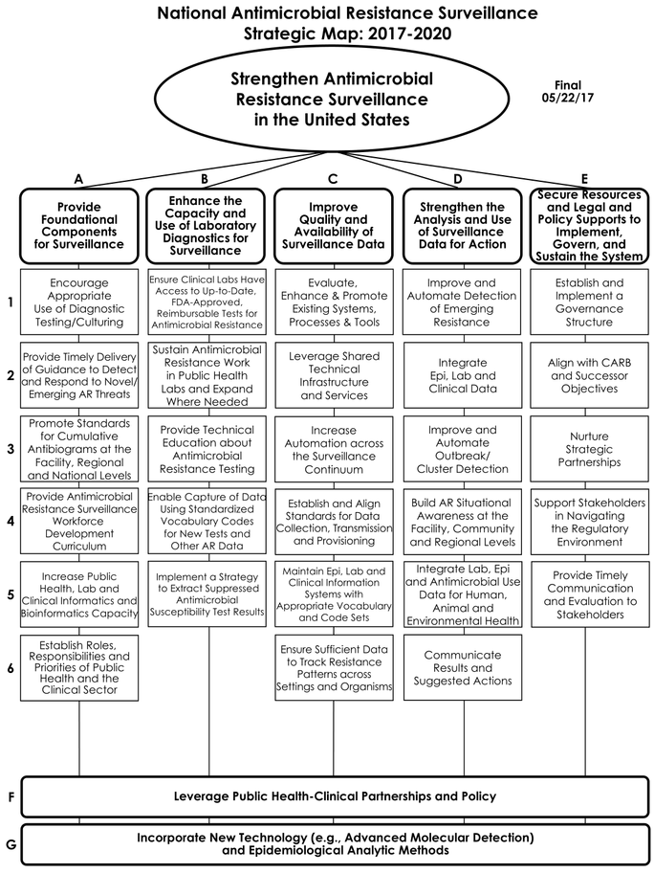
Planning Objectives
July ‘17 - June ‘18
Strategic map
Core (Gov) WG
Informatics WG
Lab WG
Crosscutting
Notes:
Strategic objectives assigned to three workgroups:
Core is the governance committee
Informatics for Epidemiology: ensure standardized information is transmitted back and forth from the various stakeholders efficiently
Laboratory for Public Health: ensure laboratories have the technology they need and that intimation flows effectively and efficiently in and out of laboratories for epidemiological tracking and prevention action.

Slide 6
Core WG Y2 objectives
E-1: Establish and implement a governance structure – ongoing
A-6: Establish roles, responsibilities, and priorities of public health and the clinical sector – not addressed yet

Slide 7
Lab WG Y2 objectives
B-4: Standardized vocabulary codes – Active assessment, expect recommendations by 6/30
B-5: Extract suppressed susceptibilities - ditto
C-4: Standards for data collection, transmission and provisioning – ditto, but harder to assess and make recommendations
A-5: Increase public health, lab and clinical informatics and bioinformatics capacity – ditto, but a challenge, involve analysis of funding resources needed, crosscuts both Workgroups, cross-WG needs more coordination in planning

Slide 8
Informatics WG Y2 objectives
C-1: Evaluate, enhance and promote existing systems, processes and tools - Active assessment, expect recommendations by 6/30
D-2: Integrate epi, lab and clinical data - ditto
C-2: Leverage shared technical infrastructure and services - ditto
A-5: Increase public health, lab and clinical informatics and bioinformatics capacity – ditto, same as Lab WG

Slide 9
Objective nesting
E-1: Governance structure (Year 2 priority)
  E-3: Nurture partnerships (not year 2 priority)
B-5: Extract suppressed susceptibilities (Y2 priority)
  C-6: Sufficient data to track patterns (not priority)
B-4: Standardized codes (Y2 priority)
  C-5: Epi, lab, clinical IS with appropriate vocabularies and codes (not priority)

Slide 10
Year 2 Planning Timeline
Activity | Dates
Assessment | Now through April 27
Review of assessment document | April 27 – May 21
In-person meeting to develop recommendations | May 21, 22 (tentative)
Development and review of recommendations document | May 22-June 14
CSTE Annual Conference presentation, roundtable | June 14- June 18
Finalize and publish assessment and recommendations documents | June 30

Slide 11
Proceedings -
December In-person Meeting
Strategic Objectives
  Bioinformatics removed from Strategic Objective a 5 (Build Capacity for Informatics and Bioinformatics
Assessment plan
  Identified questions, and whom to ask what question, and methods for data collection (e.g., gather existing publications, primary data gathering through surveys or focus groups
  Only enough data gathering to answer the questions, not scientifically complete and elegant
  Lab WG is preparing a questions for state labs who will ask clinical labs
  Informatics WG is continuing to work on their plan and will likely prepare a survey

Slide 12
Assessment Plan -spreadsheet
[See the Assessment Crosstabs Workbook]

Slide 13
Data Flow Diagram – assessment tool and information for stakeholders

Slide 14
Other Issues
Opportunities to participate
Other/open discussion

Slide 15
Contact numbers and email
Staff person | Phone | email
Rich Melchreit CSTE | (860) 912-5126 | ramrd@comcast.net
Brooke Beaulieu CSTE |  | brooke@cste.org
Kelly Wroblewski APHL |  | kelly.wroblewski@aphl.org

