Slide 1
NLM Library Associates: Standards and Policy Unit
The Role of Standard Vocabularies in Meaningful Use:
LOINC
Clement J. McDonald, MD
Director, NLM Lister Hill National Center for Biomedical Communications (LHNCBC)
March 04, 2014 CDC Atlanta GA

Slide 2
Why we need Vocabulary Standards

Slide 3
Consider first the standard for the test “name”
Without it, little chance of finding the results of interest
  For epidemiology
  Outbreak detection
  Routine public health reporting
Federal regulations already require clinical systems to standardize the test names (LOINC) for Public health and cancer registry reporting
If public health does not align with the same standards , they will not be able to absorb –take advantage of that data
Clinical systms may revolt (what is good for the goose should be good for the gander

Slide 4

It will have long term advantages
Like bar codes on groceries
Like standard internet protocols
Like standard email addresses
Standard ZIP codes for mail
Standard bank codes
for moving money
Can’t know all of the
  advantages going in, but
  fragmented communication
  never works (Breugel )

Slide 5
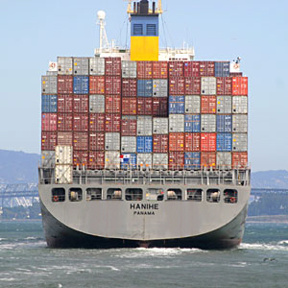
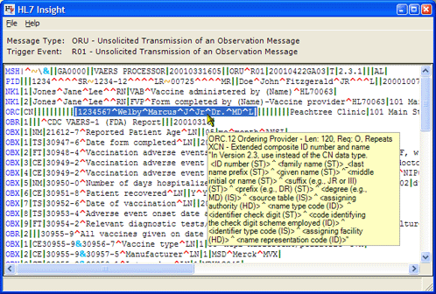
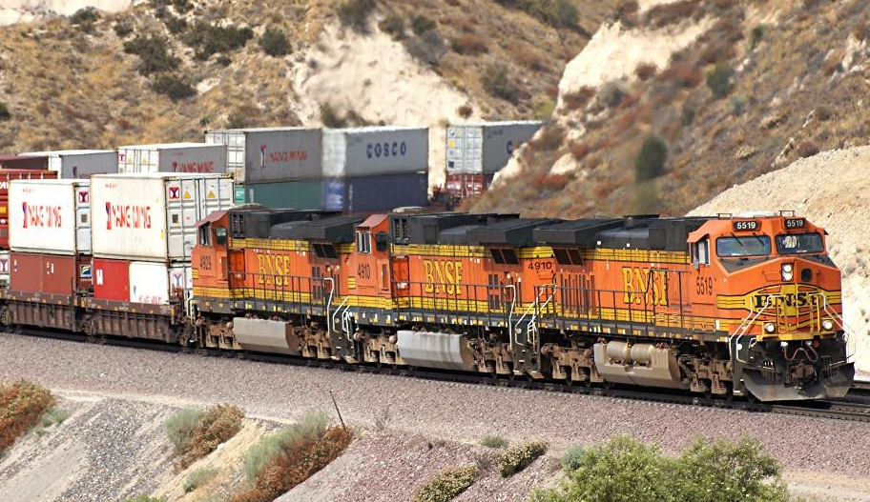
To make any of this work, we need:
Standard structures to move the information.
HL7 messages (or HL7 documents) provide the standard structures for representing the data and for shipping it around.

Slide 6

To make any of this work, we also need:
Standard codes to represent the information.
The big problem is standardizing the codes for identifying tests, reports, and other clinical content.
  Hospitals create their own codes (e.g. service codes) for this purpose.
  But local codes are idiosyncratic and not understandable outside of a given hospital.
With standard vocabularies and codes to represent data that are not simple numeric or text, the data become interchangeable.

Slide 7
A Bit about LOINC

Slide 8

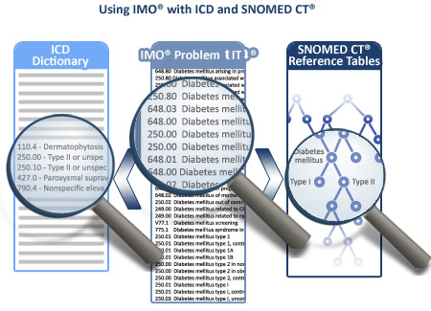
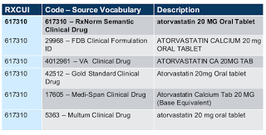
All 3 of the major code systems required by MU2 are developed or supported by NLM.

Slide 9


Slide 10
What is LOINC?
A database with universal codes and names for 72,000+ laboratory tests, clinical measures, clinical reports, and survey instruments.
  Version 2.46 released December 2013
Carries lots of information about each test and measurement – a description, units of measures, answer lists, synonyms, and references.
Comes with downloadable browsing and mapping program (RELMA).
Offers a web search engine as well.
No charge and perpetual license.

Slide 11
Where does LOINC fit in an HL7 message?
LOINC codes and names and coding system in green; Values (answers) in purple
Patient level
PID|||0999999^6^M10||TEST^PATIENT^||19920225|F||B|4050 SW WAYWARD BLVD |
Order/report level
OBR|||H9759-0^REG_LAB|20725^Hemogram^LN
Discrete Results
OBX|2|NM||789-8^RBC^LN||4.9|10*6/uL|4.0-5.4||||F|
OBX|3|NM||718-7^HGB^LN||12.4|g/dL|12.0 5.0||||F|
OBX|4|NM||20570-8^HCT^LN||50|%|35-49|H|||F|
OBX|5|NM||30428-7^MCV^LN||81|fL|80-94||||F|b

Slide 12
LOINC is international
Almost 30,000 registered users from 157 countries (almost every country)
National standard for more than 10 countries (e.g. Australia, Canada, France, Germany).
Translated into 16 languages (or dialects).
  12 are web-searchable.

Slide 13
Ties to other standards
UCUM- for units of measure
  Commonly used units in UCUM standard included for almost every quantitative variable
Big interaction with SNOMED CT, Mapping parts to SNOMED CT content. Mapping will be available publically
Big agreement with RadLex and Radiologic Society of North America (RSNA) to unify Radlex and LOINC for radiogy test ordering and reporting. The code for messages will be a LOINC code
HIT committee says all observatioins should be LOINC
HL7 CDA says the same

Slide 14


Slide 15
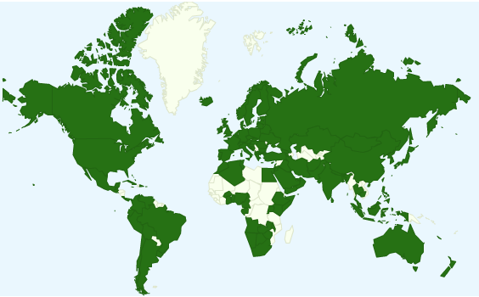
26,000+ LOINC users in 157 countries

Slide 16
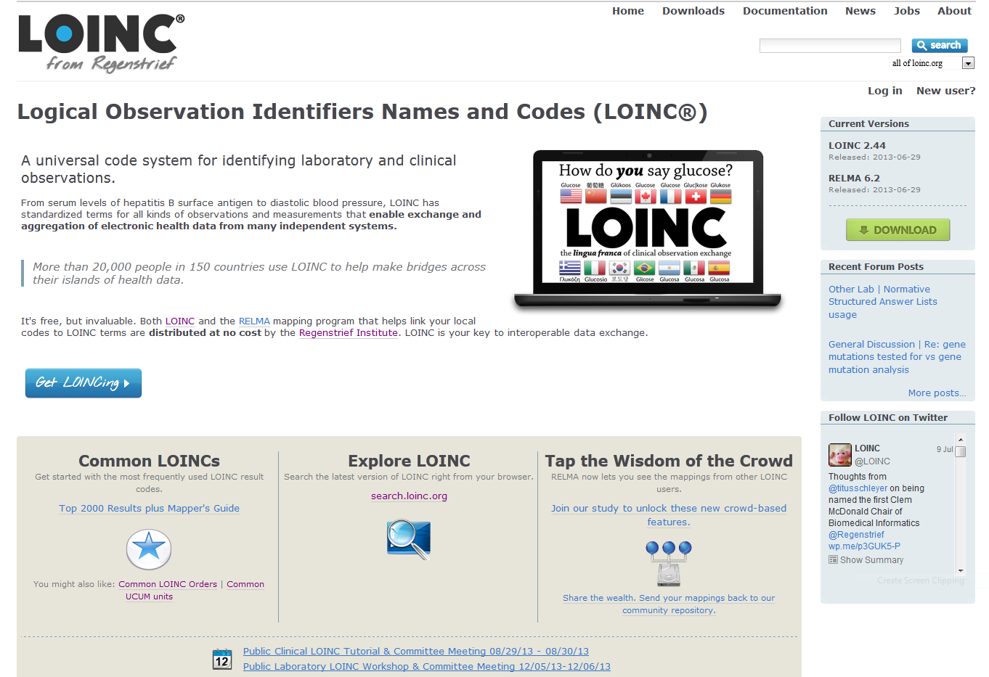
LOINC Web site: http://loinc.org

Slide 17
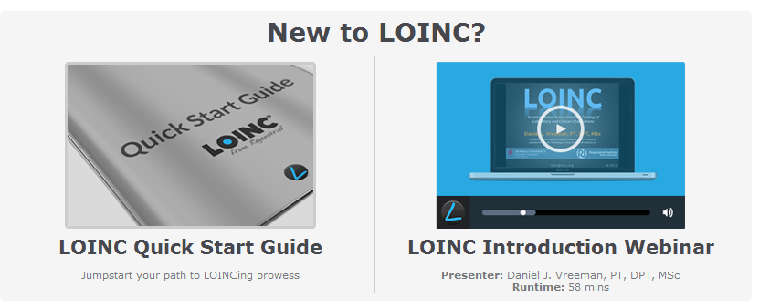
http://loinc.org/get-started
http://youtube.googleapis.com/v/6vSbqCHuUh8

Slide 18
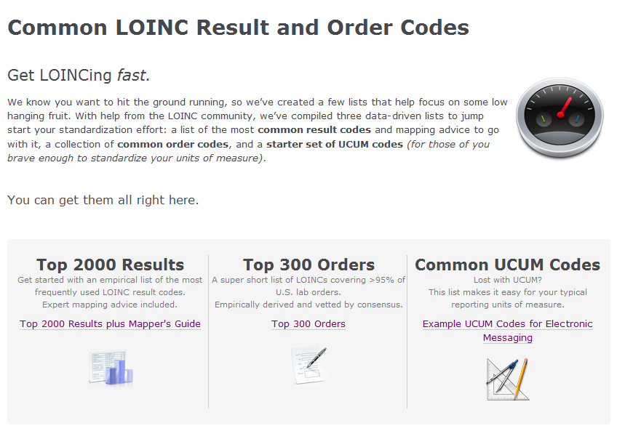
http://loinc.org/usage

Slide 19
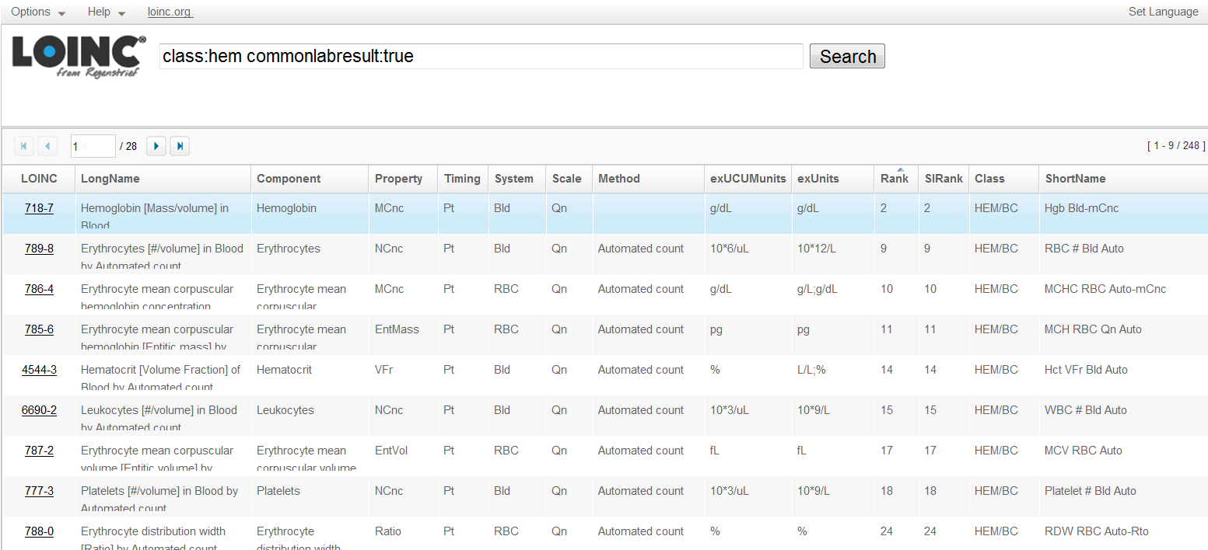
LOINC web browser: http://search.loinc.org

Slide 20
MU2 requires LOINC for:
  Identifying individual laboratory tests and some clinical measurements.
  Tests reported to public health.
  Tumor registry reporting.
  Vital signs and other observations contained in HL7’s CDA.
  Can and should apply to all clinical measurements, reports, and survey instruments
  http://loinc.org
    Try it out: http://search.loinc.org

Slide 21
“Side” Effects of Meaningful Use (MU) regulation
MU requires LOINC to be used for laboratory tests, vital signs, tumor registries, and a few other variables.
But the regulation has had effects beyond what is required.
Some referral laboratories have been using LOINC codes in HL7 v2 messages for a few years. Now most are using them.
Big laboratory instrument vendors (IVDs) are mapping all of their instrument test codes to LOINC---- without being obliged by the regulations.

Slide 22
Referral laboratories and LOINC
Today most large referral labs can deliver HL7 result messages with LOINC codes identifying each test reported.
Most large in vitro device (IVD) vendors also support LOINC.
You can find the mappings on their web sites.

Slide 23
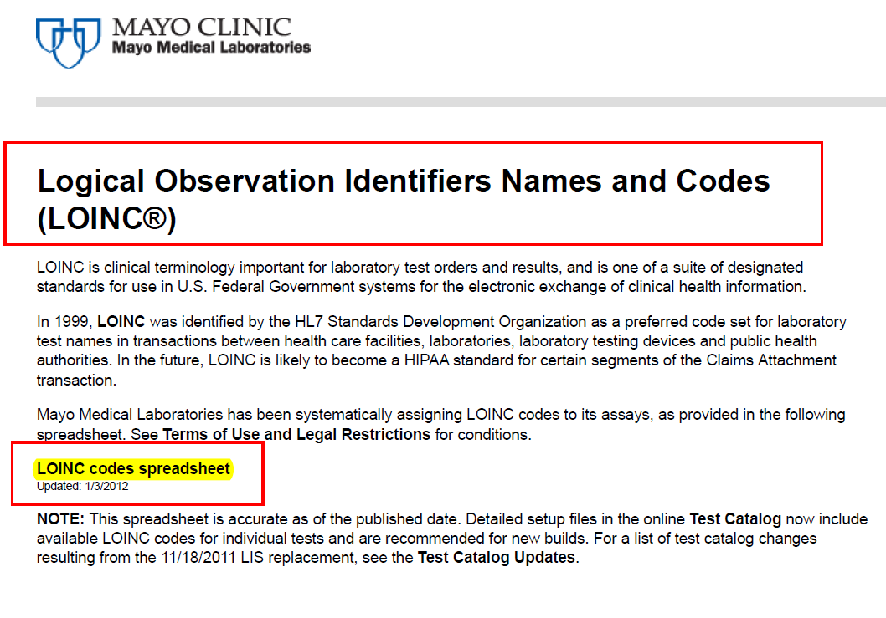
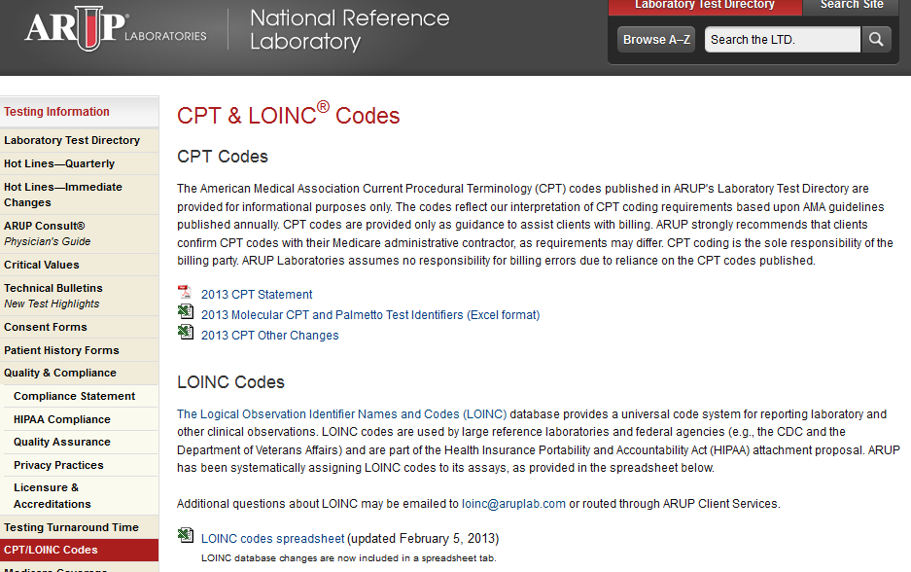
LOINC featured on laboratory web sites
(2 examples)

Slide 24
Lots of Ongoing LOINC and HL7 Standards Work
Working with S&I (Standards and Interoperability) framework on extending the use of LOINC codes for lab test ordering.
Collaboration with RadLex and LOINC re: Radiology order names. (LOINC has more than 6,000 empirically defined radiology order/report codes).
Reviewing HL7 CDA report specifications (dozens) for consistent use of LOINC.
Encouraging use of a standard syntax (UCUM) in US electronic messages for units of measure so numeric results are computable.
Collaboration between LOINC and SNOMED CT –long negotiation. Just recently signed.

Slide 25
Review of LOINC term capabilities

Slide 26
Some LOINC term attributes
Cardinality –required , repeats (recent extension)
Data type – date, coded, time stamp, ( still evolving- inclined toward FHIR data types)
Default (Brand new-)
Validation checks (new)
    Numeric range string length, pattern checks (telephone#, Email address), more
Units of measure (for numeric variables)-may be a list
Answer lists ( can be used by more than one term
Parts (used to build the term)
Definitions and general references-can be attached to part, fragment strings. And the term itself. (Try to link most to the parts)
Illustrations/figures
Synonyms- mostly attached to the parts

Slide 27
Review of LOINC’s approach to answer lists
Answer lists are “named” and can be re-used
Can be defined by enumeration or by reference
Enumerated lists (the most common) attached directly to the term
By reference- link to an outside vocabulary and/or a subset of that vocabulary
Enumerated lists can be normative- the list of stings is what must be used.. Applies to validated surveys, questions formally specified by authoritative organizations
They can also be examples. Can consider starter sets and or illustrative of the kind of content.
  Plan to divide this into “complete and samples)
Issues related to the question specific codes, the string specific codes and the concept specific codes for an answer string.

Slide 28
Answer lists more
Each answer in answer list has
  Text string
  Code – usually the code defined by the developer and usually specific to the question (e.g. a,b,c ,or 1,2,3) and has no meaning across questions
  A definition/description of the answer- when more information or explanation is needed
  A LOINC string code – the LA codes
  A universal code- In most cases will be a SNOMED code,. This would be the concept code and would expect it to be many to many. Many strings would have the same SNOMED code and some strings knight have different SNOMED codes in different circumstances.
  Sometimes – a score –
  For answers such as “other –please name” it carries a flag that says the answer can generate a prompt for a free text response.

Slide 29
Panel capabilities

Slide 30
What is a panel
A named set or collection of LOINC terms which has its own LIONC code so the set can be “named” with a single code
Think of it as a set of LOINC codes or a efficient handle for ordering many things with a single selection.
E.g., one can order Serum electrolytes which is really a short hand for r Na, K, Cl and HCO3
Or order LOINC # 62341-3-- B Burgdorferi IgG and IgM with reflex to Immune blot -- that returns 12 results for the IgG part alone– each with a distinct LOINC code) .

Slide 31
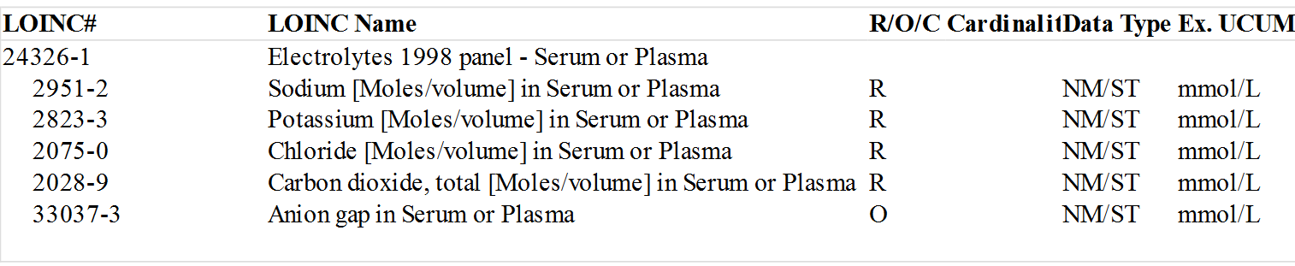
LOINC electrolyte panel

Slide 32
Differences in some lab panels
Those whose elements are independent and packaged purely for convenience
  E.g. <organism> Igg and IgM and Igg, or the old Chem 12
Those that bound by a procedure. They don’t make sense alone
  Protein electrophoresis ( the report quantifies each protein peak in the panel)
  White blood cell differential count – the percent Neutrophils, basophils, etc. are part of a whole– the differential count
Some that mix the two
Realize also that for some tests the policy is to not report panel values that have a zero result. E.g. If blasts are not observed in the blood cell differential count, nothing is reported. They are dropped from the panel if none appear.

Slide 33
One other kind of lab panel
General microbiology cultures (e.g. blood cultures) are a special case
Traditionally the results are reported in stages that specifies what has been detected so far. For a day or two , the results might be reported as no organisms isolated, then it might change to gram positive cocci, then it might be as staph aureus, and the it can go to more detail.
The work up that identifies a blood culture results, could be conceived as a panel, individual tests that report growth in different circumstances, antigen tests or even Nucleic acid tests But historically these details have not usually been reported
Things are changing again with availability of fast nucleotide testing that can speak to the susceptibility as well as the identity of the organism.

Slide 34
What else can be a panel
Sets of questions in clinical scores
  Glasgow coma score
  Apgar Score
Sets of questions in assessment instruments and surveys
  MDS assessments
Most forms in general
  ESRD medical evidence report Medicare entitlement - OMB CMS form 2728

Slide 35
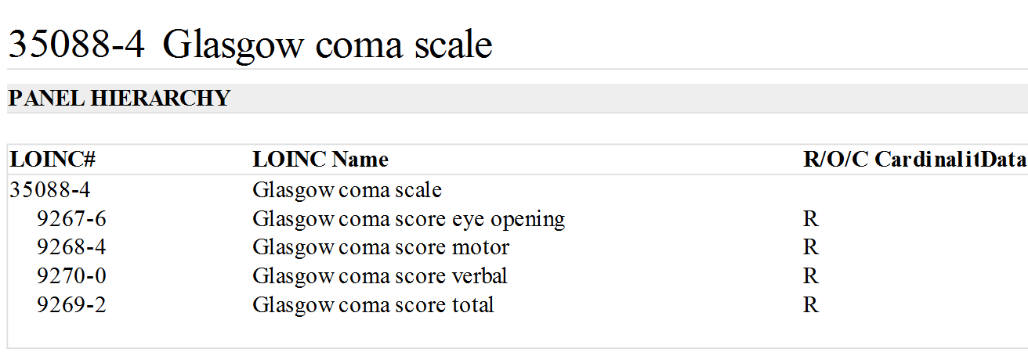
LOINC Glasgow coma scale

Slide 36
Requests for information
Case reports– where the panel carries the question of interest
Many data defining packages from CDC are cooking as LOINC panels
Much of what is in FINVADs fit perfectly in the LOINC model

Slide 37
Complicated panels
  Terms within panels can different validation check (as long as consistent with the term’s validation checks ) . They can have default values, default units, and cardinality, and even names (in rare cases) different from the term outside of the panel.
  Panels are more than the LOINC terms they carry
  They can carry “skip logic”
  They have cardinality for both the term- whether the observation is included in the plane and or/repeats and for the answers
  They carry information about which variable carries the results of calculations such as the total score for a number of variables that each carry a score or the result of a calculation based on values entered into the form such as the body mass index which is derived from body weight and height

Slide 38
Complicated panels more
Panels can be nested
So we can define little panels in one place and re-use them as parts of others.
So we organize them with sections and subsections as one sees in many standard forms.

Slide 39
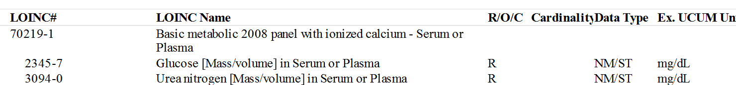
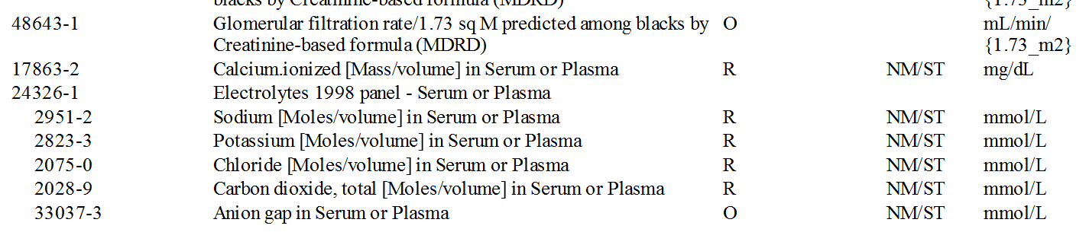
The basic metabolic panel contains the electrolyte panel that can also be ordered alone

Slide 40
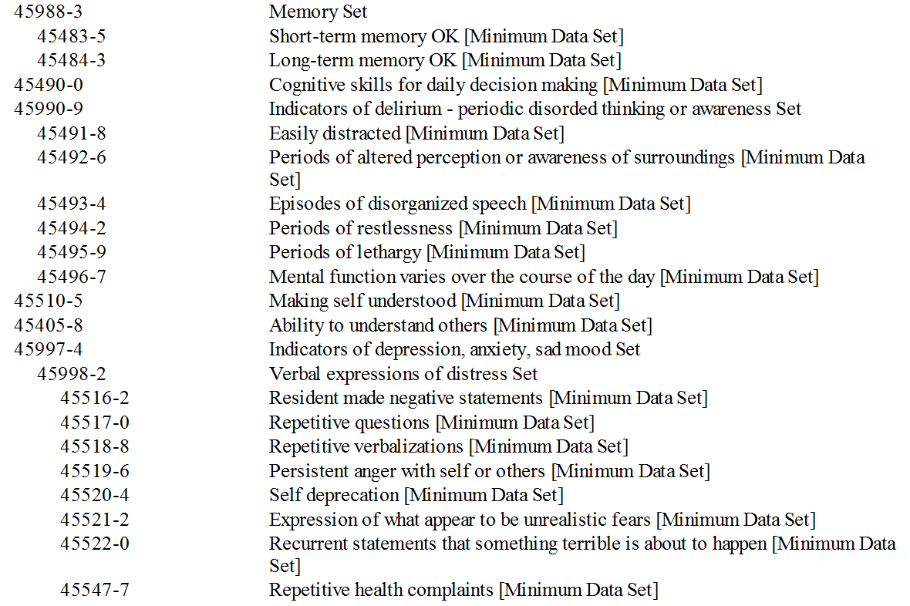
A little bit of MDS and its nesting

Slide 41
What is all of this good for
Live forms- i.e., executable web forms generated from the panel definitions that can capture user data.
For decades we have solved data storage issues by inserting a language (SQL) between the application and the data storage system
Need some thing analogous for user forms, so we can describe them – rather than hand craft them
NLM’s Lister Hill has created a widget that converts LOINC Panel definitions into executable forms. Will show you
http://lhcs-formtool.nlm.nih.gov/

Slide 42
Challenges regarding Panels

Slide 43
There are too many
A pane is subset of LOINC terms
The number of subsets of a given universe is too large to manage
If a universe contains N elements the number of subsets is 2^{N.}
So for a universe that contains 10 elements the set of all subsets is:
  2 ¹⁰ = 1024. If the set contains 50 elements , its 2⁵⁰ ⁼ 1.25 x 10¹⁵
  or 1.25 quadrillion. LOINC has about 40,000 lab terms
Clearly we have to find a away to reduce the explosion

Slide 44
Ways to reduce the explosion
Limit panel construction to common and of officially defined panels
  E.g. CMS/AMA defined panels
  Relatively frequent ones
  Formally defined. By CDC, CMS, etc.
Allow variability in the content of a single panel
  For orderable laboratory tests we define one panel that allows any number or additional (ask on order questions in the results. Any number of calculations based on the measured items),
Include lots of optional items that and any panel that included some of them would count– (creates -problems with labs that bill for the results , but might work in public health and veterinary medicine)
Other possibilities
  Ignore methods in some panel definitions. So any method with the same analytes and specimen would count.
  Use text description and no enumeration of the children of some panels (Blood cultures use a variant of that approach by ignoring the fact that internal testing is done that is ignored,

Slide 45
What LOINC would like in public health submission for new term

Slide 46
Special requests
If the test done using an FDA approved test kit
  Name it and include package insert in the submission. That is what we get from clinical laboratories. We describe it as the submitter’s test kit. It is not normative but provides an anchor for what the test represents, and it allows identification of duplicate requests that would otherwise not be possible
Be careful about using titers on FDA approved tests that are qualitative.

Slide 47
More 1
  Label tests as that are only available at CDC ( or public health) e.g, use for tracking organism instances ( subtyping, sequencing, Salmonella typing) to track epidemics, or for environmental use.
  LOINC would like to mark these to reduce the targets to which clinical labs an office practices would have to consider for mapping.
  When specimen types range across a wide spectrum ( and XXX would be the appropriate specimen type, provide a textual description of the range of specimen types in the t definition
  Consider distinguishing some specimens, e.g CSF, which has such important clinical implications and sterile human specimens from the host of other specimen types (as is routine in clinical care- so names line up better)

Slide 48
More 2
Provide a good definition/description of a submitted organisms, chemical, or macromolecule being measured when LOINC does not already have one
  Referral labs and international requesters have been very good about providing such defintions.
Regarding organisms would want to know
  What kind of organism
  Its source/vector
  What disease it causes and in whom (immune compromised)
  Treatments if available
This is probably information that CDC has. It would just have to be boiled down

Slide 49
More 3
A good example is what we have for B Burgdorferi
  Borrelia burgdorferi is a Gram negative spirochete bacterium that causes Lyme disease. It is most commonly transmitted to humans by an infected tick. Typical symptoms include fever, headache, fatigue, and a characteristic skin rash called erythema migrans that usually spreads from the bite mark. If left untreated, infection can spread to joints, the heart, and the nervous system. Paralysis of one or both sides of the face may occur. Treatment often requires antibiotics. This bacterium is microaerophillic and slow-growing, explaining the long delays when diagnosing Lyme disease. There are a large number of sub-species which differ in clinical symptoms and presentation as well as geographic distribution. The life-cycle of B. burgdorferi is complex, requiring ticks, rodents, and deer as temporary hosts. Mice are the primary reservoir for the bacteria that are transmitted to deer by the tick Ixodes scapularis

Slide 50
Attention to what is in side of reports
Many new kinds of tests on the clinical side deliver their content as text blobs. (narrative)
Some good opportunities exist for simple but more standardized and computable content
Easyish. If reporting a sequence. Either report the literal string or (better) the formal ref ID for that particular sequence
Harder- find a uniform way to report viral susceptibilities

Slide 51


Slide 52



Thank you!
Questions?
http://www.lhncbc.nlm.nih.gov

