Slide 1
ARSTF Laboratory Data Assessment for Clinical and Public Health Laboratories
Thursday, May 17, 2018

Slide 2
35
Total Responses
Clinical Laboratories performing AST in-house

Slide 3
Section 1: Informatics Infrastructure and Use of Standard Codes
Completed by IT personnel
Updated May 16, 2018

Slide 4
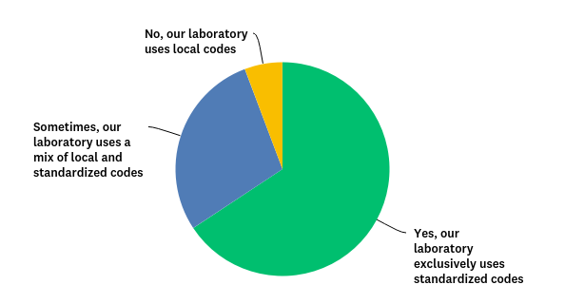
Q1: Does your laboratory or hospital use “standardized codes” (e.g. LOINC or SNOMED) for microbiology tests and/or results?
Answered: 35 Skipped: 0

Slide 5
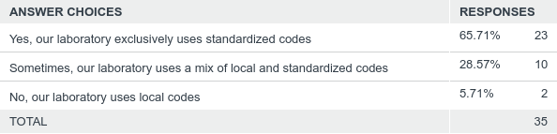
Q1: Does your laboratory or hospital use “standardized codes” (e.g. LOINC or SNOMED) for microbiology tests and/or results?
Answered: 35 Skipped: 0

Slide 6
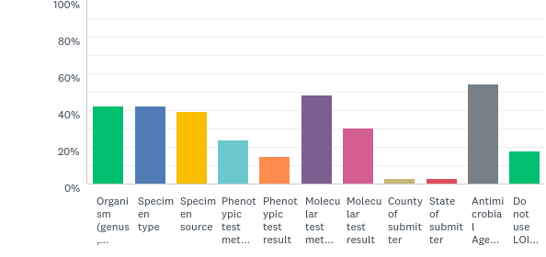
Q2: Does your laboratory use LOINC codes for any of the following data elements? Check all that apply.
Answered: 33 Skipped: 2

Slide 7
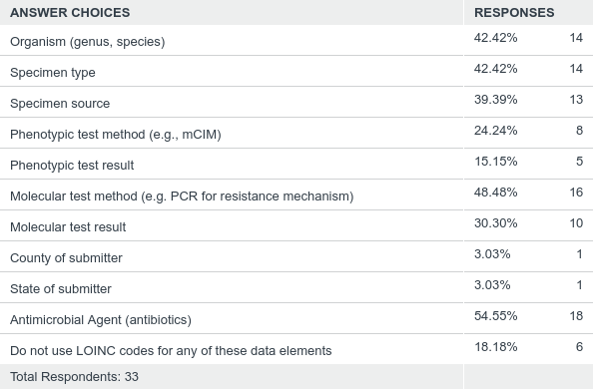
Q2: Does your laboratory use LOINC codes for any of the following data elements? Check all that apply.
Answered: 33 Skipped: 2

Slide 8
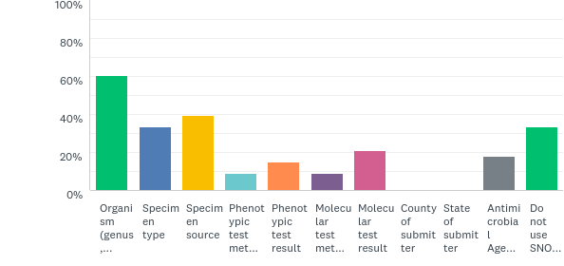
Q3: Does your laboratory use SNOMED codes for any of the following data elements? Check all that apply.
Answered: 33 Skipped: 2

Slide 9
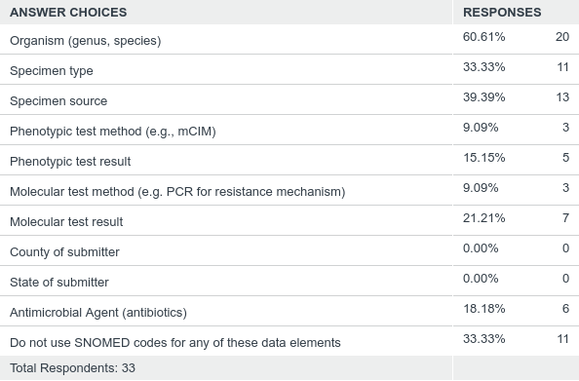
Q3: Does your laboratory use SNOMED codes for any of the following data elements? Check all that apply.
Answered: 33 Skipped: 2

Slide 10
Q4: Are any other standard codes used for the aforementioned data elements? If yes, please specify.
33 responses
No, none, N/A: 25 responses
IMO (Intelligent Medical Objects): 3 responses
Unsure: 2 responses
Other: 3 responses
  SNOMED for organism
  LOINC and SNOMED for test order names only
  FIPS: County and State of submitter

Slide 11
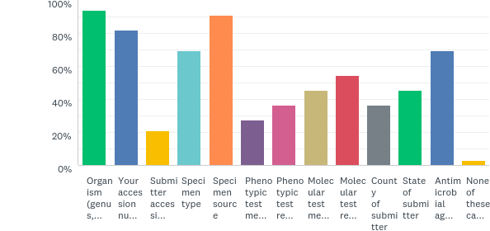
Q5: Check information that can be extracted electronically to send to Public Health. (check all that apply)
Answered: 33 Skipped: 2

Slide 12
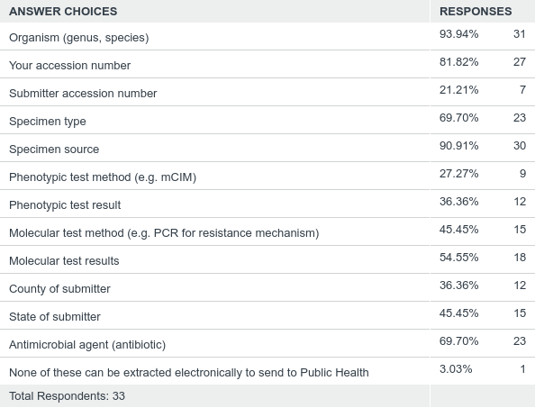
Q5: Check information that can be extracted electronically to send to Public Health. (check all that apply)
Answered: 33 Skipped: 2

Slide 13
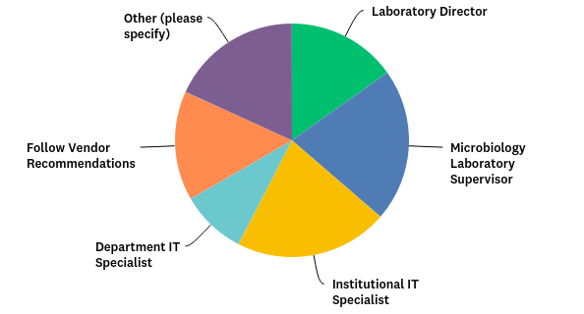
Q6: When new tests are implemented, who makes the decision to assign a standard code and which standard code to assign?
Answered: 33 Skipped: 2

Slide 14
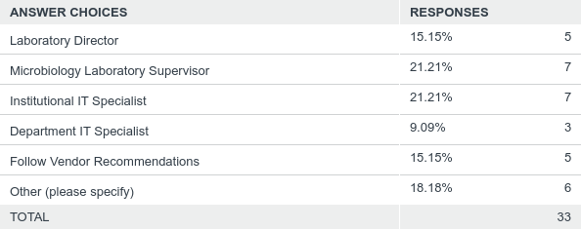
Q6: When new tests are implemented, who makes the decision to assign a standard code and which standard code to assign?
Answered: 33 Skipped: 2

Slide 15
Q6: When new tests are implemented, who makes the decision to assign a standard code and which standard code to assign?
Other (please specify) Responses
Follow Vendor Recommendations and, if not vendor defined, ask Testing Department
Lab Manager
No new are added
Micro LIS specialist, Micro Tech Leader, Lab Manager
National mandates it. LIM executes it.
Lab Director, Department T Specialist and Vendor Recommendations

Slide 16
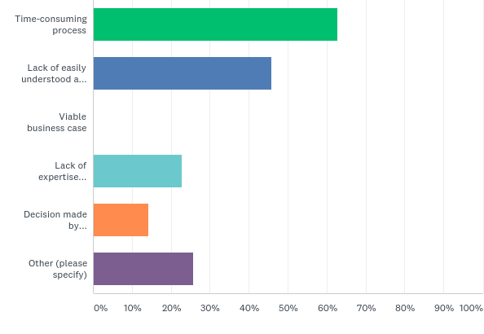
Q7: What are the barriers to implementation of standard codes? Check all that apply.
Answered: 35 Skipped: 0

Slide 17
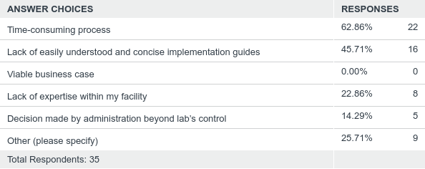
Q7: What are the barriers to implementation of standard codes? Check all that apply.
Answered: 35 Skipped: 0

Slide 18
Q7: What are the barriers to implementation of standard codes? Check all that apply.
Other (please specify) Responses
None
Not sure how to answer this question
Not all codes are updated by LIS Vendor
Standard codes are in use at our sites
Getting technical areas to supply information with new test/result set-ups
Software LIS does not allow for direct input
Changing computer system in 12/18, then will be implementing standard codes
Limited access to system functions, not sure if much of the information requested can be pulled from our system. Certainly do not anticipate coding tests used for ID and MIC, and much of the other info listed in our small lab.
Current LIS makes the use of SNOMED codes very difficult. We are going to a new LIS in Jan 2019

Slide 19
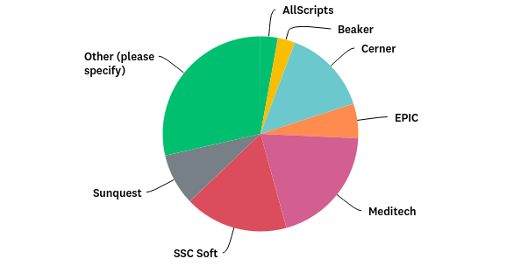
Q8: What is the primary Laboratory Information System (LIS) or Laboratory Information Management System (LIMS) utilized in your laboratory?
Answered: 35 Skipped: 0

Slide 20
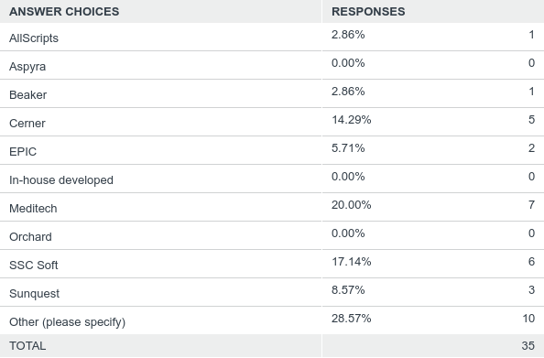
Q8: What is the primary Laboratory Information System (LIS) or Laboratory Information Management System (LIMS) utilized in your laboratory?
Answered: 35 Skipped: 0

Slide 21
Q8: What is the primary Laboratory Information System (LIS) or Laboratory Information Management System (LIMS) utilized in your laboratory?
Other (please specify) Responses
Antrim
AllScripts (formerly McKesson Paragon)
Allscripts Paragon, formerly McKesson
Paragon
CPSI (Evident)
CPSI/Evident
CPSI (will be moving to SCC Soft 1/2019)
Evident
Evident (CPSI)
VISTA

Slide 22
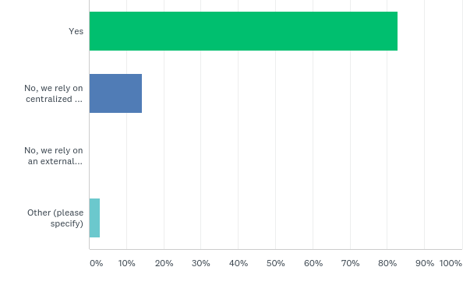
Q9: Does your laboratory have personnel with expertise required to build new tests into the LIS or LIMS?
Answered: 35 Skipped: 0

Slide 23
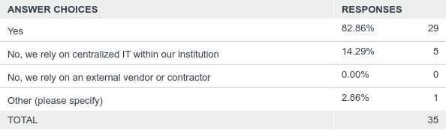
Q9: Does your laboratory have personnel with expertise required to build new tests into the LIS or LIMS?
Answered: 35 Skipped: 0
Other (please specify) Response
Only the Lab Director

Slide 24
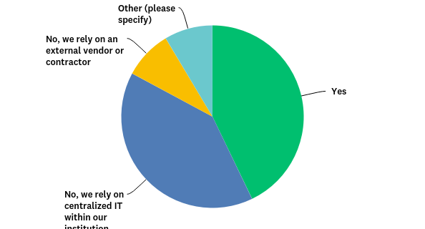
Q10: Does your laboratory have personnel with expertise required to build Electronic Laboratory Reporting (ELR) Capability for microbiology tests?
Answered: 35 Skipped: 0

Slide 25
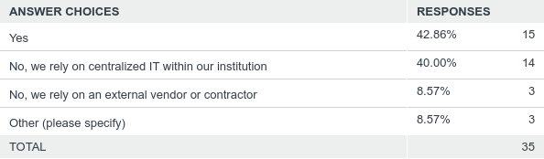
Q10: Does your laboratory have personnel with expertise required to build Electronic Laboratory Reporting (ELR) Capability for microbiology tests?
Answered: 35 Skipped: 0

Slide 26
Q10: Does your laboratory have personnel with expertise required to build Electronic Laboratory Reporting (ELR) Capability for microbiology tests?
Other (please specify) Responses
Currently sending these via INEDDS.
Combo of LIS and IT Interface specialists.
Local and regional staff (IT and LIM)

Slide 27
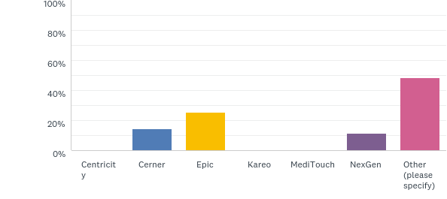
Q11: What is the primary Electronic Health Record (EHR system) utilized in your laboratory?
Answered: 35 Skipped: 0

Slide 28
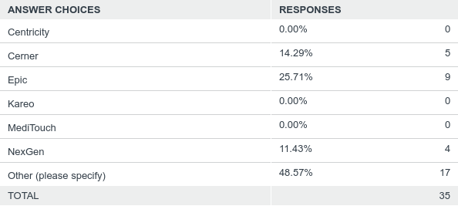
Q11: What is the primary Electronic Health Record (EHR system) utilized in your laboratory?
Answered: 35 Skipped: 0

Slide 29
Q11: What is the primary Electronic Health Record (EHR system) utilized in your laboratory?
Other (please specify) Responses
Allscripts Sunrise
Antrim
CPRS
CPSI
CPSI (moving to Allscripts 1/2019)
CPCI/Evident
Evident
Evident (CPSI)
OneContent
OneContent
Meditech
Meditech
Meditech
MEDITECH
McKesson (All Scripts)
McKesson-one content
Not electronic

Slide 30
Section 2: Questions on Data Suppression
Completed by microbiology laboratory staff
Updated May 16, 2018

Slide 31
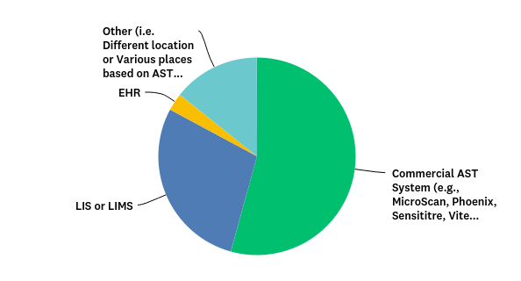
Q12: Where are AST SIR (susceptible, intermediate, resistant) with or without MIC or zone diameter measurement data stored in your laboratory?
Answered: 35 Skipped: 0

Slide 32
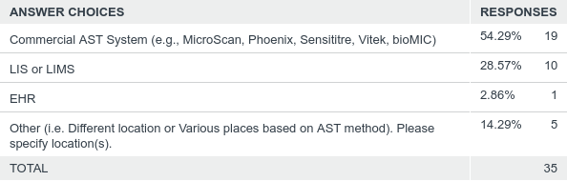
Q12: Where are AST SIR (susceptible, intermediate, resistant) with or without MIC or zone diameter measurement data stored in your laboratory?
Answered: 35 Skipped: 0

Slide 33
Q12: Where are AST SIR (susceptible, intermediate, resistant) with or without MIC or zone diameter measurement data stored in your laboratory?
Other (please specify) Responses
Both Vitek and LIS
Vitek, LIS (Antrim), Middleware (TechniData)
Various places based on method. Beaker and Vitek
All of the above, Commercial AST System, LIS or LIMS and EHR
Whonet

Slide 34
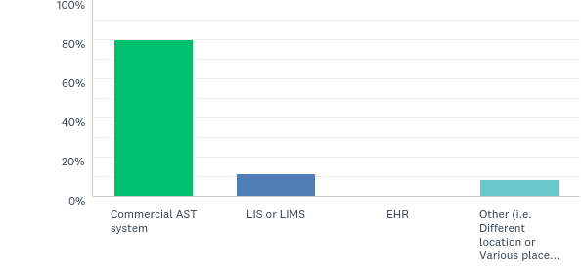
Q13: Where are AST clinical breakpoints applied in your laboratory?
Answered: 35 Skipped: 0

Slide 35
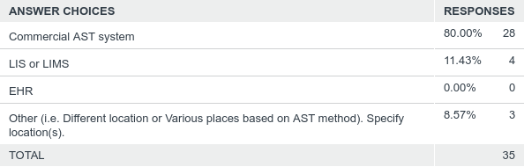
Q13: Where are AST clinical breakpoints applied in your laboratory?
Answered: 35 Skipped: 0

Slide 36
Q13: Where are AST clinical breakpoints applied in your laboratory?
Other (please specify) Responses
Commercial AST system & Middleware (Technidata)
MIC Commercial AST System KB/ETest LIS Cascading Rules LIS
Various places based on method. Beaker and Vitek

Slide 37
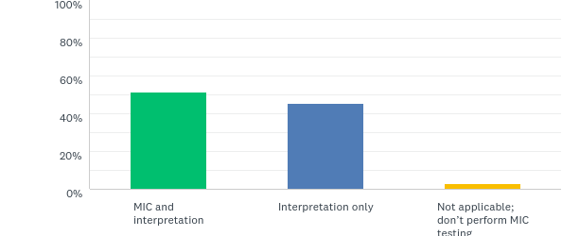
Q14: If you perform MIC testing, do you report both MIC and interpretation or just the interpretation?
Answered: 35 Skipped: 0

Slide 38
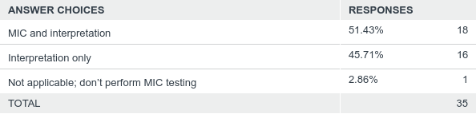
Q14: If you perform MIC testing, do you report both MIC and interpretation or just the interpretation?
Answered: 35 Skipped: 0

Slide 39
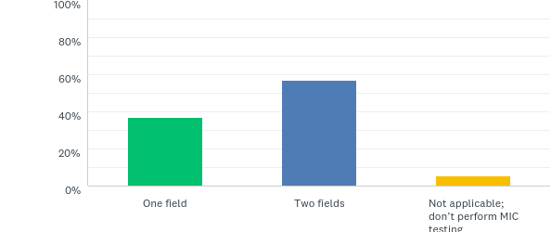
Q15: If you perform MIC testing, are MIC and interpretation entered in a single field or in two separate fields (e.g., one for MIC value and one for the interpretation)?
Answered: 35 Skipped: 0

Slide 40
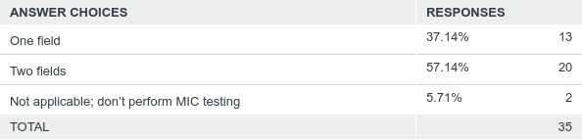
Q15: If you perform MIC testing, are MIC and interpretation entered in a single field or in two separate fields (e.g., one for MIC value and one for the interpretation)?
Answered: 35 Skipped: 0

Slide 41
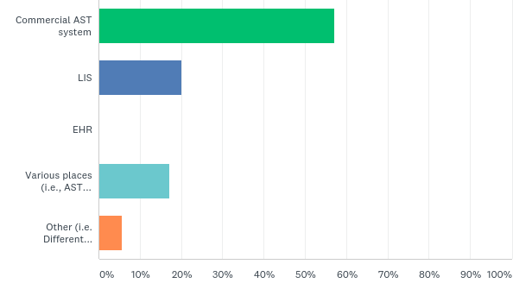
Q16: If suppression of AST data is being performed, where are the rules invoked?
Answered: 35 Skipped: 0

Slide 42
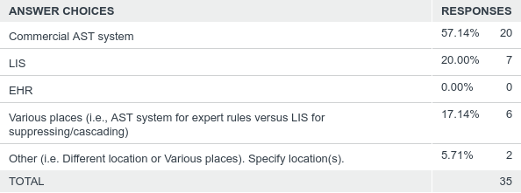
Q16: If suppression of AST data is being performed, where are the rules invoked?
Answered: 35 Skipped: 0

Slide 43
Q16: If suppression of AST data is being performed, where are the rules invoked?
Other (please specify) Responses
Commercial AST System & LIS (based on client requirement)
Commercial AST system. We also selectively report some depending on results.

Slide 44
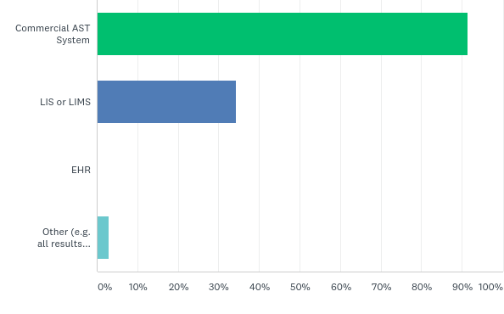
Q17: In which of the following can all AST data, including those that are suppressed, be accessed? Check all that apply.
Answered: 35 Skipped: 0

Slide 45
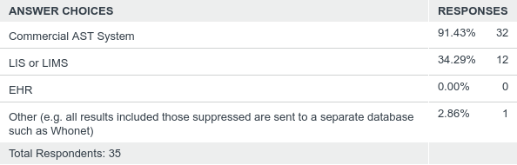
Q17: In which of the following can all AST data, including those that are suppressed, be accessed? Check all that apply.
Answered: 35 Skipped: 0

Slide 46
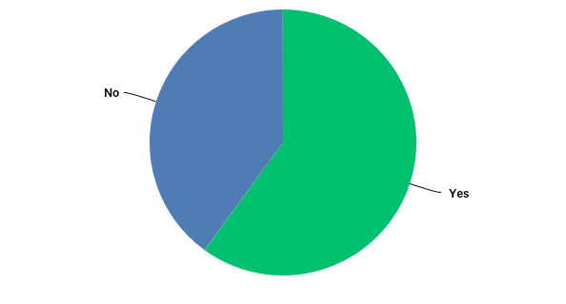
Q18: Are suppressed results captured in your routine cumulative antibiogram report?
Answered: 35 Skipped: 0

Slide 47
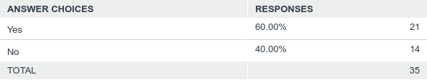
Q18: Are suppressed results captured in your routine cumulative antibiogram report?
Answered: 35 Skipped: 0

Slide 48
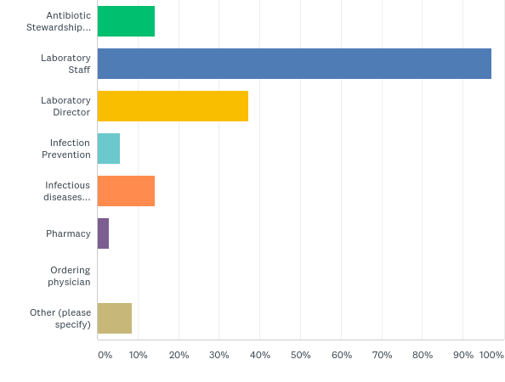
Q19: Who in your institution has direct access to all suppressed AST Results? Check all that apply.
Answered: 35 Skipped: 0

Slide 49
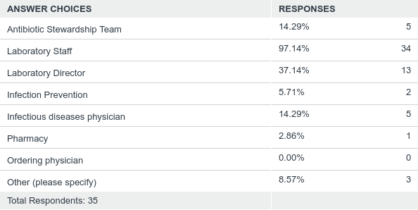
Q19: Who in your institution has direct access to all suppressed AST Results? Check all that apply.
Answered: 35 Skipped: 0

Slide 50
Q19: Who in your institution has direct access to all suppressed AST Results? Check all that apply.
Other (please specify) Responses
Micro Staff
Pathologist
Probably Lab Director, but would need to search for it (not currently done routinely)

Slide 51
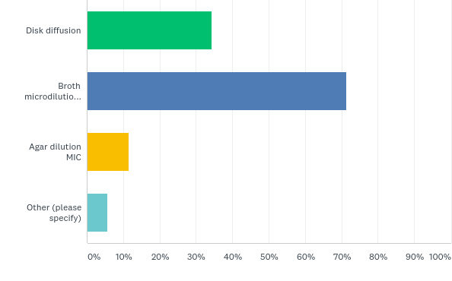
Q20: Reference AST method:
Answered: 35 Skipped: 0

Slide 52
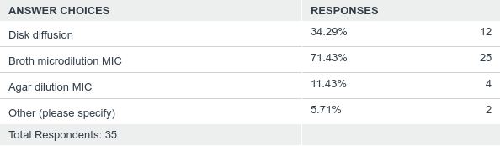
Q20: Reference AST method:
Answered: 35 Skipped: 0
Other (please specify) Response
E-test
Gradient MIC (E-test)

Slide 53
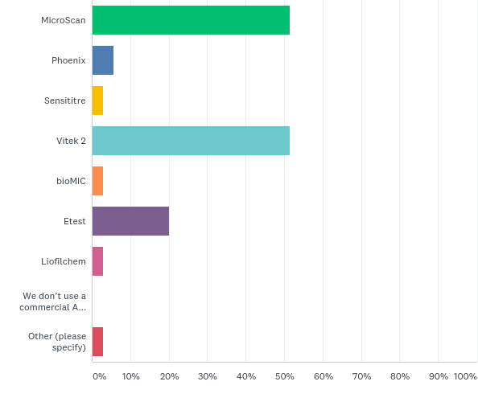
Q21: Commercial AST system:
Answered: 35 Skipped: 0

Slide 54
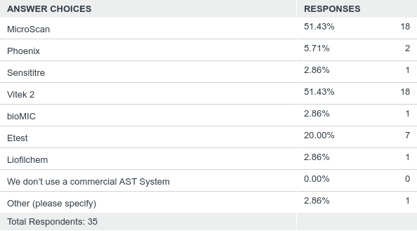
Q21: Commercial AST system:
Answered: 35 Skipped: 0
Other (please specify) Response
Microscan used at one of our affiliate hospital labs

