Slide 1

Enabling Real-Time Epidemiology for Infectious Diseases Through Interoperable IVD Data
SHIELD_{x}- putting IVD data standards to work
Current/Next Steps
Michael Waters, Ph.D.
SHIELD_{x} Team Lead/OIR RWE Representative
Office of In Vitro Diagnostics and Radiological Health (OIR)
Center for Devices and Radiologic Health (CDRH)
Food and Drug Administration (FDA)
Systemic Harmonization and Interoperability Enhancement for Lab Data

Slide 2
IVDs Provide Traceability, Context and Perspective
in vitro diagnostics (IVDs):
provide objective evidence aid in the diagnosis and treatment of a patient by a trained clinician.
generate data that gets populated in electronic healthcare records (EHRs), useful for:
  Epidemiology/outbreak monitoring
  Healthcare innovation
  Decision support/knowledge generation
  Public health reporting
  Laboratory cost savings
  Signal detection
  more

Slide 3

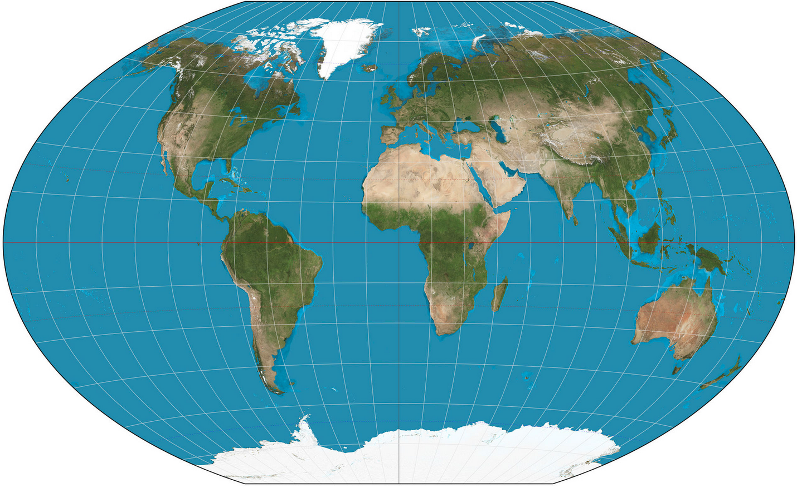
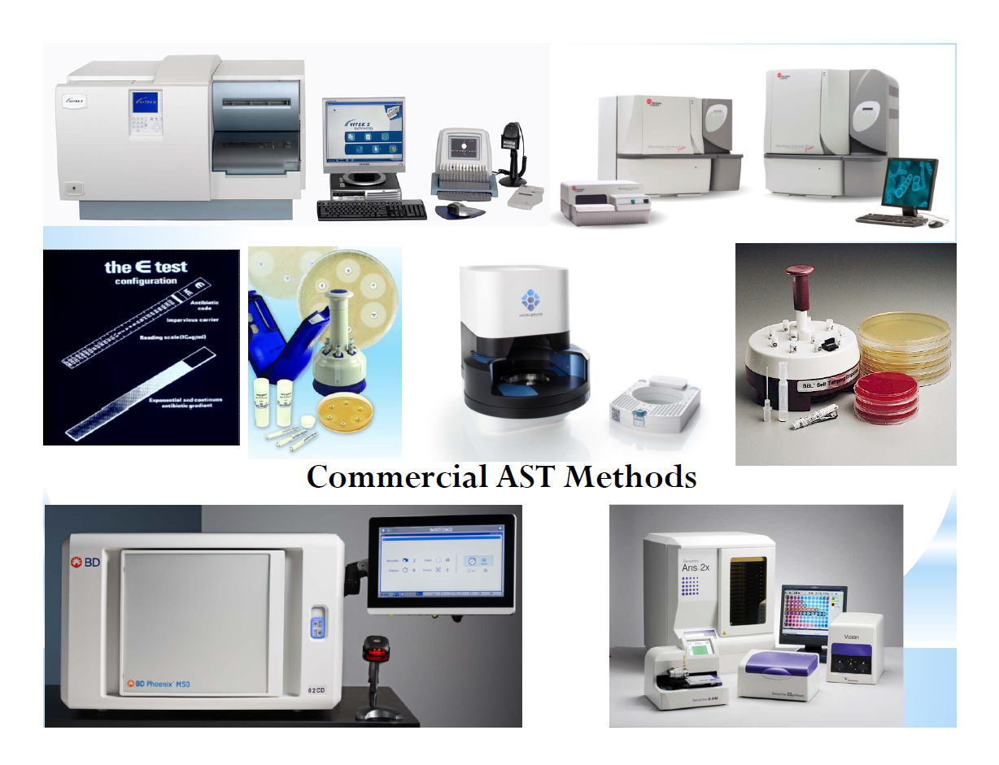

Semantic Interoperability is Essential to AMR Surveillance
?
?
?
RWE must be understood and reliable to be useful
?
Server
?
DATA INTEROPERABILITY NEEDED!
?

Slide 4
Systemic Harmonization and Interoperability Enhancement for Lab Data
SHIELD Mission:
Accelerate lab data digitization; improve quality & interoperability of IVD data to:
Improve access to high-quality RWE for regulatory decisions,
reduce burdens to the healthcare ecosystem,
promote innovative 21st century solutions to public health challenges,
build NEST (diagnostic arm).
How? – SHIELD employs consensus processes to:
leverage existing lab data standards and infrastructure,
develop standards/tools to fill lab data interoperability gaps and
expedite ubiquitous adoption & implementation of SHIELD infrastructure.
SHIELD Stakeholders (>50 institutions engaged):
FDA (CDRH, CDER, CBER), CDC, NIH, ONC, CMS, VA, CAP, IVD Manufacturers, EHR Vendors, Laboratories, Standards Developers, PEW Charitable Trusts, NEST/MDIC, Academia

Slide 5
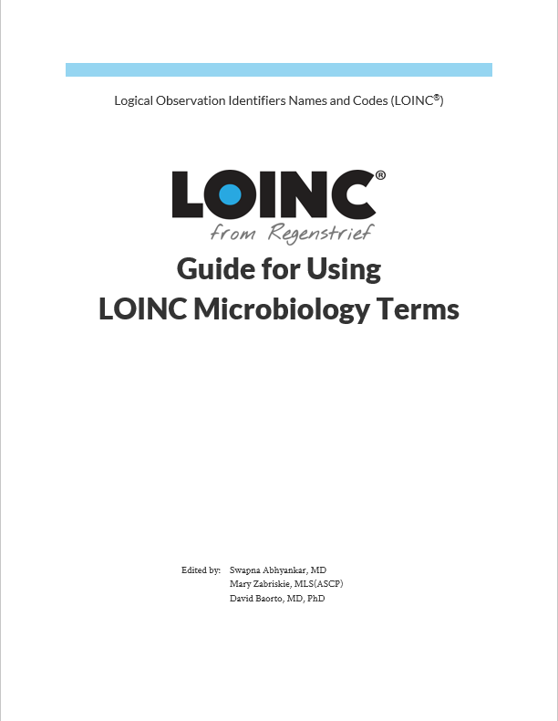
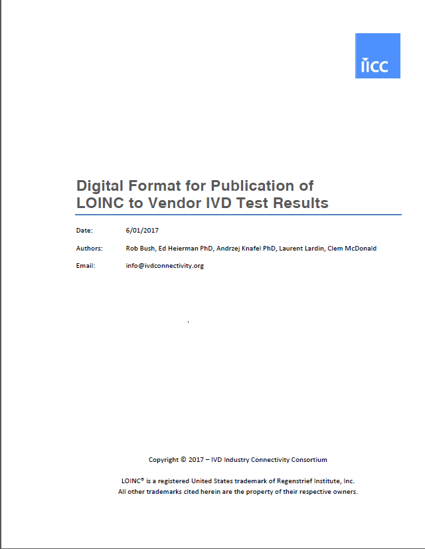
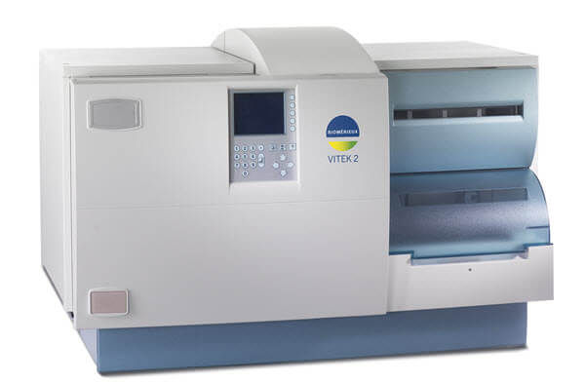






Standards Empower Lab Data Utility
W/Standards: Quality in – Quality out.
W/O Standards: Garbage in – Garbage out
Context: An IVD asks a question of a specimen to get an answer.
Patient Test Data
Data Recipients
Data Utility
e.g., Research, Regulatory Decisions,
Outbreak Signals,
Clinical Decision Support,
Meaningful Use,
etc.
  IVD (Code Standard)
  Who’s Asking (UDI)
  Question (LOINC)
  Answer (SNOMED-CT)
Structured Transfer
LIS/EHR
Data Association
Manufacturers
Labs/Providers
https://loinc.org/guides/micro/
Plan:
Government supports manufacturers/industry to provide vetted and harmonized descriptive IVD codes to labs to improve utility for consumers.
http://ivdconnectivity.org/livd/

Slide 6
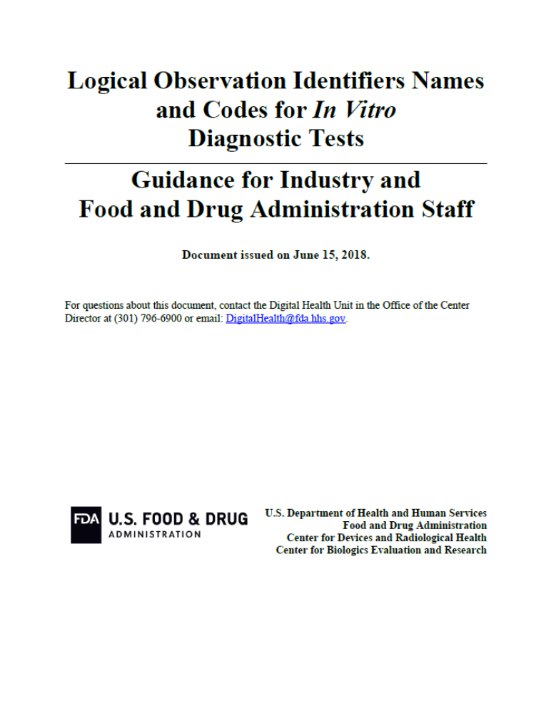
FDA Perspective on LOINC for IVDs
Any similar coding system for characterizing IVDs (e.g., LOINC) is voluntary and will not be required or reviewed by FDA
  (distinct from the required FDA-accredited UDI system*)
FDA strongly encourages use of FDA-recognized consensus standard structured data format to communicate IVD descriptive coding.
  Distribution of LOINC coding by manufacturers that suggests an unapproved/uncleared Indication for Use (i.e., off-label use) could result in the device being considered adulterated and/or misbranded.
  Laboratories and/or other users must fulfill their obligations, including (but not limited to) any statutes, regulations, and validation procedures that must be complied with when making the results from the off-label uses available to those requesting the test.
A 3rd party resource for codes (and coding) could aid in harmonization efforts (e.g., Regenstrief)
*https://www.fda.gov/MedicalDevices/DeviceRegulationandGuidance/UniqueDeviceIdentification/
Notes:
Summary from the last IVD roundtable.

Slide 7
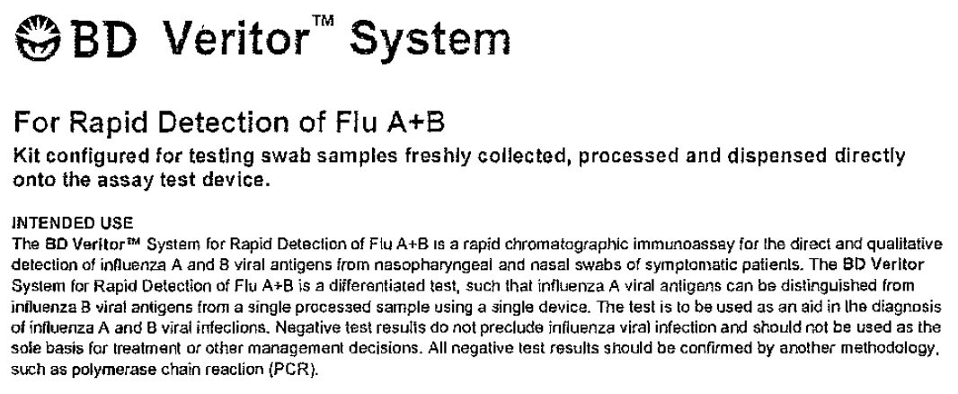
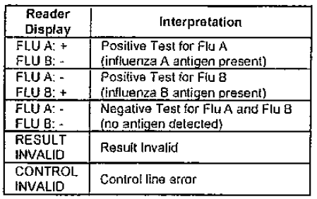
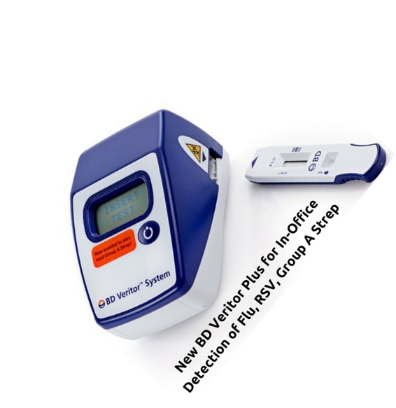

Slide 8
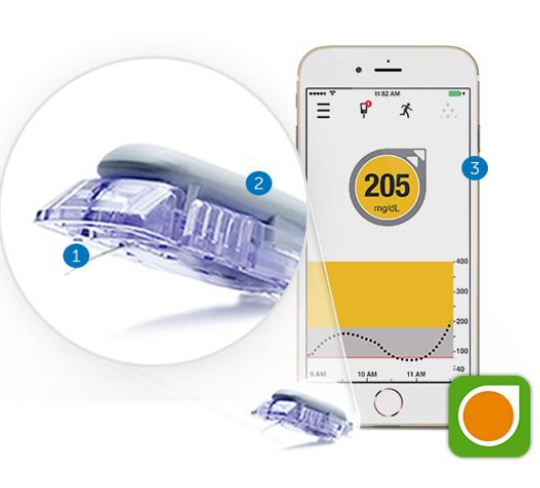
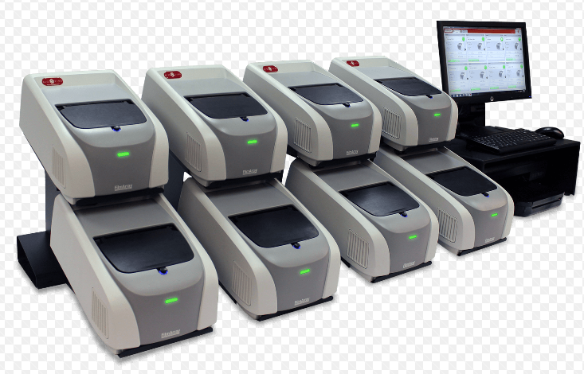
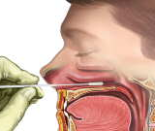
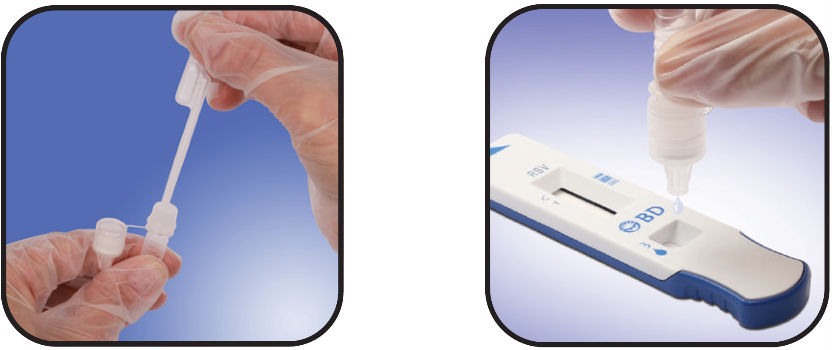
Coding the IVD Message
In vitro diagnostics (IVDs) products are… intended for use in diagnosis of disease or other conditions... 21 CFR 809.3
Each IVD asks a ‘question’ of a specimen to get an ‘answer’.
1) Collect and prepare a specimen (nasopharyngeal swab).
2) Ask Question:
Does the nasopharyngeal swab contain:
3) Provide Answer:
influenza A antigens?
LOINC Code: 43874-7
Influenza A antigens: Detected;
SNOMED-CT: 260373001
Device Identifier:
00382902560715
influenza B antigens?
LOINC Code: 43895-2
Influenza B antigens: Not detected
SNOMED-CT: 260415000

Slide 9
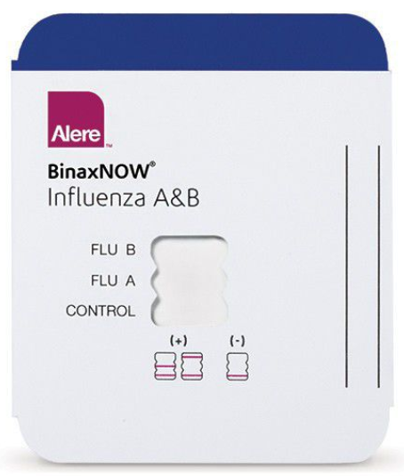
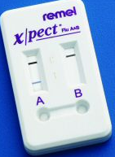
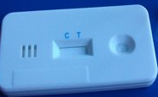
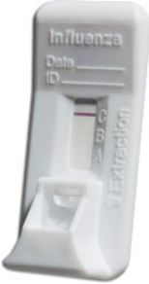
Mapping IVDs from Different Manufacturers
Same IVD Type
Same IVD Type
Unambiguous LOINC Codes
Helpdesk Support
43874-7
LOINC Mapping Manual
Influenza virus A Antigen in Nasopharynx
RELMA® LOINC Mapping Tool
43895-2
Example List
Influenza virus B Antigen in Nasopharynx

Slide 10

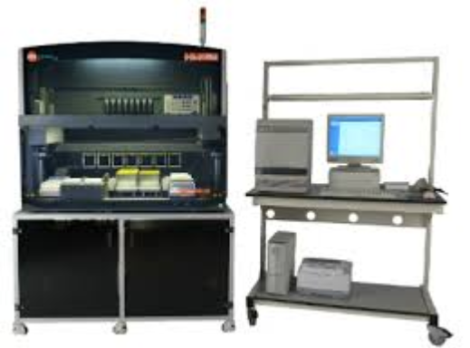
Digital Format for IVD Vendors to Provide LOINC
IVD Industry Connectivity Consortium
Digital Format for Publication of LOINC to Vendor IVD Test Results (LIVD)
Laboratory Analytical Workflow (LAW)
Laboratory Information System
(LIS)
LOINC
LAW
LIVD
SNOMED-CT
FHIR
Profile
UDI
Role
Coding Standard Nodes
Question
LOINC (Logical Observations Identifiers Names and Codes)
Answer
SNOMED-CT (Systematized NOmenclature of MEDicine – Clinical Terms)
Who’s Asking
UDI (Unique Device Identification System)

Slide 11
Digital Format for IVD Vendors to Provide LOINC
IVD Industry Connectivity Consortium
Digital Format for Publication of LOINC to Vendor IVD Test Results (LIVD)
Laboratory Analytical Workflow (LAW)
Laboratory Information System
(LIS)
LOINC
LAW
LIVD
SNOMED-CT
FHIR
Profile
UDI
Role
Coding Standard Nodes
Question
LOINC (Logical Observations Identifiers Names and Codes)
Answer
SNOMED-CT (Systematized NOmenclature of MEDicine – Clinical Terms)
Who’s Asking
UDI (Unique Device Identification System)

Slide 12

Diagnostic Device Information Flow – Upgrade!
LOINC
SNOMED-CT
UCUM
Laboratory
LIS/ LIMS
Test Catalog
eDOS
Orders
Vendor 1
LIVD
Analyzer 1
LAW
LOI
Vendor 2
Analyzer 2
LRI
Results
LIVD
LAW
Providers
Vendor 3
LIVD
Analyzer 3
LAW
eDOS now electronic and computable
Orders now standardized, harmonized with EHR requirements
New LRI with harmonized profiles
…
LIVD
…
LAW
IVD
Industry
Pre-Process & Automation
LDA
LBL
LSH
LST
etc.
LIMS/LIS Underlying Standards
MACP, MLCP, Specimen DAM
HL7 V2 Messages, LOINC, SNOMED CT, UCUM, et al

Slide 13


